Slide 1

ActivA
Personalized Health Systems
&
Virtual Research Networks

Slide 2

1
Aspectos Generales
(General Aspects) - William
2
Plataforma – Idea inicial
(Platform Initial Idea) - Miguel
3
Observación Clínica
(Clinical Observation) - Lisbeth
4
Observación Científica
(Scientific Observation) - Jordi
5
Cronograma
(GNATT chart) - William
6
Próximos pasos
(Next Steps) - TODOS

Slide 3
Overall Focus: Biomedical Research:
“from remote bedside to bench and back to remote bedside “
"Personalized" medicines
Monitoring of therapy
Genomics and Bioinformatics
Molecular
Diagnostics
Early diagnosis
Discovery of disease gene proteins
Risk assessment
Integrated Healthcare
Pharmaco-genetics
Genomics/Proteomics
Prevention
Reclassification of diseases
Genetic screening
Genetics
Clinical Trials
Toxicology prediction
Identification of drug resistance
Drug Development
Fon t: J. Jain.Current Opin Mol Ther 2002

Slide 4
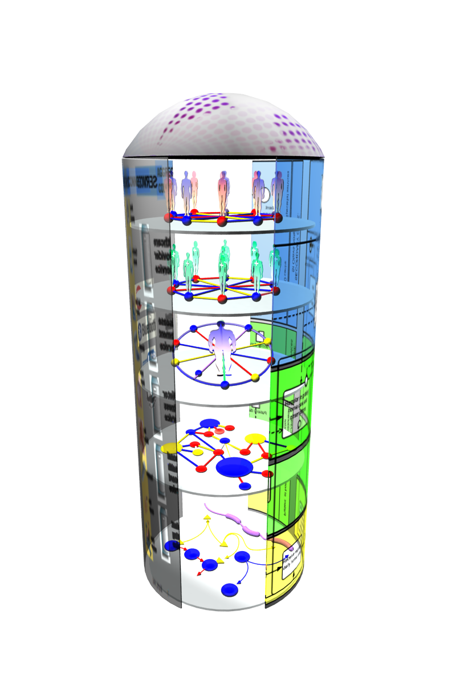
Overview – Scientific Approach
Innovation of healthcare services.
  Services based on Access, Care, Research
  Social Networking 2.0.
“Zoom in” View
  Via Local, Regional, Global links:
  Patient Networks
  Care Networks
  Translational Research Networks
  Basic Research Networks
  Biological Networks
Links:
  BP Modules
  Interconnected IP layers
  Quality Assurance & Security
A new mechanism of service delivery.

Slide 5
Overview – Technological Approach
Remote care is not seen as technological implementations, but as healthcare services in which all healthcare & support structures are always involved. This is combined with (Scientific Research and Laboratory Institutes)
Clinical care methodology and guidelines of PH services, together with Evaluation methodologies are the driving force to measure outcomes.
  Social Network – ISOCO/O2H
  Clinical Care /Rehabilitation Programs – AMFQ/O2H
    Remote Monitoring & Rehabilitation Apps – O2H/Flowlab
  Translational/Basic/Biological – UPF/O2H
Project Website and tools - O2H

Slide 6
Cronograma
1
Análisis de Servicios – Planificación
(Assessment of effectiveness services)
2
Creación de Servicios – Desarrollo
(Service Creation)
3
Estudios clínicos con pacientes - Adopción
Analysis of factors - Adoption.
4
Estudios Translacionales – Evaluación y Modificación
(Evaluation and Review)
5
Calidad – Matriz de prueba (inicio), Prueba de cada modulo (cada bloque), Prueba del Sistema (Integración)
Quality Assurance -Test Matrix (Initial), Test Component (Per Block), Test System (Integration)

