Slide 1
Using GPUs with Molecular Dynamics codes: optimizing usage from a user perspective Dr. Ole Juul Andersen CCK-11 February 1, 2018

Slide 2
Why GPUs?
CPUs: excel at doing complex manipulations to a small set of data
Good for running Operating Systems: needs to look at 100s of different types of data and make various decisions which all depend on each other.
GPUs: excel at doing simple manipulations to a large set of data
Excellent for Molecular Dynamics: needs to perform the same operations on 100,000s of atoms.
1. Calculate bond terms
2. Calculate angle terms
3. Calculate …
Notes:
First of all, let’s take a look at why we should even consider using GPU’s for our calculations. Up until 2007, scientific computations would run solely on the CPU. CPUs excel at doing complex manipulations to a small set of data. This means that they are good for running operating systems, since these need to look at 100s of different types of data and make various decisions which all depend on each other.
However, for applications that require the opposite, namely simple manipulations to a large set of data, CPUs are less than ideal. Enter the GPUs, which excel at doing exactly that. This is excellent for molecular dynamics calculations, where we don’t need to do a lot of decision making, but instead need to perform the same operations on 100,000s of atoms. For each atom, we need to calculate the bond terms, the angle terms, the dihedral terms, and so on. Thus, we need to do the same simple operations over and over again, which should spark our interest for using GPUs for our simulations.

Slide 3
Typical hardware topology of a compute node:
CPU
PCI
GPU
GPU
NVLink
Notes:
Now that we’ve decided to use GPUs for our simulations, let’s take a look at a typical hardware topology of a simple compute node. Usually, the GPU will be connected to the CPU via a so-called PCI bus (or peripheral component interconnect bus). All communication between the two will pass through this bus. It is important to realize that every time we need to send data between the two, it hurts performance, since we need to wait for the data transfer to finish before we can continue with the next step in the calculation.
It is also possible to connect a second GPU to the same PCI bus. This doubles the GPU computing power available in the node; however, this might not result on a doubling of the performance, because we add a second layer of communication, namely communication between the two GPUs through the PCI bus.
To alleviate the performance hit we get from communicating between the GPUs over the PCI bus, NVIDIA has developed a high speed interconnect called NVLink, that connects the two GPUs directly and significantly increases the rate of data transfer.

Slide 4
Typical hardware topology of a compute node:
NVLink
GPU
GPU
PCI
CPU
PCI
GPU
GPU
NVLink
Notes:
It is also possible to have two more GPUs connected to the CPU via a second PCI bus. While it might be technically feasible to run a simulation using all four GPUs, this could be a very bad idea if the software requires communication between all four GPUs, because communication between the two groups of GPUs would require data transfer over both PCI buses and the CPU, which would significantly hurt the performance.
Likewise, if one would like to run a simulation using two GPUs, it would be very wise to use two GPUs connected to the same PCI bus.

Slide 5
Typical hardware topology of a compute node:
NVLink
ID: 0
GPU
GPU
ID: 1
PCI
CPU
export CUDA_VISIBLE_DEVICES=2,3
PCI
GPU
GPU
ID: 2
ID: 3
NVLink
Notes:
In order to manually control the choice of GPUs for a simulation, we can set the CUDA_VISIBLE_DEVICES variable. Each GPU will have a unique ID, starting from 0. If we wish to run a simulation on GPUs 2 and 3, we would set CUDA_VISIBLE_DEVICES like this before running the simulation.

Slide 6
Usage of GPUs in different MD programs:
AMBER: Run all calculations on the GPU(s)
Pro: No drop in performance due to communication with the CPU.
Pro: Cost efficient (don’t need to buy expensive CPUs, less power consumption).
Con: Necessary to run GPU-inefficient parts of the MD simulation on the GPU.
Con: Less functionality.
GROMACS: Run GPU-inefficient calculations on the CPU
Pro: Calculations that are better suited for the CPU does not need to run on the GPU(s).
Pro: More functionality.
Con: Drop in performance due to communication with the CPU.
Con: Necessary to invest in expensive CPUs.
Notes:
Different MD programs take different approaches to the use of GPUs for simulations. In the later versions of AMBER, they have decided to run all the calculations on the GPUs. This has some benefits and drawbacks. One benefit is that we get no drop in performance due to communication with the CPU. It is also cost efficient, since we don’t need to buy expensive GPU resources, and it has less power consumption. A drawback is that we need to run GPU-inefficient parts of the simulation on the GPU. This can also lead to less functionality, as some functions might be so ill-suited for the GPUs that there is no reason to implement them.
GROMACS on the other hand has decided to run the GPU-inefficient calculations on the CPU. This means that calculations better suited for the CPU does not need to run on the GPUs, and we get more functionality. However, we get a drop in performance due to communication between the GPUs and the CPU, and we need to invest in expensive CPU resources.

Slide 7
Optimizing performance: clock speed (GPU Boost)
Notes:
One of the areas where we might be able to squeeze out some extra performance is the clock speed of the GPU and the possibility of using something called GPU Boost.

Slide 8
Base clock vs. boost clock
Base clock: The default clock speed set by the factory
Lower (i.e. slower) than the available boost clocks.
Low enough to keep the power consumption below a certain threshold.
Boost clock: Clock manually set by the end-user
Higher (i.e. faster) than the base clock.
Might push the power consumption above the threshold.
nvidia-smi -pm ENABLED
nvidia-smi -ac 3004,875
Notes:
NVIDIA GPUs typically use a base clock set by the factory. This clock is lower and hence slower than the available boost clocks, however, it is low enough to keep the power consumption below a certain threshold.
Boost clocks on the other hand are higher and faster clock speeds manually selected by the user. The drawback of these are that the might push the power consumption above the threshold.
In order to activate a boost clock, we need to execute the following two commands. The first one enables what is known as persistence mode, which ensures that the GPU driver will remember your selected clock speed until the next time the machine is rebooted. In the next command, you set the desired clock speeds, the values of which will depend on the model of the GPU.

Slide 9
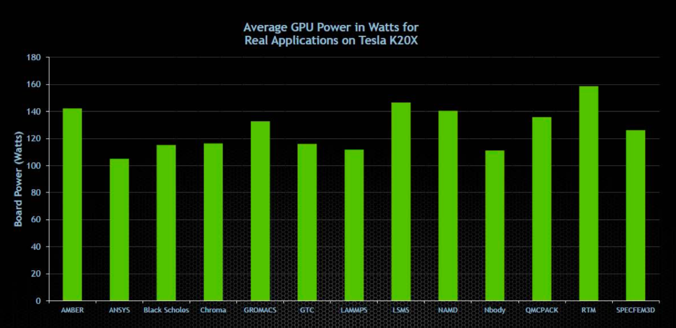
Power draw with base clock (235W threshold)
Application Note: NVIDIA GPU BOOST FOR TESLA, DA-06767-001_v02, January 2014
https://www.nvidia.com/content/PDF/kepler/nvidia-gpu-boost-tesla-k40-06767-001-v02.pdf
Notes:
In order to decide whether or not boost clocks can be used to increase the performance of our simulations, we need to take a look at the power draw on the GPU when running calculations at the base clock. This figure from NVIDIA shows the power draw on a K20X when running a range of different applications. This GPU has a threshold of 235W, and we can see that all of these applications are well within the limit. Of particular interest, we observe the presence of both AMBER, GROMACS, and NAMD in the figure.

Slide 10
Power draw on local cluster (K40: 235W threshold)
Notes:
If we take a look at one of the local clusters in the department which is equipped with K40s that also have a 235W threshold, we see that AMBER and GROMACS simulations of four different system of increasing size are all within the limit when running with the base clock. When we turn on the highest available boost clock, we get a ~20% increase in power consumption, but we still remain within the limit.

Slide 11
Power draw on local cluster (K40: 235W threshold)
Notes:
If we take a look at the simulation throughput, we get a 14% increase in performance for both AMBER and GROMACS simulations.

Slide 12
What happens if we surpass the power threshold?
Clock speed will automatically decrease to get the consumption below the threshold.
Then why do we bother setting a base clock?
Some nodes in a cluster might have less access to cooling than others.
Some types of calculations spread across multiple GPUs require the calculations to be performed in lock-step, and hence need assurance that all GPUs run at the same clock speed.
Notes:
So, what happens if we surpass the power threshold? Well, then the GPU will automatically decrease the clock speed until get back below the limit.
Now, if this is the case, you might be asking yourselves why we even bother setting a base clock if there is no danger of exceeding the power consumption threshold.
There are a few cases where base clocks are necessary, of which I’ve listed two. Some nodes in a cluster might have less access to cooling than others, and might run the risk of overheating if they run at the power limit 24/7. Hopefully the cluster cooling will have been designed to accommodate the power specs of the GPUs, but if you know you have a cooling problem, then turning on the boost clocks might not be a good idea.
Second, some types of calculations spread across multiple GPUs require the calculations to be performed in lock-step, and hence need assurance that all GPUs run at the same clock speed. However, this is not the case for Molecular Dynamics simulations, so the only issue here might be cooling.

Slide 13
Optimizing performance: CPU binding
Notes:
Next, I’m going to discuss the concept of CPU binding.

Slide 14
What is CPU binding?
Prevents process from being moved from one core to another.
Core 0
Core 1
Core 2
Core 3
Core 4
Core 5
Core 6
Core 7
GROMACS
GROMACS
GROMACS
GROMACS
GROMACS
GROMACS
GROMACS
GROMACS
OS
OS
Notes:
CPU binding is used to prevent a process from being moved from one core to another. Say for example we have a CPU with 8 cores, and we start a GROMACS simulation that uses all eight cores.
While the simulation is running, the operating system still needs to run, so the OS might schedule some tasks on one of the cores.

Slide 15
What is CPU binding?
Prevents process from being moved from one core to another.
Core 0
Core 1
Core 2
Core 3
Core 4
Core 5
Core 6
Core 7
OS
GROMACS
GROMACS
GROMACS
GROMACS
GROMACS
GROMACS
GROMACS
OS
GROMACS
Notes:
If these tasks are important enough, these will be giving priority over the GROMACS tasks. Now, without CPU binding, the GROMACS task running on this core might be transferred to another core in an attempt to distribute the workload.

Slide 16
What is CPU binding?
Prevents process from being moved from one core to another.
Core 0
Core 1
Core 2
Core 3
Core 4
Core 5
Core 6
Core 7
OS
GROMACS
GROMACS
GROMACS
GROMACS
GROMACS
GROMACS
GROMACS
OS
GROMACS
Notes:
However, moving a process from one core to another is time consuming, and more often than not, our simulation will run faster if we simply keep the process on the original core and wait for the operating system tasks to finish.

Slide 17
What is CPU binding?
Prevents process from being moved from one core to another.
Core 0
Core 1
Core 2
Core 3
Core 4
Core 5
Core 6
Core 7
OS
GROMACS
GROMACS
GROMACS
GROMACS
GROMACS
GROMACS
GROMACS
OS
GROMACS

Slide 18
What is CPU binding?
Prevents process from being moved from one core to another.
Core 0
Core 1
Core 2
Core 3
Core 4
Core 5
Core 6
Core 7
GROMACS
GROMACS
GROMACS
GROMACS
GROMACS
GROMACS
GROMACS
GROMACS
Notes:
This is why we would like to bind each process to a specific core on the CPU.

Slide 19
CPU binding on local cluster
Hardware:
CPU: 16 cores
GPU: 1xK40
CPU binding:
Distribute the number of processes equally among the cores and bind them.
Notes:
On our local cluster, the nodes have 16 CPU cores and one GPU. CPU binding on these machines is fairly straightforward. We simply distribute all processes equally among the cores and bind them. This is usually done automatically, and is not really something we need to think about.

Slide 20
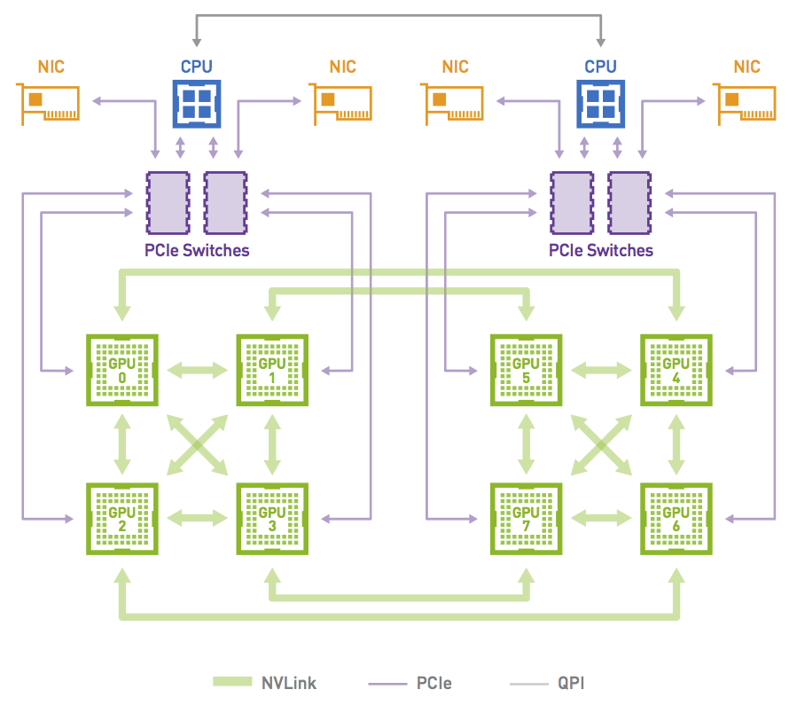
CPU binding on JADE
Hardware:
CPU: 2x20 cores (dual-socket)
GPU: 8xP100
5 cores pr. GPU
Usage:
Run a simulation using a single GPU.
CPU binding:
Bind to five cores on the CPU directly connected to the utilized GPU.
NVIDIA DGX-1: The Fastest Deep Learning System, Mark Harris, April 5, 2017
https://devblogs.nvidia.com/dgx-1-fastest-deep-learning-system/
Notes:
However, on some clusters, the hardware topology is a lot more complex, which forces us to make informed decisions on how to bind our job to the CPU.
For example, we can take a look at one of the nodes on the JADE supercomputer. Each node is a dual-socket machine that has two 20-core CPUs and 8 P100 GPUs. Thus, we have 5 cores available per GPU. The two CPUs are each connected to two PCI buses, and each PCI bus is connected to two GPUs. All GPUs connected to the same CPU are directly connected to each other via NVLink. Furthermore, each GPU is connected to one other GPU on the other socket via NVLink.
If we wish to run a simulation using a single GPU, we would need to bind the job to five cores on the CPU directly connected to the GPU. If we bound the job to the other CPU, we would increase the communication distance between the CPU and the GPU, and take a significant hit in performance.

Slide 21
CPU binding on JADE
Hardware:
CPU: 2x20 cores (dual-socket)
GPU: 8xP100
5 cores pr. GPU
Usage:
Run a simulation using four GPUs.
CPU binding:
Bind to 20 cores on the CPU directly connected to the utilized GPU.
NVIDIA DGX-1: The Fastest Deep Learning System, Mark Harris, April 5, 2017
https://devblogs.nvidia.com/dgx-1-fastest-deep-learning-system/
Notes:
Likewise, if we wish to run a simulation using four GPUs, we would need to bind the job to 20 cores on the CPU directly connected to the GPUs.
In this example, we have selected to run the job on four GPUs that are all on the same socket. In theory, we would also be able to choose for example two GPUs on each socket instead.

Slide 22
CPU binding on JADE
Hardware:
CPU: 2x20 cores (dual-socket)
GPU: 8xP100
5 cores pr. GPU
Usage:
Run a simulation using four GPUs.
CPU binding:
Bind to 10 cores on each CPU.
NVIDIA DGX-1: The Fastest Deep Learning System, Mark Harris, April 5, 2017
https://devblogs.nvidia.com/dgx-1-fastest-deep-learning-system/
Notes:
In this case, we would bind the job to 10 cores on each CPU. However, while this is possible, it is not a very desirable solution. First of all, we would loose some time doing communication between the two CPUs. But furthermore, we would also increase the communication time between the GPUs. In the previous setup, all the four GPUs were directly connected to each other via NVLink. In this setup, each GPU is only directly connected to two other GPUs. Thus, whenever we need to due communication with the third GPU, we need to go twice the distance to reach it.

Slide 23
JADE: queuing system
Notes:
These considerations have been taken into account in the design of the queuing system on JADE.

Slide 24
Queues on JADE
Queues:
big: allows 2x4- and 1x8-GPU runs
NVIDIA DGX-1: The Fastest Deep Learning System, Mark Harris, April 5, 2017
https://devblogs.nvidia.com/dgx-1-fastest-deep-learning-system/
Notes:
There are two available queues. The big queue only allows 4- and 8-GPU jobs to be submitted. This ensures that all 4-GPU jobs will run on GPUs that are all fully interconnected.

Slide 25
Queues on JADE
Queues:
big: allows 2x4- and 1x8-GPU runs
NVIDIA DGX-1: The Fastest Deep Learning System, Mark Harris, April 5, 2017
https://devblogs.nvidia.com/dgx-1-fastest-deep-learning-system/
Notes:
If we allowed single GPU jobs to be run on the same nodes, we might end up in a situation were a 4-GPU job would be split across the two sockets.

Slide 26
Queues on JADE
Queues:
small: allows 8x1-GPU runs
NVIDIA DGX-1: The Fastest Deep Learning System, Mark Harris, April 5, 2017
https://devblogs.nvidia.com/dgx-1-fastest-deep-learning-system/
Notes:
The other queue is called the small queue, which only allows single-GPU runs to be submitted. The queuing system automatically sets the CUDA_VISIBLE_DEVICES variable to the next available GPU, so this is not something you need set in your job submission script.

Slide 27
JADE: simulations

Slide 28
Simulations on JADE
AMBER:
Only allows single-GPU simulations (not likely to change).
~20-40% faster than single-GPU GROMACS simulations.
GROMACS:
1-, 4-, 8-GPU jobs.
mpirun -np 1/4/8 --bind-to socket gmx_mpi mdrun …
Note: Aggregate performance considerably better with 8x1-GPU simulations than 2x4-GPU simulations or 1x8-GPU simulation (especially with GROMACS2018).
1x4-GPU: 50 ns/day
4x1-GPU: 100 ns/day (4*25 ns/day)
4x1-GPU: 200 ns/day (4*50 ns/day)
Notes:
Regarding simulations, JADE only allows single-GPU AMBER simulations at the moment, and this is not likely to change. Performance-wise, AMBER runs about 20-40% faster the single-GPU GROMACS simulations. The reason for this is as we discussed earlier that GROMACS also needs proper amount of CPU resources to run effectively, but on JADE there is only 5 cores available per GPU, which favors AMBER over GROMACS.
GROMACS can run using both 1, 4 and 8 GPUs. Various options have been tried to optimize the CPU binding issue, and the option that was shown to give the best performance is to add the flag –bind-to-socket to mprirun.
It is important to note that while GROMACS does offer 4- and 8-GPU simulations, the aggregate performance is considerably better when you run 8x1-GPU simulations that if you run 2x4-GPU simulations or 1x8-GPU simulation. For example, if you get 50 ns/day with a 4-GPU simulation, you might get 100 ns/day of aggregate performance if you run 4 single-GPU simulations. More importantly, the single-GPU performance has been vastly in improved in the 2018 version of GROMACS, and it is approximately twice that of Gromacs 2016. So with Gromacs 2018, you might get 200 ns/day in aggregate performance.

Slide 29
Simulations on JADE
AMBER:
Only allows single-GPU simulations (not likely to change).
~20-40% faster than single-GPU GROMACS simulations.
GROMACS:
1-, 4-, 8-GPU jobs.
mpirun -np 1/4/8 --bind-to socket gmx_mpi mdrun …
Note: Aggregate performance considerably better with 8x1-GPU simulations than 2x4-GPU simulations or 1x8-GPU simulation (especially with GROMACS2018).
http://jade-hpc.readthedocs.io/en/latest/software/molecular-dynamics/gromacs.html
Notes:
You can read more details about how to set up Gromacs jobs on the JADE website. We have just updated the documentation earlier today, to even if your read it before, it would be worth reading it again.

Slide 30
THANK YOU

