Slide 1


Internet of Things for Sensing the School Environment Project

Slide 2
Contents
Introduction
Sensors 101
A
B
C
D
E
F
G

Slide 3



So what does that wordy title mean?
“Internet of Things for Sensing the Schools Environment Project”
The Internet of Things (IoT) is the connection of sensors and devices connected in a Local Area Network (LAN) (100m³ area) using technology such as Bluetooth or WIFI
Sensing in this context is the use of sensors to detect the change in environment they are placed in and send information to other electronics or computing devices.
The School Environment is the surroundings or conditions in which you, animals and plants live or operate.
Notes:
This project aims to provide you with a thorough introduction to IoT.
It introduces the key concepts of IoT, necessary in using and deploying IoT systems.
Furthermore, the application of physical computing to sense the environment around you

Slide 4
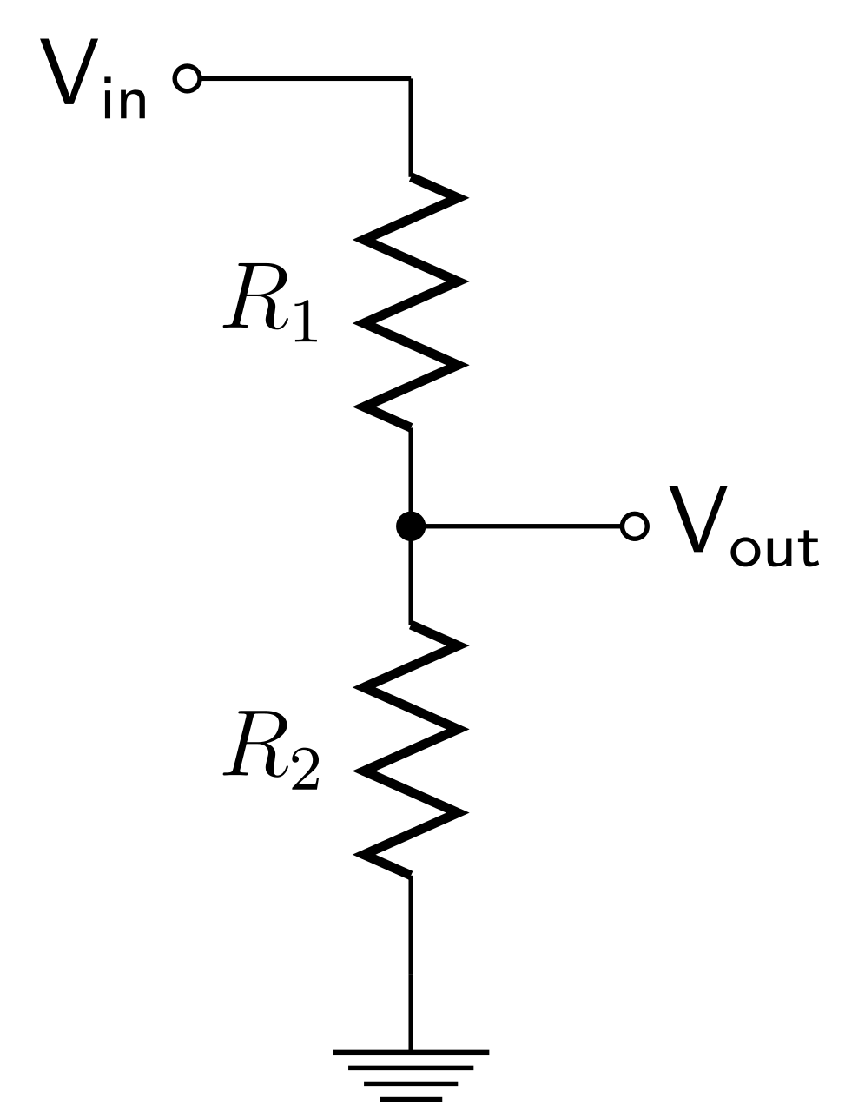
Sensors 101
Can you think of any sensors and what is their purposes?
https://en.wikipedia.org/wiki/List_of_sensors
Expanding on the previous slide, a sensor is a essentially a voltage divider circuit, which is used to measure difference between V_{in} and V_{out} a typical circuit shown ->
So by using the known input voltage and the and resistor values the output voltage can be calculated using this formula.
We are measuring the change in resistance (R₁) from an unknown phenomenon.
$V_{out}= V_{in} ∗ \frac{R_{2}}{R_{1}+R_{2}}$ or $4.45v=5v∗ \frac{1000Ω}{100Ω+1000Ω}$
Notes:
This project aims to provide you with a thorough introduction to IoT.
It introduces the key concepts of IoT, necessary in using and deploying IoT systems.
Furthermore, the application of physical computing to sense the environment around you

Slide 5
Internet of Things for Sensing the School Environment Project

