Slide 1


Internet of Things for Sensing the School’s Environment Project

Slide 2
Contents
Introduction
Sensors 101
Project Sensors
B
C
D
E
F
G

Slide 3



So what does that wordy title mean?
“Internet of Things for Sensing the Schools Environment Project”
The Internet of Things (IoT) is the connection of sensors and devices connected in a Local Area Network (LAN) (100m³ area) using technology such as Bluetooth or WIFI
Sensing in this context is the use of sensors to detect the change in environment they are placed in and send information to other electronics or computing devices.
The School Environment is the surroundings or conditions in which you, animals and plants live or operate.
Notes:
This project aims to provide you with a thorough introduction to IoT.
It introduces the key concepts of IoT, necessary in using and deploying IoT systems.
Furthermore, the application of physical computing to sense the environment around you

Slide 4
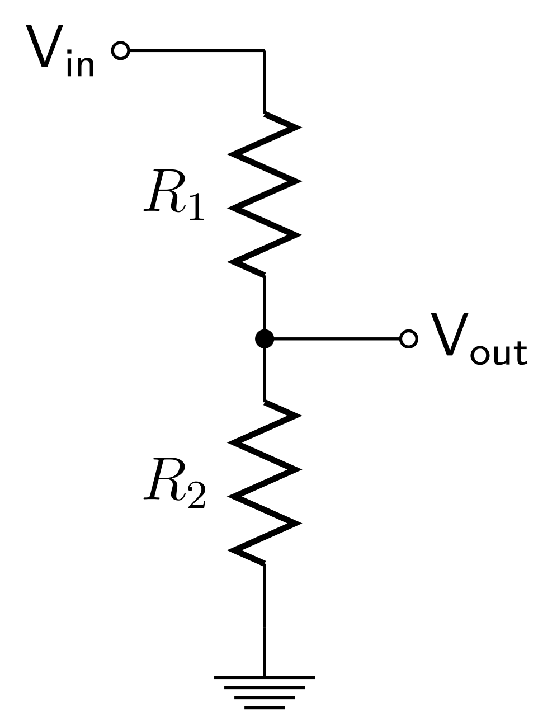
Sensors 101
Can you think of any sensors and what is their purpose?
https://en.wikipedia.org/wiki/List_of_sensors
Expanding on the previous slide, a sensor is a essentially a voltage divider circuit, which is used to measure difference between V_{in} and V_{out} a typical circuit shown ->
So by using the known input voltage and the and resistor values the output voltage can be calculated using this formula.
We are measuring the change in resistance (R₁) from an unknown phenomenon.
$V_{out}= V_{in} ∗ \frac{R_{2}}{R_{1}+R_{2}}$ or $4.45v=5v∗ \frac{1000Ω}{100Ω+1000Ω}$
Notes:
This project aims to provide you with a thorough introduction to IoT.
It introduces the key concepts of IoT, necessary in using and deploying IoT systems.
Furthermore, the application of physical computing to sense the environment around you

Slide 5
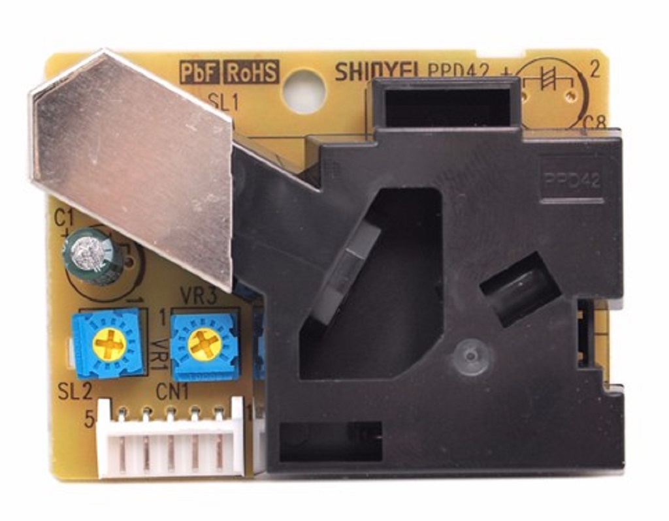
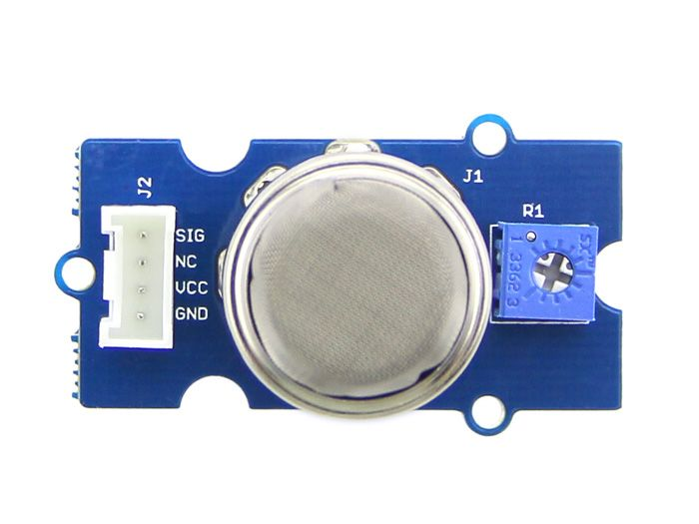
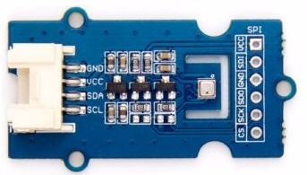
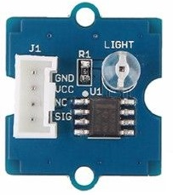
Project Sensors
MQ5 Gas Sensor
Dust Concentration Sensor
BME280 Pressure, Humidity and Temperature Sensor
Light Intensity Sensor

Slide 6
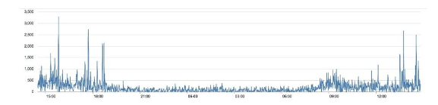
Dust Sensor
Good indication of the air quality in an environment by measuring the dust concentration.
The Particulate Matter level (PM level) in the air is measured by counting the Low Pulse Occupancy time (LPO time) in given time unit.
LPO time is proportional to PM concentration. This sensor can provide reliable data for air purifier systems; it is responsive to PM of diameter 1μm.
This sensor uses counting method to measure dust concentration, not weighing method
Unit: pcs/L or pcs/0.01cf.
We can see the concentration of dust is very low in the evening, but it is higher in the afternoon

Slide 7
MQ5 Gas Sensor
The Grove - Gas Sensor(MQ5) module is useful for gas leakage detection (in home and industry).
It is suitable for detecting H2, LPG, CH4, CO,
Hydrogen (H2), Liquid Petroleum Gas (LPG), Methane (CH4), Carbon-dioxide (C0) and ethanol/methanol.
The sensitivity of the sensor can be adjusted by using the potentiometer.
Approximation
Unit: pcs/L or pcs/0.01cf.

Slide 8
Internet of Things for Sensing the School Environment Project

