Slide 1
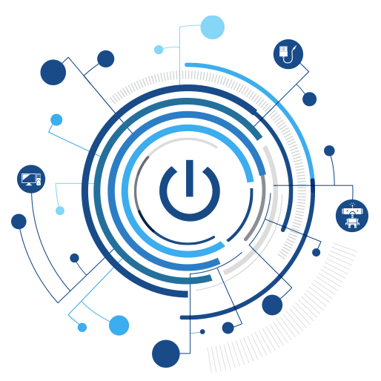

Internet of Things for Sensing the School’s Environment
What is the IoT?

Slide 2
Contents
What is the IoT?
Why IoT?
How many devices?
Applications
Examples of IoT

Slide 3

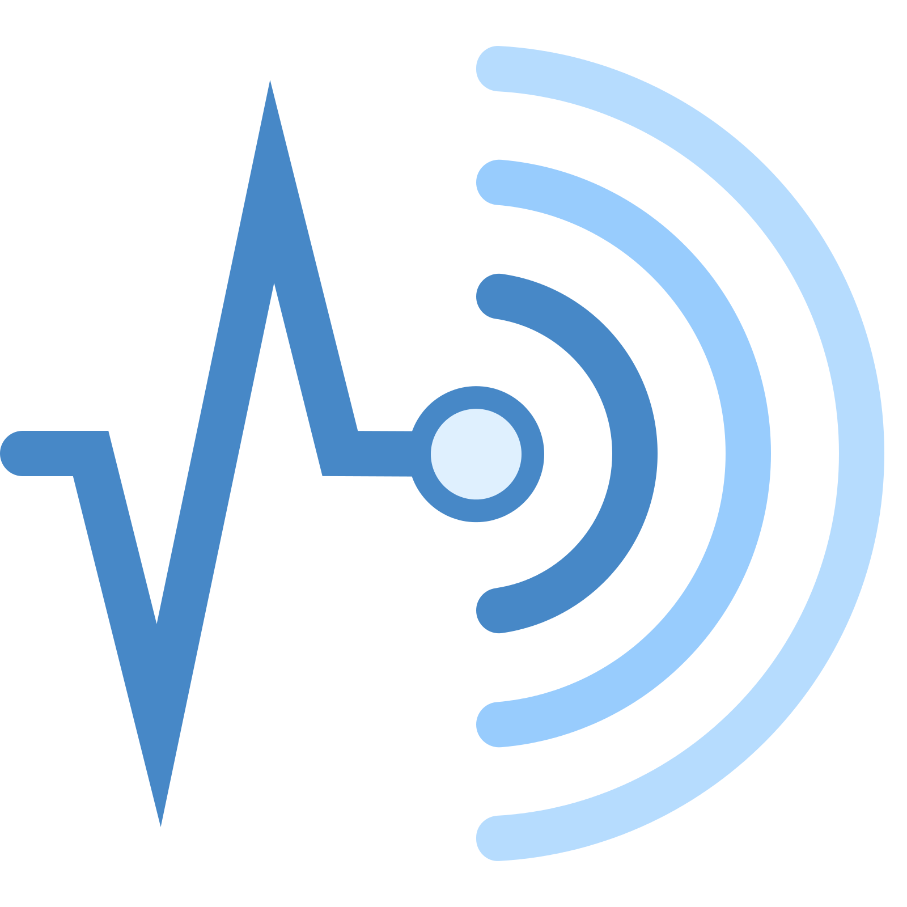
What is IoT?
Internet of Things (IoT) is a system of devices connected to the Internet with the ability to collect and exchange data from users or the environment with no human intervention.
The device or the `thing` in the IoT could be any device embedded with electronics, software and a sensor like a; smart refrigerator, a smart air conditioner, household light system, connected security system or even a person with a heart monitor or an automobile.

Slide 4




Why IoT?
We are lazy
We want to automate everything
We want to control everything remotely
We want to see data in ‘real-time’

Slide 5
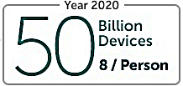

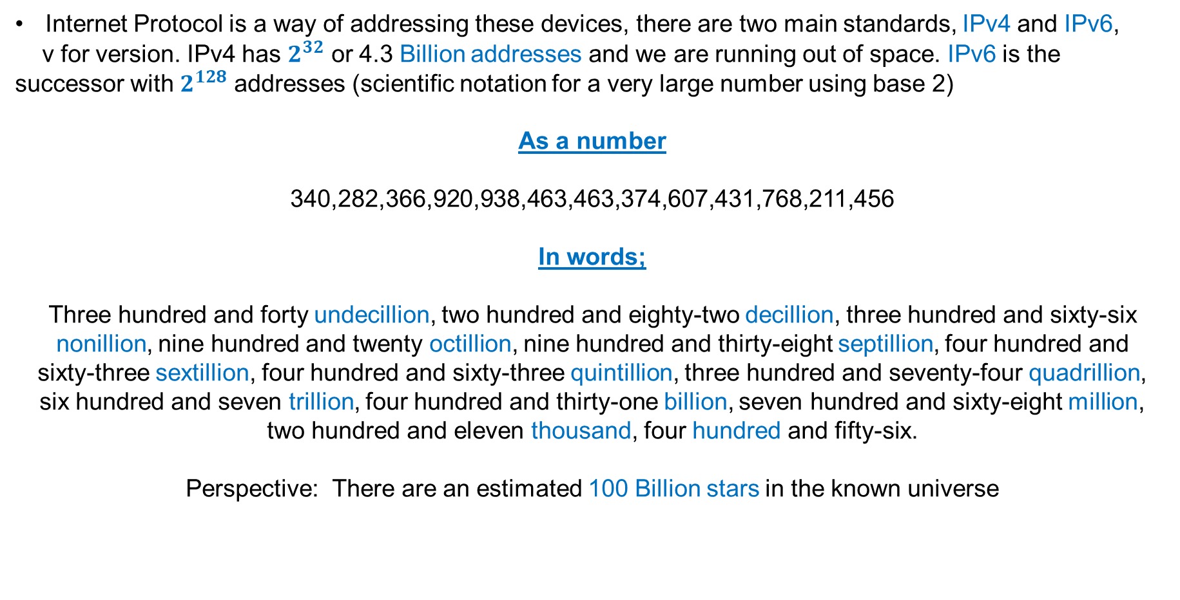
How many devices?
We are only going to be using one device with multiple sensors, but in 2020 it is estimated that there will be the equivalent of 8 devices per person.
Internet Protocol is a way of addressing these devices, there are two main standards, IPv4 and IPv6,
v for version. IPv4 has $2^{32}$ or 4.3 Billion addresses and we are running out of space. IPv6 is the successor with $2^{128}$ addresses (scientific notation for a very large number using base 2)
As a number
340,282,366,920,938,463,463,374,607,431,768,211,456
In words;
Three hundred and forty undecillion, two hundred and eighty-two decillion, three hundred and sixty-six nonillion, nine hundred and twenty octillion, nine hundred and thirty-eight septillion, four hundred and
sixty-three sextillion, four hundred and sixty-three quintillion, three hundred and seventy-four quadrillion,
six hundred and seven trillion, four hundred and thirty-one billion, seven hundred and sixty-eight million,
two hundred and eleven thousand, four hundred and fifty-six.
Perspective: There are an estimated 100 Billion stars in the known universe

Slide 6
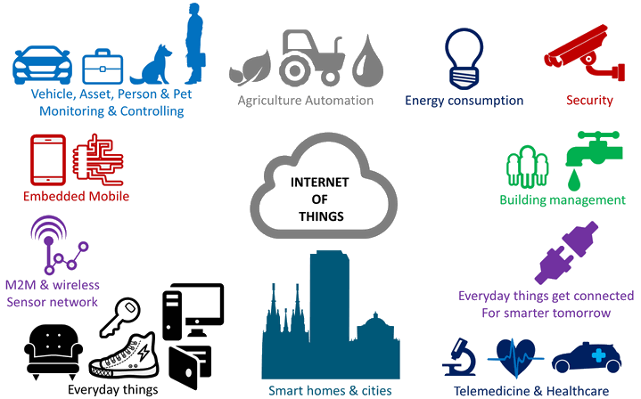
Applications

Slide 7

Summary
“Internet of Things for Sensing the Schools Environment Project”
The Internet of Things (IoT) is the connection of sensors and devices connected in a Local Area Network (LAN) (100m³ area) using technology such as Bluetooth or WIFI
Sensing in this context is the use of sensors to detect the change in environment they are placed in and send information to other electronics or computing devices.
The School Environment is the surroundings or conditions in which you, animals and plants live or operate.
Notes:
This project aims to provide you with a thorough introduction to IoT.
It introduces the key concepts of IoT, necessary in using and deploying IoT systems.
Furthermore, the application of physical computing to sense the environment around you

