Slide 1
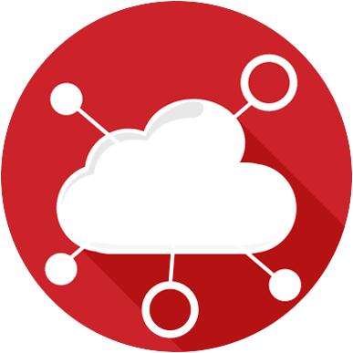
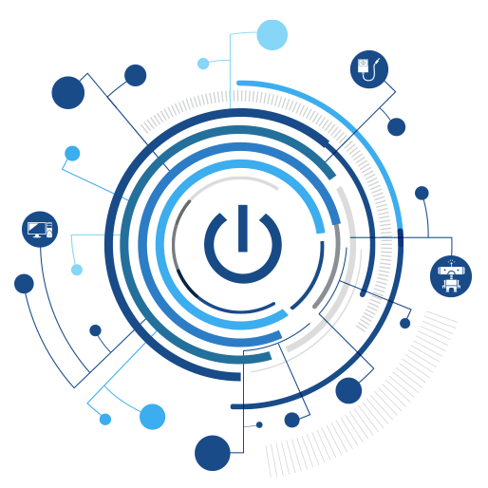

Internet of Things for Sensing the School’s Environment
Rich Blair
Notes:
Add kid friendly language
Show the image of the kit, screen shots etc

Slide 2
Contents
What is the IoT?
Why IoT?
How many devices?
What is the range?
Applications
Our Application

Slide 3

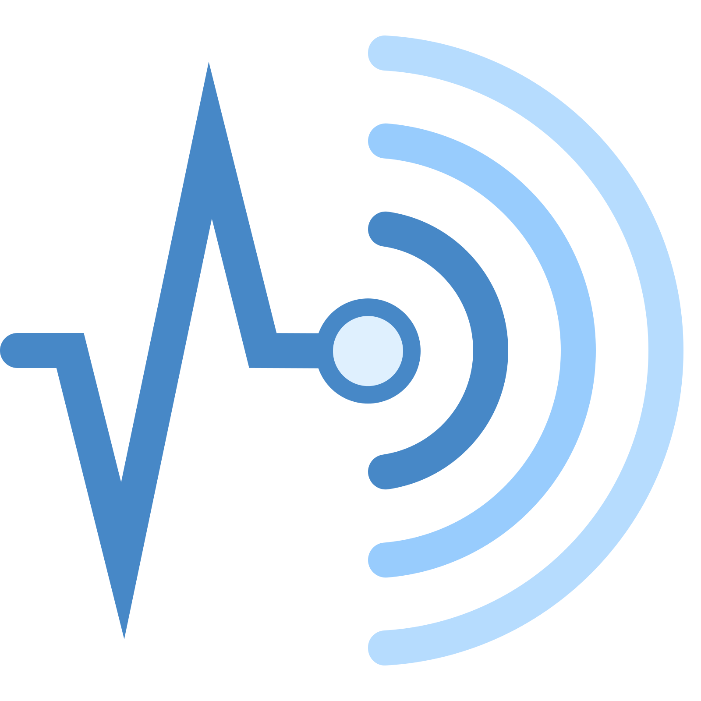
What is IoT?
Internet of Things (IoT) is a system of devices connected to the Internet with the ability to collect and exchange data from users or the environment with no human intervention.
The device or the `thing` in the IoT could be any device embedded with electronics, software and a sensor like a; smart refrigerator, a smart air conditioner, household light system, connected security system or even a person with a heart monitor or an automobile. In our case an environmental sensing kit.
Notes:
* The internet of things was first coined by British visionary Kevin Ashton in 1999. This term pronounced a system where the Internet connects to the actuality via a global network of data sensors.
* The term today has several visions based on its user and its use.
* We will be building, coding, operating our own IoT device using a range of sensors.

Slide 4

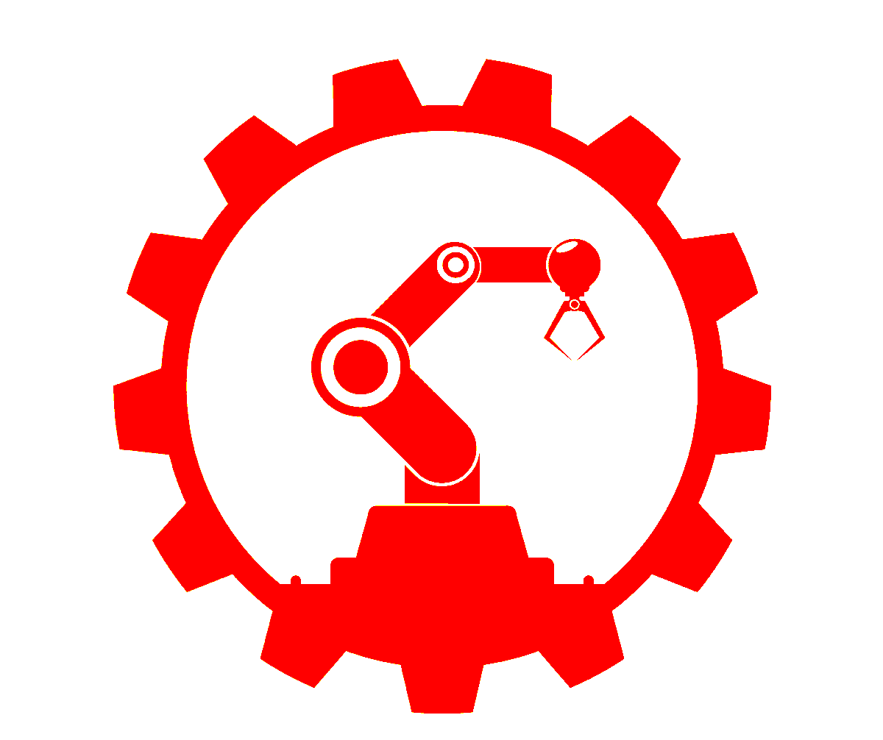

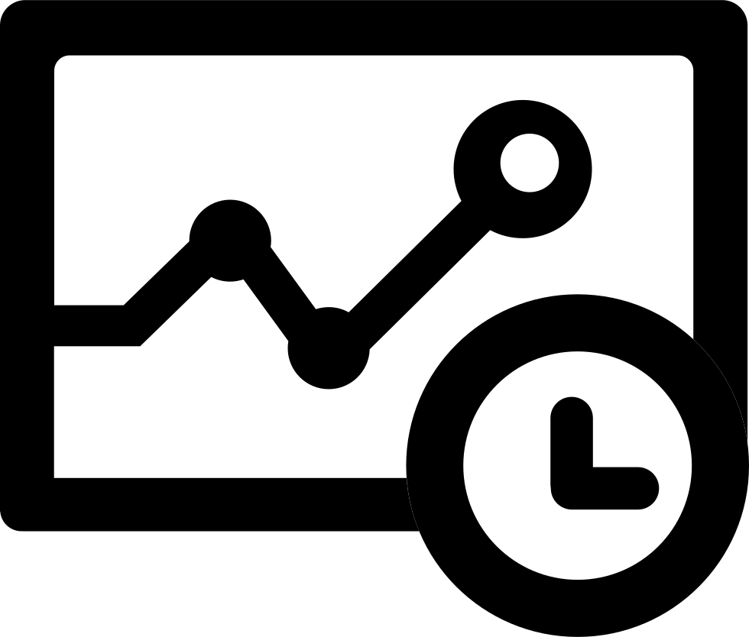
Why IoT?
We are lazy
We want to automate everything
We want to control everything remotely
We want to see data in ‘real-time’
Notes:
We are Lazy, automation is everything to the world.
But we also want to control things remotely from the comfort of a chair.
Data in real-time, this means something as close to instant as we can get, as it still takes time to sense, process, transmit, process and display the data. This could range from 10 milli-seconds to 500ms.

Slide 5
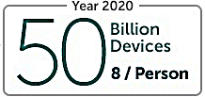
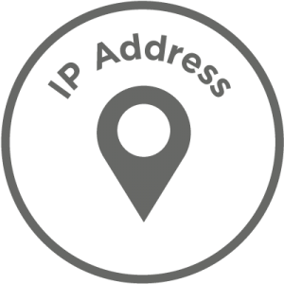
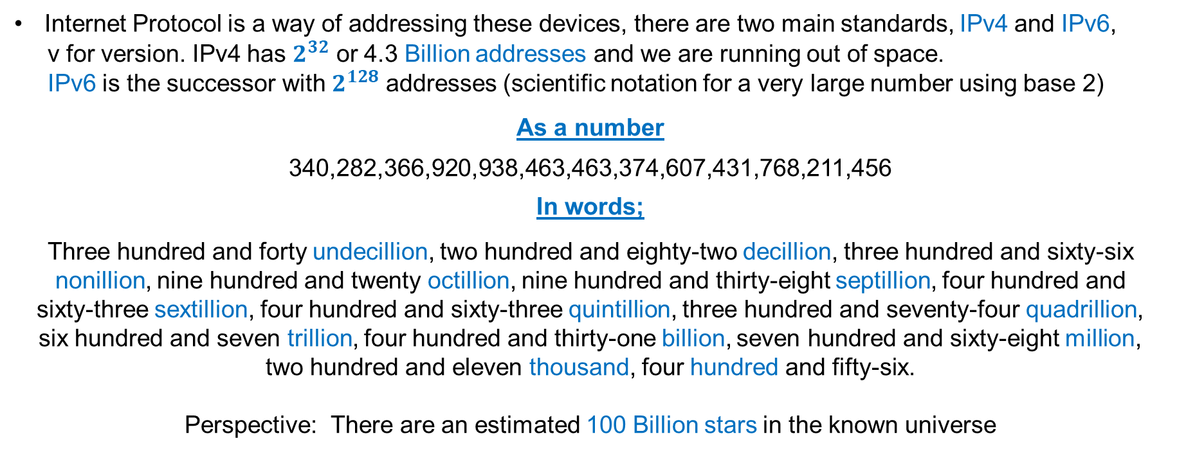
How many devices?
We are only going to be using one device with multiple sensors, but in 2020 it is estimated that there will be the equivalent of 8 devices per person.
Internet Protocol is a way of addressing these devices, there are two main standards, IPv4 and IPv6,
v for version. IPv4 has $2^{32}$ or 4.3 Billion addresses and we are running out of space.
IPv6 is the successor with $2^{128}$ addresses (scientific notation for a very large number using base 2)
As a number
340,282,366,920,938,463,463,374,607,431,768,211,456
In words;
Three hundred and forty undecillion, two hundred and eighty-two decillion, three hundred and sixty-six nonillion, nine hundred and twenty octillion, nine hundred and thirty-eight septillion, four hundred and
sixty-three sextillion, four hundred and sixty-three quintillion, three hundred and seventy-four quadrillion,
six hundred and seven trillion, four hundred and thirty-one billion, seven hundred and sixty-eight million,
two hundred and eleven thousand, four hundred and fifty-six.
Perspective: There are an estimated 100 Billion stars in the known universe
Notes:
So there is estimated to be 50 billion IoT devices by 2020 , that is equivalent to 8 devices per person currently alive today.
IoT devices require addresses, much like your PC or phone when they are on the internet. There are 2 standards for addressing devices they are:
IPv4 and IPv6
IPv4 has 4 .3 billion addresses, but this is normally expressed as 2^32, as it is in base 2. We are running out of addresses.
IPv6 has 340 undecillion addresses or 2^128. Undecillion has 33 zeroes. We are not going to run out anytime soon.
If the current pool of 4.3 billion addresses were the size of a golf ball, the new 340 undecillion address space would be about the size of the sun.

Slide 6
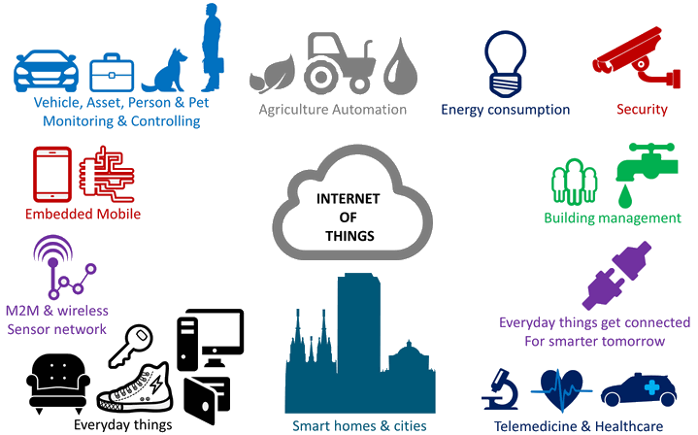
Applications
Notes:
There is almost an exhaustive list (never ending…) of applications.
Here is a list:
Smart/Connected Home
Lights, atmospheric controls, voice assistances (Alexa), CCTV IP
Wearables
Smartwatches, Glucose monitor, Medical assistance clothing
Retail
Wireless shopping scanners (ePOS – electronic Point-Of-Sale)
Smart Cities
Smart waste collection (Notify when it needs emptying), Smart street lamps(monitor light levels and adjust brightness accordingly), Parking space sensors (lights turn change colour when space is occupied)

Slide 7


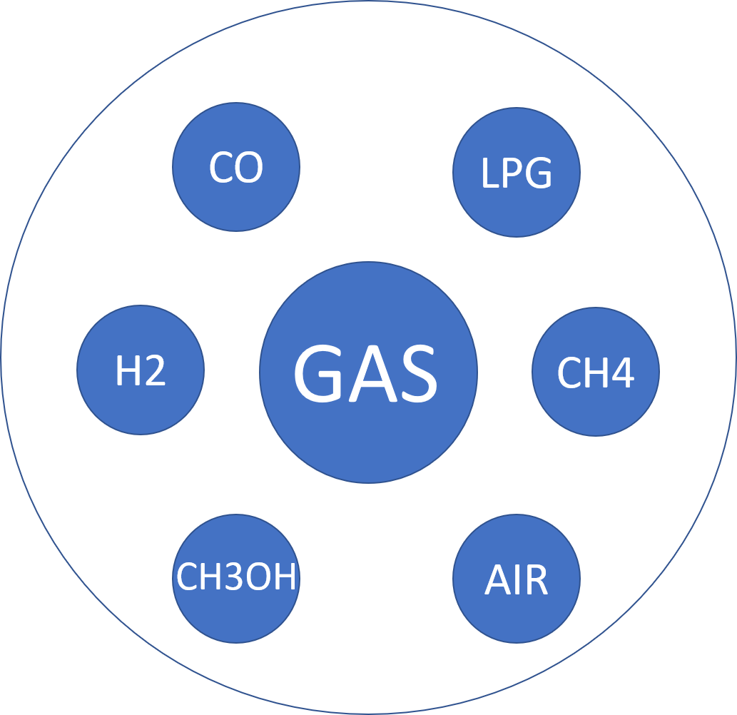
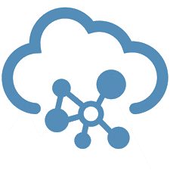

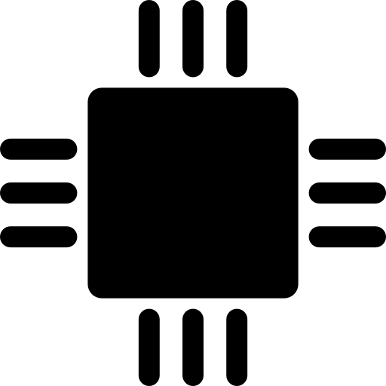
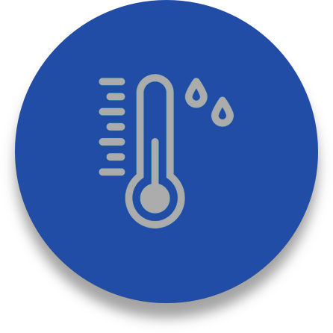
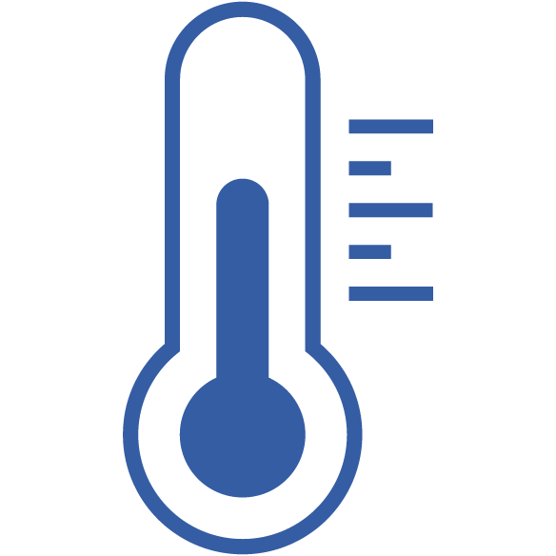


Our Application
Cloud
Retrieve Data
IoT device
Notes:
So we have our IoT device, which is made up of a microcontroller with 7 sensors, which monitors the environment and reports to a cloud(internet) and then we retrieve that data on to a screen.

Slide 8

Summary
“Internet of Things for Sensing the Schools Environment Project”
The Internet of Things (IoT) is the connection of sensors and devices connected in a Local Area Network (LAN) (100m³ area) using technology such as Bluetooth or WIFI
Sensing in this context is the use of sensors to detect the change in environment they are placed in and send information to other electronics or computing devices.
The environment in this context is the surroundings or conditions in which you, animals and plants live or operate in your school setting.
Notes:
This project aims to provide you with a thorough introduction to IoT.
It introduces the key concepts of IoT, necessary in using and deploying IoT systems.
Furthermore, the application of physical computing to sense the environment around you

Slide 9

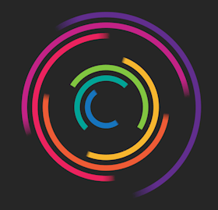


STEM Teacher Tool Kit
Environmental IoT Sensor Kit
Notes:
This project aims to provide you with a thorough introduction to IoT.
It introduces the key concepts of IoT, necessary in using and deploying IoT systems.
Furthermore, the application of physical computing to sense the environment around you

