Slide 1



Internet of Things for Sensing the School’s Environment
Sensors 101

Slide 2
Contents
Introduction
Sensors 101
Fundamentals
Sensor Circuit
Practice
Project Sensors
Dust Sensor
BMP280
MQ5 (Gas)
Light Sensor

Slide 3
Fundamentals
Can you think of any sensors?
Acoustic, sound, vibration
Automotive Sensors
Chemical Sensors
Electric current, electric potential, magnetic, radio
Environment, weather, moisture, humidity
Flow, fluid velocity
Ionizing radiation, subatomic particles,
Navigation instruments
Position, angle, displacement
Optical, light, imaging, photon…….
There are so many more sensors that have not been listed.
For more go to https://en.wikipedia.org/wiki/List_of_sensors
Notes:
This project aims to provide you with a thorough introduction to IoT.
It introduces the key concepts of IoT, necessary in using and deploying IoT systems.
Furthermore, the application of physical computing to sense the environment around you

Slide 4
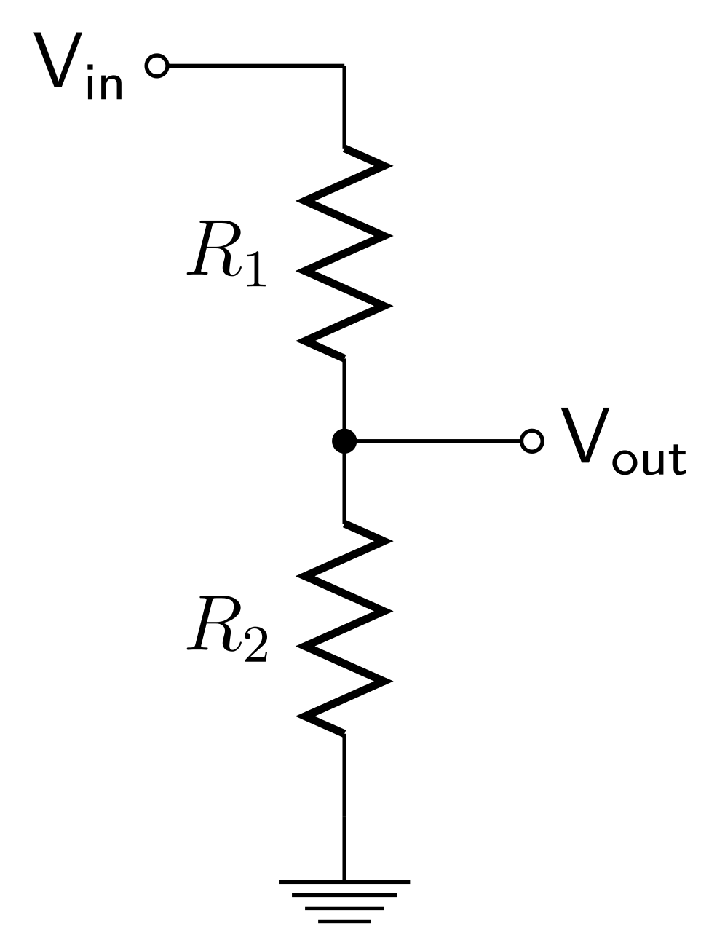
Sensor Circuit
Expanding on the previous slide, a sensor is a essentially a voltage divider circuit, which is used to measure difference between V_{in} and V_{out} a typical circuit shown below.
So by using the known input voltage and the and resistor values the output voltage can be calculated using this formula.
We are measuring the change in resistance (R₁) from an unknown phenomenon.
$V_{out}= V_{in} ∗ \frac{R_{2}}{R_{1}+R_{2}}$ or $4.45v=5v∗ \frac{1000Ω}{100Ω+1000Ω}$

Slide 5













Practice
Solve for the unknown variable in each circuit, the formula is $V_{out}= V_{in} ∗ \frac{R_{2}}{R_{1}+R_{2}}$ for you reference.
3.3V
$$25000Ω$$
$$510Ω$$
$V_{out}$ =
$V_{in}$=
2.64V
3.1V
$$3.3V$$
$$100000Ω$$
$$10000Ω$$
5V
5V
$$100Ω$$
5V
$R_{1}$ =
$$0Ω$$
1.64V
$R_{2}$ =
$$49Ω$$
$$100Ω$$

Slide 6
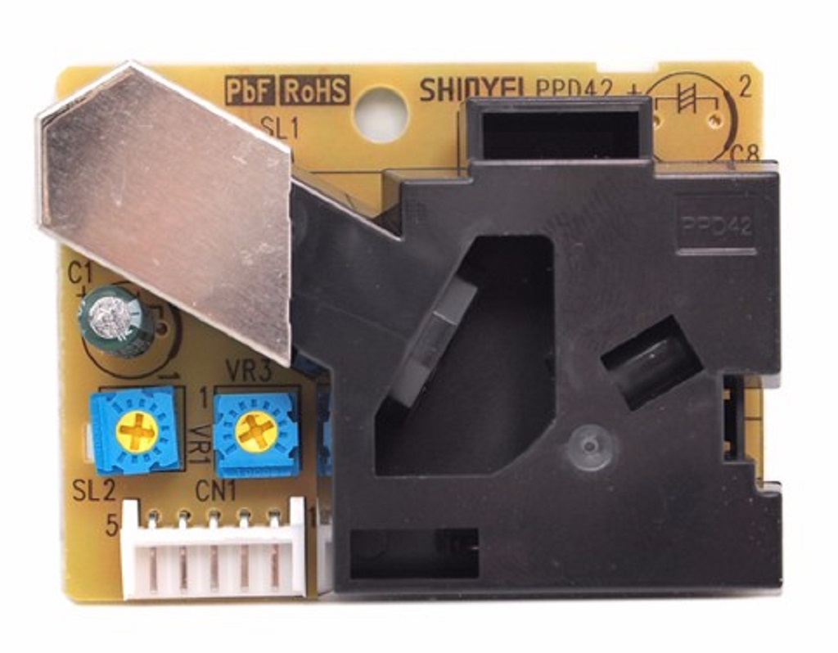
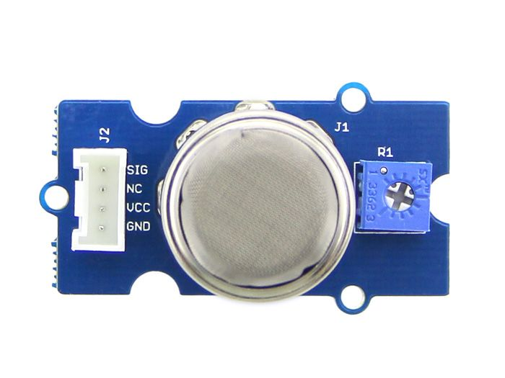
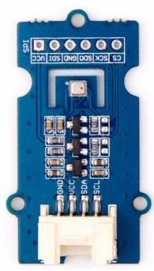
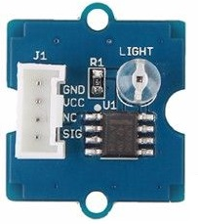
Project Sensors
MQ5 Gas Sensor
Dust Concentration Sensor
BME280 Pressure, Humidity and Temperature Sensor
Light Intensity Sensor

Slide 7
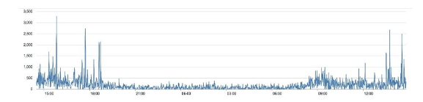
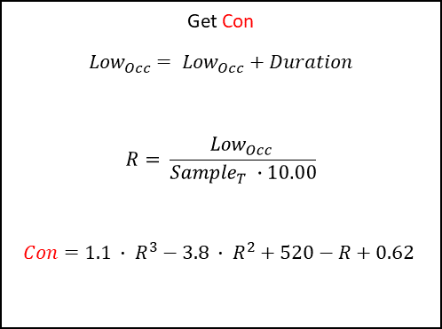
Dust Sensor
Good indication of the air quality in a environment by measuring the dust concentration.
Get Con
$${Low}_{Occ}= {Low}_{Occ}+Duration$$
$$R= \frac{{Low}_{Occ} }{{Sample}_{T} ∙10.00}$$
$$Con=1.1 ∙ R^{3}−3.8 ∙ R^{2}+520−R+0.62$$
The Particulate Matter level (PM level) in the air is measured by counting the Low Pulse Occupancy time (LPO time) in given time unit.
LPO time is proportional to PM concentration. This sensor can provide reliable data for air purifier systems; it is responsive to PM of diameter 1μm.
This sensor uses counting method to measure dust concentration, not weighing method
Unit: pcs/L or pcs/0.01cf.
We can see the concentration of dust is very low in the evening, but it is higher in the afternoon

Slide 8
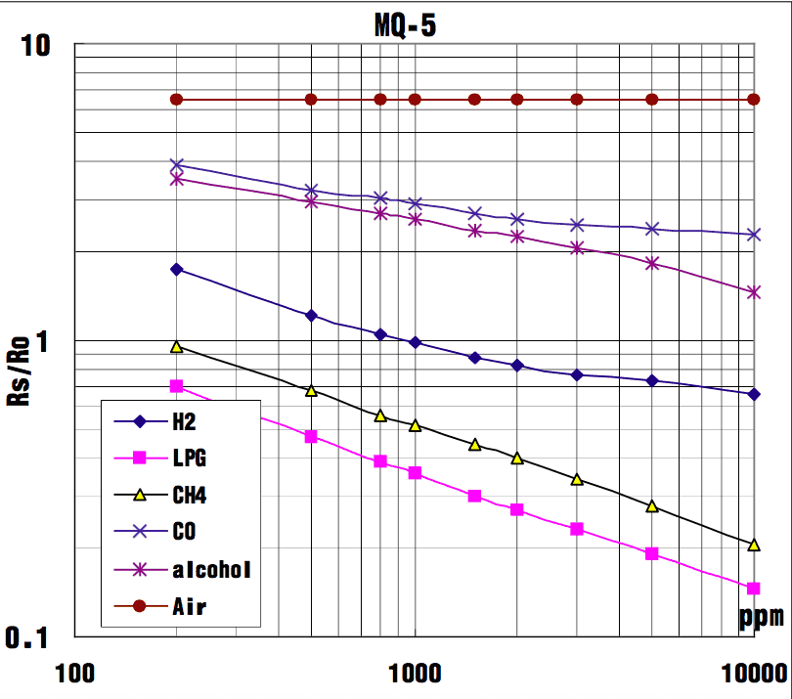
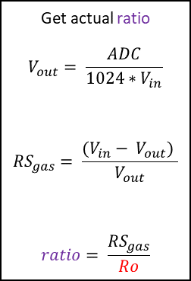
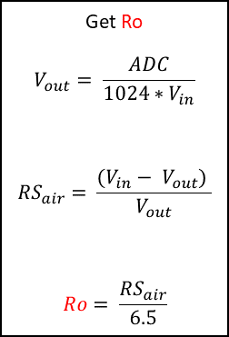
MQ5 Gas Sensor
The Grove - Gas Sensor(MQ5) module is useful for gas leakage detection (in home and industry).
It is suitable for detecting Hydrogen (H2), Liquid Petroleum Gas (LPG), Methane (CH4), Carbon-dioxide (C0) and ethanol/methanol.
Graph shows how different readings means different gases have been detected. Note RS/R0 is the ratio between that which has been sensed and the normalised ideal condition.
There is no one simple linear equation for the graph however, the Ro is worked out during a testing phase and then used in the actual implementation to get the ratio or RS/RO
Get Ro
$$V_{out}= \frac{ADC}{1024∗V_{in}}$$
$${RS}_{air}= \frac{(V_{in}− V_{out}) }{V_{out}}$$
$$Ro= \frac{{RS}_{air}}{6.5}$$
Get actual ratio
$$V_{out}= \frac{ADC}{1024∗V_{in}}$$
$${RS}_{gas}= \frac{(V_{in}− V_{out}) }{V_{out}}$$
$$ratio= \frac{{RS}_{gas}}{Ro}$$

Slide 9
Light Level Sensor
The Grove - Light sensor integrates a photo-resistor(light dependent resistor) to detect the intensity of light. The resistance of photo-resistor decreases when the intensity of light increases. The output signal is analogue value, the brighter the light is, the larger the value.
This module can be used to build a light controlled switch i.e. switch off lights during day time and switch on lights during night time.
If a door has been opened during the day
Sun light in a greenhouse
A robot that reacts to light

Slide 10
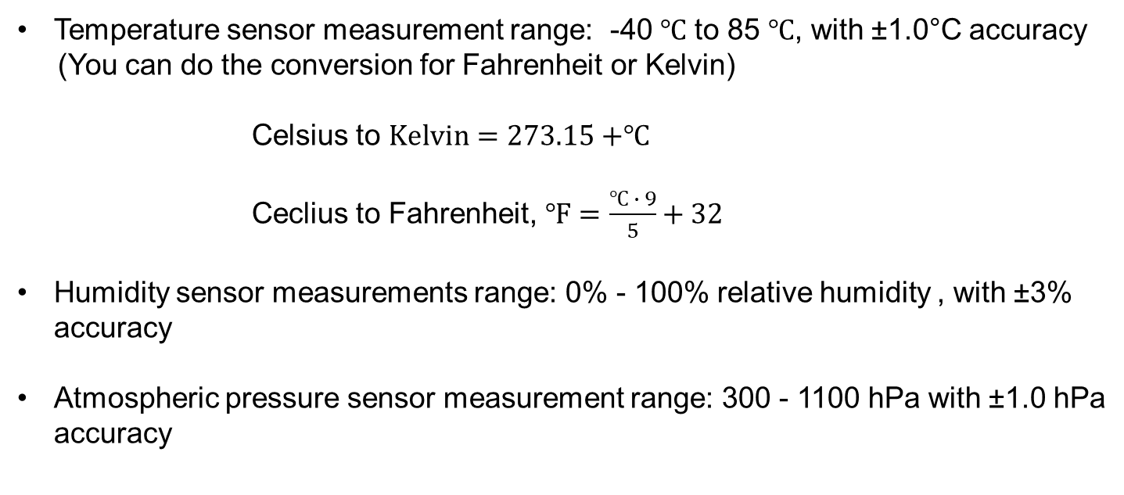
BME280 Sensor
Grove – The BME280 is high-precision, low-power combined humidity, pressure, and temperature sensor. As the atmospheric pressure changes with altitude, it can also measure approximate altitude of a place.
Temperature sensor measurement range: -40 ℃ to 85 ℃, with ±1.0°C accuracy
(You can do the conversion for Fahrenheit or Kelvin)
Celsius to $Kelvin=273.15+$℃
Ceclius to Fahrenheit, $℉=\frac{℃ ∙ 9}{5}+32$
Humidity sensor measurements range: 0% - 100% relative humidity , with ±3% accuracy
Atmospheric pressure sensor measurement range: 300 - 1100 hPa with ±1.0 hPa accuracy

