Slide 1



Internet of Things for Sensing the School’s Environment
Sensors 101

Slide 2
Contents
Introduction
Sensors 101
Fundamentals
Sensor Circuit
Practice
Project Sensors
Dust Sensor
BME680
MQ5 (Gas)
Light Sensor

Slide 3
Fundamentals
Can you think of any sensors?
Acoustic, sound, vibration
Automotive Sensors
Chemical Sensors
Electric current, electric potential, magnetic, radio
Environment, weather, moisture, humidity
Flow, fluid velocity
Ionizing radiation, subatomic particles,
Navigation instruments
Position, angle, displacement
Optical, light, imaging, photon…….
There are so many more sensors that have not been listed.
For more go to https://en.wikipedia.org/wiki/List_of_sensors
Notes:
So can you think of any sensors? Hints: Thermometer, Gigacounter, pressure sensor, Ph sensor, Light sensor Volt/Amp meter
There are so many types and variations from analogue to digital (glass thermometer, electronic thermometer).

Slide 4
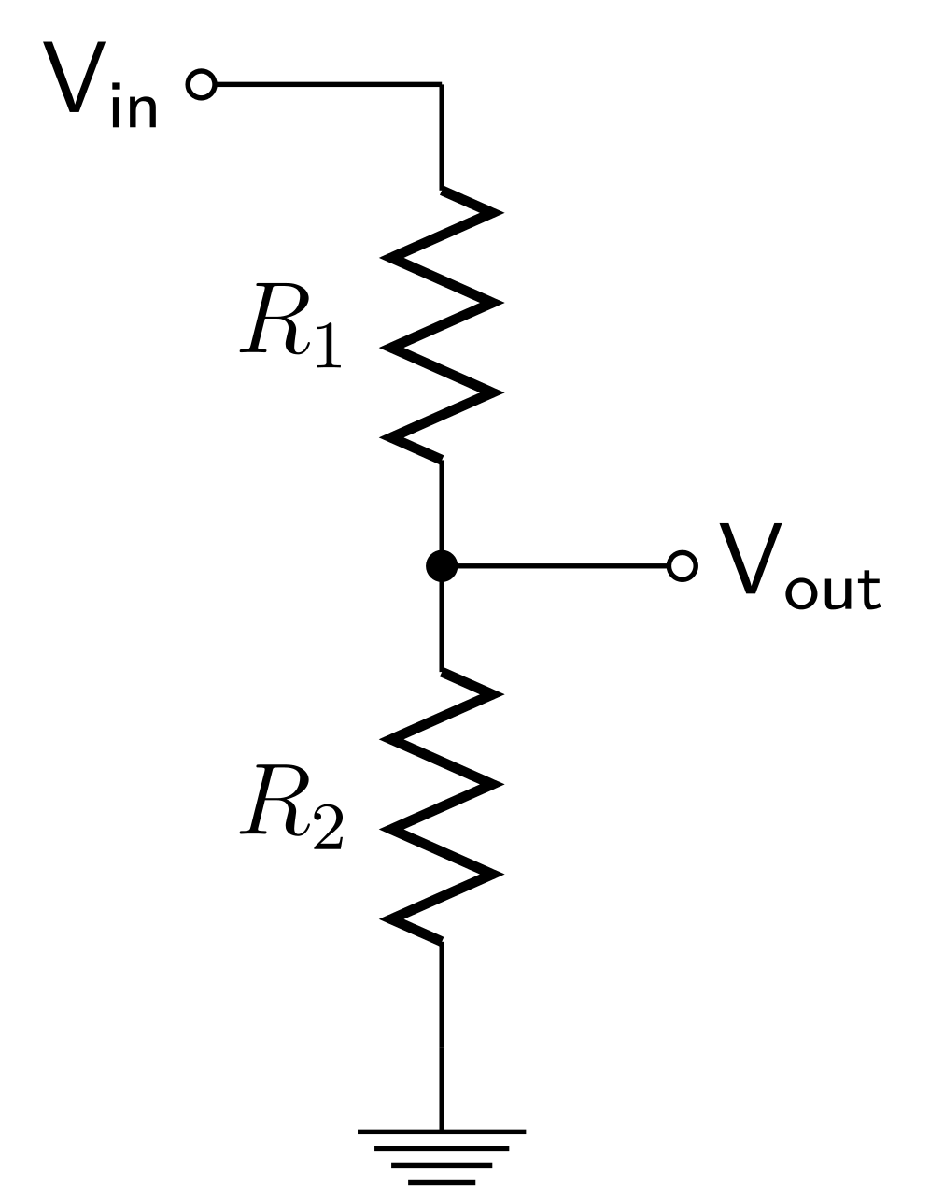
Sensor Circuit
Expanding on the previous slide, a sensor is a essentially a voltage divider circuit, which is used to measure difference between V_{in} and V_{out} a typical circuit shown below.
So by using the known input voltage and the and resistor values the output voltage can be calculated using this formula.
We are measuring the change in resistance (R₁) from an unknown phenomenon.
$V_{out}= V_{in} ∗ \frac{R_{2}}{R_{1}+R_{2}}$ or $4.45v=5v∗ \frac{1000Ω}{100Ω+1000Ω}$
Notes:
A sensor circuit is essentially a voltage divider with either resistors, capacitors or inductive components.
This a resistive voltage divider and is sensing that which is present. Say sunlight, as light increases so does the resistance. The higher the Vout the more light there is. The name for this component is called a Light dependant resistor (LDR)
Voltage in (Vin) is the source say 5v and the Voltage out (Vout).
R1 is the LDR and R2 is a normal resistor.
This formula is used in some of our sensors.

Slide 5
















Practice
Solve for $V_{out}$ in each circuit, the formula is: $V_{out}= V_{in} ∗ \frac{R_{2}}{R_{1}+R_{2}}$
3.3v
19.1v
$$25000Ω$$
$$12732Ω$$
$V_{out}$ =
2.64v
$V_{out }$=
$15.22$v
$$100000Ω$$
$$50000Ω$$
$$V_{in}= \frac{V_{out}}{\frac{R_{2}}{R_{1}+R_{2}}}$$
5v
$$0Ω$$
$$100Ω$$
$V_{out}$ =
$0.00$v
1.64v
$V_{in}$=
$$5v$$
$$100Ω$$
$$49Ω$$
Notes:
Voltage is V
Resistance is Ohms represented as $Ω$
Half a mark if the symbols are missing.
2.64v
15.22v
0.00v
4.94v or 5.00v depending on the calculator (the equation should be re arranged or transposed to make Vin the subject: appears with answer.

Slide 6
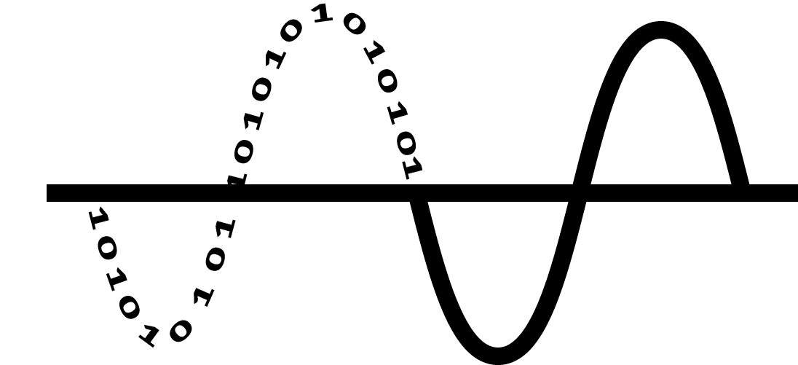
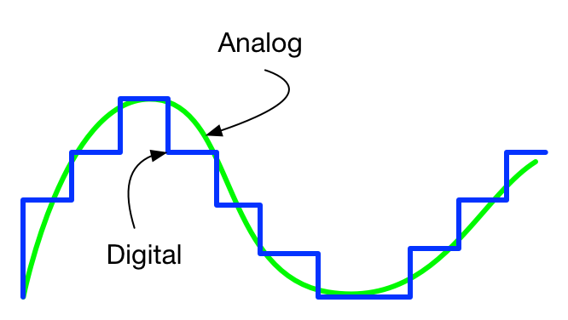
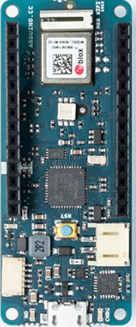
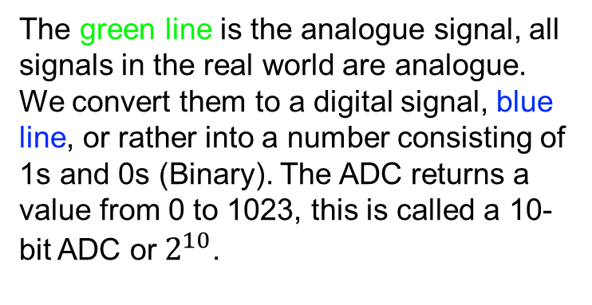
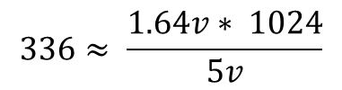
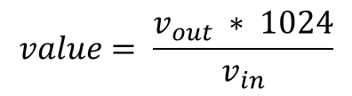
Analogue to Digital Converter
The Microcontroller a is device that can process one action at a time. For this project we are using an Ardunio MKR1010 WiFi. Other than sending our data over WiFi and controlling our sensors it serves. There is a very important function that the MKR1010 performs, the Analogue Digital Converter (ADC).
The green line is the analogue signal, all signals in the real world are analogue. We convert them to a digital signal, blue line, or rather into a number consisting of 1s and 0s (Binary). The ADC returns a value from 0 to 1023, this is called a 10-bit ADC or$2^{10}$.
$$value= \frac{v_{out} ∗ 1024}{v_{in}}$$
We then use more maths to turn that into something understandable for what we are measuring.
The when we get that voltage out value from the sensor we need to turn that into something meaningful so…
$$336≈ \frac{1.64v∗ 1024}{5v}$$
Notes:
This is a microcontroller, there are many types and variations, but we are using a ardunio MKR1010 WiFi.
There are many functionalities of a microcontroller, we programme it to perform functions that take inputs and produce outputs real world.
One of the main functions is the Analogue Digital Converter (ADC), there are range of ADCs and they are defined as 2,4,8,10,12,16 etc bit ADC.
10 bit is expressed as 1024 or 2^10 this gives a range from 0 to 1023 (note 0 to 1023 has 1024 numbers) like 2^4 is 16 but would range from 0 to 15.
The calculation takes the voltage out, which is an analogue signal and converts it into a digital signal in the range of the ADC (0 to 1023)
We then take that value and use more equations to turn it into a value we can understand, such as temperature.

Slide 7
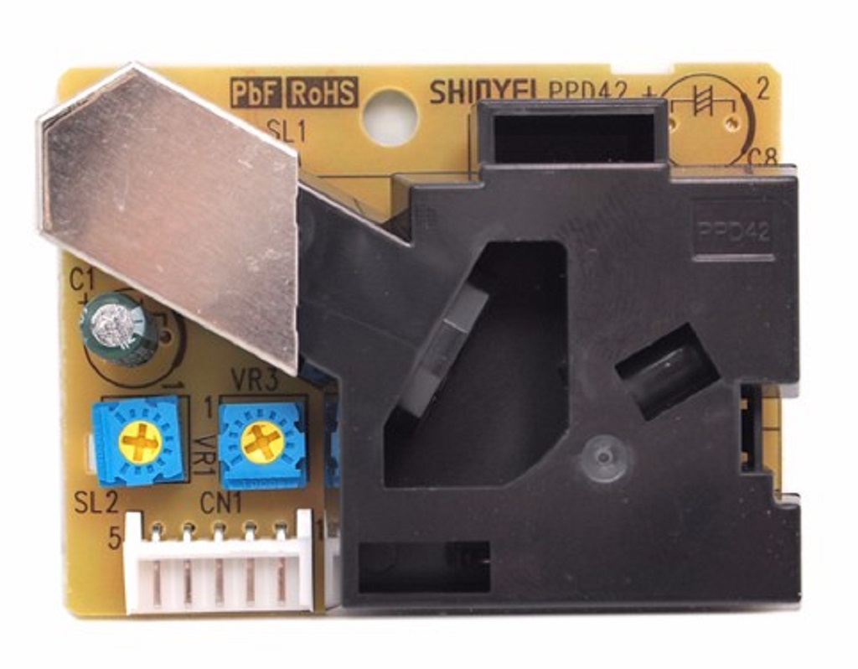
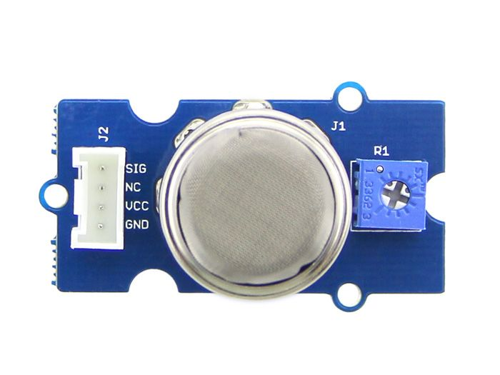
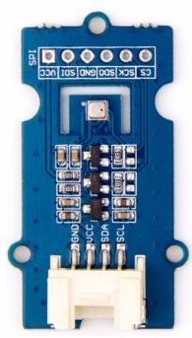
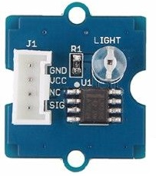
Project Sensors
MQ5 Gas Sensor
Dust Concentration Sensor
BME680 Pressure, Humidity and Temperature, VOC Sensor
Light Intensity Sensor
Notes:
Here are the sensors we are going to use, and we will talk about how each one functions.

Slide 8
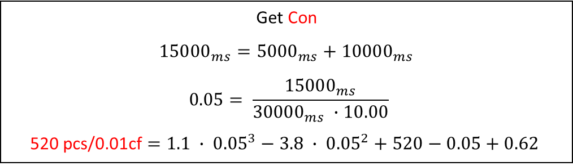
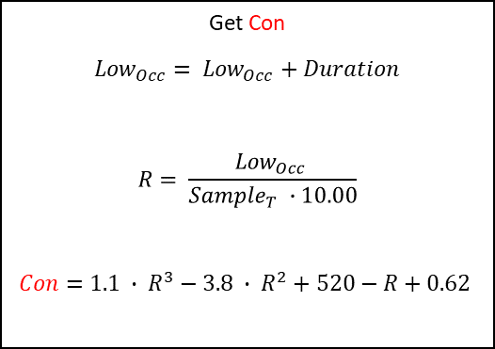
Dust Sensor
Good indication of the air quality in a environment by measuring the dust concentration.
Get Con
$${Low}_{Occ}= {Low}_{Occ}+Duration$$
$$R= \frac{{Low}_{Occ} }{{Sample}_{T} ∙10.00}$$
$$Con=1.1 ∙ R^{3}−3.8 ∙ R^{2}+520−R+0.62$$
The Particulate Matter level (PM level) in the air is measured by counting the Low Pulse Occupancy time (LPO time) in given time unit.
LPO time is proportional to PM concentration. This sensor can provide reliable data for air purifier systems; it is responsive to PM of diameter 1μm.
This sensor uses counting method to measure dust concentration, not weighing method
Unit: pcs/L or pcs/0.01cf.
Example
Get Con
$${15000}_{ms}={5000}_{ms}+{10000}_{ms}$$
$$0.05= \frac{{15000}_{ms}}{{30000}_{ms} ∙10.00}$$
520 pcs/0.01cf $=1.1 ∙ {0.05}^{3}−3.8 ∙ {0.05}^{2}+520−0.05+0.62$
Notes:
The dust sensor is fairly complex but for basically it uses a laser to measure the dust particles falling through the laser beam.
Dust, pollen, pollution (soot) etc is called Particulate matter.
Low occupancy is the amount of time there is dust blocking the laser beam in an amount of time.
Notice con in red is the Concentration. Duration and LowOcc is in ms milli-seconds
Unit is Particles (pcs) per 0.01 cubic feet

Slide 9
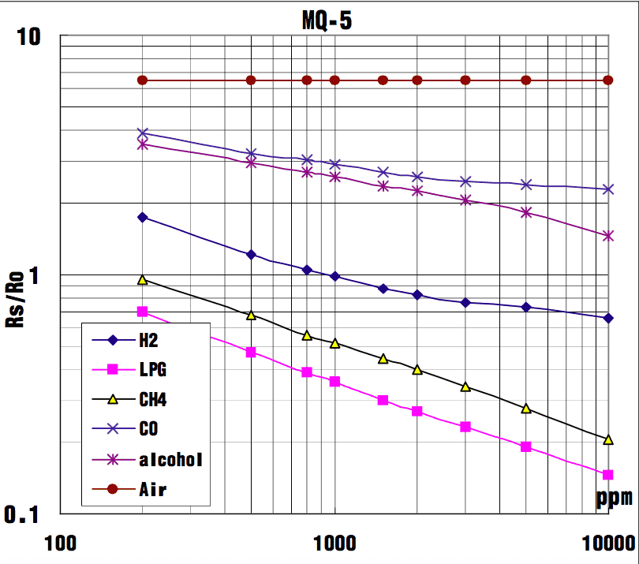
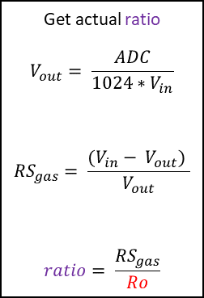
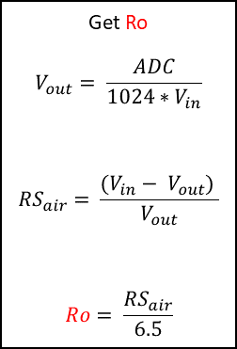
MQ5 Gas Sensor
The Grove - Gas Sensor(MQ5) module is useful for gas leakage detection (in home and industry).
It is suitable for detecting Hydrogen (H2), Liquid Petroleum Gas (LPG), Methane (CH4), Carbon-dioxide (C0) and ethanol/methanol.
Graph shows how different readings means different gases have been detected. Note RS/R0 is the ratio between that which has been sensed and the normalised ideal condition.
There is no one simple linear equation for the graph however, the Ro is worked out during a testing phase and then used in the actual implementation to get the ratio or RS/RO
Get Ro
$$V_{out}= \frac{ADC}{1024∗V_{in}}$$
$${RS}_{air}= \frac{(V_{in}− V_{out}) }{V_{out}}$$
$$Ro= \frac{{RS}_{air}}{6.5}$$
Get actual ratio
$$V_{out}= \frac{ADC}{1024∗V_{in}}$$
$${RS}_{gas}= \frac{(V_{in}− V_{out}) }{V_{out}}$$
$$ratio= \frac{{RS}_{gas}}{Ro}$$
Notes:
This sensor composed of a micro AL2O3 ceramic tube, Tin Dioxide (SnO2) sensitive layer, measuring electrode and heater which are fixed into a
crust made by plastic and a stainless steel net.
Used to measure a range of gases.
Math involved consists of several dividing functions. First R0 and Rs_air are found using a ADC formula. Then the ratio is found, this ratio is between 0.1 and 10, see graph.
There is no linear formula for this, however manual interpretation of the graph we can get the values of each gas parts per million. There is a way to do this in code, but that is for later.

Slide 10
Light Level Sensor
The Grove - Light sensor integrates a photo-resistor(light dependent resistor) to detect the intensity of light. The resistance of photo-resistor decreases when the intensity of light increases. The output signal is analogue value, the brighter the light is, the larger the value.
This module can be used to build a light controlled switch i.e. switch off lights during day time and switch on lights during night time.
If a door has been opened during the day
Sun light in a greenhouse
A robot that reacts to light
Notes:
This is the simplest sensor, a photodiode is put next to a resistor just like a voltage divider circuit.
We take the value and then assign some meaning to it such as 900 ADC is bright, 200 or lower is dark.

Slide 11
BME680 Sensor
Grove – The BME680 is high-precision, low-power combined temperature, humidity, pressure, and Volatile Organic Compound (VOC) sensor. As the atmospheric pressure changes with altitude, it can also measure approximate altitude of a place.
Temperature sensor measurement range: -40 ℃ to 85 ℃, with ±1.0°C accuracy
Humidity sensor measurements range: 0% to 100% relative humidity , with ±3% accuracy
Atmospheric pressure sensor measurement range: 300 to 1100 kPa with ±1.0 kPa accuracy
VOC measurement range: 1.000 to 300.00 kOhms. With clever bit of maths we can convert this to the Indoor Air Quality (IAQ) Index 0 to +300%, excellent to hazardous to life air quality.
Notes:
The BME680 is a 4-in-1 sensor, temperature, humidity, air pressure and Volatile Organic Compound (VOC).
Thermometer ranges from -40 ℃ to 85 ℃ with ±1.0°C accuracy
Humidity ranges from 0 to 100% % relative humidity , with ±3% accuracy
Atmospheric pressure sensor measurement range: 300 to 1100 kPa with ±0.001 kPa accuracy
Finally the VOC measures gas resistance in kOhms, this is converted to the Indoor Air Quality (IAQ) index which ranges from 0 to +300% , excellent to hazardous to life air quality.

