Slide 1

Android User Input, Variables and Operations
Mobile Applications for Engineering

Slide 2
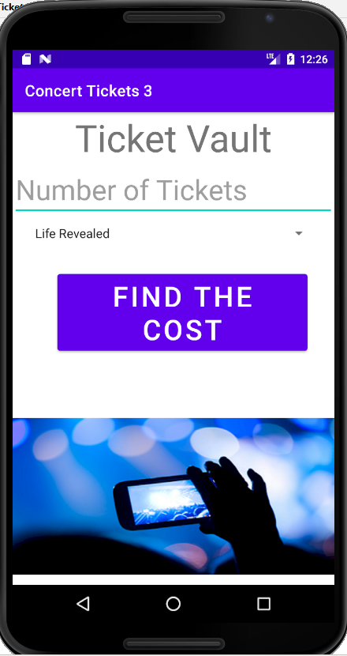
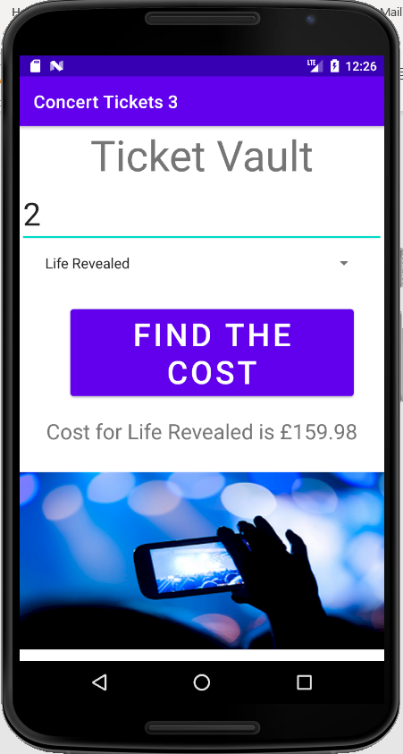
Concert Tickets Application

Slide 3
Android Themes
A theme is a style applied to an Activity or an entire application
Themes are Android’s mechanism for applying a consistent style to an app or Activity
The style specifies the visual properties of the elements that make up a user interface, such as colour, height, padding, and font size
Some themes change the background wallpaper of the Activity, while others hide the title bar or display an action bar

Slide 4
Android Themes (continued)
Some themes display a background depending on the size of the mobile device
You can preview themes in the emulator in activity_main.xml
By changing the theme in the emulator in activity_main.xml file, you can preview what the theme looks like, but to change it permanently in the application, you must define the themes in the themes.xml file within the values subfolder of the Activity
The default for Nexus 6 shows the title bar displaying the app name with a white background when running the app
More on change of app theme on:
https://developer.android.com/codelabs/basic-android-kotlin-training-change-app-theme#0

Slide 5
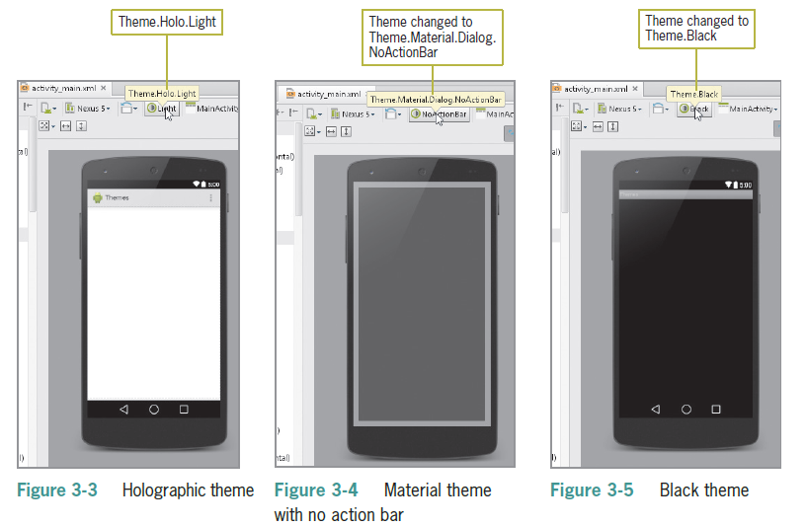
Previewing a Theme
Check the activity_main.xml file in the emulator to see what your screen looks like

Slide 6
Simplifying User Input
Users can enter text in multiple ways on Android phone:
Through an onscreen soft keyboard
An attached flip button hard keyboard
Voice-to-text capabilities on most phone models
The onscreen keyboard is called a soft keyboard
Input can be in the form of tapping or gestures (using two fingers to pan, rotate, or zoom)
Primary design challenge is to simplify user experiences
Use legible fonts, simplify input, and optimize each device’s capabilities to maximize user experience

Slide 7
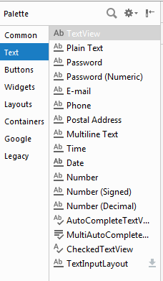
Simplifying User Input (continued)
Using Android Text Fields
Text Fields are the most common type of mobile input
Can be free-form plain text
Numbers
A person’s name, password, email, phone number
A date and time
Multiline text

Slide 8
Simplifying User Input (continued)
The Concert Tickets app requests the number of concert tickets which is a positive integer number
There is a variety of Text Fields to choose from in Android Studio
By selecting the Number text field, users can enter only positive integers from the keyboard
This way, the app will not accept letters or symbols from the keyboard, saving developers time for writing data validation code

Slide 9
Adding a String Array
In order to define a drop-down list in Android Studio, you will need to define a string-array in strings.xml
A string array defines a string resource of related items in a central location within strings.xml
An item defines an individual entry within a string array
As you type the string-array XML code, the Android Studio editor offers suggestions in a panel that can complete the statement

Slide 10
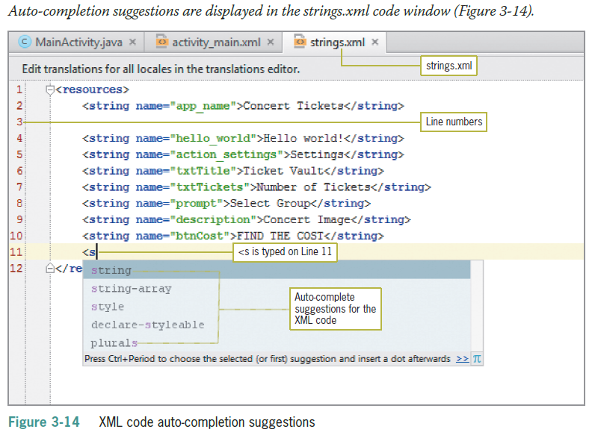
Adding a String Array(continued)

Slide 11
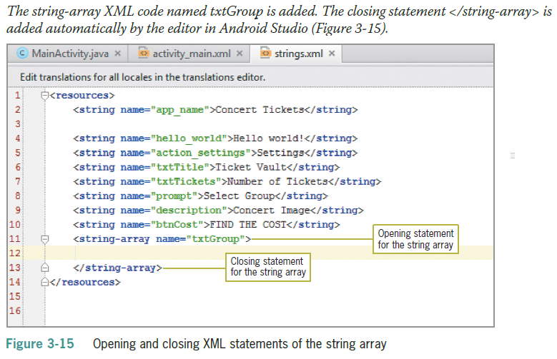
Adding a String Array(continued)

Slide 12
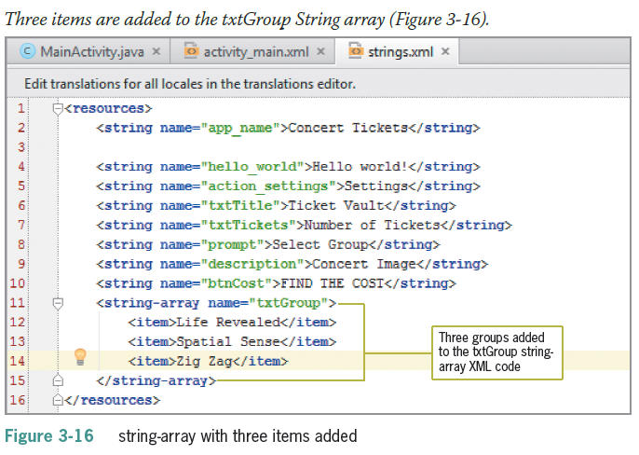
Adding a String Array(continued)

Slide 13
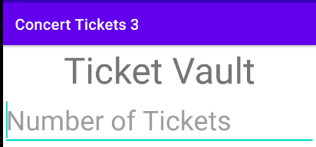
Setting the Hint Property for a Text Field
A hint is a short description of a field visible as light-colored text (called a watermark)
When the user clicks the control, the hint is removed, and the user is free to type the requested input

Slide 14
Using the Android Spinner Control
A Spinner control is a widget like a drop-down list for selecting a single item from a fixed list
The spinner control displays a list of strings called items in a pop-up window
A prompt, which can be used to display instructions at the top of the Spinner control, also is stored in strings.xml and is named prompt
The Spinner property called entries connects the String Array to the Spinner control for display in the application

Slide 15
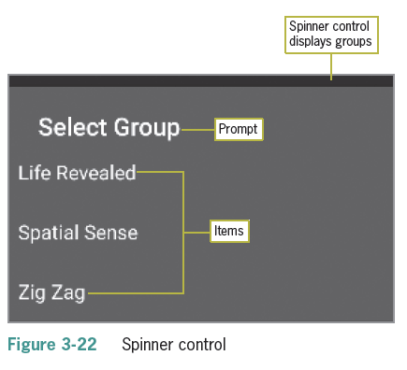
Using the Android Spinner Control (continued)

Slide 16
Using the Android Spinner Control (continued)
The prompt property of the Spinner connects to the resource named @string/prompt
The entries property of the Spinner connects to the resources of the string array @array/txtGroup
The actual groups are displayed in the Spinner when the app is executed in the emulator

Slide 17
Coding the EditText Class
A variable is used in programming to contain data that changes during the execution of a program
Final variables can be initialized but cannot be changed
EditText code assigns input value to variable named tickets
final EditText tickets = findViewById(R.id.editTextNumber);

Slide 18
Coding the Spinner Control
The Spinner assigns the value from the user’s input to the variable named group
final Spinner group = findViewById(R.id.spinner);

Slide 19
Variables
Variables stores values
Each variable has
an identifier (name)
a type (data type)
variable size
range of values
the operations that can be performed with this variable type

Slide 20
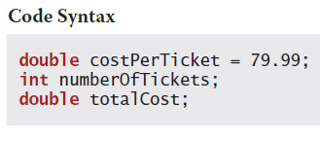
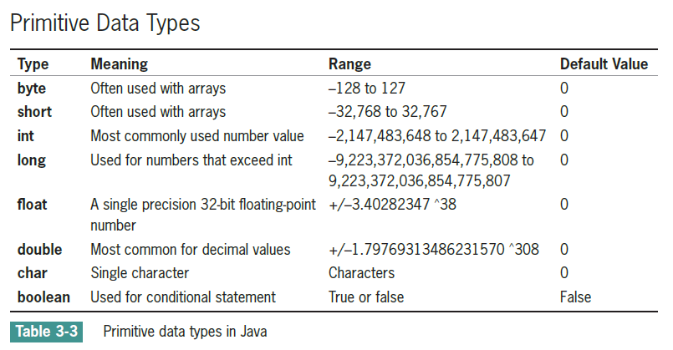
Declaring Variables
Declare the variable
Assign a value to the variable

Slide 21
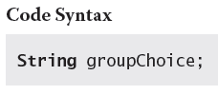
Declaring Variables (continued)
String Data Type
The String type is a class and not a primitive data type
A string can be a character, word, or phrase
Declaring the Variables
Typically declared at the beginning of an Activity
Variables must be declared before you can use them

Slide 22
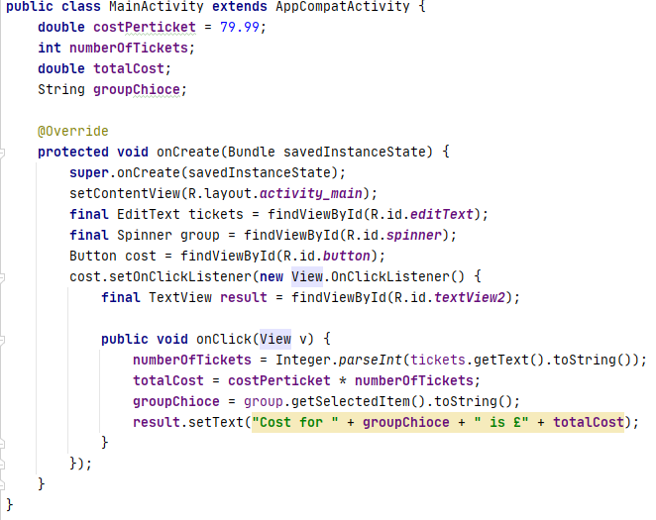
Declaring Variables (continued)

Slide 23
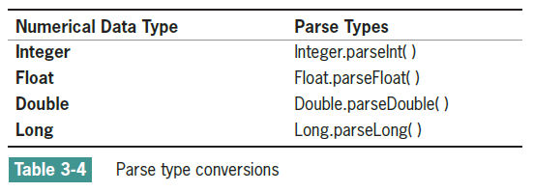
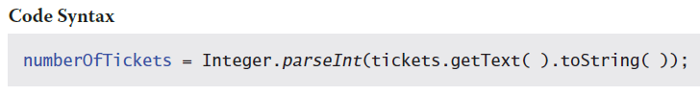
getText() Method
Read data stored in the EditText control with the getText() method
Data is read in as a string, by default
A Parse class is used to convert strings into numbers

Slide 24
getText() Method (continued)
The getText() method extracts the text from EditText tickets and converts it to String
The parseInt()method converts a string to integer
numberOfTickets = Integer.parseInt(tickets.getText().toString());

Slide 25
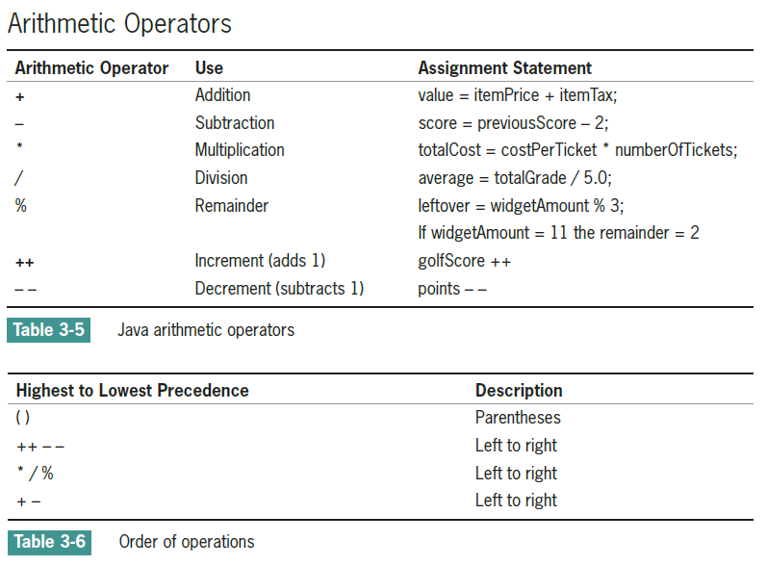
Working with Mathematical Operations

Slide 26
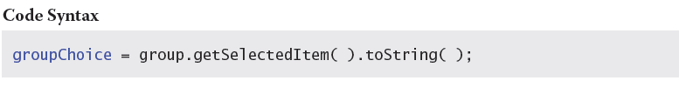
Displaying Android Output
getSelectedItem() Method
The getSelectedItem() method returns the text label of the currently selected Spinner item
setText () Method
The setText() method displays text in a TextView control

Slide 27
Further Reading:
Hoisington, C. (2016) Android Boot Camp for Developers Using Java: A Guide to Creating Your First Android Apps, Cengage Learning, Chapter 3

