Slide 1
Master degree in
Computer Engineering for the Internet of Things
Course Name
IoT Systems
Project
Smart buildings and automation: a proposal for an IoT system to monitor
covid-aware cafeterias in a university campus setting.
Assignment on
Simulation
Professors
Giancarlo Fortino
Giandomenico Spezzano
Claudio Savaglio
Speaker
Fabio Capparelli
GitHub Link
click here

Slide 2
Simulation
Simulator → EdgeCloudSim
Built on top of CloudSim, that is a simulator for Cloud Computing
Allow simulation on both Edge and Cloud environment
Uses three simple configuration files and it is based on ScenarioFactory design pattern
Allow mobility of devices and Edge Servers Orchestration
Written in Java

Slide 3
Simulation
Tasks
We considered four principal tasks:
Tensorflow task: that runs when the devices will be offline and the values of temperature and humidity will be predicted (it runs only on the edge in the reality);
Forward Parameter task: used for forwarding the temperature and humidity values periodically when the devices are online (it runs only on the edge in the reality);
Information task: used for emulating the smart information service to send notification to the current state of the cafeteria to the users (it runs only on the cloud in the reality),
Covid Monitoring task: used for emulating the decision-making algorithm for controlling the covid risk and send alerts to the administrator of cafeterias (it runs only on the cloud in the reality).

Slide 4
Simulation
Scenarios
Scenario_1
Edge runs:
Tensorflow task;
Forward Parameter task.
Cloud runs:
Information task;
Covid Monitoring task.
2-Tier + patch
N.B.
EdgeCloudSim has been patched to allow as to link the edge with the cloud.
Scenario_2
Edge runs:
Cloud runs:
Tensorflow task;
Forward Parameter task.
Information task;
Covid Monitoring task.
2-Tier
Scenario_3
Edge runs:
Tensorflow task;
Forward Parameter task.
Information task;
Covid Monitoring task.
Cloud runs:
1-Tier

Slide 5
Simulation
Scenarios
Scenario_4
[Much powerful cloud]
Edge runs:
Tensorflow task;
Forward Parameter task.
Cloud runs:
Information task;
Covid Monitoring task.
2-Tier + patch
N.B.
EdgeCloudSim has been patched to allow as to link the edge with the cloud.
Scenario_5
[Much powerful cloud]
Edge runs:
Cloud runs:
Tensorflow task;
Forward Parameter task.
Information task;
Covid Monitoring task.
2-Tier

Slide 6
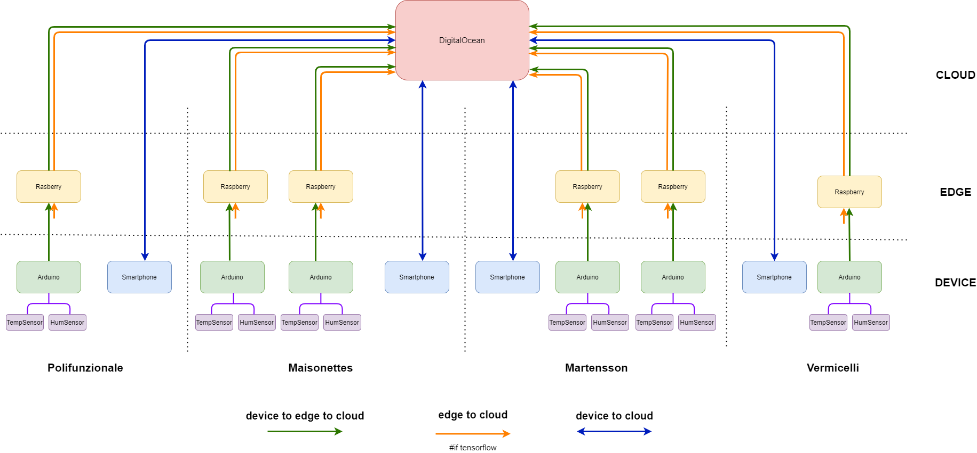
Simulation
Scenario_1 & Scenario_4 → Topology

Slide 7
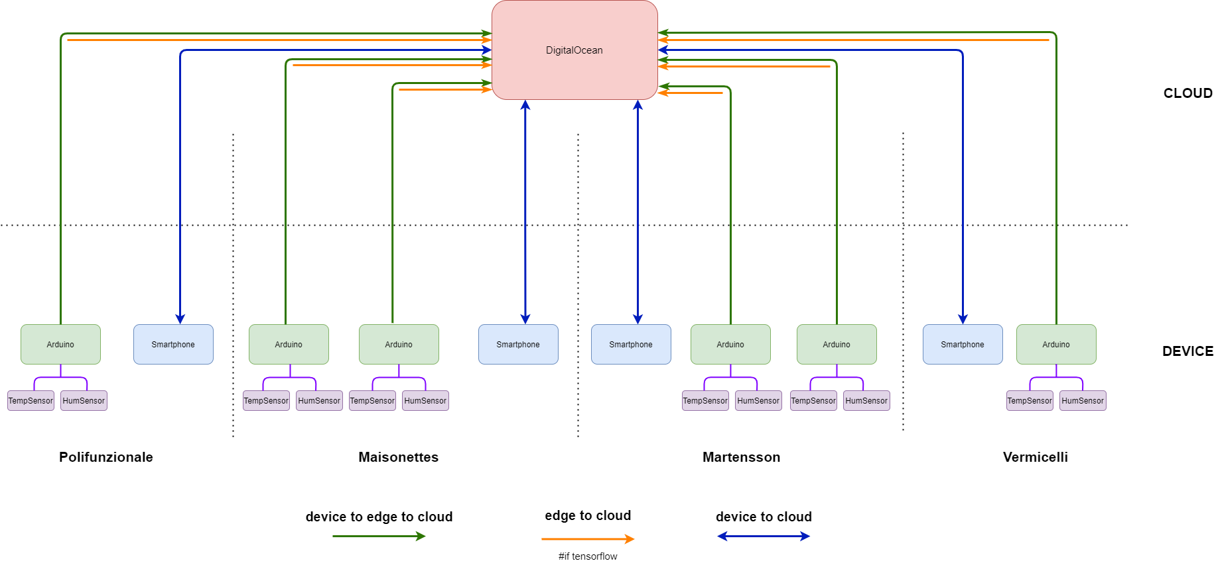

Simulation
Scenario_2 & Scenario_5 → Topology

Slide 8
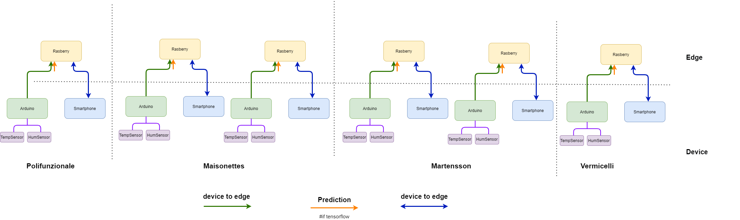
Simulation
Scenario_3 → Topology

Slide 9
Simulation
Scenarios → Parameters
General Parameters
Simulation time | 3 [Hours]
MIN mobile devices | 300
MAX mobile devices | 1530
Variability size | 306
Simulation scenarios | 1_TIER/2_TIER
Attractiveness L1 | 20 [Min]
Attractiveness L2 | 35 [min]
Attractiveness L3 | 50 [min]
Attractiveness
Polifunzionale | 0
Maisonettes_A | 1
Maisonettes_B | 2
Martensson_A | 1
Martensson_B | 2
Vermicelli | 2
Network
WAN
Propagation delay | 0.1 sec
Bandwidth | 15 [Mbps]
WLAN
Internal delay | 0.005 sec
Bandwidth (baud) | 1 [Mbps]

Slide 10
Simulation
Scenarios → Servers
Edge Servers | Raspberry Pi
Model | B
Ram | 4 [GB]
Storage | 16 [GB]
MIPS | 3500
# Cores | 4
Frequency | 1.5 [GHz]
Architecture | 32 [Bit]
OS | Linux
Cloud Server | Digital Ocean
Ram | 1 [GB]
Storage | 25 [GB]
MIPS | 3000
# Cores | 1
Frequency | 1.8 [GHz]
Architecture | 64 [Bit]
OS | Linux
Cloud Server | Digital Ocean
Ram | 16 [GB]
Storage | 1 [TB]
MIPS | 4500
# Cores | 4
Frequency | 3.6 [GHz]
Architecture | 64 [Bit]
OS | Linux

Slide 11
Simulation
Scenarios → Tasks
Tasks | Cloud Probability |  |  | Poisson Interarival | Active Period | Idle Period | Data Upload | Data Download | Task Length
Tensorflow | 0 | 100 | 0 | 600 | 1.3 | 1198.7 | 4 | 0.37 | 4550
Forward Parameter | 0 | 100 | 0 | 120 | 0.2 | 299.8 | 0.05 | 0.37 | 1500
Information | 100 | 100 | 0 | 120 | 0.1 | 119 | 0.6 | 0.6 | 300
Covid Monitoring | 100 | 100 | 0 | 30 | 0.4 | 4.6 | 0.6 | 0.6 | 1200
 | % |  |  | Sec | Sec | Sec | Kbyte | Kbyte | MI

Slide 12
Simulation
Results→ Tasks

Slide 13
Simulation
Results→ Tasks

Slide 14
Simulation
Results → Timing

Slide 15
Simulation
Results → Timing

Slide 16
Simulation
Results → Usage

Slide 17
Simulation
Results → Usage

Slide 18
THANKS FOR THE ATTENTION
GitHub Link
click here

