Slide 1
Non-adjacent Reduplicant Infixation:
-- Suspecting or sustaining a subsequential analysis?
Logan Peng
12 December 2016

Slide 2
Backgrounds:
Adjacent reduplication is Strictly-local (SL) (Chandlee & Heinz 2012, Chandlee 2014).
non-adjacent reduplication = nonlocal reduplication (Chandlee);
nonlocal suffixation ≈ opposite-edge reduplication (Inkelas & Zoll 2005) ≈ wrong-side reduplication (Kusmer & Hauser 2016);
Two major subtypes of nonadjacent reduplication frequently discussed:
Suffixal: -C₁VC₂ in Koryak (2014) and Chukchee (2003);
Infixal: in Koasati and Creek (both are Muskogean languages).
Suffixal non-adjacent reduplication is bounded by right-edge and is shown as subsequential;
Non-adjacent infixal reduplication is predicated to be unattested. However, it exists in both Koasati and Creek, as presented here.

Slide 3
-Co- reduplication in Koasati (Kimball 1988, 1991)
Koasati verb punctual reduplication (Kimball 1988, 1991):
copóksin copokcó:sin ‘to be a hill’
cóffin cofcó:lin ‘to jump’
Pattern: word-initial CV of verb is reduplicated, V is replaced by vowel o, and inserted between final and penult syllables of the root (1991: 351).
Syllable canons: final syllable only CV; penultimate CVC or CV.
Verbal morphology: final –n is the infinitival suffix with null agreement.
This reduplication applies only to bi- and tri-syllabic roots ending CVC.CV.
Alternative punctual reduplication pattern (-ho infixation after first syllable):
okcáyyan okhocáyyan ‘to be alive’ -- first syllable has no C onset
stokhátkan stokhohátkan ‘to be gray’ -- CC onset cluster

Slide 4
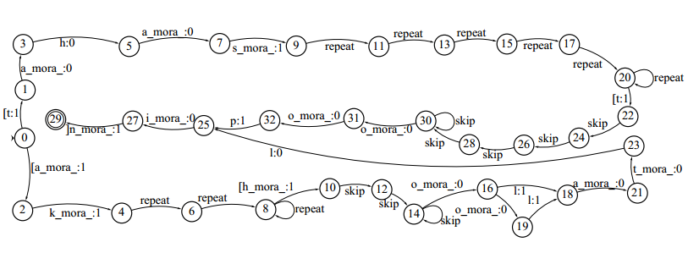
FSA with syllable structure (Walther 2000):
Reduplications for tahasto:pin and infixation for akholatlin;
Could be schematized using nowadays’ subsequential approach.

Slide 5
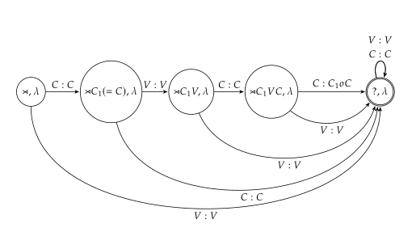
Non-adjacent is still local!
Because this reduplication is limited to verbal stem of CVC.CV or CV.CVC.CV, the infixing position of the reduplicant is bounded distance (2 segments for bisyllabic root and 4 for trisyllabic) away from the base.
Thus, this non-adjacent infixation reduplication is still local!
FSA for bi-syllabic reduplication on the left:
C₁VCC_{RED}oC
Example:
cóffin cofcó:lin ‘to jump’

Slide 6
Suffixal analysis?
Kusmer & Hauser (2016) assumes the final CV is a tense suffix (occurring before –n).
However, Kimball (1991) explicitly states that tense suffixes are –sa, -ti, -to, -ki; and that the final CV in verbs is part of the root.
Moreover, in another Myskogean language, Creek (Martin 2011), verb-final consonants (even clusters) are parts of the stem as well.
Thus, this plural/punctual reduplication is INFIXAL in both languages (not suffixal).

Slide 7
Right-edge-bounded instead?
Partial non-adjacent reduplication in Creek (a more complicated version?):
Monosyllabic roots:
C₁V₁C C_{RED}V_{RED} C hátk-i: hathak-i: ‘white’
C₁V₁:C C_{RED}V_{RED} C tó:sk-i: to:stok-i: ‘mangy’
Bisyllabic roots:
C₁V₁ CVC C_{RED}V_{RED} C likácw-i: likacliw-i: ‘dirty’
C₁V₁ CV: C_{RED}V_{RED}C lowá:k-i: lowa:lok-i: ‘limber, flexible’
V C₁V₁: C_{RED}V_{RED}C acá:k-i: aca:cak-i: ‘precious’
In Creek, it seems like that C_{RED}V_{RED} is of arbitrary distance away from C₁V₁.
However, reduplicant is always 1-segment to the left of the right-edge. Would an alternative right-edge-bounded analysis still be subsequential? Let’s try!

Slide 8
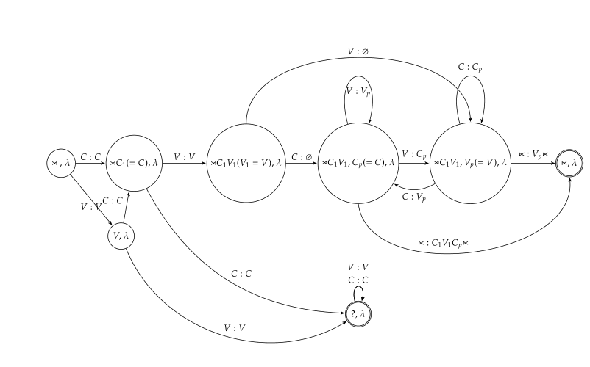
Trying: a possible FSA for right-edge-bounded analysis?
Examples in Creek:
hátk-i: ‘white’
→ hathak-i:
likácw-i: ‘dirty’
→ likacliw-i:
acá:k-i: ‘precious’
→ aca:cak-i:
If such an analysis works, Creek is as simple/complex as Koasati, both being subsequential.

Slide 9
References:
Chandlee, J. 2014. Strictly local phonological processes. PhD Thesis, University of Delaware.
Chandlee, J. and J. Heinz. 2012. Bounded copying is subsequential: Implications for metathesis and reduplication. In Proceedings of the 12th Meeting of the ACL Special Interest Group on Computational Morphology and Phonology, 42–51.
Inkelas, S. and C. Zoll. 2005. Reduplication: doubling in morphology. Cambridge: Cambridge University Press.
Kimball, G. 1988. Koasati reduplication. In W. Shipley (ed.), Honor of Mary Haas: From the Haas Festival Conference on Native American Linguistics. Berlin: Mouton de Gruyter, 431-442.
Kimball, G. 1991. Koasati Grammar. Lincoln, Nebraska: University of Nebraska Press.
Kusmer, L. and I. Hauser. 2016. Wrong-side reduplication in Koasati. Talk at the 24th Manchester Phonology Meeting.
Martin, J. B. 2011. A grammar of Creek (Muskogee). University of Nebraska Press.
Riggle, Jason. 2003. Nonlocal reduplication. Proceedings of the 34th annual meeting of the North Eastern Linguistic Society.
Walther, M. 2000. Finite-state reduplication in one-level prosodic morphology. In Proceedings of the 1st North American chapter of the Association for Computational Linguistics conference(NAACL 2000). 296-302.

