Slide 1
Sound uses for entrapment datasets
Andrew Dowsey
Population Health Sciences, University of Bristol

Slide 2
Target
Decoy

Slide 3
Target
Entrapment
Decoy
Entrapment Decoys

Slide 4
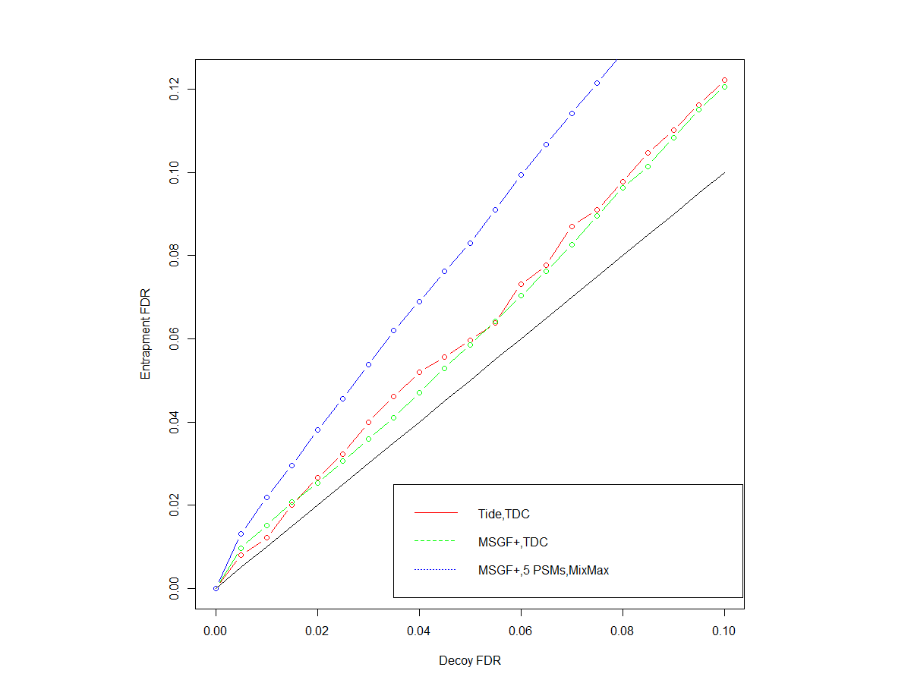
Kim et al. Human Liver Elite 83 [24 fractions]

Slide 5
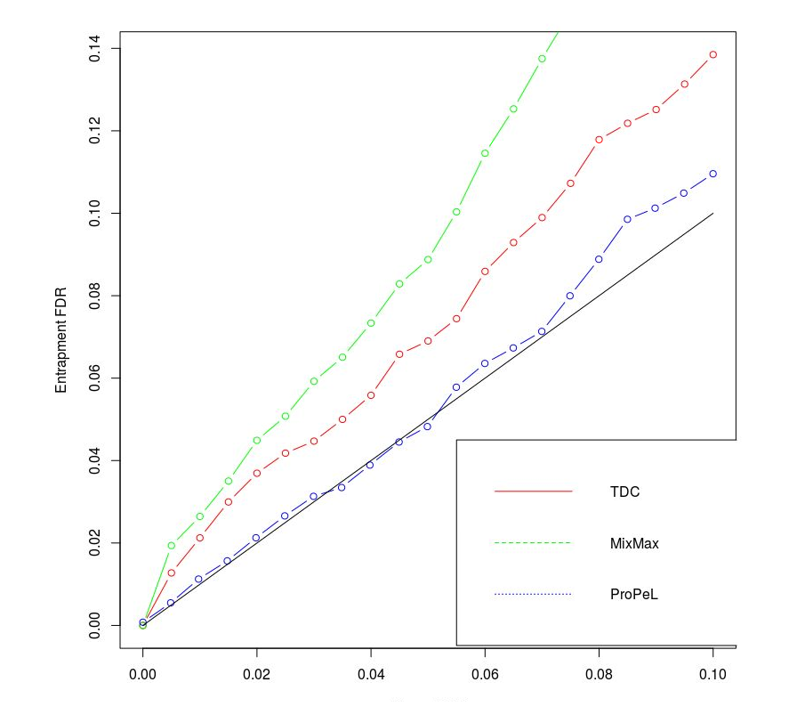
Kim et al. Human Liver Elite 83 [24 fractions]

