Slide 1
Pitch slides
Mathias Walzer
www.ebi.ac.uk

Slide 2
#1

Slide 3

qcML
PSI working group for QC developments
Formed June 2016
To establish a revised qcML format and associated CV terms as a HUPO-PSI standard
Monthly telco / @-list: psi-qc-dev@lists.sourceforge.net

Slide 4
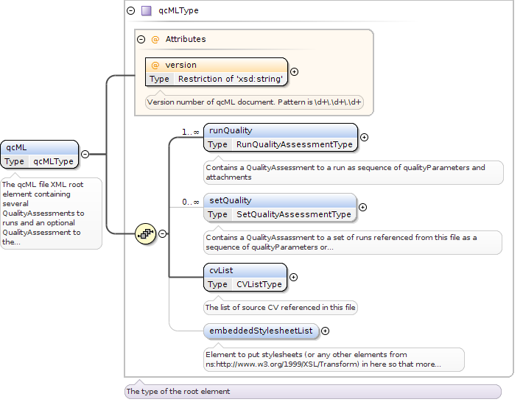
Schema view

Slide 5
CV / Metrics overview
Metrics represented by a CV term (or combinations)
CV is collection of known/used metrics and definitions
55 old entries in obo
Describing single values (e.g. total number of PSMs) or
Types of data (e.g. mass accuracy over time plot)
57 metrics from Ghent meeting in non-obo formatting:
name, measuring quality for, IDfree?, format, (value_shortname [unit] {datatype}, ...), Explanation
Integration of NIST and 57 from Ghent:
https://github.com/mwalzer/qcML-development/blob/feature/QC-CV-Metric_overview/cv/qc-metric-collection.md

Slide 6
#2

Slide 7
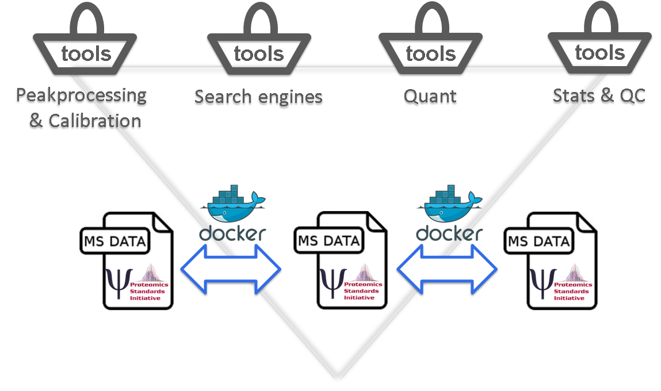


cloud connection
Poster no.C-072

