Slide 1
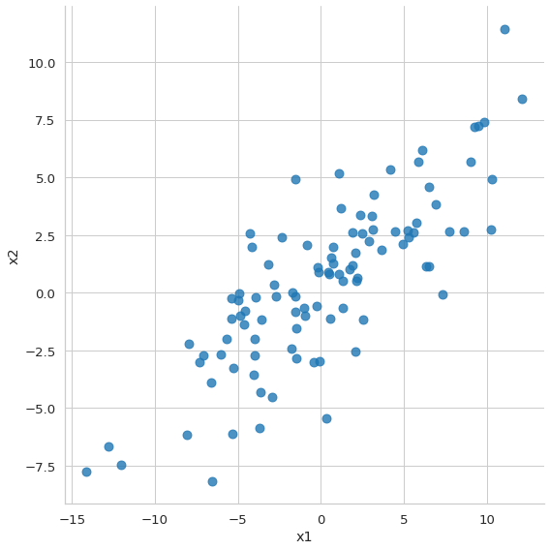
Principle components analysis
Unsupervised
Dimensionality reduction
Feature extraction: principle components
  Orthogonal
  Direction of largest variance
Centered data

Slide 2
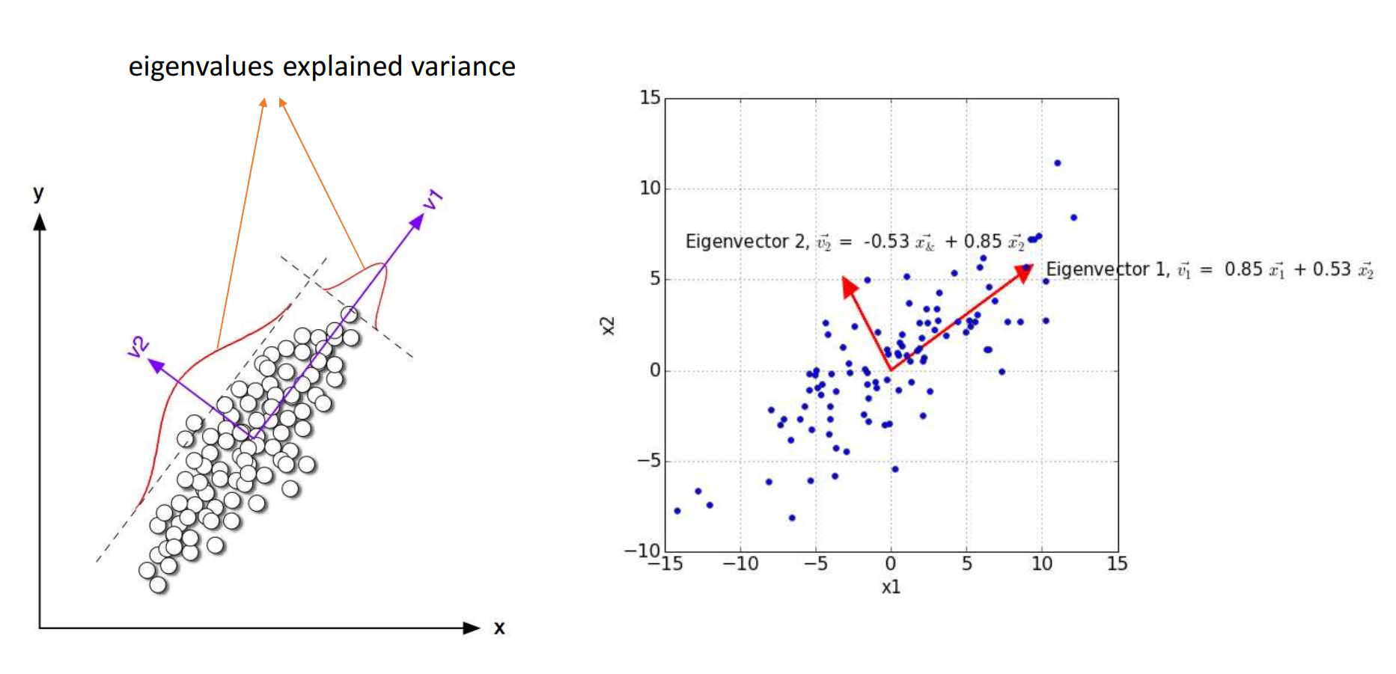
Principle components analysis

Slide 3
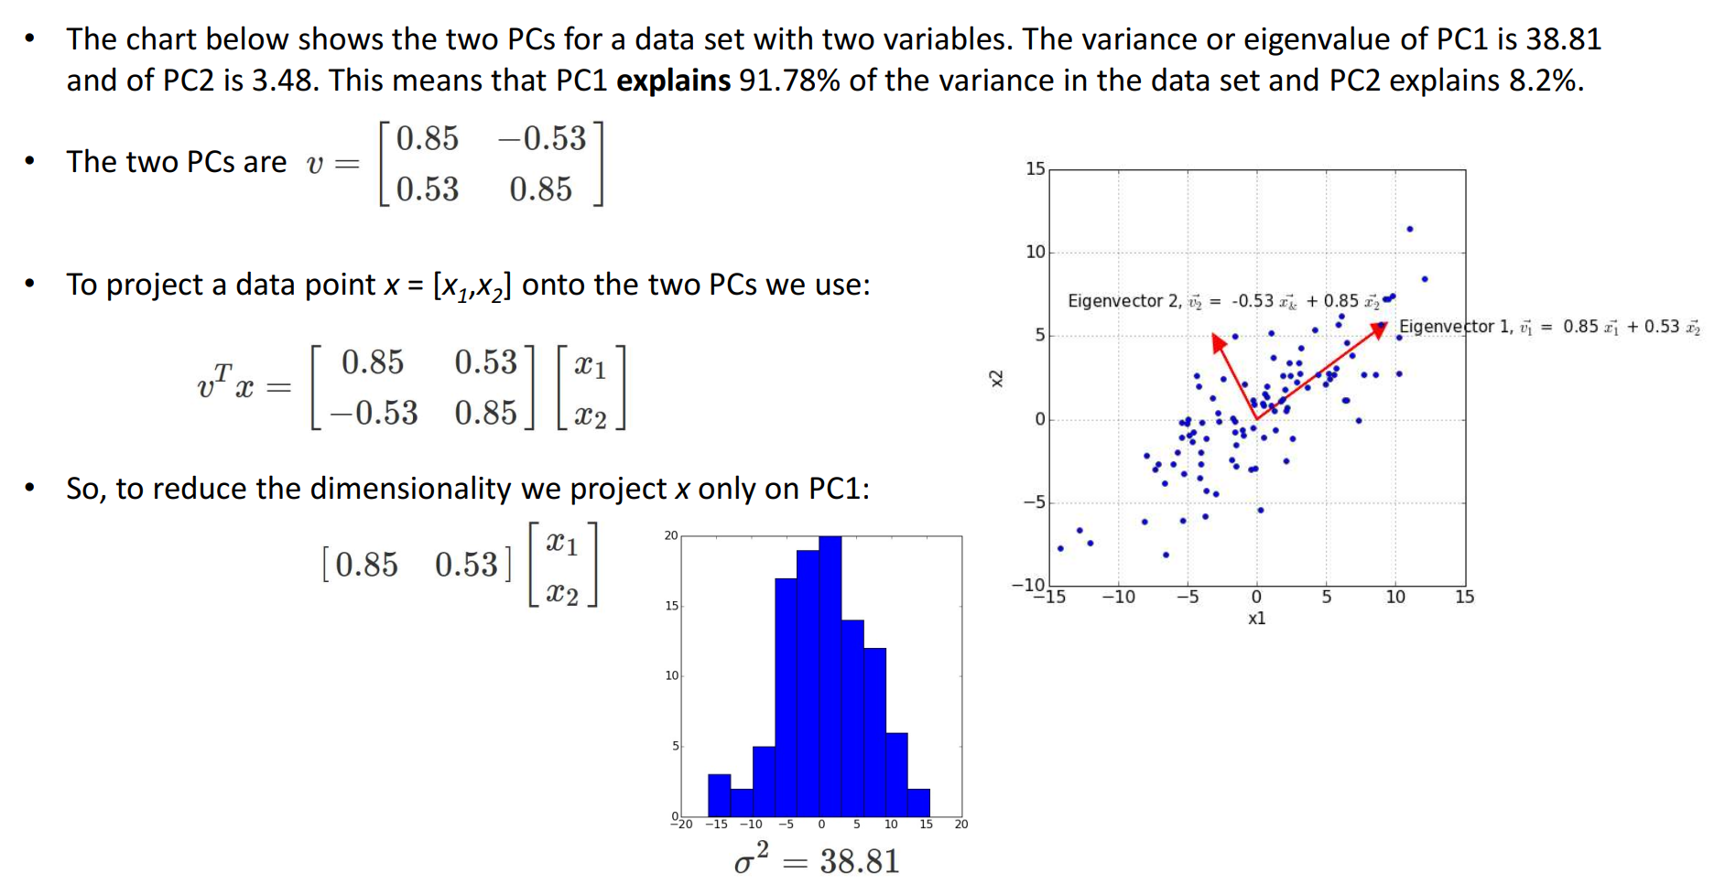
Principle components analysis

