Slide 1
Decision tree
A decision tree is a supervised machine learning algorithm used for classification and regression tasks. It models decisions and their possible consequences in a tree-like structure, where nodes represent features, branches represent decision rules, and leaves represent outcomes.
Decision trees split data based on feature values, using criteria like Gini impurity or entropy (information gain) in classification, and mean squared error (MSE) in regression. They recursively divide the dataset into subsets to make predictions.
They are interpretable and easy to understand but prone to overfitting, which can be mitigated by techniques like pruning or max depth limitation.
The concept of decision trees dates back to the 1960s, with ID3 being a notable early algorithm introduced by Ross Quinlan in 1986.

Slide 2
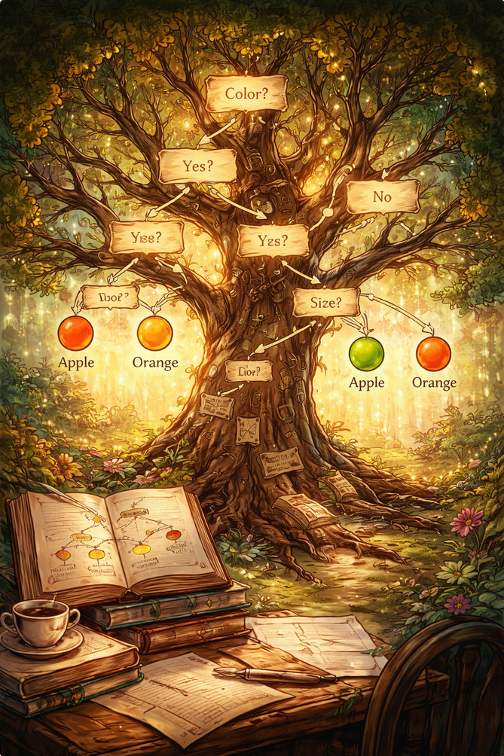

Slide 3

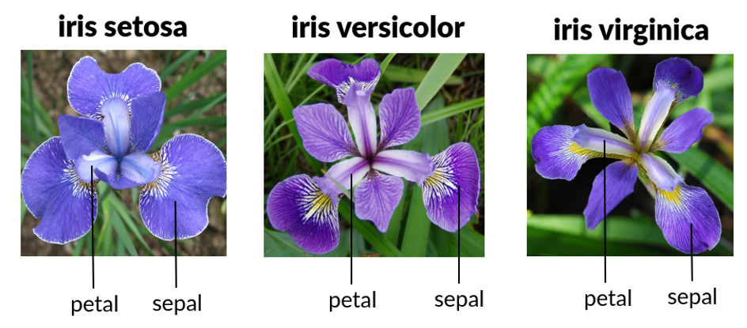
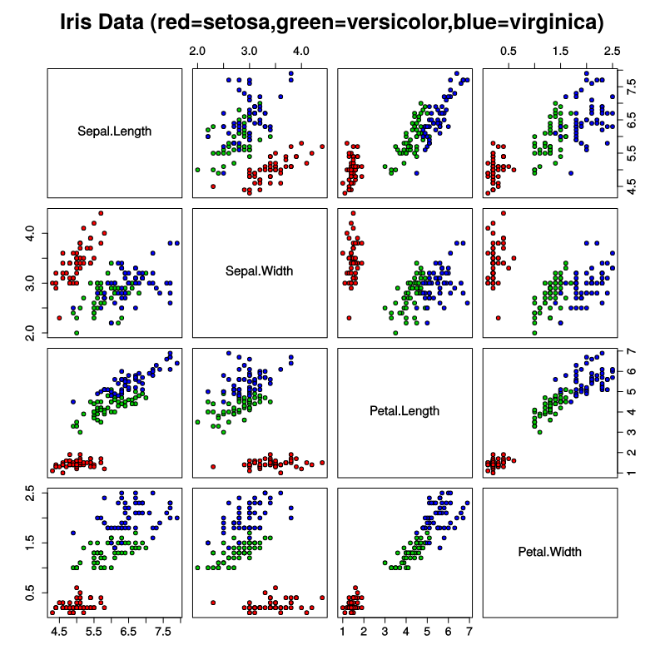
Iris dataset
Fisher, R.A. (1936) The Use of Multiple Measurements in Taxonomic Problems. Annals Eugenics, 7, 179-188.

Slide 4
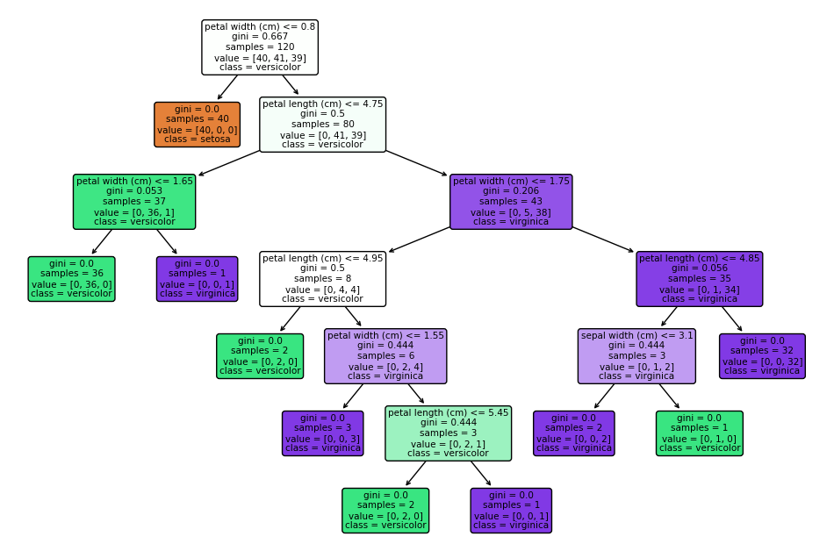
Decision tree

Slide 5
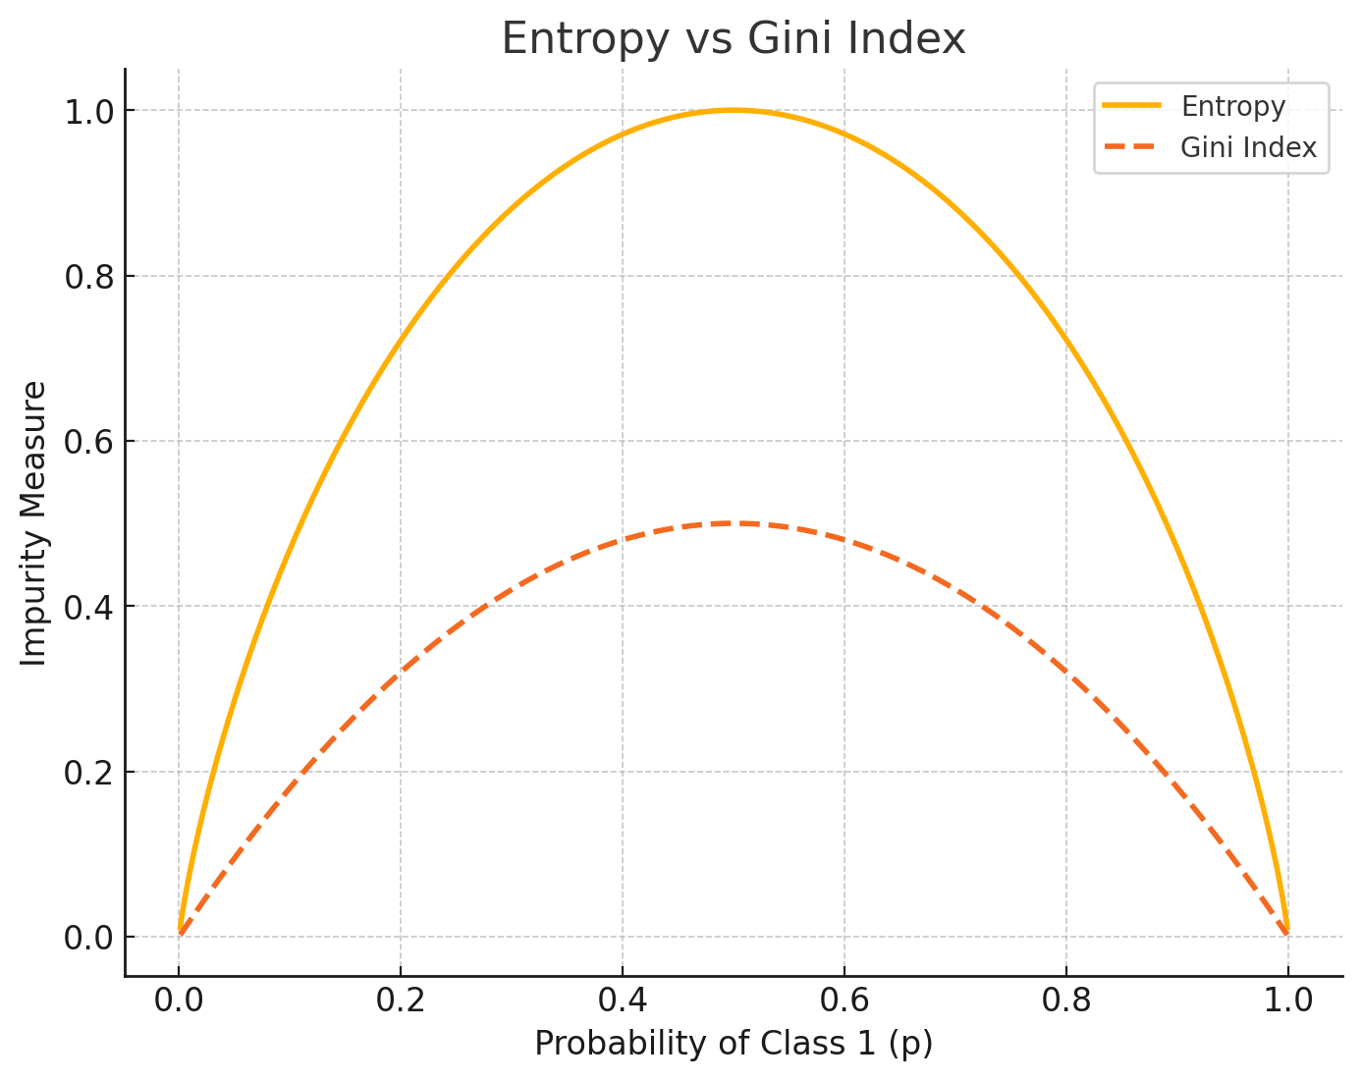
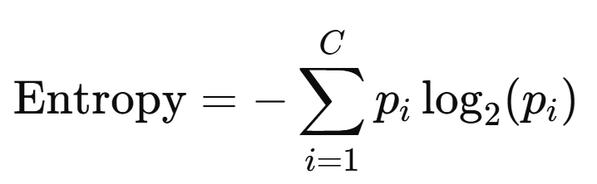
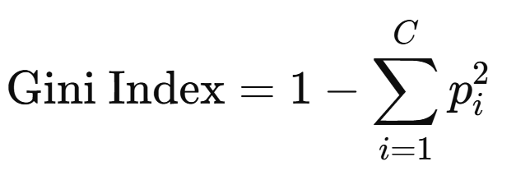
Decision tree

Slide 6
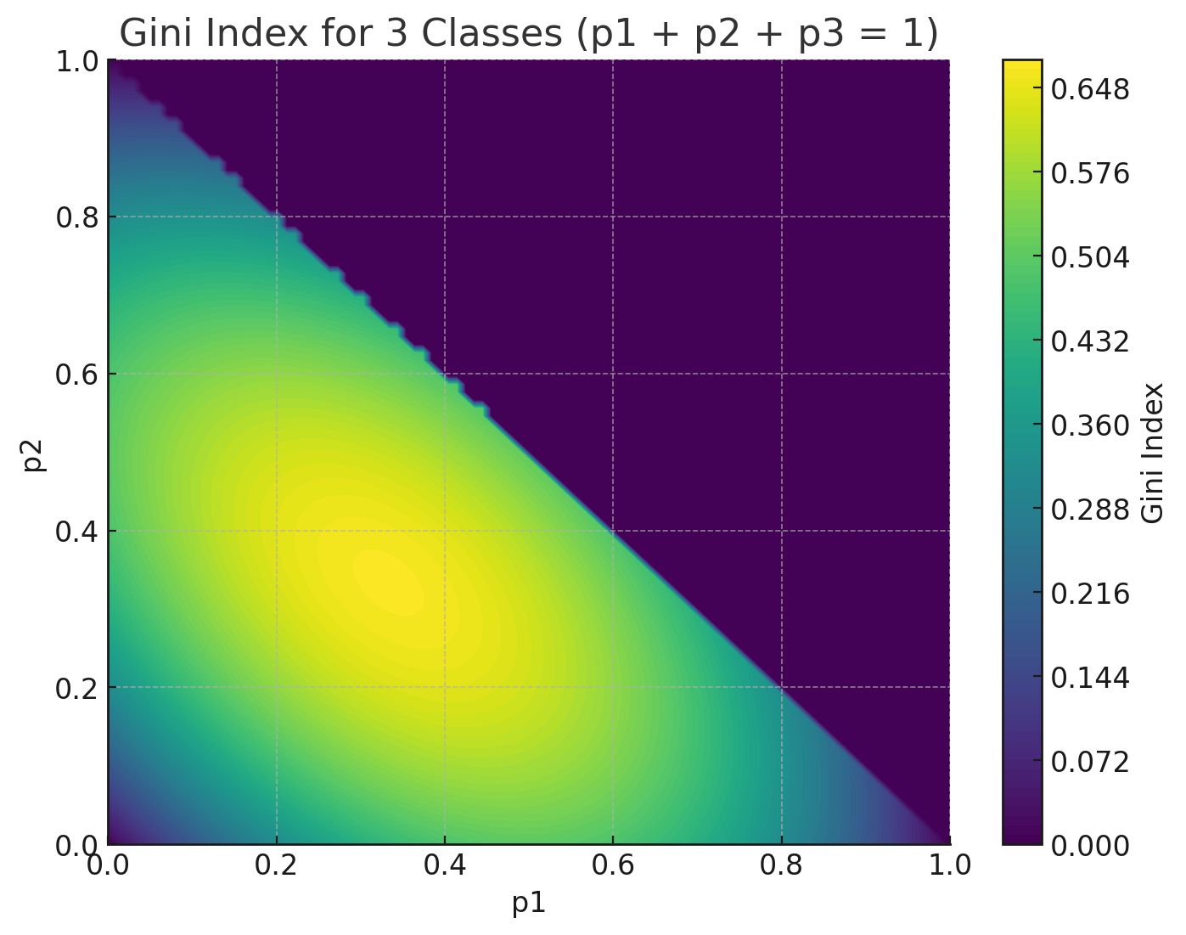
Decision tree

Slide 7
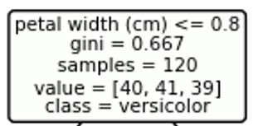
Decision tree

Slide 8
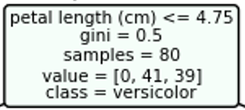
Decision tree

Slide 9
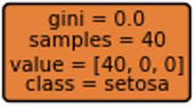
Decision tree

Slide 10
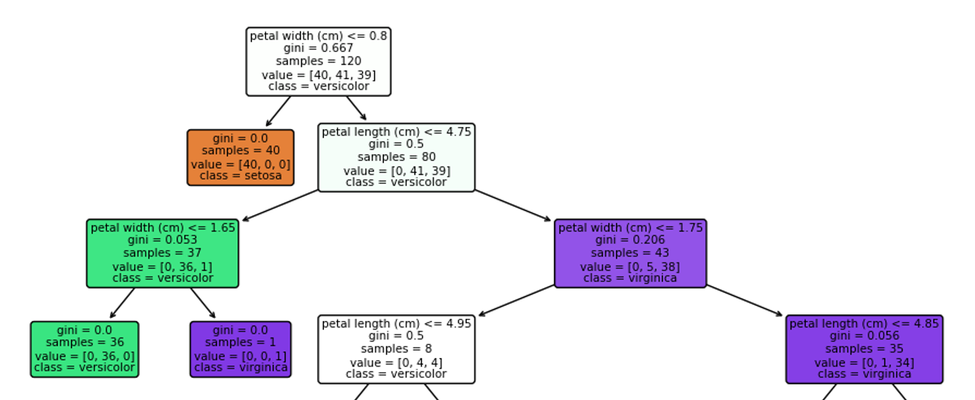
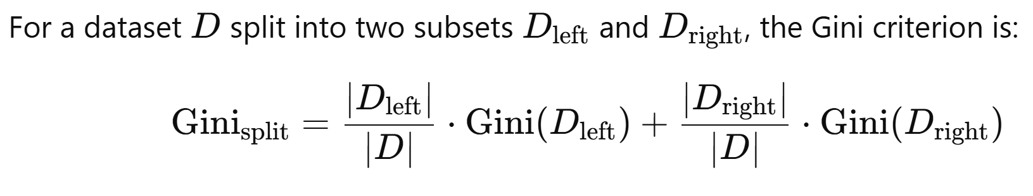
Decision tree

