Slide 1
Ensemble methods
Decision trees serve as the foundation for ensemble methods like Random Forest and Gradient Boosting, which combine multiple trees to improve accuracy and robustness.
Ensemble learning reduces variance and bias, as bagging (e.g., Random Forest) decreases overfitting, while boosting (e.g., AdaBoost, XGBoost) enhances weak learners by correcting misclassified instances iteratively.

Slide 2
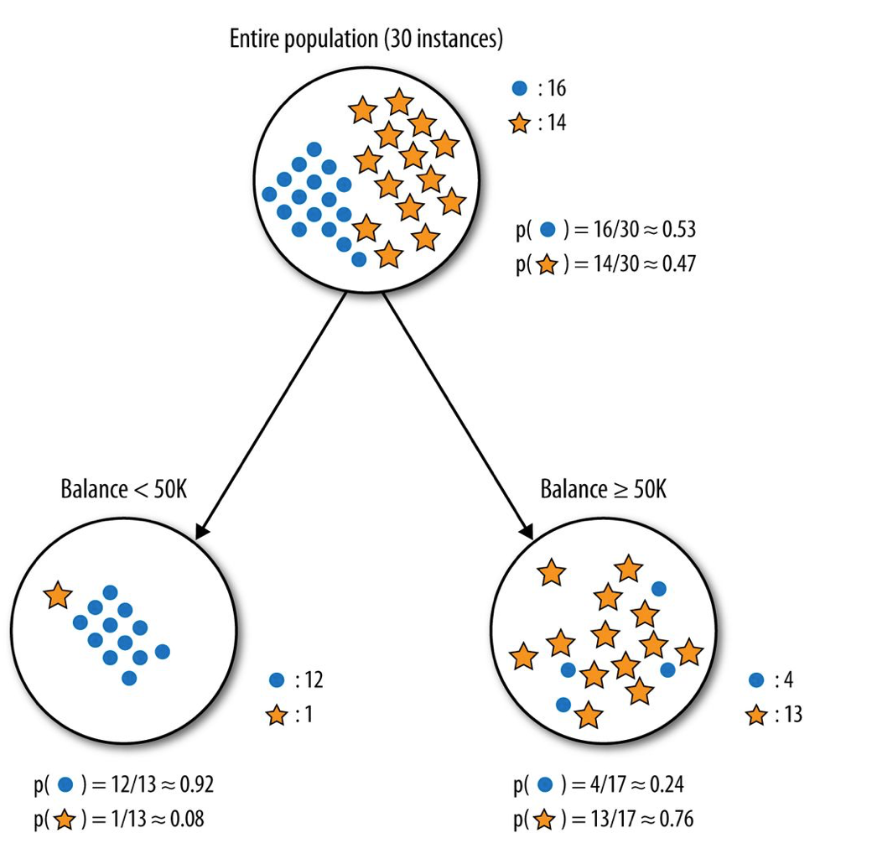

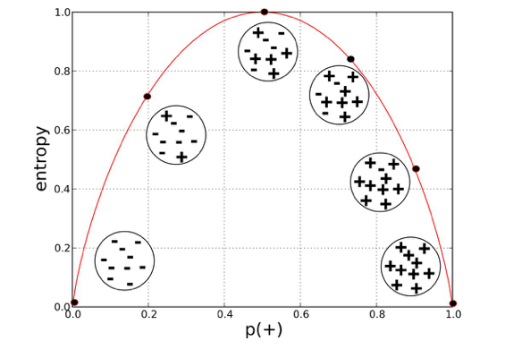
decision tree models

Slide 3
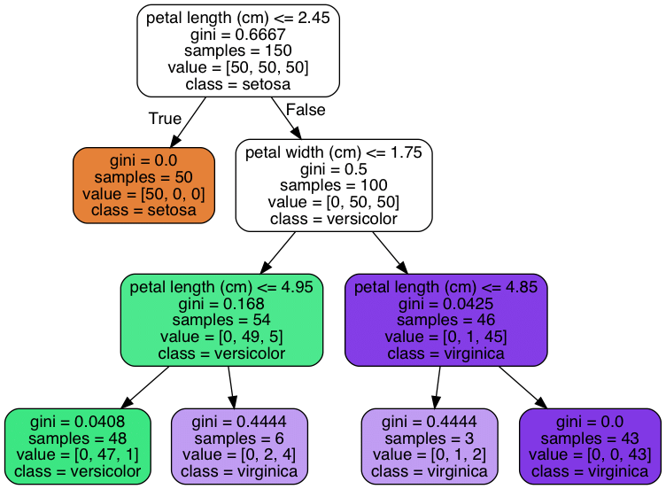
Decision tree
advantages:
ease of interpretation
handles continuous and discrete features
invariant to monotone transformation of features
variable selection automated
low bias (deep trees)
disadvantages:
high variance
overfitting

Slide 4
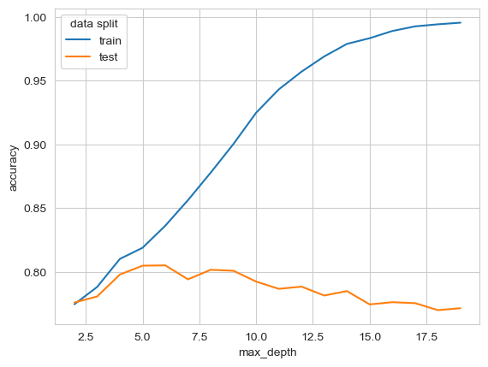
model selection

Slide 5
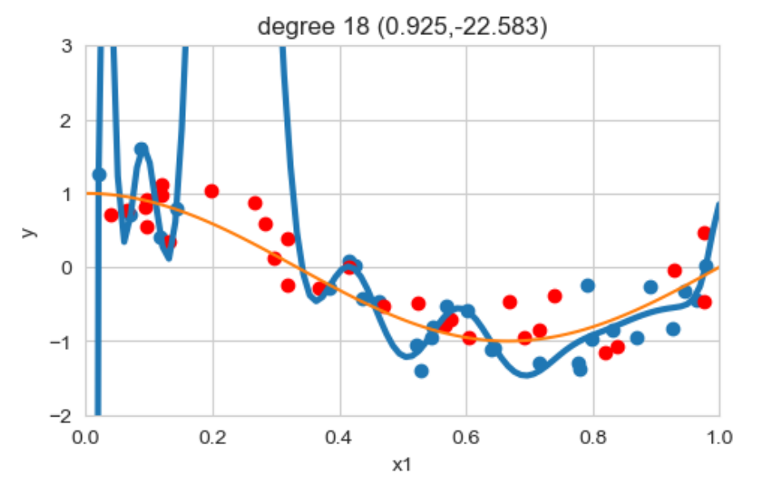
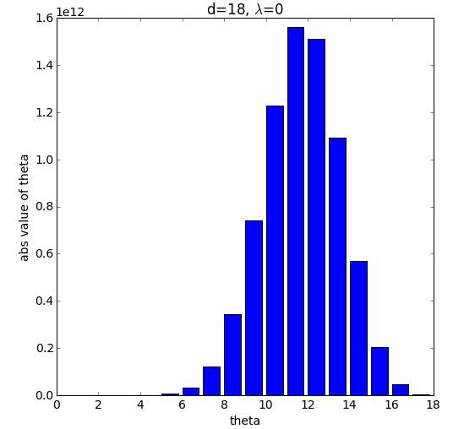
regularized linear regression

Slide 6

5-fold cross-validation
Validation data

Slide 7
5-fold cross-validation

Slide 8
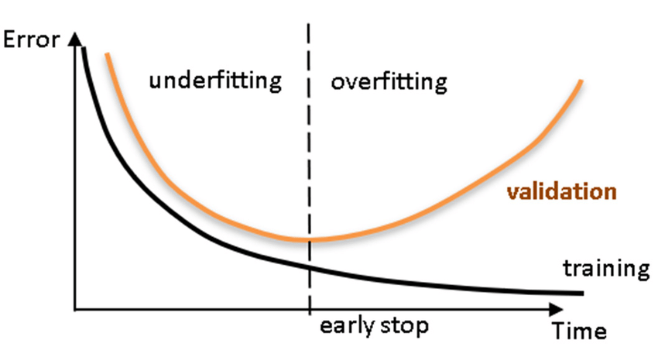
Tuning regularization
Maximum depth

Slide 9
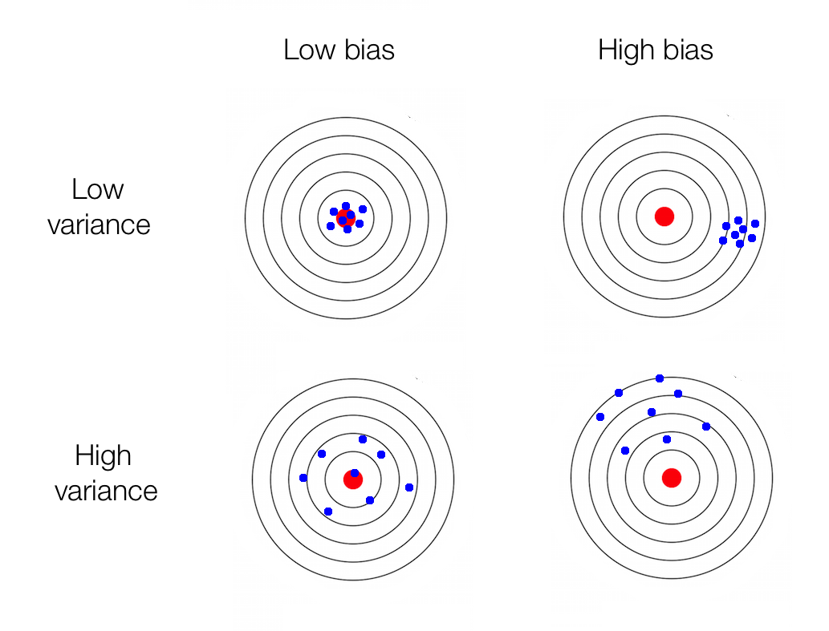
bias <> variance
Error due to bias
(systematic errors,
oversimplification)
Error due to variance
(sensitivity due to flexibility,
overcomplification)
Irreducible error

Slide 10
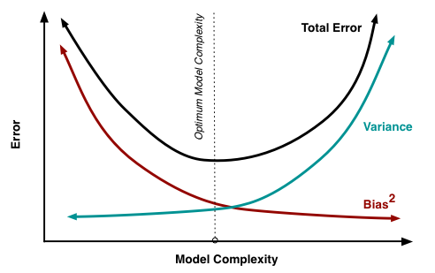
bias <> variance
Error due to bias
Error due to variance
Irreducible error

Slide 11
bagging <> boosting
boosting
bagging

Slide 12
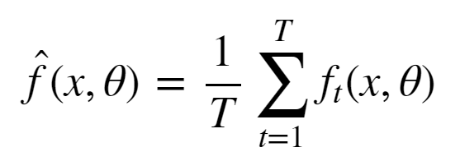
bagging
Simulate the notion of different train set samples:
sample data points from train set to create new train set
fit low bias high variance model on new train set
repeat steps (1) and (2) T times
average the predictions of the T models

Slide 13
bagging: Random Forest
Train set contains n data points with m features.
Construct T low bias high variance decision trees by following these steps:
Sample n data points at random with replacement from the train set.
At each node, select h from m features at random where (h<<m) and compute the best split using only these h features.
Each tree is grown to the largest extent possible. Or at least to a high-level complexity
Step 3 ensures that the bagged models are low bias by learning deep complex decision trees.

Slide 14
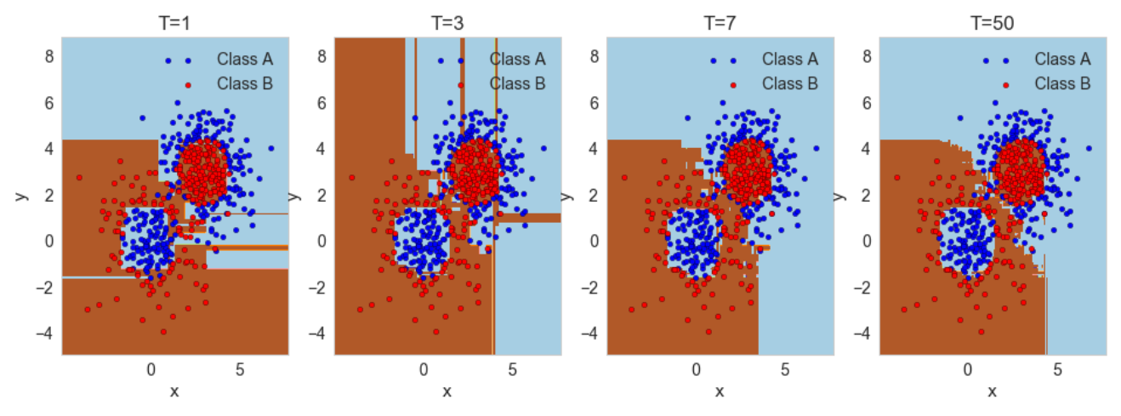
bagging: Random Forest
X2

Slide 15
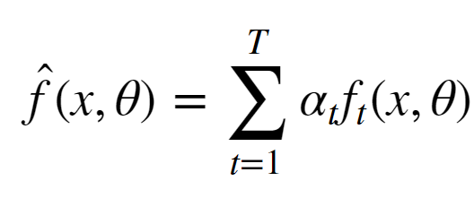
boosting
reduce the bias of a high bias low variance model
turning an ensemble of weak learners into a strong learner
the meta-model is additive, i.e. Adaboost:

Slide 16
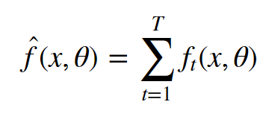
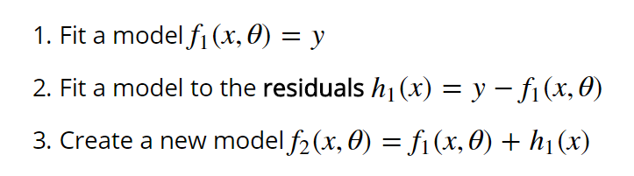
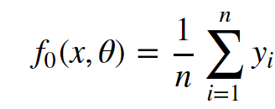

boosting: Gradient boosting

Slide 17
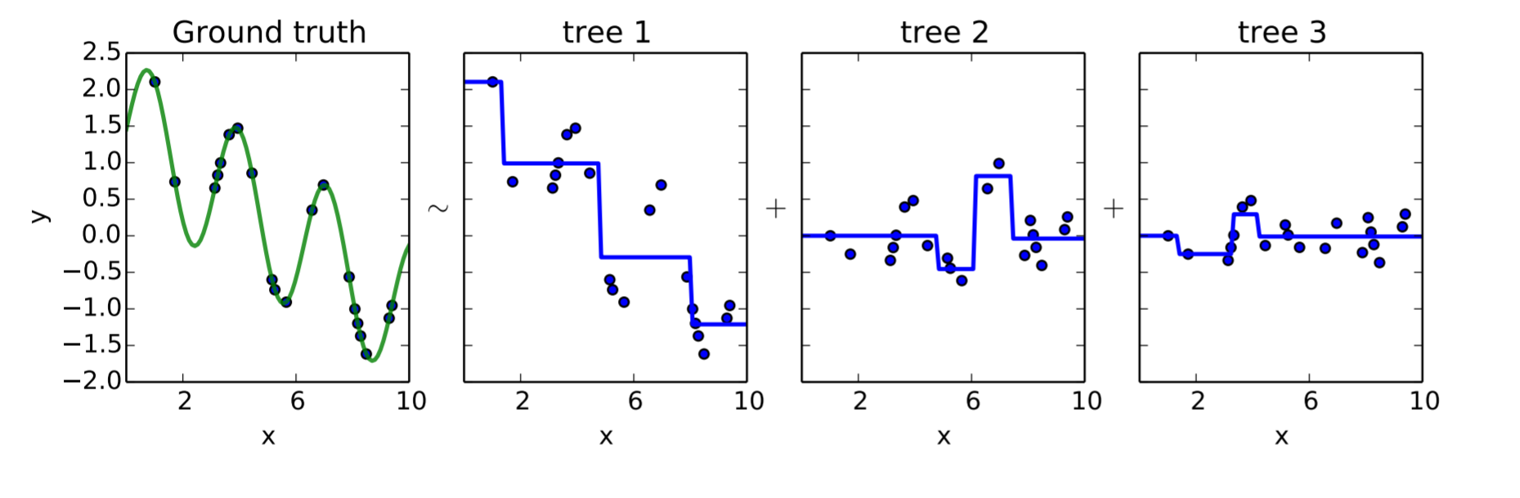
boosting: Gradient boosting
Gradient Boosting explained [demonstration]

Slide 18
Following slides will be skipped, only for those very interested

Slide 19
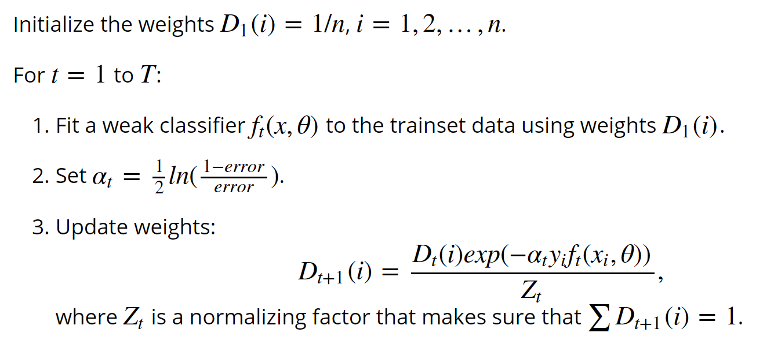

Boosting: Adaboost

Slide 20
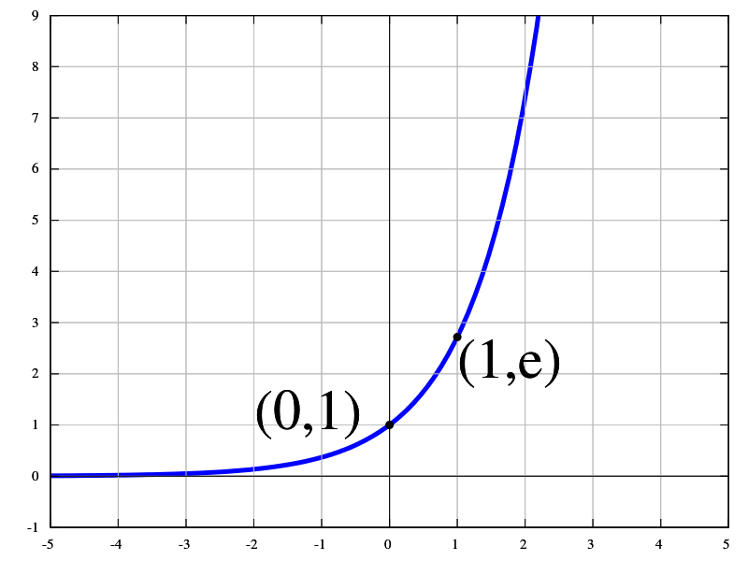
Boosting: Adaboost

Slide 21
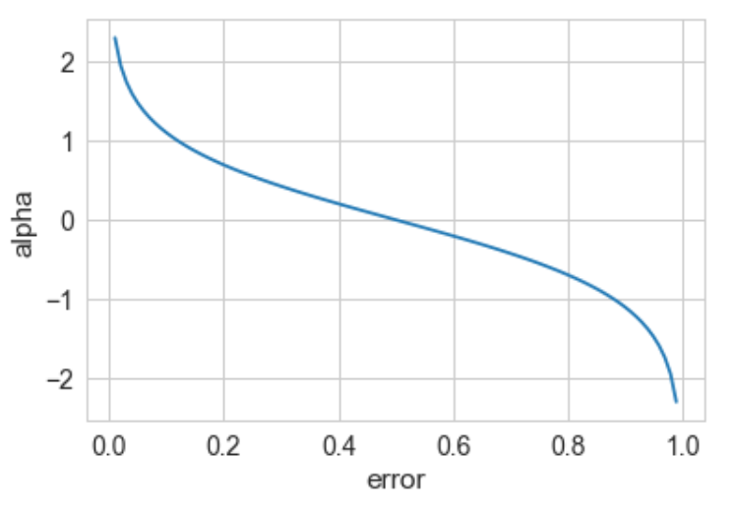
Boosting: Adaboost
The weight of a weak model in the boosted meta-model increases exponentially as the error approaches 0. Better models are given exponentially more weight.
The weight is zero if the error rate is 0.5. A model with 50% accuracy is no better than random guessing, so it is ignored.
The weight decreases exponentially as the error approaches 1. A negative weight is given to classifiers with worse than 50% accuracy. “Whatever that classifier says, do the opposite!”.

Slide 22
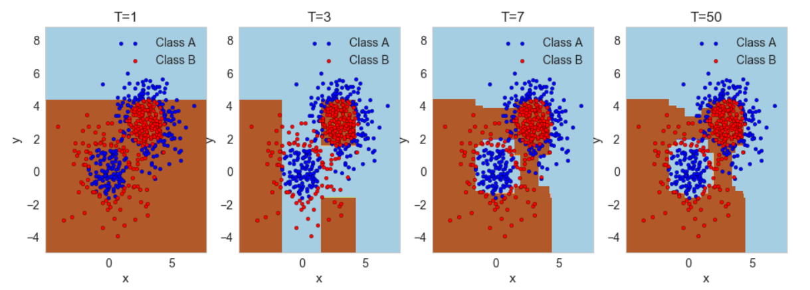
Boosting: Adaboost

