Slide 1
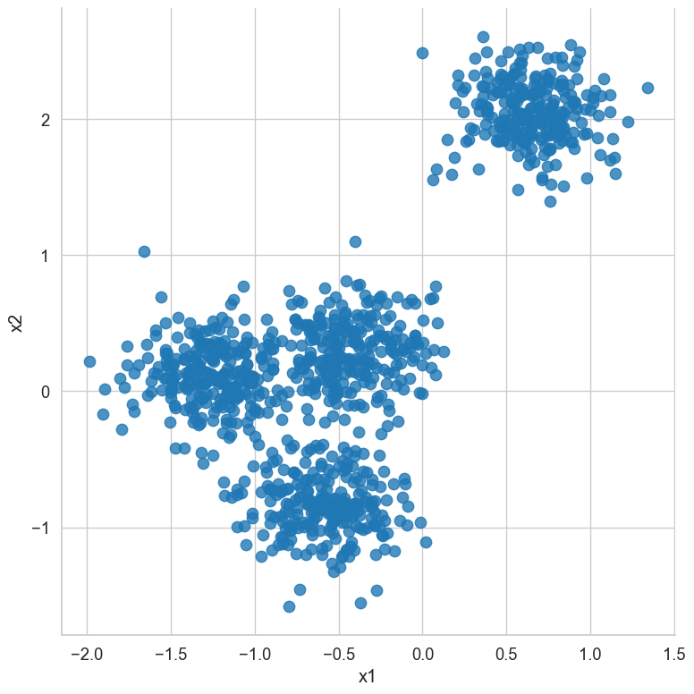
k-means clustering
Types of learning
Supervised learning
Unsupervised learning
(Hidden) structure
Data groups

Slide 2
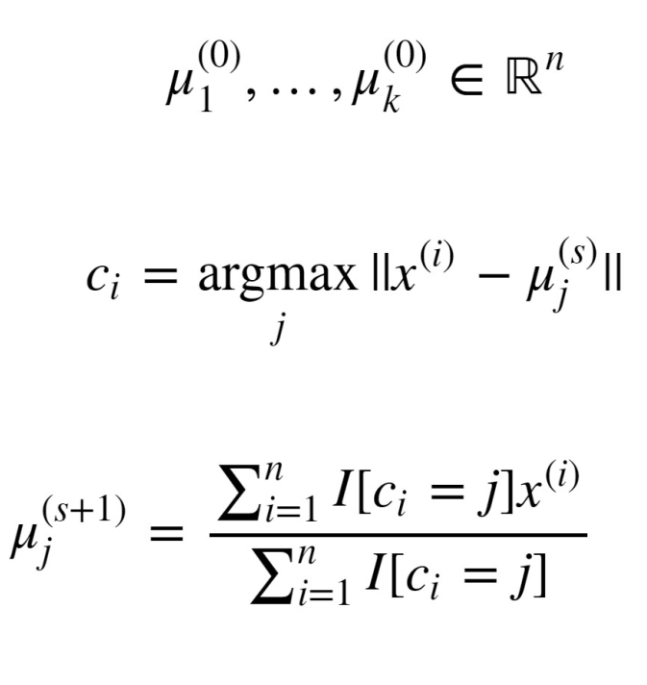
k-means clustering

Slide 3
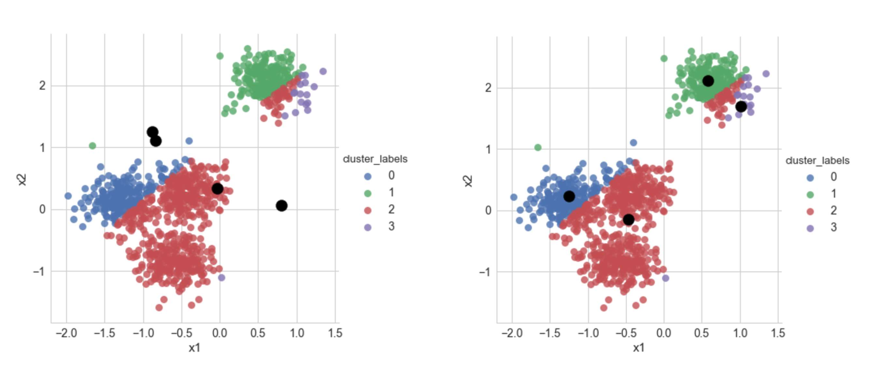
k-means clustering

Slide 4
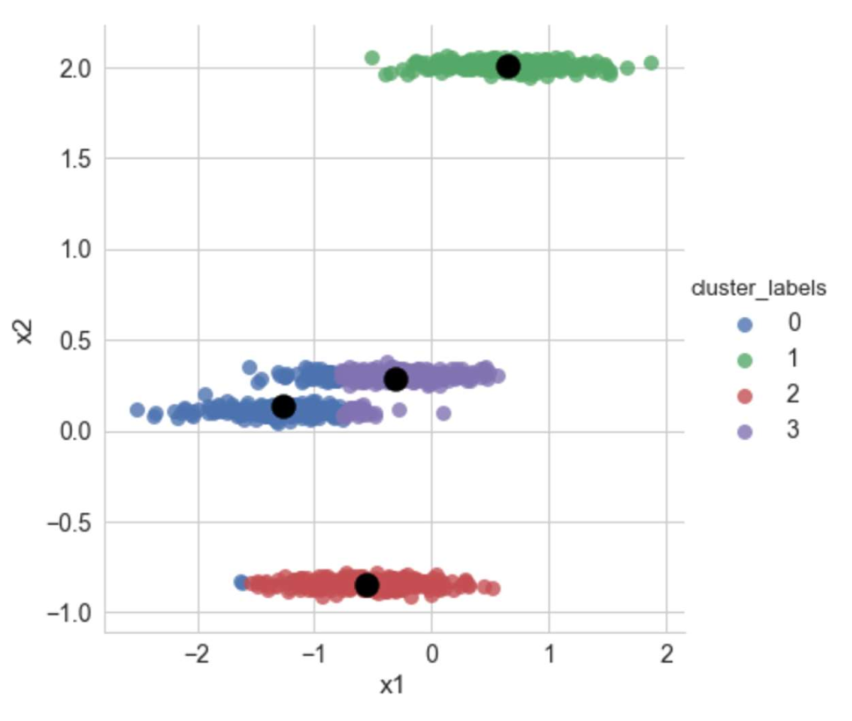
k-means clustering

Slide 5
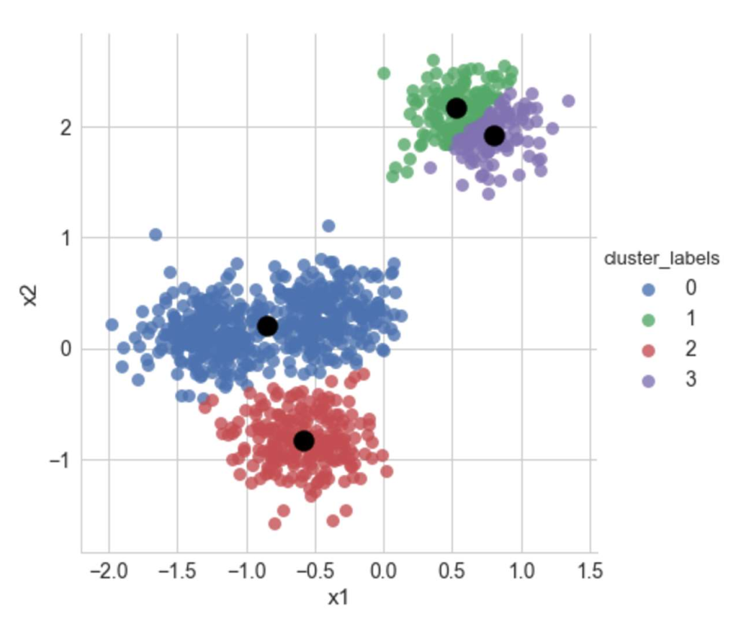
k-means clustering
the first centroid is chosen uniformly at random from the data points that are being clustered
each subsequent centroid is chosen from the remaining data points with probability proportional to its squared distance from the point's closest existing centroid
better spread of the initial centroids

Slide 6
k-means clustering
the first centroid is chosen uniformly at random from the data points that are being clustered
each subsequent centroid is chosen from the remaining data points with probability proportional to its squared distance from the point's closest existing centroid
better spread of the initial centroids

Slide 7
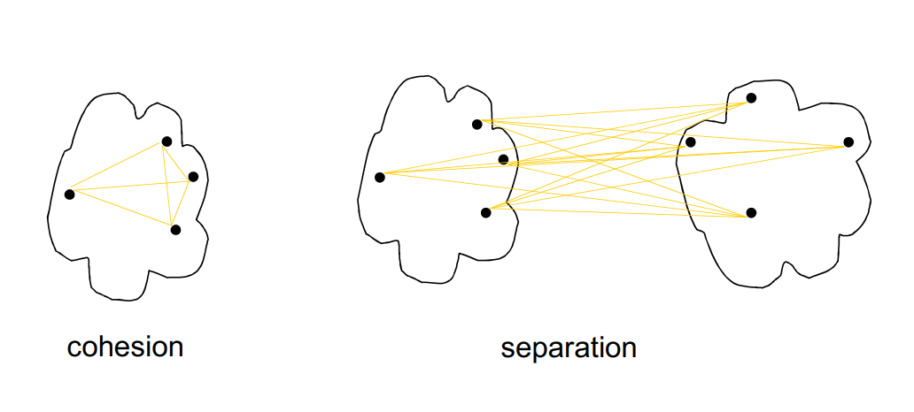
k-means++ clustering: finding k
Cohesion: measures how closely related are objects in a cluster
Separation: measure how well-separated a cluster is from other clusters

Slide 8
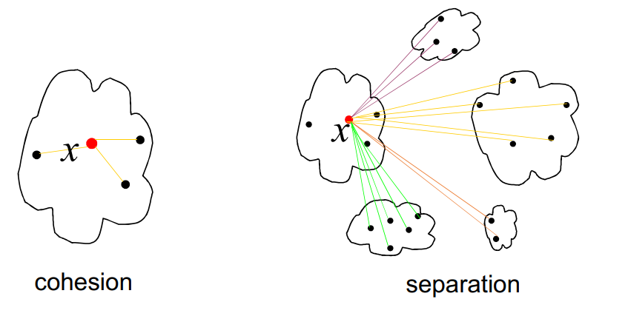
k-means++ clustering: finding k
Cohesion a(x): the mean distance between the data point and all other points in the same cluster
Separation b(x): the mean distance between the data point and all other points in the next nearest cluster

Slide 9
k-means++ clustering: finding k
Cohesion a(x): the mean distance between the data point and all other points in the same cluster
Separation b(x): the mean distance between the data point and all other points in the next nearest cluster

Slide 10
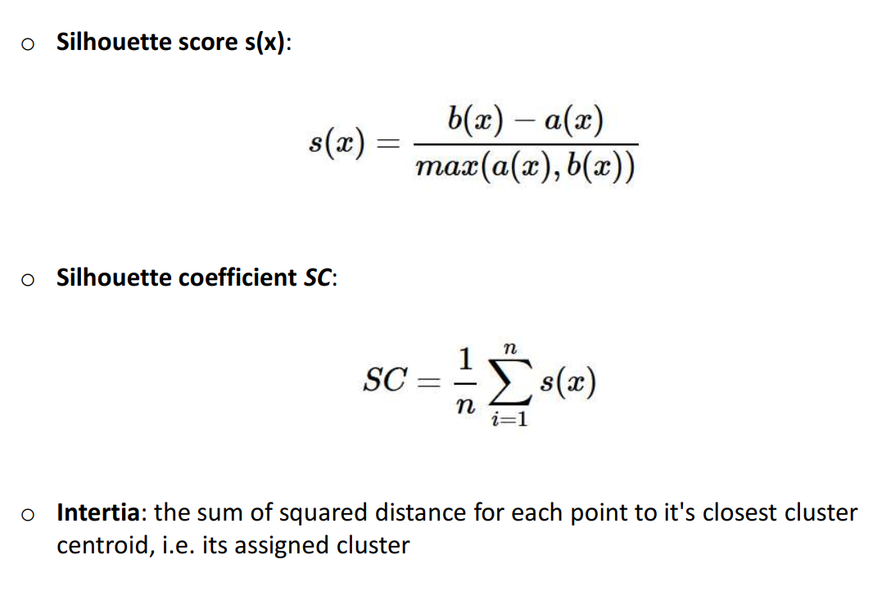
k-means++ clustering: finding k

Slide 11
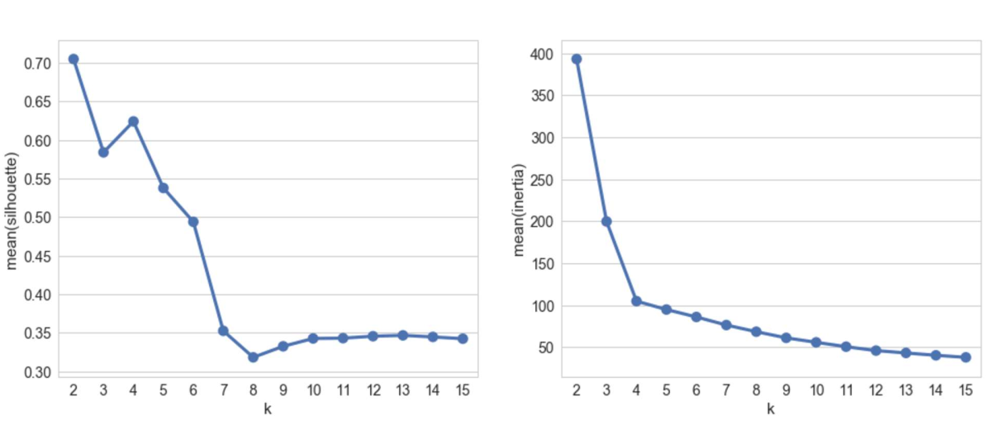
k-means++ clustering: finding k

Slide 12
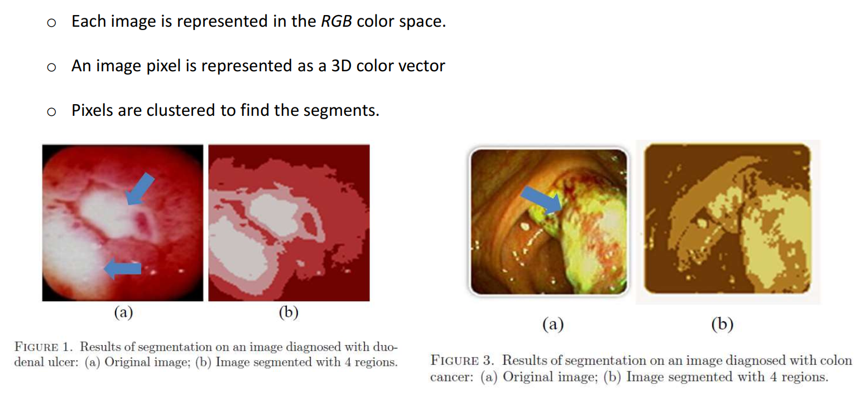
Image segmentation

