Slide 1
Regression models the behavior between features and continuous target values
Failure mode | What goes wrong? | Useful check
Underfitting | The model misses a useful pattern. | Training and validation performance
Overfitting | The model fits accidental details. | The training–validation gap
Bias in the data | Some conditions have poor coverage. | Sampling and performance by group
Out of distribution | New conditions differ from those studied. | The intended conditions of use
Information leakage | Training and test information overlap. | Split units and data preparation
1
Notes:
Use five concrete questions: can the model describe the training pattern, does the pattern transfer, whose samples does the dataset represent, do new samples match the conditions studied, and was the final evaluation independent? Here bias means systematic problems in sampling, measurement or targets. Statistical bias in the bias–variance discussion is a different use of the word and connects to underfitting. Poor coverage does not inevitably cause poor performance, but it limits the evidence for performance in that group. A gap alone cannot diagnose every cause. Validation-based model selection is an intended part of development. Leakage compromises data intended to provide an independent check, or introduces information unavailable under the intended prediction conditions.
Sources
https://scikit-learn.org/stable/auto_examples/model_selection/plot_underfitting_overfitting.html
https://doi.org/10.6028/NIST.SP.1270
https://doi.org/10.1038/s43246-024-00731-w
https://doi.org/10.1016/j.patter.2023.100804

Slide 2
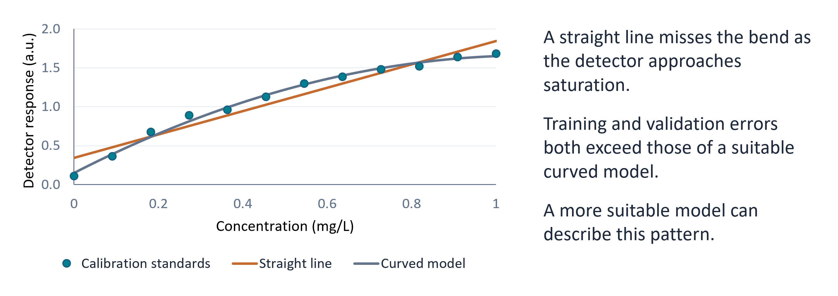
Underfitting is biased towards assumptions of the underlying trend of the data
1
Notes:
Use five concrete questions: can the model describe the training pattern, does the pattern transfer, whose samples does the dataset represent, do new samples match the conditions studied, and was the final evaluation independent? Here bias means systematic problems in sampling, measurement or targets. Statistical bias in the bias–variance discussion is a different use of the word and connects to underfitting. Poor coverage does not inevitably cause poor performance, but it limits the evidence for performance in that group. A gap alone cannot diagnose every cause. Validation-based model selection is an intended part of development. Leakage compromises data intended to provide an independent check, or introduces information unavailable under the intended prediction conditions.
Sources
https://scikit-learn.org/stable/auto_examples/model_selection/plot_underfitting_overfitting.html
https://doi.org/10.6028/NIST.SP.1270
https://doi.org/10.1038/s43246-024-00731-w
https://doi.org/10.1016/j.patter.2023.100804

Slide 3
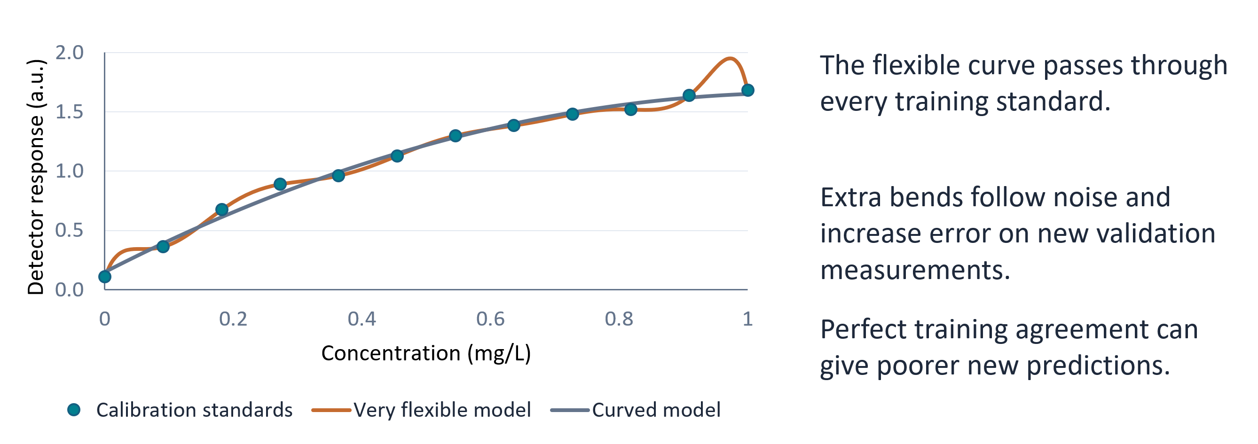
Underfitting is biased towards assumptions of the underlying trend of the data
1
Notes:
Use five concrete questions: can the model describe the training pattern, does the pattern transfer, whose samples does the dataset represent, do new samples match the conditions studied, and was the final evaluation independent? Here bias means systematic problems in sampling, measurement or targets. Statistical bias in the bias–variance discussion is a different use of the word and connects to underfitting. Poor coverage does not inevitably cause poor performance, but it limits the evidence for performance in that group. A gap alone cannot diagnose every cause. Validation-based model selection is an intended part of development. Leakage compromises data intended to provide an independent check, or introduces information unavailable under the intended prediction conditions.
Sources
https://scikit-learn.org/stable/auto_examples/model_selection/plot_underfitting_overfitting.html
https://doi.org/10.6028/NIST.SP.1270
https://doi.org/10.1038/s43246-024-00731-w
https://doi.org/10.1016/j.patter.2023.100804

Slide 4
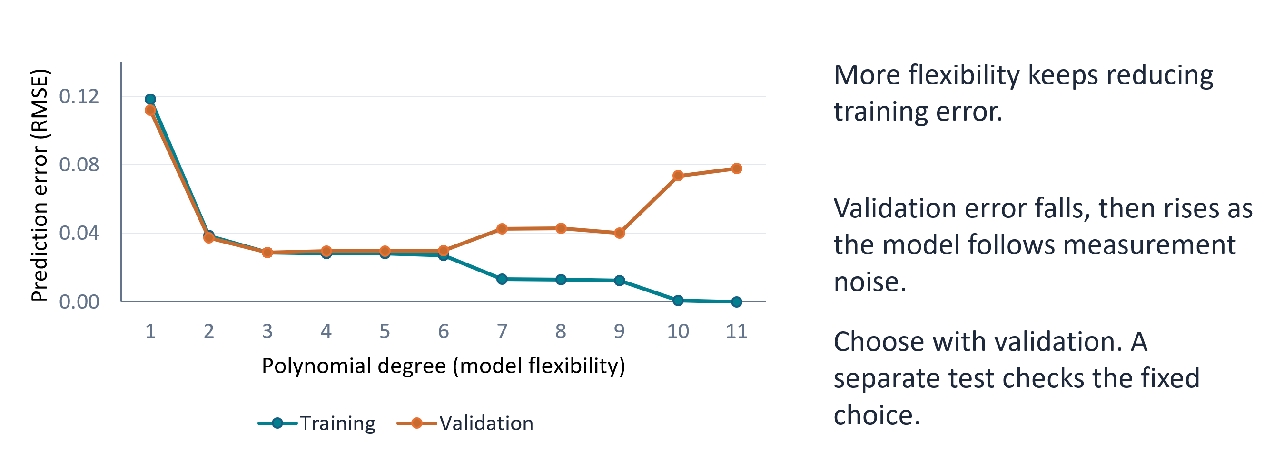
Underfitting is biased towards assumptions of the underlying trend of the data
1
Notes:
Use five concrete questions: can the model describe the training pattern, does the pattern transfer, whose samples does the dataset represent, do new samples match the conditions studied, and was the final evaluation independent? Here bias means systematic problems in sampling, measurement or targets. Statistical bias in the bias–variance discussion is a different use of the word and connects to underfitting. Poor coverage does not inevitably cause poor performance, but it limits the evidence for performance in that group. A gap alone cannot diagnose every cause. Validation-based model selection is an intended part of development. Leakage compromises data intended to provide an independent check, or introduces information unavailable under the intended prediction conditions.
Sources
https://scikit-learn.org/stable/auto_examples/model_selection/plot_underfitting_overfitting.html
https://doi.org/10.6028/NIST.SP.1270
https://doi.org/10.1038/s43246-024-00731-w
https://doi.org/10.1016/j.patter.2023.100804

Slide 5
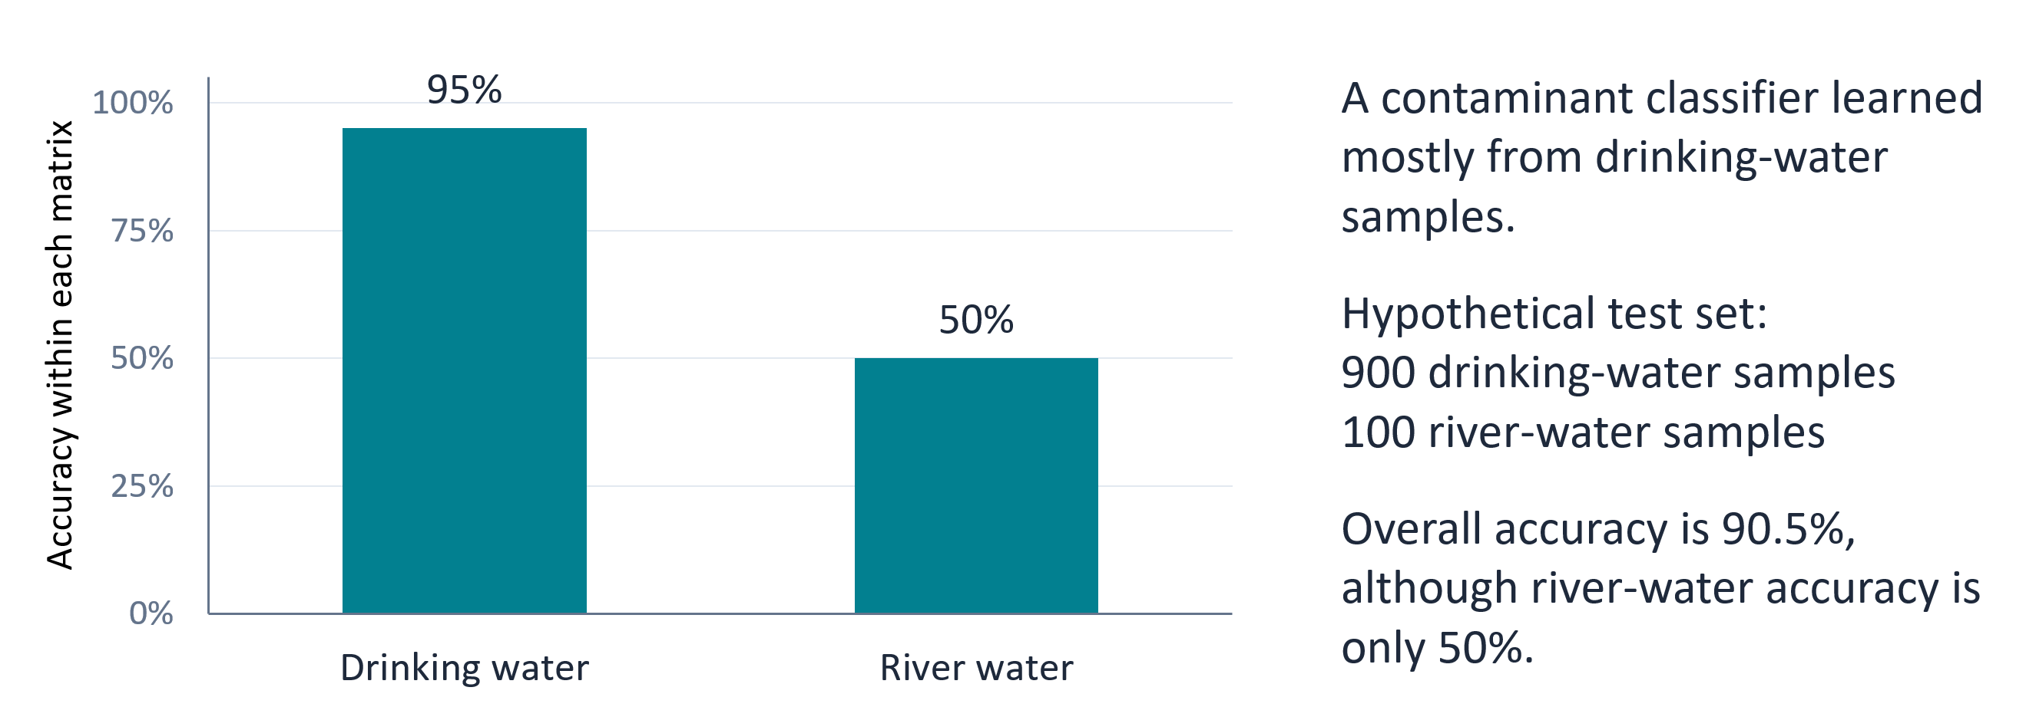
Underfitting is biased towards assumptions of the underlying trend of the data
1
Notes:
Use five concrete questions: can the model describe the training pattern, does the pattern transfer, whose samples does the dataset represent, do new samples match the conditions studied, and was the final evaluation independent? Here bias means systematic problems in sampling, measurement or targets. Statistical bias in the bias–variance discussion is a different use of the word and connects to underfitting. Poor coverage does not inevitably cause poor performance, but it limits the evidence for performance in that group. A gap alone cannot diagnose every cause. Validation-based model selection is an intended part of development. Leakage compromises data intended to provide an independent check, or introduces information unavailable under the intended prediction conditions.
Sources
https://scikit-learn.org/stable/auto_examples/model_selection/plot_underfitting_overfitting.html
https://doi.org/10.6028/NIST.SP.1270
https://doi.org/10.1038/s43246-024-00731-w
https://doi.org/10.1016/j.patter.2023.100804

Slide 6
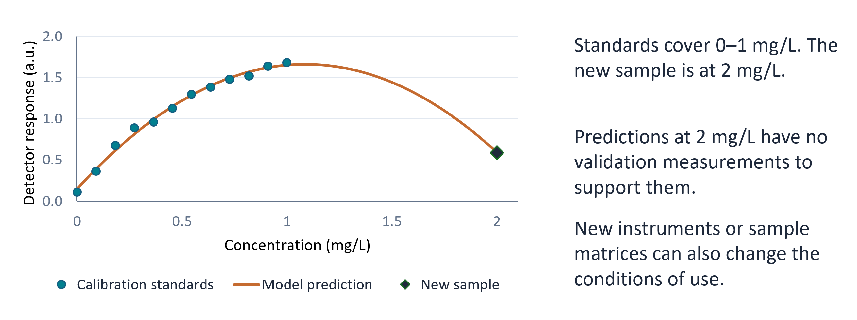
Underfitting is biased towards assumptions of the underlying trend of the data
1
Notes:
Use five concrete questions: can the model describe the training pattern, does the pattern transfer, whose samples does the dataset represent, do new samples match the conditions studied, and was the final evaluation independent? Here bias means systematic problems in sampling, measurement or targets. Statistical bias in the bias–variance discussion is a different use of the word and connects to underfitting. Poor coverage does not inevitably cause poor performance, but it limits the evidence for performance in that group. A gap alone cannot diagnose every cause. Validation-based model selection is an intended part of development. Leakage compromises data intended to provide an independent check, or introduces information unavailable under the intended prediction conditions.
Sources
https://scikit-learn.org/stable/auto_examples/model_selection/plot_underfitting_overfitting.html
https://doi.org/10.6028/NIST.SP.1270
https://doi.org/10.1038/s43246-024-00731-w
https://doi.org/10.1016/j.patter.2023.100804

Slide 7
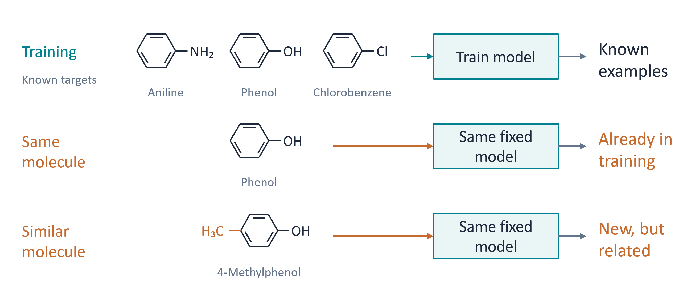
Underfitting is biased towards assumptions of the underlying trend of the data
1
Notes:
Use five concrete questions: can the model describe the training pattern, does the pattern transfer, whose samples does the dataset represent, do new samples match the conditions studied, and was the final evaluation independent? Here bias means systematic problems in sampling, measurement or targets. Statistical bias in the bias–variance discussion is a different use of the word and connects to underfitting. Poor coverage does not inevitably cause poor performance, but it limits the evidence for performance in that group. A gap alone cannot diagnose every cause. Validation-based model selection is an intended part of development. Leakage compromises data intended to provide an independent check, or introduces information unavailable under the intended prediction conditions.
Sources
https://scikit-learn.org/stable/auto_examples/model_selection/plot_underfitting_overfitting.html
https://doi.org/10.6028/NIST.SP.1270
https://doi.org/10.1038/s43246-024-00731-w
https://doi.org/10.1016/j.patter.2023.100804

Slide 8
Regression models the behavior between features and continuous target values
Failure mode | What goes wrong? | Useful check
Underfitting | The model misses a useful pattern. | Training and validation performance
Overfitting | The model fits accidental details. | The training–validation gap
Bias in the data | Some conditions have poor coverage. | Sampling and performance by group
Out of distribution | New conditions differ from those studied. | The intended conditions of use
Information leakage | Training and test information overlap. | Split units and data preparation
1
Notes:
Use five concrete questions: can the model describe the training pattern, does the pattern transfer, whose samples does the dataset represent, do new samples match the conditions studied, and was the final evaluation independent? Here bias means systematic problems in sampling, measurement or targets. Statistical bias in the bias–variance discussion is a different use of the word and connects to underfitting. Poor coverage does not inevitably cause poor performance, but it limits the evidence for performance in that group. A gap alone cannot diagnose every cause. Validation-based model selection is an intended part of development. Leakage compromises data intended to provide an independent check, or introduces information unavailable under the intended prediction conditions.
Sources
https://scikit-learn.org/stable/auto_examples/model_selection/plot_underfitting_overfitting.html
https://doi.org/10.6028/NIST.SP.1270
https://doi.org/10.1038/s43246-024-00731-w
https://doi.org/10.1016/j.patter.2023.100804

Slide 9
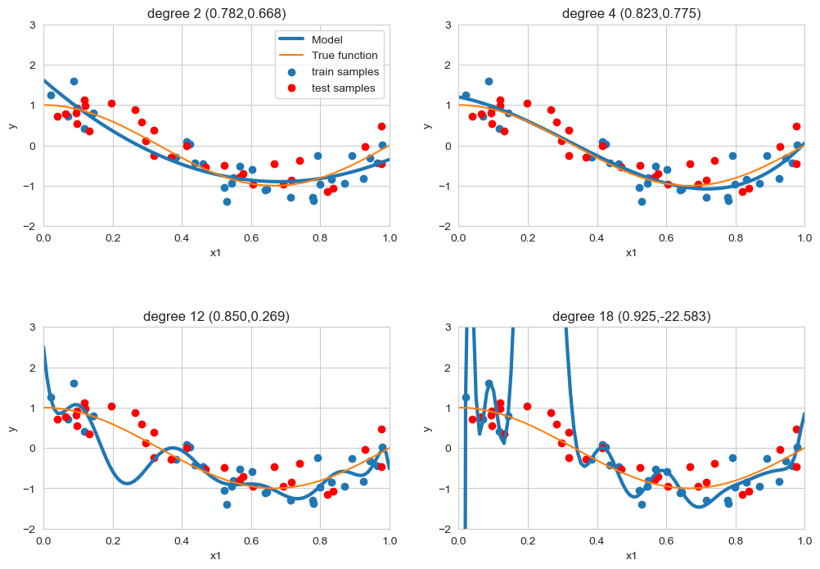
model regularization
label noise
feature noise
feature relevance
relatively small train sets
don’t try to fit the data perfectly
don’t try to use all features
notice how R² on the train set does increase with d

Slide 10

Validation hold-out set
Validation data

Slide 11
Validation hold-out set
Validation data

Slide 12
5-fold cross-validation

Slide 13
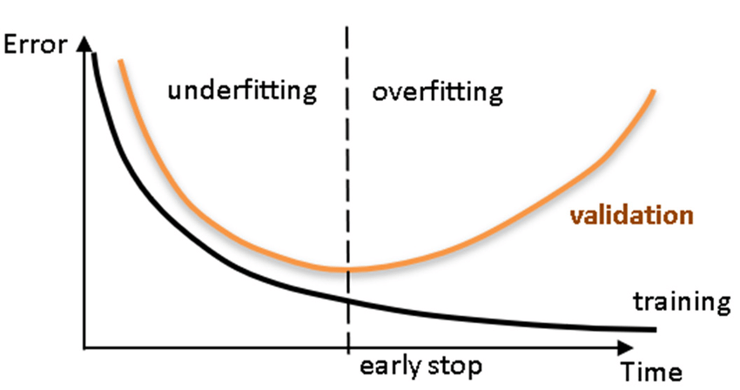
Tuning regularization
Maximum depth

Slide 14
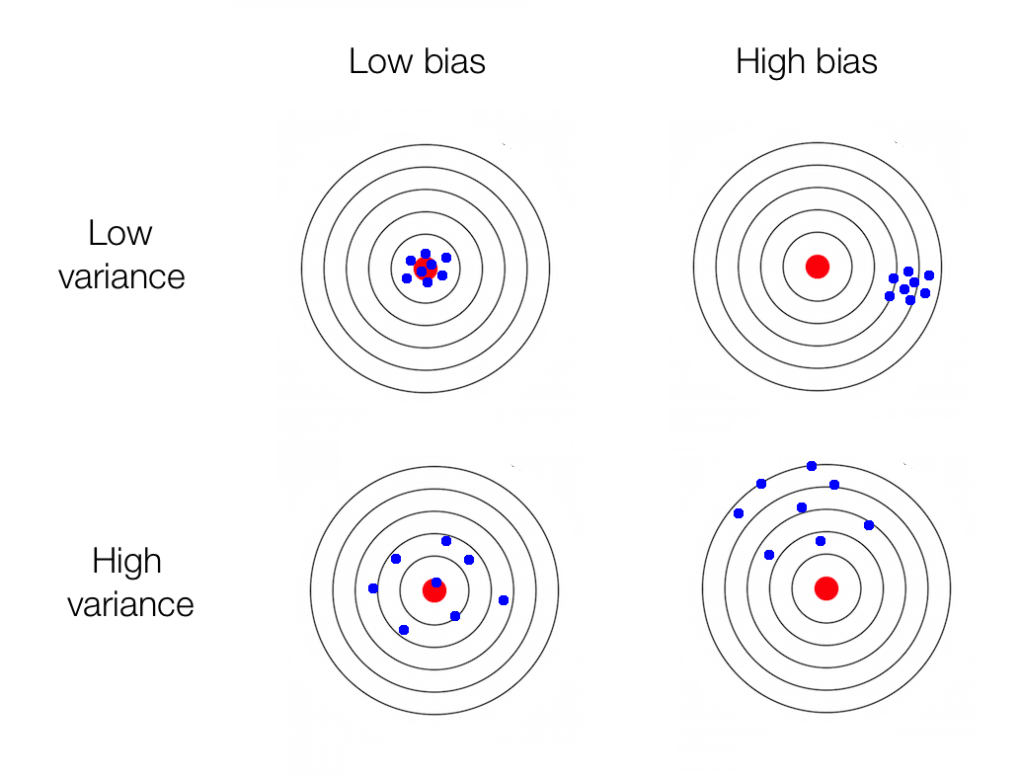
bias <> variance
Error due to bias
(systematic errors,
oversimplification)
Error due to variance
(sensitivity due to flexibility,
overcomplification)
Irreducible error

Slide 15
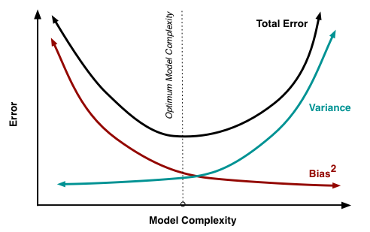
bias <> variance
Error due to bias
Error due to variance
Irreducible error

Slide 16





regularized linear regression
cost function
regularized cost function

Slide 17

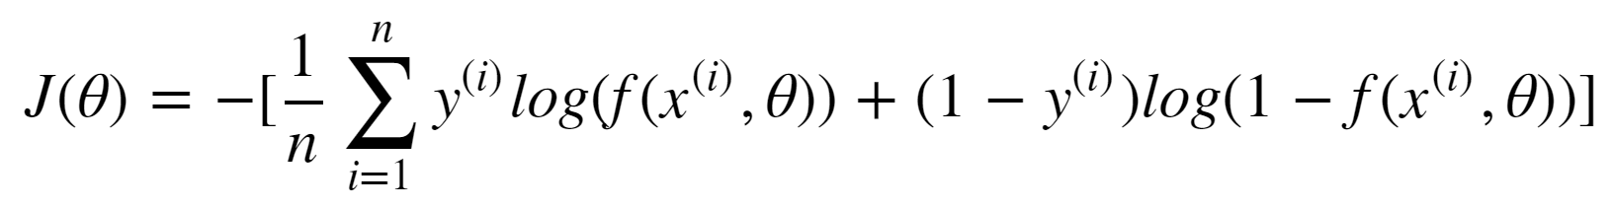
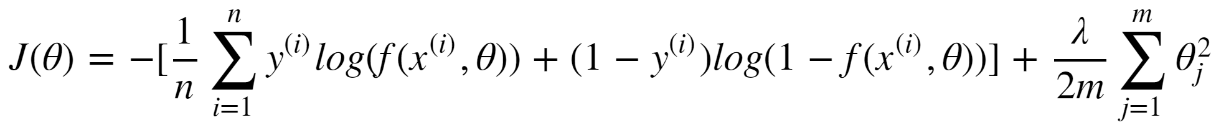
regularized logistic regression
cost function
regularized cost function

Slide 18
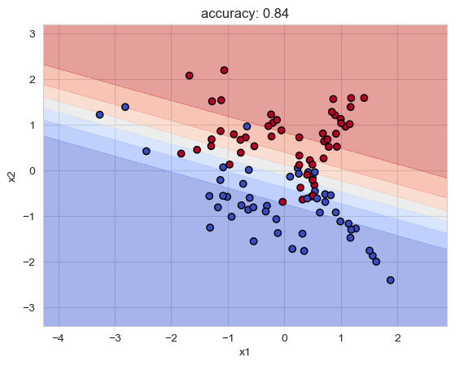
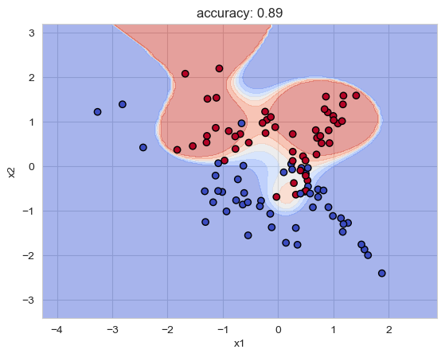
model regularization

Slide 19
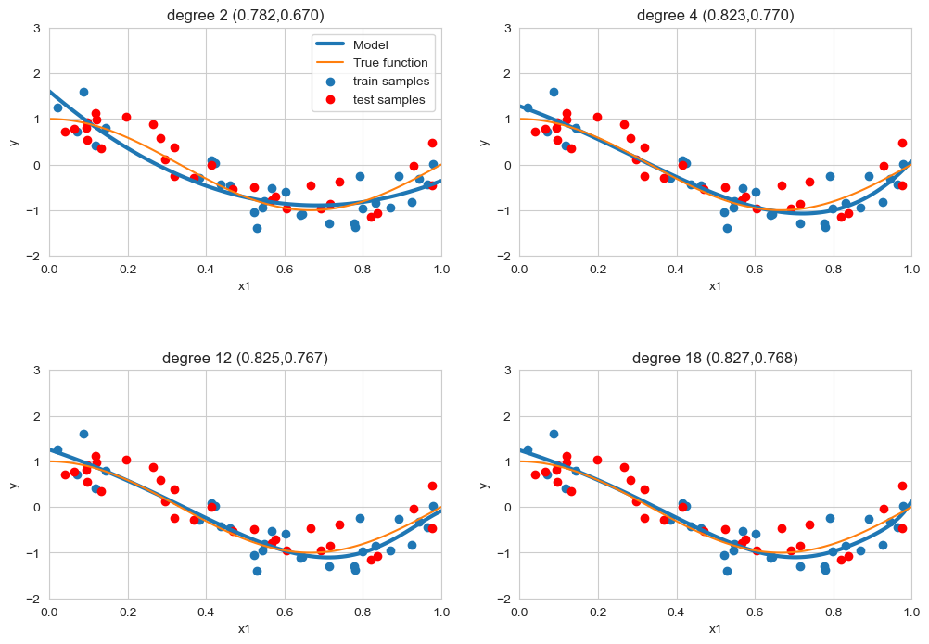
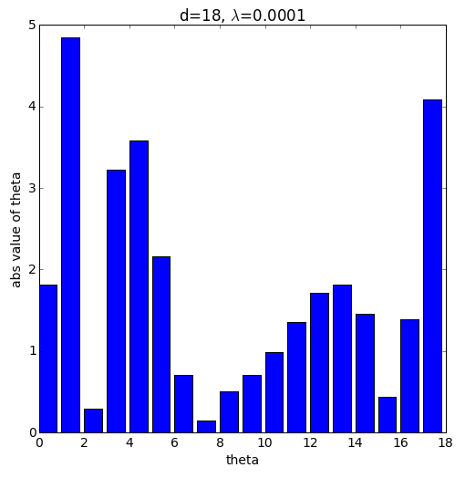
regularized linear regression

Slide 20
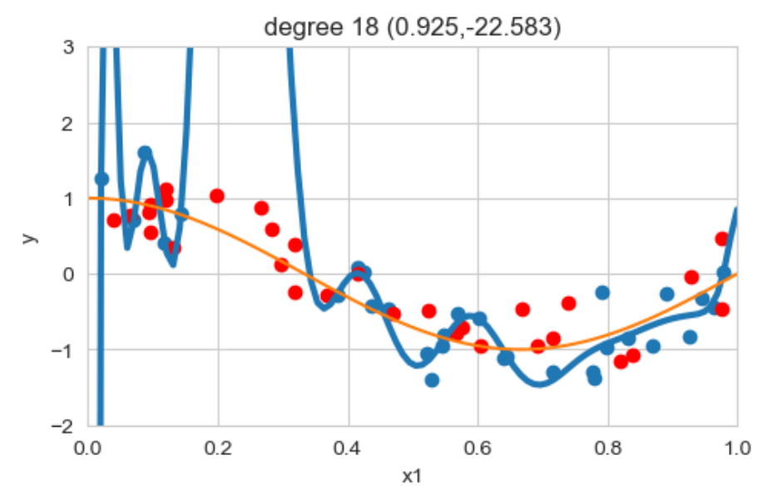
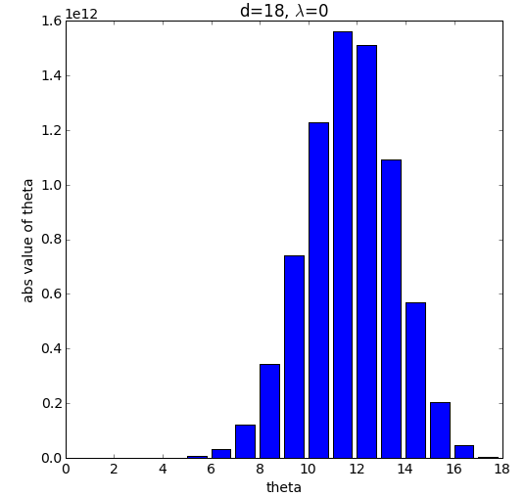
regularized linear regression

Slide 21
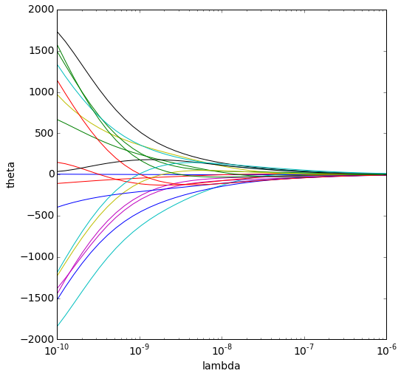
regularized linear regression
high complexity
low complexity

