Slide 1
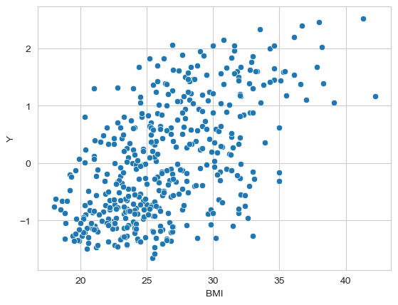
Regression models the behavior between features and continuous target values
Can BMI explain Y?
Can BMI predict Y?
How does Y vary with BMI?
Regression is a general term for modeling the relationship between a label
(a.k.a. dependent variable or target) and one or more features (a.k.a. the attributes, the independent or explanatory variable(s)).

Slide 2
Linear regression models assumes the relation between features and continuous target values is linear
We need to make
assumptions
about the
model
that generated the data.
linear relationship
linear model

Slide 3
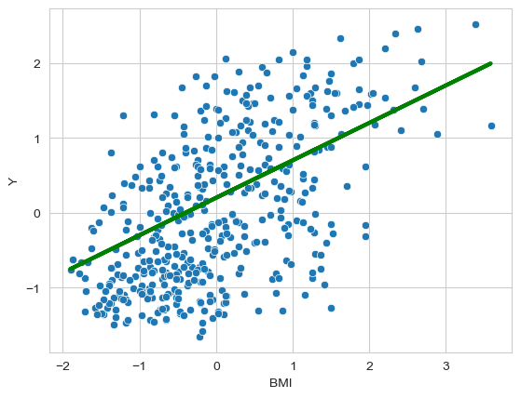

Linear regression models can be expressed as a simple equation containing trainable parameters and features
a and b are model parameters
a is the slope to the line (direction)
b is the intercept or bias (position)

Slide 4
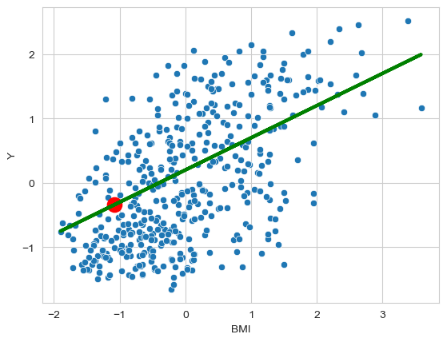
Linear regression models are capable of predicting new values when only the feature is known
BMI(70kg, 1.8 meter) = 21.6
scaled data!
scaled BMI = -1.08
predicted value = -0.34
generalization!!

Slide 5
There are multiple ways you can fit a linear model through training data
What values for a and b fit the data best?
How can we evaluate them?

Slide 6
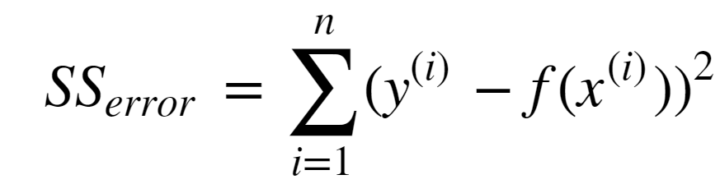
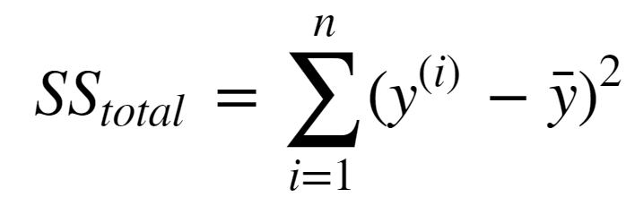
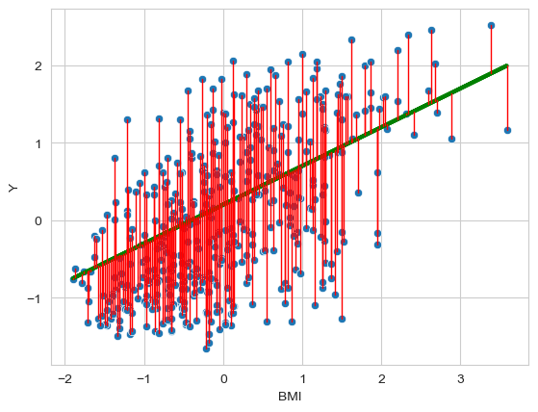
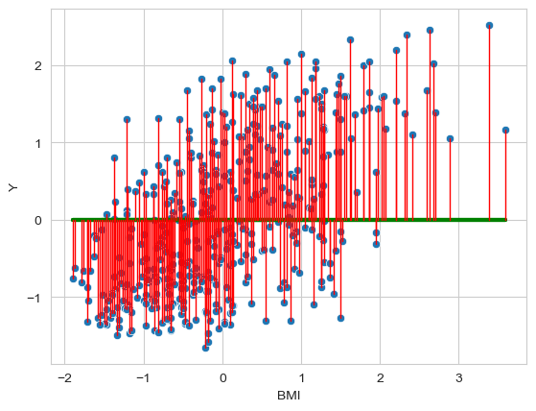


Some parameter values are better than others …

Slide 7





Linear regression formalized as equation
Dataset
linear regression
Learning Algorithm

Slide 8
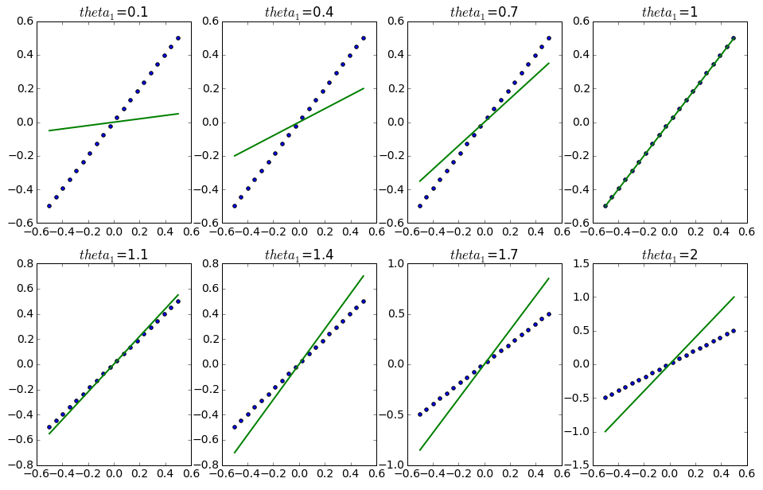
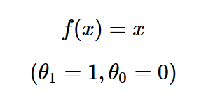
Linear regression cost function for different parameter values

Slide 9
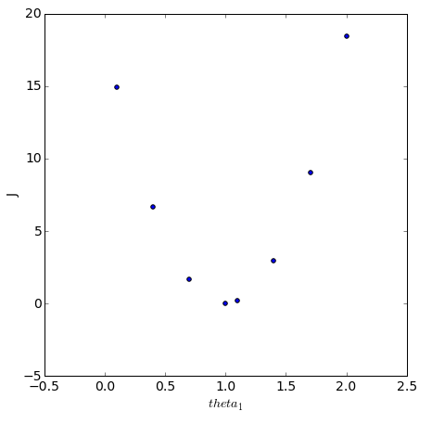



Linear regression cost function for different parameter values

Slide 10

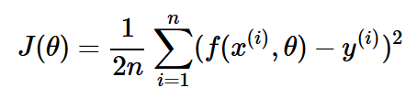
Linear regression formalized and associated cost function
Fit a linear model
to the data set such that the cost function
is minimal.

Slide 11
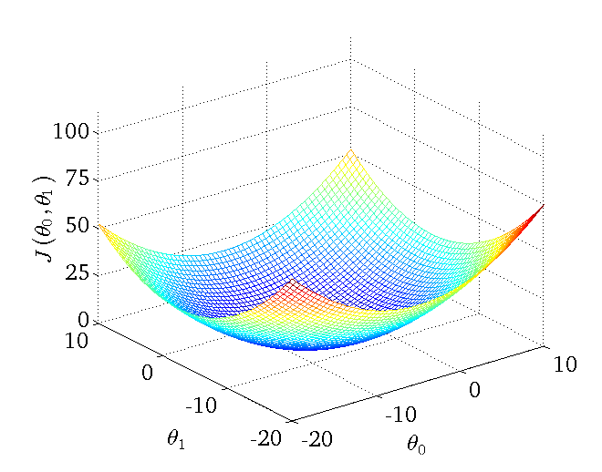
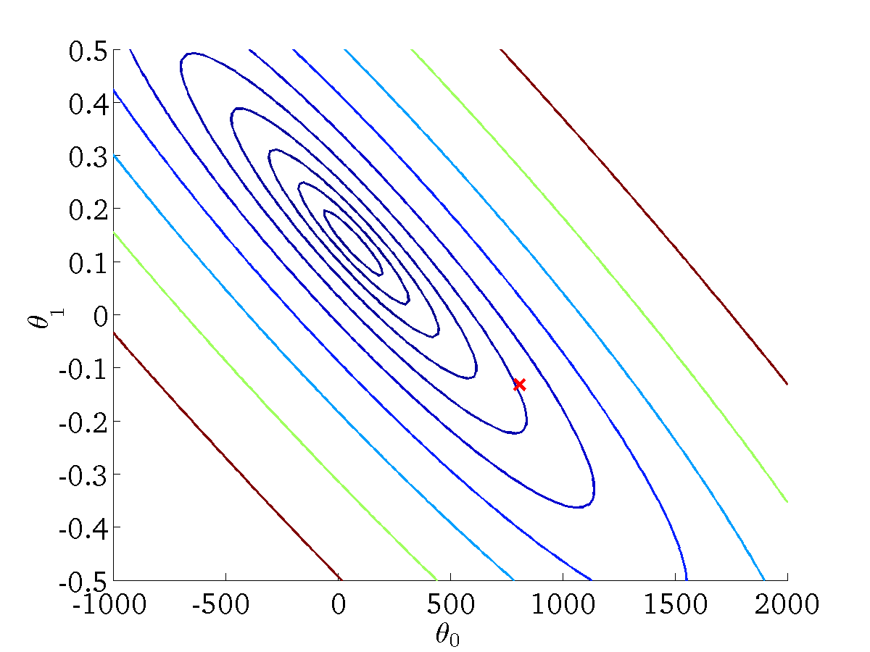
Linear regression formalized and associated cost function

Slide 12
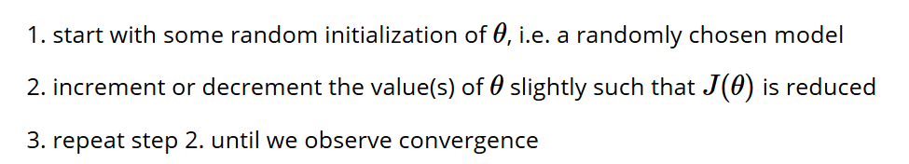
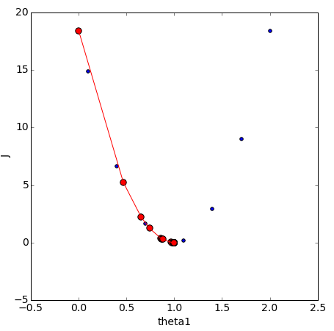
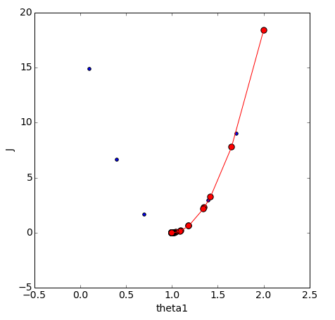

Linear regression uses gradient descent to optimize parameters

Slide 13
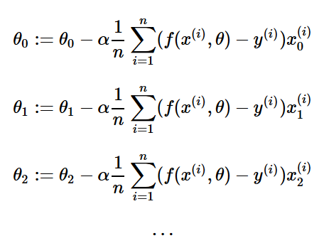
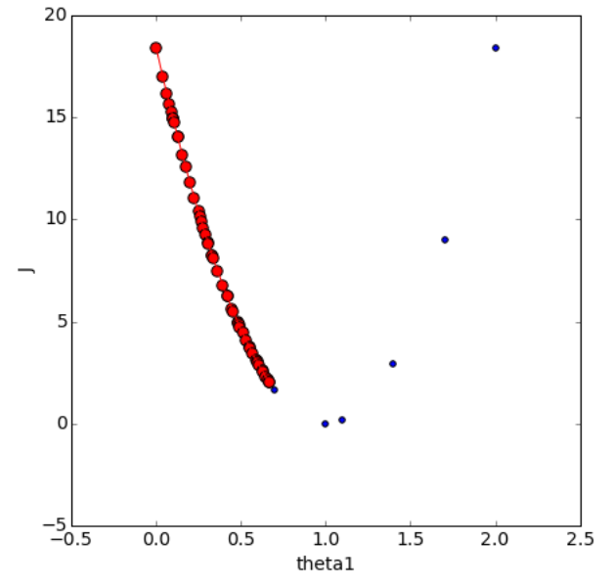
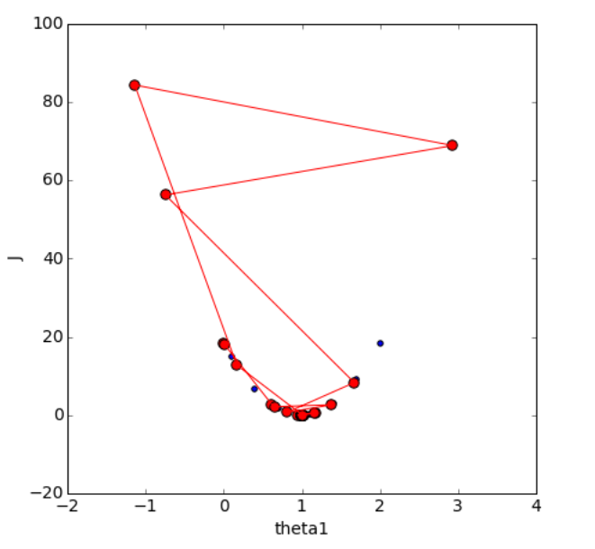
Gradient descent uses a scaling factor (learning rate) to determine the size of the parameter change

Slide 14



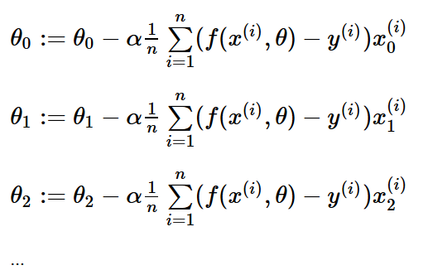


Gradient descent to set parameter values that minimize the cost function
model:
cost function:
Goal:
Learning: 1. start with some
2. change to reduce
3. repeat 2. until convergence

Slide 15
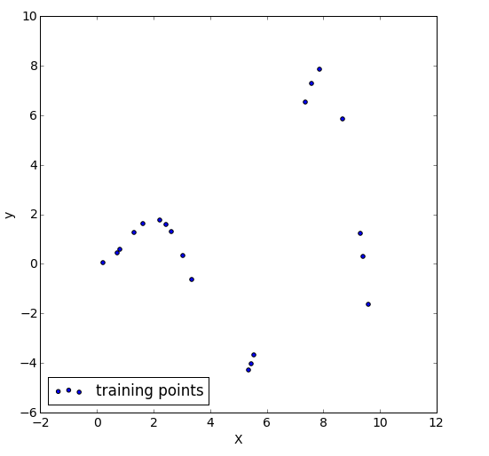

Non-linear regression through taking higher order polynomials for the feature values
Does y vary linearly with X?
Can we fit a non-linear model? Yes
Or we could add polynomial transformations of the features.

Slide 16
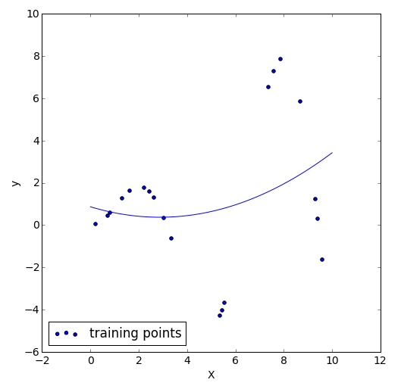
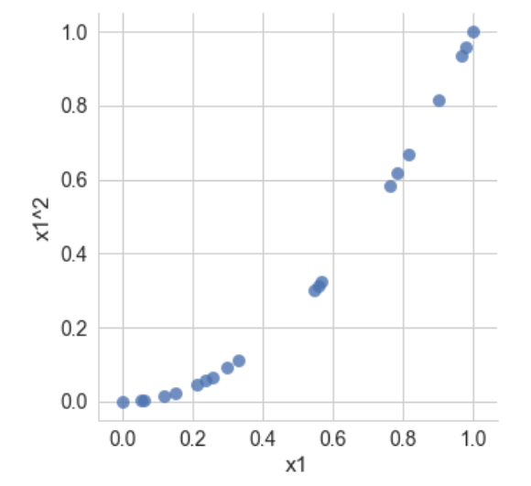
Non-linear regression through taking higher order polynomials for the feature values
Does y vary linearly with X?
Can we fit a non-linear model? Yes
Or we could add polynomial transformations of the features.

Slide 17
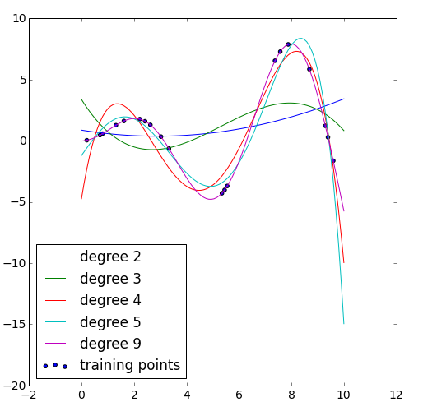
Non-linear regression through taking higher order polynomials for the feature values

