Slide 1
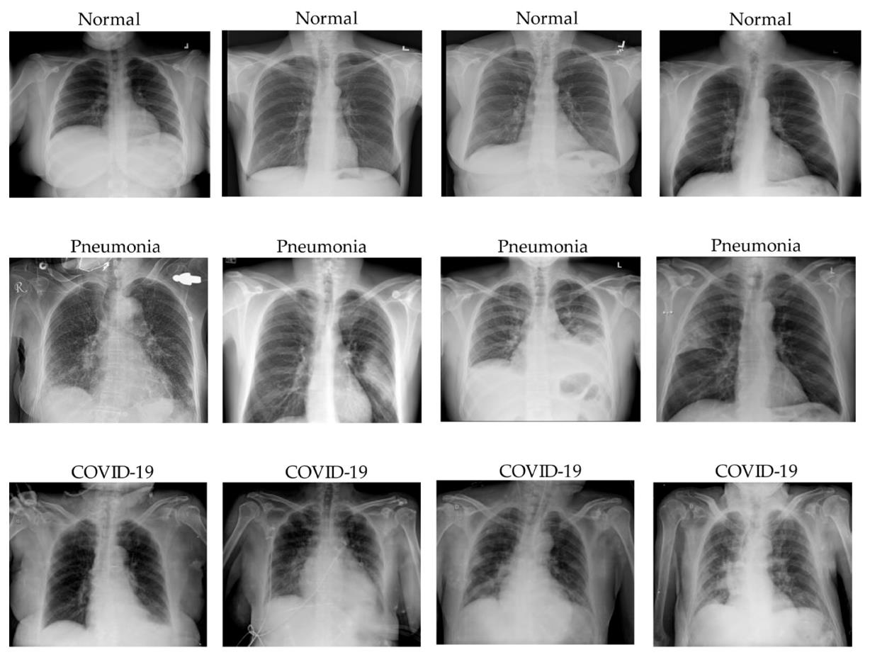
There are various prediction tasks in computer vision: Classification
Notes:
In computer vision, one important task is image classification, where the goal is to assign a single label to an entire image. In biomedical contexts, this could mean predicting whether an X-ray is normal or abnormal, or assigning an image to a disease category such as COVID-19 or pneumonia. The model does not indicate where the relevant pattern is located; it only predicts the overall class of the image.

Slide 2
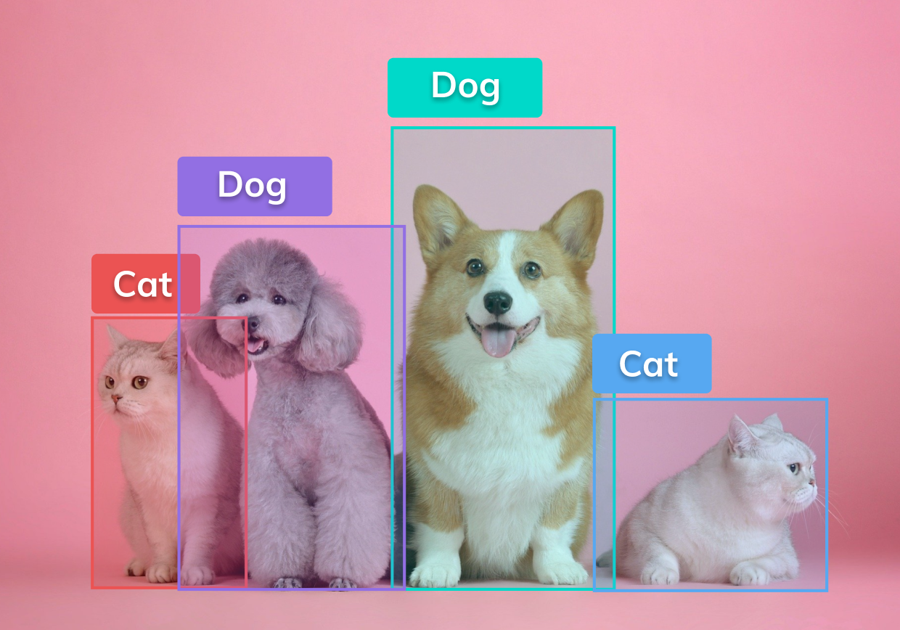
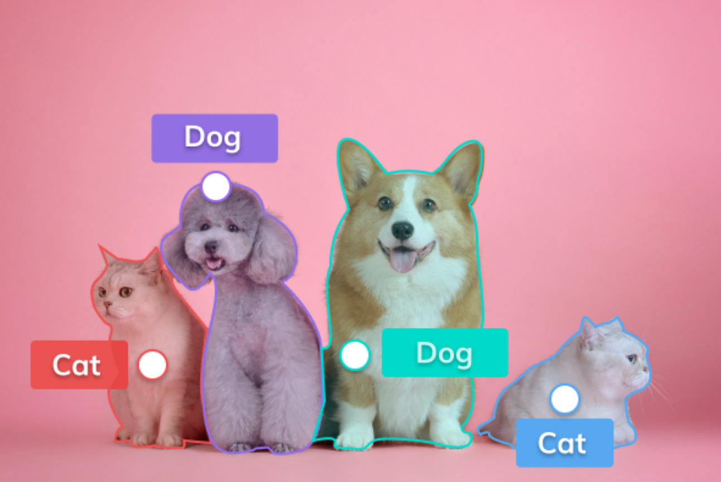
There are various prediction tasks in computer vision:
Detection & segmentation
Notes:
Computer vision tasks can also require more detailed outputs than a single class label. In object detection, the model identifies and localizes objects, typically with bounding boxes. In segmentation, the model predicts which individual pixels belong to which object or region. These tasks are especially important in biomedical imaging, where one may want to detect lesions, outline tumors, or separate cells from background tissue.

Slide 3
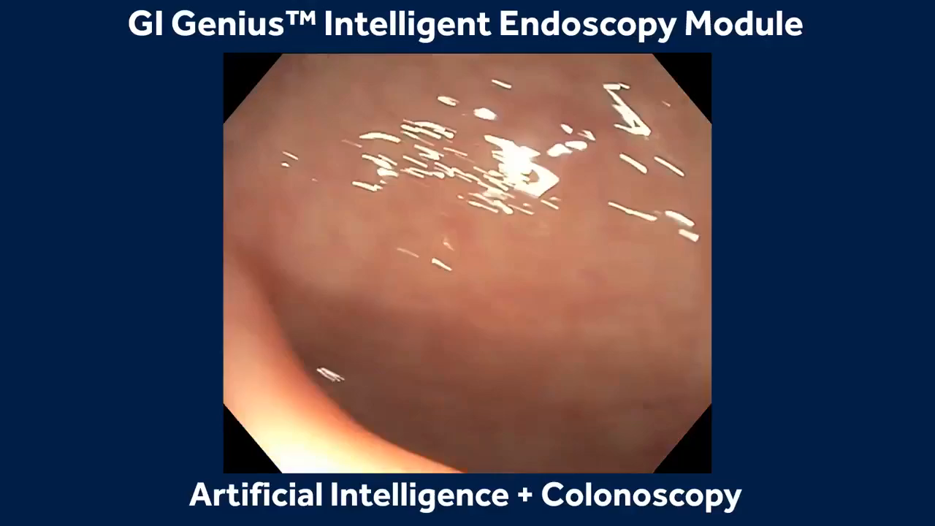
There are various prediction tasks in computer vision:
Object detection
Notes:
In object detection, determining where it is located can be useful in applications such as endoscopy, pathology, or radiology, where the location of a suspicious region matters as much as its presence. Detection therefore extends classification by adding spatial localization.

Slide 4
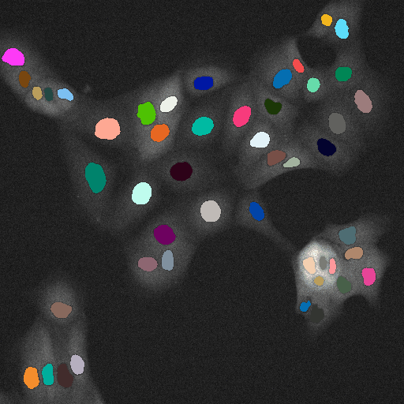
There are various prediction tasks in computer vision:
Object tracking
Notes:
Some computer vision problems involve following objects over time rather than analyzing a single static image. In object tracking, the model identifies the same object across consecutive frames of a video or time-lapse experiment. In biomedical research, this is commonly used to track cells, organelles, or other structures as they move, divide, or interact over time.

Slide 5
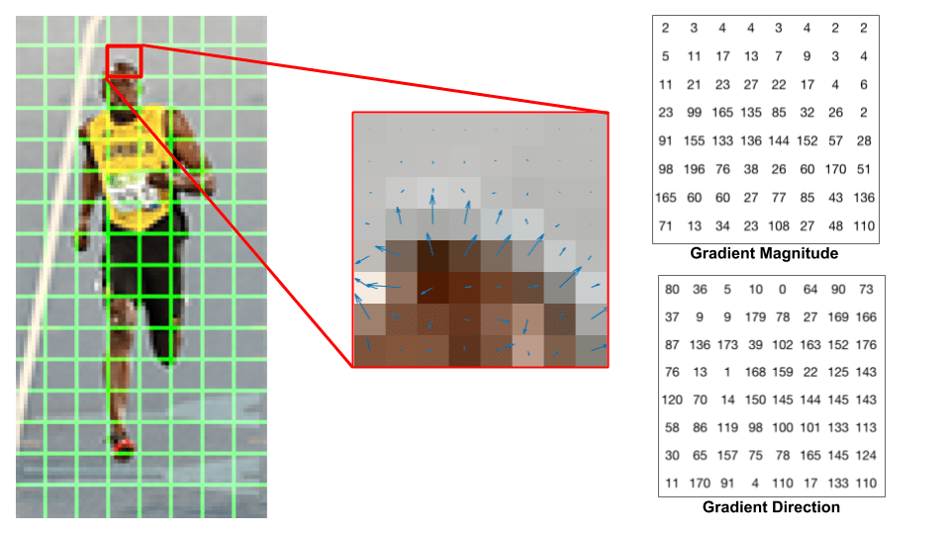
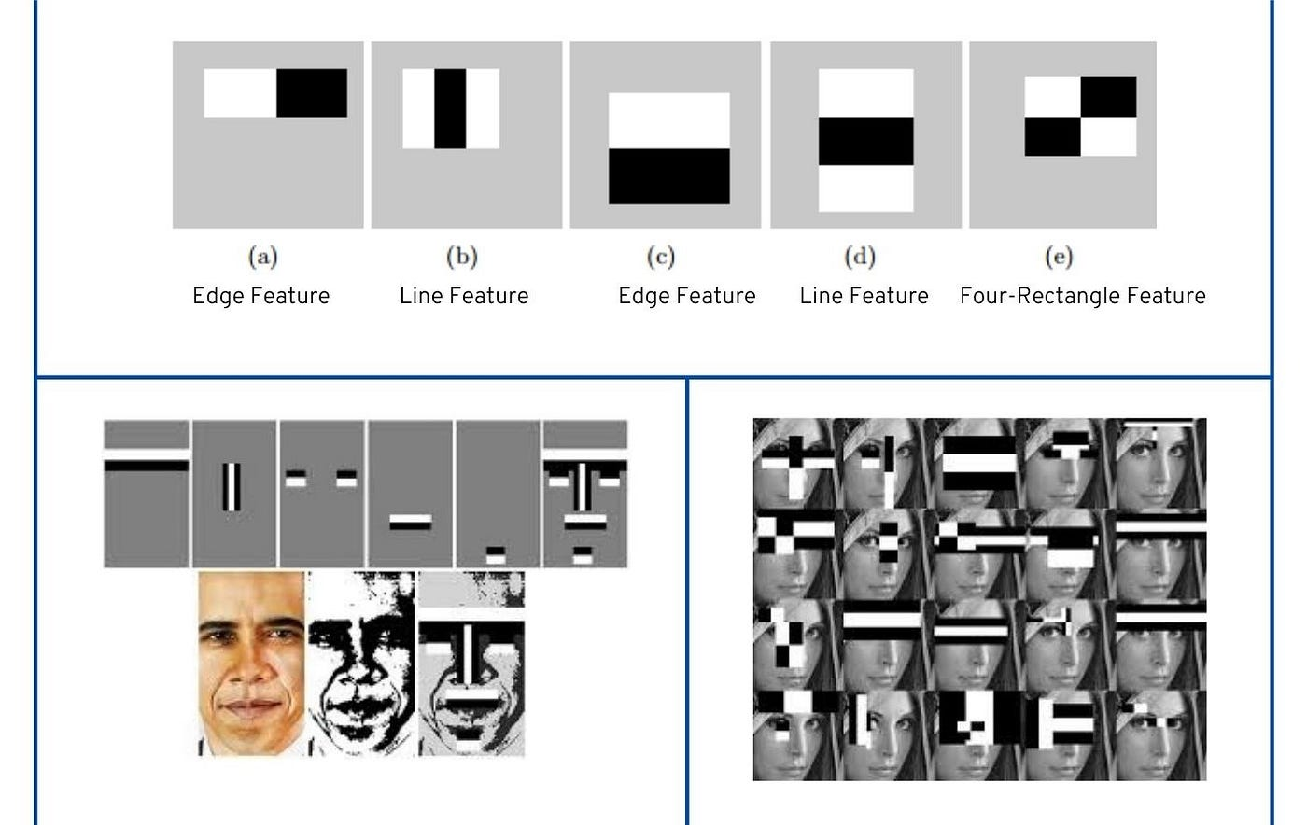
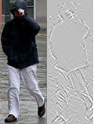
Methods before CNNs involved manual feature extraction
Histogram of oriented gradients
Edge detection
Notes:
Before CNNs became dominant, image analysis often relied on manual feature extraction. Researchers designed features such as edges, gradients, textures, or shapes and then passed those features to a separate machine-learning model. This approach could work well, but it depended heavily on expert knowledge and on the assumption that the manually designed features captured the relevant biological or visual information.

Slide 6
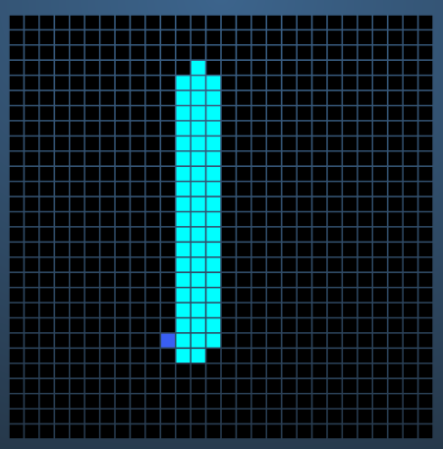
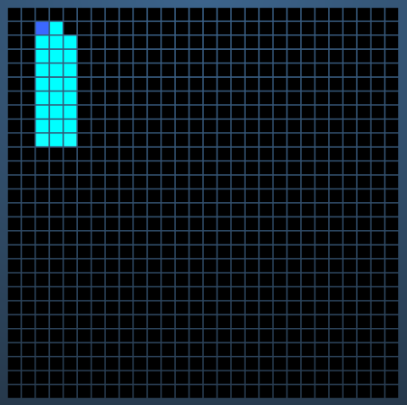


What if neural networks could learn visual patterns instead?
Regular neural network
✅ Can learn visual patterns itself!
❌ Expects the image to stay in the same location (not robust against translation invariance).
When digit is centered:
good prediction
When digit is NOT centered:
bad prediction
Notes:
A standard fully connected neural network can, in principle, learn from image pixels directly. However, it treats the image as a collection of input values rather than as a structured 2D object. As a result, it is sensitive to the exact position of patterns in the image. If an object shifts to another location, the network may respond very differently, even though the image content is biologically or visually the same.

Slide 7
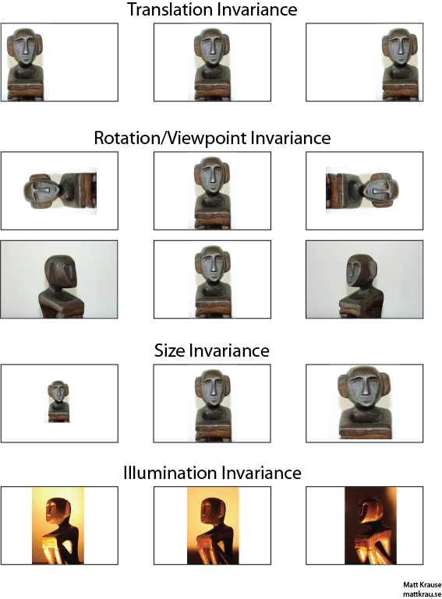
Image recognition must be robust against variances
Notes:
Real-world images vary in many ways. Objects can appear at different positions, sizes, orientations, or lighting conditions. These are called object invariances. A useful image-recognition model must therefore be robust to such variations. In biomedical imaging, similar challenges arise because samples may differ in staining intensity, imaging angle, magnification, or acquisition conditions. CNNs were designed in part to better handle this type of variability.

Slide 8
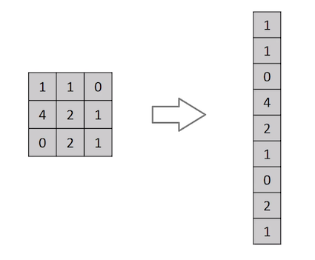
A regular neural network requires flattening of the 2D image, rendering the model not robust against translation invariance
Notes:
A regular neural network requires the image to be flattened into a one-dimensional vector before it can be processed. This conversion removes the explicit spatial arrangement of neighboring pixels. Consequently, the model no longer naturally knows which pixels were adjacent in the original image, making it harder to recognize the same pattern when it appears in a different location.

Slide 9
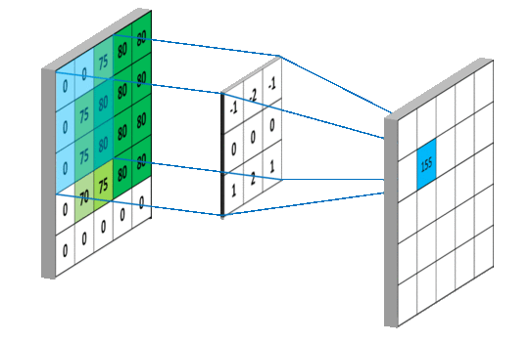
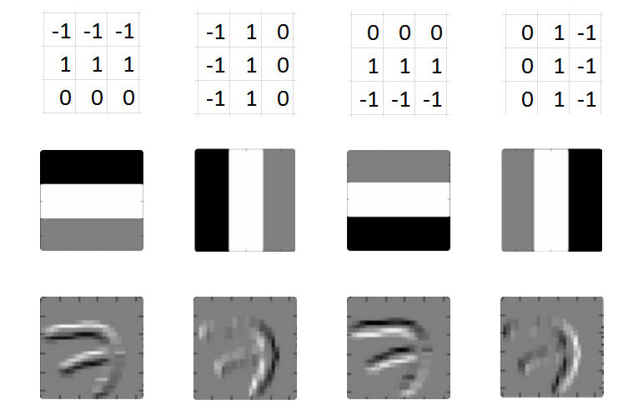
Kernels (aka filters) solve the problem of translation invariance
Kernels ‘convolve’ over the image
Have been used for manual feature engineering, for instance, for edge detection
Notes:
CNNs address this limitation by using kernels, also called filters, that slide across the image. A kernel applies the same small set of weights at many positions, allowing the model to detect the same local pattern wherever it appears. This idea is related to earlier image-processing methods such as edge-detection filters, but in CNNs the filters are learned from data rather than manually specified.

Slide 10
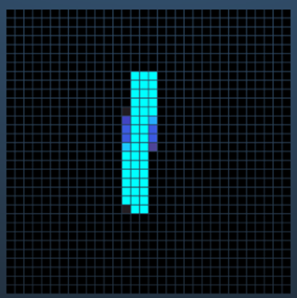
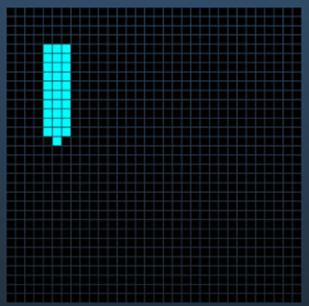
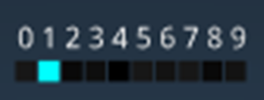
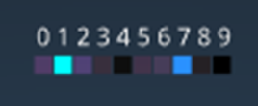
Kernels (aka filters) solve the problem of translation invariance
Convolutional neural network
✅ Can learn visual patterns itself!
✅ Is robust against translation invariance
Good prediction independently of object location
Notes:
Because the same filter is applied across the entire image, a convolutional neural network can recognize a pattern even when it appears at different positions. This makes CNNs much more robust to translation invariance than standard fully connected networks. The model still learns from data, but it does so in a way that respects the spatial structure of images.

Slide 11
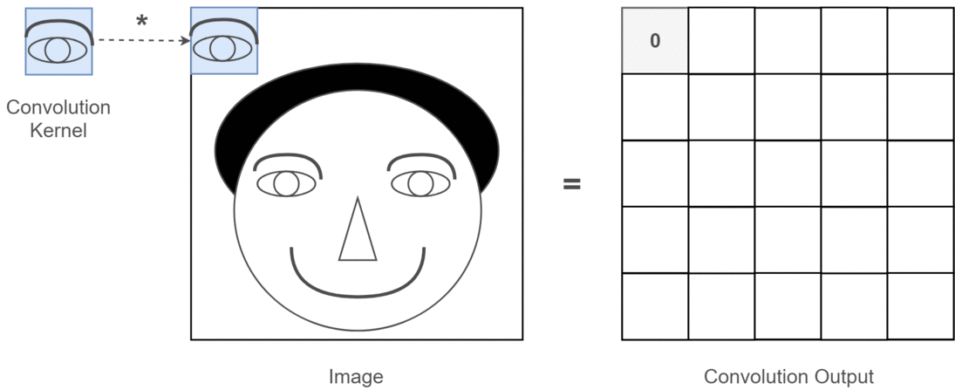
Kernels, simplified
Notes:
A kernel can be understood as a small window that scans over the image and computes a new value at each position. The output records how strongly the local image region matches the pattern encoded by the kernel. Repeating this operation over the whole image produces a feature map, which highlights where that visual pattern is present.

Slide 12
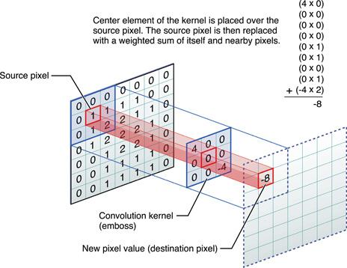











In CNNs, kernels values are learnable parameters of the model
$$x_{0}$$
$$θ_{0}$$
$$x_{1}$$
$$θ_{1}$$
$g()$ =
$$a_{1}^{1}$$
$$f(x,θ)$$
$$θ_{2}$$
$$x_{2}$$
$$θ_{3}$$
$$x_{3}$$
source pixel
kernel values
new pixel
Notes:
In a CNN, the values inside a kernel are not fixed by the user. They are learnable parameters that are optimized during training, just like weights in a dense neural-network layer. During learning, the model adjusts these filter values so that the resulting feature maps become useful for the prediction task. In this sense, a convolution is a local weighted combination of nearby pixels.

Slide 13
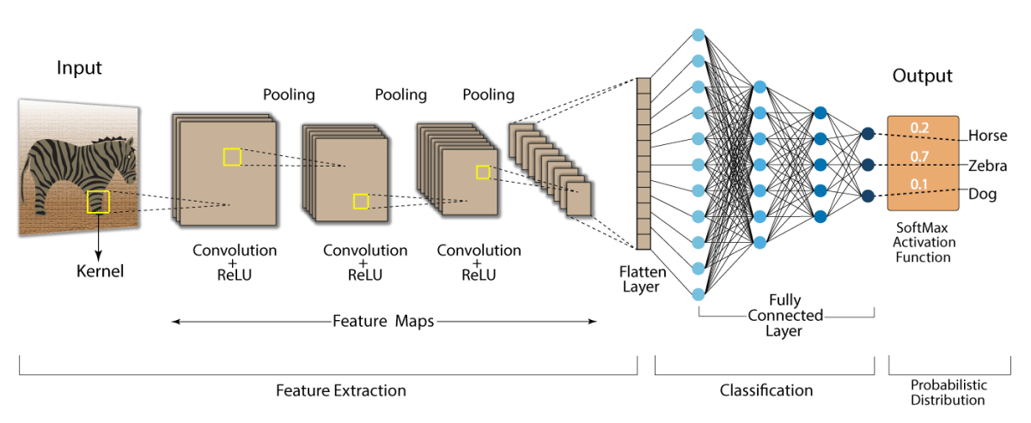
Multiple convolutions can be stacked in layers
Notes:
CNNs become powerful because multiple convolutional layers can be stacked. Early layers often detect simple patterns such as edges or textures. Later layers combine these simpler patterns into more complex structures. In biomedical imaging, this hierarchy might progress from local contrast changes to tissue architecture, cell morphology, or lesion patterns. The final layers then use these learned representations for classification or another downstream task.

Slide 14
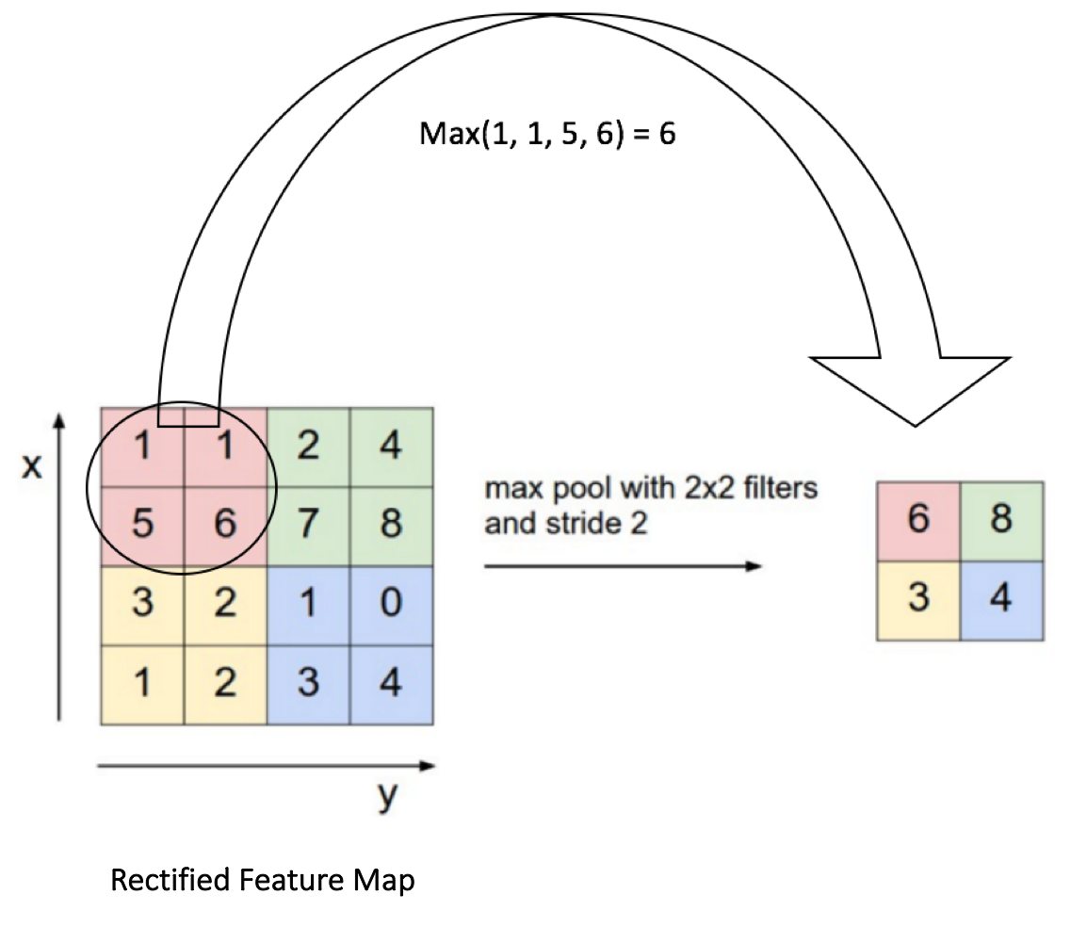
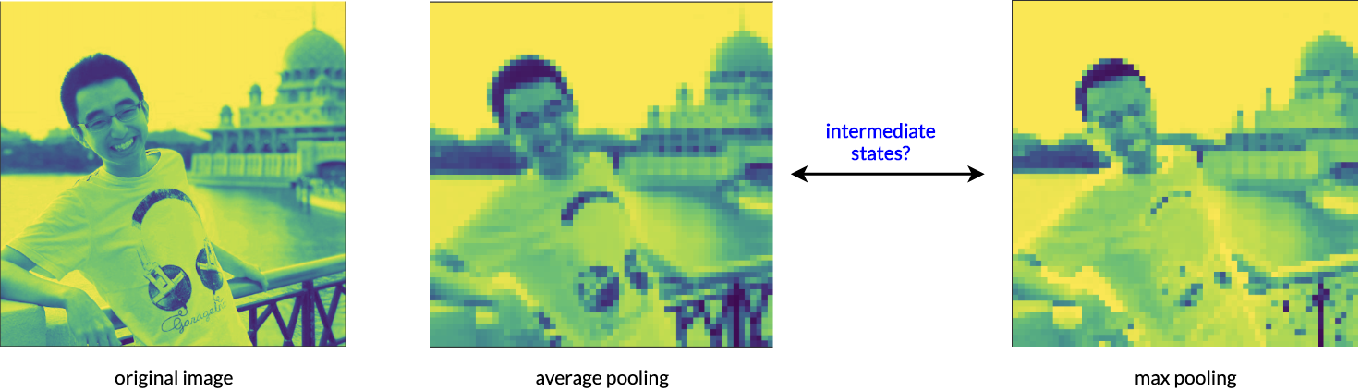
Pooling operations downscale the feature map (or image)
original image
after max pooling
Notes:
Pooling reduces the spatial size of a feature map by summarizing small local regions, for example by taking the maximum value. This makes the representation more compact and reduces computational cost. Pooling can also make the model less sensitive to small local shifts, because the exact pixel position becomes less important once nearby responses are aggregated.

Slide 15
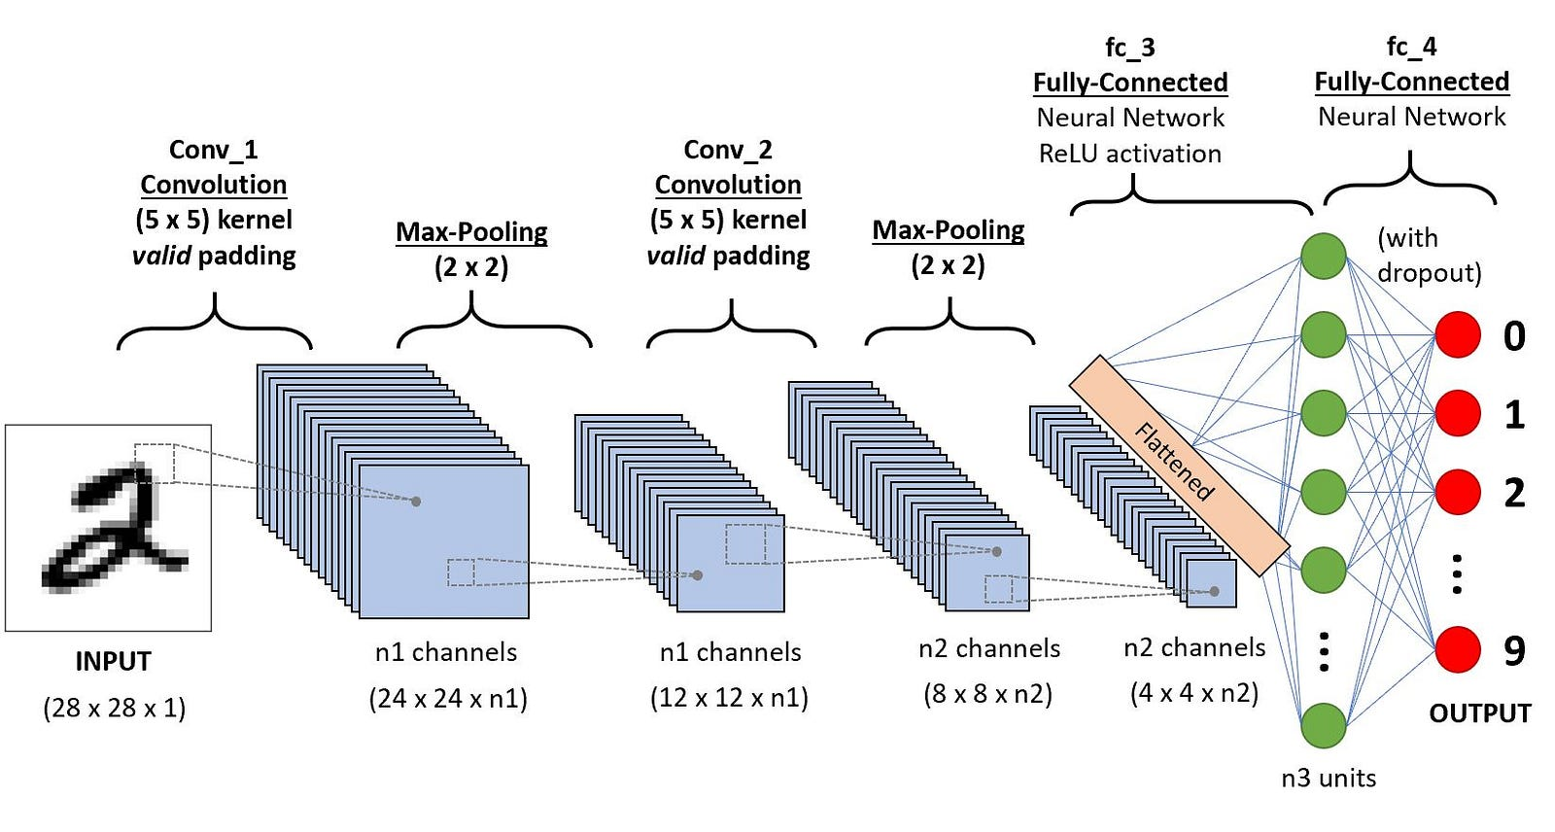
Some noteworthy architectures throughout the years…
LeNet introduced end-to-end CNN-based image recognition
Notes:
LeNet was one of the earliest successful convolutional neural networks and helped establish the basic CNN design: convolution, pooling, and fully connected classification layers. Its importance lies in showing that image-recognition features could be learned directly from data in an end-to-end manner, rather than being manually engineered in advance.

Slide 16
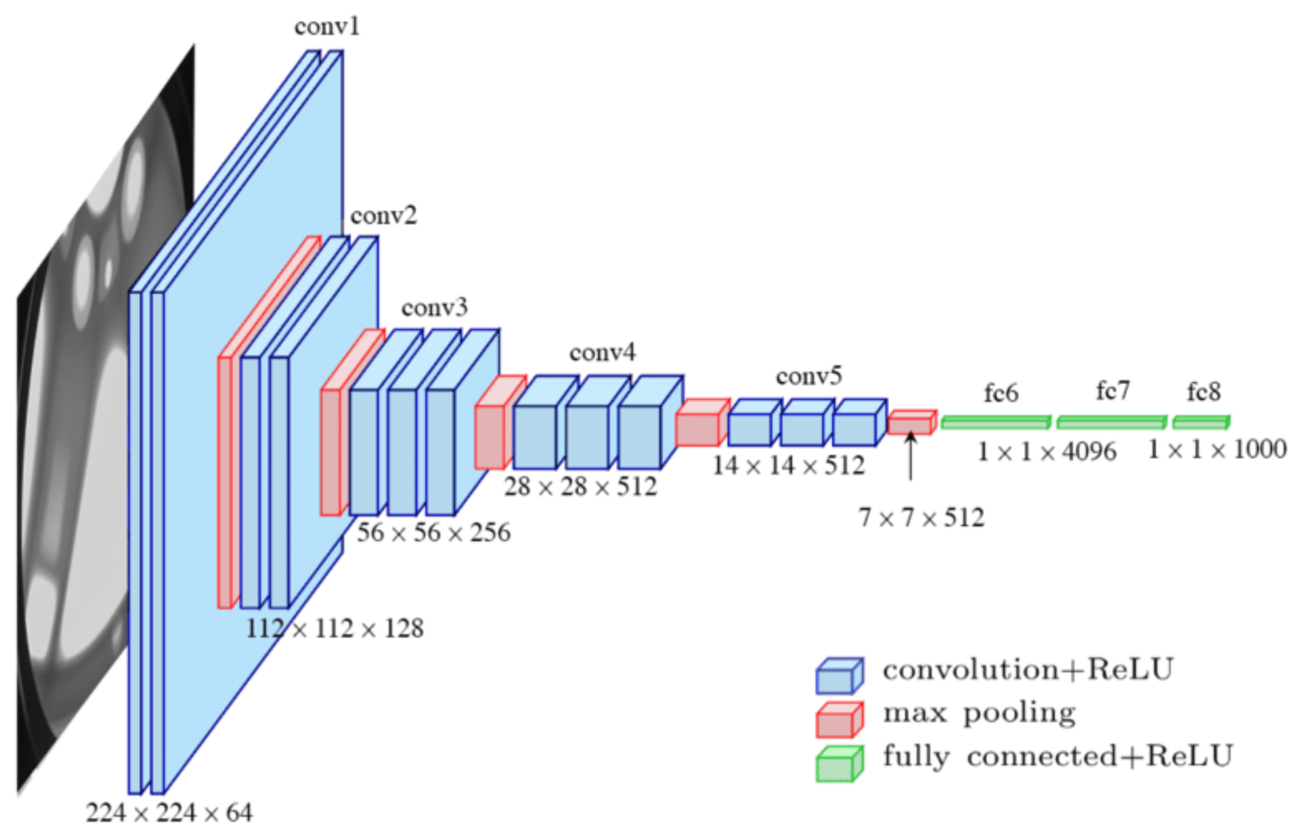
Some noteworthy architectures throughout the years…
VGG showed that deeper CNNs greatly improved accuracy
Notes:
VGG showed that CNN performance could be improved by using a simple but much deeper architecture built from repeated small convolutional filters. Its design was influential because it demonstrated that depth itself was powerful, even without highly complicated architectural components. VGG also became a widely used backbone and feature extractor in many later computer-vision applications.
Note how the size of the feature maps decreases across layers (224 to 7), but the number of channels increases (64 to 512). This shows how the model is condensing spatial information into a non-spatial output.

Slide 17
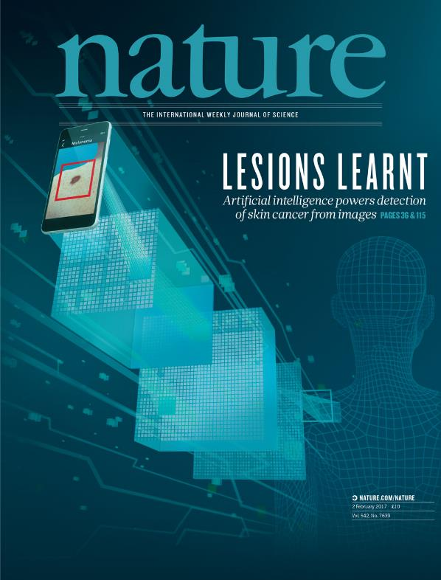
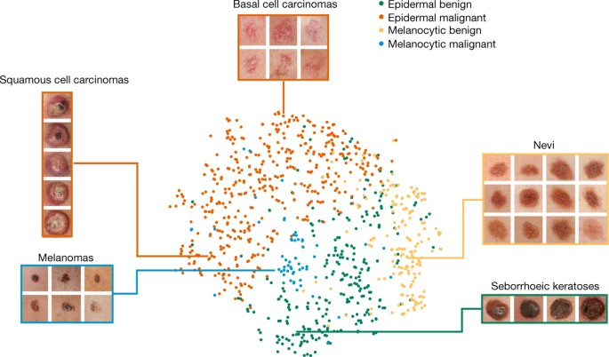
Our dataset for this afternoon: Skin lesions with CNNs
One of the first CNNs that reached expert-level performance
Notes:
This example shows a landmark medical-imaging application of CNNs: skin-lesion classification. The study became highly influential because it suggested that deep neural networks could achieve expert-level performance on a clinically relevant image-recognition problem. More broadly, it helped establish deep learning as a serious approach in biomedical image analysis.

Slide 18
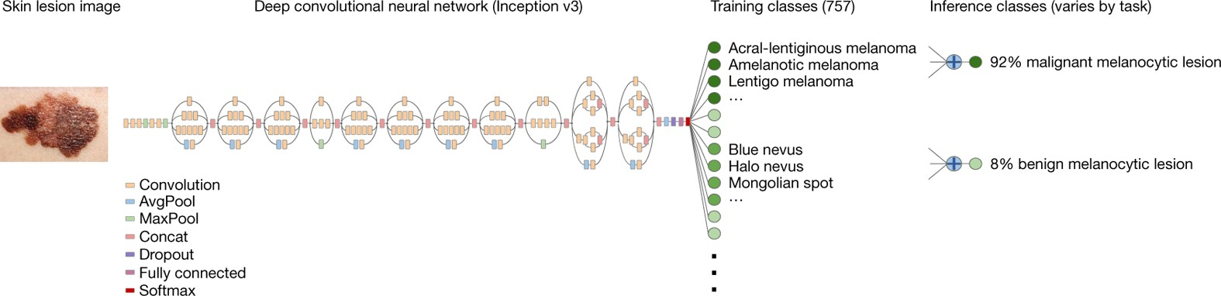
Our dataset for this afternoon: Skin lesions with CNNs
One of the first CNNs that reached expert-level performance

Slide 19
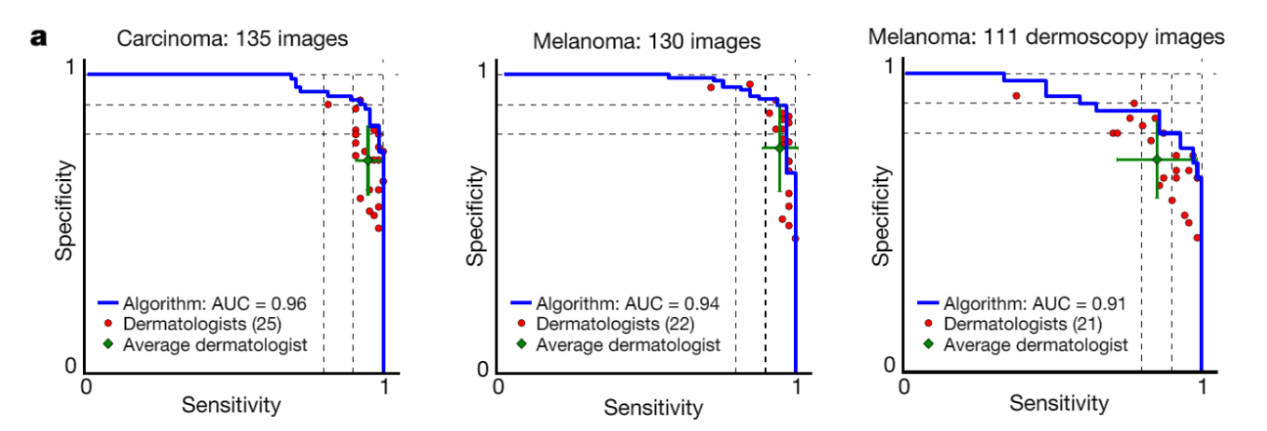
Our dataset for this afternoon: Skin lesions with CNNs
One of the first CNNs that reached expert-level performance

