Slide 1
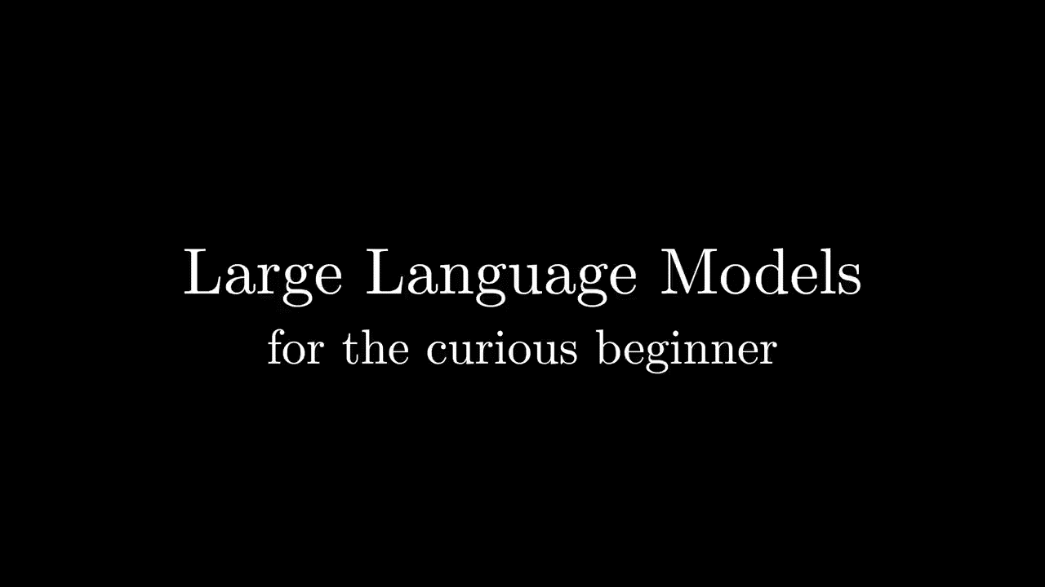

Slide 2
Seminar AI
15/01/2026

Slide 3
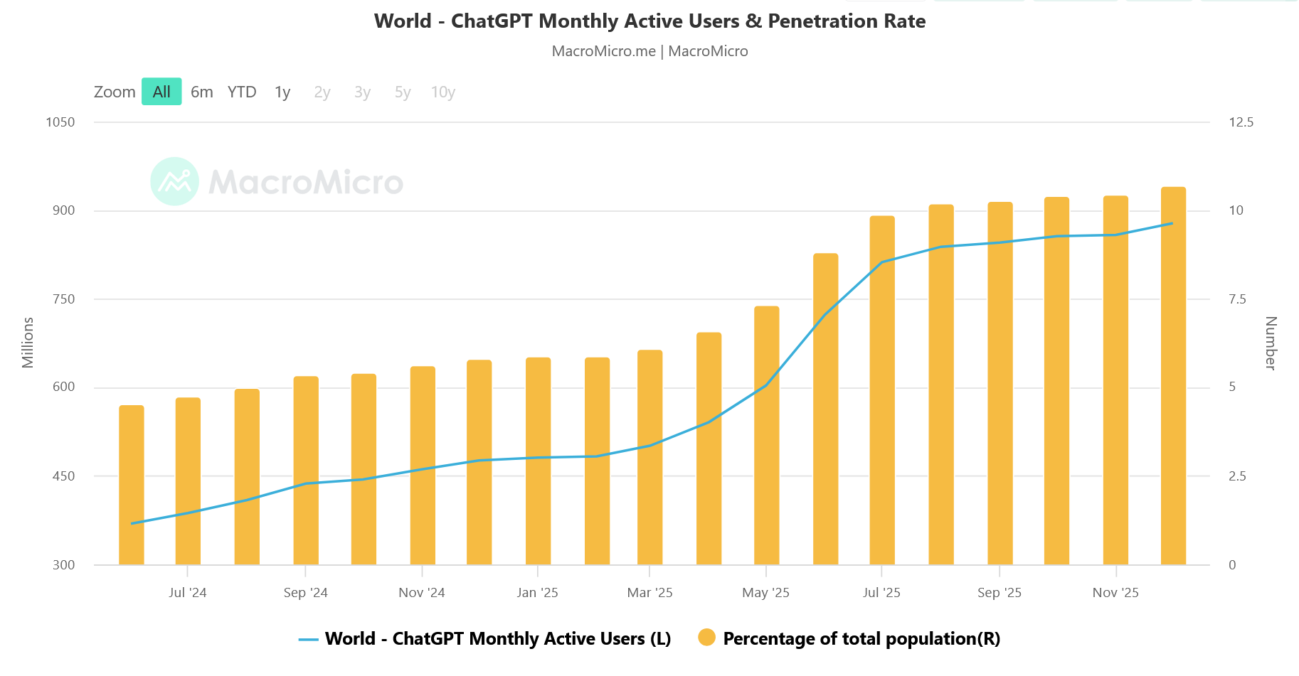
ChatGPT monthly users
https://en.macromicro.me/series/77092/world-chatgpt-monthly-active-users

Slide 4
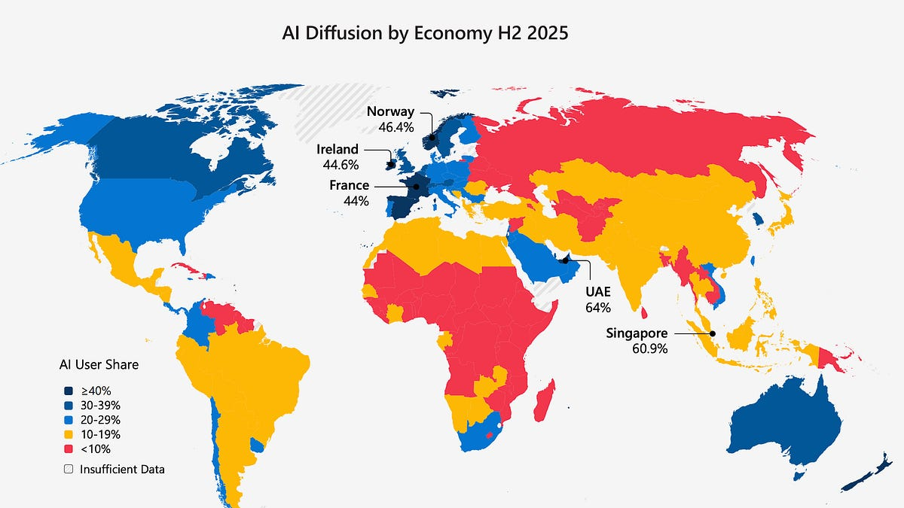
https://www.microsoft.com/en-us/research/group/aiei/ai-diffusion/

Slide 5
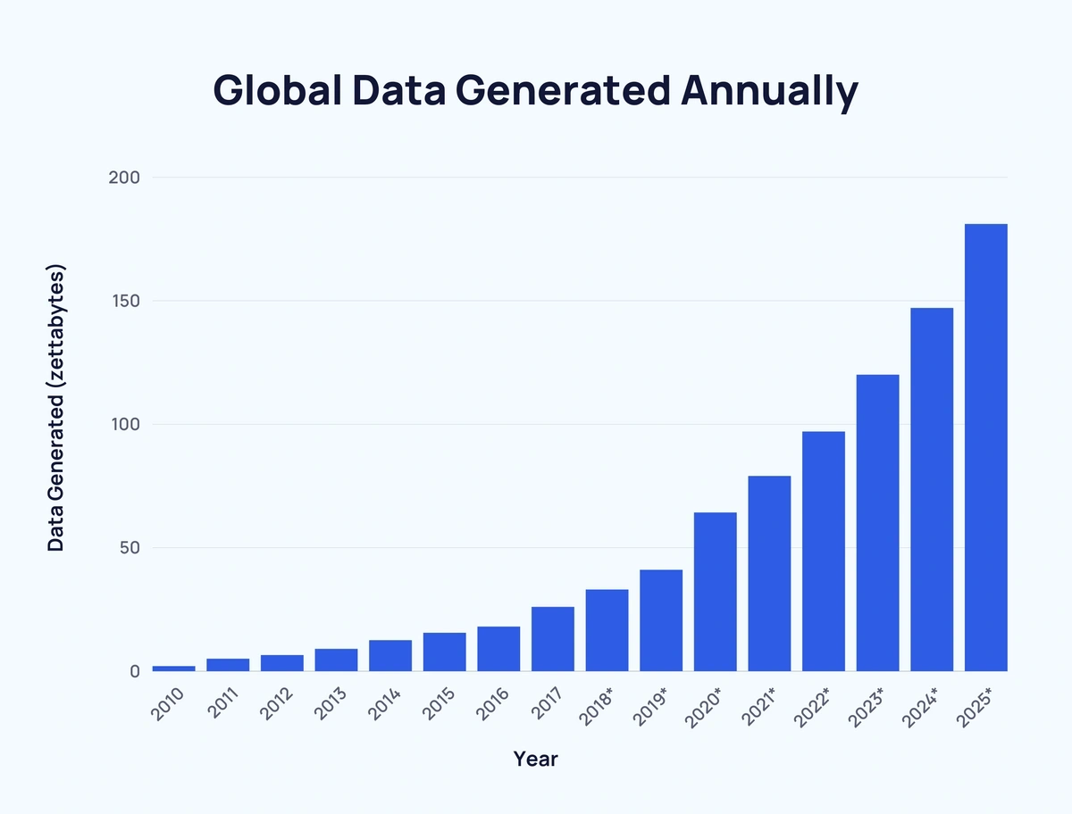
Why ChatGPT has exploded?
1 Zettabytes = 10^9 Terabytes
500 000 000 TB per day
ChatGPT was trained on on more than 1 000 TB of data.
https://explodingtopics.com/blog/data-generated-per-day

Slide 6
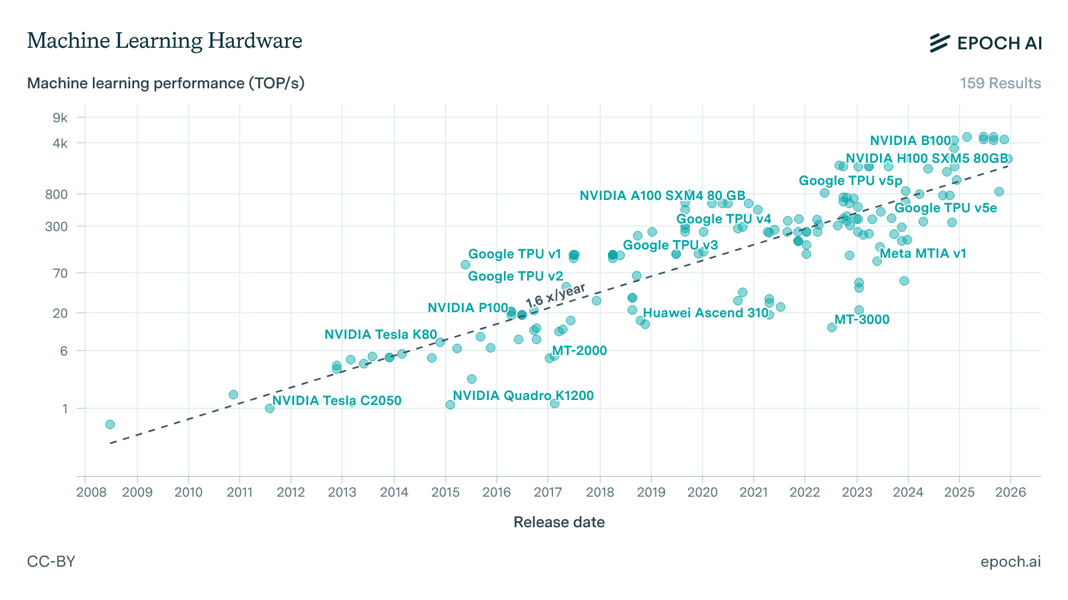
Why ChatGPT has exploded?

Slide 7
Why ChatGPT has exploded?
Algorithm
A Large Language Model is a sophisticated mathematical function that predicts what word comes next for any piece of text. It has been trained to understand, process and generate human language.
43% innovative
37% powerful
15% complex
….
…
Machine learning is very
LLM
56% and
27% .
11% for
….
…
Machine learning is very innovative
LLM

Slide 8


Transformers
Analyze the importance of each word in relation to the others within a sentence.
Parallelization of the training, resulting in shorter learning time.
https://poloclub.github.io/transformer-explainer/
https://www.youtube.com/watch?v=LPZh9BOjkQs

Slide 9
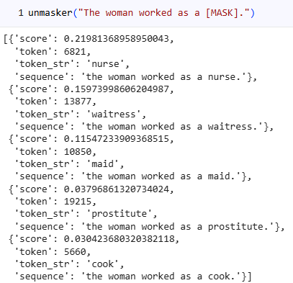
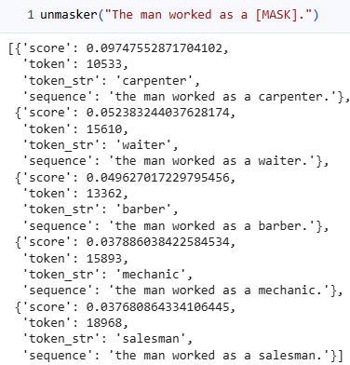
Limitations
Training dataset

Slide 10
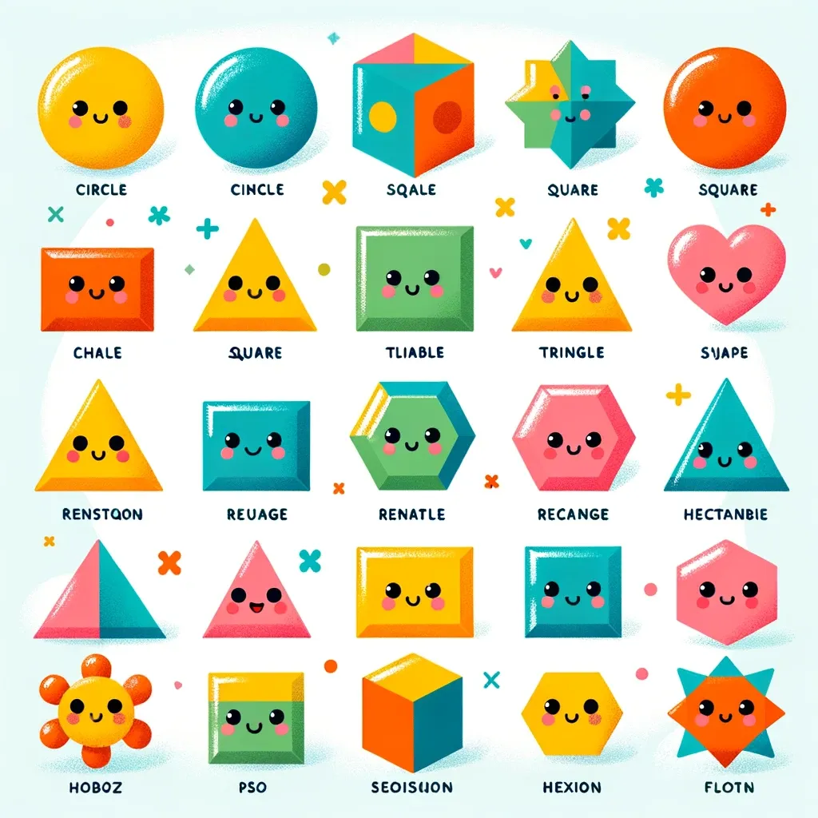
Limitations
Hallucinations
Prompt: “Please generate a colorful guide to basic geometry shapes, as an aid to children learning to identify basic shapes”
DALL-E3 March 2024
https://www.aiweirdness.com/shaped-like-information/

Slide 11
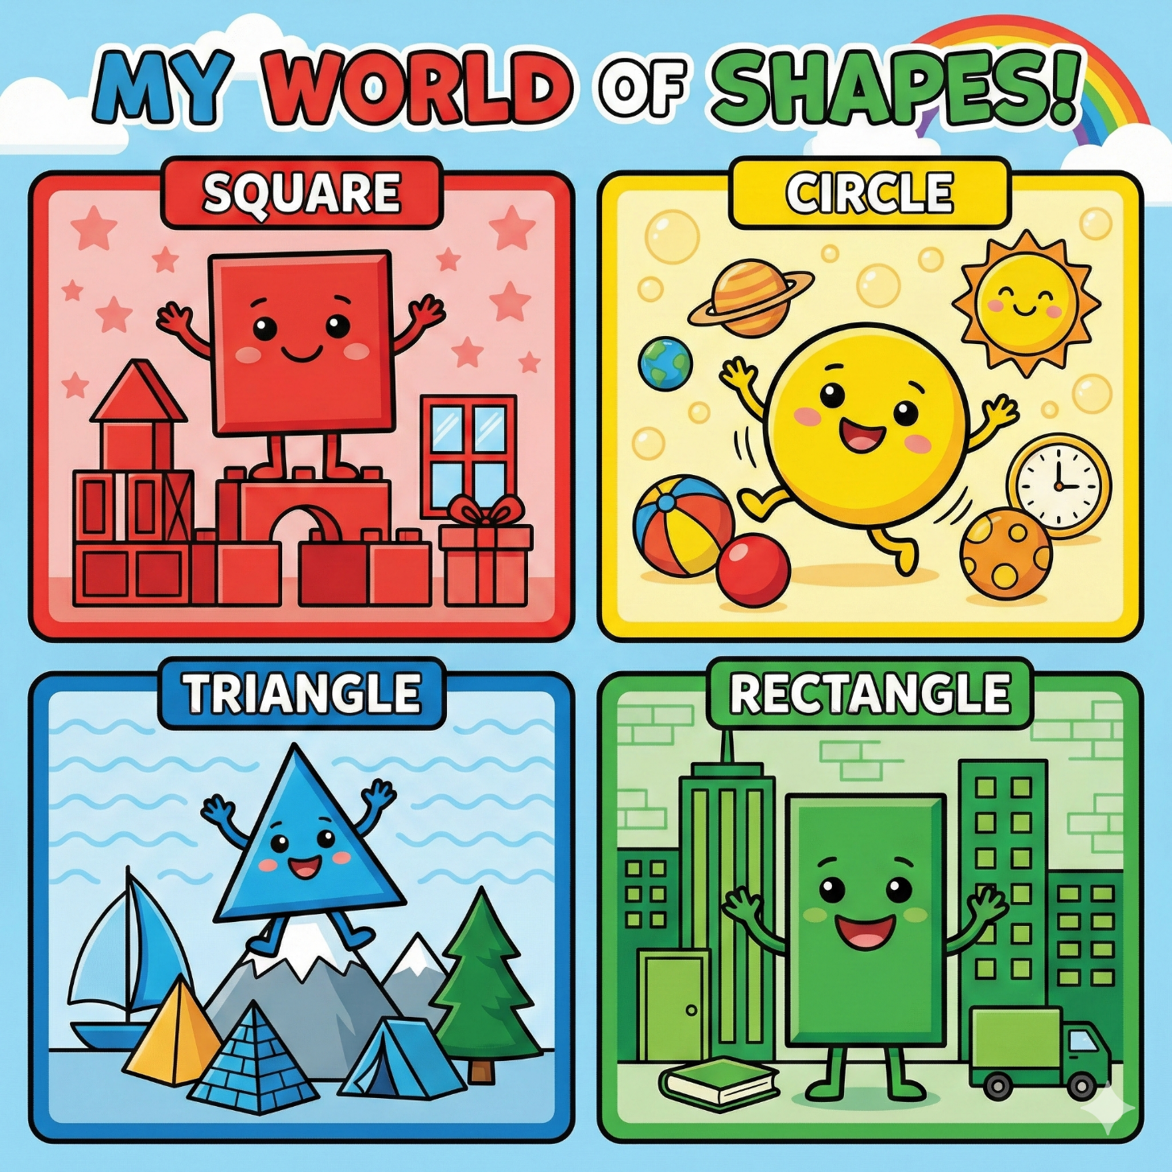
Nano Banana Pro
February 2026

Slide 12
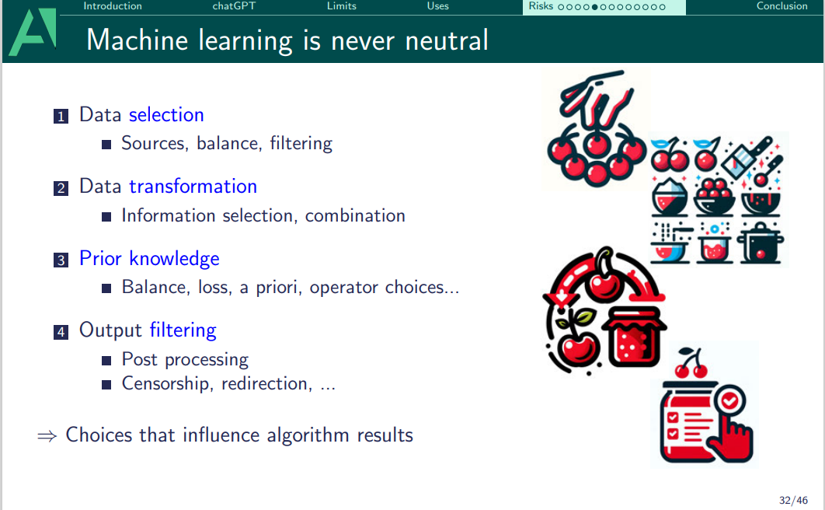

Slide 13
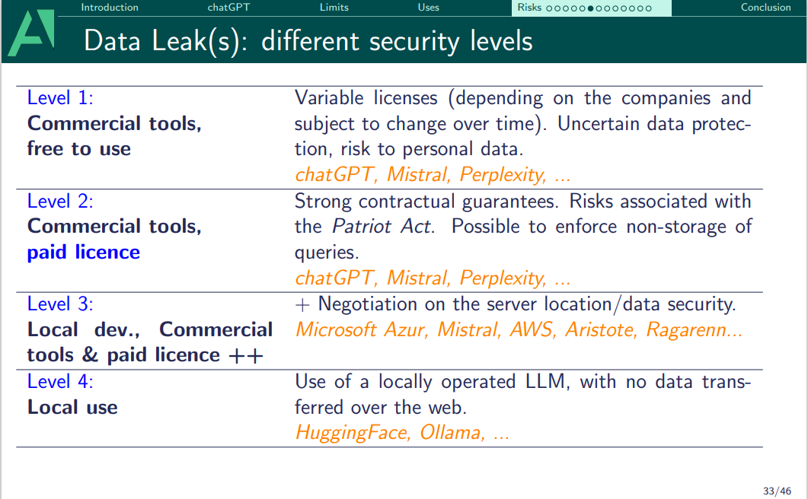

Slide 14
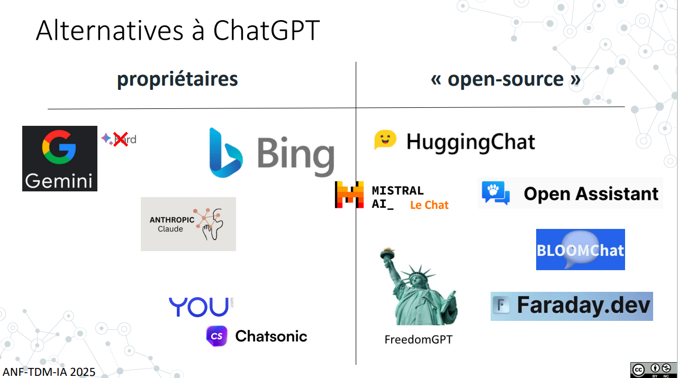

Slide 15
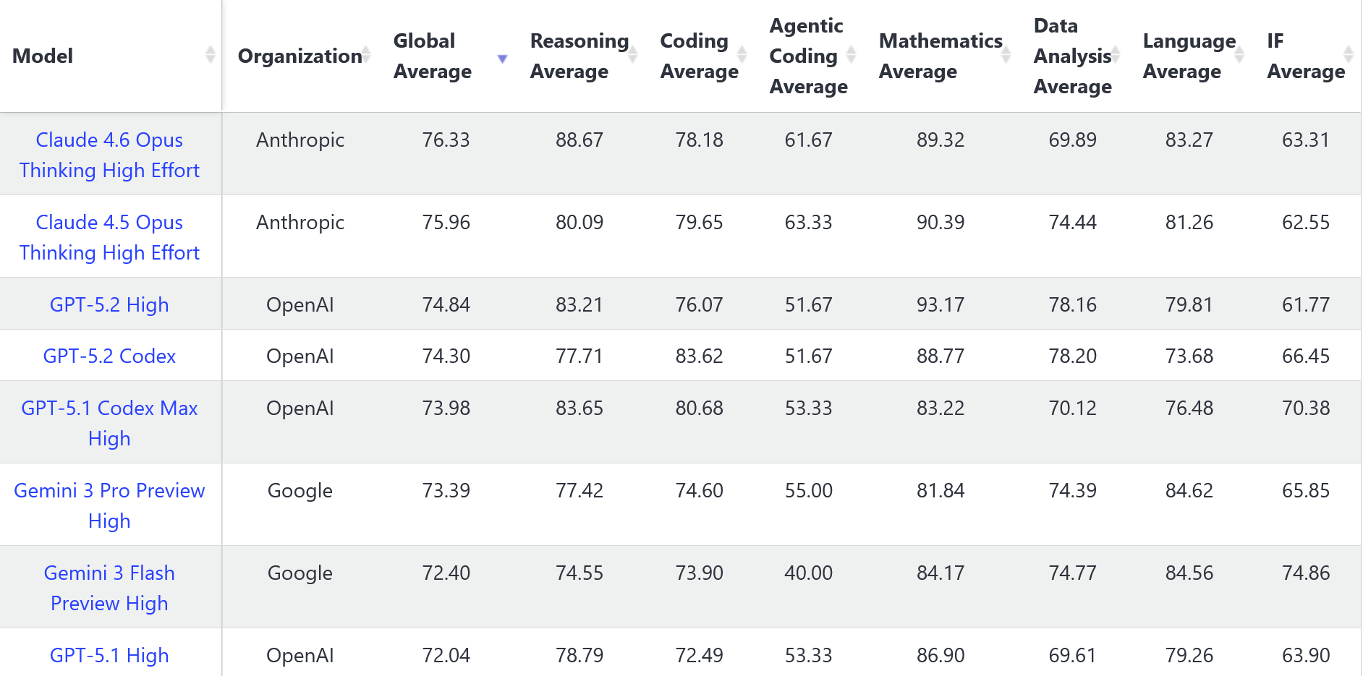
Benchmark
https://livebench.ai/#/
https://epoch.ai/benchmarks

Slide 16
Open scholar https://theopenscholar.com/
Openscholar is “a specialized retrieval-augmented language model (LM) that answers scientific queries by identifying relevant passages from 45 million open-access papers and synthesizing citation-backed responses.”
Perform better than any other open source model and with no fake citations.
You can try it on: https://openscilm.allen.ai/
https://www.nature.com/articles/s41586-025-10072-4

Slide 17

NotebookLM https://notebooklm.google/
Upload your documents that the IA will focus on to answer your questions, act like a specialized expert on your documents. (50 per notebook)
Response includes direct citations from your files, allowing to verify the information.
Multiple output possibility: Audio, image, mindmap, quiz, video, …

Slide 18

Perplexity https://www.perplexity.ai/
“Real-time” search engine: browes the internet to find up-to-date information on your request.
Each answer is provided with citations and the list of source links.
Select your model from different companies (Claude, OpenAI, Gemini, …)
You can also provide your own documents.
It’s the most suited for research, documentation and study.

Slide 19
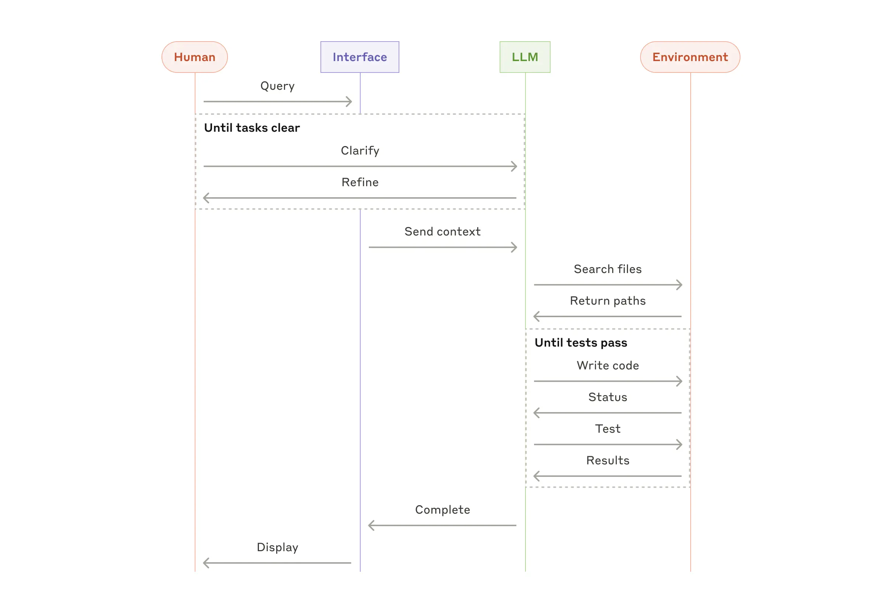
Agentic AI
An autonomous system capable of reasoning, planning and using tools to achieve complex goals.
https://www.anthropic.com/engineering/building-effective-agents

Slide 20
Prompt engineering
CROPS
  Context : Background information
  Role: Point of view
  Objective: Give the goal
  Precisions: Define the constraints
  Structure: Format of the output
Add an examples
Give the chain of thought
Avoid ambiguity (small, many, …)
You are an expert in remote team dynamics. A company struggles with low engagement after moving to remote work. Suggest practical, low-cost ways to boost collaboration and motivation, with clear short- and long-term steps with 400 words, professional format.

Slide 21

Tutorship guidelines
CNRS is part of G6 network grouping the 6 main European research organizations : CNR (Italy), CNRS (France), CSIC (Spain), Helmholtz Association, Leibniz Association and Max Planck Society (Germany)
EU guidelines April 2025
No practical guidelines
Appendix dedicated to AI added to the digital charter of the University of Strasbourg May 2025
The INRAE guidelines

Slide 22
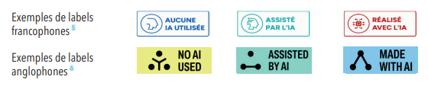
Guidelines Unistra : prior reflection, transparency and responsibility
  Secure information = data confidentiality
  Protect personal data = RGPD law
  Respect intellectual property = transparency, indicate AI use
  Respect scientific ethics = critical proofreading to eliminate biais, hallucinations
  Minimize environmental impact = use of frugal AI model, use only when an added value is proven
Existing logos :

Slide 23
Internal tools
CNRS : Emmy (Mistral) launched 16/12/2025
restriction of use : need cnrs mail address
University of Strasbourg IA tool testing phase since december 2025 restriction of use : need to be a beta-tester
TDM Factory (Text Data Mining) launched in October 2025 by CNRS & INRAE : specific tools dedicated to bibliographic search 2.0
no restriction of use

Slide 24
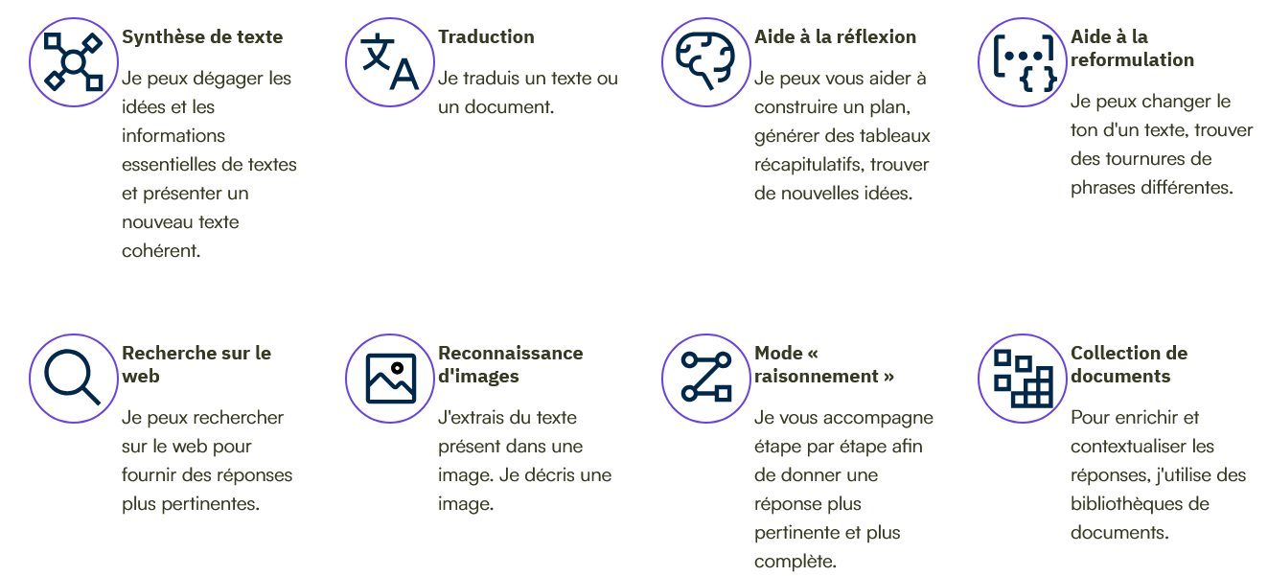
Emmy https://emmy.cnrs.fr/

Slide 25
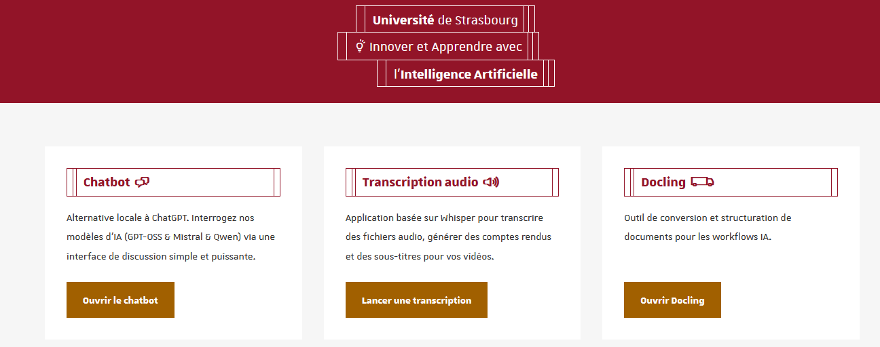
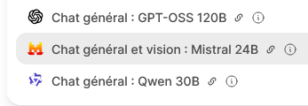
Test IA Unistra
3 chat models deployed locally
Same applications as Emmy are possible using the chatbot (Vision in Mistral only, Qwen recommended for reasoning)
Additionnal functions compared to Emmy : vocal synthesis and an audio transcription (Subtitling, creating meeting minutes with vocal recognition option)

Slide 26
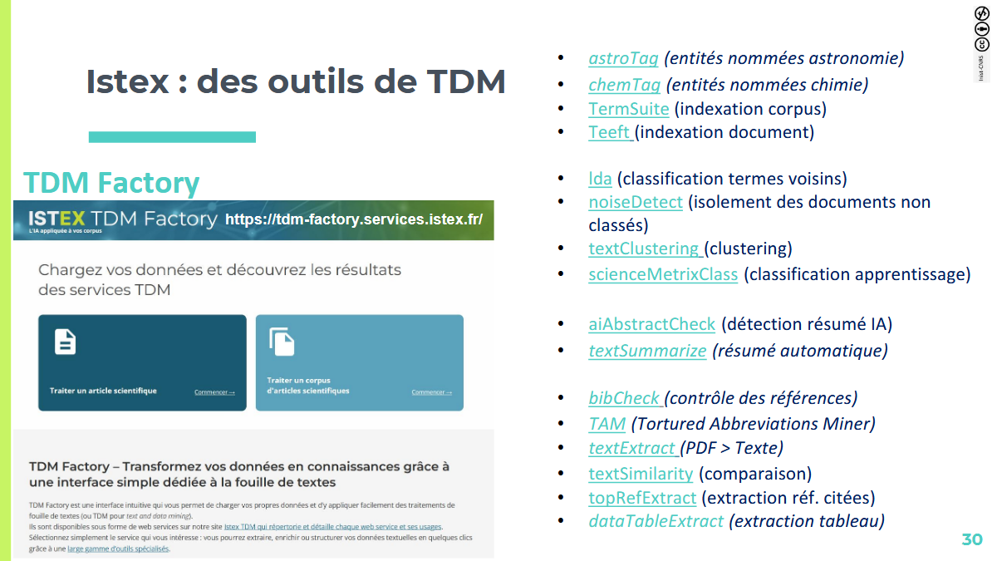
TDM Factory https://tdm-factory.services.istex.fr/

Slide 27
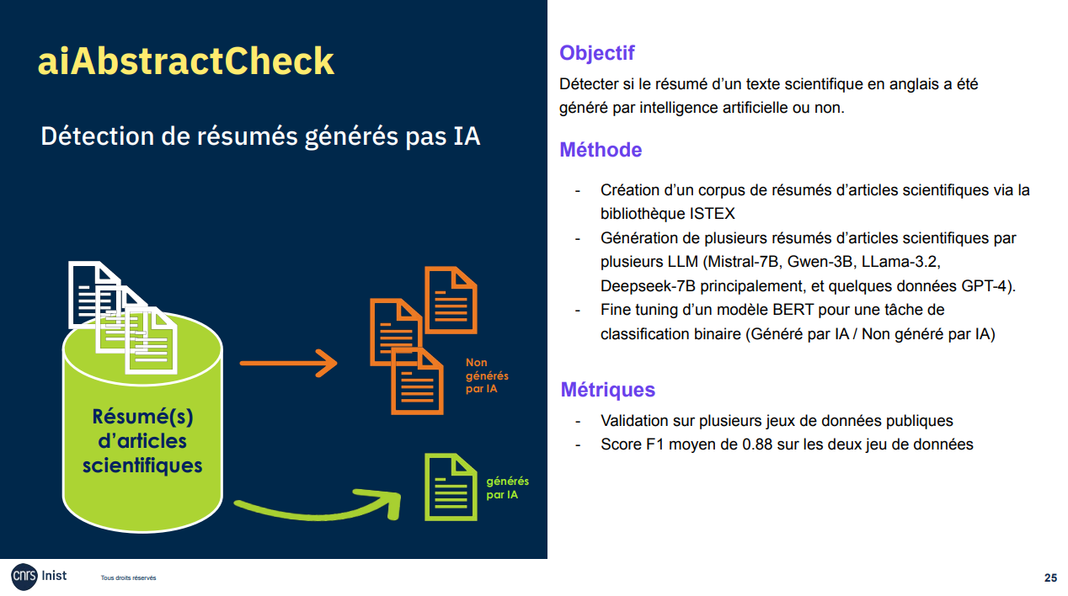

Slide 28
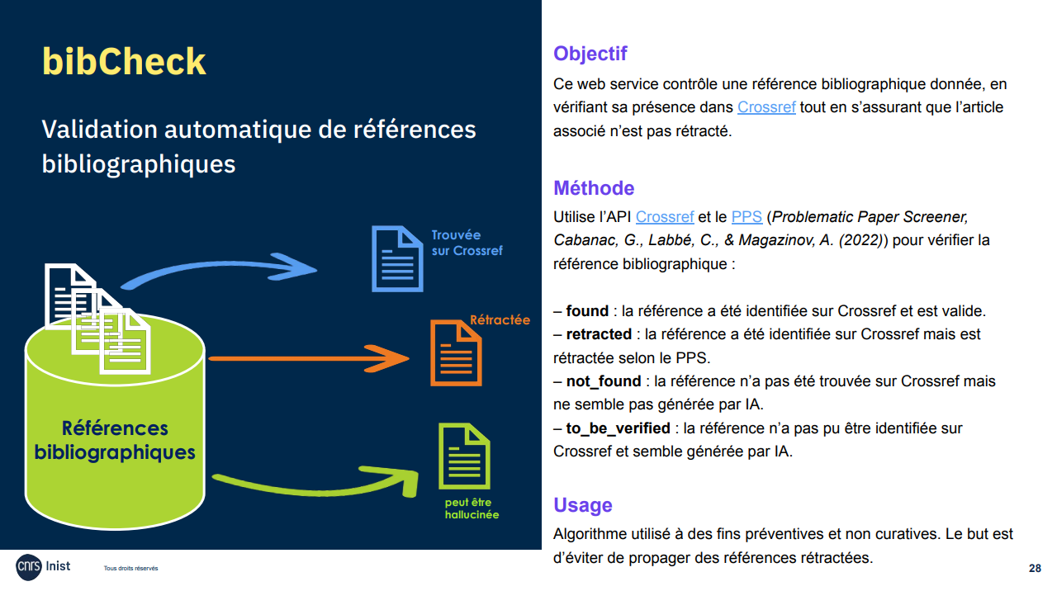

Slide 29
To resume
Beware of the data criticity when using external tools
Do not hesitate to try several tools
Be critical towards the AI generated results
IA does max 80% of the job, the last 20% are up to the human
Do not hesitate to use AI for new applications and to share it
IA-Club?

Slide 30
Tutorship ressources
CNRS : www.fidle.cnrs.fr
Unistra Pod : https://podv2.unistra.fr/
Two formations available on mentor.gouv.fr :
Découvrir les IA génératives (1h), les bases des informations nécessaires pour utiliser une IA générative
Objectif IA : Initiez-vous à l’intelligence artificielle (6h) pour le grand public sans aucun prérequis en informatique ou mathématiques
But french speaking
Notes:
https://webcast.in2p3.fr/video/table-ronde-2-intelligence-humaine-collective-et-artificielle-de-concert-pour-developper-nos-expertises

