Slide 1

CompOmics: Proteomics Informatics from A(I) to Z(witterion)
15/04/2026

Slide 2
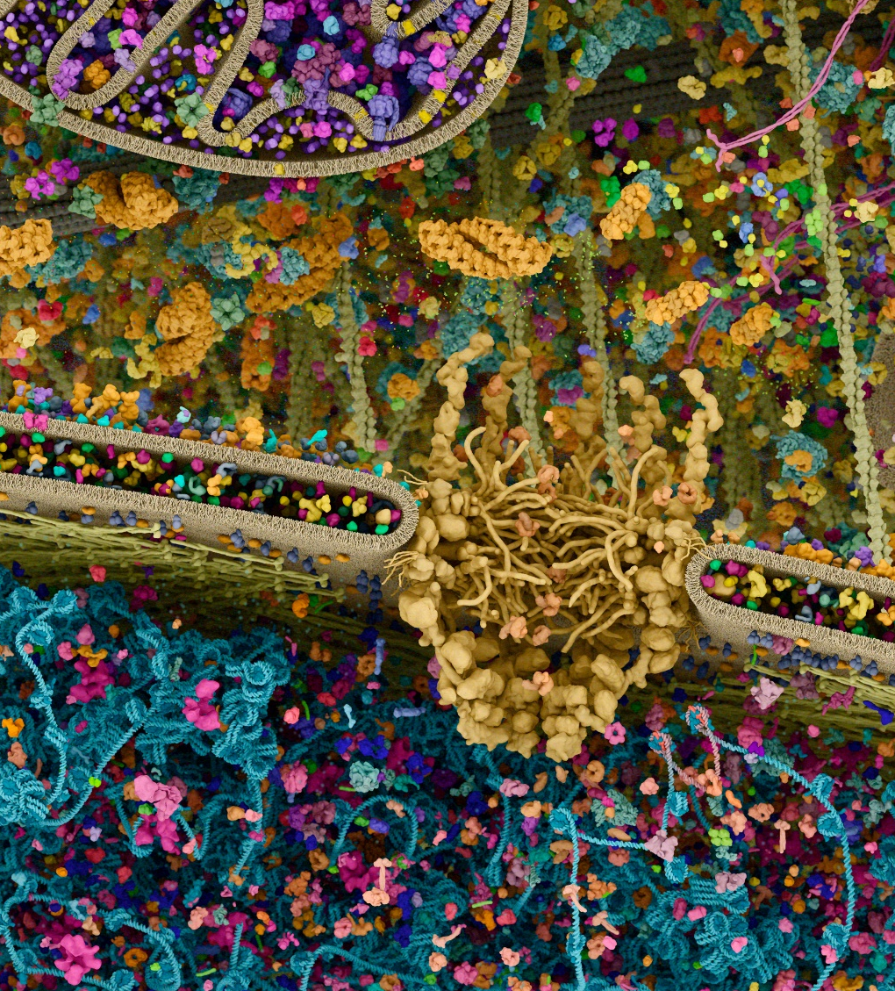
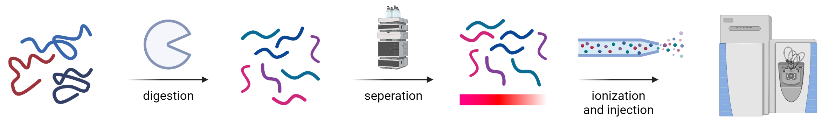

From biological research questions to data, identification + quantification, and biological insights
Identification
+
Quantification
Digizyme - Knowledge Through Visual Science
$$t_{R}$$

Slide 3
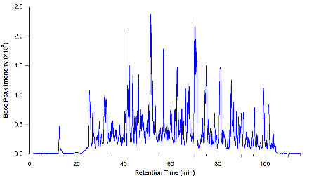
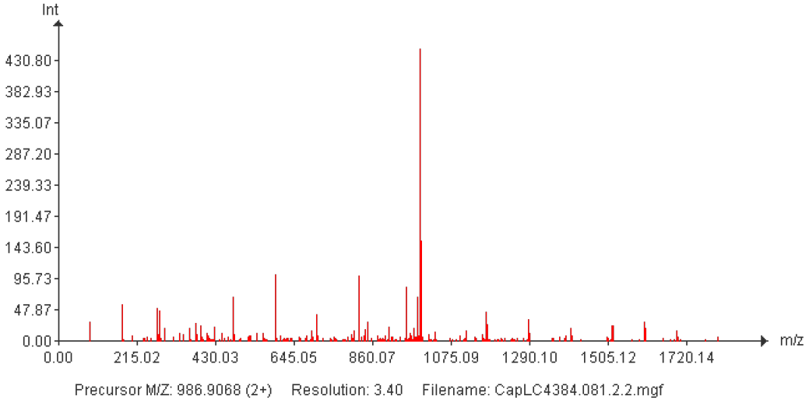


MS-based proteomics from data to identification & quantification
experimental
HPYLEDR
LC
TIMS
MS scan
fragmentation
GDLVLFDR
AAAAGSLDK
$$t_{D}$$
peptides
chromatogram
mobilogram
MS1
MS2
Identification
Quantification
+
$$t_{R}$$

Slide 4
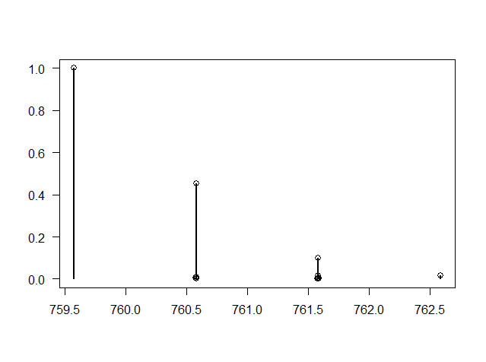
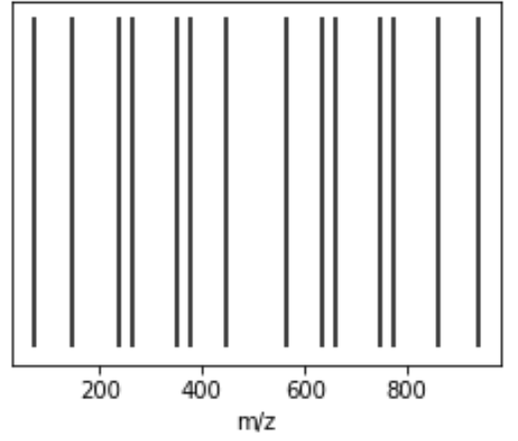
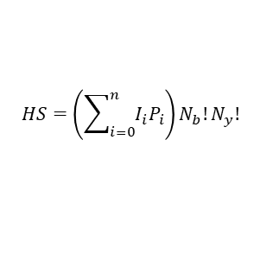
MS-based proteomics from data to identification & quantification
experimental
HPYLEDR
LC
TIMS
MS scan
fragmentation
GDLVLFDR
AAAAGSLDK
$$t_{D}$$
peptides
chromatogram
mobilogram
MS1
MS2
Scoring function
Identification
Quantification
$$HS=\left(\sum_{i=0}^{n}{I_{i}P_{i}}\right)N_{b}!N_{y}!$$
+
in silico
$$t_{R}$$
m/z
calculate
mass
in silico
MS/MS
m/z
theoretical
spectra
fasta
database
precursor mass
(and isotopic distribution)

Slide 5

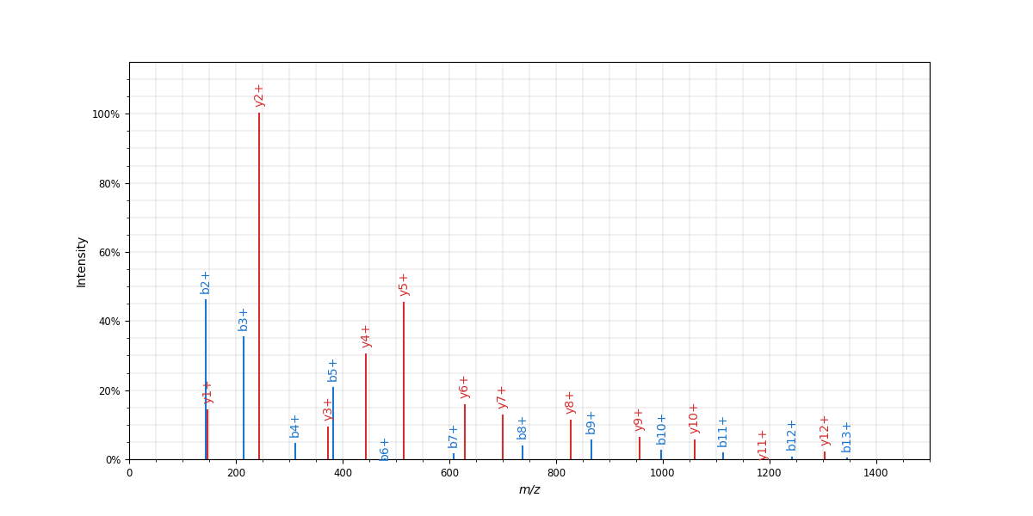






Predicted behavior for better in silico representation of the signal
experimental
HPYLEDR
LC
TIMS
MS scan
fragmentation
GDLVLFDR
AAAAGSLDK
$$t_{D}$$
peptides
chromatogram
mobilogram
MS1
MS2
Scoring function
Identification
Quantification
+
in silico
$$t_{R}$$
m/z
Predict $t_{R}$
m/z
Predict mobility
m/z
calculate
mass
in silico
MS/MS
m/z
$$t_{R}$$
$$t_{R}$$
$$t_{R}$$
$$t_{D}$$
$$t_{D}$$
Int.
m/z
theoretical
spectra
fasta
database
precursor mass
(and isotopic distribution)

Slide 6
Predicted behavior for better in silico representation of the signal
experimental
HPYLEDR
LC
TIMS
MS scan
fragmentation
GDLVLFDR
AAAAGSLDK
$$t_{D}$$
peptides
chromatogram
mobilogram
MS1
MS2
Scoring function
Identification
Quantification
+
in silico
$$t_{R}$$
m/z
Predict $t_{R}$
m/z
Predict mobility
m/z
calculate
mass
in silico
MS/MS
m/z
$$t_{R}$$
$$t_{R}$$
$$t_{R}$$
$$t_{D}$$
$$t_{D}$$
Int.
m/z
theoretical
spectra
fasta
database
precursor mass
(and isotopic distribution)

Slide 7
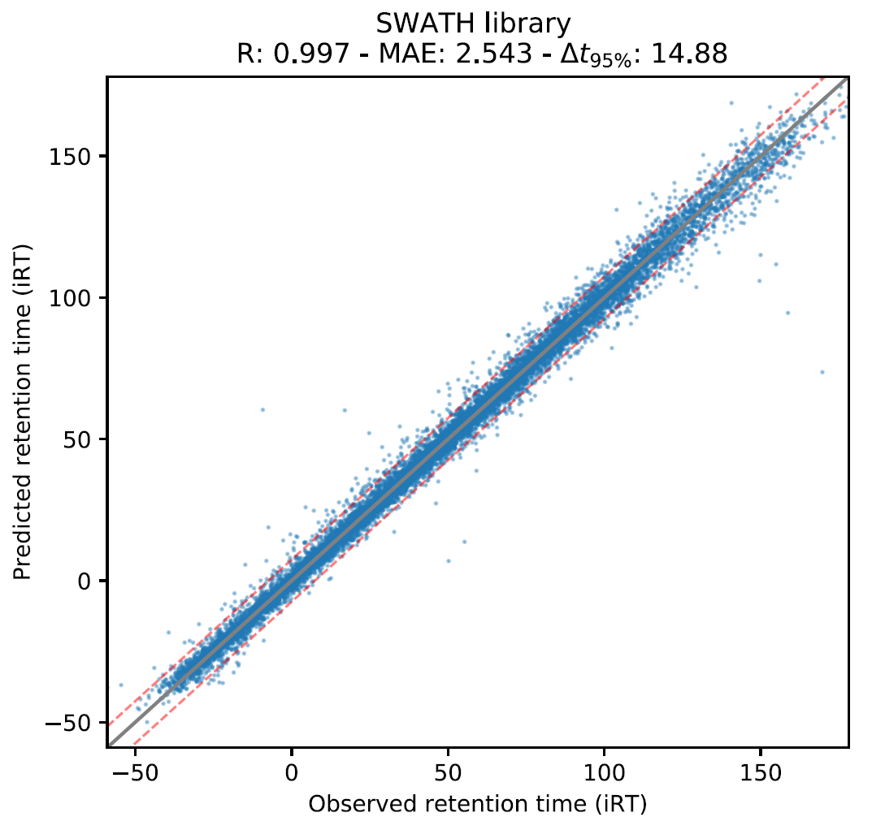
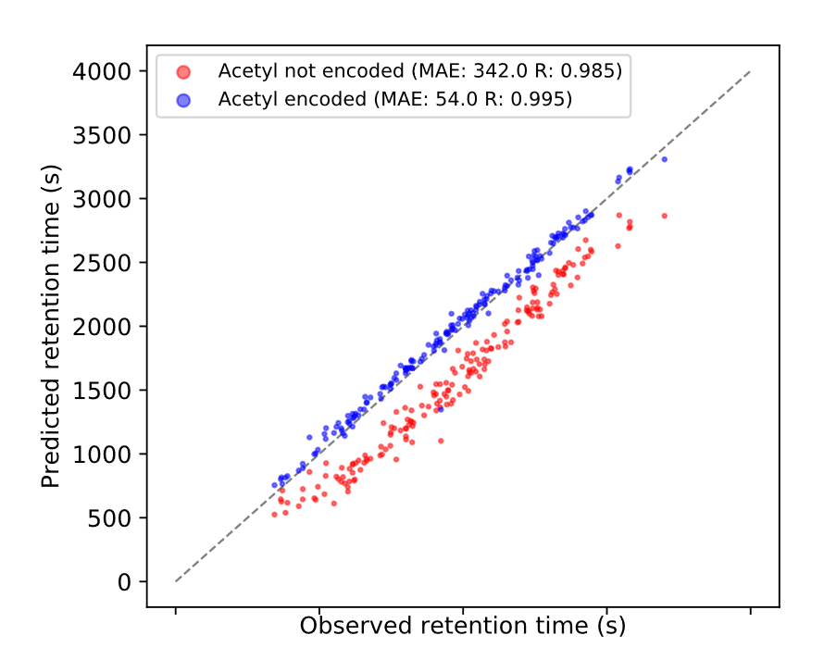
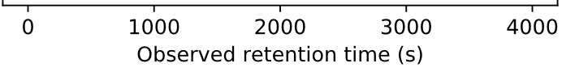
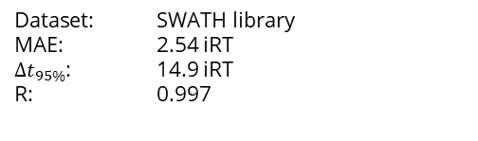
DeepLC can accurately predict retention times of (modified) peptides; more than just a retention time shift
Dataset: SWATH library
MAE: 2.54 iRT
${∆t}_{95\%}$: 14.9 iRT
R: 0.997
Acetyl traditional
Acetyl DeepLC
Bouwmeester et al. Nature Methods (2021)

Slide 8
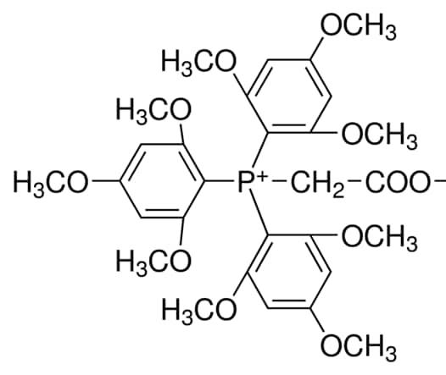

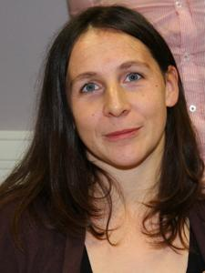
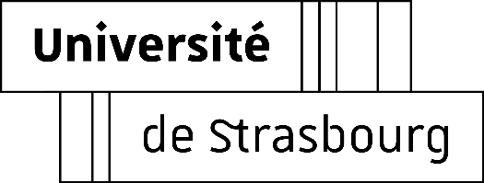
Transfer learning for TMPP labels shows the potential for modifications very different from previous training data
(tris(trimethoxyphenyl)phosphine)-labels
Christine Carapito
Magali Rompais
Train new model
Calibration
Transfer learning
MAE: 1.51
95th perc.: 7.67
R: 0.839
MAE: 0.87
95th perc.: 5.13
R: 0.941
MAE: 0.26
95th perc.: 1.39
R: 0.995

Slide 9
Predicted behavior for better in silico representation of the signal
experimental
HPYLEDR
LC
TIMS
MS scan
fragmentation
GDLVLFDR
AAAAGSLDK
$$t_{D}$$
peptides
chromatogram
mobilogram
MS1
MS2
Scoring function
Identification
Quantification
+
in silico
$$t_{R}$$
m/z
Predict $t_{R}$
m/z
Predict mobility
m/z
calculate
mass
in silico
MS/MS
m/z
$$t_{R}$$
$$t_{R}$$
$$t_{R}$$
$$t_{D}$$
$$t_{D}$$
Int.
m/z
theoretical
spectra
fasta
database
precursor mass
(and isotopic distribution)

Slide 10

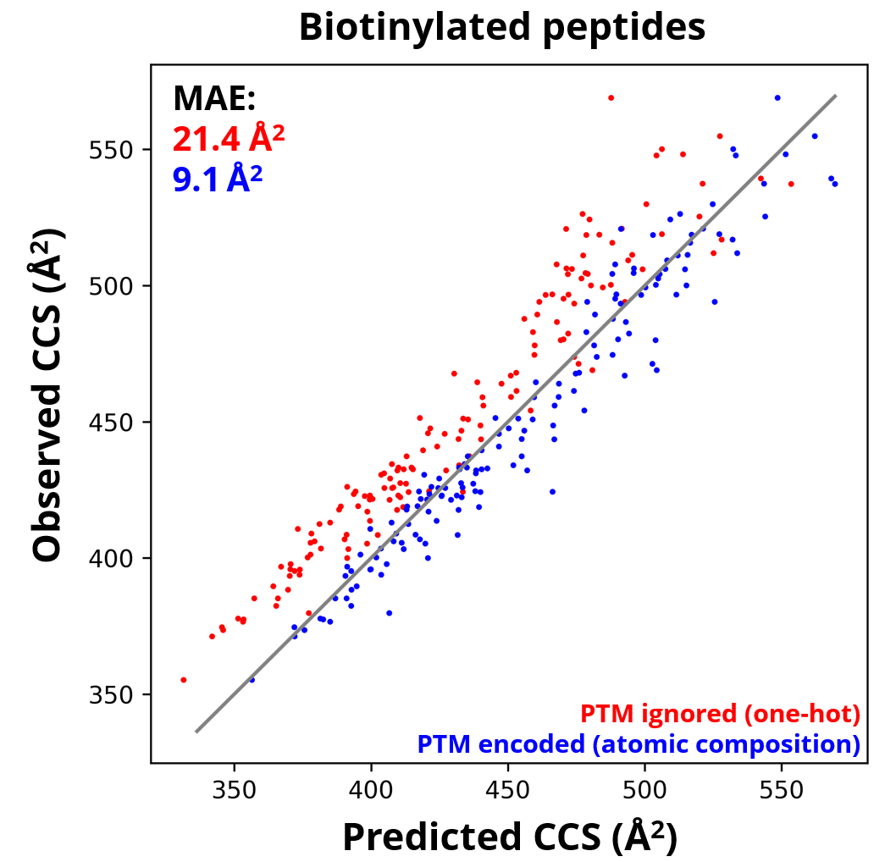
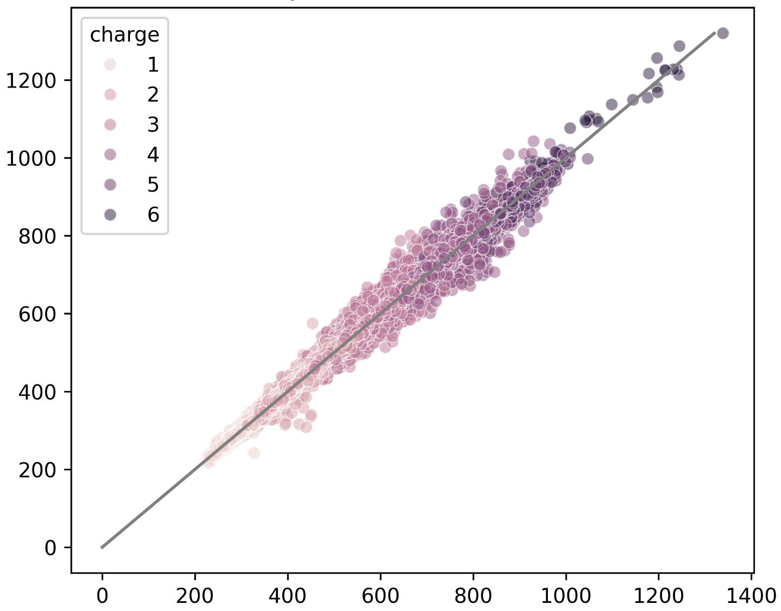
Encoding modified peptides by their atomic composition allows accurate CCS predictions for PTMs
Charge
+1
+2
+3
+4
+5
+6
Observed CCS (Å²)
Overall performance
MAE: 6.26 Å²
MRE: 0.91%
R: 0.996
Predicted CCS (Å²)
Declercq*, Devreese* et al. (2024) bioRXiv. doi:10.1101/2024.05.29.596400

Slide 11
Predicted behavior for better in silico representation of the signal
experimental
HPYLEDR
LC
TIMS
MS scan
fragmentation
GDLVLFDR
AAAAGSLDK
$$t_{D}$$
peptides
chromatogram
mobilogram
MS1
MS2
Scoring function
Identification
Quantification
+
in silico
$$t_{R}$$
m/z
Predict $t_{R}$
m/z
Predict mobility
m/z
calculate
mass
in silico
MS/MS
m/z
$$t_{R}$$
$$t_{R}$$
$$t_{R}$$
$$t_{D}$$
$$t_{D}$$
Int.
m/z
theoretical
spectra
fasta
database
precursor mass
(and isotopic distribution)

Slide 12
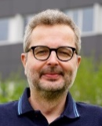


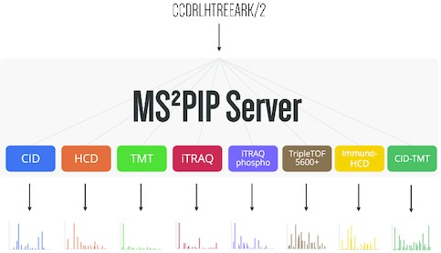
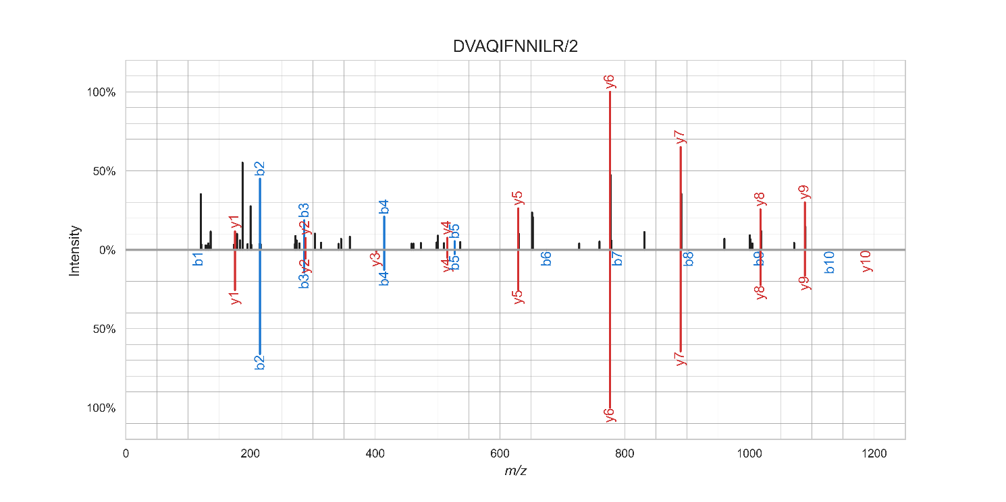
Our MS²PIP fragmentation models accurately predict peptide fragmentation behavior in varying conditions

Slide 13
Predicted behavior for better in silico representation of the signal
experimental
HPYLEDR
LC
TIMS
MS scan
fragmentation
GDLVLFDR
AAAAGSLDK
$$t_{D}$$
peptides
chromatogram
mobilogram
MS1
MS2
Scoring function
Identification
Quantification
+
in silico
$$t_{R}$$
m/z
Predict $t_{R}$
m/z
Predict mobility
m/z
calculate
mass
in silico
MS/MS
m/z
$$t_{R}$$
$$t_{R}$$
$$t_{R}$$
$$t_{D}$$
$$t_{D}$$
Int.
m/z
theoretical
spectra
fasta
database
precursor mass
(and isotopic distribution)

Slide 14


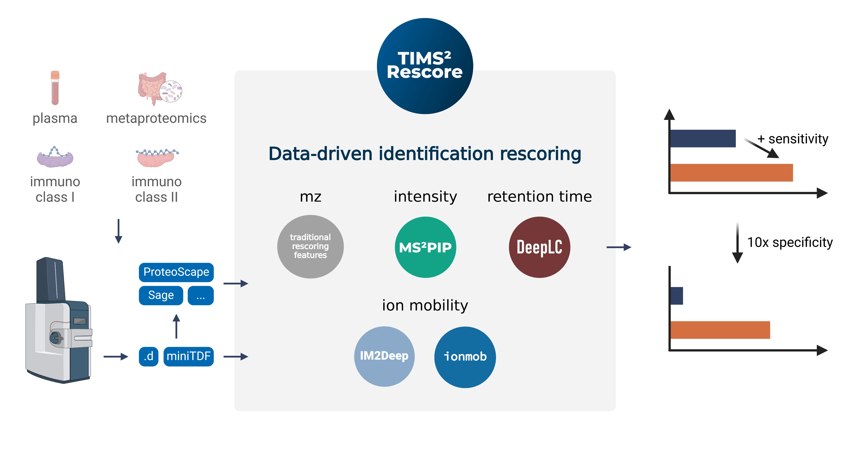
TIMS²Rescore combines the full workflow in
ProteoScape (and is also available as a Python package)

Slide 15
TIMS²Rescore combines the full workflow in
ProteoScape (and is also available as a Python package)

Slide 16
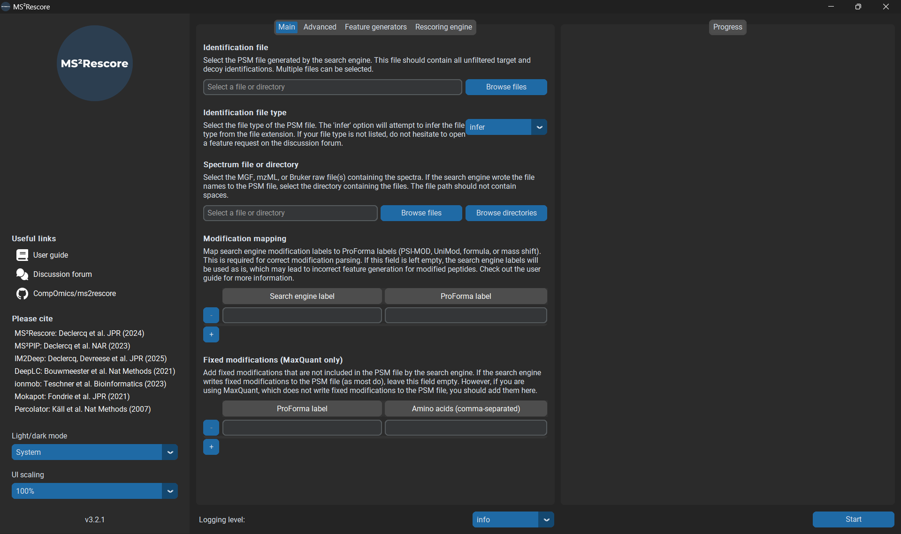
MS²Rescore is an open and freely available
(and is also available as a Python package)
https://github.com/compomics/ms2rescore

Slide 17
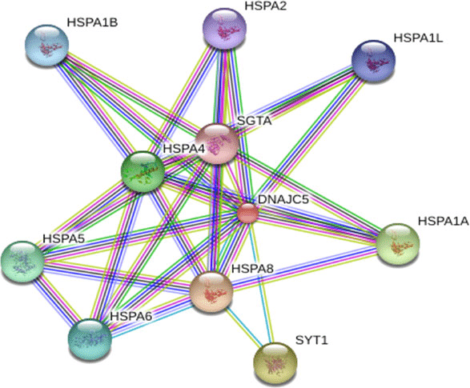
Networks or graphs to represent peptides; the next big thing in behavior prediction

Slide 18

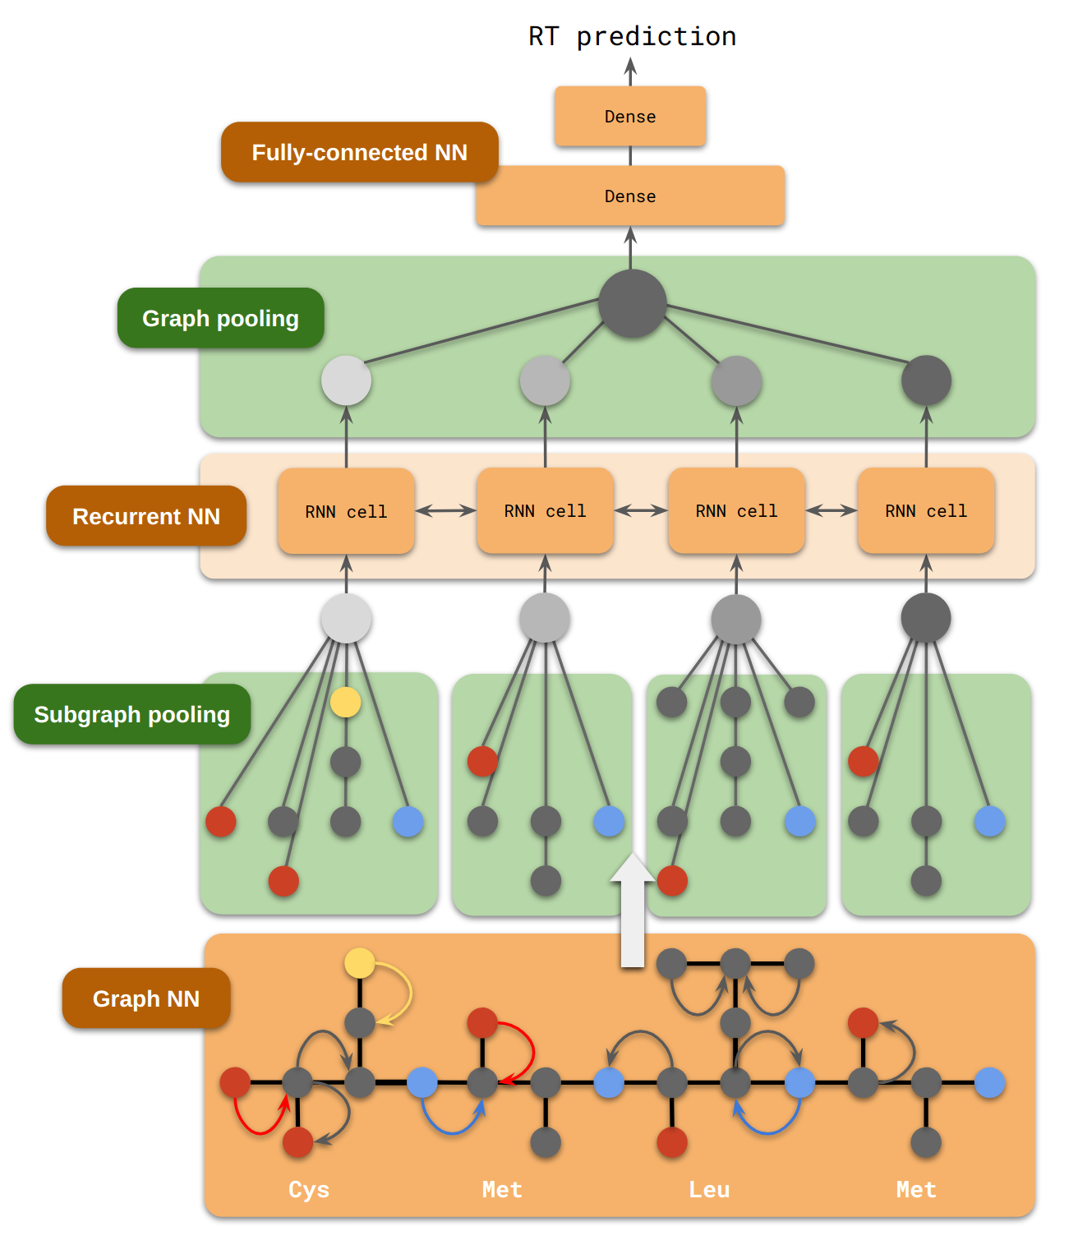
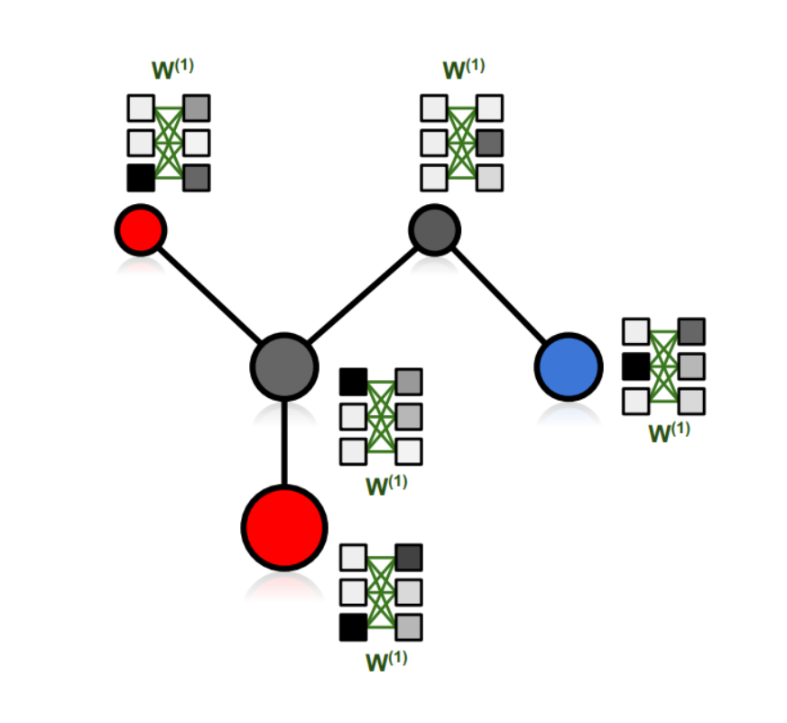
An improved representation with graph neural networks; respecting full structural impact
Alexander Kensert
Nodes
Edges

Slide 19
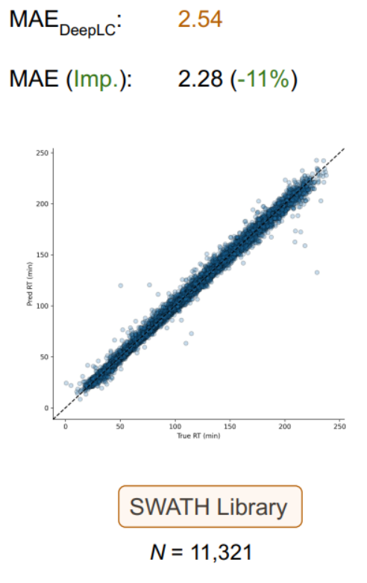
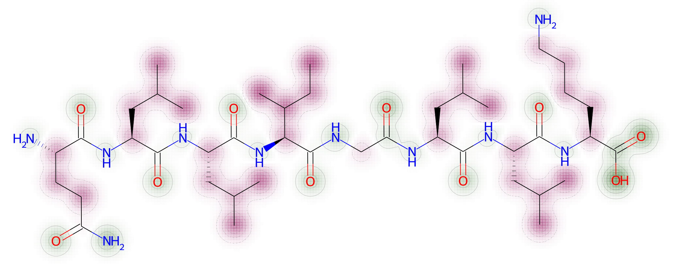
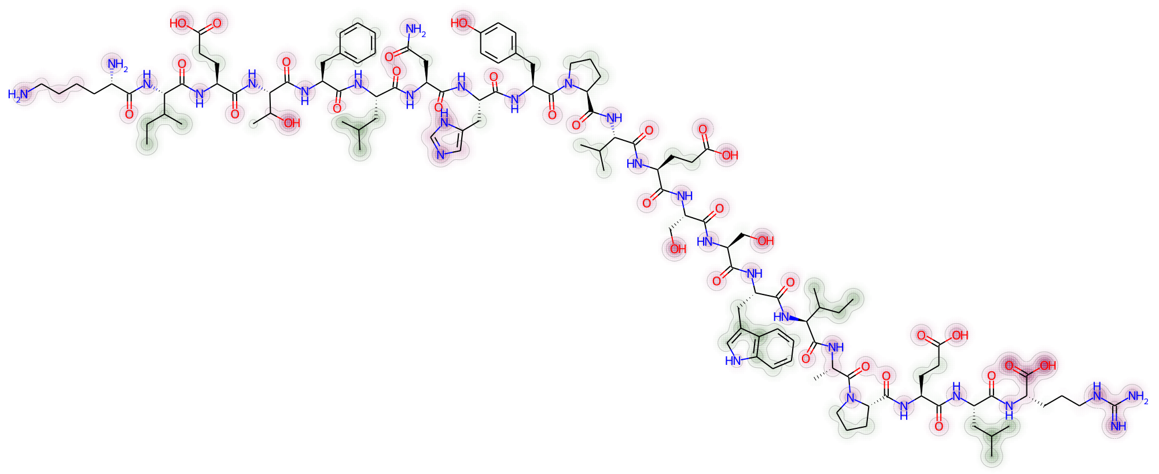
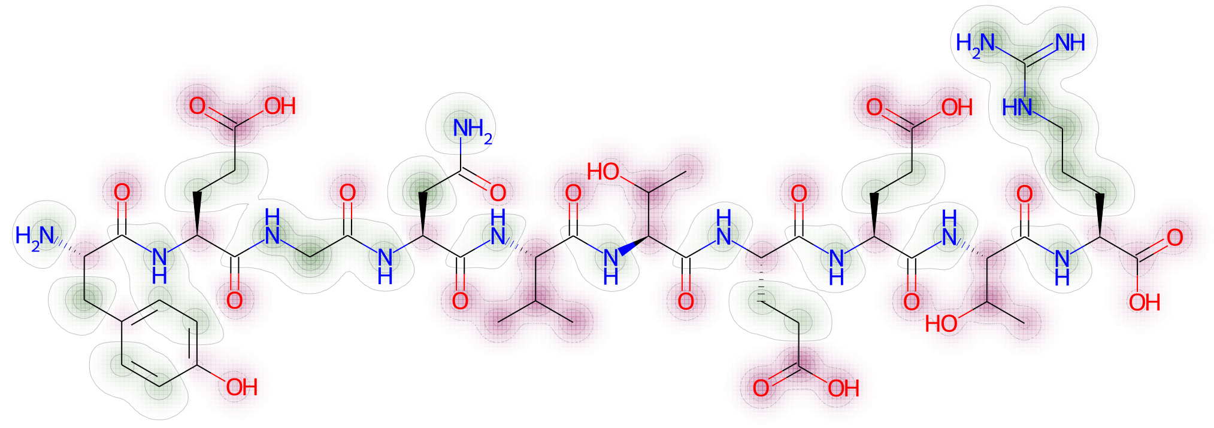
Graph representation slightly improves performance;
more importantly structure contribution interpretation
Alexander Kensert
Positive retention time contribution
Negative retention time contribution

Slide 20
Graph representation slightly improves performance; more importantly structure contribution interpretation
Alexander Kensert
Positive retention time contribution
Negative retention time contribution

Slide 21
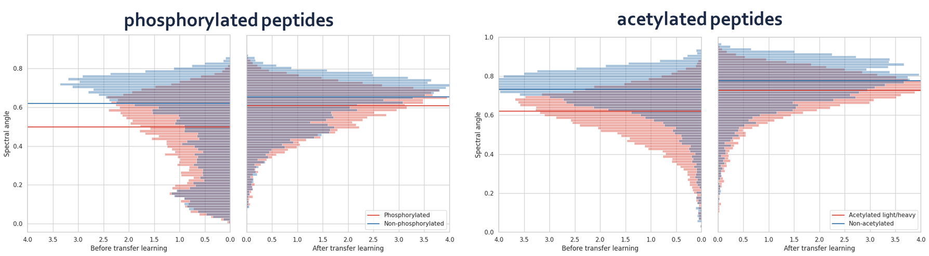
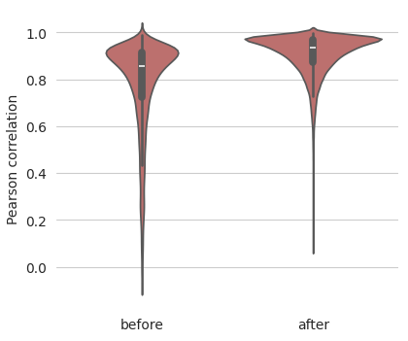
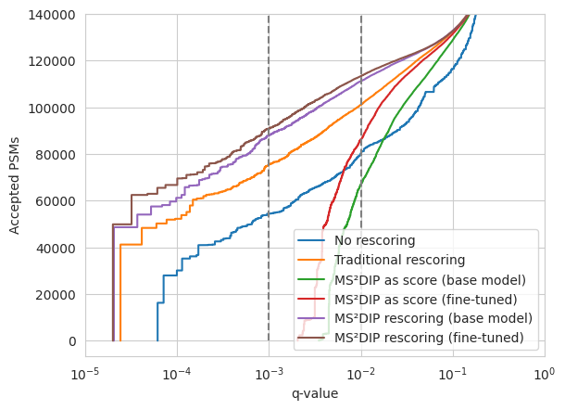
The GNNs also bring transfer learning capabilities, allowing these to adapt even better to diversity
Orbitrap Astral
Gabriels, in preparation

Slide 22
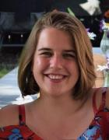




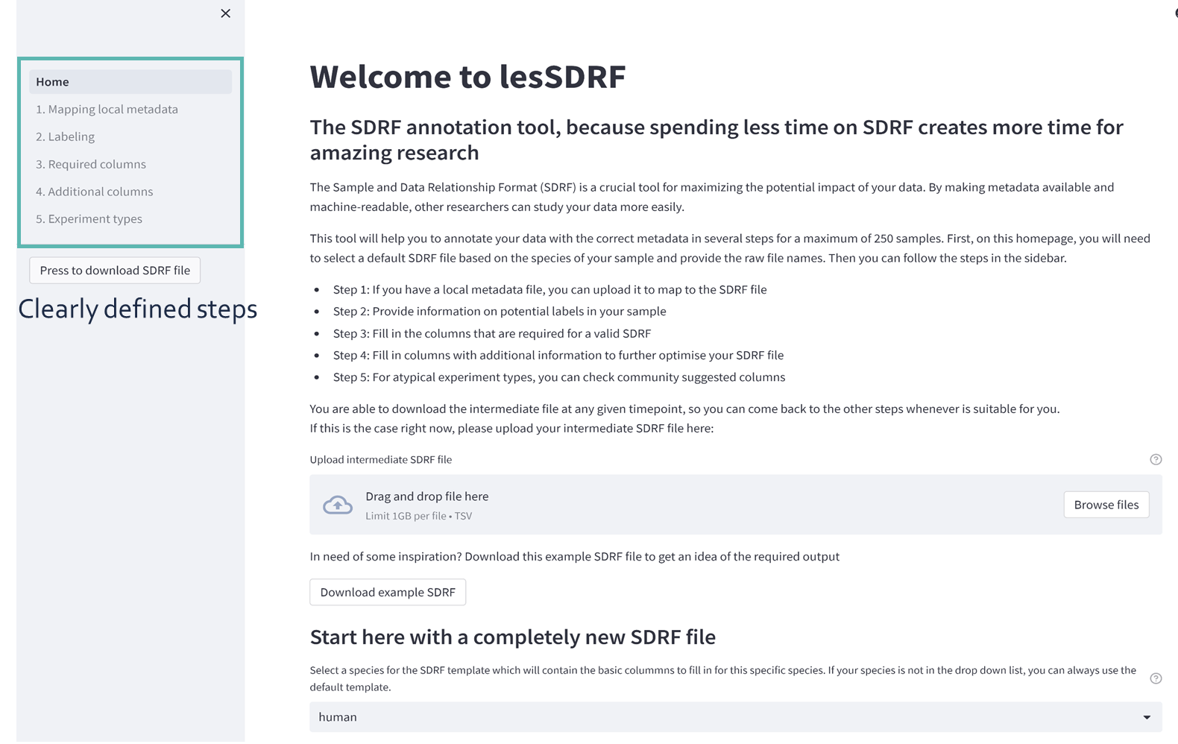

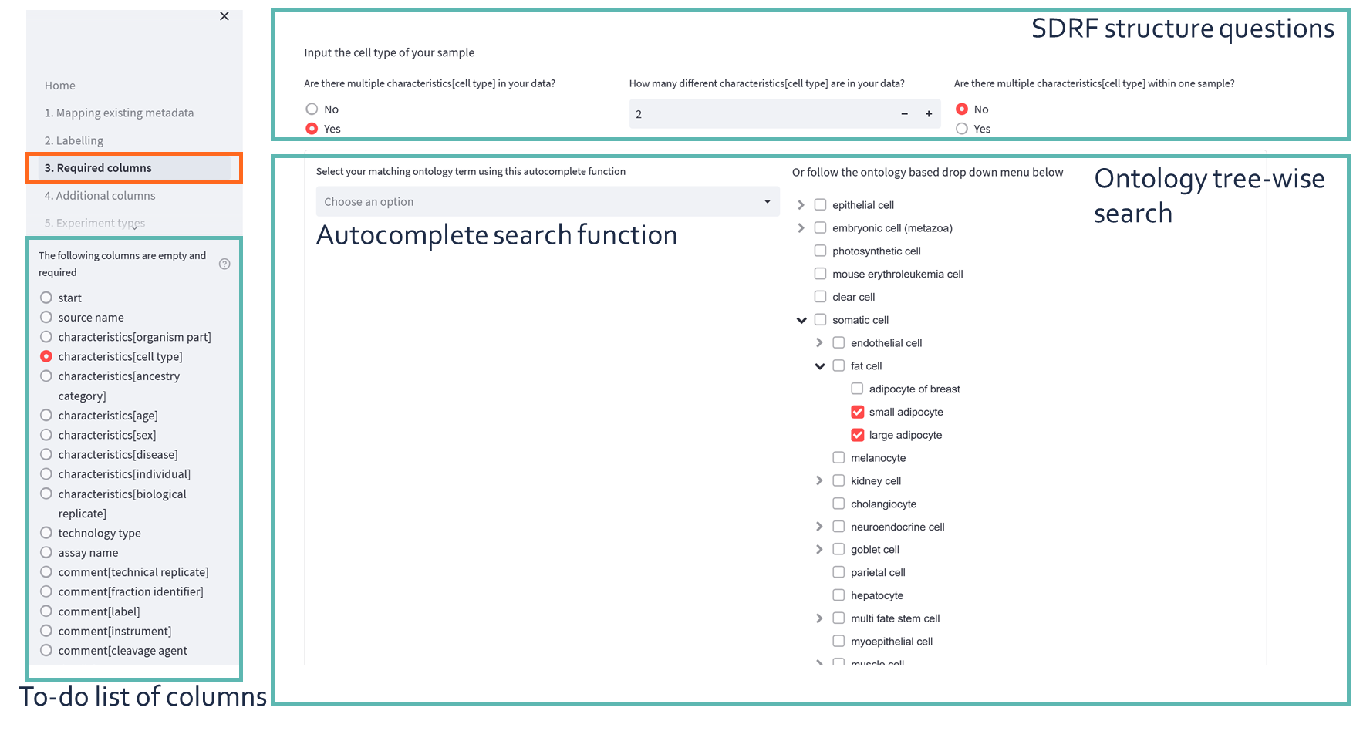
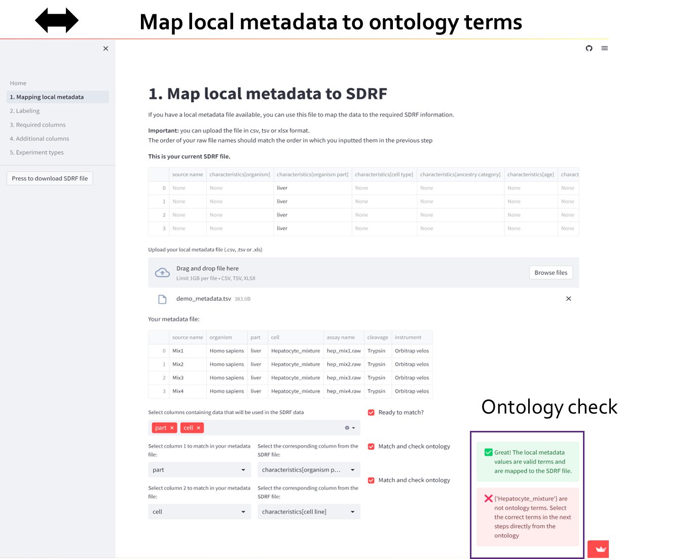

So, we built an online, free, open, and easy-to-use tool to provide proteomics metadata: lesSDRF
Ontologies
https://lessdrf.streamlit.app/
SDRF guidelines
Local metadata
lesSDRF
freely available
open source
no install required
https://github.com/compomics/lesSDRF
Claeys, Nature Communications, 2023

Slide 23



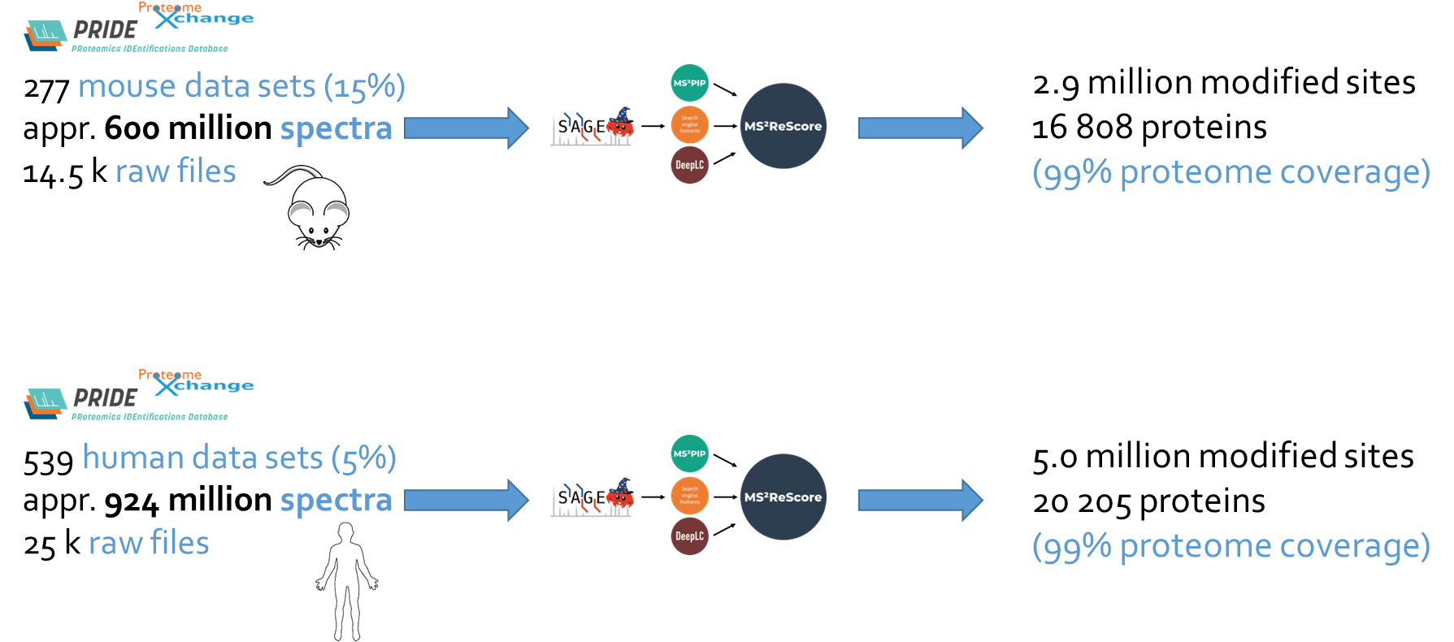
Public human and mouse data reprocessing using our AI tools reveals a hidden and diverse world of protein modifications

Slide 24


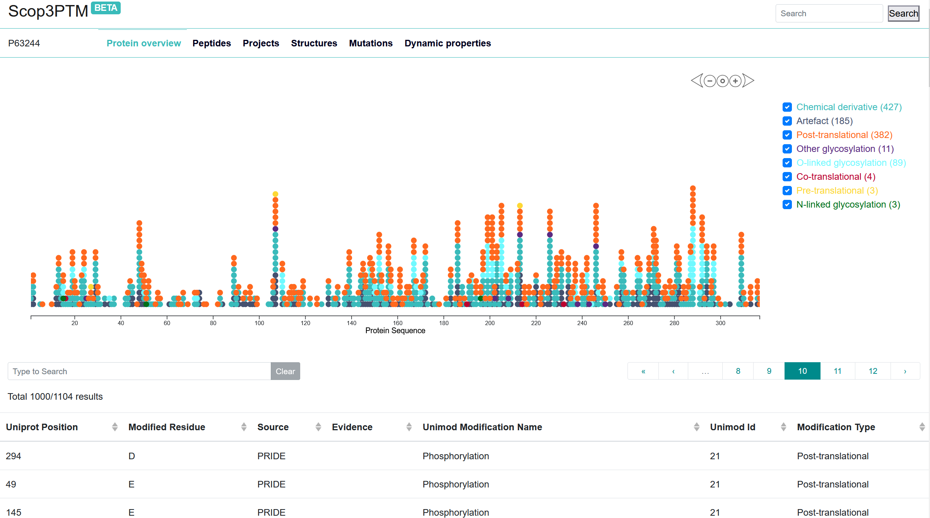
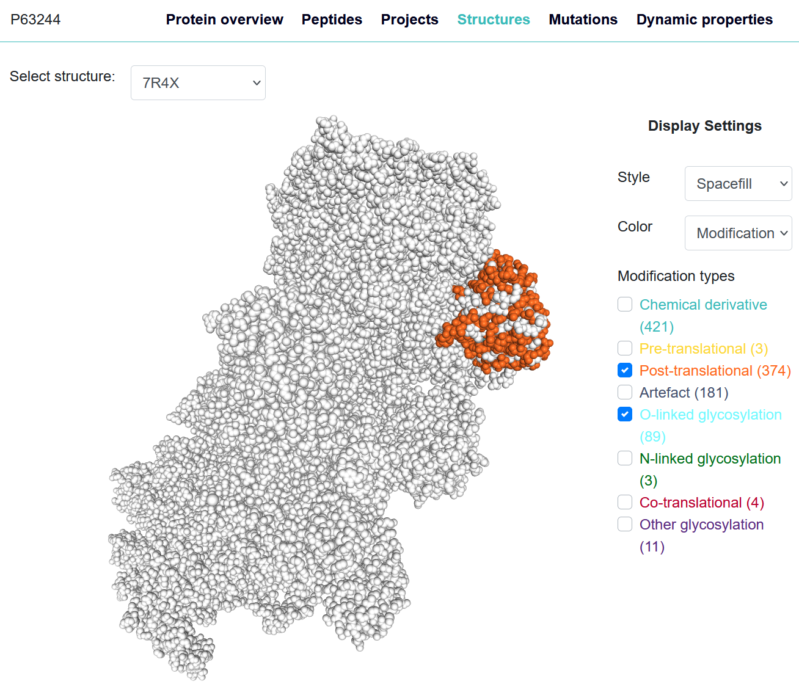
PRIDE will be fully reprocessed using our enhanced ML tools and Scop3PTM disseminates the results
small ribosomal subunit protein RACK1
7R4X: Cryo-EM reconstruction of the human 40S
ribosomal subunit - Full map
https://iomics.ugent.be/scop3ptm/P63244/summary
Ramasamy, in preparation
Notes:
https://iomics.ugent.be/scop3ptm/O00571/summary

Slide 25
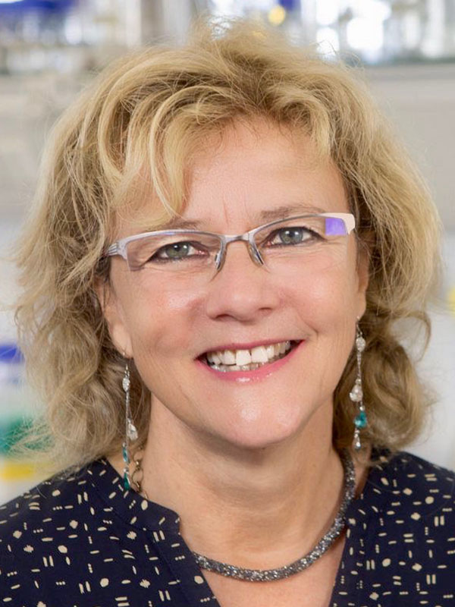
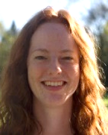
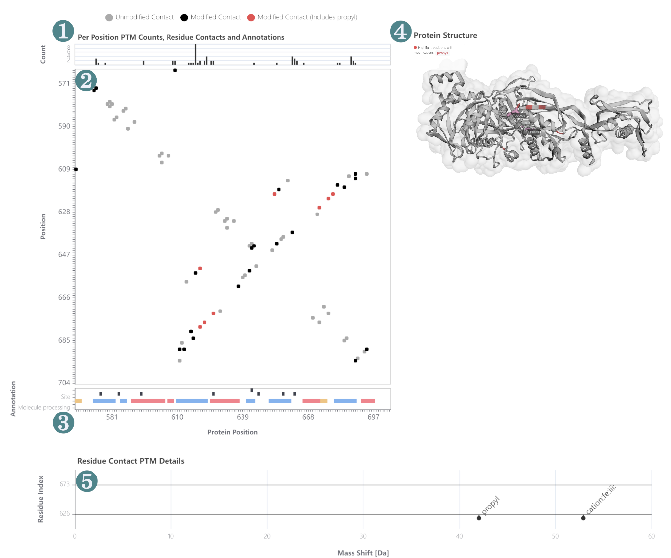
PTMVision provides really interesting ways to visualise your proteome-wide PTM discovery data
https://ptmvision-tuevis.cs.uni-tuebingen.de/
Hackl, Journal of Proteome Research, 2025

Slide 26
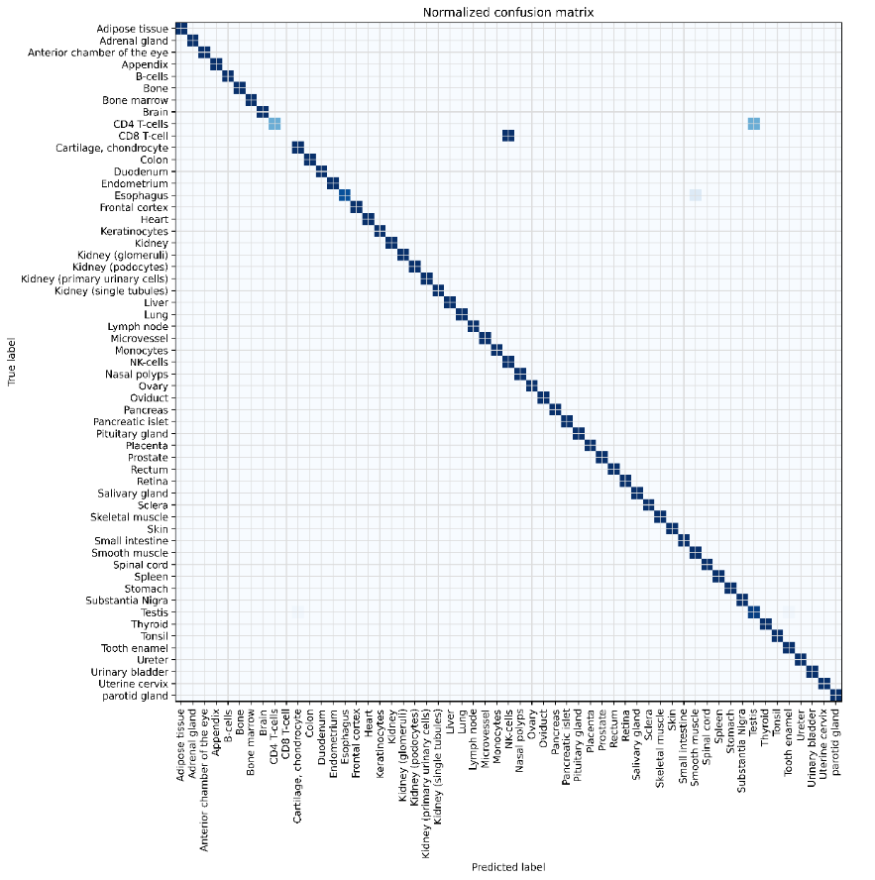
We built a machine learning-based tissue predictor, capable of knowledge extraction and hypothesis generation
Claeys, J Prot Res, 2022

Slide 27
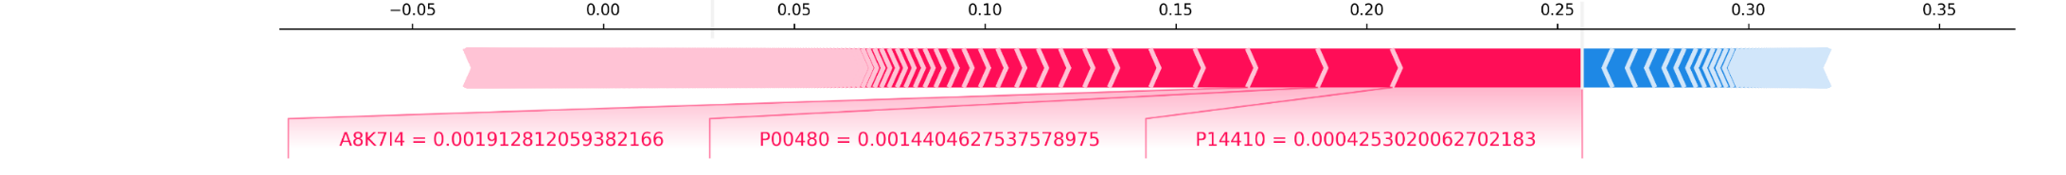
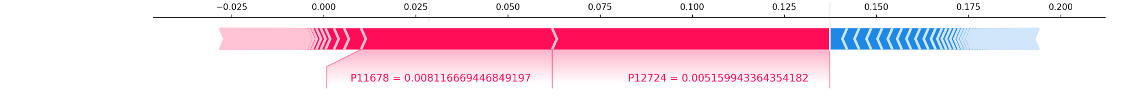
Strikingly, the predictor functions as a reliable detector of the molecular changes in a diseased tissue
With celiac disease proteome (PXD008992) as input
small intestine
26%
nasal polyps
14%
Protein | Protein name | Tissue specificity (HPA, Uniprot)
P14410 | Sucrase-isomaltase | Small intestine specific
Q99795 | Cell surface A33 antigen | Gastrointestinal epithelium
P12724 | Eosinophil cationic protein | Immune related (eosinophiles)
P11678 | Eosinophil peroxidase | Immune related (eosinophiles)
Q05315 | Galectin-10 | Immune related (eosinophiles), known celiac disease marker
Claeys, submitted, https://www.biorxiv.org/content/10.1101/2025.06.10.658642v1

Slide 28
Strikingly, the predictor functions as a reliable detector of the molecular changes in a diseased tissue
With celiac disease proteome (PXD008992) as input
small intestine
26%
nasal polyps
14%
Protein | Protein name | Tissue specificity (HPA, Uniprot) | Original differential expression analysis
P14410 | Sucrase-isomaltase | Small intestine specific | Significantly downregulated
Q99795 | Cell surface A33 antigen | Gastrointestinal epithelium | Below threshold of downregulation
P12724 | Eosinophil cationic protein | Immune related (eosinophiles) | Significantly upregulated
P11678 | Eosinophil peroxidase | Immune related (eosinophiles) | Significantly upregulated
Q05315 | Galectin-10 | Immune related (eosinophiles), known celiac disease marker | Below threshold of upregulation
Claeys, submitted, https://www.biorxiv.org/content/10.1101/2025.06.10.658642v1

Slide 29


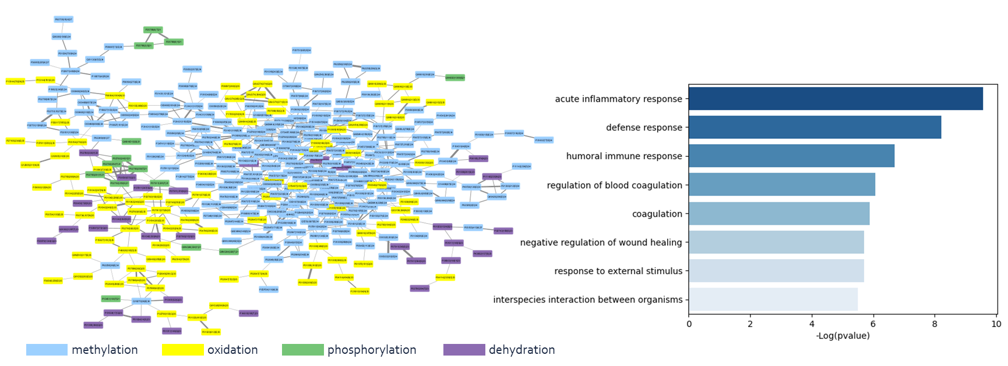
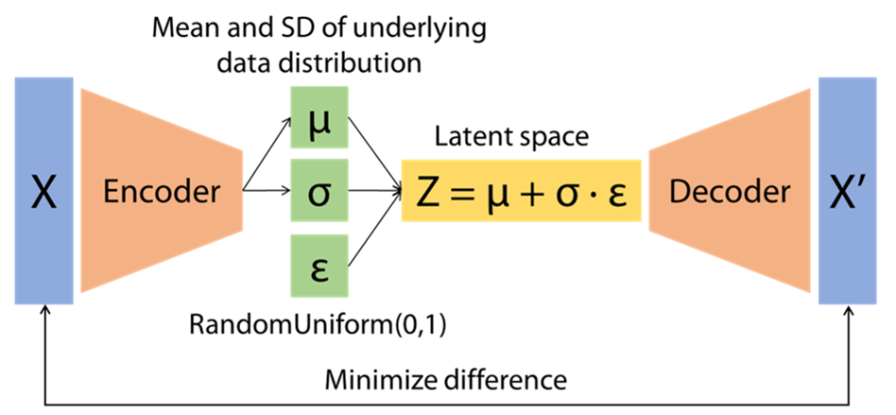
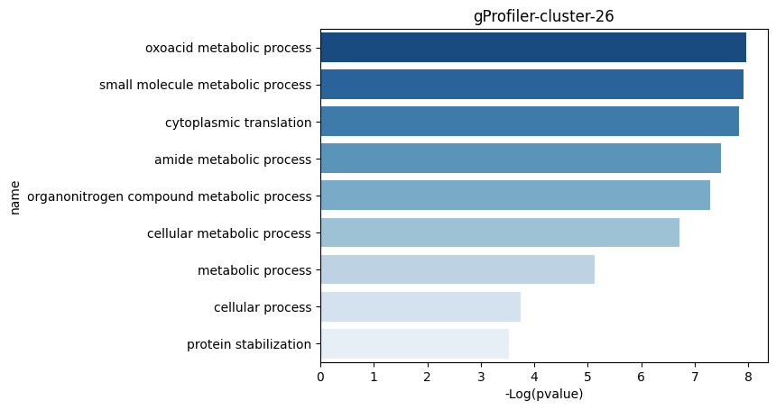
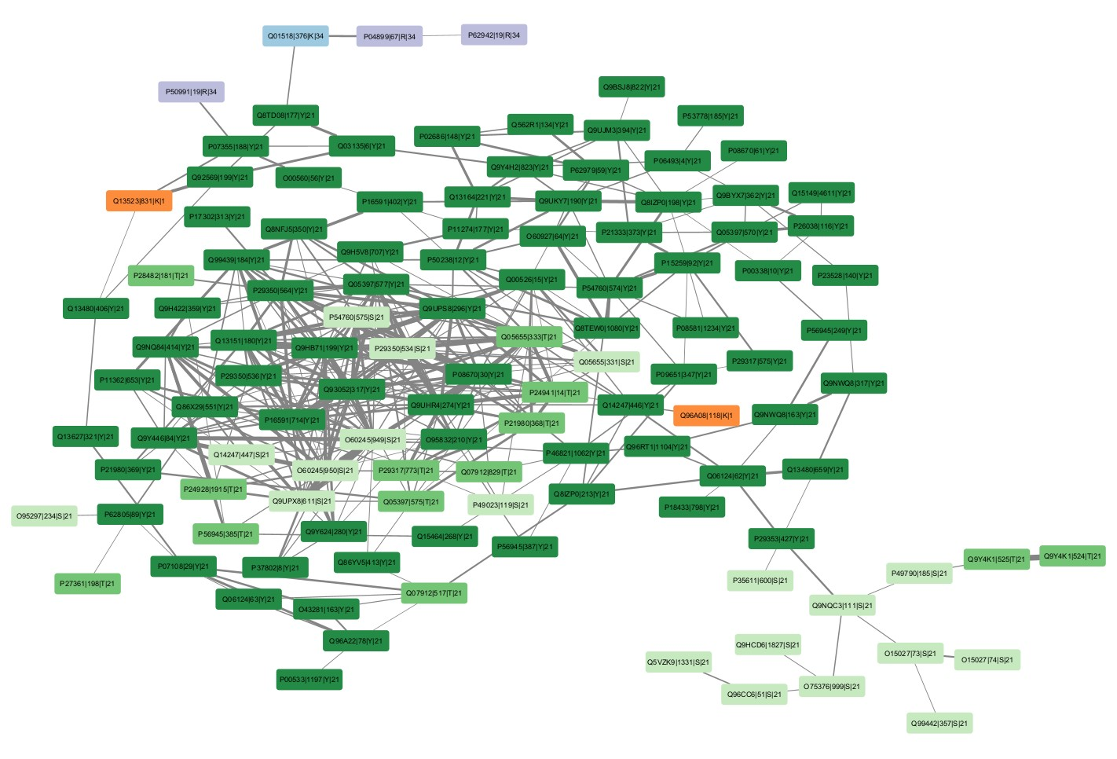
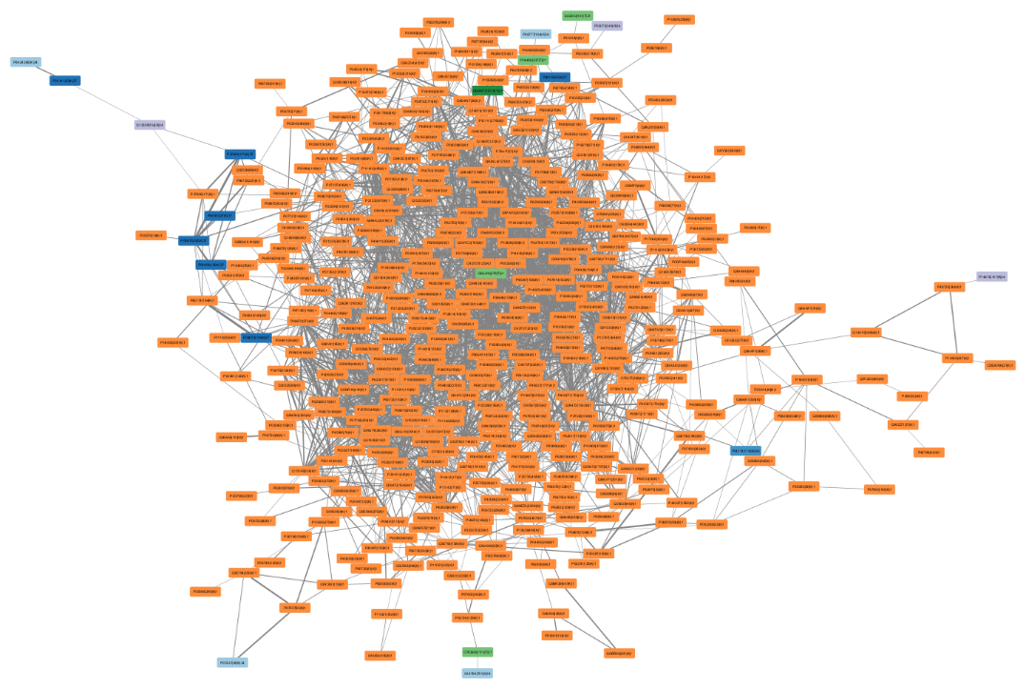

Modification-dependent protein association (MoDPA) networks have been built using a modified FAVA approach
GO analysis for gProfiler cluster 202
PCC
Koutrouli, Bioinformatics, 2024

Slide 30

Our online Tabloid Proteome has been updated to disseminate our MoDPA results
http://www.tabloidproteome.com
Tichshenko and Massignani, in preparation

Slide 31

The new TabloidProteome also brings insights into alternative gene products, by incorporating sORFs.
large ribosomal subunit protein uL13
→ known ubiquitinylation and acetylation
on K159
http://www.tabloidproteome.com
Tichshenko and Massignani, in preparation

Slide 32
Conclusion and outlook
Predicted behavior can help to increase sensitivity and specificity rescoring for the identification of (non-tryptic) peptides
Graph neural networks naturally support the structure of peptides and allow for interpretation through saliency maps
Reprocessing allows for deeper interpretation of the proteome, but the right tools are required to visualize and interpret the data
Be ready for the AI wave that will empower (non-)coders to analyze proteomics data

Slide 33


























Alexander Kensert
Alireza Nameni
Arthur Declercq
Caroline Jachmann
Enrico Massignani
Harikrishnan Ramadasan
Jasper Zuallaert
Kevin Velghe
Lyudmila Kovalchuke
Natalia Tichshenko
Pathmanaban Ramasamy
Patricia Lefèvre
Pieter Verschaffelt
Ralf Gabriels
Robbe Devreese
Lennart Martens
Sakina Bombaywala
Tine Claeys
Sander Heyndrickx
Tanja Holstein
Tim Van Den Bossche
Sam van Puyenbroeck
Toon Callens
Xuxa Malliet

Slide 34





Saliency maps to gain fundamental knowledge on the retention mechanism
Jiří Urban
Katerina Hruzova
RP
(Hydrophobicity)
FA
(Formic Acid)
Positive retention time contribution
Negative retention time contribution
AA
(Acetic Acid)
HILIC
(Hydrophilicity)
EG
(Ethylene Glycol)
SCX
(cation interactions)
Notes:
Pep1: ILFGGAGVK
Pep2: AAVATFLQSVQVPEFTPK

