Slide 1
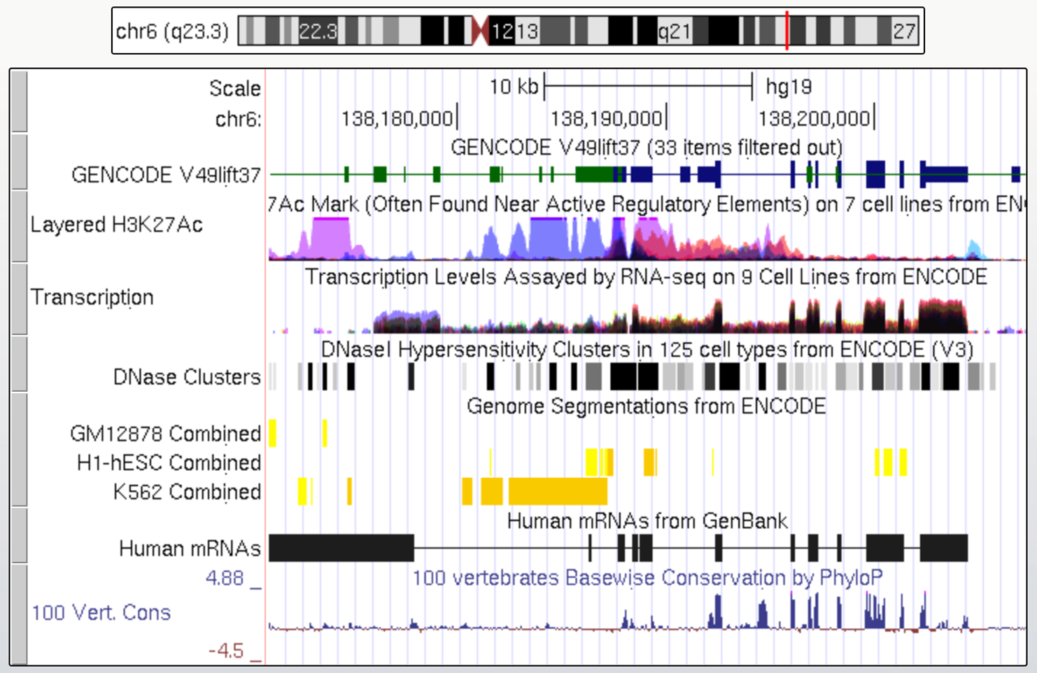
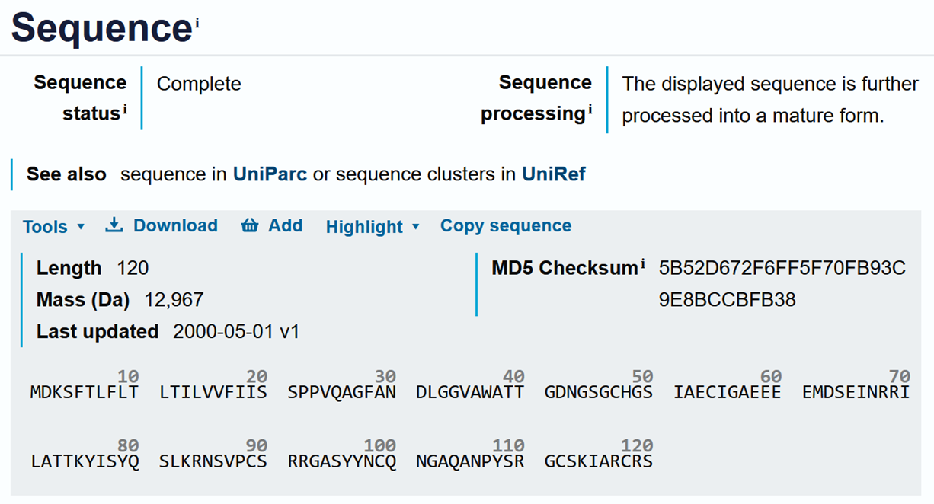
Sequence data are everywhere in biomedicine
genome data
proteins
Notes:
Many biomedical data types are naturally represented as sequences. Genomes and proteins are sequences of biological symbols, where the order of nucleotides or amino acids carries functional information. This makes sequence modelling a central problem across modern biomedical research.

Slide 2
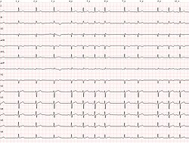
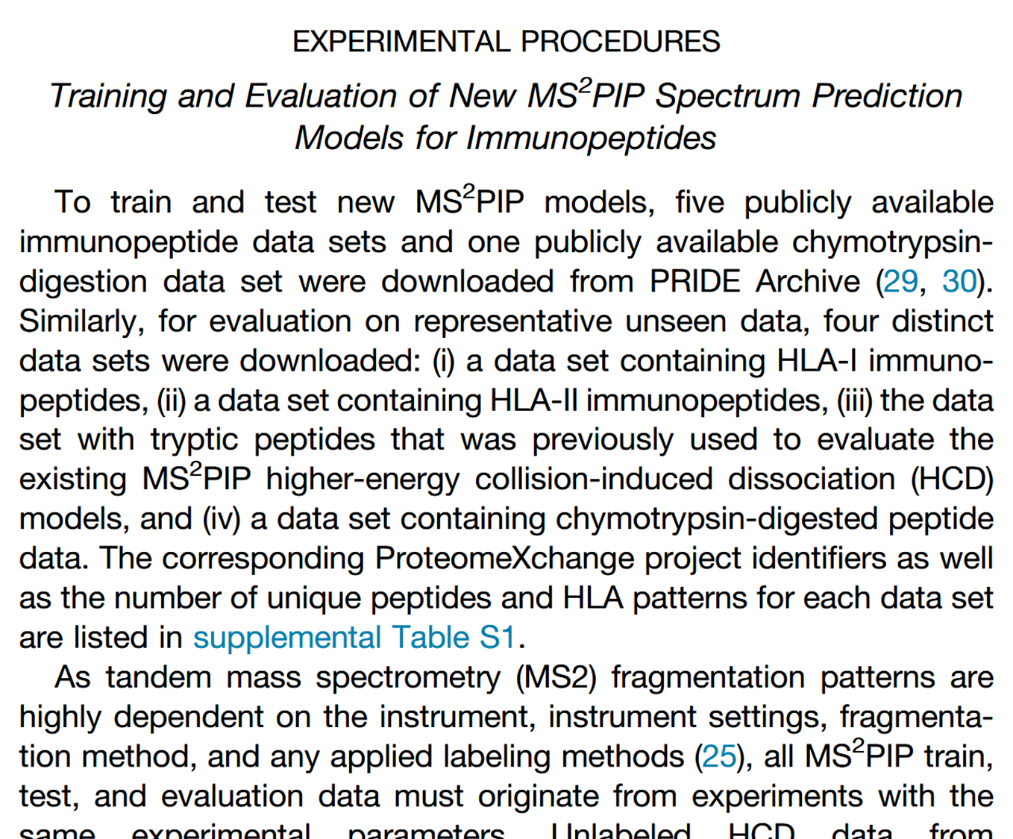
Sequence data are everywhere in biomedicine
electrocardiogram
research articles
Notes:
Not all biomedical sequences are molecular. Signals such as electrocardiograms and ordered text such as research articles are also sequential data, because meaning depends on what appears earlier or later. Sequence models are therefore useful far beyond genomics and proteomics.

Slide 3
Symbols must first be converted into numbers
Manual feature engineering
one-hot encoding
learned embedding
ACDTK
ACDTK
ACDTK
 | A | C | D | T | K
Basi | 37 | 35 | 59 | 129 | 191
Heli | 68 | 23 | 33 | 29 | 32
Hydr | 51 | 75 | 25 | 35 | 0
pI | 32 | 23 | 0 | 27 | 69
 | A | C | D | T | K
A? | 1 | 0 | 0 | 0 | 0
C? | 0 | 1 | 0 | 0 | 0
D? | 0 | 0 | 1 | 0 | 0
… | … | … | … | … | …
T? | 0 | 0 | 0 | 1 | 0
… | … | … | … | … | …
K? | 0 | 0 | 0 | 0 | 1
… | … | … | … | … | …
A | C | D | T | K
0.73 | 0.14 | 0.88 | 0.46 | 0.21
0.57 | 0.95 | 0.32 | 0.69 | 0.04
0.81 | 0.27 | 0.53 | 0.10 | 0.76
0.38 | 0.62 | 0.17 | 0.84 | 0.49
0.92 | 0.35 | 0.58 | 0.07 | 0.64
0.11 | 0.79 | 0.43 | 0.96 | 0.28
0.67 | 0.24 | 0.85 | 0.51 | 0.13
0.40 | 0.73 | 0.19 | 0.60 | 0.88
Notes:
Neural networks cannot work directly on symbolic inputs such as letters or words. These symbols must first be converted into numerical representations, for example through manual feature engineering, one-hot encoding, or learned embeddings. The choice of representation strongly influences what patterns a model can learn.

Slide 4
In sequence data, order matters
Cage the swallow.
MDKSFTLFLTLTILVVFIISSPPVQAGFANDLGGVAWATTGDNGSGCHGSIAECIGAEEEEMDSEINRRILATTKYISYQSLKRNSVPCSRRGASYYNCQNGAQANPYSRGCSKIARCRS
≠
≠
MDKSFTLFLTLTILVVFIISSPPVQAGFANDLGGVAWATTGDNGSGCHGSIAECIGAEEDMEESEINRRILATTKYISYQSLKRNSVPCSRRGASYYNCQNGAQANPYSRGCSKIARCRS
Swallow the cage.
Notes:
In sequence data, the same elements in a different order can have a different meaning. This is true both for language and for biological sequences, where even a small change in position can alter interpretation or function. Sequence models are designed specifically to preserve and use this ordering information.

Slide 5
In sequence data, memory matters as well
culture
office culture
cell culture
bank
river bank
investment bank
expression
artistic expression
gene expression
cell
immune cell
prison cell
Notes:
In many sequences, the correct interpretation of one element depends on the context that came before it. The same word can have different meanings in different phrases, just as the importance of a residue or motif may depend on the broader biological sequence. A useful sequence model therefore needs not only order, but also some notion of memory.

Slide 6
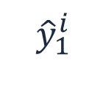
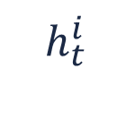
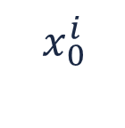
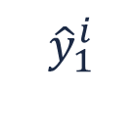
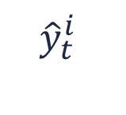
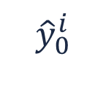
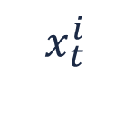
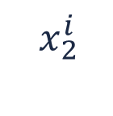
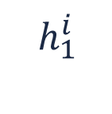
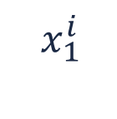
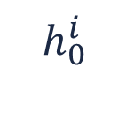
Recurrent neural networks process a sequence one step at a time
$${\hat{y}}_{0}^{i}$$
$${\hat{y}}_{1}^{i}$$
$${\hat{y}}_{1}^{i}$$
$${\hat{y}}_{t}^{i}$$
$$h_{0}^{i}$$
$$h_{1}^{i}$$
$$h_{t}^{i}$$
$$x_{0}^{i}$$
$$x_{1}^{i}$$
$$x_{2}^{i}$$
$$x_{t}^{i}$$
<cage>
<the>
<swallow>
Sequence
Notes:
A recurrent neural network (RNN) reads a sequence one element at a time and updates its internal state after each step. The same recurrent unit is reused across the sequence, which allows the model to process inputs of variable length. In this way, information from earlier positions can influence later predictions.

Slide 7
The hidden state acts as a running summary of the past
$${\hat{y}}_{0}^{i}$$
$${\hat{y}}_{1}^{i}$$
$${\hat{y}}_{1}^{i}$$
cage
$$h_{0}^{i}$$
cage
the
$$h_{1}^{i}$$
cage
the
swallow
$$x_{0}^{i}$$
$$x_{1}^{i}$$
$$x_{2}^{i}$$
<cage>
<the>
<swallow>
Sequence
Notes:
The hidden state of an RNN can be viewed as a compact summary of everything the model has seen so far. After each new input, this summary is updated to incorporate the new information. The model therefore carries forward a learned representation of past context while moving through the sequence.

Slide 8
Recurrent neural networks can predict at each step or at the end
sequence to sequence
(many to many)
sequence to one
(many to one)
Notes:
RNNs can be used for different sequence tasks depending on where predictions are made. In sequence-to-sequence settings, the model produces an output at each step, while in sequence-to-one settings it produces a single output after reading the full sequence. This makes recurrent models flexible for both token-level and sequence-level prediction problems.

Slide 9
Vanilla RNNs struggle with long-range dependencies
model memory
M
MDKSF
MDKSFTLFLT
time steps throughout the sequence
MDKSFTLFLTLTILV
MDKSFTLFLTLTILVVFIIS
MDKSFTLFLTLTILVVFIISSPPVQ
Notes:
A basic RNN has difficulty preserving information over many time steps. As a sequence becomes longer, relevant earlier information may gradually fade from the model’s internal state. This makes it hard for vanilla RNNs to capture long-range dependencies, which are common in biological and linguistic data.

Slide 10



LSTMs and GRUs introduced gated memory to better preserve the important information
$${\hat{y}}_{t}^{i}$$
$$h_{t}^{i}$$
$$x_{t}^{i}$$
Notes:
LSTMs and GRUs were developed to address the memory limitations of vanilla RNNs. They introduce gating mechanisms that help the model decide what information to keep, update, or forget over time. This makes them more effective when important context must be preserved across longer sequences.

Slide 11
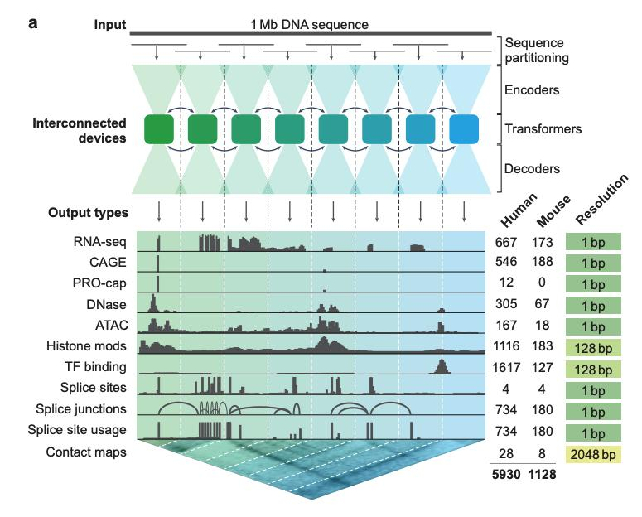
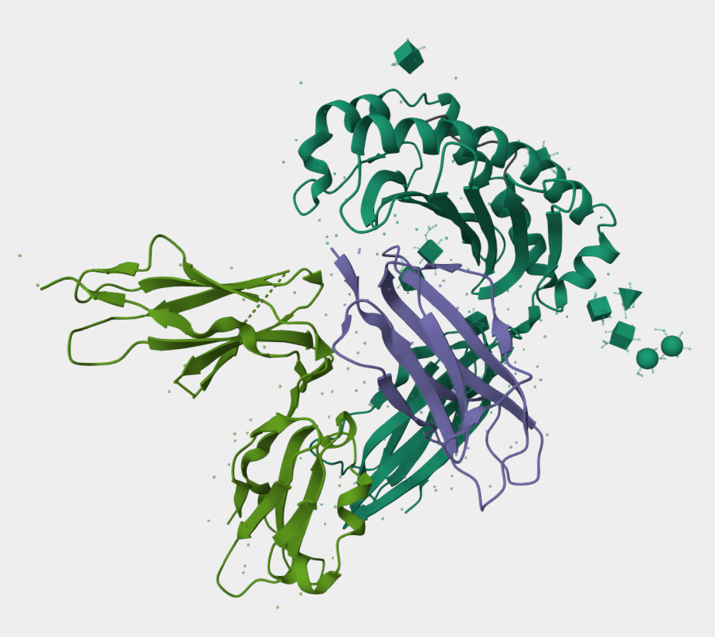
For complex tasks, recurrent memory is often not enough…
Especially when important context is far away
Long-range genome interactions
Amino acid interactions in 3D structure
Notes:
Some sequence problems require the model to relate positions that are far apart. In biomedicine, this occurs for example in long-range genome interactions and in proteins, where residues distant in sequence can still interact in three-dimensional space. In such settings, compressing all past information into a single recurrent memory can become a major limitation.

Slide 12
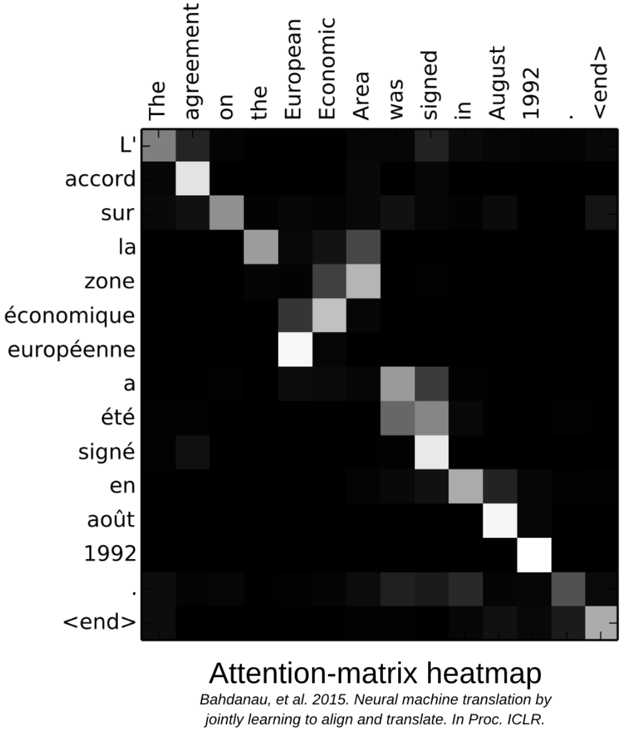
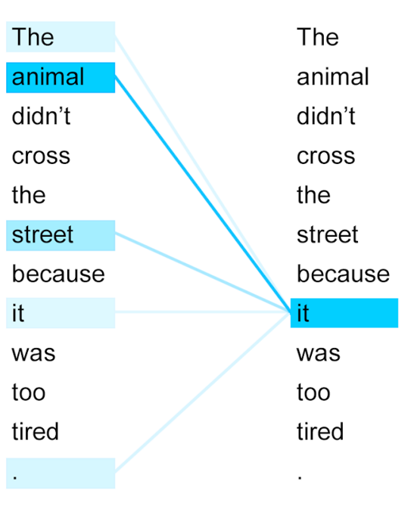
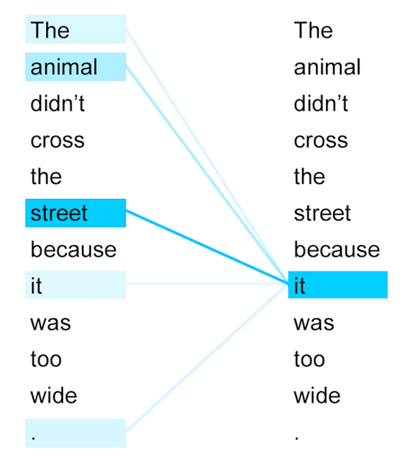
Attention lets the model focus on the most relevant parts of the entire sequence
Notes:
Attention allows the model to assign different importance to different positions in the sequence when making a prediction. Instead of relying only on a compressed memory, the model can look back at the most relevant elements directly. This makes it easier to capture relationships between distant sequence positions.

Slide 13
Transformers replace recurrence memory by attention
RNN
summary through time
Transformer
direct context lookup
I
am
happy
I
I
I
am
I
am
happy
am
happy
Notes:
Transformers move away from recurrent step-by-step memory and instead rely primarily on attention. Rather than summarizing the past into a single evolving hidden state, each position can directly consult other relevant positions in the sequence. This makes transformers particularly powerful for modelling complex dependencies over long distances.

Slide 14
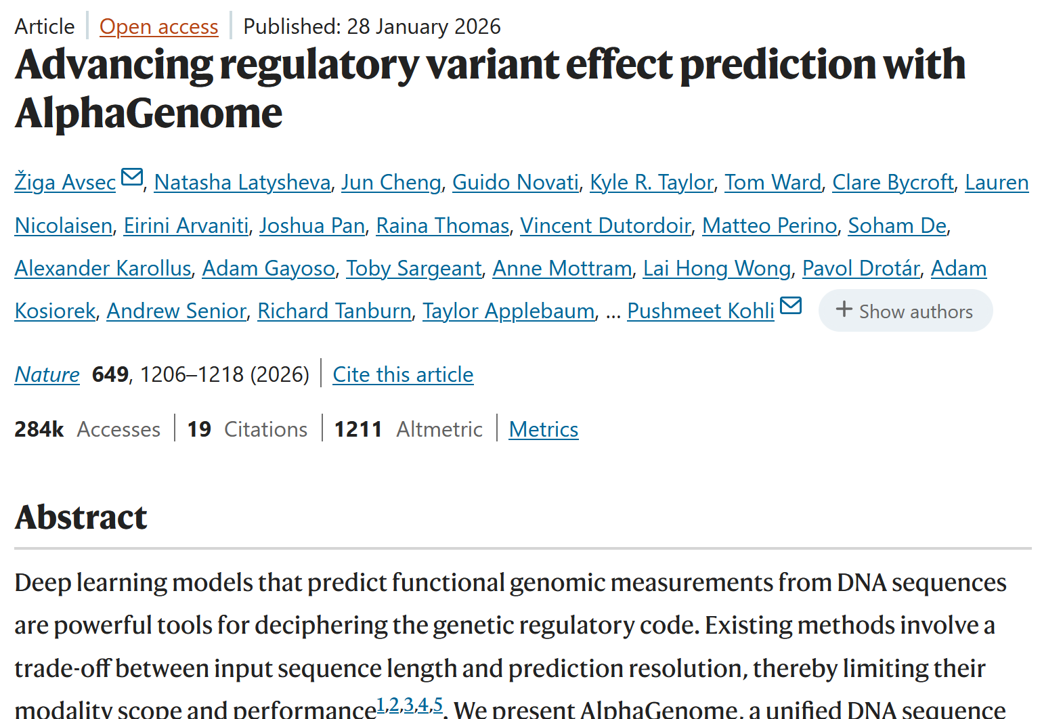
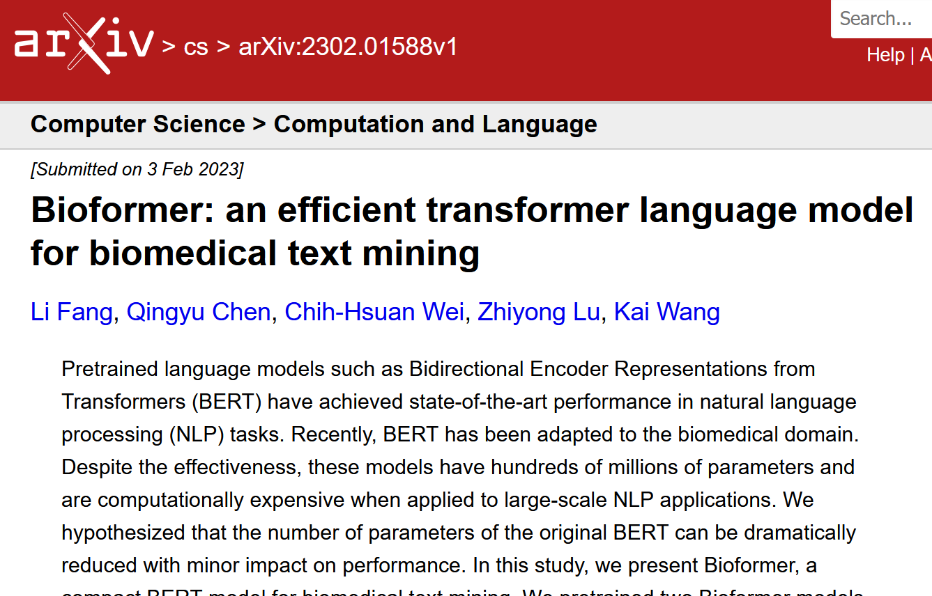
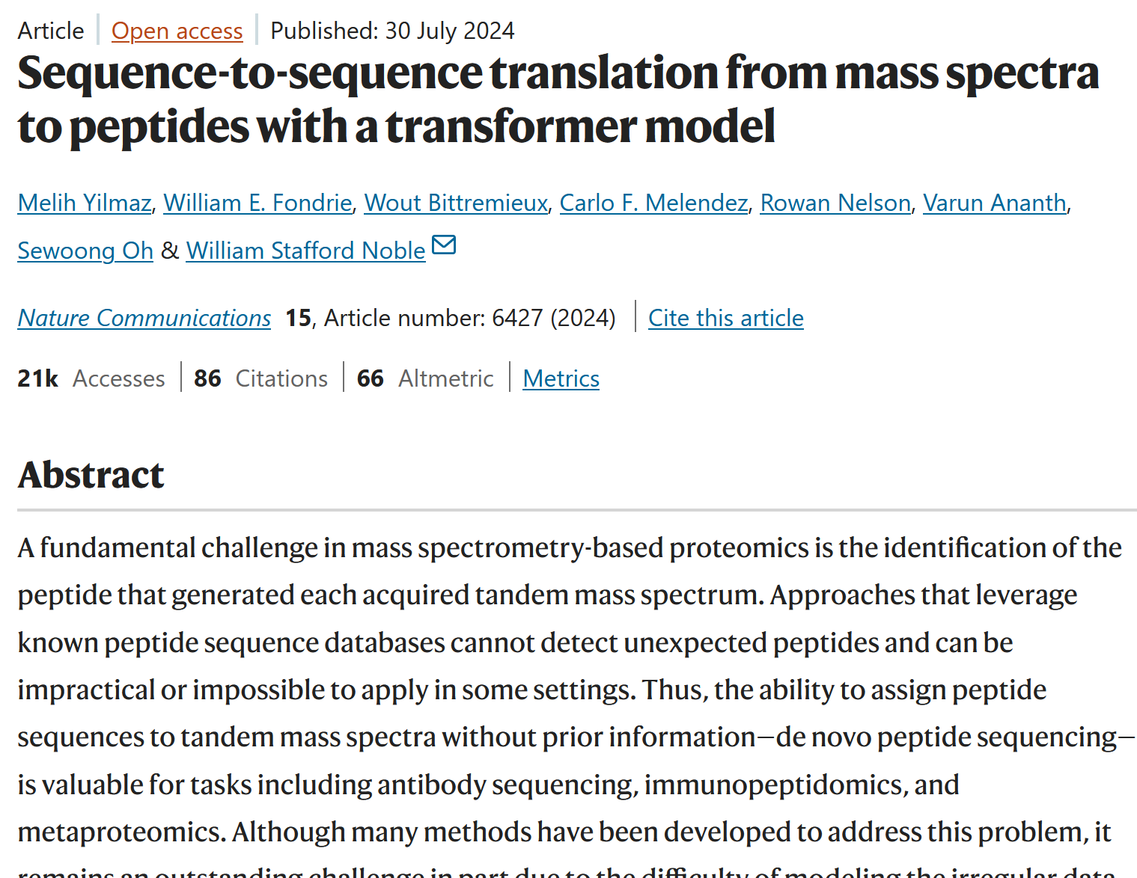
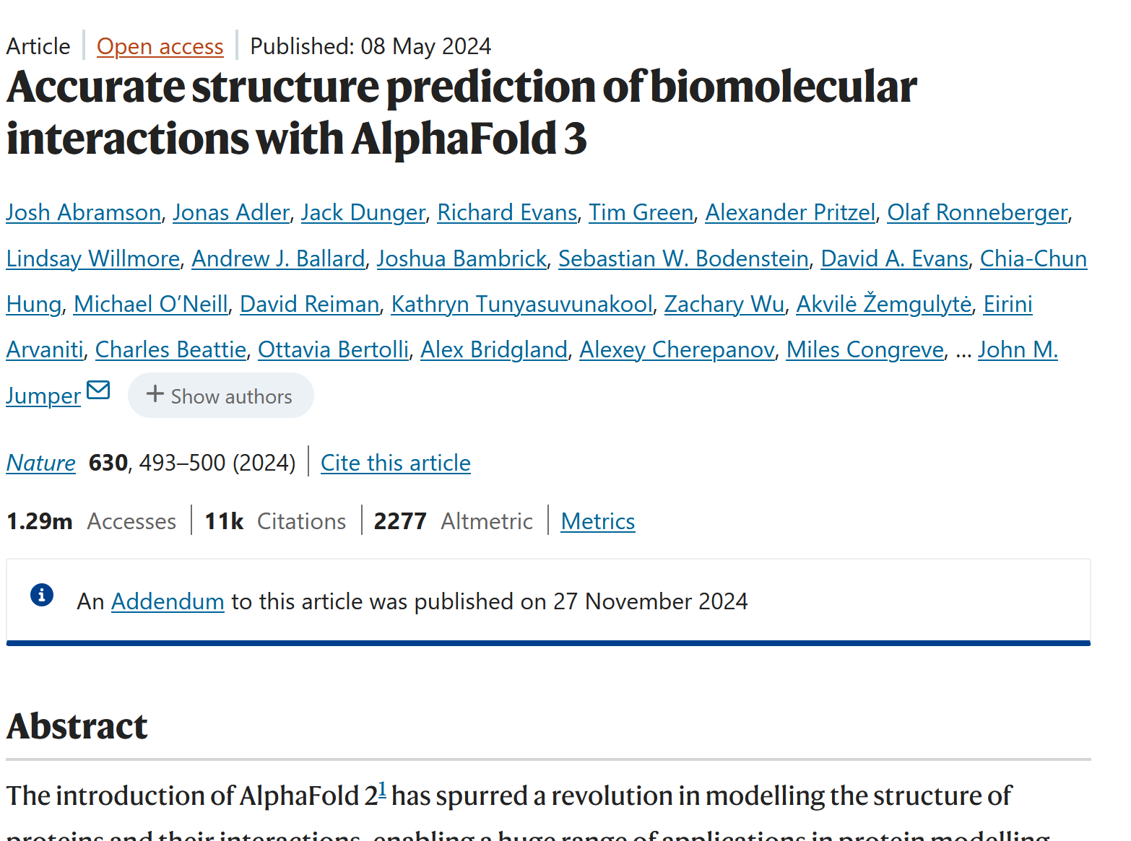
Transformers are now widely used across biomedical data types
Notes:
Transformer-based models are now used across a wide range of biomedical domains, including genomics, proteomics, biomedical language processing, and related areas. Their strength lies in learning rich sequence representations and in capturing long-range context efficiently. As a result, they have become a major modern architecture for sequence modelling in biomedicine.

Slide 15
Recap
Sequence data are ordered, so position carries meaning.
Symbols must be converted into numbers, often through learned embeddings.
RNNs process sequences step by step and maintain a hidden state as memory.
Vanilla RNNs struggle with long-range dependencies; LSTMs and GRUs improve this.
Transformers use attention to relate distant sequence elements directly.

