Slide 1
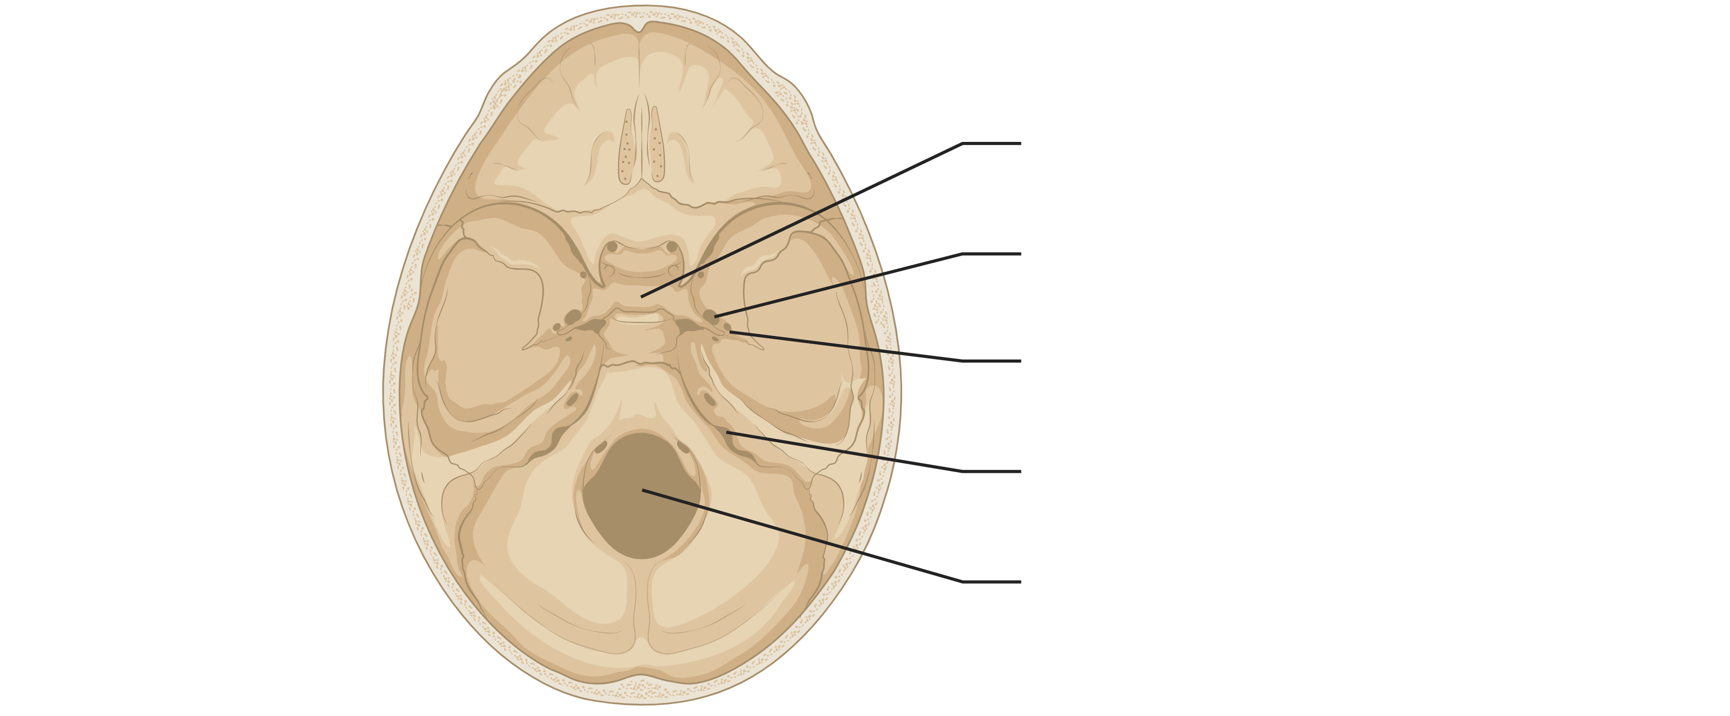
It is easier to learn patterns if you know the language
sella turcica
Turkish saddle
foramen ovale
oval hole
foramen spinosum
spiny hole
foramen jugularis
neck hole
foramen magnum
big hole
Notes:
Recognizing patterns is much easier when one already understands the underlying “language” of the data. In anatomy, knowing the Latin language makes it easier to memorize the structure terminology, as the terms are now interpretable. The same general principle applies in machine learning: models perform better when they first learn the structure and conventions of the data domain before tackling a specific downstream prediction task.

Slide 2
Foundation models can learn general sequence ‘language’ from a large corpus of text
Learn the language from a general task
Predict the missing word
Predict the missing nucleotides
A sentence ________ words.
ATACG___GCTAGTCC
A sentence eats words.
ATACGCCGGCTAGTCC
A sentence contains words.
ATACGTTAGCTAGTCC
No exact labels required
Usually, a lot of data available
Notes:
Foundation models are typically trained on very large amounts of data using a general learning objective rather than a narrowly defined task. One common strategy is to hide part of the input and ask the model to predict the missing token, word, or nucleotide. Because the supervision comes from the data itself (i.e., it is self-supervised), this approach usually does not require exact manual labels and can exploit the large unlabeled datasets that are common in biology and medicine.

Slide 3
Pretraining & fine-tuning turns one model into many predictors
Step 1: Foundation model learns the language
foundation model
nucleotide prediction
ATACGCCGGCTAGTCC
ATACG___GCTAGTCC
ATACGTTAGCTAGTCC
Notes:
The key idea behind foundation models is that one broadly trained model can later be adapted to many different downstream tasks. In the pretraining phase, the model learns general patterns and structure from a large corpus. In the fine-tuning phase, that pretrained knowledge is reused and specialized for a particular prediction problem.

Slide 4
Pretraining & fine-tuning turns one model into many predictors
Step 1: Foundation model learns the language
foundation model
nucleotide prediction
ATACGCCGGCTAGTCC
ATACG___GCTAGTCC
ATACGTTAGCTAGTCC
Step 2: Learn the specific task,
reusing the foundation model
foundation model
(already trained)
TF motif prediction
CGTGGAGGCAGTTAAC
CGTGGAGGCAGTTAAC
CGTGGAGGCAGTTAAC
foundation model
(already trained)
splice site prediction
ATCGTATGCTAGGCTT
ATCGTATGCTAGGCTT
ATCGTATGCTAGGCTT
Requires much less training data!
Notes:
Once a foundation model has learned the general “language” of a data type, it can be reused for several more specific tasks with much less task-specific training data. Instead of training a separate model from scratch for each application, the pretrained model acts as a strong starting point that already captures useful domain structure. This is especially attractive in biomedicine, where labeled datasets are often limited or expensive to obtain.

Slide 5
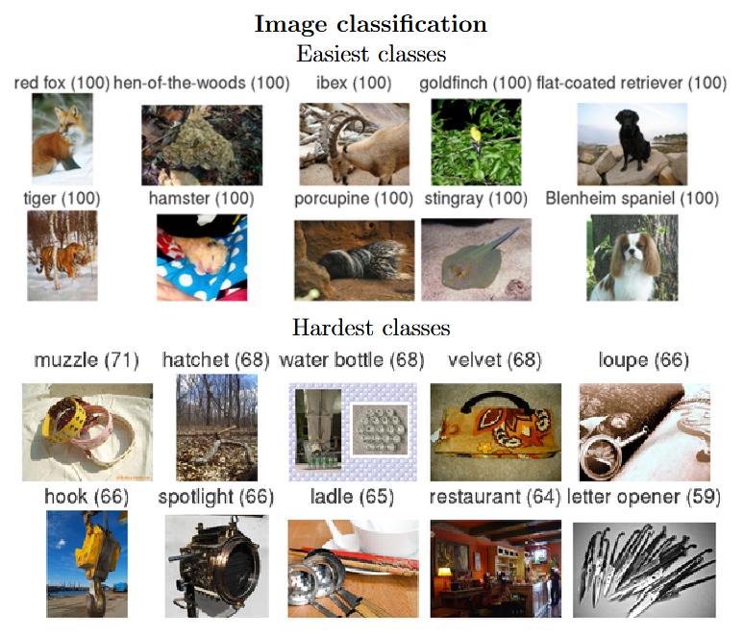
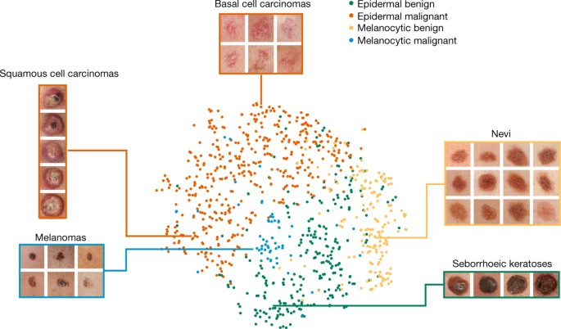
Foundation models can be highly generic, while the subsequent finetuning task can be very domain-specific
Inception v3, as foundation model
trained on >1m images of 1k object categories
Finetuned for skin lesion classification
finetuned with 127,463 images of skin lesions
Notes:
A foundation model does not always need to be trained on domain-specific data from the start. In some cases, a very general model trained on a broad and diverse dataset can still provide useful representations that transfer well to a much more specialized task. The skin-lesion example illustrates this idea: a model pretrained on generic natural images can still serve as a useful starting point for medical image classification after task-specific fine-tuning.

Slide 6
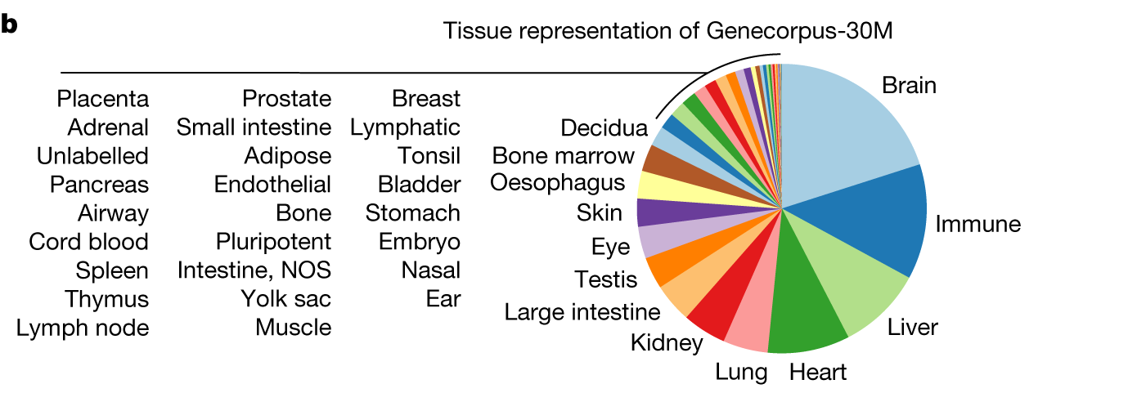
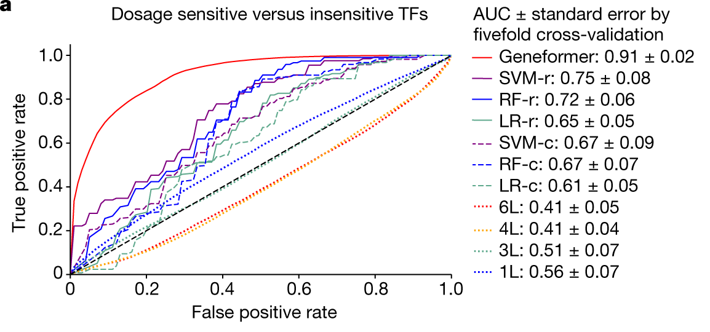
Foundation models can also be more domain-specific, but exploit large corpuses of unlabeled data
Pretraining on transcriptomics data
~30 million single cell transcriptome samples
Finetuned for copy number variation gene dosage sensitivity
10.000 transcription factors with known sensitivity
Notes:
Foundation models can also be trained directly within a specific domain when sufficiently large unlabeled datasets are available. In that case, pretraining can capture more domain-relevant structure than a generic model would. The transcriptomics example illustrates how large-scale pretraining on single-cell data can later support a much more specific biological prediction task with comparatively limited labeled examples.

Slide 7
Amino acids can be directly encoded in various ways
Manual feature engineering
one-hot encoding
learned embedding
ACDTK
ACDTK
ACDTK
 | A | C | D | T | K
Basi | 37 | 35 | 59 | 129 | 191
Heli | 68 | 23 | 33 | 29 | 32
Hydr | 51 | 75 | 25 | 35 | 0
pI | 32 | 23 | 0 | 27 | 69
 | A | C | D | T | K
A? | 1 | 0 | 0 | 0 | 0
C? | 0 | 1 | 0 | 0 | 0
D? | 0 | 0 | 1 | 0 | 0
… | … | … | … | … | …
T? | 0 | 0 | 0 | 1 | 0
… | … | … | … | … | …
K? | 0 | 0 | 0 | 0 | 1
… | … | … | … | … | …
A | C | D | T | K
0.73 | 0.14 | 0.88 | 0.46 | 0.21
0.57 | 0.95 | 0.32 | 0.69 | 0.04
0.81 | 0.27 | 0.53 | 0.10 | 0.76
0.38 | 0.62 | 0.17 | 0.84 | 0.49
0.92 | 0.35 | 0.58 | 0.07 | 0.64
0.11 | 0.79 | 0.43 | 0.96 | 0.28
0.67 | 0.24 | 0.85 | 0.51 | 0.13
0.40 | 0.73 | 0.19 | 0.60 | 0.88
Notes:
As seen in the lecture on recurrent neural networks, before a model can learn from amino-acid sequences, those symbols must first be converted into numbers. This can be done through manual feature engineering, one-hot encoding, or learned embeddings. These encodings differ in how much prior biological knowledge they inject and in how flexibly they allow the model to learn useful similarities between residues.

Slide 8
In summary, pretraining and finetuning serve two different goals
 | Direct training | Pretraining | Finetuning
Objective | Learn the ‘language’ & the specific task at once | Learn the general ‘language’ of the training task | Learn the specific training task
Method | Supervised | Supervised (with labels) or self-supervised (masking) | Supervised (with labels)
Data requirement | Large corpus of examples | Very large corpus of examples | Much smaller data set*
Downstream applicability | Very specific | Very diverse | Very specific
Notes:
Pretraining and fine-tuning are related but distinct stages. Pretraining aims to learn the general structure or “language” of the data, often from a large and only weakly labeled or unlabeled dataset. Fine-tuning then uses that learned representation to solve a specific downstream task with a smaller, more targeted labeled dataset. This distinction is central to understanding what makes foundation models different from task-specific models trained from scratch.

Slide 9
Recap
Foundation models first learn the general structure of a data domain from large datasets.
This pretraining step is often self-supervised, so exact labels are not always required.
The pretrained model can then be fine-tuned for specific downstream tasks.
This is very useful in biomedicine, where labeled data are often scarce but unlabeled data can be abundant.

