Slide 1
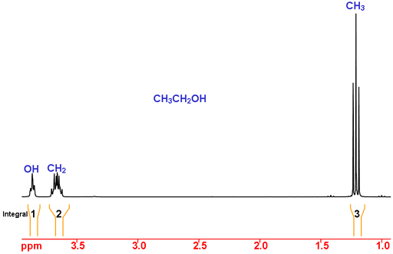
NMR: clues about a molecule’s structure
Nuclear magnetic resonance measures signals from atomic nuclei.
Ethanol in CDCl₃
What produces the signal?
In a strong magnetic field, radiofrequency pulses excite nuclei.
What do the peaks tell us?
Position: chemical surroundings.
Area in ¹H NMR: relative number of hydrogens.
Goal: find a molecular structure that explains the spectrum.
Measured ¹H NMR spectrum of ethanol in CDCl₃. Hebrew University NMR laboratory, Fig. 2.
1
Notes:
This is the measured ethanol spectrum published by the Hebrew University NMR laboratory, Figure 2, recorded in CDCl3. The original image includes actual multiplet structure and orange integration traces: OH 1, CH2 2 and CH3 3. The OH signal lies near 3.9 ppm here and changes with conditions. The figure preserves the source signal and axes; only GIF-to-PNG format conversion was used. Peak height alone does not count hydrogens. Use this known structure to introduce the inverse question of identifying an unknown molecule.
Spectrum and interpretation
https://chem.ch.huji.ac.il/nmr/techniques/1d/row1/h.html
https://chem.ch.huji.ac.il/nmr/techniques/1d/row1/h_files/ethanol.gif
NMR-Solver
https://doi.org/10.1038/s41467-026-71315-0

Slide 2
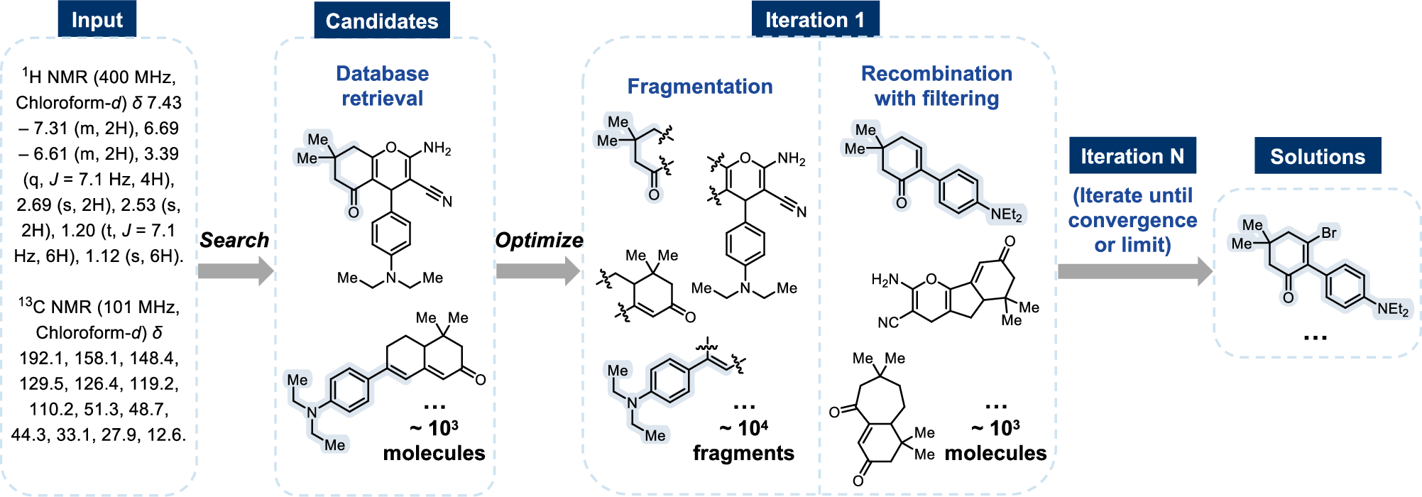
NMR-Solver: proposing a molecular structure
Problem: which molecule explains the measured ¹H and ¹³C chemical shifts?
1 Find starting candidates
Search a database of predicted shifts.
2 Try related molecules
Recombine molecular fragments.
3 Compare and repeat
A neural network predicts the shifts.
Jin et al. (2026), Fig. 2. CC BY 4.0
2
Notes:
Compare each predicted shift set with the measurements. Keep promising candidates and repeat. A molecular formula or expert starting structure can constrain the search. Figure reproduced unchanged.
Sources
https://doi.org/10.1038/s41467-026-71315-0
https://creativecommons.org/licenses/by/4.0/

Slide 3
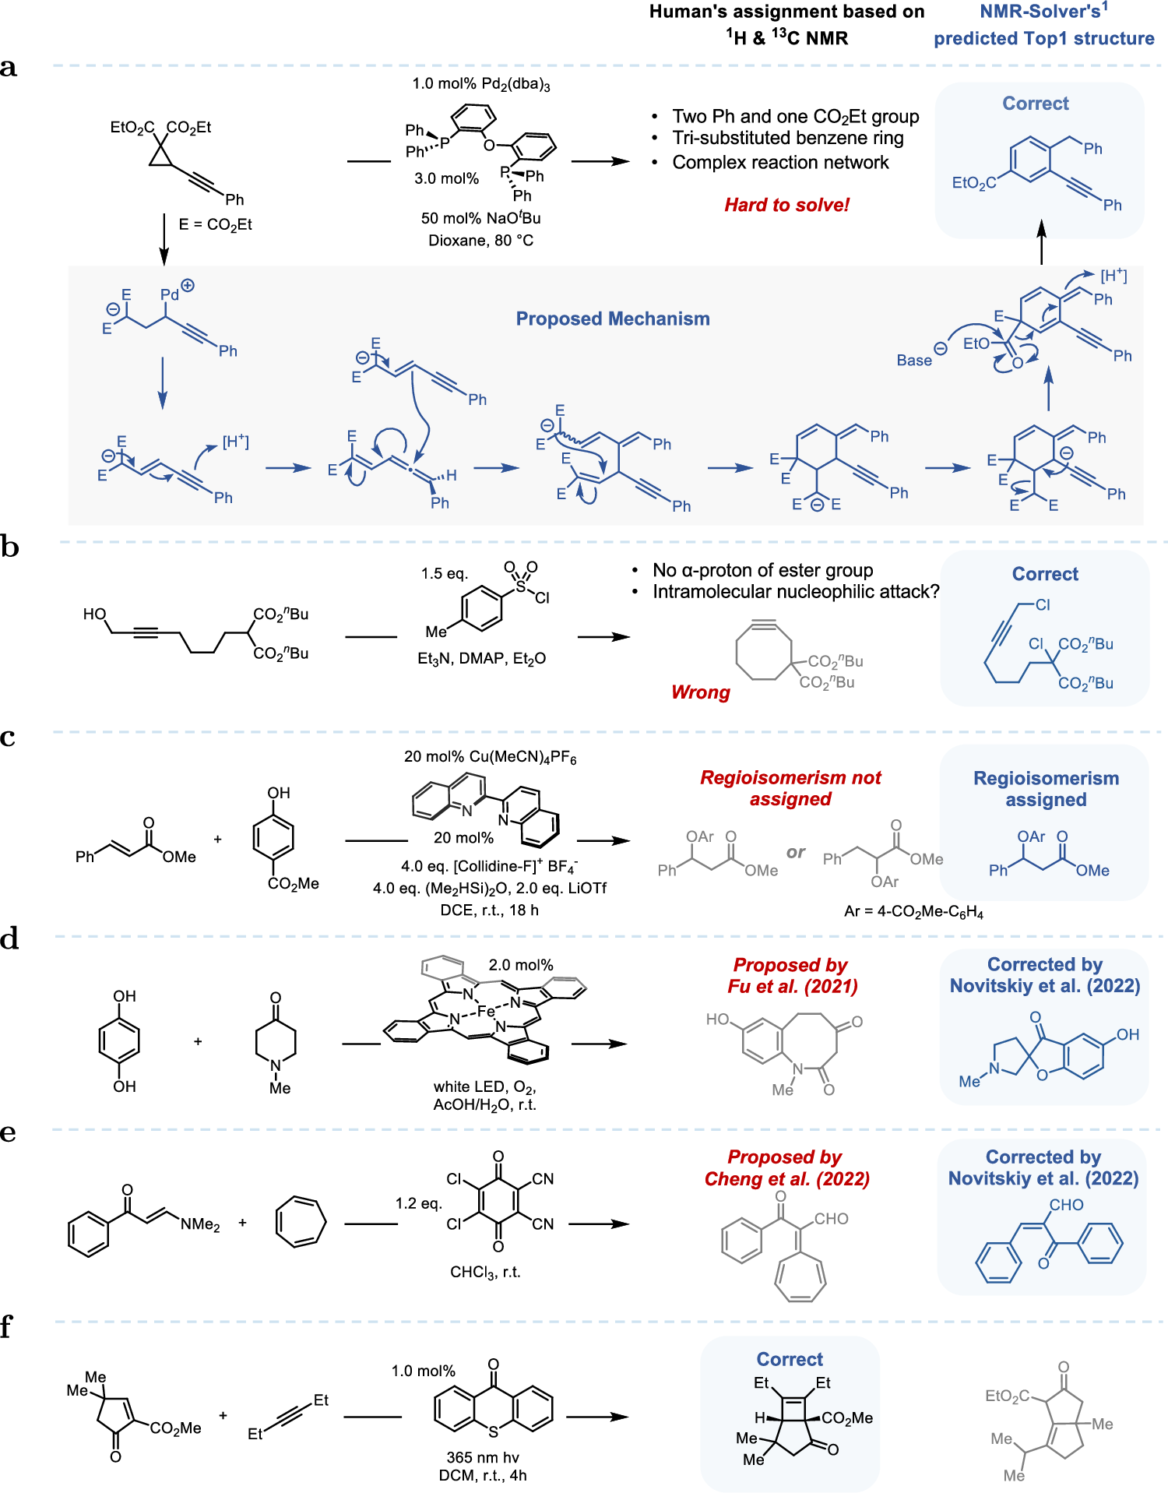
NMR-Solver: useful predictions and a failure
Results include laboratory assignments and a documented wrong prediction.
A laboratory product
A strained molecule
Actual product
Model prediction
Additional 2D NMR and high-resolution mass spectrometry supported this assignment.
Inaccurate predicted shifts made the wrong structure look more convincing.
What extra evidence would you request before accepting a proposed structure?
Jin et al. (2026), extracts from Fig. 4a and 4f. CC BY 4.0
3
Notes:
Left: a Pd-catalysed transformation, checked using HMBC, HSQC and HRMS. Right: forward-model error favoured the wrong structure. Crops omit reaction mechanisms and other cases.
Sources
https://doi.org/10.1038/s41467-026-71315-0
https://creativecommons.org/licenses/by/4.0/

Slide 4
Raman: a fingerprint of molecular vibrations
A small fraction of scattered laser light changes energy.
Similar compounds can share many peaks
What produces the signal?
Signal intensity (arbitrary units)
Laser light exchanges energy with molecular vibrations.
What do the peaks tell us?
Peak positions reflect vibrations.
The overall pattern helps distinguish compounds.
Raman shift (cm⁻¹)
Goal here: identify microorganisms from single-cell Raman fingerprints.
Concept: Renishaw, What is Raman scattering? Schematic spectra of hypothetical compounds.
4
Notes:
Raman shift measures energy exchanged with molecular vibrations. The curves are schematic compound spectra. A whole cell contains many chemical components, and its combined spectrum can help distinguish microorganisms. The following example uses a CNN trained on known species.
Sources
https://www.renishaw.com/en/what-is-raman-scattering--25805
https://doi.org/10.1038/s41467-025-66996-y

Slide 5
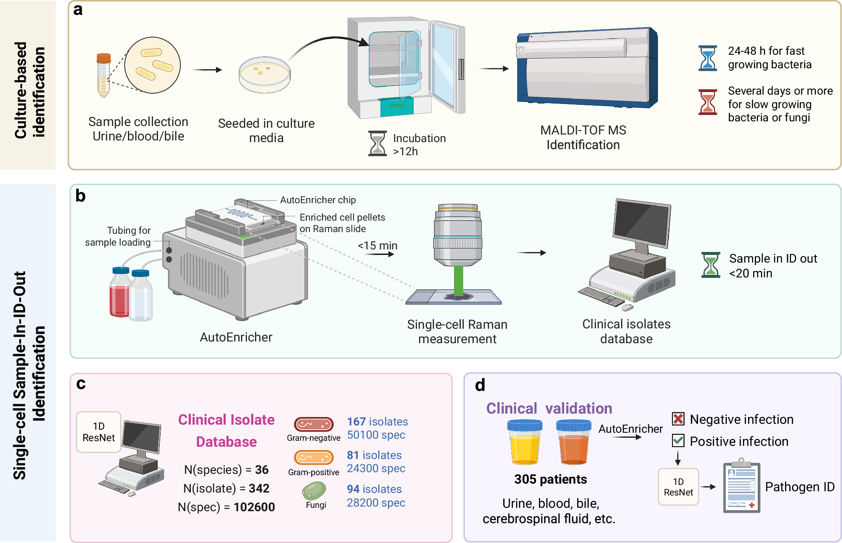
Raman: identifying microorganisms directly
Question: which microorganism is present in the sample?
1 Enrich the sample
Collect microbial cells.
2 Learn spectral patterns
A CNN learns from known species.
3 Combine cell predictions
Several cells contribute to each result.
Li et al., Nature Communications 17, 283 (2026), Fig. 1b, cropped. CC BY 4.0
5
Notes:
A one-dimensional ResNet learns local Raman patterns from 342 clinical isolates representing 36 species. Several measured cells contribute to each identification. This is classification among represented species. Fig. 1b is cropped from Li et al.; figure credit: Xu, J., BioRender https://BioRender.com/dmb6g5f.
https://doi.org/10.1038/s41467-025-66996-y
https://creativecommons.org/licenses/by/4.0/

Slide 6
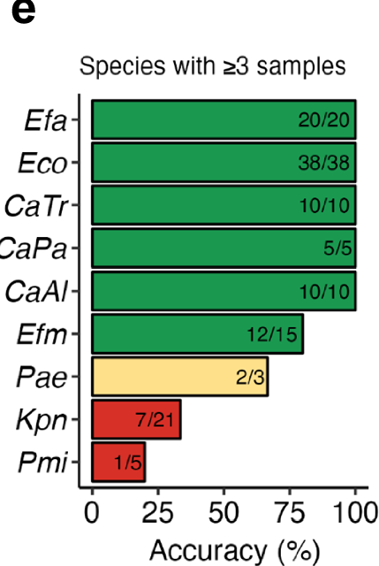
Raman: performance depends on the evaluation
Isolate validation and clinical agreement answer different questions.
95.1%
Some species perform poorly
Accuracy across 342 clinical isolates
Validation keeps each isolate’s spectra together.
82.5%
99 of 120 selected positive samples agreed
with culture and MALDI-TOF identification.
Selected known species, mostly urine samples. Broader validation remains necessary.
Li et al., Nature Communications 17, 283 (2026), Fig. 8e, cropped. CC BY 4.0
6
Notes:
Isolate result: grouped five-fold cross-validation. Clinical identification: blinded evaluation of 120 selected positive samples with represented species and culture/MALDI-TOF results. These are distinct cohorts and endpoints. Clinical agreement: 82.5%, 95% CI 74.7–88.3%. The abstract’s 95.4% concerns infection screening, not species identification. Direct transfer between instruments also performed poorly in a six-Candida-species subset.
https://doi.org/10.1038/s41467-025-66996-y
https://creativecommons.org/licenses/by/4.0/

Slide 7
Powder diffraction: clues about atomic positions
A powder contains many tiny crystals in different orientations.
Intensity at different scattering angles
What produces the pattern?
Signal intensity (arbitrary units)
Atoms scatter X-rays. Waves reinforce each other at certain angles.
What do the peaks tell us?
Positions reflect repeating spacings.
Intensities depend on the atoms and their positions.
Scattering angle 2θ (degrees)
Goal here: use the pattern and formula to infer an atomic arrangement.
Concept: IUCr teaching pamphlet, An introduction to X-ray diffraction. Schematic pattern.
7
Notes:
This is a hypothetical powder pattern, not a specific material or a PXRDGen result. Different orientations produce diffraction at different angles. Peak positions constrain lattice spacings, while relative intensities contain information about unit-cell contents. Overlap complicates inversion. PXRDGen uses the chemical formula as an additional constraint.
Sources
https://www.iucr.org/education/pamphlets/2/full-text
https://doi.org/10.1038/s41467-025-62708-8

Slide 8
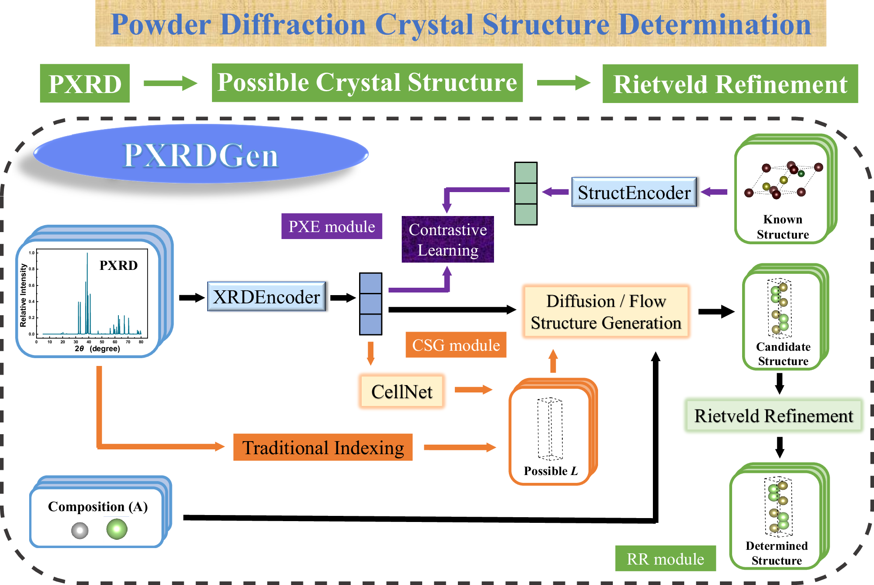
PXRDGen: atomic arrangements from a powder
Problem: overlapping diffraction peaks make crystal structures difficult to solve.
Read the pattern
A neural network extracts information from the diffraction peaks.
Propose atomic arrangements
A generative model uses the pattern and chemical formula.
Refine against the data
Rietveld refinement adjusts the structure to improve the fit.
Li et al. (2025), Fig. 1 reproduced unchanged. CC BY-NC-ND 4.0
8
Notes:
PXRD means powder X-ray diffraction. The generator learns plausible crystal structures. Rietveld refinement compares calculated and input diffraction intensities. Full original figure, without crops or overlays.
Sources
https://doi.org/10.1038/s41467-025-62708-8
https://creativecommons.org/licenses/by-nc-nd/4.0/

Slide 9
PXRDGen: a strong benchmark with limits
MP-20 benchmark with simulated diffraction patterns
Benchmark conditions
Known unit-cell parameters.
20 candidate structures per case.
Scope
The training benchmark contains inorganic crystals with at most 20 atoms per primitive cell.
Complex oxides and organic crystals need further development.
A close diffraction fit still needs chemical assessment.
Li et al. (2025), results underlying Fig. 5. Counts redrawn from the text.
9
Notes:
These counts use flow-CNN-Ltruth: 8,238 valid entries from 9,046 test cases, 7,946 structure matches and 7,304 automatic refinements. Do not generalise this result to all experimental powders.
Sources
https://doi.org/10.1038/s41467-025-62708-8

