Slide 1
List of some commonly used learning algorithms
Decision trees
Neural networks
Support vector machines
Random forests
Nearest neighbour algorithms
...

Slide 2
Intermezzo: the binary system
Decimal system: 5 273
10000 1000 100 10 1
0 5 2 7 3
Every column represents a decimal, and every decimal digit has a value from 0 to 9 (inclusive)
Binary system: 1 / 2 / 9 / 15
16 8 4 2 1
0 0 0 0 1 → 1 in decimal
0 0 0 1 0 → 2 in decimal
0 1 0 0 1 → 9 in decimal
0 1 1 1 1 → 15 in decimal
Every column represents one bit, and every bit (binary digit) has a value of 0 or 1

Slide 3
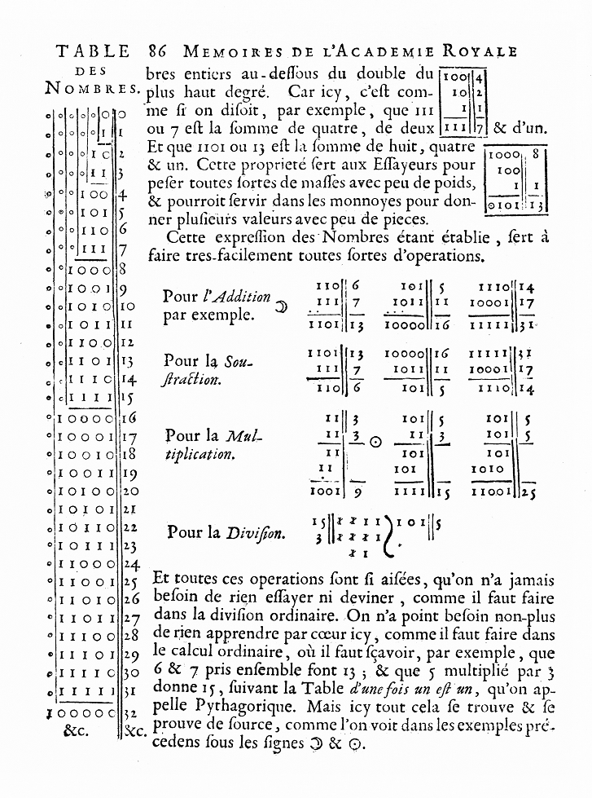
Binary counting in the early 18th century with Leibniz (in French!)
Explication de l'Arithmétique Binaire, Gottfried Wilhelm von Leibniz, 1703

Slide 4
Entropy, bits, and states
DNA has four bases (or four possible ‘states’): A, C, G, and T
We can code every base (‘state’) as a number:
A → 0 C → 1 G → 2 T → 3
We can write these four decimal numbers in binary as well:
base decimal binary
A 0 00
C 1 01
G 2 10
T 3 11
→ We need two bits to encode these four bases.

Slide 5
Maximal entropy for a system
The maximal entropy of a system is equal to the minimal number of bits
needed to encode all possible states of that systeem.
maximal entropy = log₂(#states)
Logarithm base 2 because we count in bits,
that can take one of two values: 0 or 1
Number of possible states that the system can occupy,
e.g., four different states for a DNA base

Slide 6
Some examples of maximal entropy
The maximal entropy of the biological system “sex” is 1
  two states are possible: XY en XX
  1 bit is enough to code this:
    XY → 0 and XX → 1
    or:
    log₂(2) = 1
The maximal entropy of a single letter in the western alphabet is just over 4.7
  There are 26 possible states: A to Z (inclusive)
  We need more than four bits, but less than five complete bits to encode this:
    A → 0 / B → 1 / … / Y → 24 / Z → 25 and 25 = 11001 in binary
    More precisely:
    log₂(26) = 4.70044 (rounded)

Slide 7
The concept of local entropy
The local entropy of a system is calculated based on the frequency with which every actually observed state occurs.
Local entropy = – ∑ (p_{i} log₂(p_{i}))
Sum across all actually occuring states
Frequency of this state

Slide 8
Some examples of local entropy
De local entropy of the starting years of first-year biomedical sciences students is roughly 0.59
  There are 181 students, and 3 effective states (“2014”, “2015”, en “2016”)
  “2016”: 160/181 ; “2015”: 18/181 ; “2014”: 3/181
  – { (160/181) * log₂(160/181) +
  (18/181) * log₂( 18/181) +
  (3/181) * log₂( 3/181) } = 0.586 (rounded)
The local entropy of the first letters of every word in this sentence: approximately 2.9
  t, l, e, o, t, f, l, o, e, w, i, t, s → 13 letters, of which 8 are unique
  t: 3/13 ; l: 2/13 ; e: 2/13 ; o: 2/13 ; f: 1/13 ; w: 1/13 ; i: 1/13 ; s: 1/13
  – { (3/13)*log₂(3/13) + (2/13)*log₂(2/13) + (2/13)*log₂(2/13) +
  (2/13)*log₂(2/13) + (1/13)*log₂(1/13)) + (1/13)*log₂(1/13) +
  (1/13)*log₂(1/13) + (1/13)*log₂(1/13)} = 2.873 (rounded)

Slide 9
Local entropy and maximal entropy for a system
The maximal entropy of the starting years of first-year biomedical sciences students is: log₂(3 possibilities) = 1.58 (rounded)
The lcoal entropy for AY 2016-2017, as calculated on the previous slide, is: 0.586 (rounded)
The local entropy is about a third of the maximal entropy – indicating a relatively homogeneous composition
Let us now change the composition of the first-year students as follows:
  “2016”: 101/181 ; “2015”: 46/181 ; “2014”: 34/181
  The local entropy now becomes: 1.425 (rounded)
  The local entropy now becomes almost equal to the maximal entropy (1.58, see top) –indicating a quite randomly dispersed composition

Slide 10
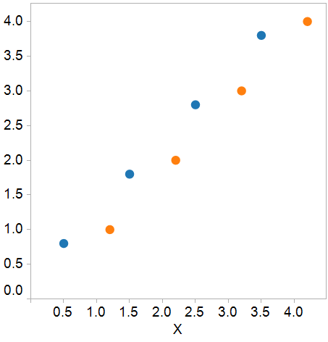
Decision tree
B
B
>2
<=2
A
A
<3
>=3
<1
>=1
A

Slide 11
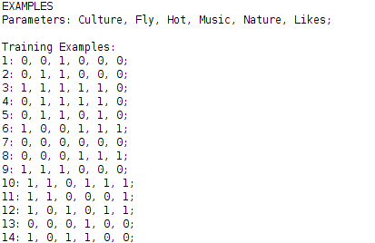


Induction of a decision tree
decision tree
of

Slide 12
Induction of a decision tree
Information Entropy Minimalisation
decision tree
of

Slide 13
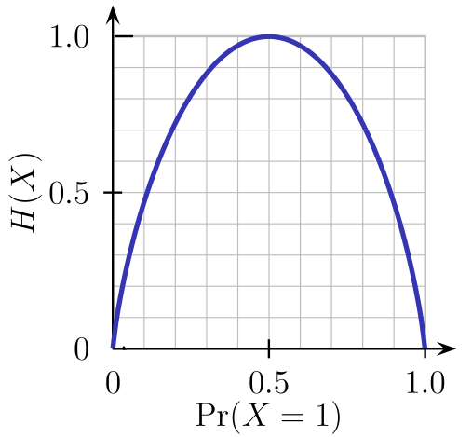
Entropy
entropy(data_set) =
-1*(p(“Yes”)*log₂(p(“Yes”) )+ p(“No”)*log₂(p(“No”)))
-1* ((13/26) log₂(13/26) + (13/26) *log₂(13/26)) = 1
p(“Yes”)

Slide 14
Information gain (delta entropy)
B
Information gain
(delta entropy / entropy reduction)

Slide 15
Information gain
entropy = 1
B
entropy reduction = 0.5
entropy = 0.6
entropy = 0.4
average entropy = 0.5

Slide 16
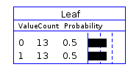
Decision tree data structure
EXAMPLE STRUCTURE
[Numeric ID: Culture, Fly, Hot, Music, Nature, Like;]
Training examples:
01: 0, 0, 1, 0, 0, 0;
02: 0, 1, 1, 0, 0, 0;
03: 1, 1, 1, 1, 1, 0;
04: 0, 1, 1, 1, 1, 0;
05: 0, 1, 1, 0, 1, 0;
…
26: 0, 1, 0, 1, 0, 1;
Like

Slide 17
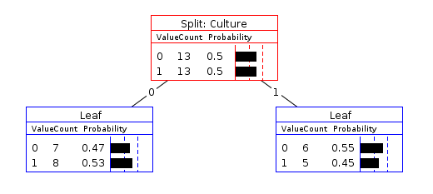
Decision tree
entropy = 1
entropy = -1 * (0.47*log₂(0.47)+0.53*log₂(0.53)) = 0.997
entropy = -1 * (0.55*log₂ (0.55)+0.45*log₂ (0.45)) = 0.991

Slide 18
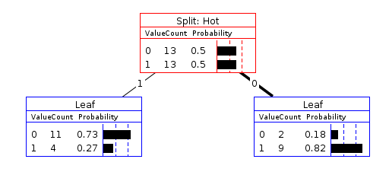
Decision tree
entropy = 1
entropy = -1 * (0.73*log₂(0.73)+0.27*log₂ (0.27)) = 0.84
entropy = -1 * (0.18*log₂ (0.18)+0.82*log₂ (0.82)) = 0.68

Slide 19

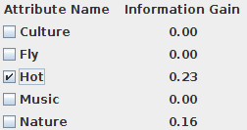
Decision tree

Slide 20
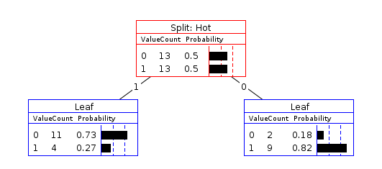
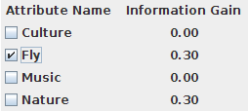
Decision tree

Slide 21
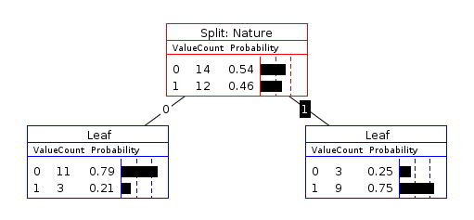
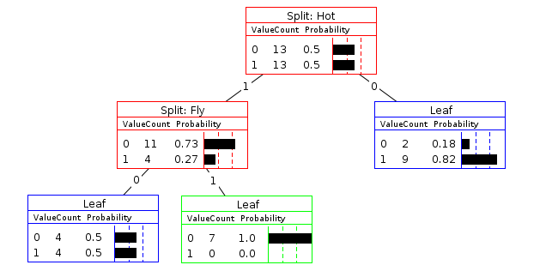
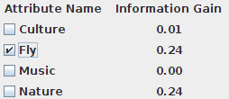
Decision tree

Slide 22
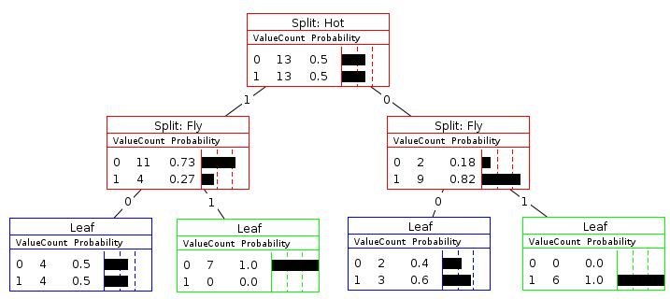

Decision tree

Slide 23
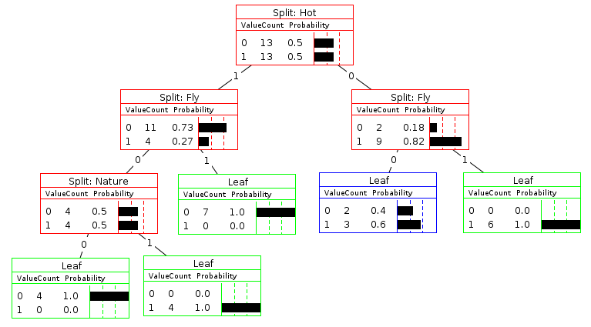


Decision tree

Slide 24
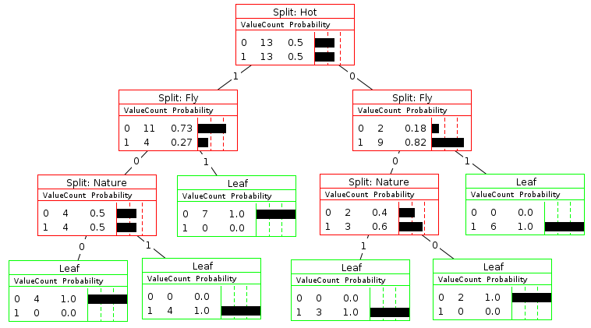
Decision tree

