Slide 1
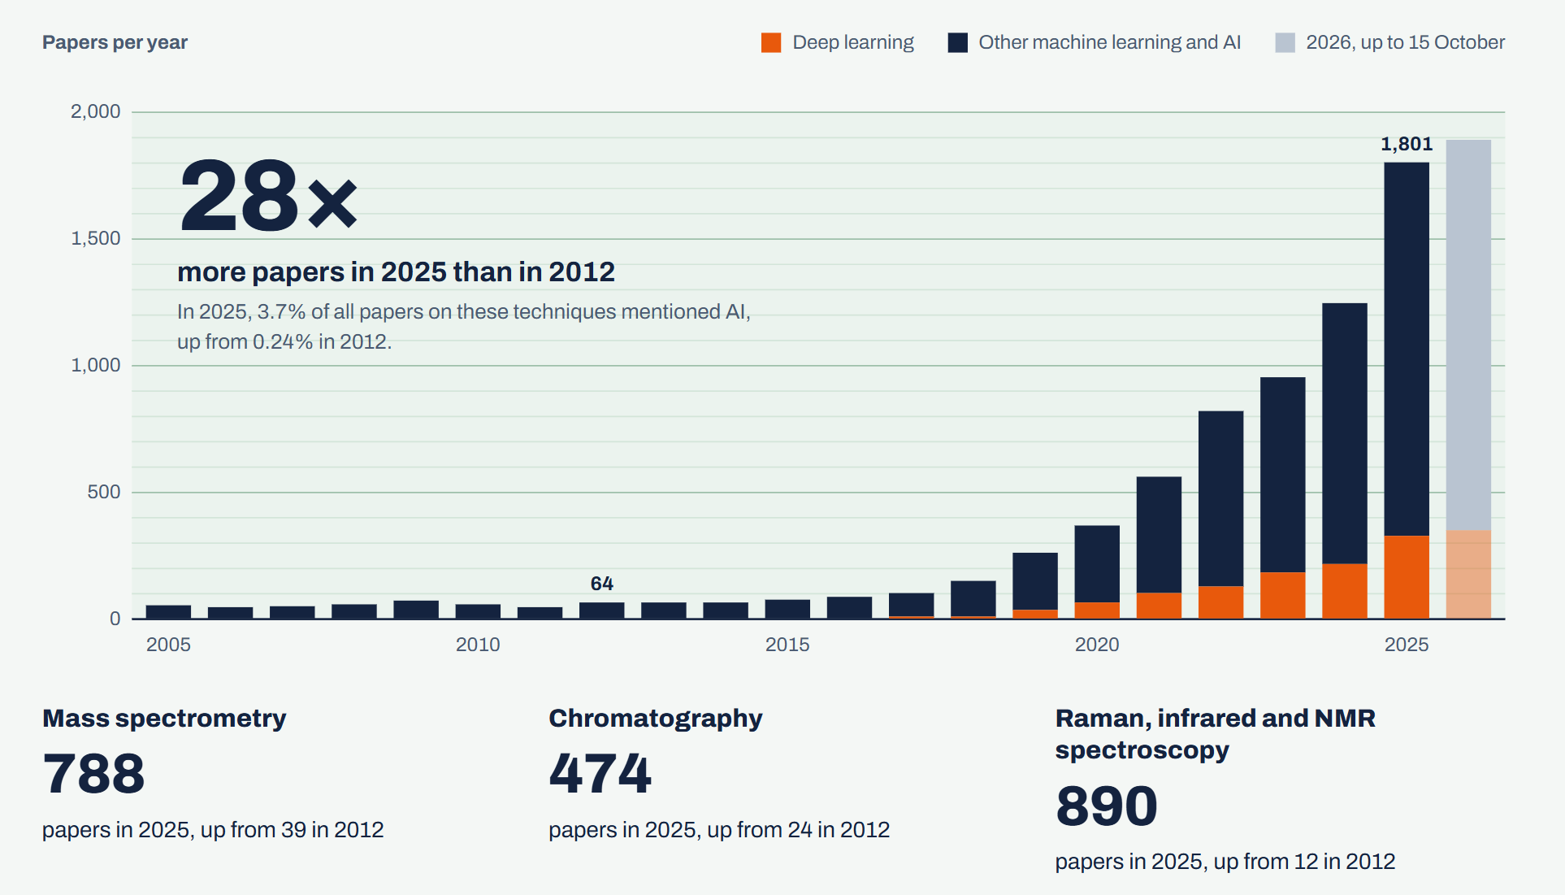

Slide 2
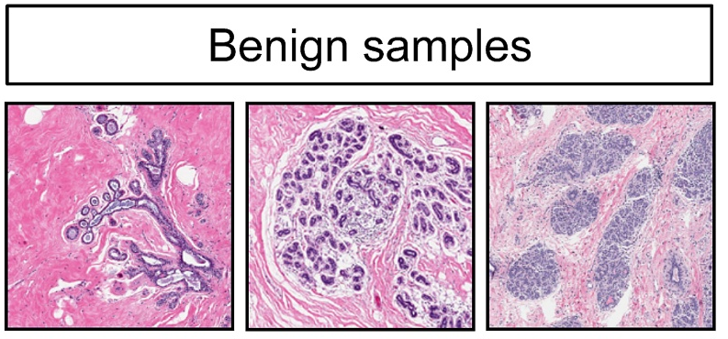
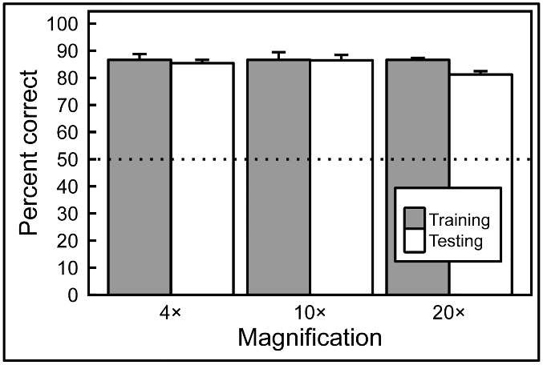
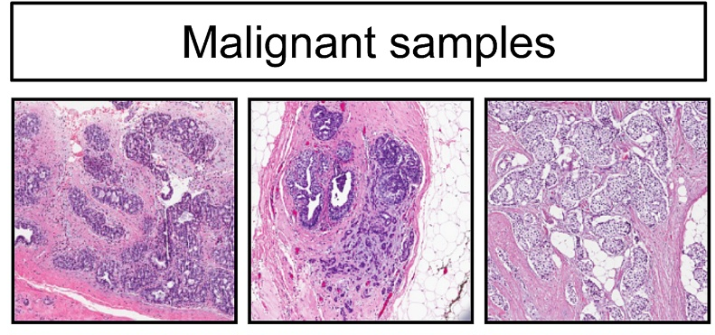
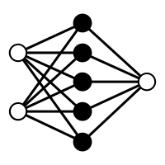
Human expert competing with Artificial Intelligence (Machine Learning model) to classify benign or malignant breast cancer slides
Human Expert
Machine Learning

Slide 3
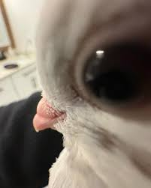
I lied; multiple pigeons learned to do this in just 14 days. Machine Learning works with the same principles though
Human Expert

Slide 4
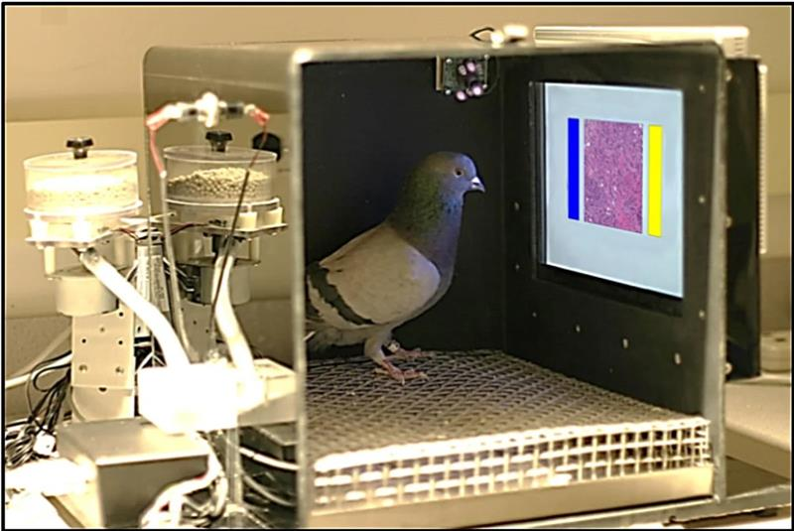
ML trains a model from experience (data) with respect to a task and performance measure that should be able to generalize
Using Pigeons to Diagnose Cancer | Scientific American

Slide 5
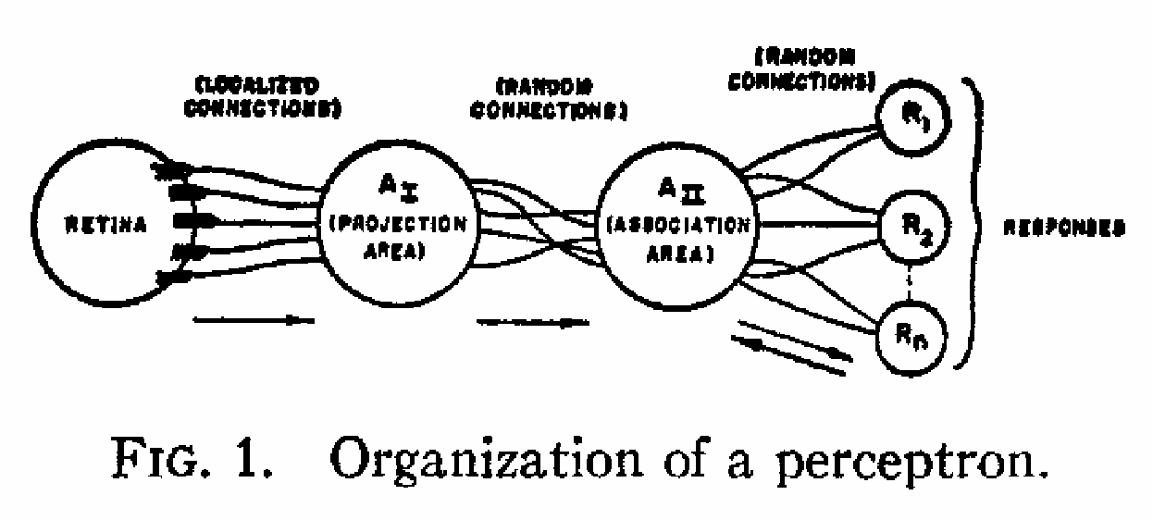
ML trains a model from experience (data) with respect to a task and performance measure that should be able to generalize
Rosenblatt, F. (1958). The perceptron: a probabilistic model for information storage and organization in the brain. Psychological review, 65(6), 386.

Slide 6
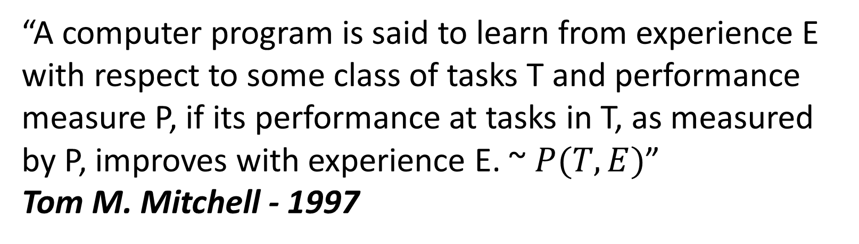
“field of study that gives computers the ability to learn without being explicitly programmed.”
Arthur Samuel - 1958
“A computer program is said to learn from experience E with respect to some class of tasks T and performance measure P, if its performance at tasks in T, as measured by P, improves with experience E. ~ $P(T,E)$”
Tom M. Mitchell - 1997

Slide 7
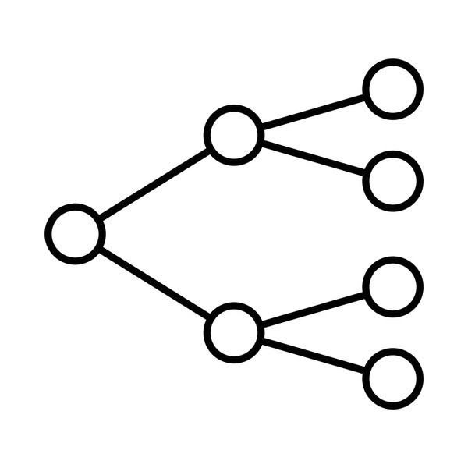
Machine learning maps between data (features) and a target value, from a trained model you can obtain predictions when providing the model with only data and an unknown target
Data (features)
Model
Target

Slide 8
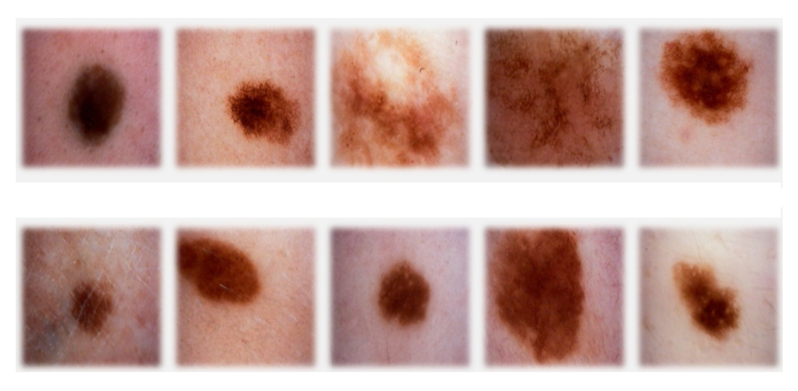
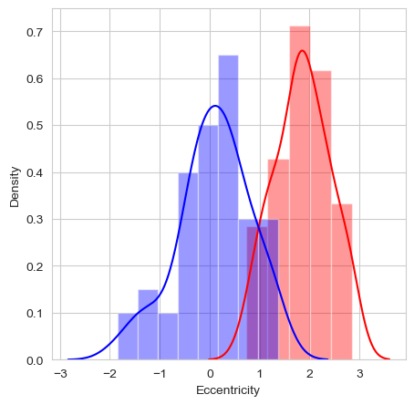
Skin melanoma as a simplified example of how a model learns;
note that a computer only works with numbers!
Data (features)
Model
Target
Eccentricity
1
<= -2.0
> -2.0
0
2
0
1
1
-0.5
1.8

Slide 9
A random decision boundary to start, the difference between predictions and target are used to move the boundary
Data (features)
Model
Predictions
Target
Eccentricity
1
1
<= -2.0
> -2.0
1
0
2
0
1
1
1
-0.5
1.8

Slide 10
A decision boundary is optimized; based on presented data for a task and performance measure that should be able to generalize
Data (features)
Model
Predictions
Target
Eccentricity
1
1
<= 1.0
> 1.0
0
0
2
0
1
1
1
-0.5
1.8

Slide 11



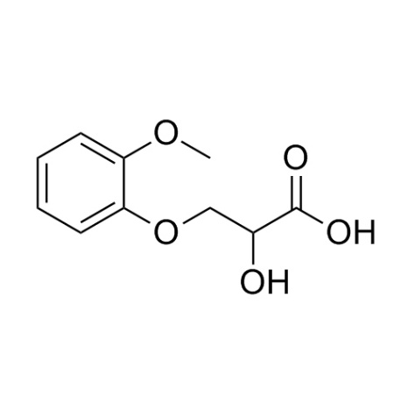
AI has an impact on many different healthcare topics; from small molecules to medical records
Biomedical analytics
Medical imaging
ECG
Drug design
Omics
Medical records

Slide 12
AI has an impact on many different healthcare topics; from small molecules to medical records
Biomedical analytics
Medical imaging
ECG
Type of data
Tabular
Type of models
Tree-based
Continuous
Neural-network
(deep learning)
Target
Disease state
Anomaly detection
Drug design
Omics
Medical records
Ning et al. Scientific Reports (2025); Lauritsen et al. Artificial Intelligence in Medicine (2020)
Notes:
https://www.nature.com/articles/s41598-025-09439-4
https://www.sciencedirect.com/science/article/pii/S0933365719303173

Slide 13
AI has an impact on many different healthcare topics; from small molecules to medical records
Biomedical analytics
Medical imaging
ECG
Type of data
Images/videos
Type of models
Tree-based
Continuous
Convolutional
Neural-network
(deep learning)
Target
Disease state
Segmentation
Anomaly detection
Drug design
Omics
Medical records
Le Dinh et al. Applied Sciences (2022)
Notes:
https://www.mdpi.com/2076-3417/12/10/4861

Slide 14
AI has an impact on many different healthcare topics; from small molecules to medical records
Biomedical analytics
Medical imaging
ECG
Type of data
Temporal ordered (sequential)
Type of models
Tree-based
Continuous
Recurrent
Neural-network
(deep learning)
Target
Disease state
Anomaly detection
Drug design
Omics
Medical records
Le Dinh et al. Applied Sciences (2022)
Notes:
https://www.nature.com/articles/s41467-020-15432-4

Slide 15
AI has an impact on many different healthcare topics; from small molecules to medical records
Biomedical analytics
Medical imaging
ECG
Type of data
Tabular
Structural (2D/3D)
Type of models
Tree-based
Continuous
Recurrent/Convolutional/Graph Neural-networks
(deep learning)
Target
Drug efficiency
IC50
Drug stability
Drug design
Omics
Medical records
Arus-Pous et al. Journal of Cheminformatics (2020)
Notes:
https://jcheminf.biomedcentral.com/articles/10.1186/s13321-020-00441-8

Slide 16
AI has an impact on many different healthcare topics; from small molecules to medical records
Biomedical analytics
Medical imaging
ECG
Type of data
Tabular
Sequential
Type of models
Tree-based
Continuous
Recurrent
Neural-networks
(deep learning)
Target
Pathogenicity
Structure
Interactions
Drug design
Omics
Medical records
Jumper et al. Nature (2021)
Notes:
https://www.nature.com/articles/s41586-021-03819-2

Slide 17
AI has an impact on many different healthcare topics; from small molecules to medical records
Biomedical analytics
Medical imaging
ECG
Type of data
Human written text
Type of models
Transformer Neural-networks (deep learning)
Recurrent
Neural-networks
(deep learning)
Target
Model the underlying textual structure
Drug design
Omics
Medical records
Yao Jiang et al. Nature (2023)
Notes:
https://www.nature.com/articles/s41586-023-06160-y

Slide 18
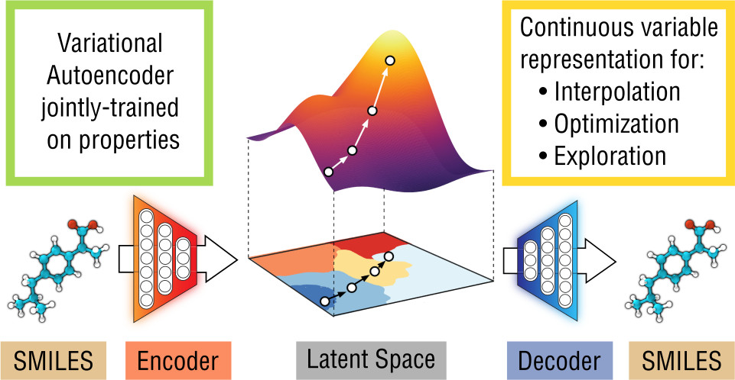
Drug design with variational auto-encoders; able to sample the latent space to find potentially interesting drugs
Gomez-Bombarelli et al. ACS Central Science (2023)
Notes:
https://pubs.acs.org/doi/10.1021/acscentsci.7b00572

Slide 19
Drug design with variational auto-encoders; able to sample the latent space to find potentially interesting drugs
Gomez-Bombarelli et al. ACS Central Science (2023)
Notes:
https://pubs.acs.org/doi/10.1021/acscentsci.7b00572

Slide 20
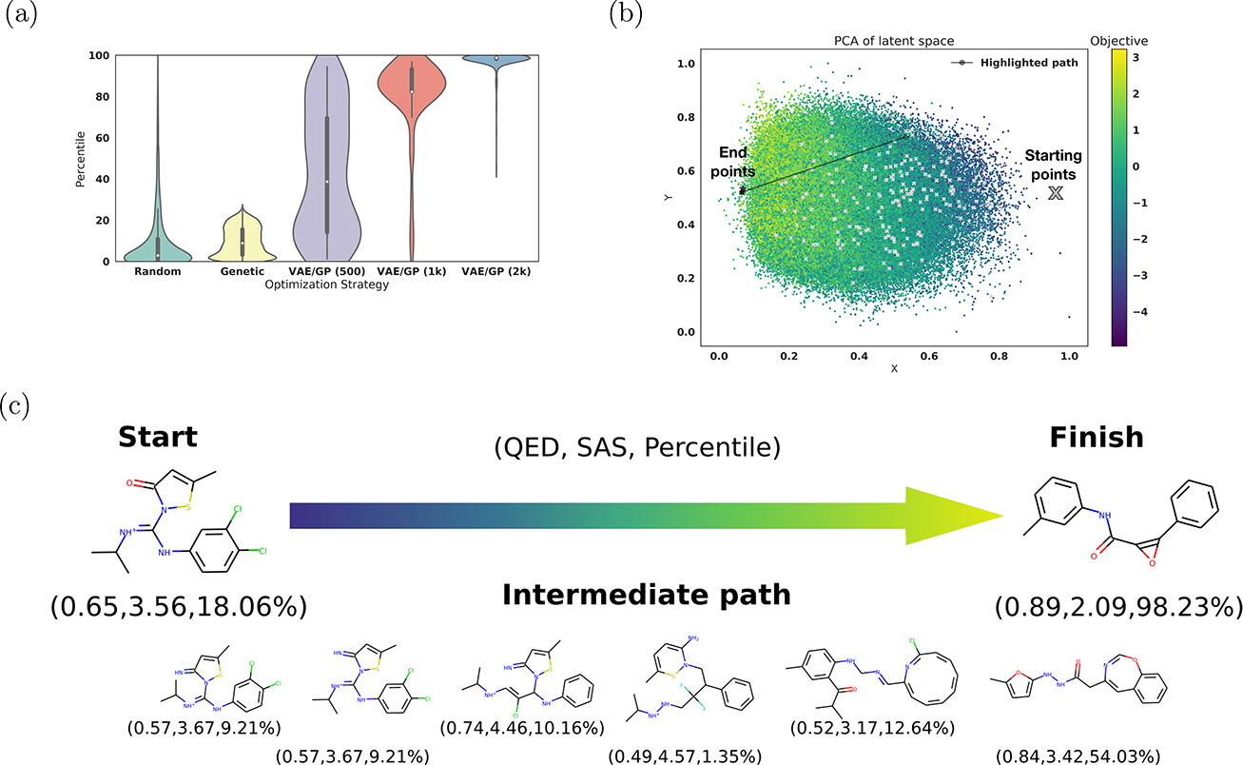
Reconstructing ibuprofen-like molecules yields much higher percentile (likeness) scores for the variational autoencoder
Gomez-Bombarelli et al. ACS Central Science (2023)
Notes:
https://pubs.acs.org/doi/10.1021/acscentsci.7b00572

Slide 21
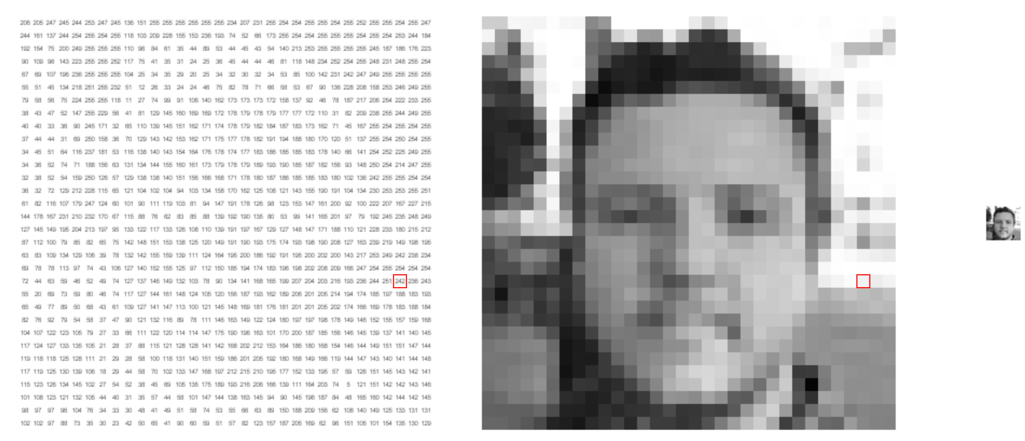
Computer vision is a large subfield in AI that deals with 2D and 3D images and videos
https://setosa.io/ev/image-kernels/

Slide 22
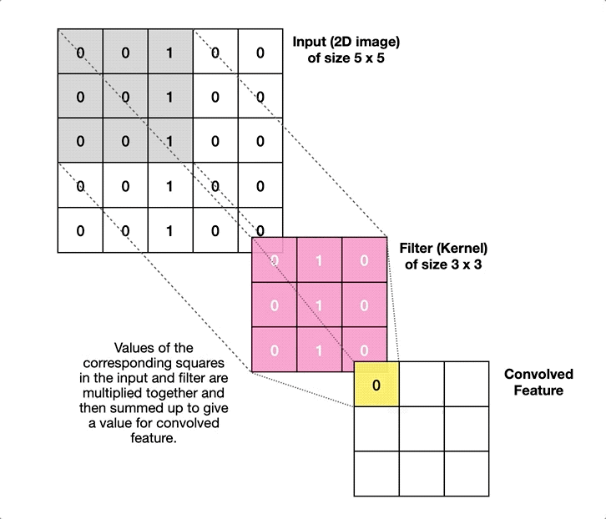
Filters are used to obtain small and unlocalized features of images that can be combined in subsequent convolutional layers

Slide 23
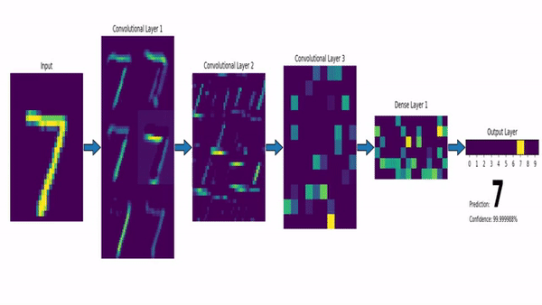
Filters are used to obtain small and unlocalized features of images that can be combined in subsequent convolutional layers

Slide 24
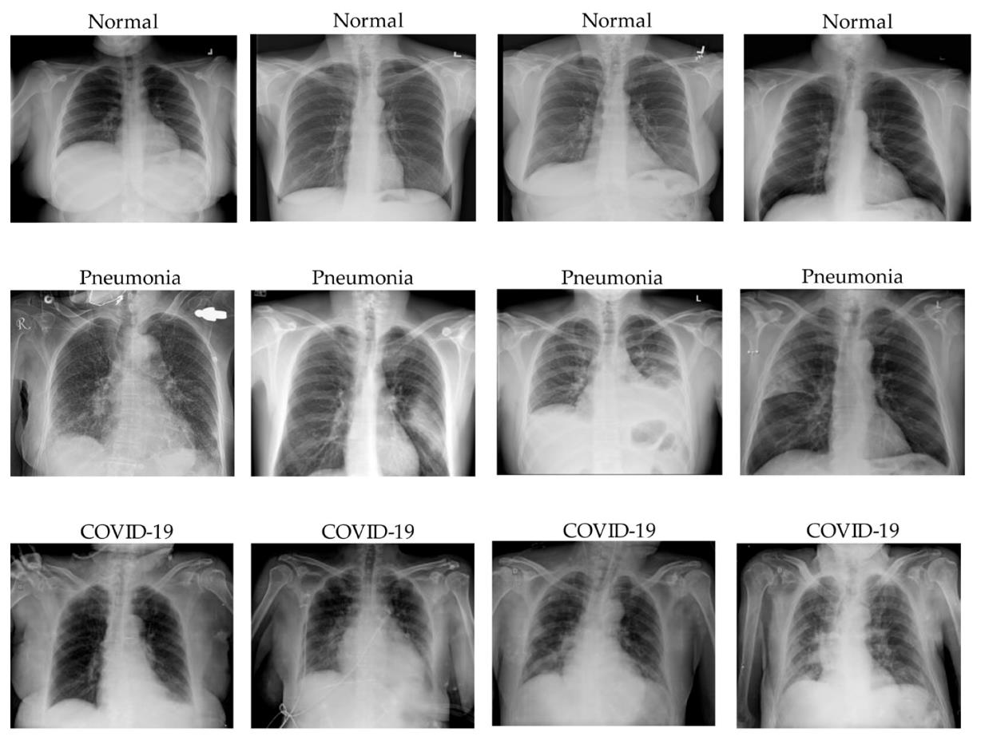
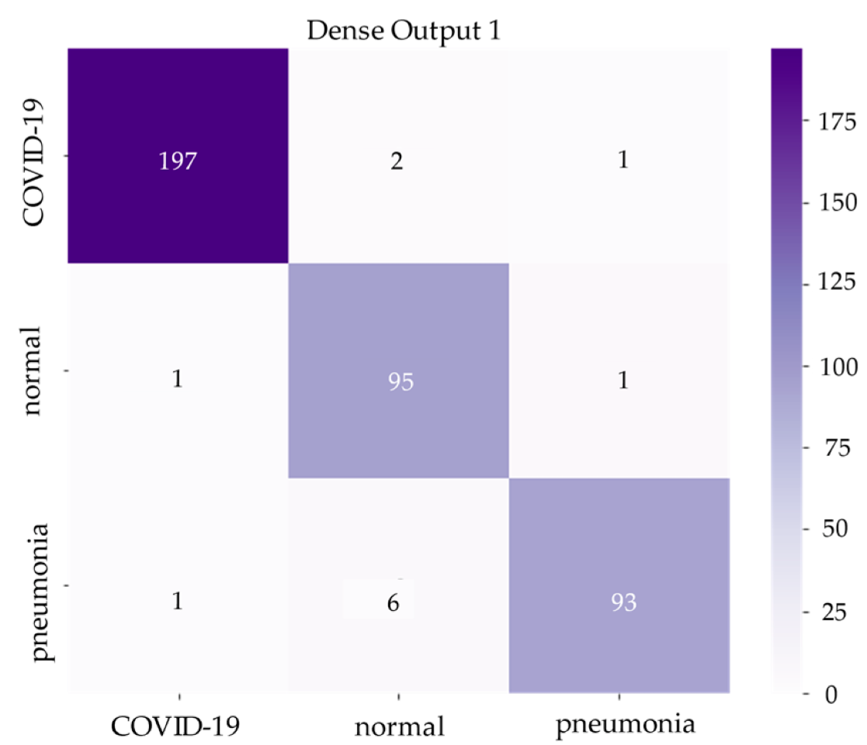
COVID can be detected with high sensitivity and specificity, and also be distinguished from pneumonia
Predictions
True labels
Le Dinh, T, et al. COVID-19 Chest X-ray Classification and Severity Assessment Using Convolutional and Transformer Neural Networks. Appl. Sci. 2022, 12, 4861
Notes:
!!! Change the reference

Slide 25
ML trains a model from experience (data) with respect to a task and performance measure that should be able to generalize
Using Pigeons to Diagnose Cancer | Scientific American

Slide 26
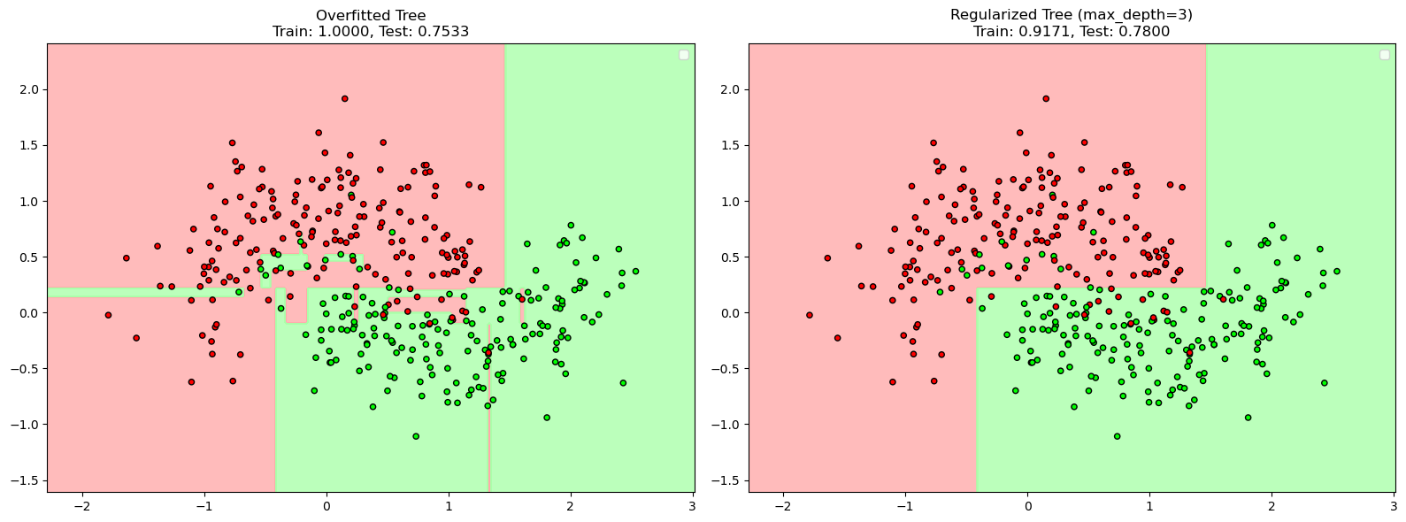
AI cheating

Slide 27
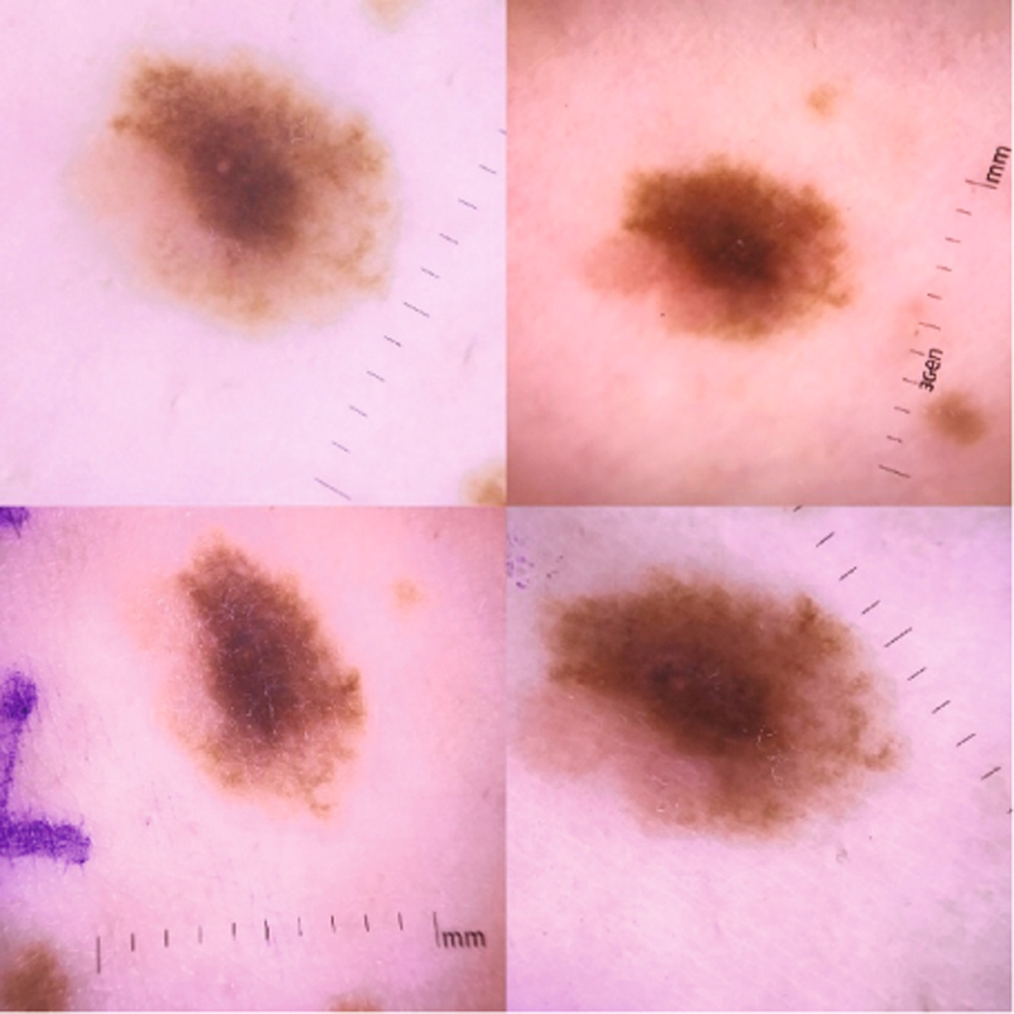
AI cares about optimizing the objective function; AI can cheat
Automated Classification of Skin Lesions: From Pixels to Practice - Akhila Narla ∙ Brett Kuprel ∙ Kavita Sarin ∙ Roberto Novoa ∙ Justin Ko
Notes:
!!! Change ref

Slide 28
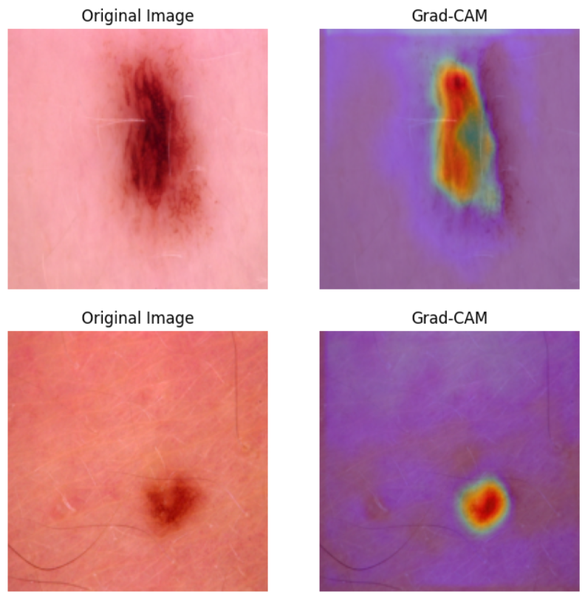
AI cares about optimizing the objective function; AI can cheat
Automated Classification of Skin Lesions: From Pixels to Practice - Akhila Narla ∙ Brett Kuprel ∙ Kavita Sarin ∙ Roberto Novoa ∙ Justin Ko

Slide 29
Conclusion and outlook
ML trains a model from experience (data) with respect to a task and performance measure that should be able to generalize
Different objectives, ML algorithms, and input data:
disease state, anomaly detection, segmentation, drug efficiency, IC50, drug stability, pathogenicity, structure, interactions, textual structure, …
tree-based, continuous, neural-network, recurrent NN, convolutional NN, transformer (LLM), …
tabular, image, video, temporal ordered, sequence, structural, textual, …
Notes:
!!! Add qr to slides

