Slide 1
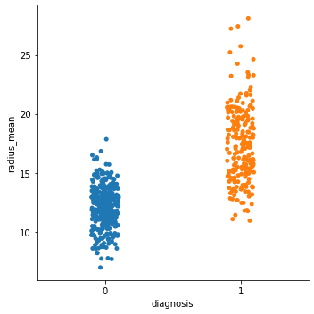
Classification – breast cancer data

Slide 2
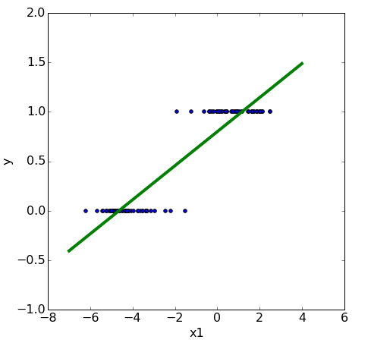

classification
We need to make
assumptions
about the
model
that generated the data.
linear relationship
linear model

Slide 3
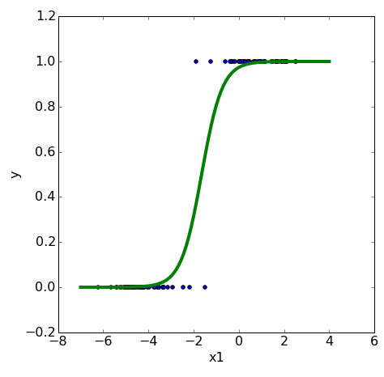

logistic regression
We need to make
assumptions
about the
model
that generated the data.
linearly separable
logistic model

Slide 4


logistic regression

Slide 5
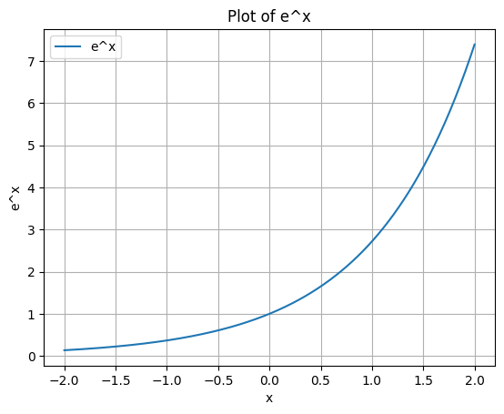
logistic regression

Slide 6
logistic regression

Slide 7
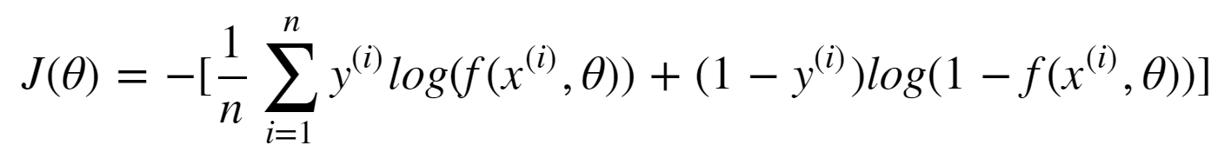
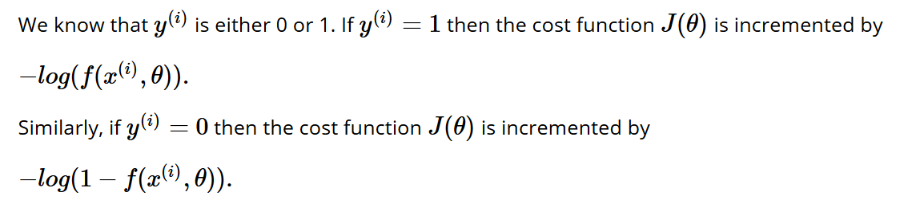
logistic regression: cost (loss function)

Slide 8
logistic regression: cost (loss function)
Only active when target is “1”
Only active when target is “0”

Slide 9
logistic regression: cost (loss function)

Slide 10
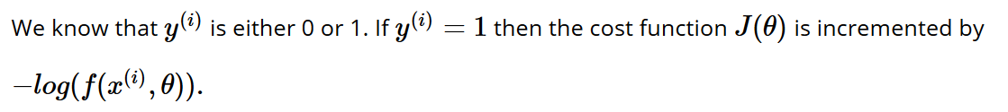
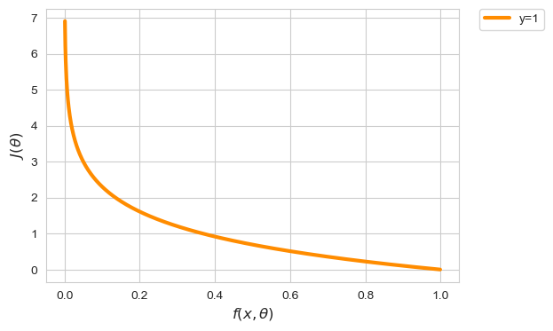
logistic regression: cost (loss function)
Notes:
X-as is predictie
Y-as is cost van predictie indien y == 1

Slide 11
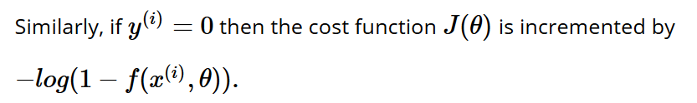
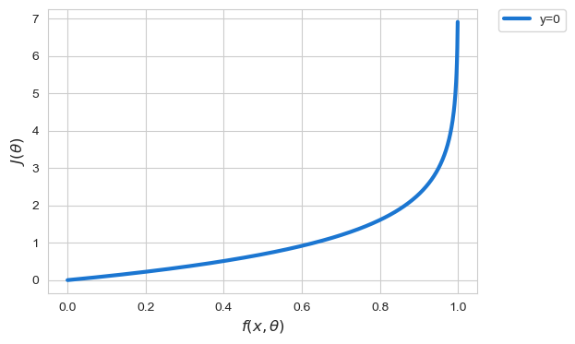
logistic regression: cost (loss function)

Slide 12
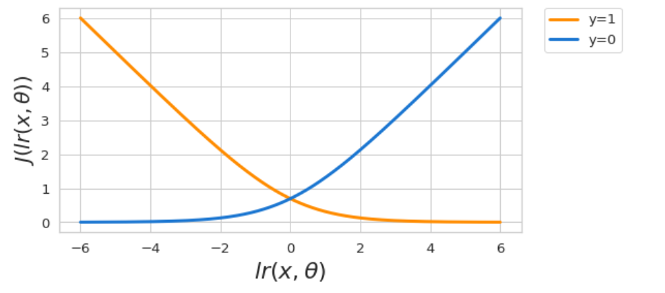
Logistic regression: cost (loss function)

Slide 13

logistic regression
Fit a logistic model
to the data set such that the cost function
is minimized using gradient descent
Notes:
Also convex!

