Slide 1
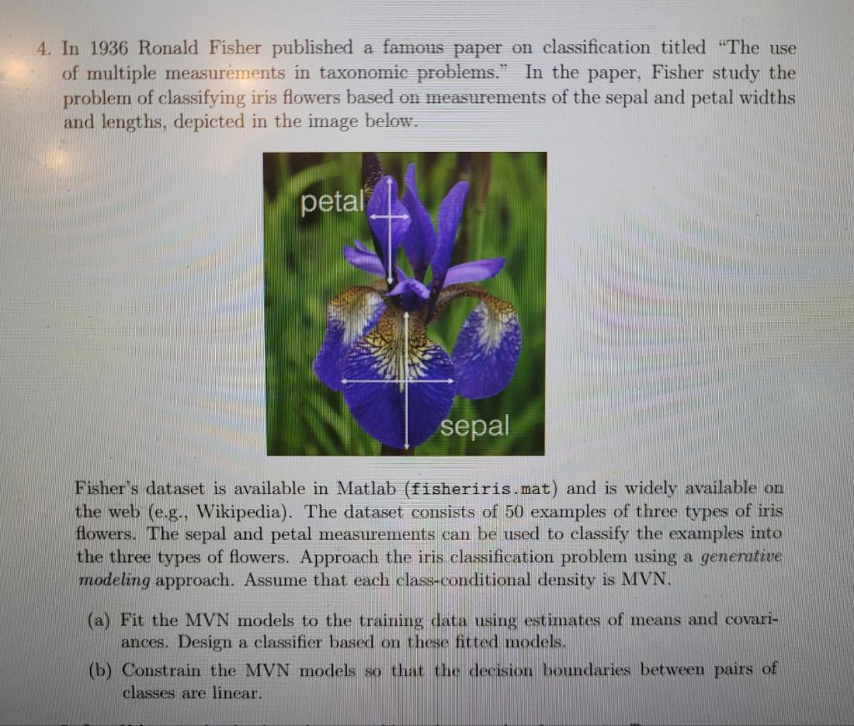
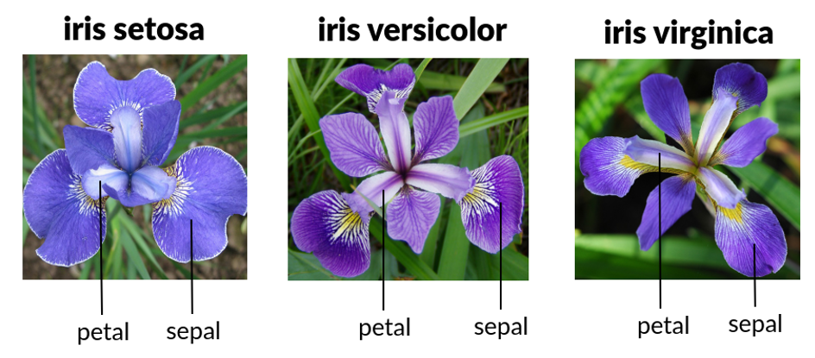
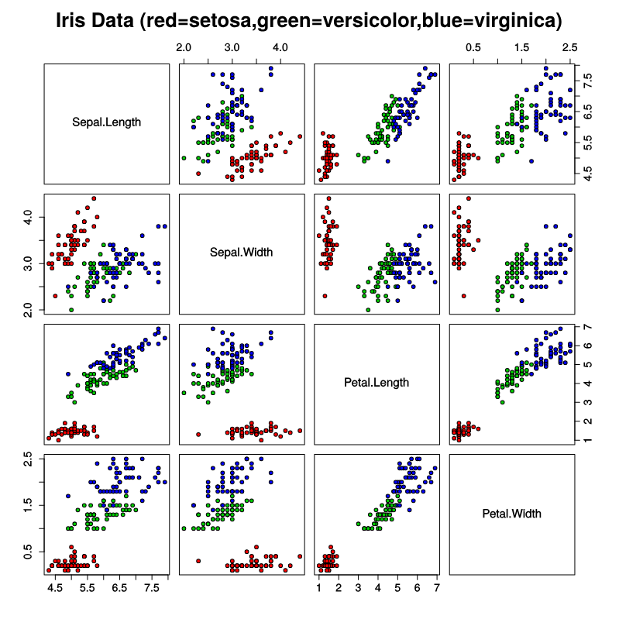
Iris dataset
Fisher, R.A. (1936) The Use of Multiple Measurements in Taxonomic Problems. Annals Eugenics, 7, 179-188.

Slide 2
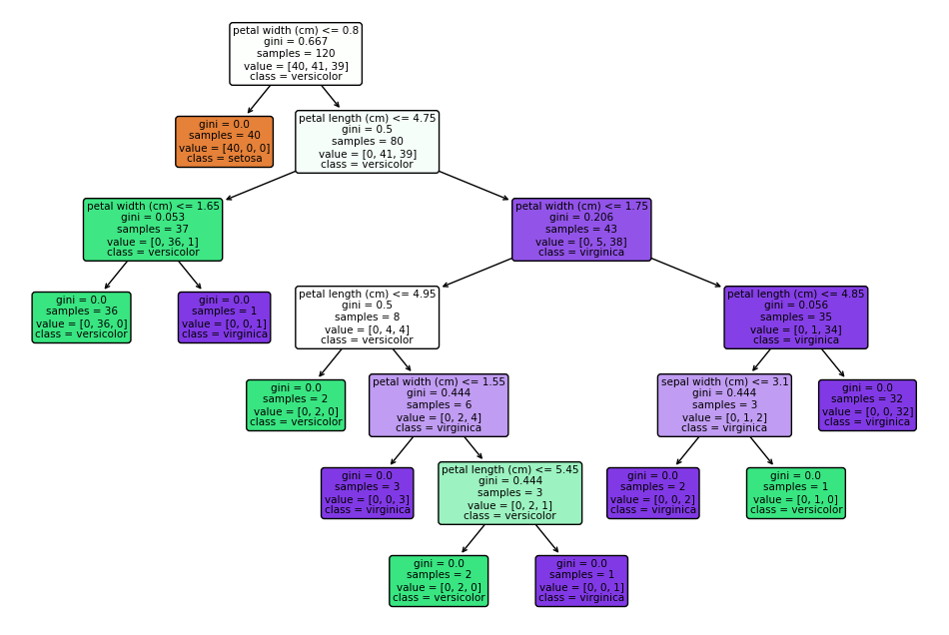
Decision tree

Slide 3
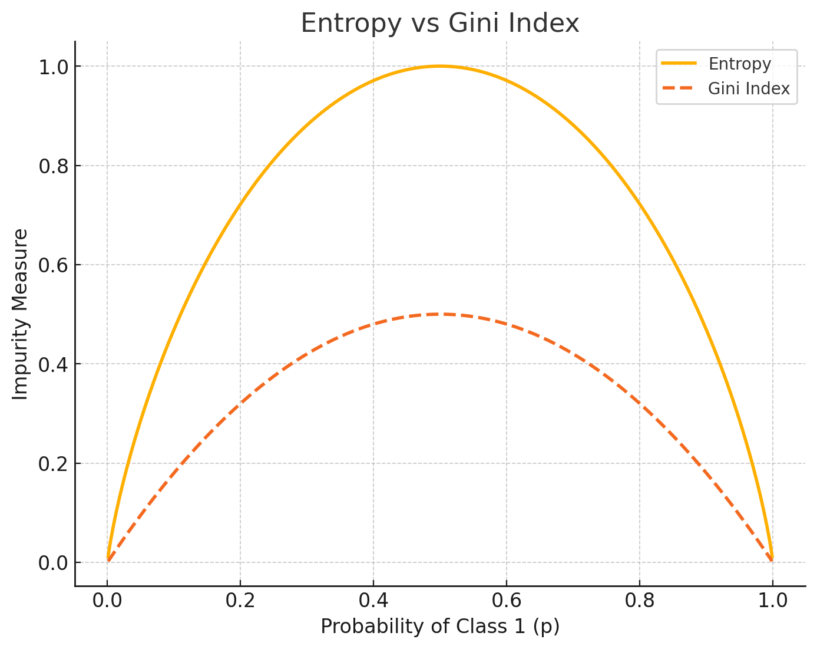
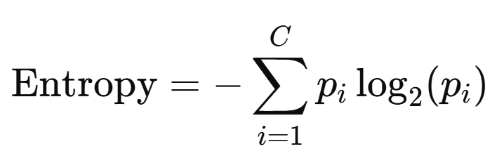
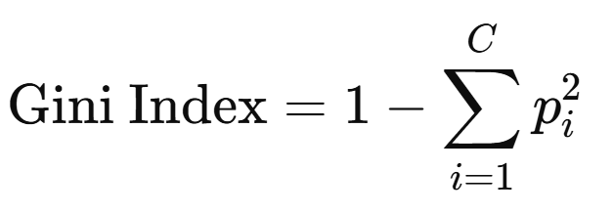
Decision tree formalization of the cost function

Slide 4
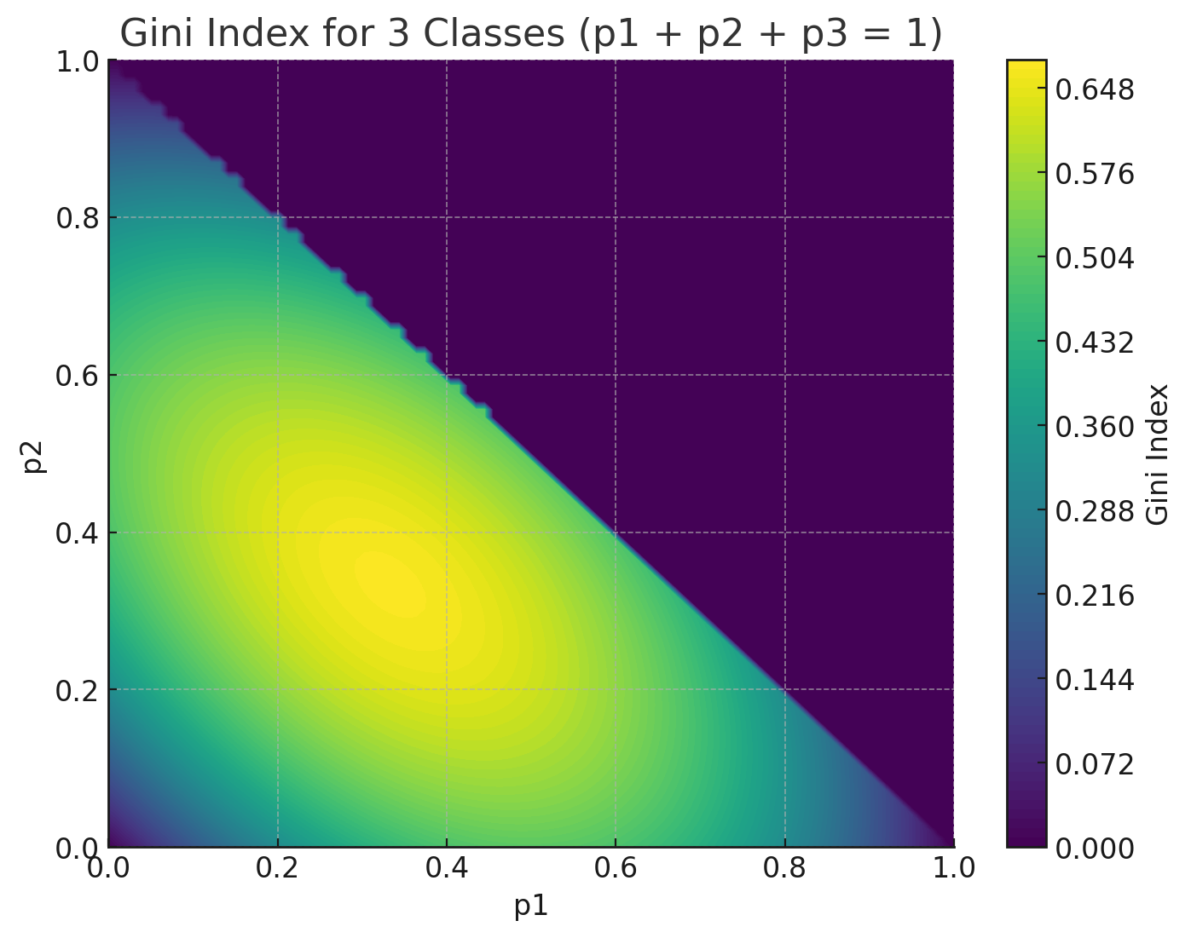
Decision tree formalization of the cost function

Slide 5
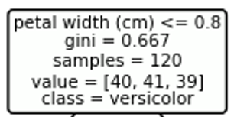
Decision tree formalization of the cost function

Slide 6
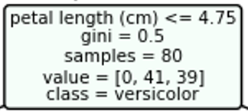
Decision tree formalization of the cost function

Slide 7
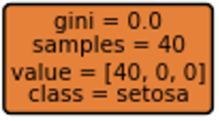
Decision tree formalization of the cost function

Slide 8
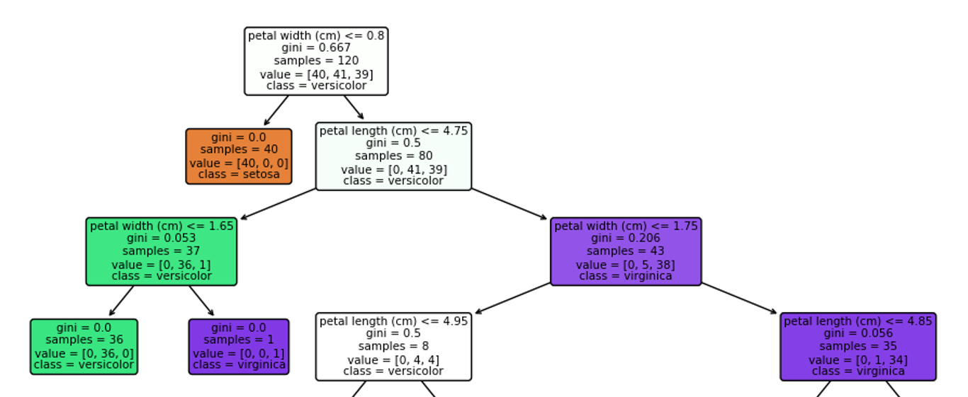
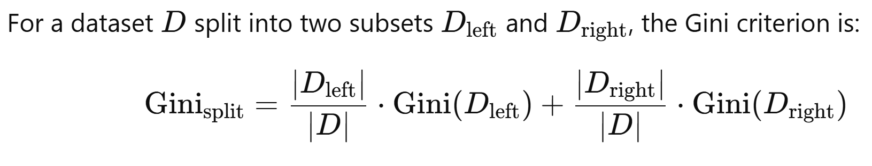
Decision tree formalization of the cost function

