Slide 1
Ensemble methods can use overfitting and underfitting to their advantage
Decision trees serve as the foundation for ensemble methods like Random Forest and Gradient Boosting, which combine multiple trees to improve accuracy and robustness.
Ensemble learning reduces variance and bias, as bagging (e.g., Random Forest) decreases overfitting, while boosting (e.g., AdaBoost, XGBoost) enhances weak learners by correcting misclassified instances iteratively.

Slide 2
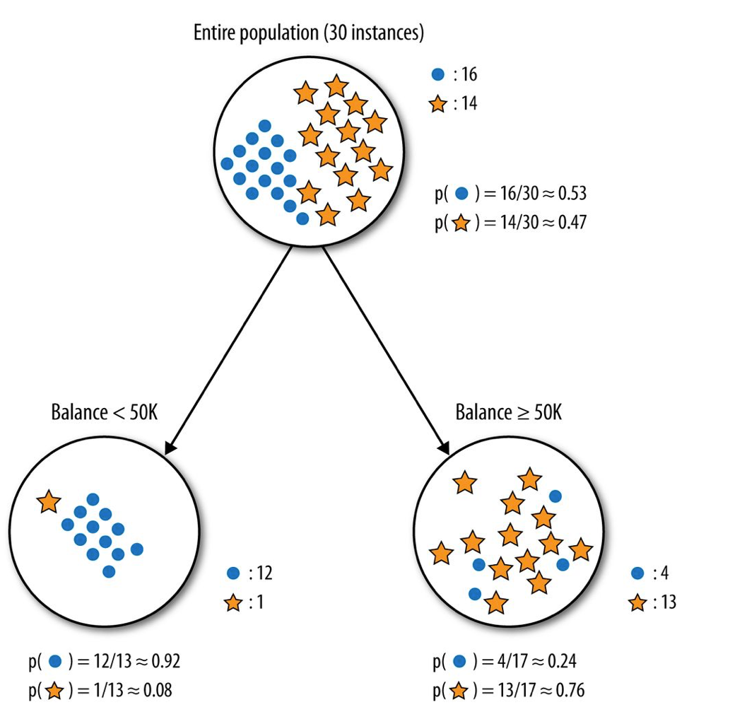

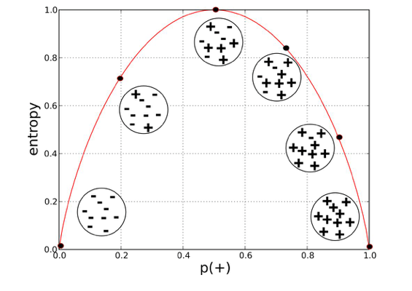
Decision tree models - recap

Slide 3
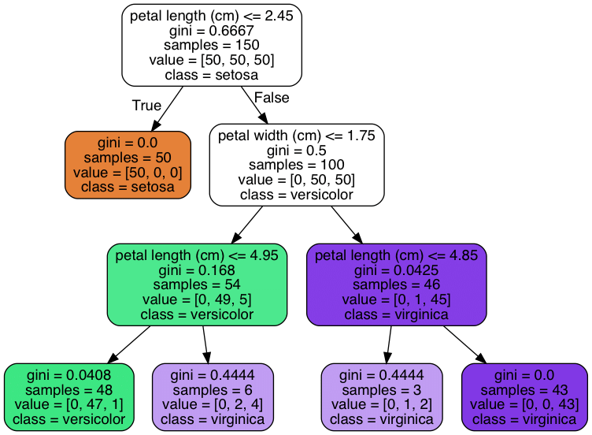
Single decision trees have several advantages and disadvantages
advantages:
ease of interpretation
handles continuous and discrete features
invariant to monotone transformation of features
variable selection automated
low bias (deep trees)
disadvantages:
high variance
overfitting

Slide 4
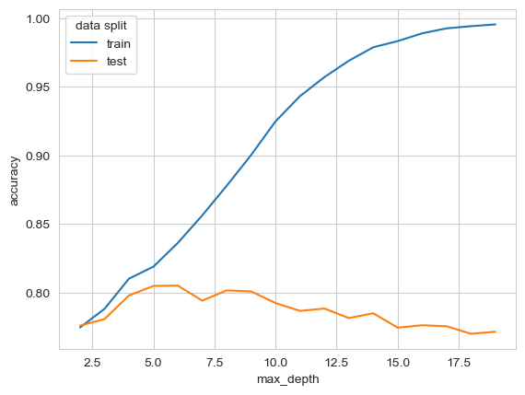
Model hyperparameter optimization on unseen data

Slide 5
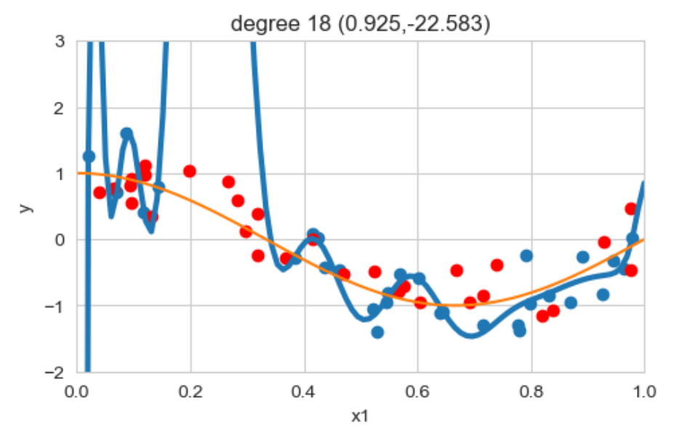
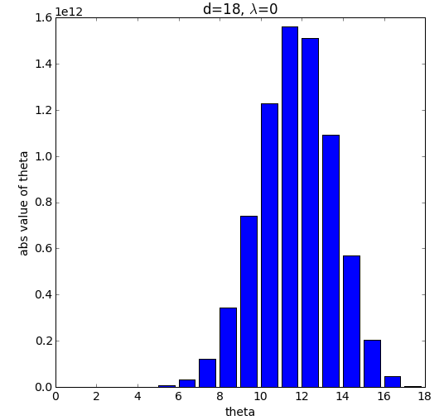
Regularized regression

Slide 6

Validation hold-out set
Validation data

Slide 7
5-fold cross-validation; mostly when not sufficient data is available

Slide 8
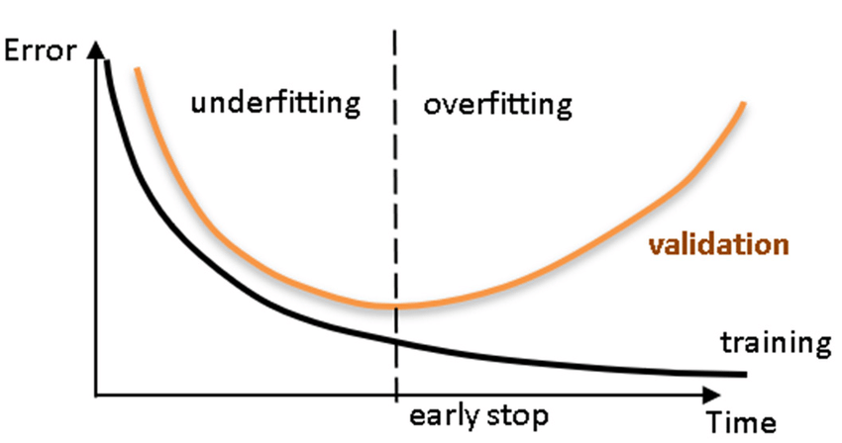
Where do we want to sit in terms of underfitting and overfitting
Maximum depth

Slide 9
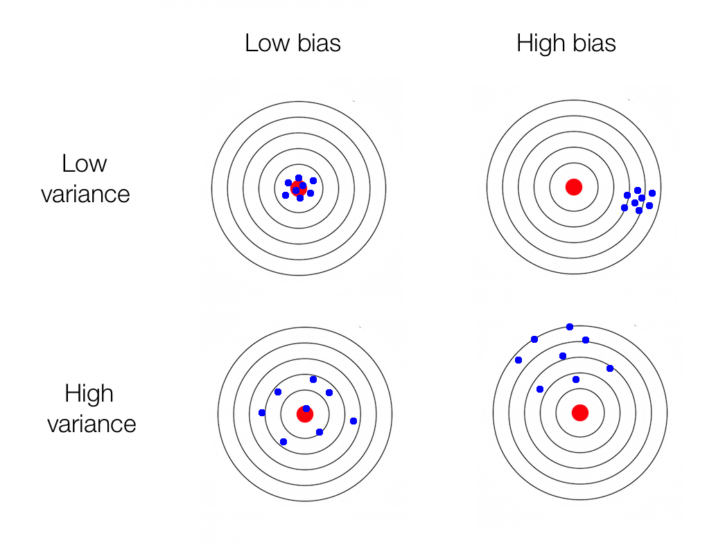
Concept of bias and variance is a foundation of fitting models
Error due to bias
(systematic errors,
oversimplification)
Error due to variance
(sensitivity due to flexibility,
overcomplification)
Irreducible error

Slide 10
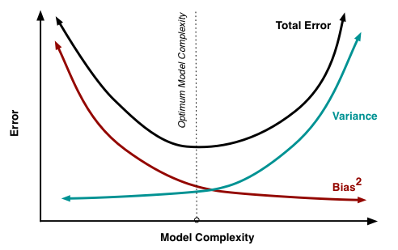
Concept of bias and variance is a foundation of fitting models
Error due to bias
Error due to variance
Irreducible error

Slide 11
Bagging and boosting use under- and overfitting to get more performant models
boosting
bagging

Slide 12
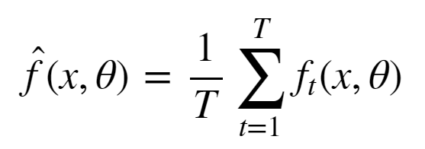
Bagging uses multiple overfitted (high variance) trees to reduce overfitting (low variance)
Simulate the notion of different train set samples:
    sample data points from train set to create new train set
    fit low bias high variance model on new train set
    repeat steps (1) and (2) T times
    average the predictions of the T models

Slide 13
Bagging: Random Forest
Train set contains n data points with m features.
Construct T low bias high variance decision trees by following these steps:
  Sample n data points at random with replacement from the train set.
  At each node, select h from m features at random where (h<<m) and compute the best split using only these h features.
  Each tree is grown to the largest extent possible. Or at least to a high-level complexity
Step 3 ensures that the bagged models are low bias by learning deep complex decision trees.

Slide 14
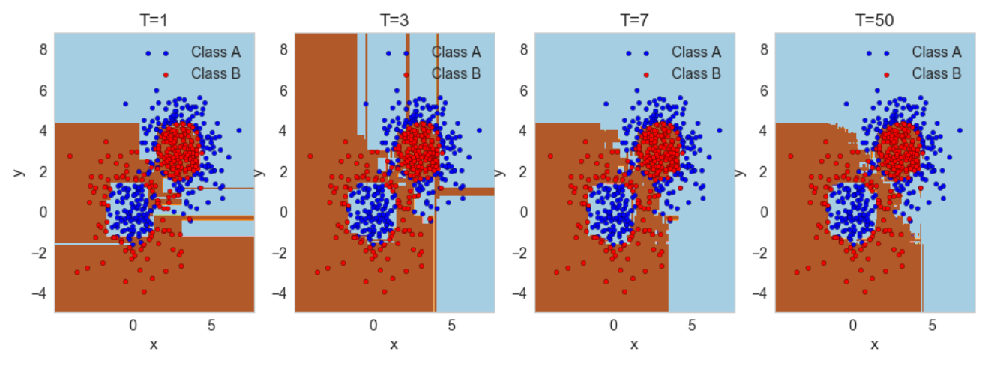
Bagging: Random Forest
X2

Slide 15
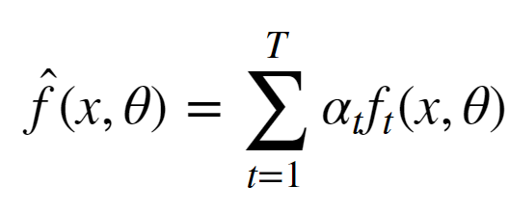
Boosting uses multiple underfitted (low variance; high bias) trees to reduce underfitting (low variance; low bias)
reduce the bias of a high bias low variance model
turning an ensemble of weak learners into a strong learner
the meta-model is additive, i.e. Adaboost:

Slide 16
Bagging and boosting use under- and overfitting to get more performant models
boosting
bagging

Slide 17
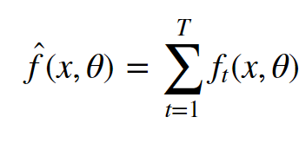
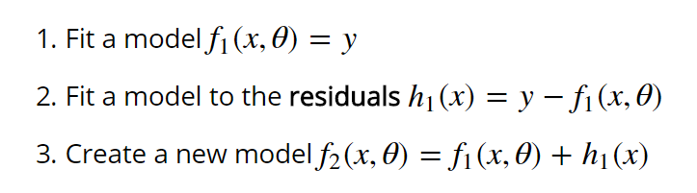
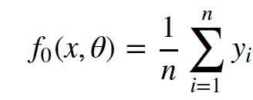

Boosting: Gradient boosting

Slide 18
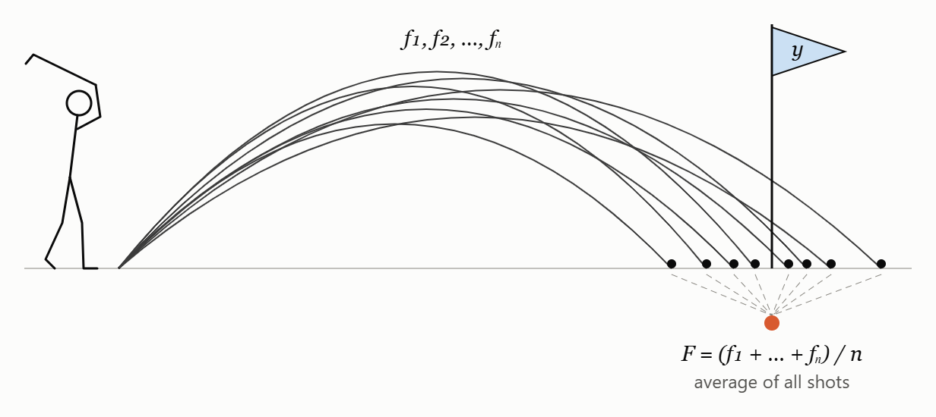
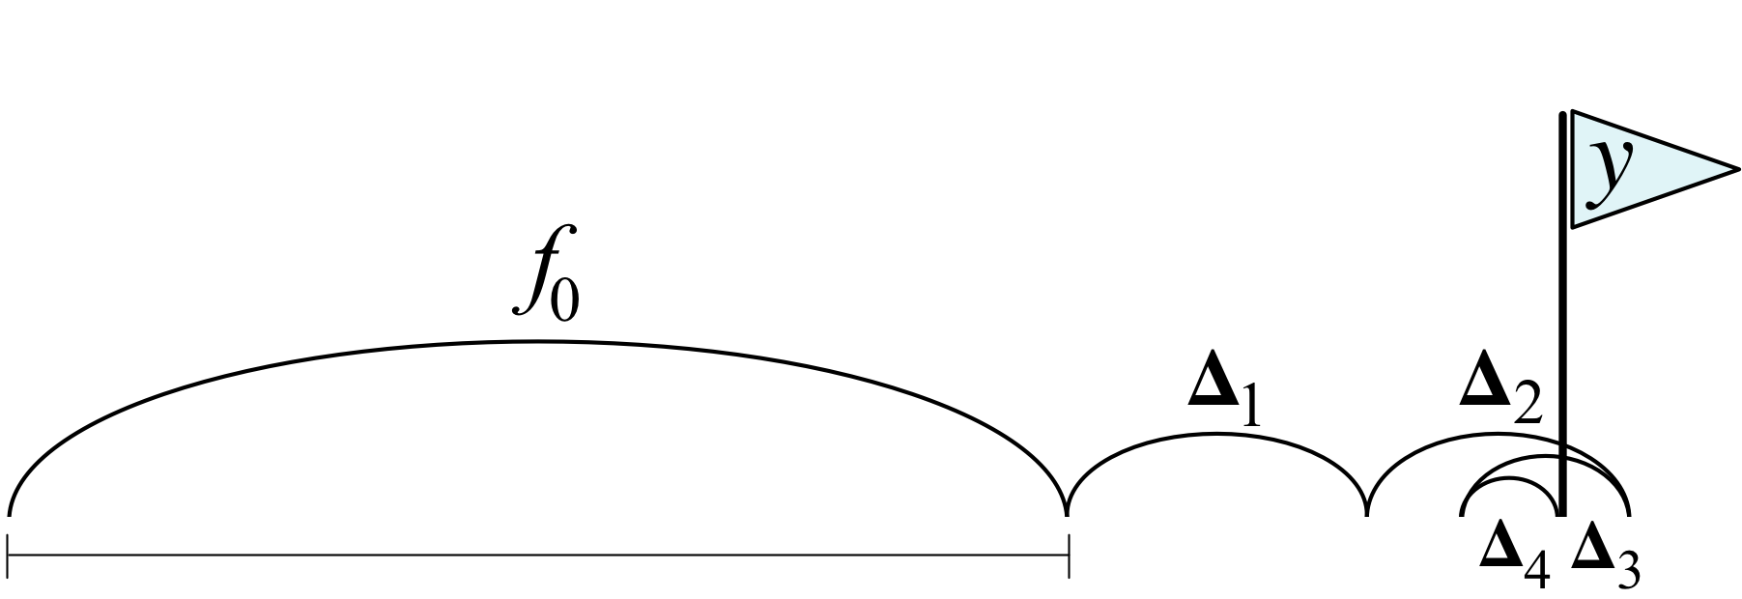
Random forest (top) compared to gradient boosting (bottom)

Slide 19
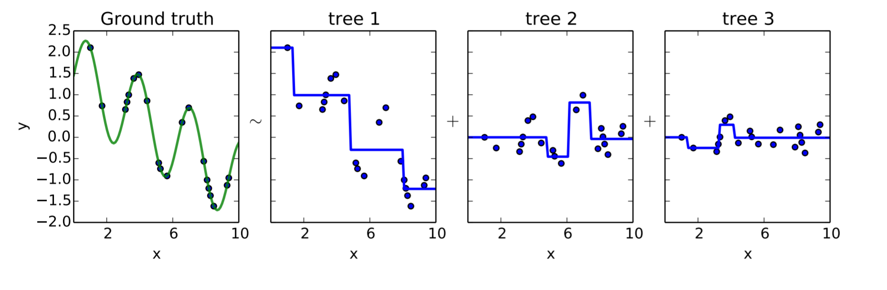
Boosting: Gradient boosting
Gradient Boosting explained [demonstration]

