Slide 1

Introduction to Quantum Chemistry with ORCA
Elias Harrer
02.07.2024

Slide 2
General Quantum Chemistry Workflow
MM
Molecular Mechanics Optimization
Short Molecular Dynamic Runs
SQM
Semiempirical Optimization
Conformational Sampling
QM
Ensemble Sorting
QM Optimization
Calculation of Properties
Literature: Bursch M., Mewes J. M., Hansen A., Grimme S., Best-Practice DFT Protocols for Basic Molecular Computational Chemistry. Angew. Chem. Int. Ed. 2022, 61, e202205735. DOI: doi.org/10.1002/anie.202205735

Slide 3
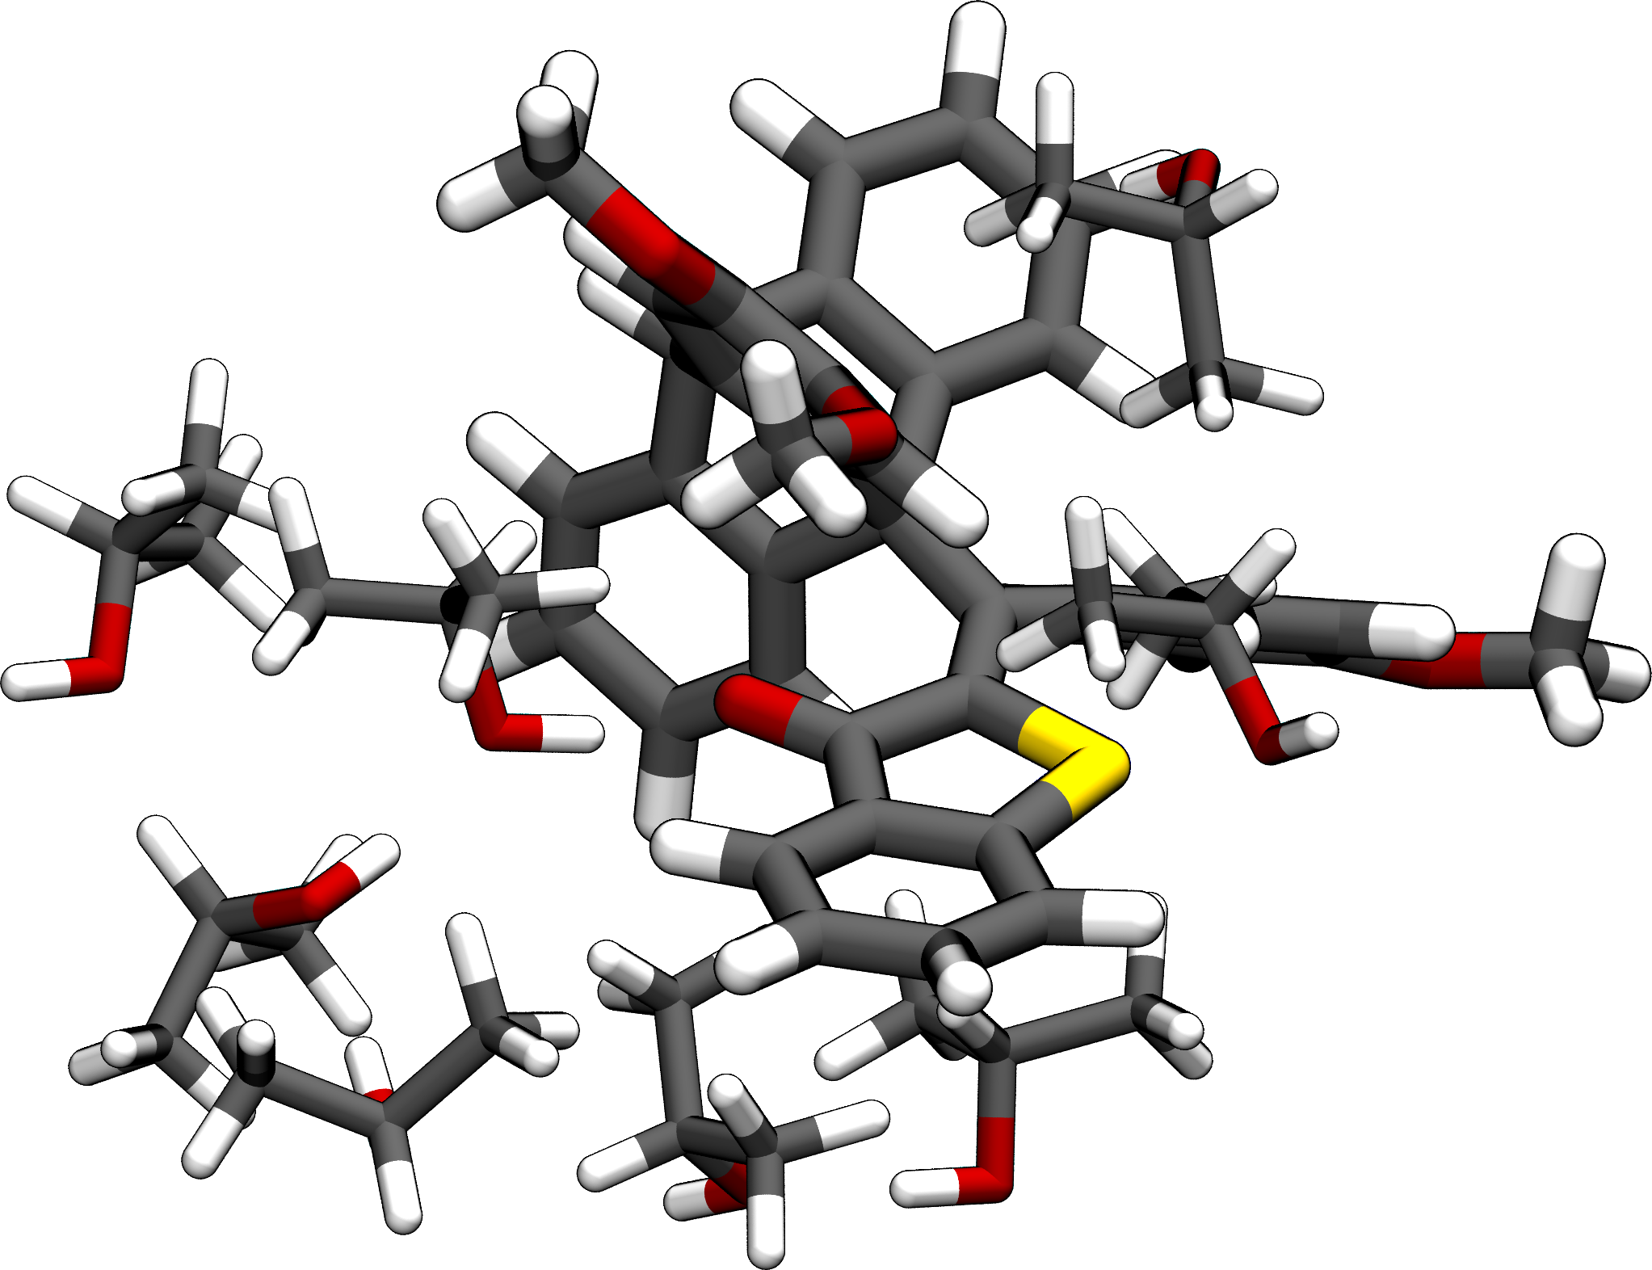
Stage 1: Molecular Mechanics (MM)
Software - LAMMPS, Maestro, OpenMM, Amber, …
Methodology
Crude preoptimization using force fields included in software (Maestro, Avogadro, …)
Short NVT runs (~ 10 ns) using freely available force field parameters (e.g. GAFF)
Objective
Obtain reasonable starting structures for SQM Optimization
Study explicit solvation effects -> Consider explicit solvent molecules later …
Molecular Clustering -> Consider Dimers (H- and T-stacking), Trimers, …
Generation of a thermal ensemble
Advantages / Disadvantages
Excellent scaling (> 10⁶ atoms)
Efficient calculation of forces (> 1μs)
No explicit treatment of electrons (bond-breaking)
Literature: Boereboom, J. M., Fleurat-Lessard, P., Bulo, R. E., Explicit Solvation Matters: Performance of QM/MM Solvation Models in Nucleophilic Addition. J. Chem. Theory Comput. 2018, 14, 4, 1841–1852. DOI: https://doi.org/10.1021/acs.jctc.7b01206
Jacobi, R., González, L., Resonance energy transfer in orthogonally arranged chromophores: a question of molecular representation. Phys. Chem. Chem. Phys., 2024, 26, 12299-12305. DOI: 10.1039/D4CP00420E

Slide 4
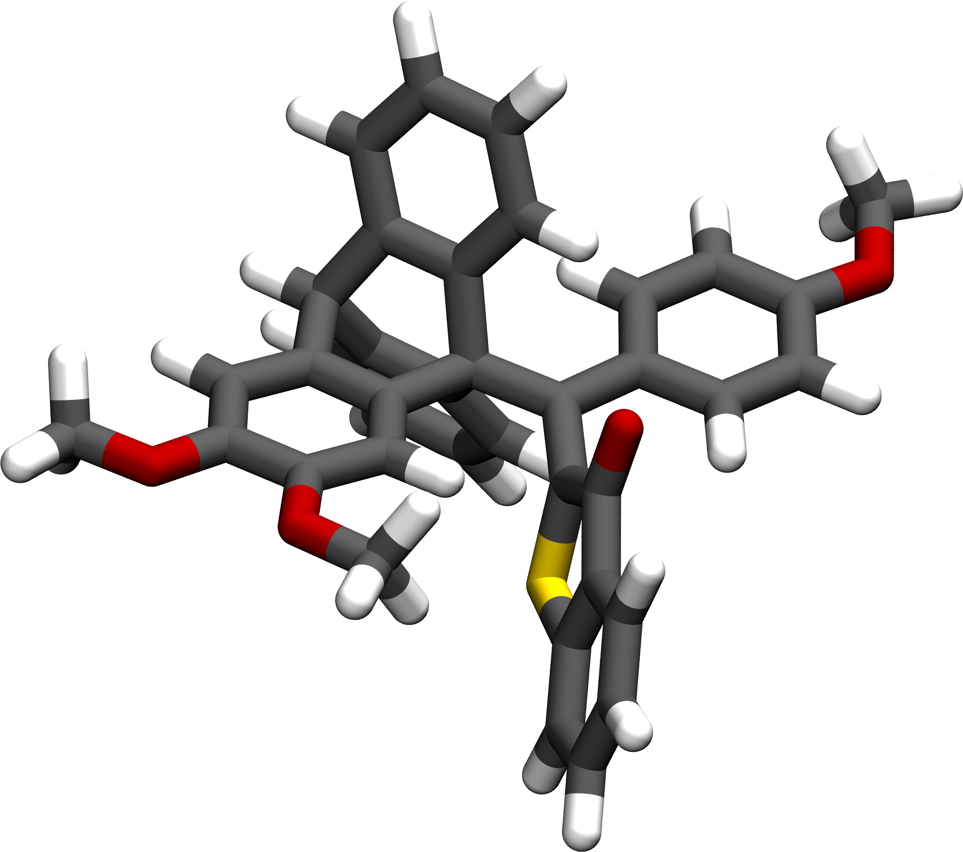
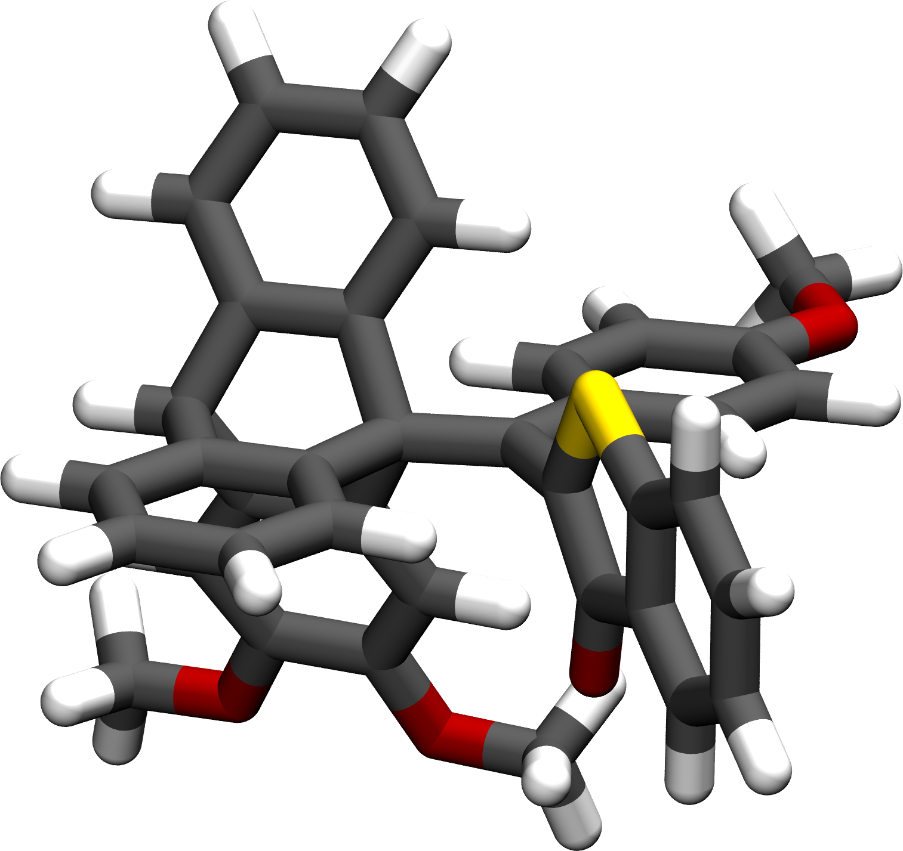
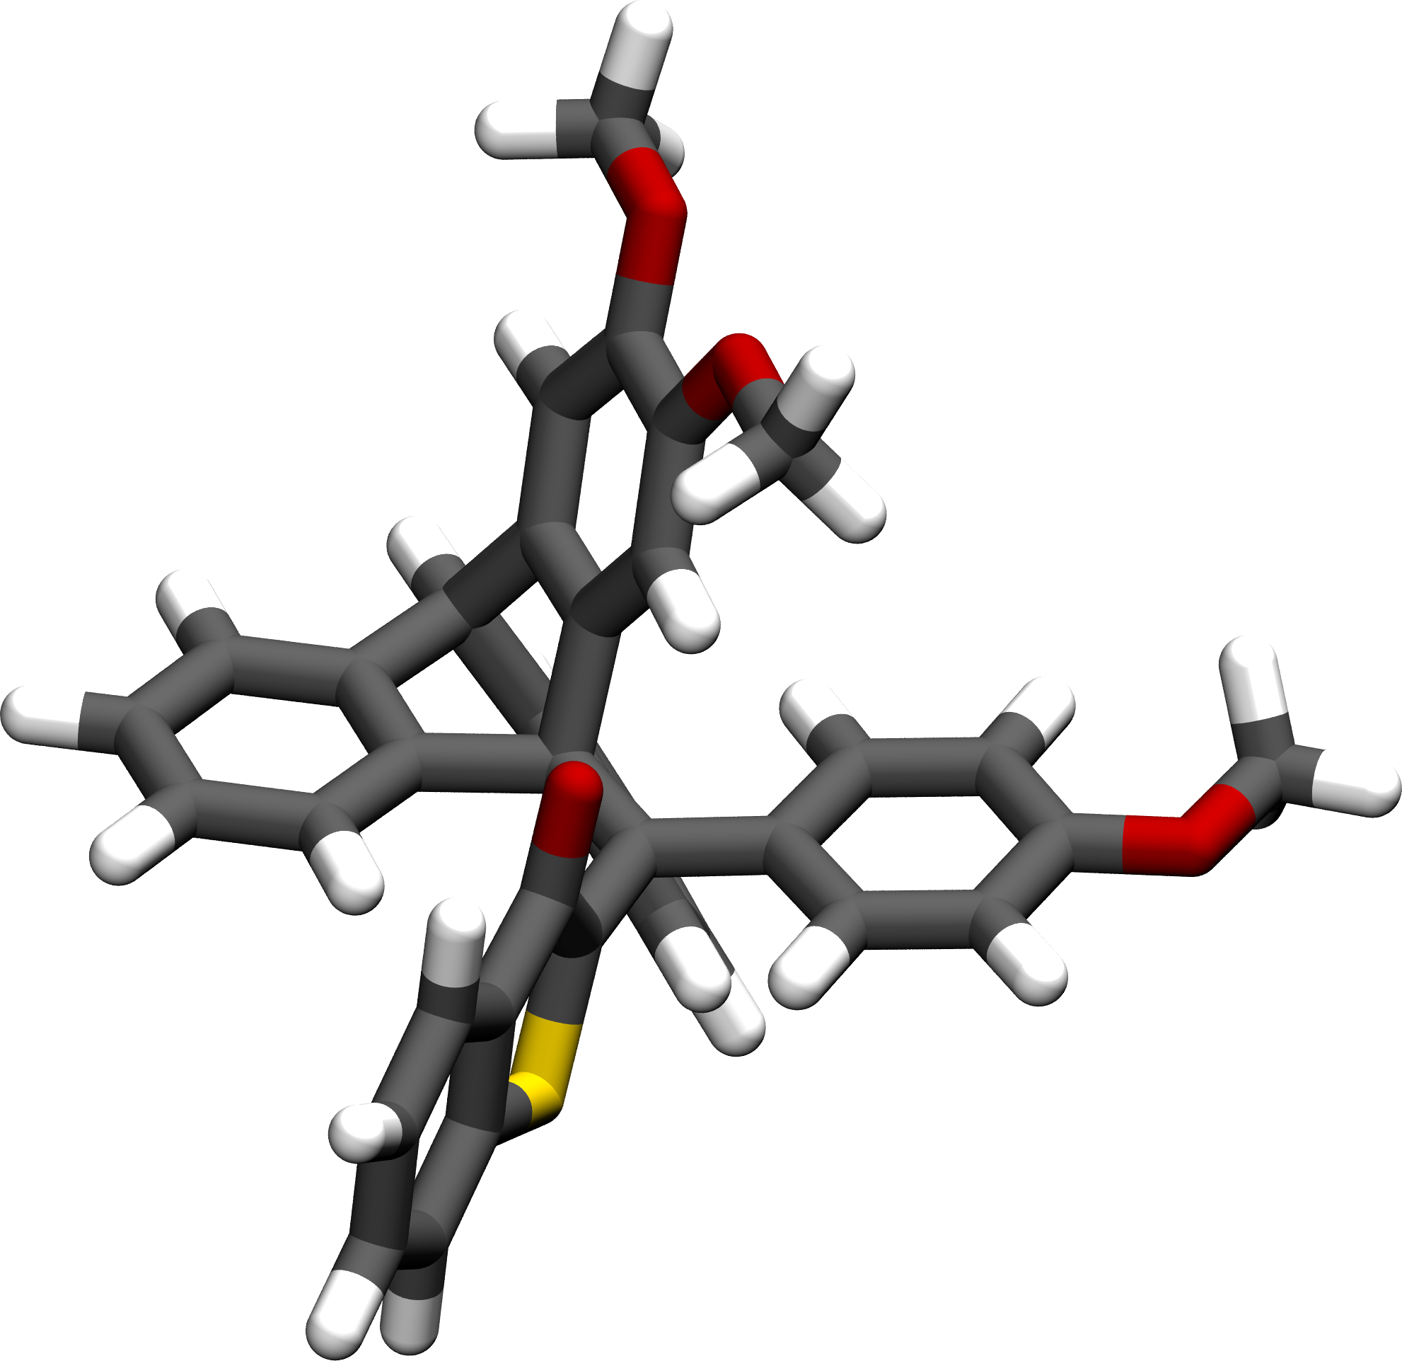
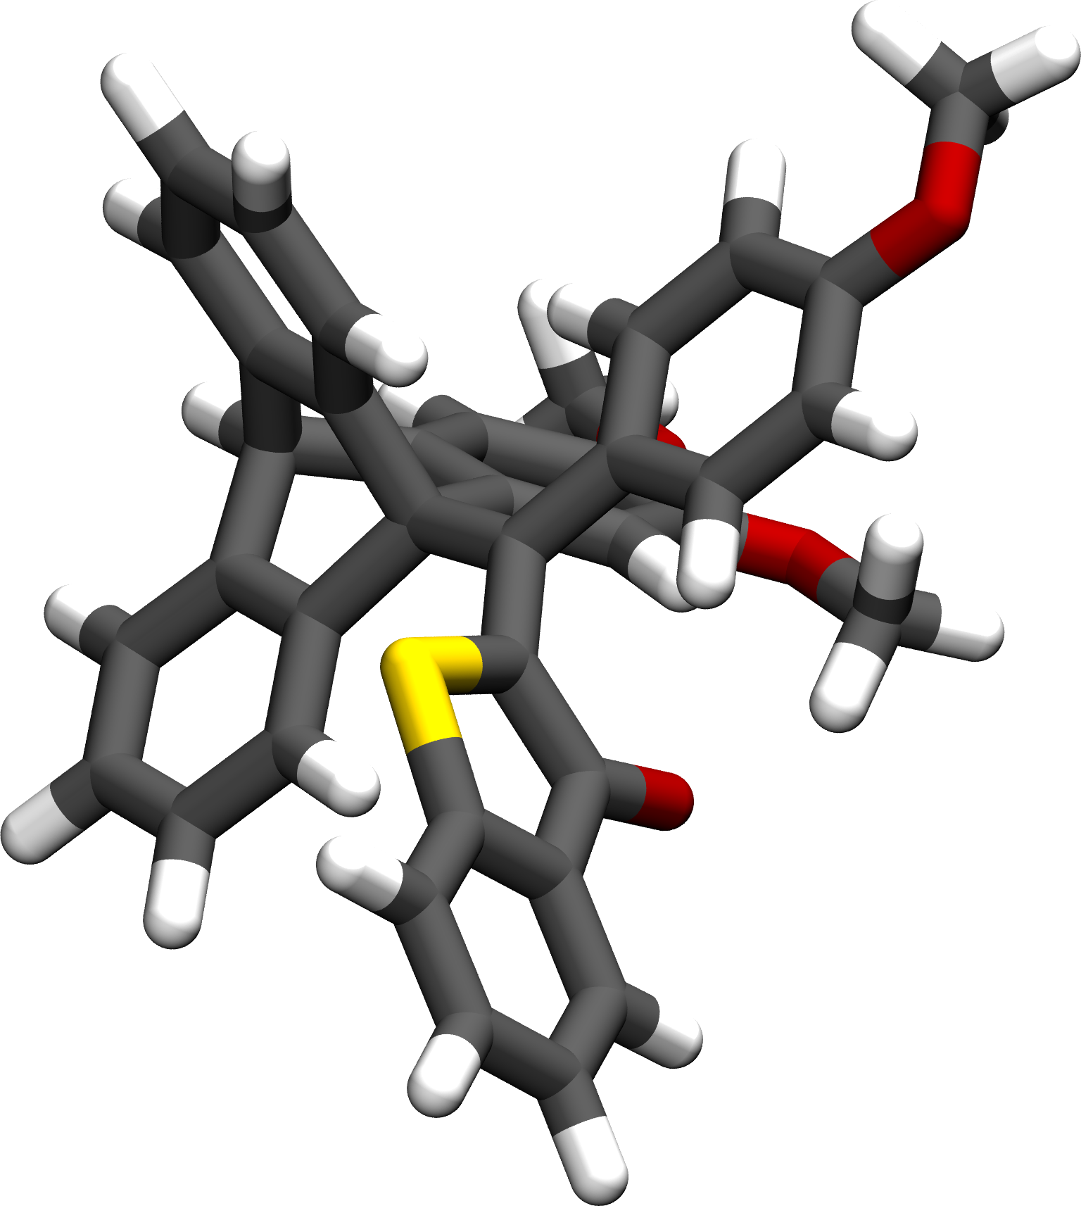
Stage 2: Semi-empirical Quantum Mechanics (SQM)
Software - xTB, CREST, ORCA, DFTB⁺, …
Methodology
Optimizations using xTB with GFN2 (Geometry, Frequency, Non-covalent interactions)
Conformational sampling using CREST: Metadynamics on input structure with consequent GFN2 optimizations
Objective
xTB: Obtain reasonable starting structure for CREST sampling
CREST: Obtain a conformational ensemble of the target molecule
CREST: Generation of non-covalent complexes and aggregates
Advantages / Disadvantages
Great scaling (> 10⁴ atoms)
Explicit treatment of electrons
Often underestimates NCI-strength
Better for thermodynamics than kinetics
Software: https://xtb-docs.readthedocs.io/en/latest/index.html; https://crest-lab.github.io/crest-docs/
Literature: Bannwarth C. et al., Extended tight-binding quantum chemistry methods. DOI: https://doi.org/10.1002/wcms.1493
Pracht, P. et al., Automated exploration of the low-energy chemical space with fast quantum chemical methods. Phys. Chem. Chem. Phys., 2020,22, 7169-7192. DOI: https://doi.org/10.1039/C9CP06869D

Slide 5
Stage 2: Semi-empirical Quantum Mechanics (SQM)
Software - xTB
Installation
Precompiled Binaries (export PATH variable)
Compilation from Source
Usage
> xtb input.xyz --opt --gfn 2 > preopt.out &
Further important flags:
--chrg Charge
--uhf Number of unpaired electrons (NOT multiplicity!)
--alpb solvent
--gbsa solvent
-T Number of cores
(For available solvents see:
https://xtb-docs.readthedocs.io/en/latest/gbsa.html)
Output
preopt.out: Includes energies, properties, population analysis, …
xtbopt.xyz: Optimized structure
xtbopt.log: Optimization trajectory
wbo: Wiberg bond order
charges: Atomic partial charges
xtbrestart: Restart file
Software: https://github.com/grimme-lab/xtb/releases/tag/v6.7.0
Literature: Bannwarth C. et al., Extended tight-binding quantum chemistry methods. DOI: https://doi.org/10.1002/wcms.1493

Slide 6
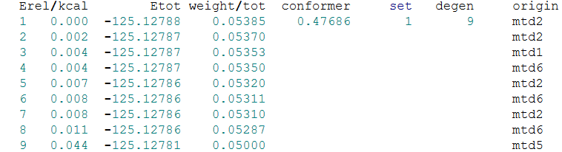
Stage 2: Semi-empirical Quantum Mechanics (SQM)
Software - Crest
Installation
Precompiled Binaries (export PATH variable, needs xTB)
Compilation from Source
Usage
> crest preopt.xyz --gfn 2 > crest.out &
Further important flags:
--chrg Charge
--uhf Number of unpaired electrons (NOT multiplicity!)
--alpb solvent
--gbsa solvent
-T Number of cores
--nci (Sample non-covalently bound clusters)
Output
crest.out: Includes energies, Boltzmann weights of all conformers/rotamers
crest_best.xyz: energetically lowest conformer
crest_conformers.xyz: all conformers below a threshold of 6 kcal/mol
crest_rotamers.xyz: all rotamers corresponding to the conformers
crest.energies: energie values corresponding to the conformers
Software: https://github.com/crest-lab/crest
Literature: Pracht, P. et al., Automated exploration of the low-energy chemical space with fast quantum chemical methods. Phys. Chem. Chem. Phys., 2020,22, 7169-7192. DOI: https://doi.org/10.1039/C9CP06869D

Slide 7
Stage 3: Density functional theory (DFT) using ORCA
Software - ORCA, CENSO, Psi4, Turbomole, …
Methodology
Evaluation of conformational ensembles using functionals of different stages on Jacob’s Ladder
High-level DFT treatment of the electron exchange and correlation
Objective
CENSO: Refined (QM) energetic sorting of the conformational ensemble obtained by CREST
ORCA: Calculation of properties, accurate thermodynamics and barriers, …
Advantages / Disadvantages
Good to medium scaling
(< 10³ atoms)
Very high accuracy regarding energies
Variety of properties obtainable
Single reference method (no static correlation)
Not systematically improvable
Self-interaction error
No implicit dispersion
Software: https://github.com/grimme-lab/CENSO/releases, https://www.faccts.de/docs/orca/5.0/tutorials/index.html
Literature: Bursch M., Mewes J. M., Hansen A., Grimme S., Best-Practice DFT Protocols for Basic Molecular Computational Chemistry. Angew. Chem. Int. Ed. 2022, 61, e202205735. DOI: doi.org/10.1002/anie.202205735

Slide 8
Stage 3: Density functional theory (DFT) using ORCA
Software - Censo
Installation
Precompiled Binaries (export PATH variable)
Compilation from Source
Usage
> censo -newconfig (only for the first time)
> mv censorc_new ~/.censor (only for the first time)
> censo -inp crest_conformers.xyz > censo.out &
Further important flags:
-inprc /path/to/.censorc
The CENSO Workflow
Part0
Cheap prescreening
B97-D3(0) / def2-SV(P) SP energies
Part1
Prescreening
r2SCAN-3c SP energies
Part2
Optimization
Optimizing structures at the r2SCAN-3c level of theory
Part3
Part4
GFN2-xTB thermostatical contribtutions
GFN2-xTB thermostatical contribtutions
Refinement (optional)
High-level single point energies
PBE0-D4 / def2-TZVP (recommendation)
Properties (optional)
NMR-couplings and shielding
Optical rotation (Turbomole only)
Software: https://github.com/grimme-lab/CENSO/releases
Literature: Grimme S., Efficient Quantum Chemical Calculation of Structure Ensembles and Free Energies for Nonrigid Molecules. J. Phys. Chem. A 2021, 125, 19, 4039–4054. DOI: https://doi.org/10.1021/acs.jpca.1c00971

Slide 9
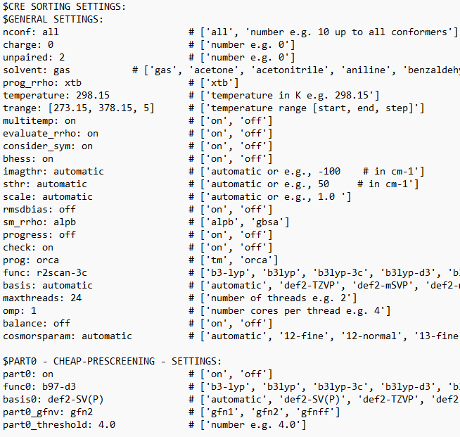
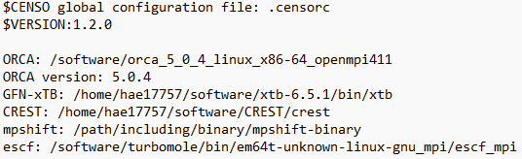
Stage 3: Density functional theory (DFT) using ORCA
Software - Censo
Installation
Precompiled Binaries (export PATH variable)
Compilation from Source
Usage
> censo -newconfig (only for the first time)
> mv censorc_new ~/.censor (only for the first time)
> censo -inp crest_conformers.xyz > censo.out &
Further important flags:
-inprc /path/to/.censorc
The .censorc file:
Check before starting CENSO
ORCA PATH and version
xTB and CREST PATH
Turbomole
Method
Software: https://github.com/grimme-lab/CENSO/releases
Literature: Grimme S., Efficient Quantum Chemical Calculation of Structure Ensembles and Free Energies for Nonrigid Molecules. J. Phys. Chem. A 2021, 125, 19, 4039–4054. DOI: https://doi.org/10.1021/acs.jpca.1c00971

Slide 10
Stage 3: Density functional theory (DFT) using ORCA
Software - Censo
Installation
Precompiled Binaries (export PATH variable)
Compilation from Source
Usage
> censo -newconfig (only for the first time)
> mv censorc_new ~/.censor (only for the first time)
> censo -inp crest_conformers.xyz > censo.out &
Further important flags:
-inprc /path/to/.censorc
Output
censo.out: Includes energies, Boltzmann weights of all conformers/rotamers after each part
censo_ensemble_partX_p_Y.xyz: sorted conformers after part X within the lowest Y percent of Boltzmann population
CONFX/: Directories for each starting conformer. Includes subdirectories with calculations performed in each part
Software: https://github.com/grimme-lab/CENSO/releases
Literature: Grimme S., Efficient Quantum Chemical Calculation of Structure Ensembles and Free Energies for Nonrigid Molecules. J. Phys. Chem. A 2021, 125, 19, 4039–4054. DOI: https://doi.org/10.1021/acs.jpca.1c00971

Slide 11
Stage 3: Density functional theory (DFT) using ORCA
Software - ORCA
Installation
Precompiled Binaries (export PATH variable)
Requires OpenMPI
Usage
> run_orca5 basename &
Run Script for ORCA:
#!/bin/bash export PATH=$PATH:/path/to/orca export LD_LIBRARY_PATH=$LD_LIBRARY_PATH:/path/to/orca export PATH=$PATH:/path/to/openmpi export LD_LIBRARY_PATH=$LD_LIBRARY_PATH:/path/to/openmpi/lib if [ -z "$1" ] then echo "Please enter name of <name.inp>" echo "" echo "Usage: run_orca5 name.inp &" exit 1 fi fn=`basename $1 .inp` /path/to/orca/orca $fn.inp > $fn.out
Software: https://orcaforum.kofo.mpg.de/app.php/portal
Literature: Neese F., Software update: The ORCA program system—Version 5.0. DOI: https://doi.org/10.1002/wcms.1606

Slide 12
Stage 3: Density functional theory (DFT) using ORCA
Method
Calculation Type
Software - ORCA
General Input Structure
! B3LYP D4 def2-TZVP Opt Freq
! CPCM(acetonitrile)
%pal
nprocs 12
end
%maxcore 2000
%geom
maxiter 500
end
%scf
maxiter 500
end
*xyzfile 0 1 filename.xyz
Keyword line
Solvation
Number of cores and memory per core
Keyword block
Geometry Input
Charge and Multiplicity
Software: https://orcaforum.kofo.mpg.de/app.php/portal
Literature: Neese F., Software update: The ORCA program system—Version 5.0. DOI: https://doi.org/10.1002/wcms.1606

Slide 13
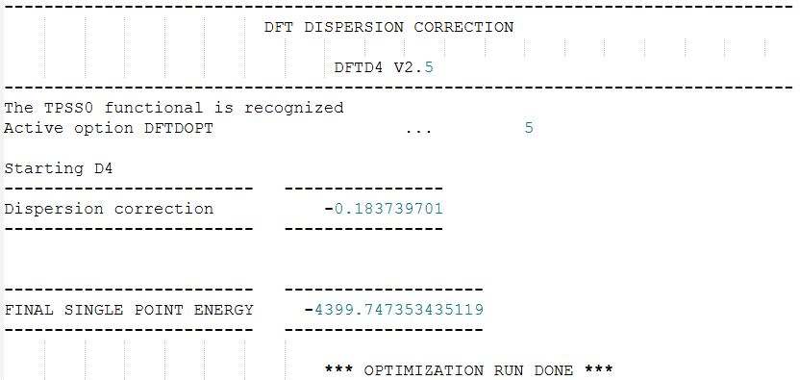
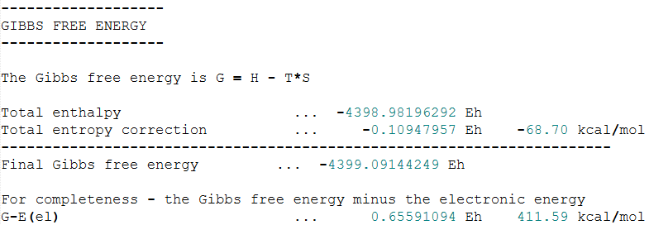
Stage 3: Density functional theory (DFT) using ORCA
Software - ORCA
Output (Opt Freq)
basename.xyz: optimized structure
basename_trj.xyz: optimization trajectory
basename_property.txt: contains properties of calculation (also in .out)
basename.opt: optimization details (gradients, internal coordinates, …)
basename.gbw: wavefunction file (binary)
basename.densities: electron density (binary)
basename.cpcm: solvation details
Output: basename.out
Input details
SCF and Geometry Optimization details/convergence
Population analysis
Energies
Properties
Electronic energy [Eh]
Software: https://orcaforum.kofo.mpg.de/app.php/portal
Literature: Neese F., Software update: The ORCA program system—Version 5.0. DOI: https://doi.org/10.1002/wcms.1606

Slide 14
Choice of Setup
Choice of Method
single-reference structure?
yes
no
gas phase?
multi-reference methods
yes
no
short MD run
aggregation?
explicit solvents?
MM
DFT
no
yes
no
yes
multiple solutes
CPCM
QM/MM
flexible molecule?
no
yes
SQM
CREST/CENSO conformational search
Literature: Bursch M., Mewes J. M., Hansen A., Grimme S., Best-Practice DFT Protocols for Basic Molecular Computational Chemistry. Angew. Chem. Int. Ed. 2022, 61, e202205735. DOI: doi.org/10.1002/anie.202205735

Slide 15
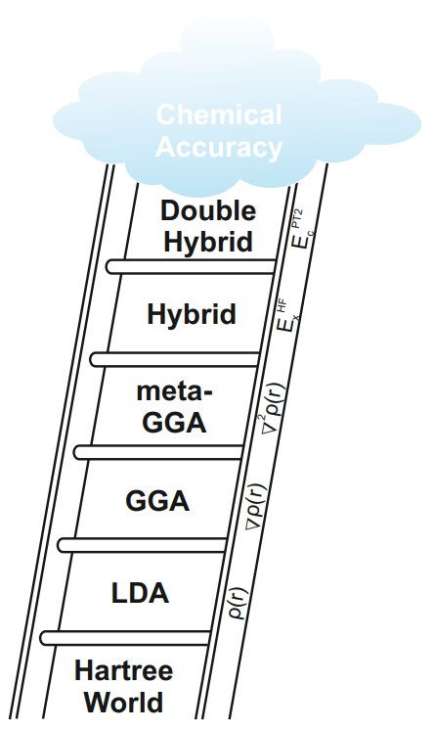
Excursus: Choice of the DFT method
 | Strength | Weakness | Examples | Usage
(meta)-GGA | Very fast (~N³) Often good geometries and frequencies | Underbinding: NCI, Lewis-acid coordination SIE: Underestimation of barriers | BLYP PBE r²SCAN TPSS | Fast optimization of large geometries. Calculation of ZPE corrections
Hybrid | Reduced SIE Good description of NCI | Expensive (~N⁴) Global amount of Fock-Exchange | B3LYP PBE0 TPSS0 | Accurate optimization of more complex structures
NCI: Non-Covalent Interactions
SIE: Self-Interaction Error
Literature: Bursch M., Mewes J. M., Hansen A., Grimme S., Best-Practice DFT Protocols for Basic Molecular Computational Chemistry. Angew. Chem. Int. Ed. 2022, 61, e202205735. DOI: doi.org/10.1002/anie.202205735

Slide 16
Excursus: Choice of the DFT method
 | Strength | Weakness | Examples | Usage
Range-separated Hybrids (RSH) | Great thermodynamic AND kinetic energies Good description of CT excitations | More expensive than Hybrids | CAM-B3LYP ωB97X ωB97M ωPBE | Single-Point energies on medium-sized systems. TDDFT calculations.
Double-Hybrids | Excellent energies | VERY expensive (~N⁵) < 200 Atoms | B2PLYP DSD-PBEP86 | Single-Point energies on small systems
NCI: Non-Covalent Interactions
SIE: Self-Interaction Error
CT: Charge-Transfer
Literature: Bursch M., Mewes J. M., Hansen A., Grimme S., Best-Practice DFT Protocols for Basic Molecular Computational Chemistry. Angew. Chem. Int. Ed. 2022, 61, e202205735. DOI: doi.org/10.1002/anie.202205735

Slide 17
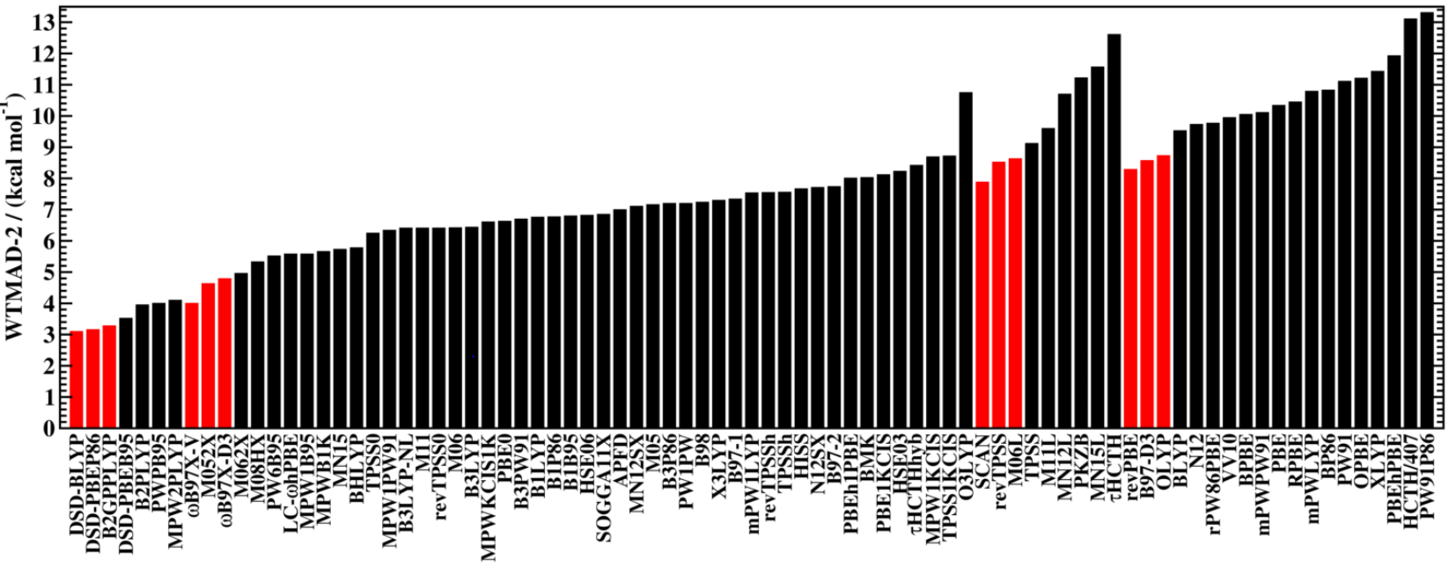
Excursus: Choice of the DFT method
Best Cost/Value ratio for large molecules: Composite Methods
r²SCAN-3c and PBEh-3c
Adapted dispersion correction
Geometric counterpoise correction
Adapted basis-set
Literature: Bursch M., Mewes J. M., Hansen A., Grimme S., Best-Practice DFT Protocols for Basic Molecular Computational Chemistry. Angew. Chem. Int. Ed. 2022, 61, e202205735. DOI: doi.org/10.1002/anie.202205735
Goerigk, L. et al., A look at the density functional theory zoo with the advanced GMTKN55 database for general main group thermochemistry, kinetics and noncovalent interactions. Phys. Chem. Chem. Phys., 2017,19, 32184-32215. DOI: https://doi.org/10.1039/C7CP04913G

Slide 18
Choice of Setup
Choice of Method
Optimization / Frequencies
single-reference structure?
> 250 Atoms?
yes
no
gas phase?
multi-reference methods
yes
no
Non-covalent Interactions?
yes
no
short MD run
no
yes
r²SCAN-3c
PBEh-3c
PBE0-D4 / def2-TZVP
aggregation?
explicit solvents?
MM
DFT
yes
Transition Metal?
no
yes
no
yes
multiple solutes
CPCM
QM/MM
Single Point Energies
flexible molecule?
> 100 Atoms?
no
yes
SQM
yes
no
CREST/CENSO conformational search
ωB97M-V / def2-QZVPP
DSD-PBEP86-D3(BJ) / def2-QZVPP
Literature: Bursch M., Mewes J. M., Hansen A., Grimme S., Best-Practice DFT Protocols for Basic Molecular Computational Chemistry. Angew. Chem. Int. Ed. 2022, 61, e202205735. DOI: doi.org/10.1002/anie.202205735

Slide 19
Literature
Must Read DFT Review:
Bursch M., Mewes J. M., Hansen A., Grimme S., Best-Practice DFT Protocols for Basic Molecular Computational Chemistry. Angew. Chem. Int. Ed. 2022, 61, e202205735. DOI: doi.org/10.1002/anie.202205735
DFT Functional Benchmark:
Goerigk, L. et al., A look at the density functional theory zoo with the advanced GMTKN55 database for general main group thermochemistry, kinetics and noncovalent interactions. Phys. Chem. Chem. Phys., 2017,19, 32184-32215. DOI: https://doi.org/10.1039/C7CP04913G
ORCA Tutorials:
https://www.faccts.de/docs/orca/5.0/tutorials/index.html
https://sites.google.com/site/orcainputlibrary/home

