Slide 1
Rootfinding
115/11/08
CHAPTER 2 of ‘A first course in Computational Physics’, Paul L. DeVries, John Wiley & Sons (1994)
CHAPTER 3 of ‘Elementary Numerical Analysis’, 3rd Edition, Kendall Atkinson and Weimin Han, John Wiley & Sons (2004)

Slide 2
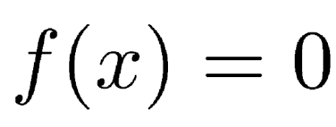
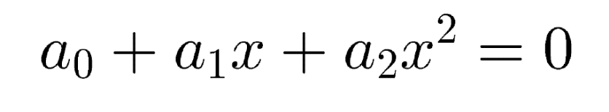
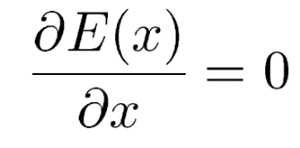
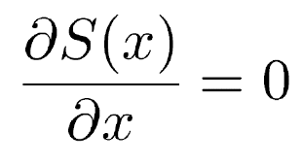


Introduction
Problem to be solved:
for example:
This type of problem occurs very frequently, for example maximization/minimization
min energy: max entropy:
Usually the problem cannot be solved analytically!
for example:

Slide 3
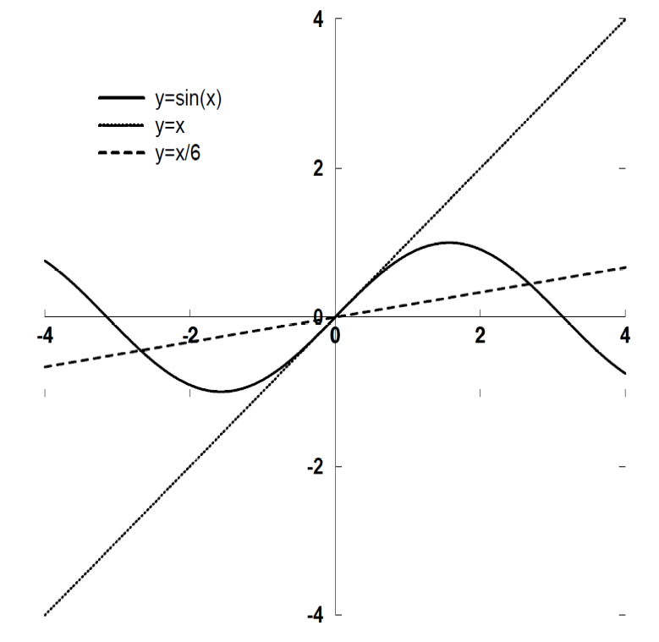
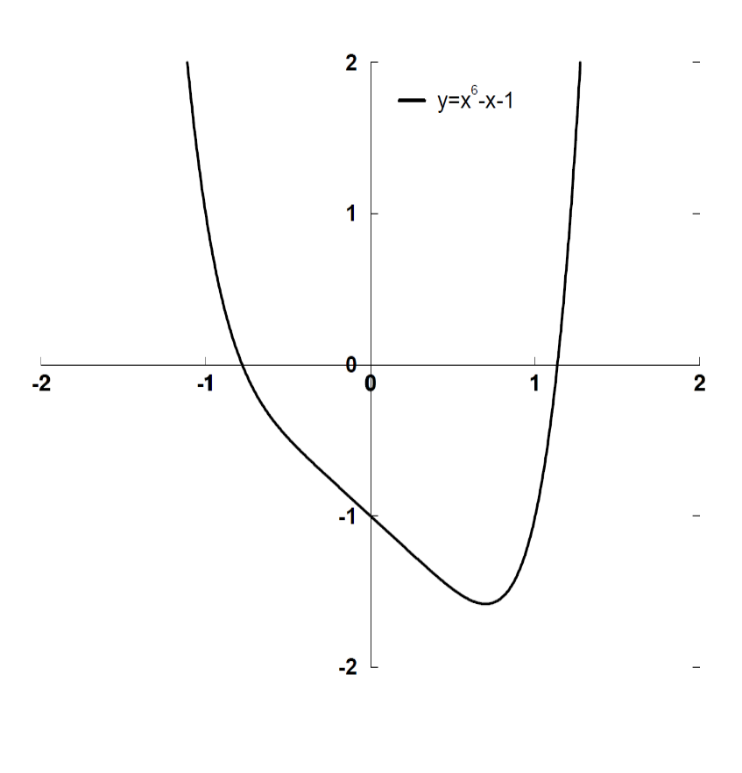

Graphical approach
First try to get as much insight as possible!

Slide 4
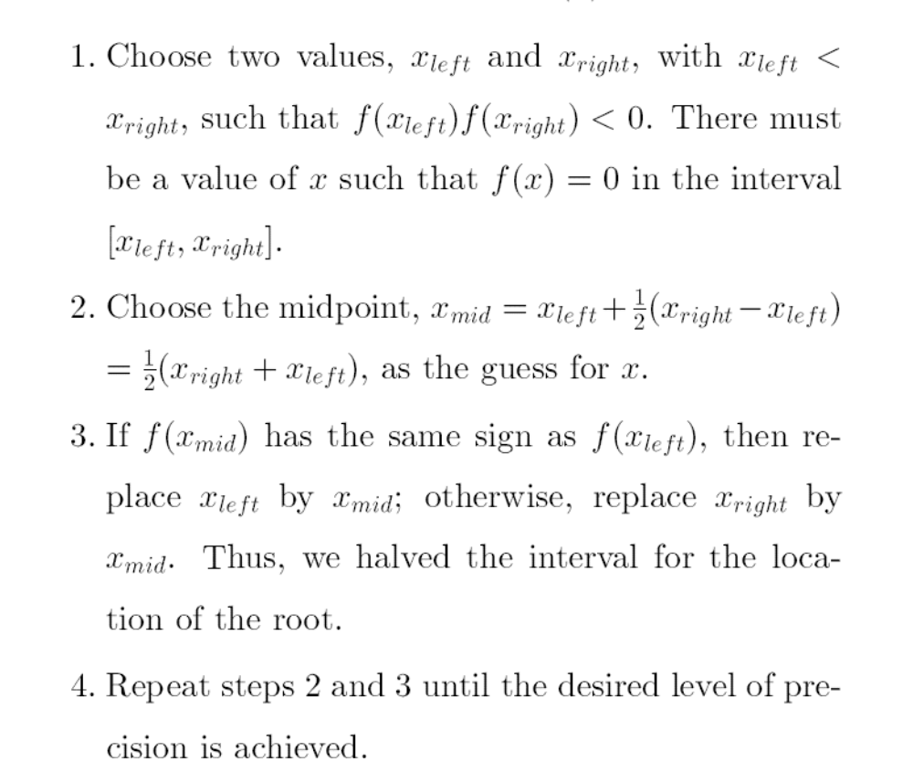
Bisection method
Very robust and reliable
Slow: see later for examples and error analysis

Slide 5
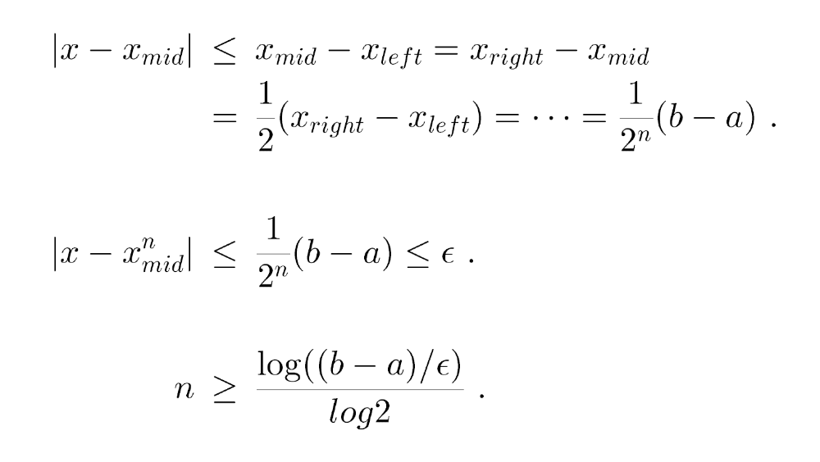
Bisection method - error
At each iteration the error is reduced by 1/2

Slide 6
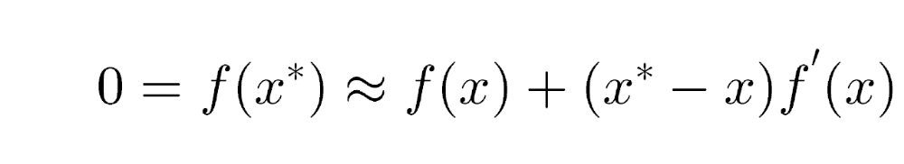
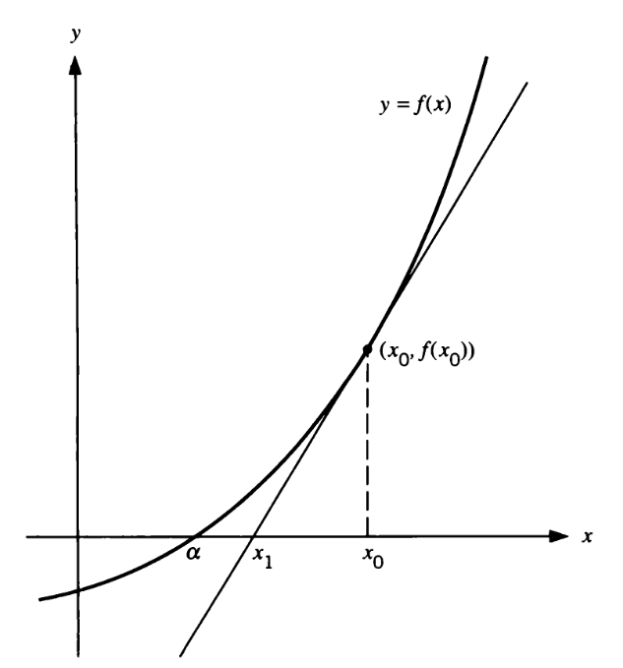
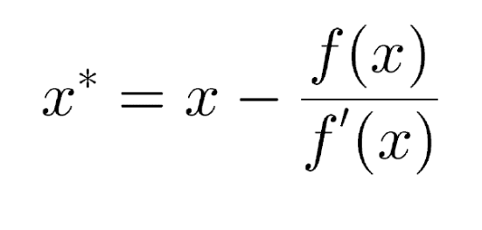

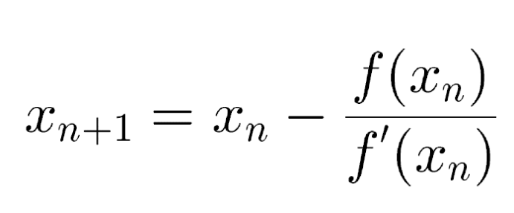
Newton-Raphson method
Can converge very fast
Needs accurate starting point
Needs both the function and its derivative

Slide 7
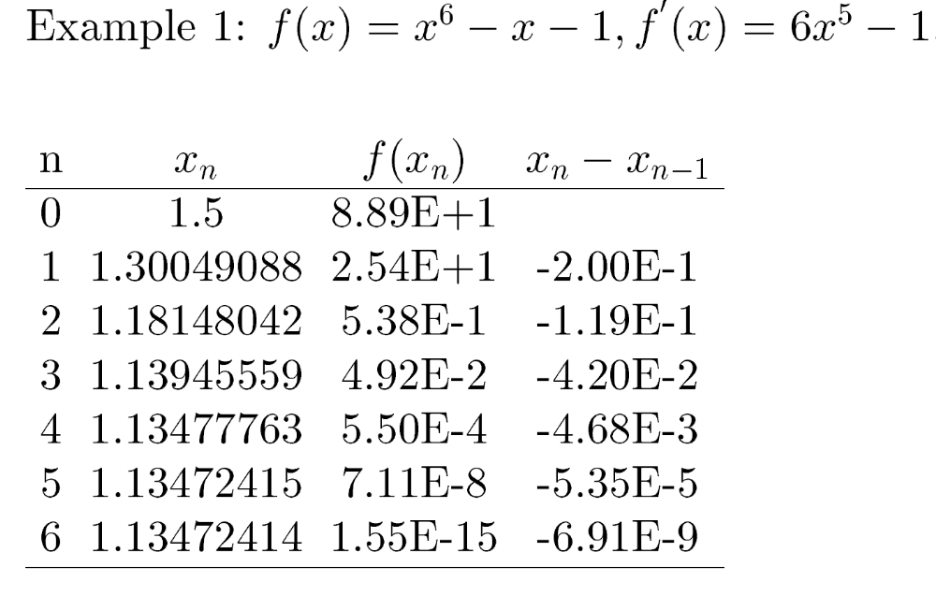
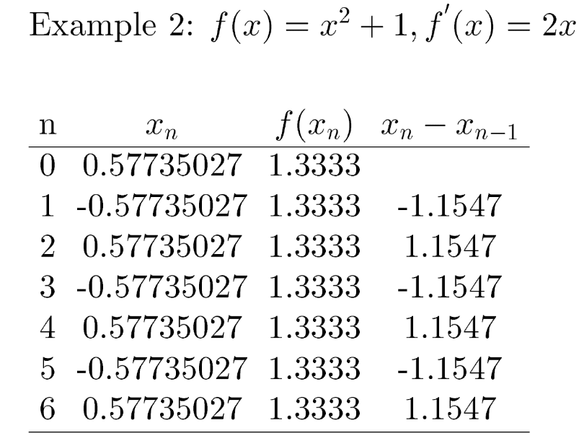
Newton-Raphson method - examples

Slide 8
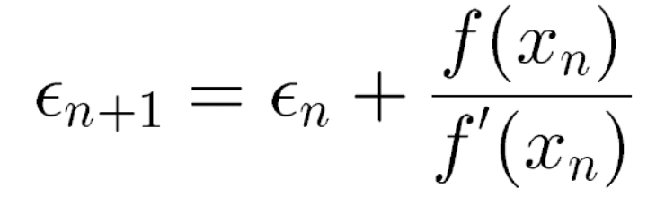
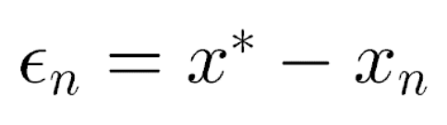
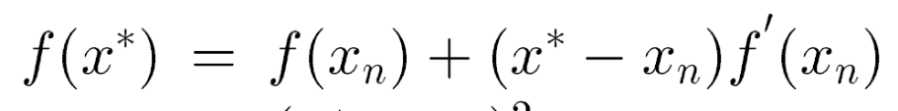
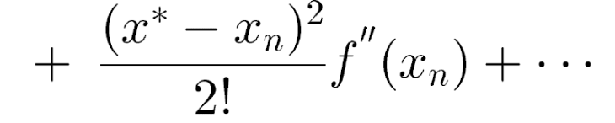

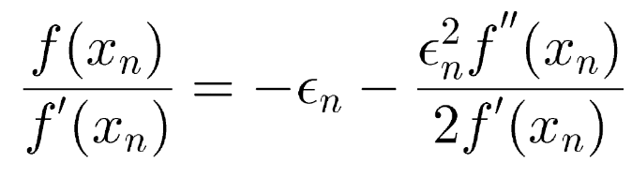
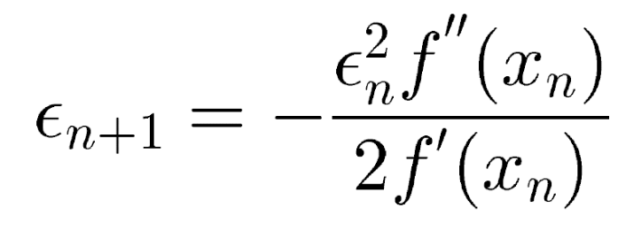
Newton-Raphson method – error estimate
Using the Taylor expansion:
Finally:

Slide 9
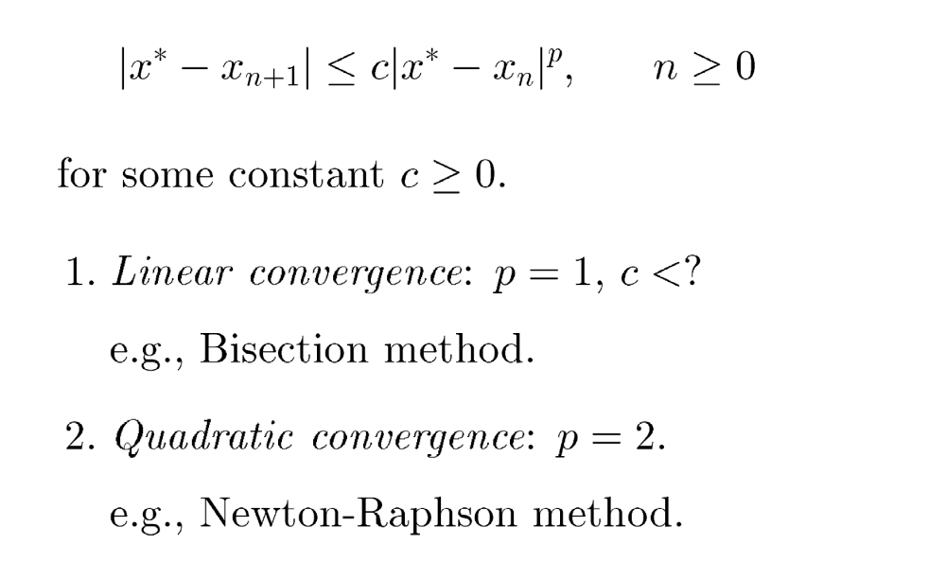
Rate of convergence

Slide 10
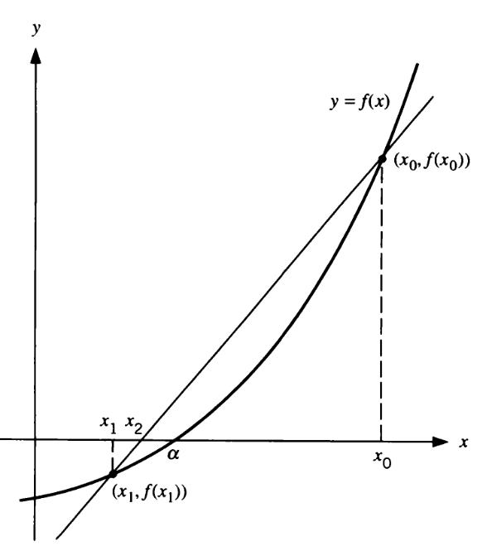
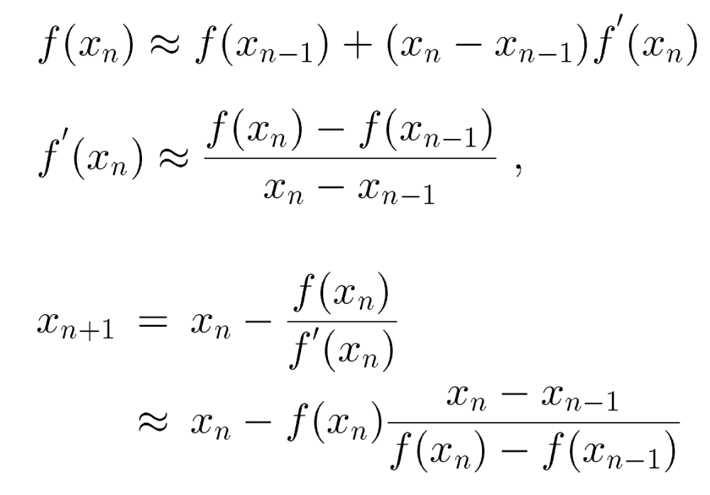
The secant method
Suppose the derivative is not available:

Slide 11
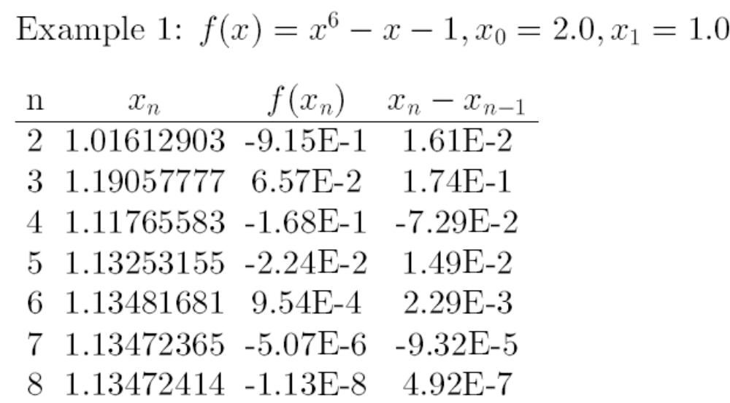
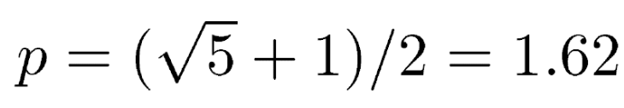
Secant method - rate of convergence
Newton method
Rate of convergence

Slide 12
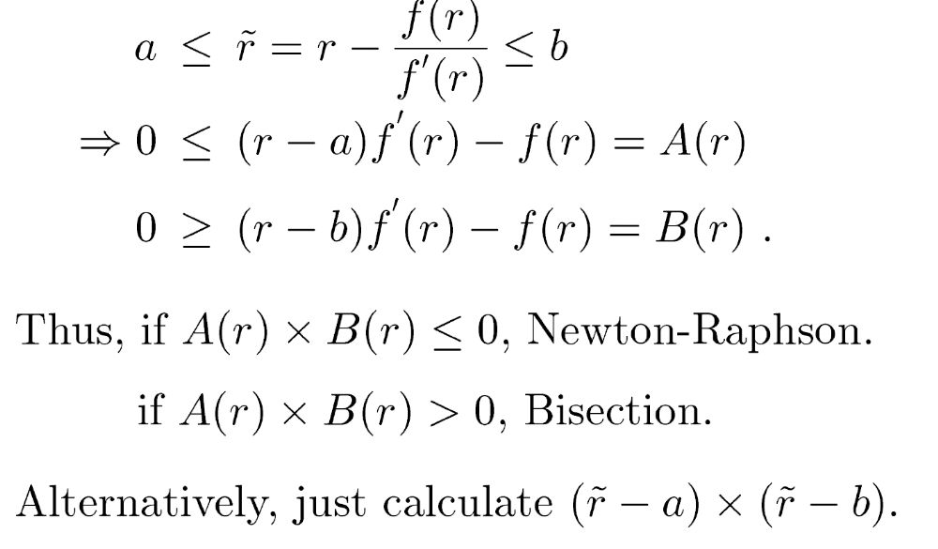
Hybrid methods
Bisection+Newton (stability+rapid convergence)
If derivative is not available: Bisection+secant

Slide 13
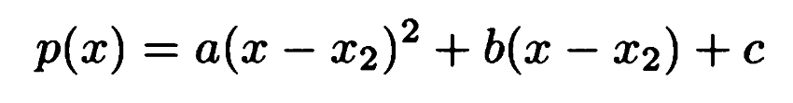
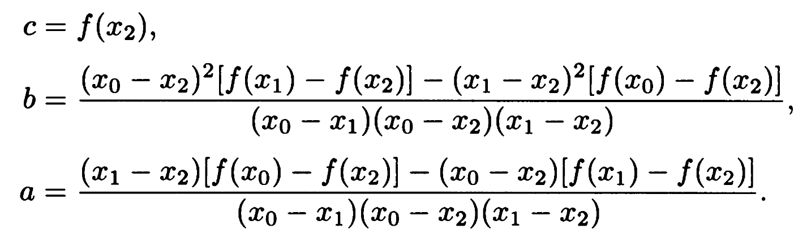
Accelerated method
If function is computationally expensive, we should try not discard information!
Newton method uses 1 point, while bisection, secant use 2 points. What about using 3 points?
Polynomial approx:

Slide 14
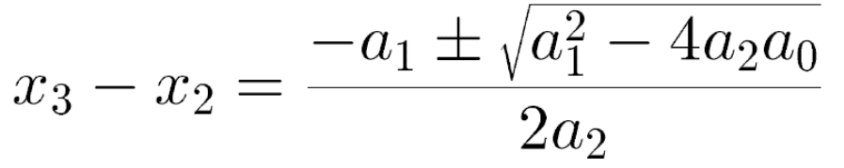
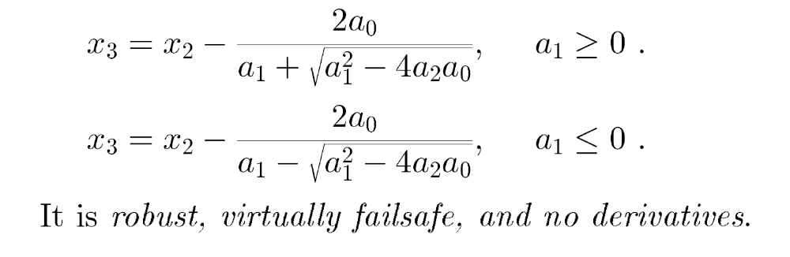
Accelerated method
New estimate of the root:
with which sign?
see book of DeVries for extended discussion

Slide 15
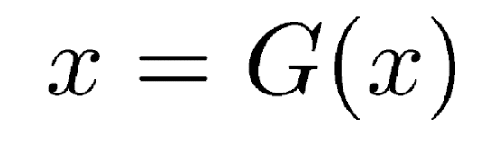
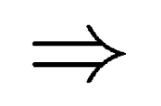
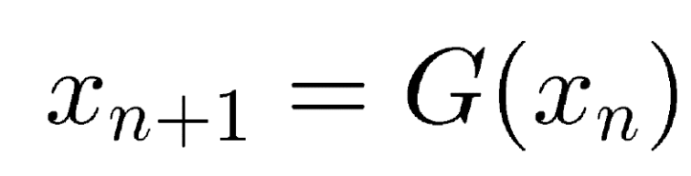
General theory of one-point iteration
REMARK: the Newton method is of this type
Here we only touch the main points of this general problem see the book of Atkinson & Han for details

Slide 16
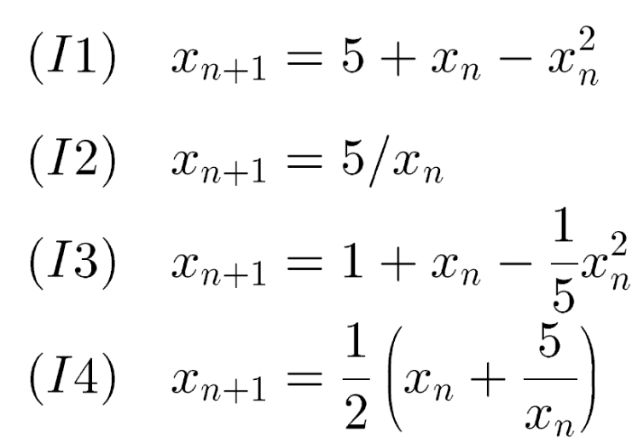
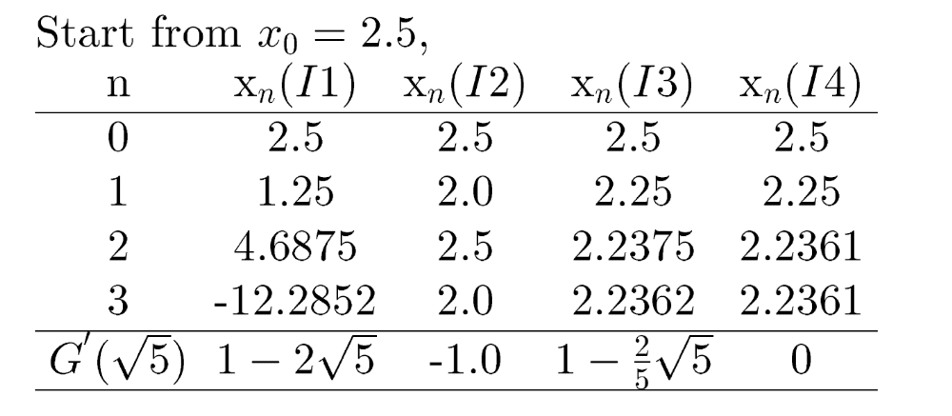
One-point iteration - examples
Why this behavior? Discuss on blackboard…

Slide 17
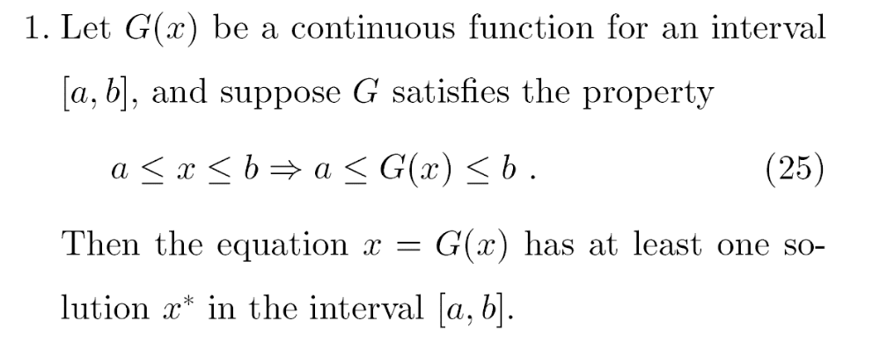
Formal properties - 1
Intuitive (make drawing)
For detailed proof: see the textbook or Prof Lin’s note

Slide 18
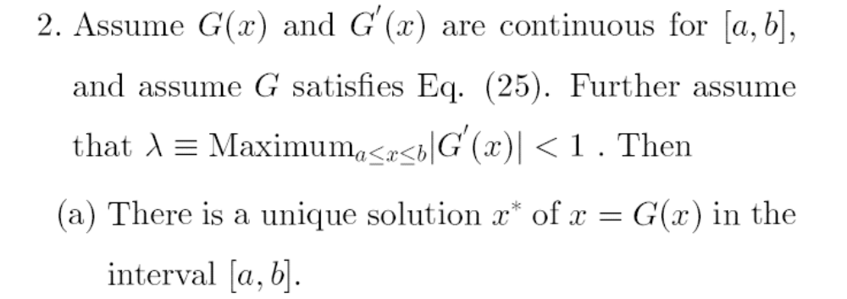
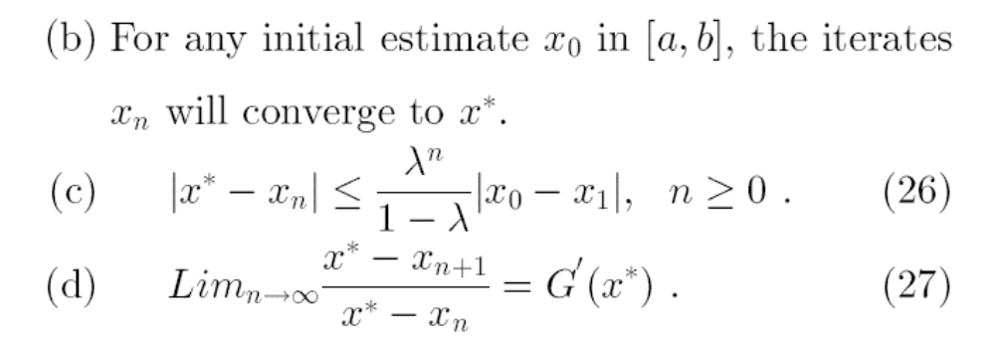
Formal properties - 2

Slide 19
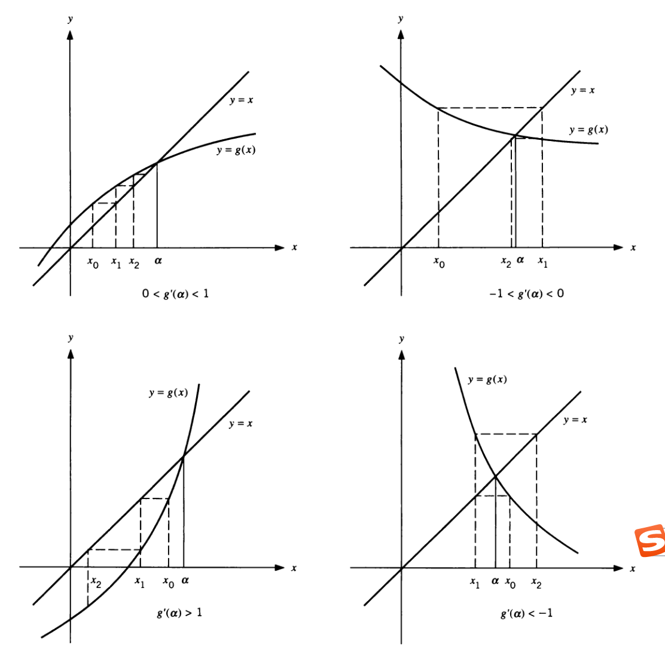
Graphical examples
Question: derivative of G(x) for
the Newton-Raphson method?

Slide 20
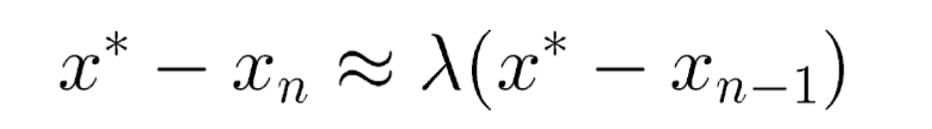
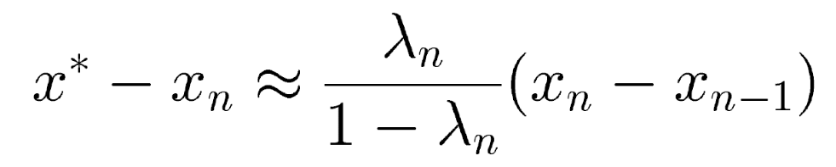
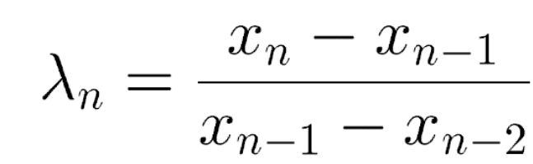
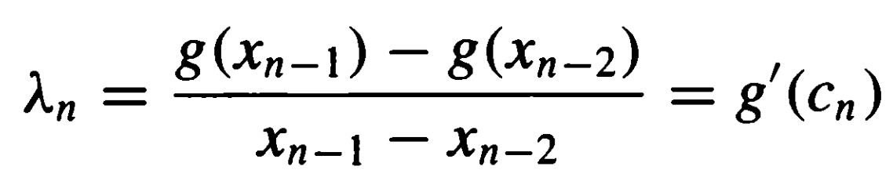
Aitken’s estimate of the error
Use property (d):
This gives the error:
How to estimate λ?
Justification:

Slide 21
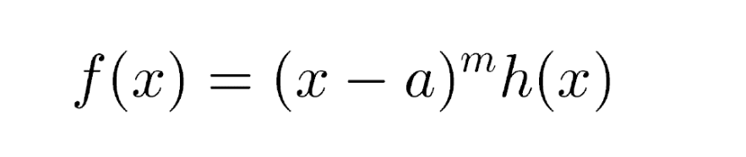
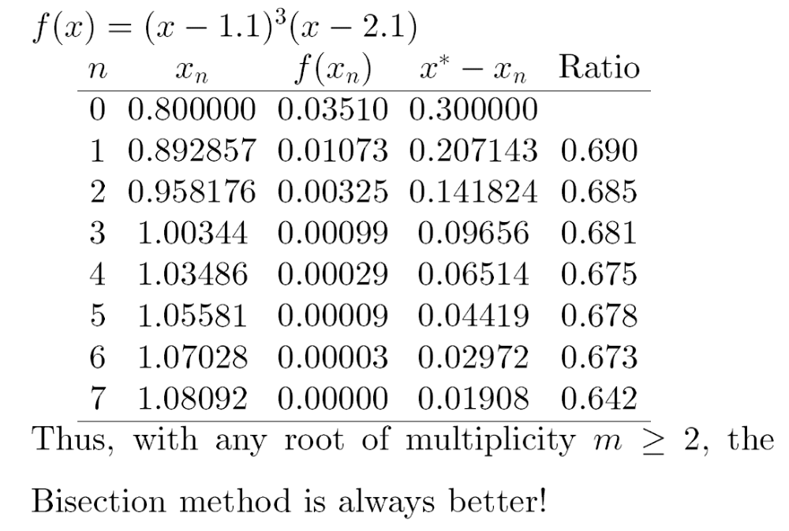
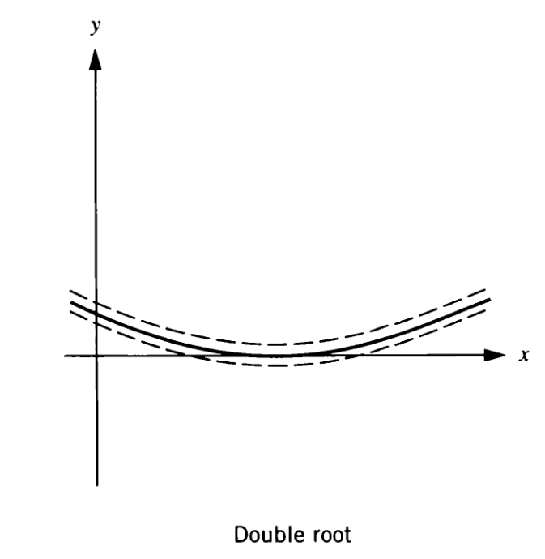
Difficult situations – multiple roots
Multiple roots
Slower convergence & noise in evaluation of f(x)

Slide 22
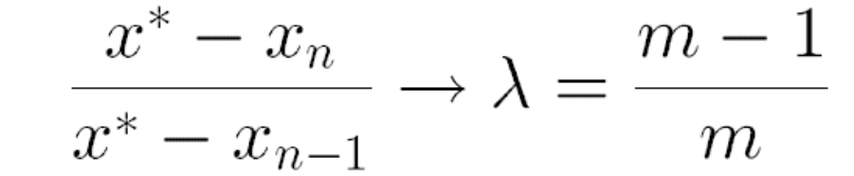
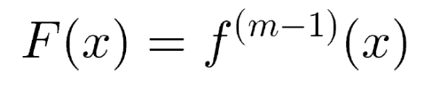
Difficult situations – multiple roots
Multiple roots
Slower convergence & noise in evaluation of f(x)
One can use the ratio to estimate m
Try to remove multiple root, e.g.,

Slide 23
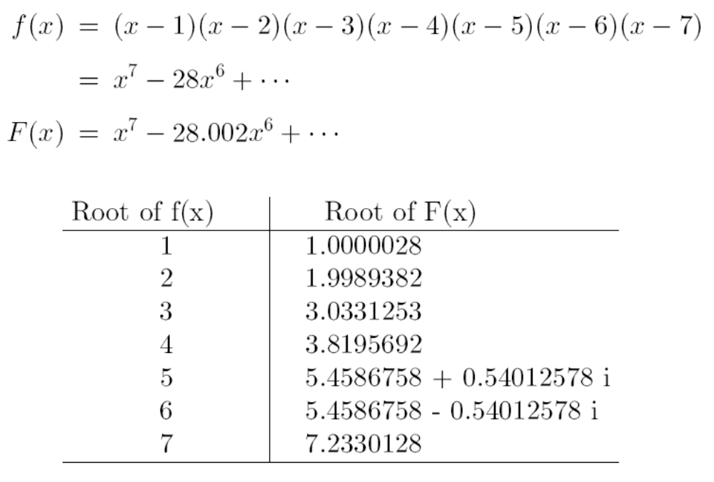
Difficult situations – unstable problems
High precision arithmetic? Reformulate the problem?

Slide 24
Other issues
How to find all the roots?
No simple method: needs some insight on the particular function, or scan the desired interval.
Multi-dimensional functions?
Other methods?
See also Chapter 9 of Numerical Recipes

Slide 25
Summary
Simple algorithms: Bisection, Newton, Secant
Rate of convergence, stability
Hybrid methods, three-point iteration
General properties of one-point iterations
Difficulties

