Slide 1
Quantum Systems
Stefano Chesi
Beijing Computational Science Research Center
ppt based on:
Chapter 16 of ‘An Introduction to Computer Simulation Methods : Applications to Physical Systems’, H. Gould and J. Tobochnik
Lecture notes by Hai-Qing Lin (“Quantum Systems” )

Slide 2
Motivation
Quantum systems are much more challenging to simulate than classical systems
State of a 1D classical particle: x(t), p(t)
Quantum state (wavefunction): ψ(x,t)
The problem becomes quickly intractable with N
Many-body wavefunction: ψ(x₁, x₂, x₃, … x_{N}, t)
However, specialized techniques exists (e.g., QMC)
Notes:
Mention: no simultaneous coordinates x and p, exponentially increasing complexity with N

Slide 3
Topics
Review of quantum mechanical evolution
Time evolution of the wavefunction
Energy eigenstates, shooting method
Variational Quantum Monte Carlo
Diffusion Quantum Monte Carlo

Slide 4
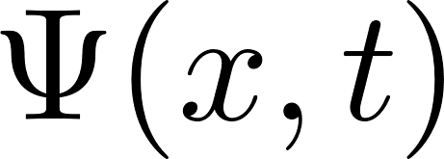
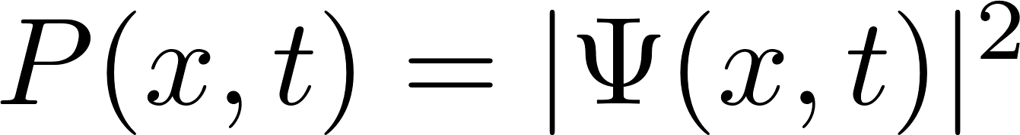
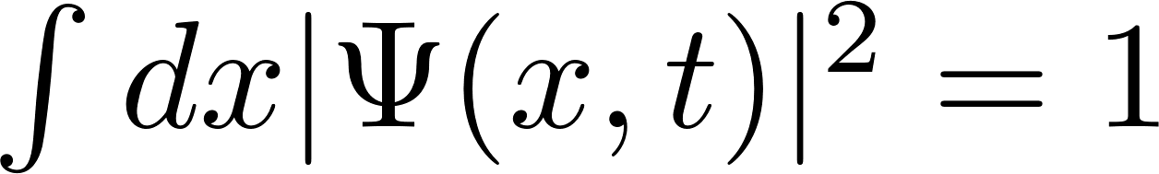
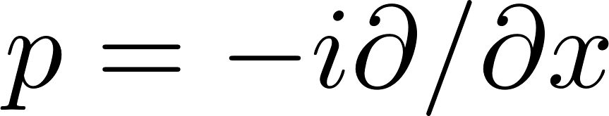
Wavefunction (review)
In coordinate representation, the state is a complex function of x:
Spatial distribution (probability density):
with
Expectation values of other observables:
Example (momentum operator):

Slide 5
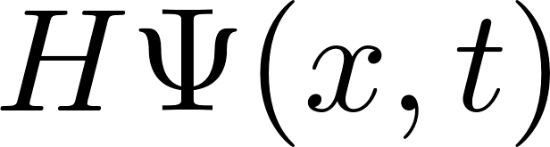
Schroedinger equation
Two possible strategies of solution:
Direct integration of time-dependence
Expansion in eigenstates of H

Slide 6
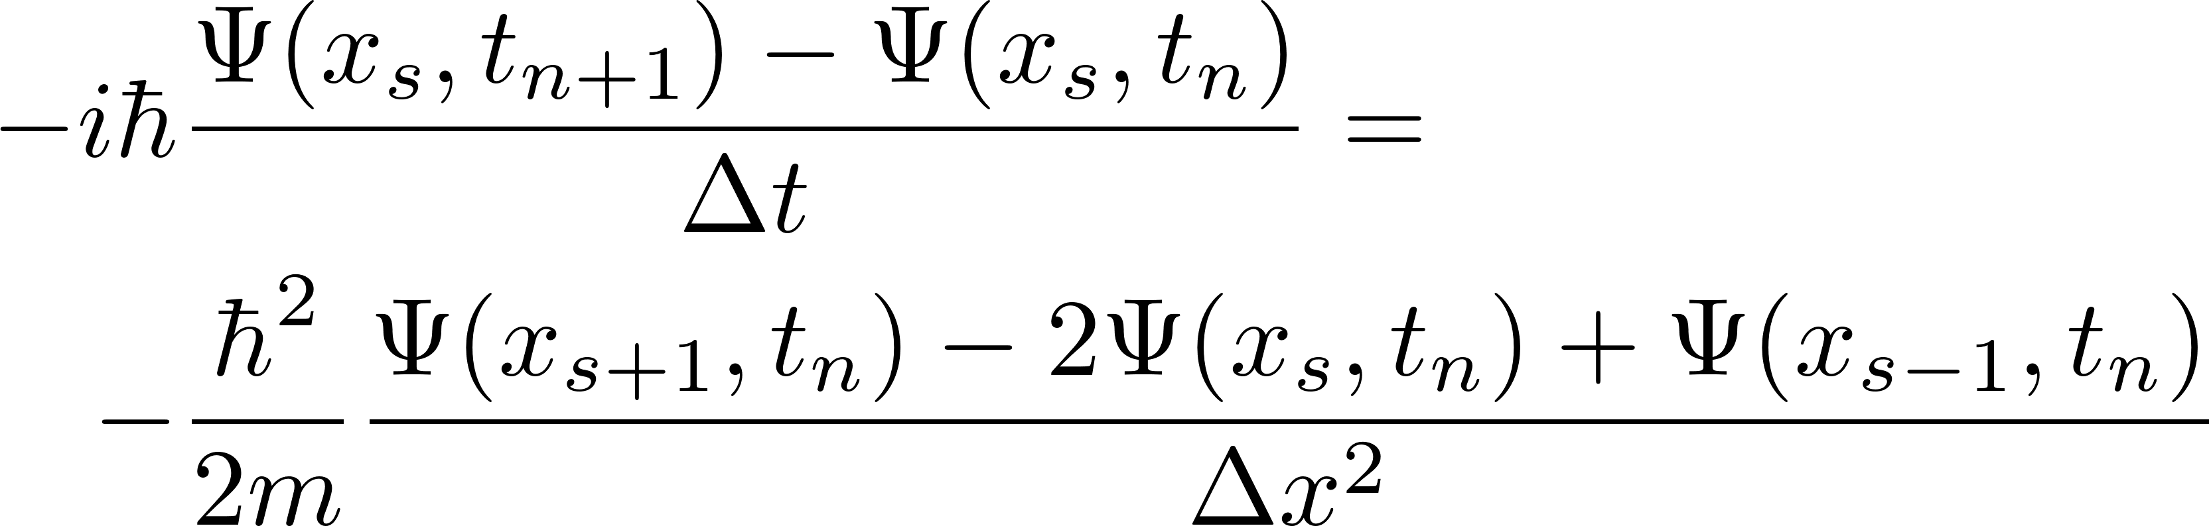
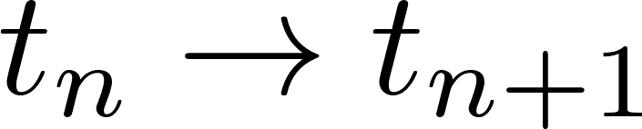
Numerical solution of SE
Proceed as usual, discretizing time and space
Simplest integration scheme (free particle):
Implicit scheme: on right-hand side

Slide 7
Visscher’s scheme
Consider
Discretization (half-step method):

Slide 8
Visscher’s scheme
Important features:
Explicit
Stable
Conserves probability
Reference: P. B. Visscher, Computers in Physics 5, 596 (1991)

Slide 9
Expansion with energy eigenstates
Time-independent Schroedinger equation:
Stationary states:
General state:
where

Slide 10
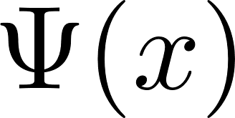
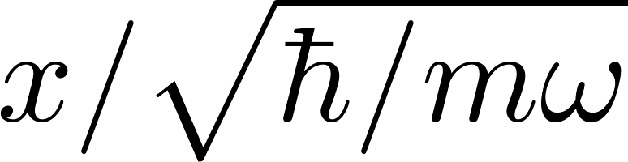


Shooting method
Solve the diff equation at generic E:
Example for harmonic oscillator:

Slide 11
Euler-Cromer algorithm

Slide 12
Euler-Cromer algorithm

Slide 13
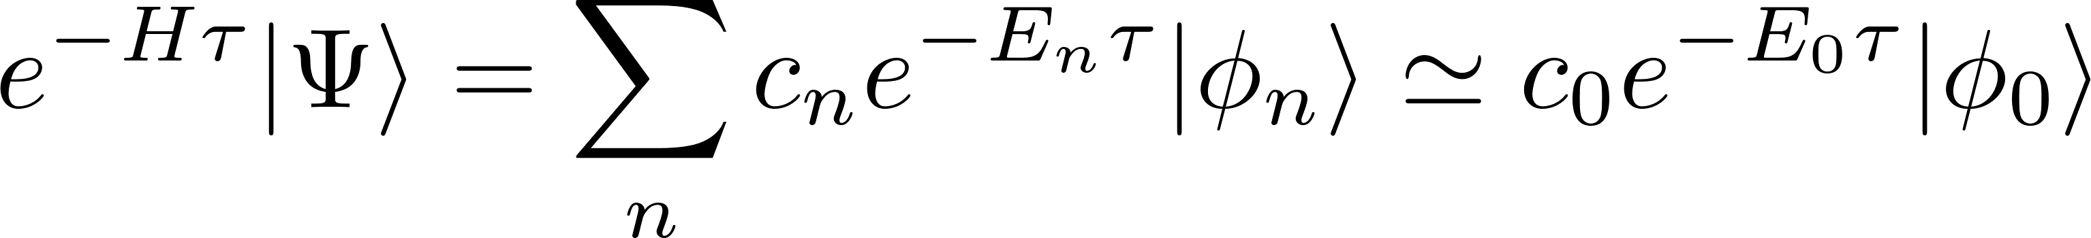
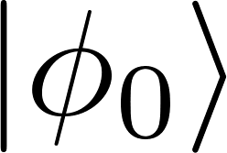
Monte-Carlo methods
Variational Quantum Monte Carlo (QMC)
based on the variational principle
Diffusion or path-integral QMC
based on imaginary-time evolution
Powerful methods to study ground-state

Slide 14
Variational Monte-Carlo
where:
(local energy)
NOTE: x is a multidimensional space
Metropolis algorithm!

Slide 15
Random walk QMC
Basic principle:
Consider the SE in imaginary time
diffusion process (random walk)
branching process

Slide 16

Random walk QMC - remarks
1)
2) The population of walkers goes to zero (E₀>0) or infinity (E₀>0):
Solution: Adjust the reference energy during the simulation, such that the population is approx. constant!

Slide 17
Random walk QMC - algorithm

Slide 18
Random walk QMC - algorithm

Slide 19
Alternative view of diffusion/branching
Green’s function approach:
At short times:
where:

Slide 20
Diffusion QMC - algorithm

Slide 21
Diffusion QMC - algorithm

Slide 22
Importance sampling
A good approximation can facilitate QMC
Consider
Modified SE in imaginary time:
where
Introduces a drift of random walkers (see textbook for details)

Slide 23
Summary
Review of quantum mechanical evolution
Time evolution of the wavefunction
Energy eigenstates, shooting method
Variational Quantum Monte Carlo
Diffusion Quantum Monte Carlo

