Slide 1
108/05/27
Exact Diagonalization Technique
Hai-Qing Lin
Beijing Computational Science Research Center
Refs. PRB 42, 6561 (1990);
Computer in Physics 7, 400 (1993);
Can. J. Phys. 77, 353 (1999).

Slide 2

Outline
Introduction
Searching Algorithm
Iteration Scheme
Applications
Current Status and Improvements
Finite size scaling

Slide 3
Exact Diagonalization
Exact solution on finite lattice
Gain insights on correlations
Flexibility (BC, interactions, etc)
Check on approximations and simulations
Finite size scaling scheme is desired
Usually prefer short-range interactions

Slide 4
Exact Diagonalization Procedure
Eigenvalue problems
H_{ij} = ⟨i|H|j⟩,
i, j = 1, 2, …, M
H|Φ⟩ = λ|Φ⟩,
|Φ⟩ = Σ_{i} α_{i} |i⟩
⟨O⟩ = ⟨Φ|O|Φ⟩

Slide 5
Orthonomal Basis
Hubbard model: 0, ↑, ↓, ↑↓
M = 4^{N}, N = number of Lattice
Spin model: S_{i}^{z} = −S, −S + 1, …, S.
M = (2S + 1)^{N}. e.g., Spin-½ , M = 2^{N}
Binary representation and bit operation:
I_{σ} = Σ_{i} n_{σ} 2^{i−1}.
I = Σ_{i} s(i) (2S + 1)^{i−1} ,
s(i) ≡ S_{i}^{z} + S = 0, 1, …, 2S.
c_{i}†c_{j} + h.c. or S_{i}⁺S_{j}⁻ + h.c.: (1,0) ↔ (0,1)

Slide 6
Search Algorithm
H |i> =∑ H_{ij} |j⟩
For a give binary representation of spin (electron) configuration, how to find an efficient storage/lookup table?
‘‘Direct’’ Method
J(I) = 1, 2, …, M, I up to (2S+1) ^{N} (4^{N})
Length of vector J(I) could be too long
Too many null entries

Slide 7
Hashing Technique
Commonly used in computer science (read)
Hashing function, h(I) = [I (mod K)] + 1.
Length of vector h(I) ≥ M.
Collision, h(I₁) = h(I₂), I₁ ≠ I₂
Non-vectorizable, hard to parallel, slow.

Slide 8
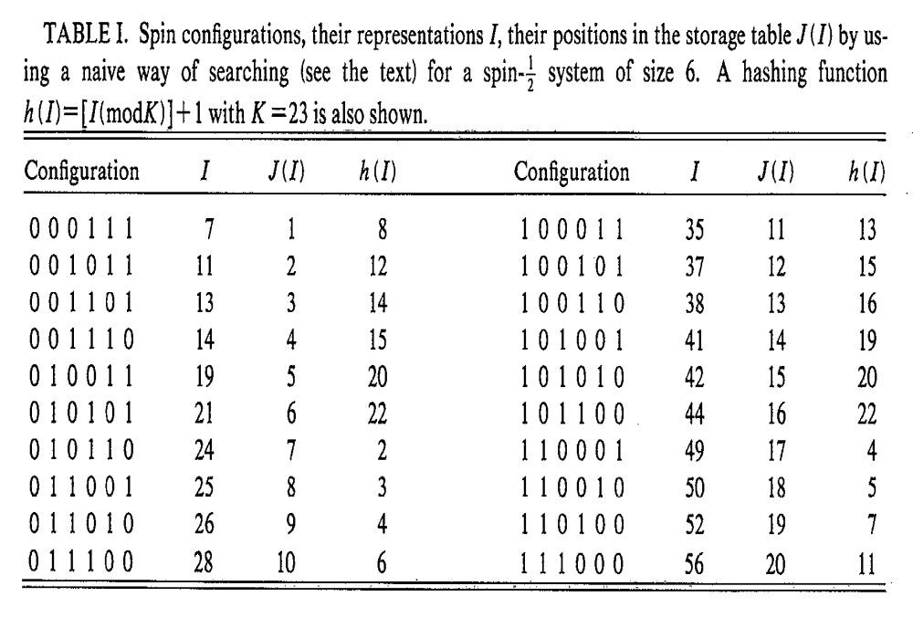

Slide 9
‘‘Two-Table’’ Technique
N = Na + Nb
I_{a} = Σ_{i}^{N}a s(i) (2S + 1)^{i−1}.
I_{b} = Σ_{i}^{N}b s(i) (2S + 1)^{i−1} , s(i) ≡ S_{i}^{z} + S = 0, 1, …, 2S
J(I) = J(I_{a}) + J(I_{b}).
Length of vector h(I) ≤ √M (reduces memory).
No collision.
Vectorizable (parallelizable), very fast.
Similar for fermions. (how?)

Slide 10
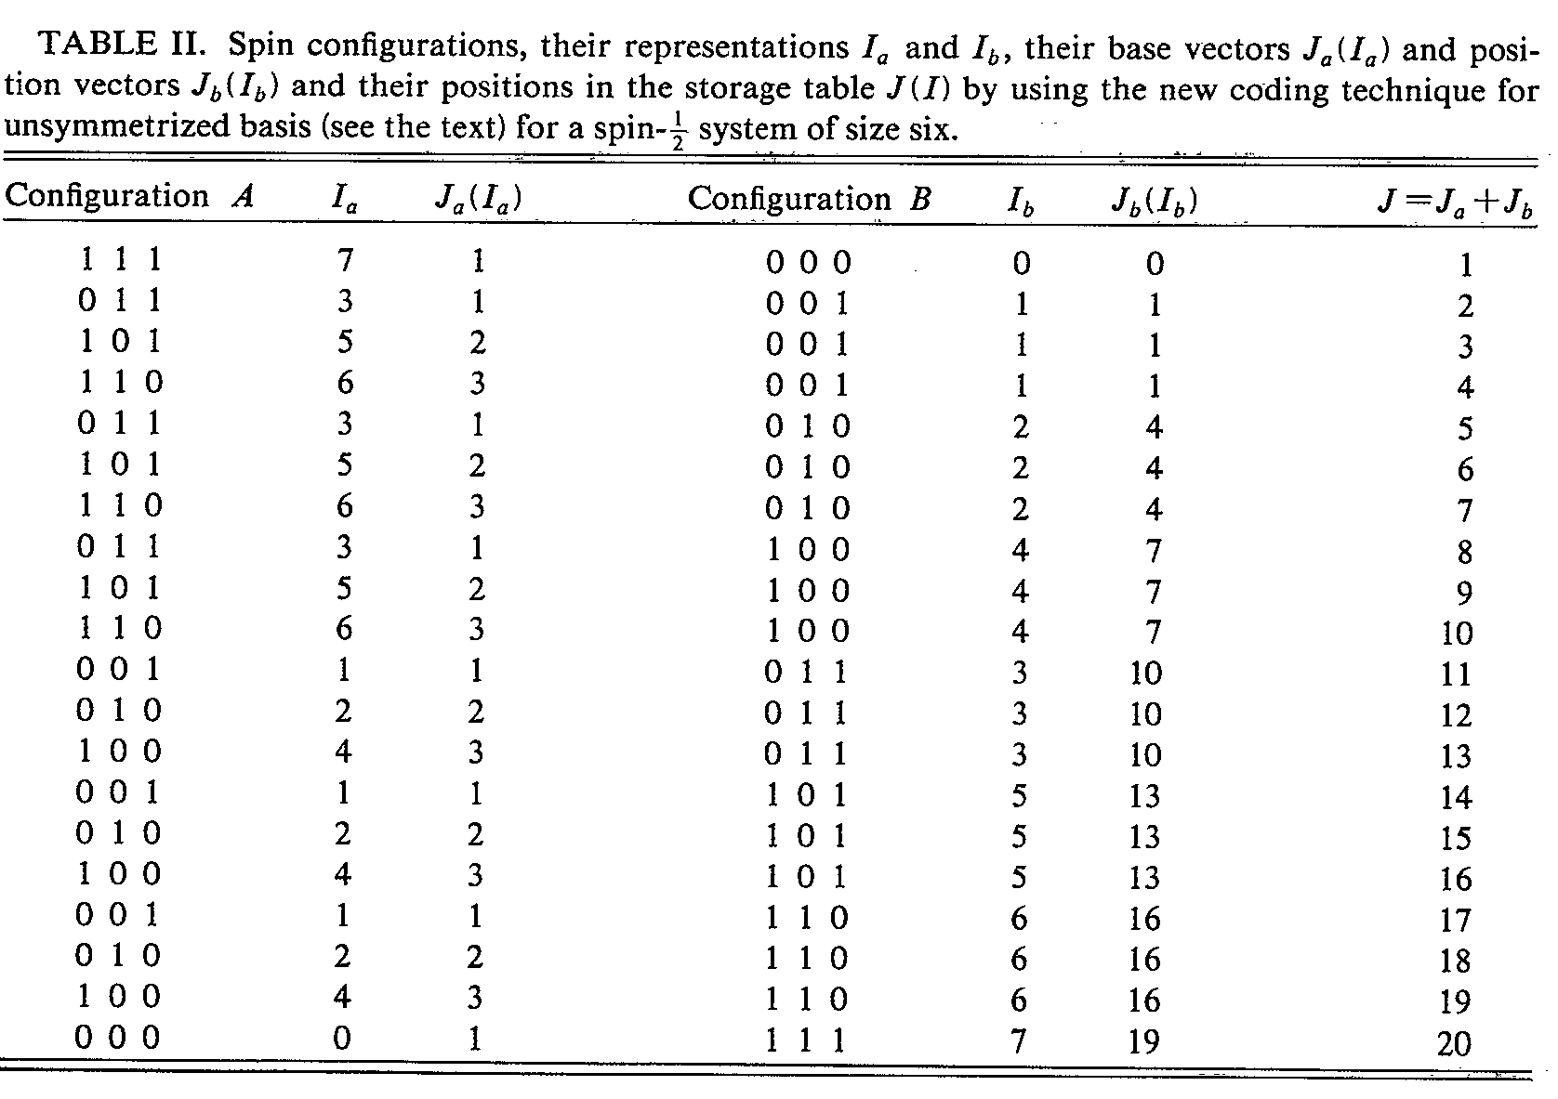

Slide 11
Symmetries
[H, O_{s}] = 0
H = H₁ ⊕ H₂ ⊕ ⋅⋅⋅
Translation (Periodic Boundary Condition)
Rotation (D ≥ 2)
Reflection (may not commute with rotation)
N↑, N↓ (S_{T}^{z}), S²

Slide 12
Sparse Matrix
There exists many zero matrix elements
Number of operations ~ N log(N), not N³
Ground state properties (low dimensions)
No finite temperature phase transitions
(Mermin-Wagner)
E_{f} ≈ 10⁵T:
Low lying excitations determine basic physics

Slide 13
Iteration Scheme
Standard approach, basic linear algebra
Power method
Lanczos method
Similar approach: e.g, projection (QMC)

Slide 14
Power Method
Select a state | Ψ >
Apply H (or shift by a constant) to | Ψ > and calculate
E^{n} = < Ψ | H^{n} | Ψ >/ < Ψ | Ψ >
In the limit n →∞, E^{n} converges to the ground state if | Ψ > is not orthogonal to the ground state

Slide 15
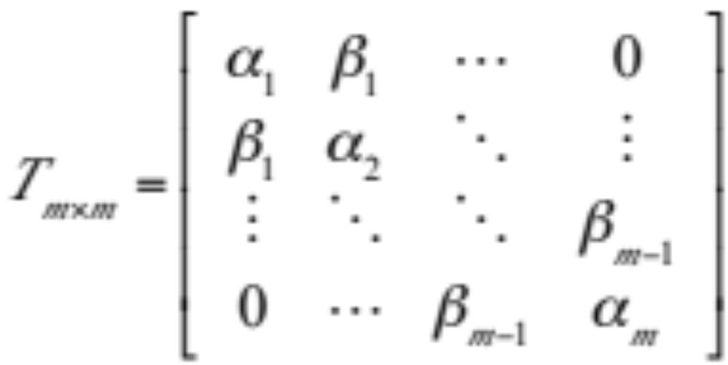
Lanczös Algorithm
Recursion Relation
H|Φ_{j}⟩ = β_{j−1}|Φ_{j−1}⟩ + α_{j}|Φ_{j}⟩ + β_{j}|Φ_{j+1}⟩
Tridiagonal matrix
It is a canonical transform

Slide 16
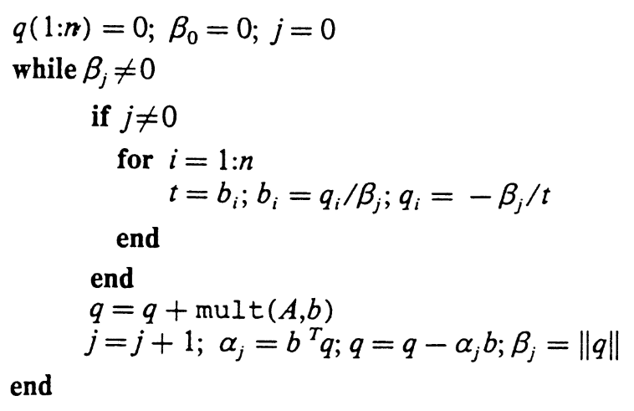
Lanczös Algorithm
Orthogonality
⟨Φ_{i}|Φ_{j}⟩ = δ_{ij}
α_{i} = ⟨Φ_{j}|H|Φ_{j}⟩
β_{i} = ⟨Φ_{j+1}|H|Φ_{j}⟩
Pseudocode

Slide 17
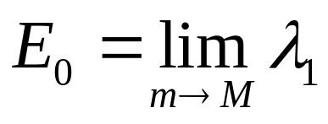
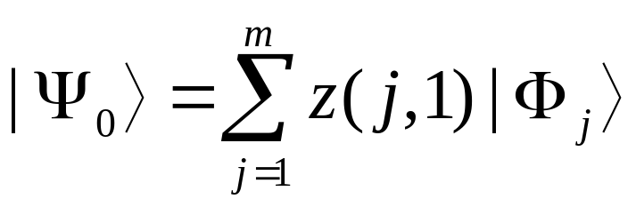
Iteration
Eigenvalues of the matrix T_{m×m}
λ_{i}(m + 1) ≤ λ_{i}(m)
The ground state energy of H
The ground state wave function
where z(j,1) is eigenvector of λ₁(m)
In practice, m = 30 – 100 (10 digits in E₀).

Slide 18
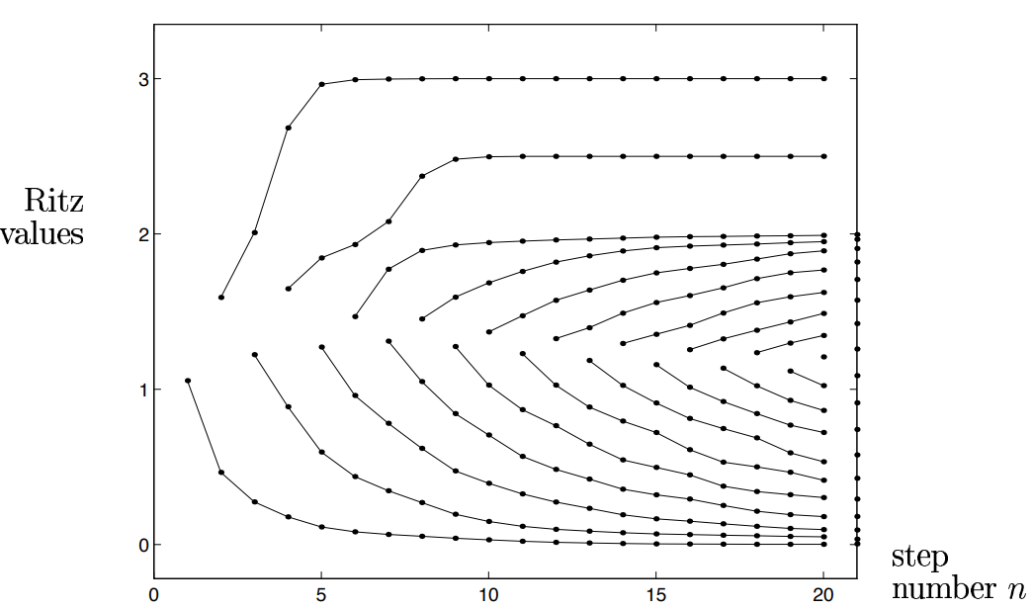
Convergence
Convergence to endpoint eigenvalues in a few steps

Slide 19
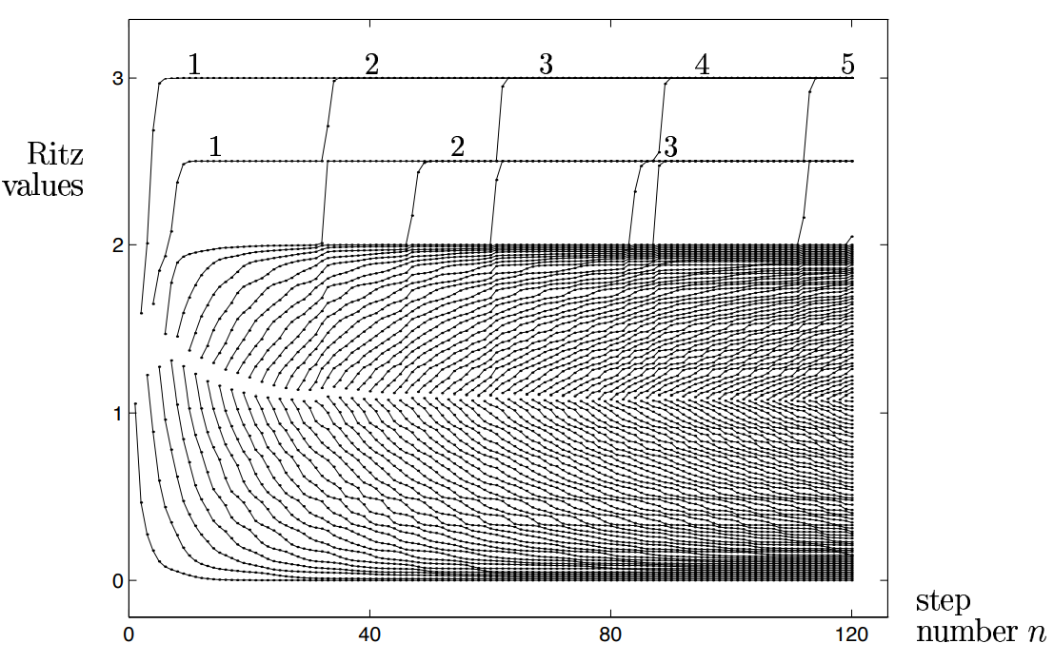
Convergence
Solution: enforcing orthogonality of the basis at each step (more expensive)
Rounding errors are the source of ghost eigenvalues → loss
of orthogonality between the basis vectors.

Slide 20
Symmetry and Conservation Quantities
If [H, O_{s}] = 0, and |Φ₁⟩ is in a subspace of O_{s},
then all |Φ_{j}⟩ are in the subspace of O_{s} and so is |Ψ₀⟩ .
|Φ_{j=1,2,…,m}⟩ belongs to an invariant subspace of H.
Choosing different initial state.
4×4 Hubbard, Ne= 8 + 8,
M = 4¹⁶ = 4 294 967 296
→ (16)!/(8!)² = 601 080 390 → 1 310 242 (90 sec.)

Slide 21
Programming and Improvements
Notes on Programming
Good initial trial state (physics)
Reorthogonalization
Fast I/O
Lift degeneracy
Picking up important configurations?

Slide 22

Summary
Achievements
  Hubbard model, N = 18, M = 16,445,304
  Heisenberg model, N = 36, M ≈ 16 M
Applications
  Widely used currently
  LRO in AFH, and other models
  ΔE, Pairing correlations, etc

Slide 23
Square Lattice (Oitma and Betts, 1978)
l² + m² = n
l, m, n are integers
l + m = even
•
•
•
•
•
•
•
•
•
10
8
•
•
•
•
•
•
•
•
•
•
•
2×2
•
•
6×6
•
•
•
•
•
•
•
•
•
•
•
•
•
•
•
•
•
•
•
•
•
•
•
•
•
•
•
•
•
•
18
•
•
•
•
•
•
4×4
•
•
•
•
•
•
•
•
•
•
•
•
•
•
•
•
•
•

Slide 24
Square Lattice (Oitma and Betts, 1978)
l² + m² = n
l, m, n are integers
l + m = even
•
•
•
•
•
•
•
•
•
•
•
•
•
•
•
•
20
•
•
•
•
•
•
•
•
•
•
•
•
•
•
•
•
•
•
•
•
•
•
32
•
•
•
•
•
•
•
•
•
•
•
•
•
•
•
•
•
•
•
•
•
•
•
•
•
•
•
•
•
•
26
•
•
•
•
•
•
•
•
•
•

Slide 25
More Bipartite Square Lattice (Betts, Lin, Flynn)
Old:
N = 8, 10, 4 × 4, 18, 20, 26, 32, 6 × 6 (8 total)
New:
N = 12, 16, 18, 22, 24 (4), 26, 28 (2), 30, 32,
34 (14 additions)
Topological bipartite imperfection, I_{B}(N)
QMC: 16 × 16

Slide 26
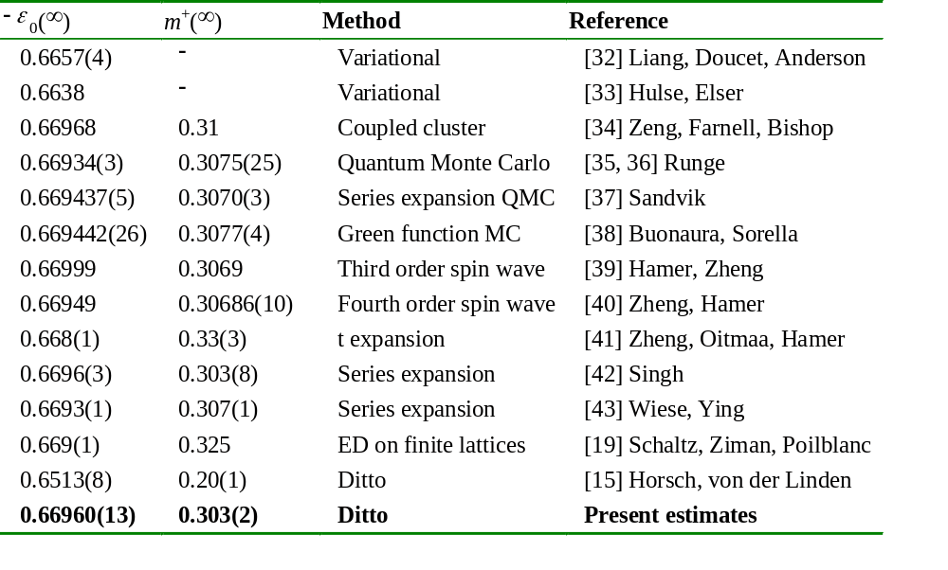
Comparison of estimates of the energy per vertex, ε₀, and the staggered magnetization per vertex, m⁺, of the S = ½ Heisenberg antiferromagnet on the infinite square lattice at T = 0

Slide 27
Related Issues
Density Matrix Renormalization (DMRG)
Finite temperature Lanczos method
Monte Carlo Simulation of Eigenvectors
Finite size scaling:
  scaling function, e.g., spin-wave theory
  establish bounds, e.g., variation principle
  …

Slide 28
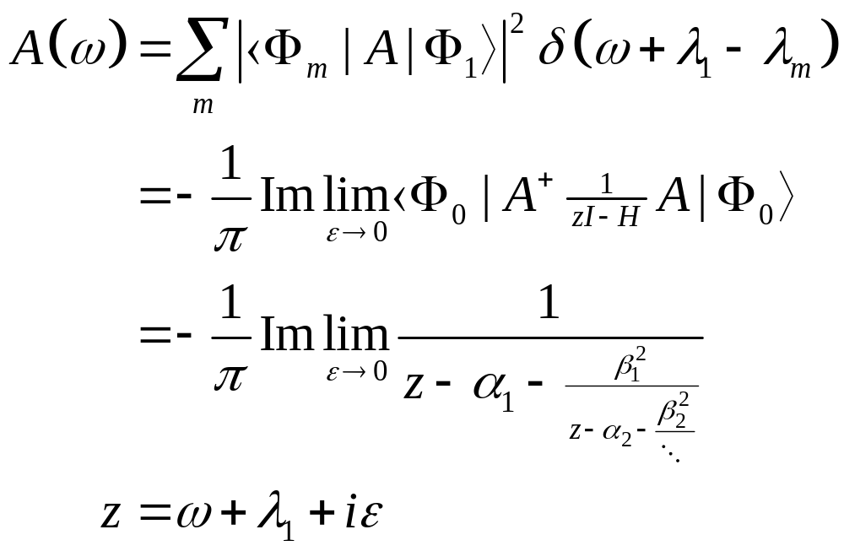
Spectral Function
A = current operator: A(ω) is optical conductivity.
A = S⁺ or S⁻: A(ω) is magnetic susceptibility.

Slide 29
Perturbation Theory
For H = H₀ + V, H₀|Φ₀⟩ = E₀|Φ₀⟩, we compute the Greens function ((E + iε)I – H)^{–1} and obtain the continued fraction
Pade approximation
Brillouin-Wigner perturbation theory

