Slide 1
Introduction
Magnetic Moment
Magnetic Ordering
Origin of Magnetism

Slide 2
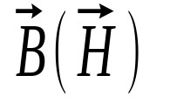
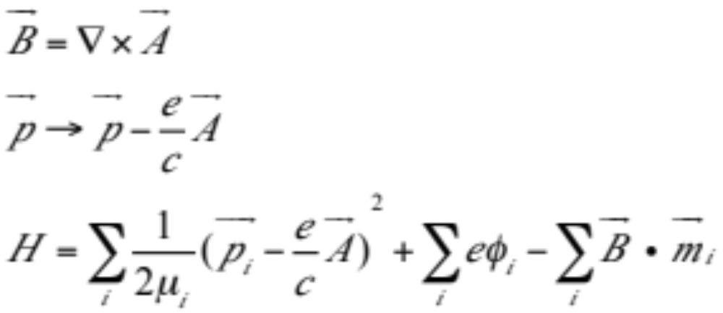
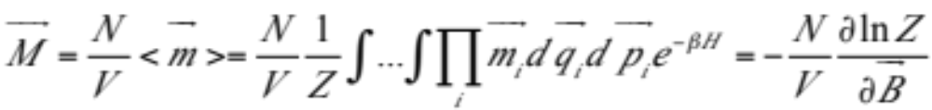

Origin of Magnetism
Let’s consider magnetic moments in an external magnetic field
Magnetization (Boltzmann distribution):

Slide 3
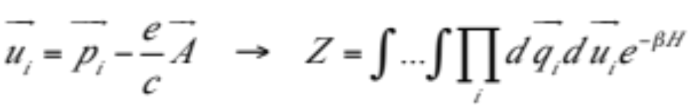
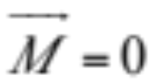
Origin of Magnetism
Change variables
(Integration from -∞ to +∞), Z is independent of A, so its derivative with respect to magnetic field is zero, i.e., (Miss van Leeuwen’s Theorem)
Conclusion: we have to consider the discreteness of the eigenvalues of the system, i.e., quantum nature.

Slide 4
Physical Issues
There are many
Why/how the nature creates these ordered structures? (QM, microscopic)
Order ⬄ Disorder Transition (thermodynamic properties, macroscopic)
Dynamics of carriers
Relation to other quantum state?
…

Slide 5
Microscopic Mechanisms
Stoner criterion
Band structures (van Hove, Flat-band, etc.)
Itinerant versus localization
The role of electron-electron interaction (U=∞)
The role of degeneracy (multi-orbital systems)
…

Slide 6
108/05/26
The Hubbard Model
Hai-Qing Lin
Beijing Computational Science Research Center

Slide 7
Outline
Model Hamiltonian
History
Current Interest
Related Models
Symmetries
Solving Many-Body Hamiltonian

Slide 8
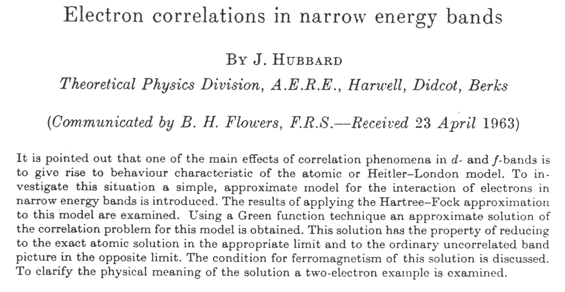
Hubbard Model
Proc. R. Soc. London, Ser. A276, 283(1963); 281, 401 (1964). 7844 citations (May, 2019)

Slide 9

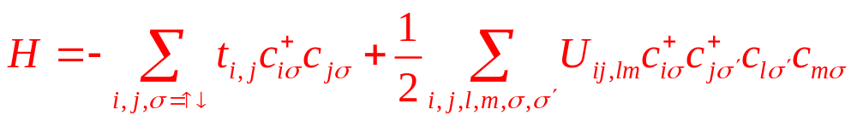
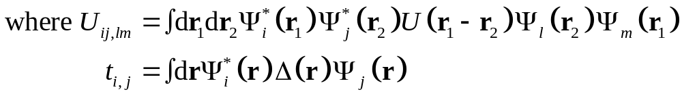
Hubbard Model
Coulomb potential
Hubbard approximation (1963):
t_{i,j} = t if i and j are nearest neighbor
U_{ij,lm} = Uδ_{ij}δ_{il}δ_{im}, (on-site U only).
Extended Hubbard model: U_{ij,lm} = Vδ_{ij}δ_{jl}δ_{i,j±a}.
Magnetism.

Slide 10
Why the Hubbard Model?
Simplest model to describe many-body interactions.
Some Statistics: (Web of Science)
“Hubbard” before 1987: 930/937; 1987-2011: 5,243/15,702
Widely used in condensed matter physics:
  Quasi-2D organic superconductor
  1D conducting polymers, the Peierls-Hubbard model
  Metal-insulator transition
  Degenerate Hubbard model
  LDA + U
  Books, Meetings (e.g., APS Hubbard Section, etc.)
  …

Slide 11
Hubbard Model
H_{Hubbard} = – t Σ_{⟨i,j⟩σ} (c†_{iσ} c_{jσ} + h.c.) Kinetic
+ U Σ_{i} n_{i↑} n_{i↓} Coulomb
H_{k} = Σ_{kσ} ε_{k} c†_{kσ} c_{kσ}
H_{I} = Σ_{i} (– 2U/3)(S_{i})² + N_{e}U/6
Parameters: U/t, N_{e}/N
↑
t
(Bipartite lattice)
↑
U
↓
Localized moment

Slide 12
Current Interests
Superconductivity:
  High-T_{c} superconductors
  Organic superconductors
n(k), Z = 0, is 2D close to 1D?
Spin-charge separation
Magnetism
Phase separation
Effects of long-range Coulomb interactions
Emulations in other realms: Atomic Physics
→ Cold atoms trapped by laser beams
Out-of-equilibrium
?

Slide 13
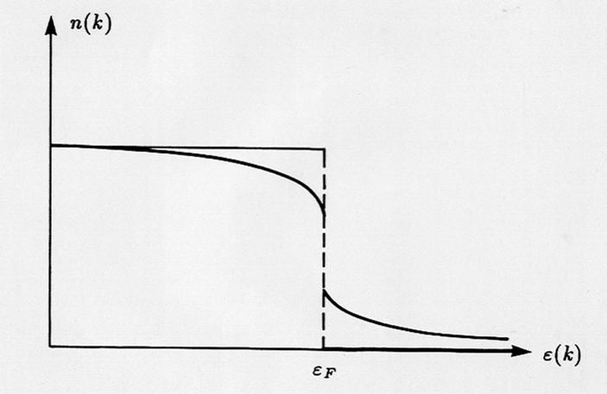

Green’s Function
n(k)
Z
Quasi-particle weight
Occupancy of energy levels of the non-interacting case
(straight line) and interacting case (curved line)

Slide 14
Models for Highly Correlated Systems
Three-band Hubbard Model (Cu-O cuprates)
Degenerate Hubbard Model (d or f-orbital)
Peierls-Hubbard Model (lattice distortion)
Anderson Impurity/Lattice Model (local moment)
Kondo Impurity/Lattice Model
Double Exchange Model (CMR materials)
Quantum Spin Model (e.g., Heisenberg Model)
…

Slide 15
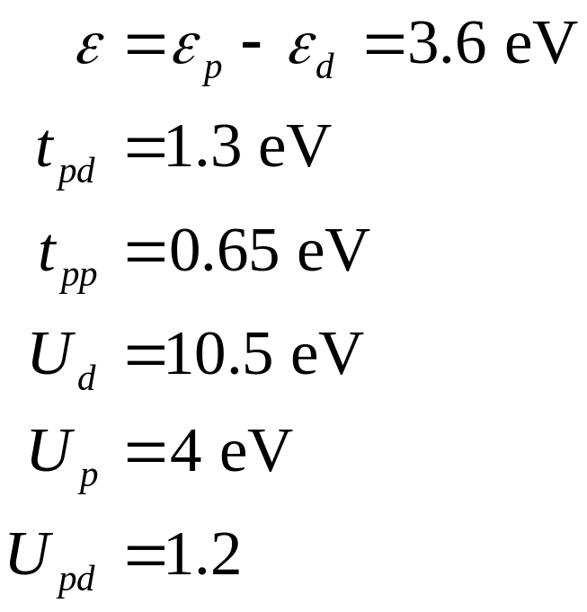








3-Band Hubbard Model
LDA Estimates
CuO₂ Unit Cell

Slide 16
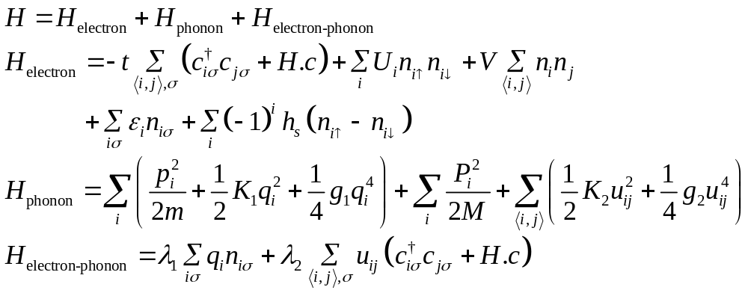
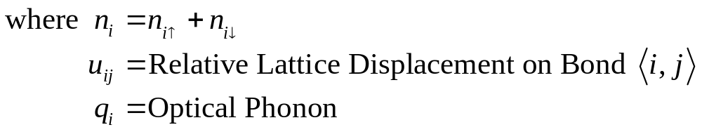
The Peierls-Hubbard Model
SSH, Holstein (Dimerization, Soliton, etc).
Adiabatic Approximation (Double Well)

Slide 17
The Degenerate Hubbard Model
Consider degenerate d-orbital in real metals.
Hund’s rule couplings
Ferromagnetism?
Proc. R. Soc. London, Ser. A276, 283(1963); 281, 401 (1964).

Slide 18
The Anderson Impurity Model
Hybridization
Used to describe magnetic impurities embedded in metals.
Anderson lattice model
Kondo model (intimately related to the Anderson impurity model, as can be shown by Schrieffer–Wolff transformation.)
…

Slide 19
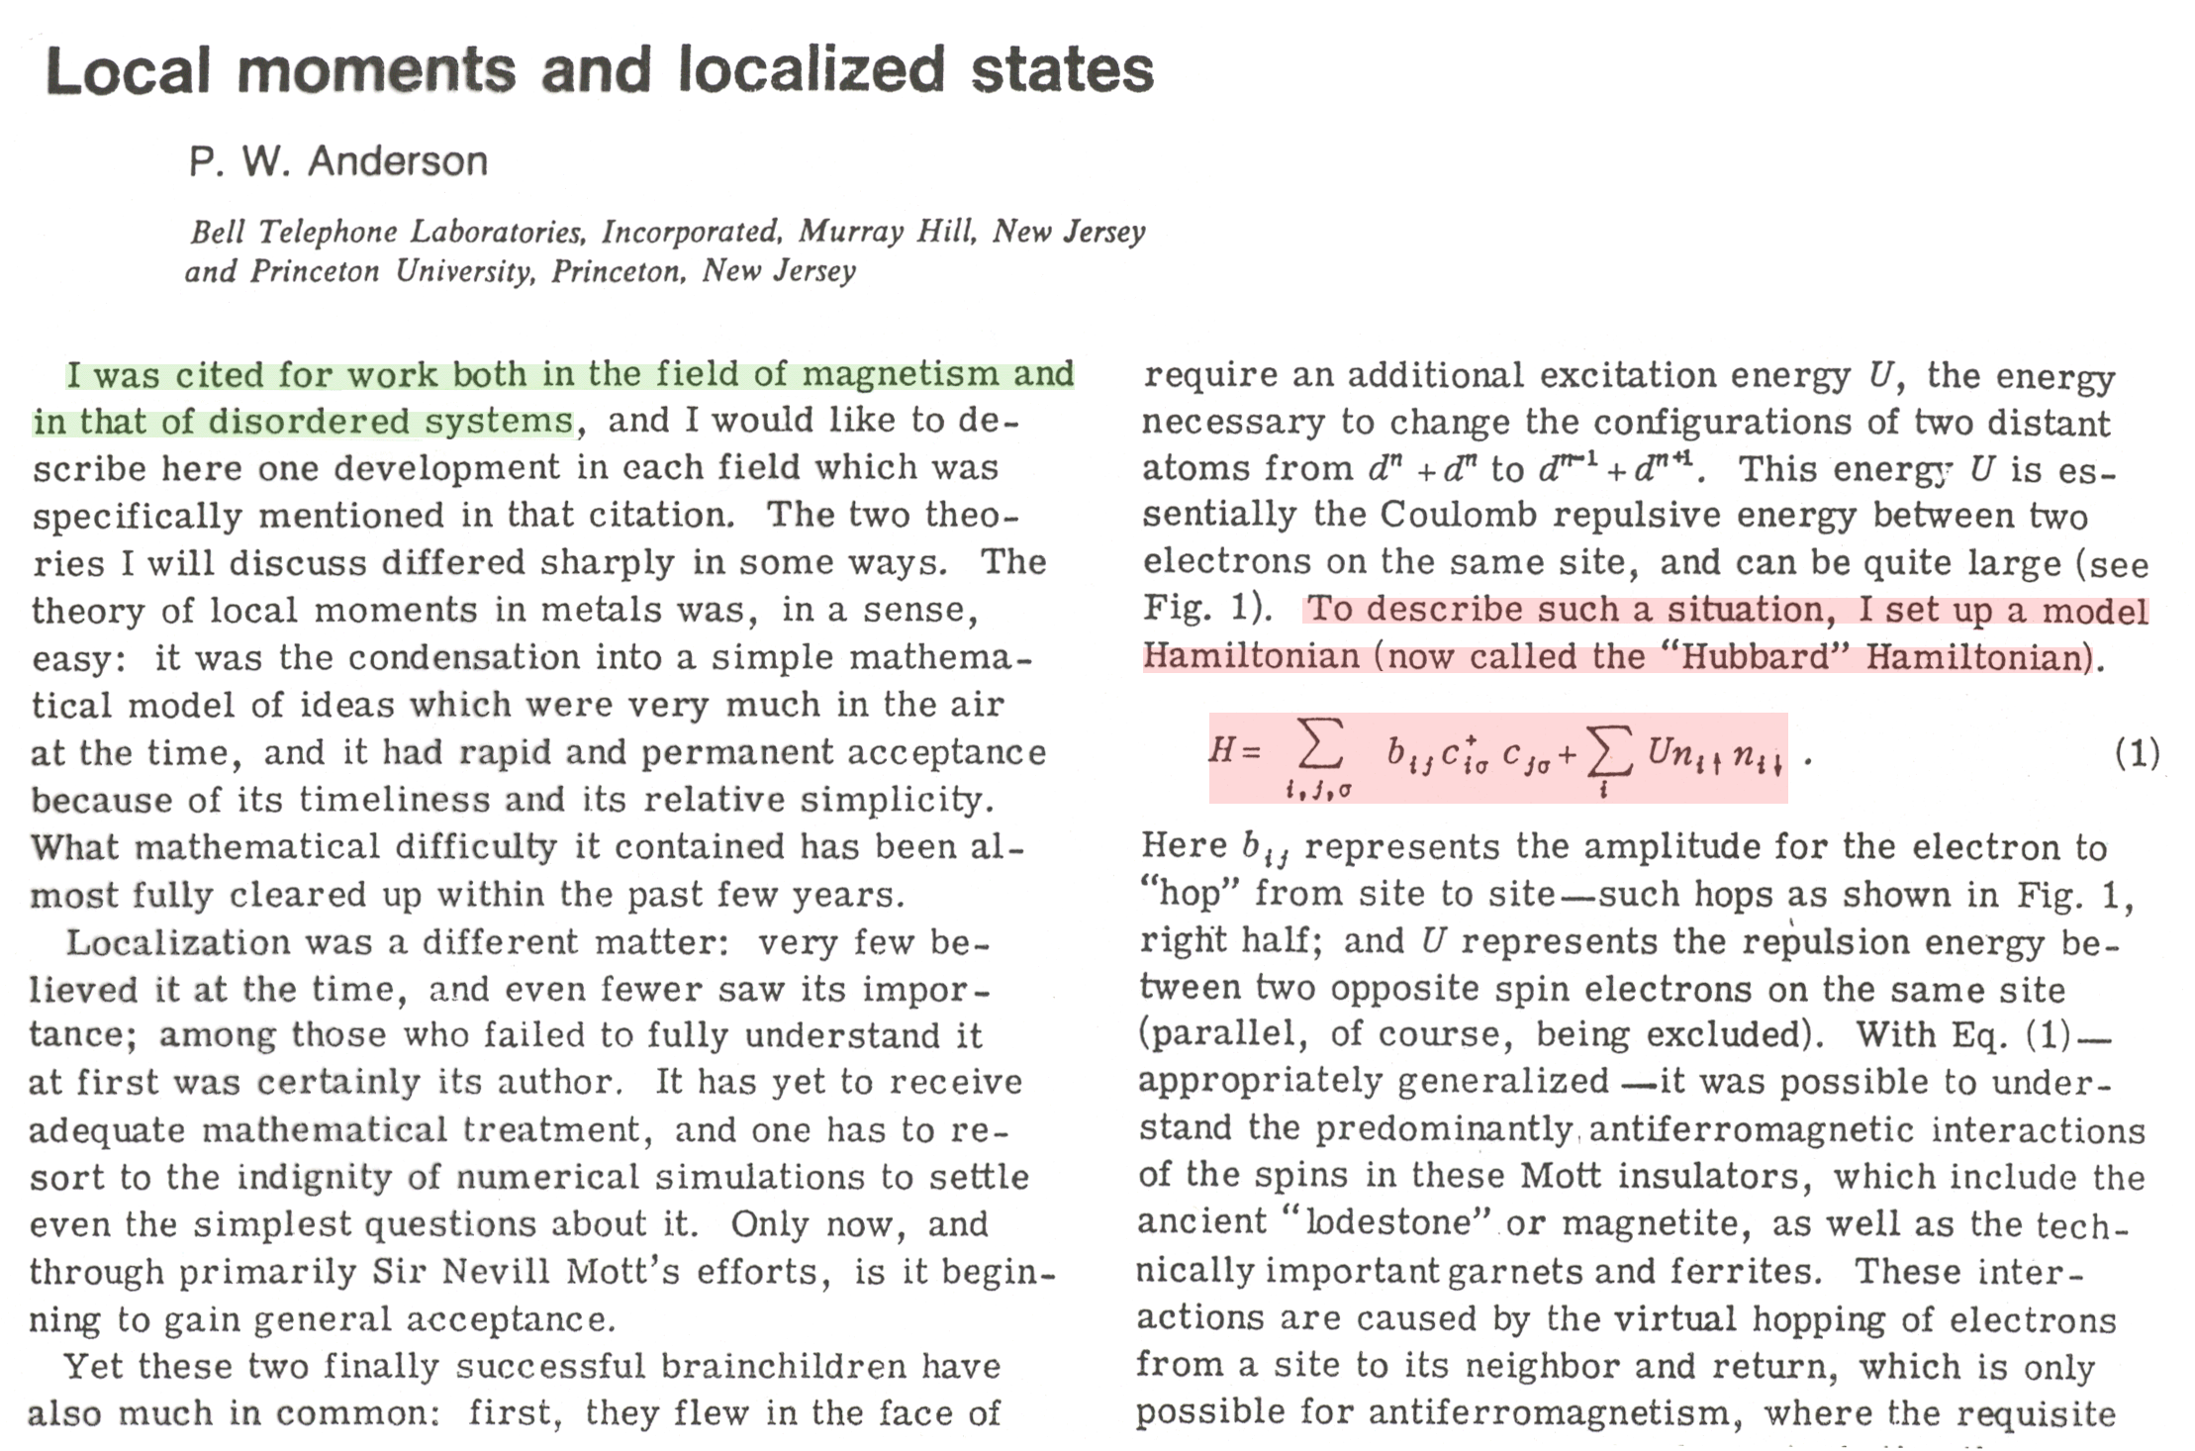
Local Moments and Localized States

Slide 20
Citations from P. W. Anderson
Nobel Prize (1977) Speech
I was cited for both in the field of magnetism and in that of disordered systems.
To describe such a situation, I set up a model Hamiltonian (now called the “Hubbard” Hamiltonian)
H = Σ_{i,j,σ} b_{ij} c†_{iσ} c_{jσ} + U Σ_{i} n_{i↑} n_{i↓}

Slide 21
Solution of the Hubbard Model
In one dimension:
  Lieb-Wu Bethe Ansatz solution (1968)
  Field theory
  RG analysis
  …
For two and higher dimensions:
  Various approximation schemes
  Numeric: Exact diagonalization, QMC

Slide 22
Solving Many-Body Model Hamiltonian
Mean-Field Approximation, Slave Particles
Rigorous Solutions (e.g., Bethe Ansatz)
Perturbation Theory
Variational Wave Function
Field Theory, Functional Integral
Exact Diagonalization
Quantum Monte Carlo simulations
…

Slide 23
Solving Many-Body Model Hamiltonian
Direct Investigate H-matrix
Canonical Transformation
Use Symmetries
Study Limiting Cases
Making Approximation
Numerical
…
Computational Physics does not mean “numerical”!

Slide 24
Solving Many-Body Model Hamiltonian
Direct Investigate H-matrix
  Taking a proper basis to set up the H-matrix
  Observe if there is any special characteristics allow us to estimate its spectrum
Canonical Transformation: map the model into the one we know how to solve. e.g.,
  Fourier transform
  Jordan-Wigner Transformation (see note), fermion ⬄ spin ⬄ boson

Slide 25
Symmetries in the Hubbard Model
Gauge symmetry (charge conservation)
and
Remains invariant if this transformation is applied
→ Therefore, the particle number is conserved

Slide 26
Symmetries in the Hubbard Model
Spin rotational invariance: SU(2) algebra
→ S² and S_{z} are good quantum numbers.
Local spin operators (at site j):
Global spin operators:
They form an SU(2) algebra
The Hamiltonian commutes with these operators → it possess SU(2) symmetry

Slide 27
Symmetries in the Hubbard Model
Electron-Hole Transformations:
T₁: c†_{iσ} ↔ c_{iσ}
H(N↑, N↓, U, t) = H(N – N↑, N – N↓, U, – t)
– U (N – N↑ – N↓).
T₂: c†_{iσ} ↔ (–1)^{i} c†_{iσ}
H(N↑, N↓, U, t) = H(N↑, N↓, U, – t).
T₃: c†_{iσ}↔ (–1)^{i} c_{iσ}
H(N↑, N↓, U, t) = H(N – N↑, N↓, – U, t) + U ( N↑)
= H(N↑, N – N↓, – U, t) + U ( N↓).

Slide 28
Solving the Hubbard Model
The Hamiltonian contains two parts: T and V
T is diagonal in momentum space
V is diagonal in real space
T and V do not commute → difficulty

Slide 29
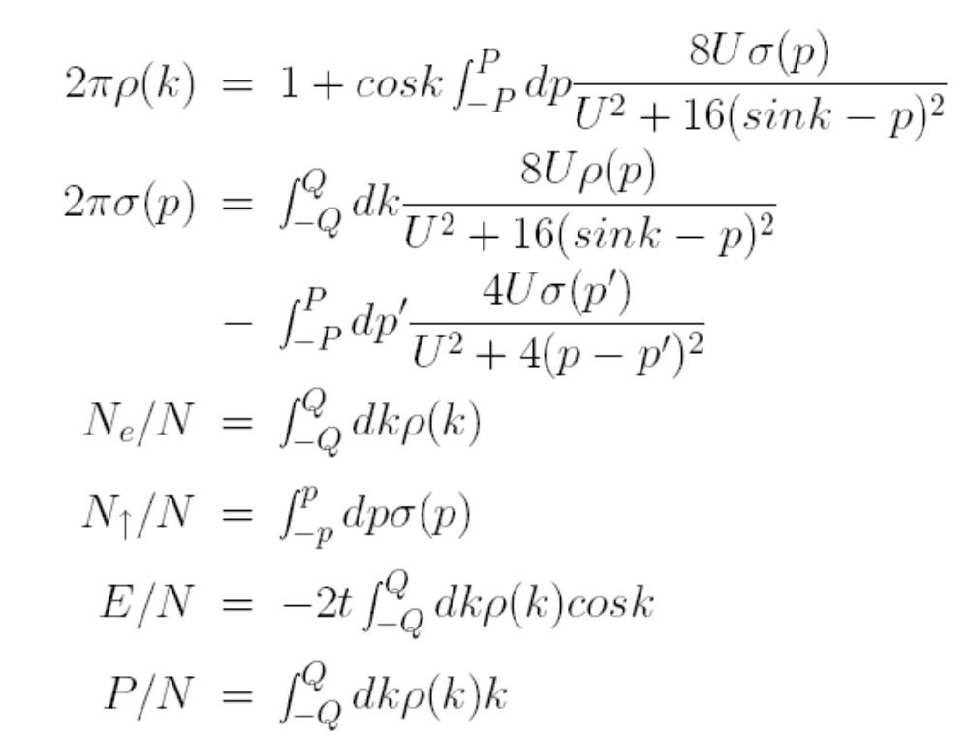
Bethe Ansatz Approach
Lieb and Wu, 1968
Exact, L or ∞
1D Only
No correlation functions
No M-I transition
Depends on the magnetization and charge densities

Slide 30
Solving the Hubbard Model
Exact Solution: Bethe Ansatz
t = 0, Real space
U = 0, K-space; tight binding model
2-site problem, (Exact Diagonalization)
Strong Coupling Limit => Heisenberg Model
Mean-Field Approach
Functional Integral
Quantum Monte Carlo
Variational Wave function
Green’s Function and Feynman Diagram

Slide 31
Solving the Hubbard Model
t = 0, solve it in real space
Highly degenerate
Classical problem (Atomic limit → finding configurations and their energy is reduced to a counting problem)

Slide 32
Solving the Hubbard Model
U = 0, solve it in K-space (tight binding)
Fourier transform (canonical transform)
Boundary conditions

Slide 33
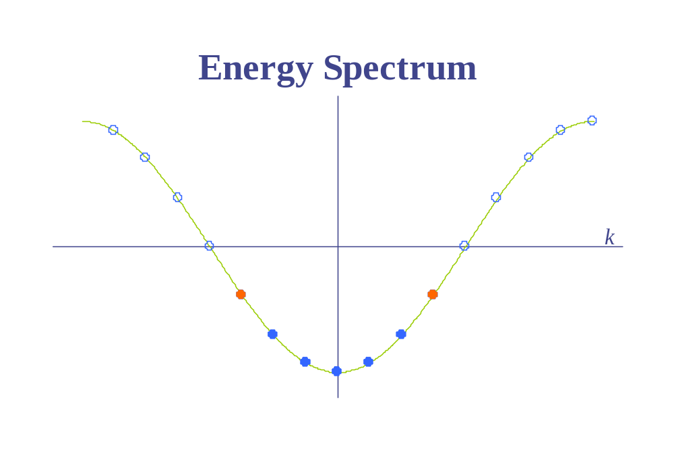
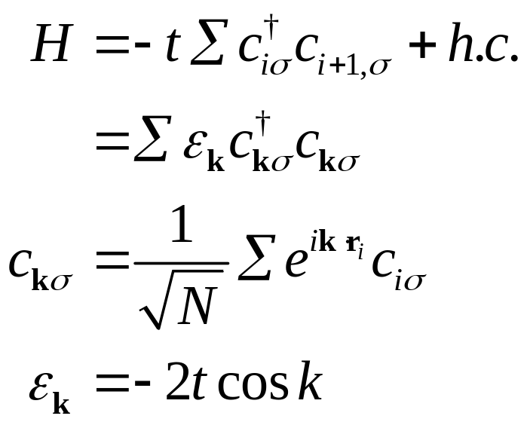
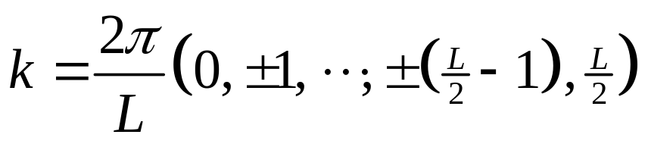
Noninteracting Fermion Ring
PBC
2n + 1: non-degenerate
2n: degenerate

Slide 34
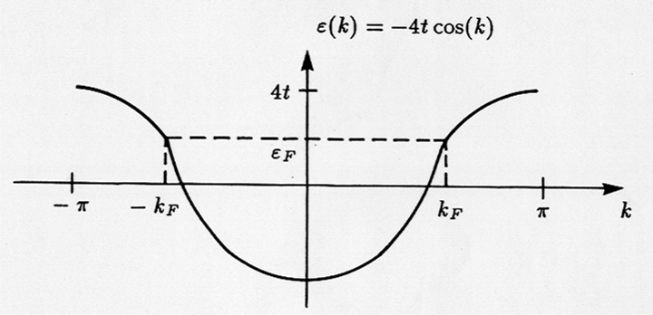
Tight-binding Model

Slide 35
Noninteracting Electron
Equation of Motion Approach
Fourier Transform
Calculate Correlation Functions

Slide 36
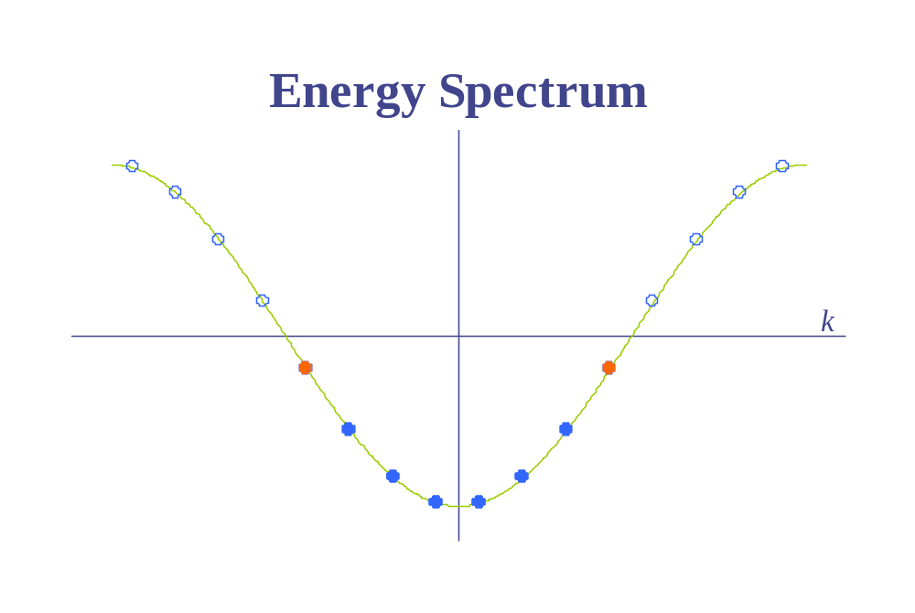
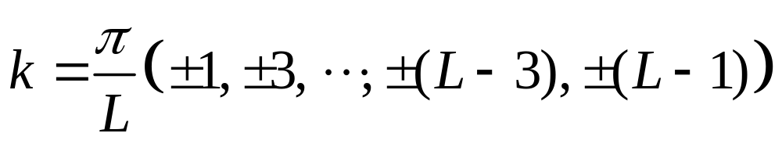
Noninteracting Fermion Ring
APBC
2n: non-degenerate
2n + 1: degenerate

Slide 37
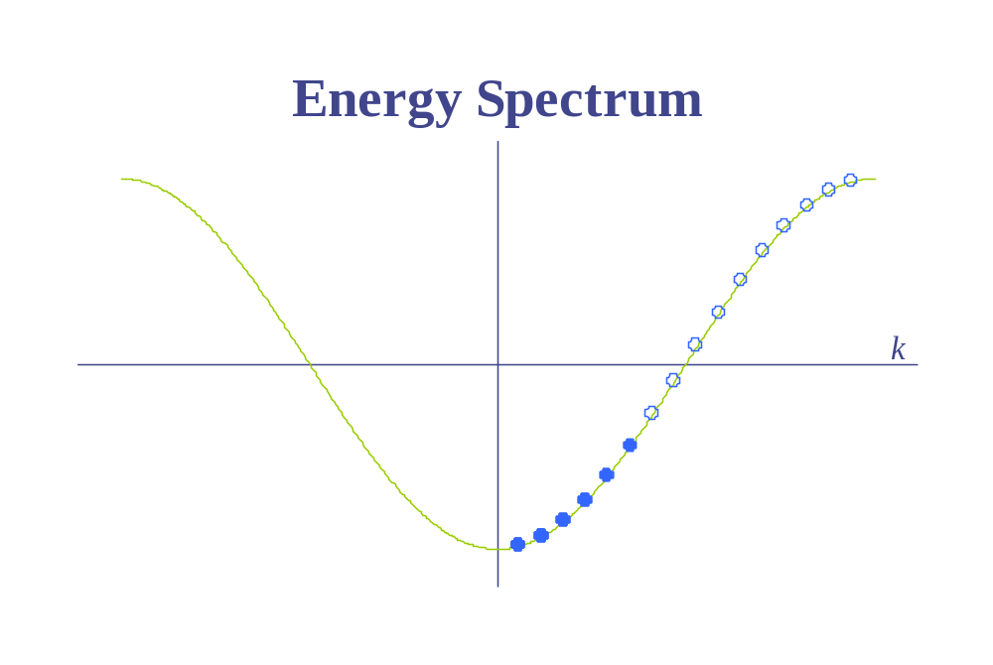
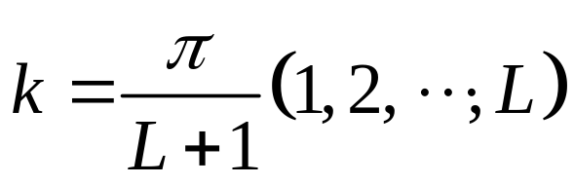
Noninteracting Fermion Chain
OBC
always non-degenerate

Slide 38
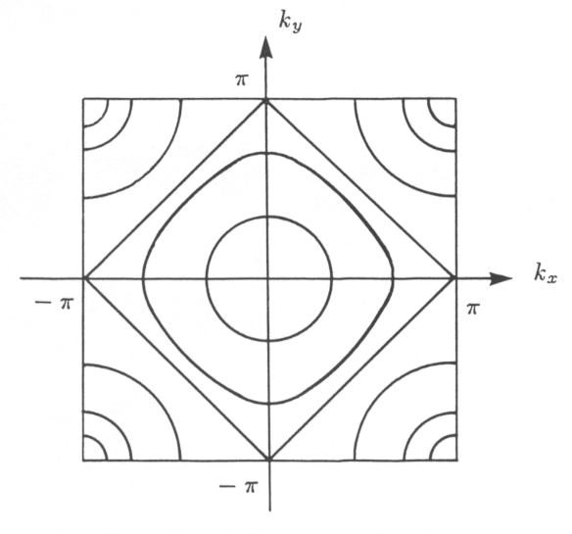
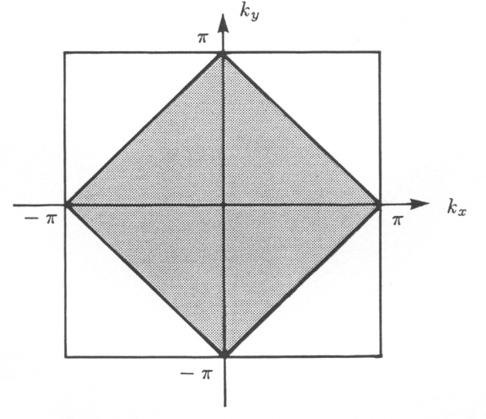
Fermi Sea
Constant energy curves for H₀ on a square lattice
ε_{K} = – 2t (cosk_{x} + cosk_{y})
(– 4t, 4t) w = 8t
|ε_{K}| = ε_{F} |ε_{K}| < ε_{F}
ε_{F} = 0
Fermi sea for free electrons on a square lattice at half filling (the lattice spacing is unity).
Q

Slide 39
Exact Diagonalization Technique
Set up Basis, | i ⟩ and H-matrix, H_{ij}
Eigenvalue & Eigenvector: H |Φ⟩ = λ |Φ⟩, |Φ⟩ = Σ_{i} α_{i} |i⟩, (i, j = 1, 2, …, M)
Expectations: ⟨Φ| O |Φ⟩
Exact solution on finite size lattices
Standard Linear Algebra Problems

Slide 40
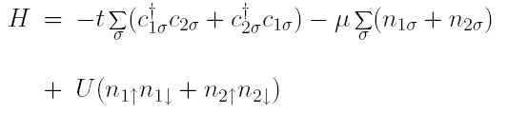
Solving the Hubbard Model: 2-Site
Model Hamiltonian
Diagonal in particle number N = N↑ + N↓, and magnetization S_{z} = N↑ - N↓
Symmetry with up ⬄ down, particle-hole
(N↑, N↓) = (0,0); (2,2)
(N↑, N↓) = (1,0), (0,1); (2,1), (1,2)
(N↑, N↓) = (2,0), (0,2)
These are easy cases to solve.

Slide 41
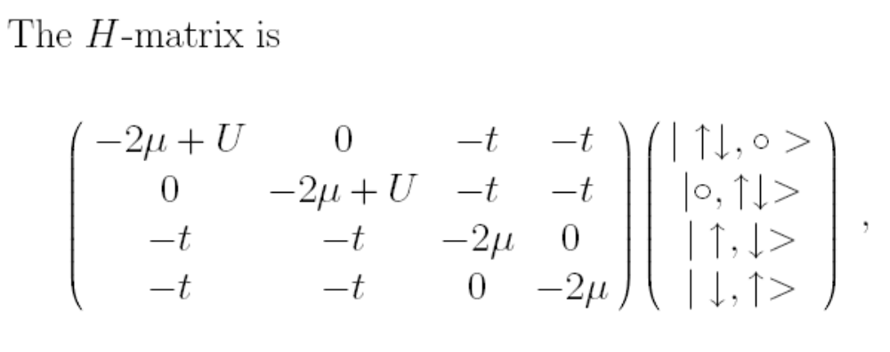
Solving the Hubbard Model: 2-Site
(N↑, N↓) = (1, 1), there are 4 configurations:
Example: making H-matrix elements

Slide 42
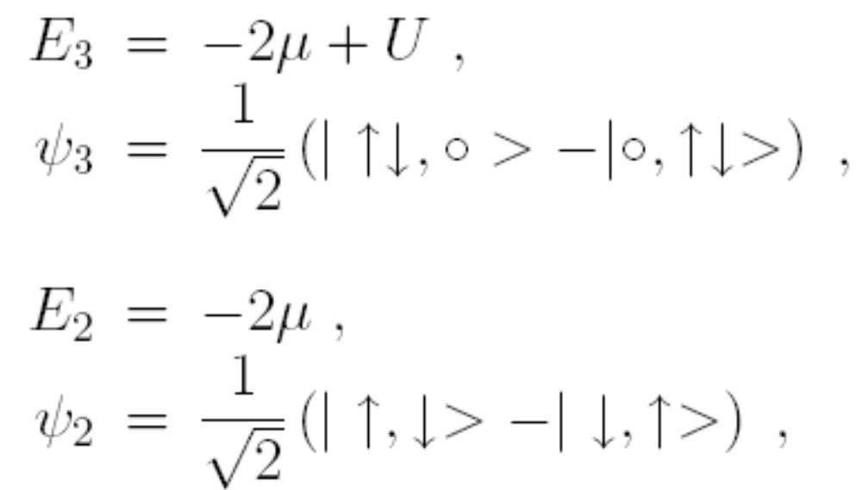
Solving the Hubbard Model: 2-Site
Eigenvalues and Eigenvectors:
Easy solution

Slide 43
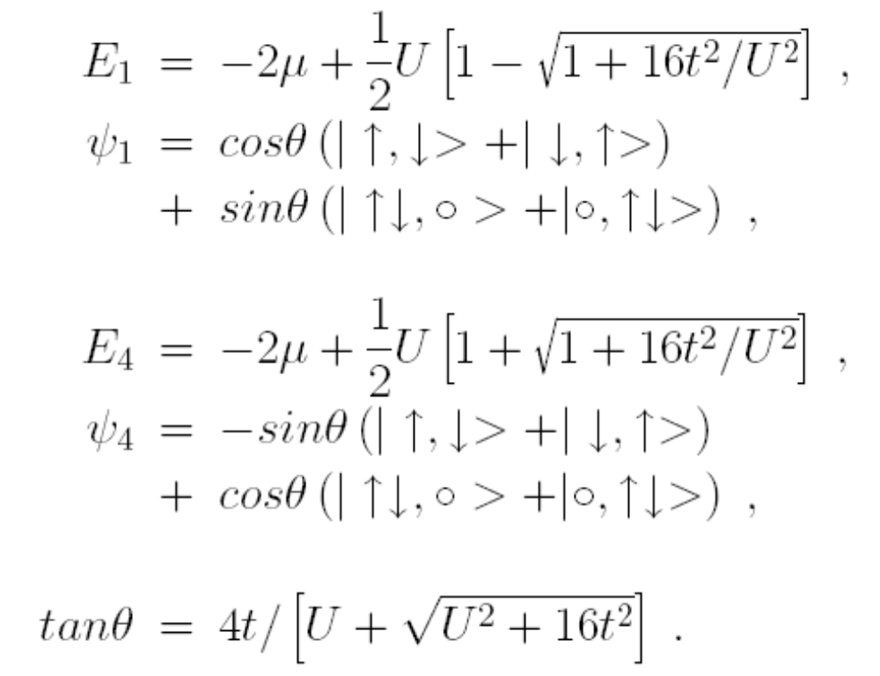
Solving the Hubbard Model: 2-Site

Slide 44
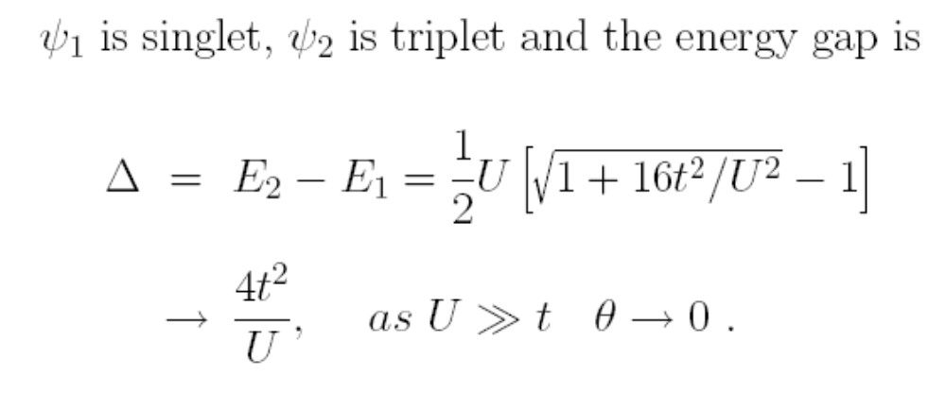
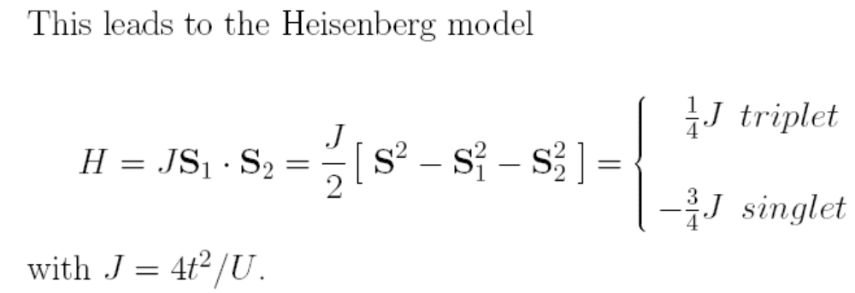
Solving the Hubbard Model: 2-Site

Slide 45
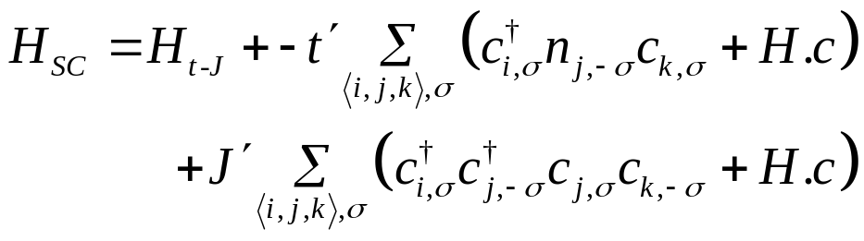
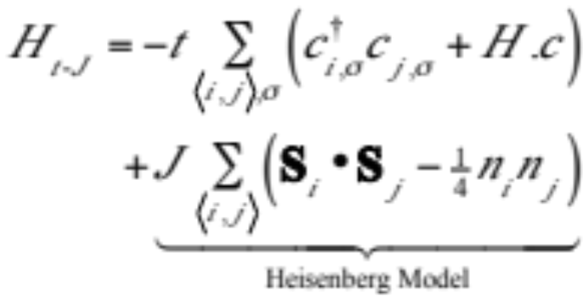
Strong Coupling Limit (U >> t)
Eliminate Double Occupied States
2nd order Degenerate Perturbation Theory
(Schrieffer-Wolff Transformation)
–t'
J'
t
–J
½-Filled Band: AF Heisenberg Model
J = 4t²/U, t' = J' = t²/U (taken as free parameters)

