Slide 1
Mean field approximation
Based on Eur. J. Phys. 35 (2014) 035023 – Claveau, Arnaud, Di Matteo
Rubem Mondaini
Beijing Computational Science Research Center

Slide 2
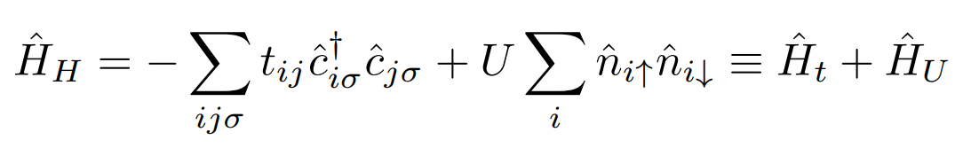
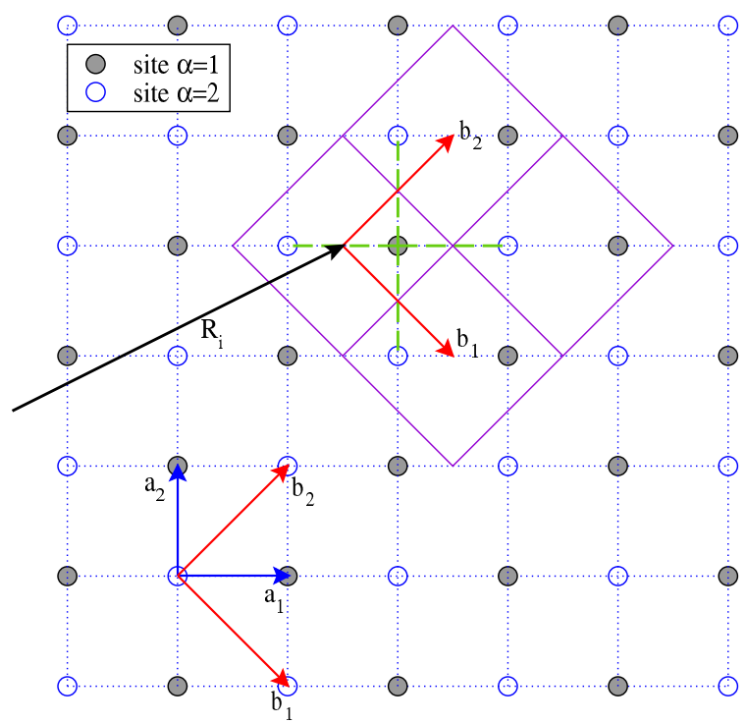
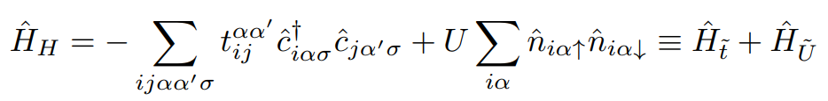
Hubbard model - definition
Non-degenerate band (one orbital per site)
→ Bipartite lattice with NN hoppings
→ One can define unit cells with two sites instead (it will be important later)

Slide 3


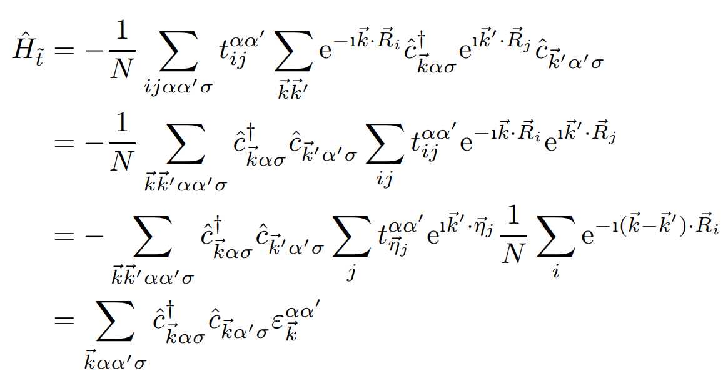

Tight-binding solution (U=0)
Fourier transform of the fermionic operators
Hamiltonian in momentum space:
and
where

Slide 4
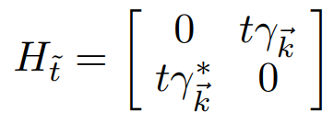
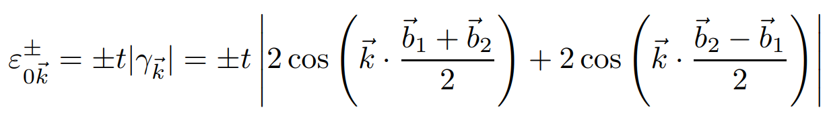
Tight-binding solution (U=0)

Slide 5
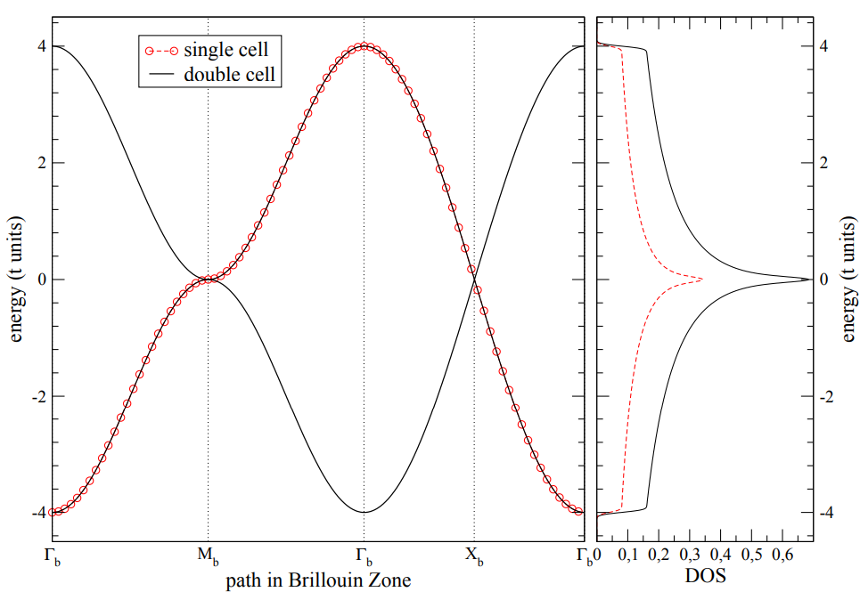
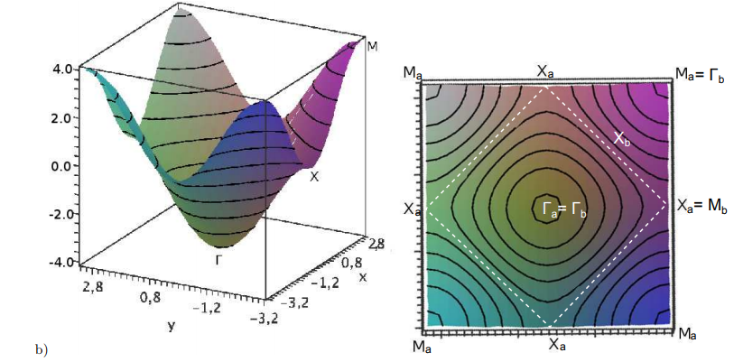
Tight-binding solution (U=0)
Comparison between the BZ
of two different unit cells
They are perfect equivalent
after considering folding
Note van Hove singularity

Slide 6


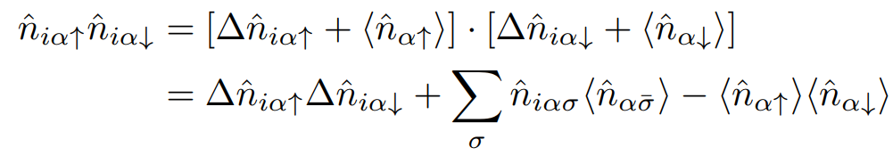
Introduction of interactions -Mean field
mean-field approximation corresponds to neglecting the fluctuations around the mean density
Fluctuations are defined as:
Mean occupation number
Assuming homogeneity, the interaction term is written as
0
In the MF approx. we neglect terms which are quadratic in the fluctuations

Slide 7
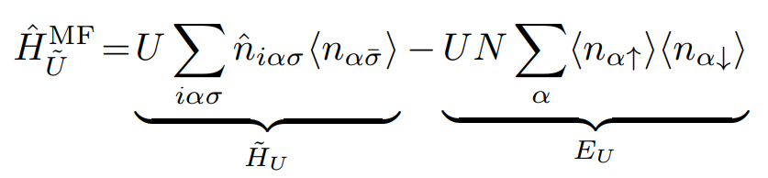


Introduction of interactions -Mean field
The interaction term becomes:
It is a number but
It needs to be taken
Into account → regulates
The appearance of different
Magnetic phases
Fourier transform (again!):
(diagonal in momentum)

Slide 8


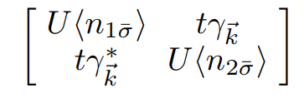
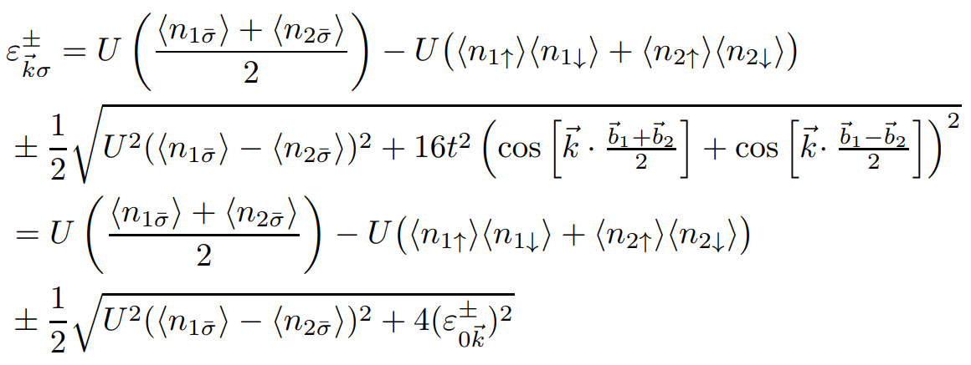
Introduction of interactions -Mean field
The final Hamiltonian (incorporating both kinetic and MF term):
Diagonalizing:

Slide 9
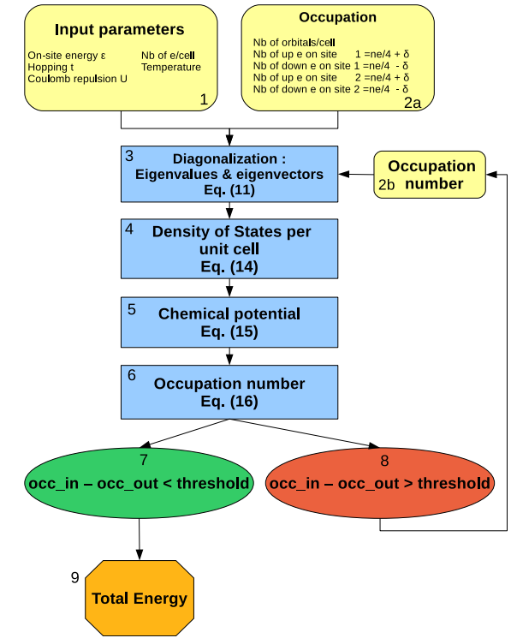


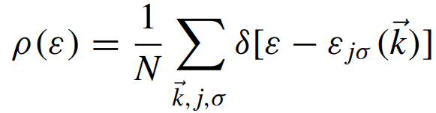
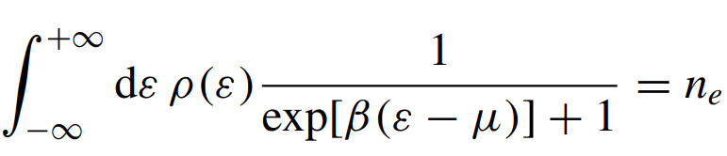
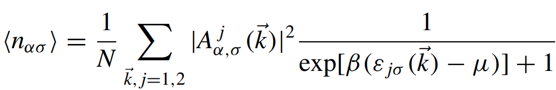
Computational protocol - self-consistency

Slide 10
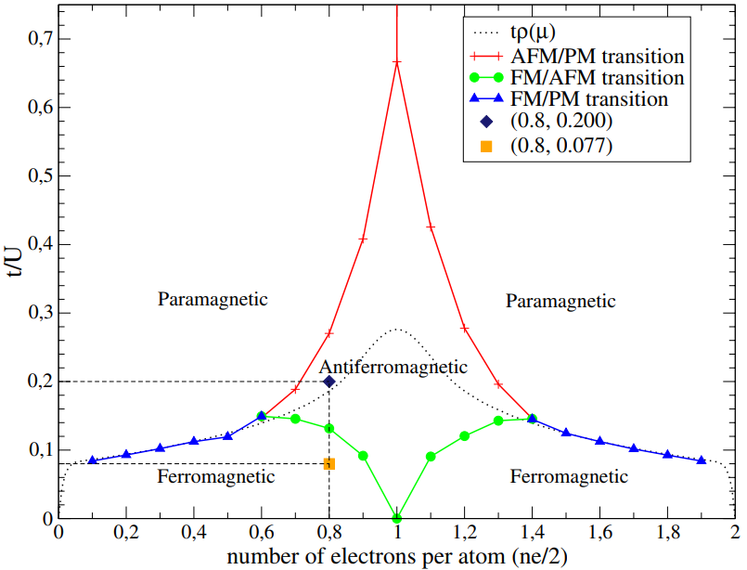
Phase diagram – square lattice

