Slide 1
Quantum Monte Carlo
115/11/08
Introduction
The World-Line Algorithm
The Determinant Algorithm
The Impurity Algorithm
The “sign” Problem & Constraint Path
…

Slide 2

What is Quantum Monte Carlo (QMC)?
Solving quantum mechanical problems by using Monte Carlo methods.
QMC has been successfully applied to various interesting quantum systems.
Compare to classical system, QMC is still under developing. There exists some technical problems, especially for fermions.
Some QMC methods: world-line, Green’s function, variation, determinant, etc.

Slide 3
Quantum Monte Carlo Simulations
Characteristics:
  Treat correlations exactly
  “Exact” solutions on finite (bigger) lattices, 12×12, 16×16, 20×20, …
  Check on approximations
Issues:
  Finite size scaling
  Stability: low temperatures, larger U, etc
  “Negative” sign problem -> Constrained Path Monte Carlo (CPMC)

Slide 4
Quantum Monte Carlo Overview
QMC are the Monte Carlo method (ways to do integration/summation) applied to quantum systems.
The formalism overhead for quantum applications is higher than that for classical applications (operator to number; D to D+1).
There exists no single best QMC method.

Slide 5
Quantum Monte Carlo Overview
It is usually based on Path Integral formalism to transfer D-dimensional quantum operator →
D+1-dimensional classical variables.
One evaluates matrix elements directly or uses HS (alike) transformation to transfer many-body problem into a one-body (non-interacting) problem.
Trace over quantum degrees are exactly performed (QM expectations, Wick’s theorem, etc.).
Evaluate physical quantities (multi-dimensional integrals, classical) by the MC method.

Slide 6
Main QMC Methods
Lattice
T = 0 AF (Projector)
VMC
GFMC
T ≠0 AF (Determinant)
World-Line
Continuum
DMC (Projector)
VMC
GFMC
Path Integral

Slide 7
Main QMC Methods
AF – Auxiliary Field. This is the heart of most QMC methods for lattice models.
DMC – Diffusion MC. An AF method in disguise. It is extensively used & very useful.
VMC – Variational MC. It is used more for continuum problems than for lattice.
GFMC – Green’s Function MC. It is used infrequently because computational overhead.
World-Line – The path integral in a discrete basis.

Slide 8
Mathematics
Commutation relations
Trotter Decomposition
Linear algebra: matrix manipulations, eigenvalue analysis, singular value decomposition, etc.
Integration, e.g., Gaussian integral
Random number generation

Slide 9
Technical Issues
HS-like Transformations
Time domain algorithm: impurity, etc.
Rate of configurations change (∆τ, local minimum, critical slowing down, etc.)
Numerical stability
Bit operation
Hybridization with Molecular Dynamics
Parallelization
“negative” sign!

Slide 10

Introduction to
World-Line QMC Algorithm
115/11/08
General Framework
Quantum Anharmonic Oscillator
One-dimensional Extended Hubbard Model
Parallelization, etc.
Example Code on CM-200

Slide 11
World-Line QMC Framework
It is based on the Path Integral formalism
It is mainly used to compute finite-temperature properties. Zero-temperature properties are approached by taking β → ∞
Expectation value of an operator A
⟨A⟩ = (Tr A e^{−βH})/Z
where Z = Tr e^{−βH}, H = T + V
Evaluate these expectation values (multi-dimensional integrals) by the MC method.

Slide 12
Two Useful Mathematical Facts
Factorizibility of exponentials
e^{−βH} = (e^{−Δτ H})^{L} = e^{−Δτ H} e^{−Δτ H} ⋅⋅⋅ e^{−Δτ H}
where LΔτ = β
Cyclic property of a trace
Tr A e^{−βH} = Tr A e^{−LΔτ H}
= Tr e^{−ΔτH} A e^{−(L−1)Δτ H}
= Tr e^{−2ΔτH} A e^{−(L−2)Δτ H}
= etc.

Slide 13
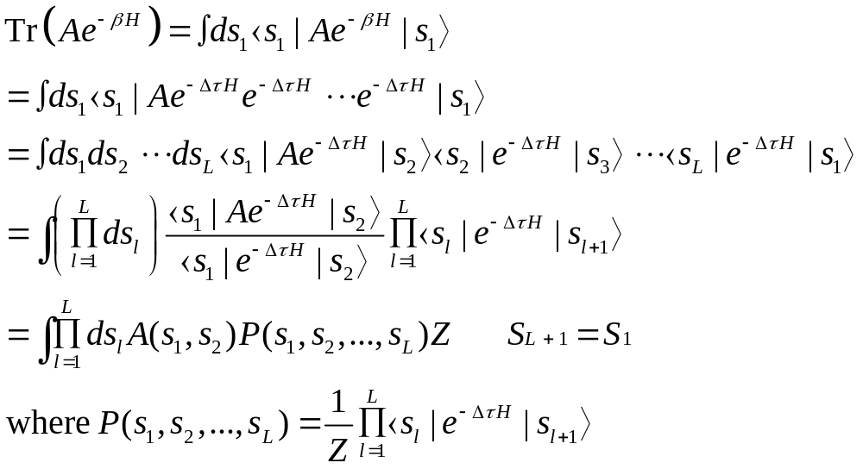
Formal Development
Let {|s⟩} be some complete set of states:
⟨s|s'⟩ = δ(s − s') and ∫ ds |s⟩ ⟨s| = 1

Slide 14
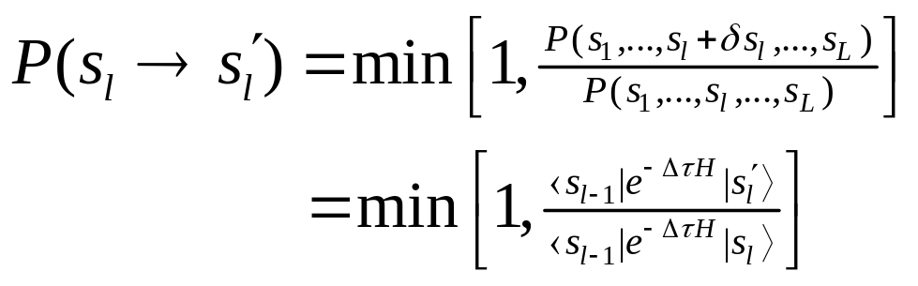
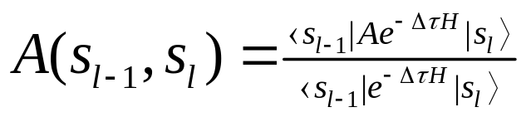


Application of the MC Method
1. Regard different {|s_{l}⟩} as occurring at different “time” steps
2. At each time step l
  Propose |s_{l}⟩ → |s'_{l}⟩
  Accept or reject each proposed move, for example, according to
  For each observable of interest, compute and record
3. Go back to step 2 and repeat until sufficient statistics are accumulated.
4. Compute final averages, estimate statistical error, and quit.

Slide 15
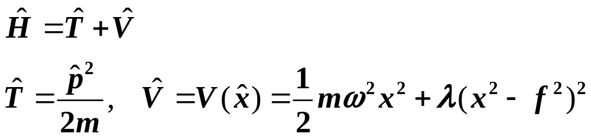
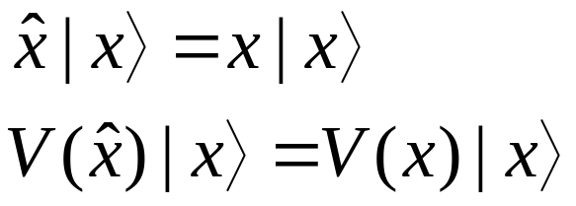
Quantum Anharmonic Oscillator
In this example there is only one quantum particle moving in a 1D continuum.
Hamiltonian
Typically, {|s⟩} = {|x⟩}, the eigenstates of the position operator

Slide 16
Trotter Approximation
Factorization of exponentials
e^{−Δτ (A+B)} = e^{−Δτ A} e^{−Δτ B} + O([A,B]Δτ ²)
Symmetric Factorization of exponentials
e^{−Δτ (A+B)} = e^{−Δτ A/2} e^{−Δτ B} e^{−Δτ A/2}
+ O([A,B]Δτ ³)

Slide 17
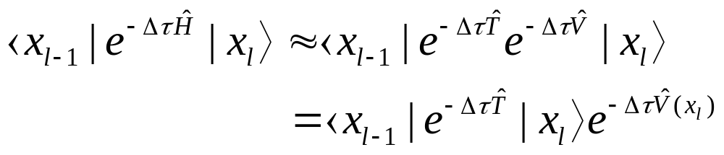
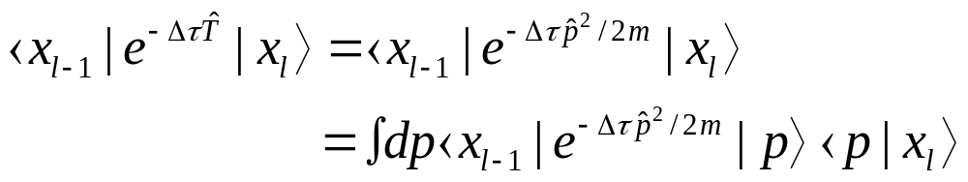
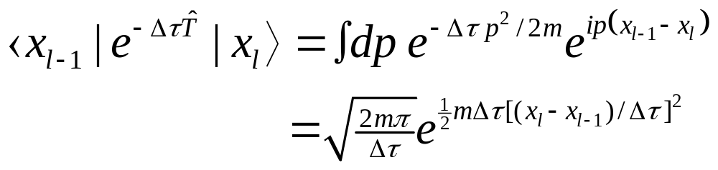
Matrix Element Evaluation
The key matrix element
where |p⟩ is an eigenstate of the momentum operator
⟨x|p⟩ = e^{ipx}
Accordingly

Slide 18
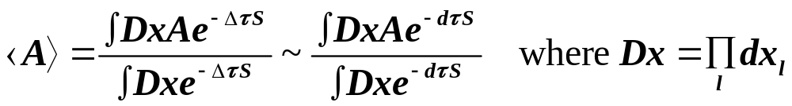
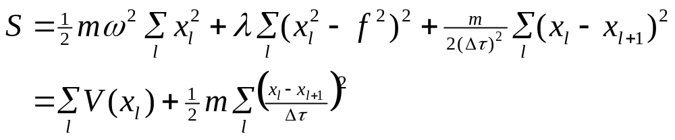
The Path Integral
When all the pieces are assembled, an imaginary-time Feynman path integral appears
(The overall constants divide out of expectation values.)
The integration has the interpretation of a sum over all possible paths.

Slide 19
Physical Interpretation
The single particle quantum problem has been transformed into a L particle classical problem.
Each classical particle moves in the potential V(x) and interacts with its neighbor through a harmonic potential whose force constant is m/(Δτ)².
Since x₁ = x_{L+1}, because of the periodicity in imaginary-time imposed by the trace, the particle chain forms a loop (world-line).

Slide 20
Important Points
Choice of {|s_{l}⟩}
The states are usually chosen so that either T or V is easily diagonalized.
Value of ⟨s_{l−1}|e^{−Δτ H} |s_{l}⟩
If Δτ is small, one can use the Trotter approximation as follow (assume {|s_{l}⟩} diagonalized V)
⟨s_{l−1}|e^{−Δτ H} |s_{l}⟩ ≈ ⟨s_{l−1}|e^{−Δτ T} e^{−Δτ V} |s_{l}⟩
= ∫ ds ⟨s_{l−1}|e^{−Δτ T} |s⟩ ⟨s| e^{−Δτ V} |s_{l}⟩
= ∫ ds ⟨s_{l−1}|e^{−Δτ T} |s⟩ e^{−Δτ V(sl)} δ(s − s_{l})
= ⟨s_{l−1}|e^{−Δτ T} |s_{l}⟩ e^{−Δτ V(sl)}
The remaining matrix element is evaluated by some “standard” means.

Slide 21
Important Points
Positivity of P(s₁, s₂, …,s_{L})
In fact it is almost never always positive for fermions in two and higher dimensions and frustrated quantum spin systems.
Model dependent, e.g., XXZ model.

Slide 22
Physical Interpretation
The d-dimensional many particle quantum problem has been transformed into a d+1-dimensional classical problem.
This could be regarded as an Ising model with complicated couplings (matrix elements) and the summation (Monte Carlo) is over all possible configuration (paths).
Due to the periodicity in imaginary-time imposed by the trace, s₀ = s_{2L}, the ‘‘particle’’ travels in a loop, i.e., the world-line.

Slide 23

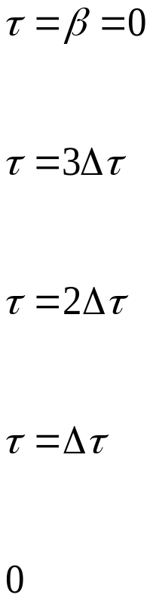
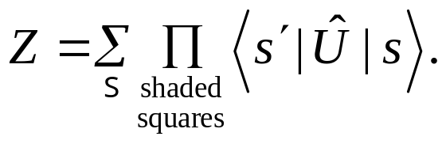
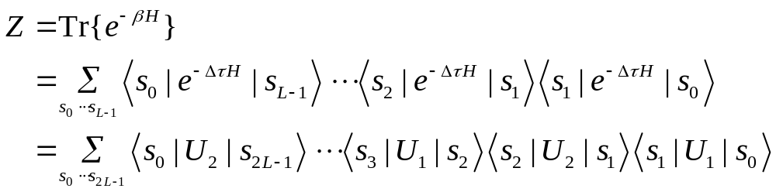
Checkboards and World-lines

Slide 24
World-Line QMC Algorithm
Applications
Path Integral Decomposition of the Partition Function
Checkboard and World-line
Propagation Matrix Elements
Monte Carlo Simulation
Statistics of WLQMC
Parallelization of WLQMC

Slide 25
World-Line QMC Applications
Hubbard-like (e-e) models
Peierls-Hubbard (e-p) models
Short-range interactions
Mostly one dimension
Non-frustrated spin models (2-, 3-D)
:
:

Slide 26
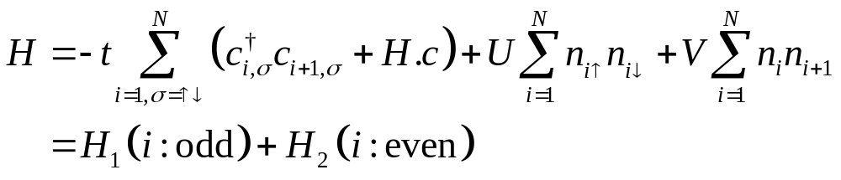
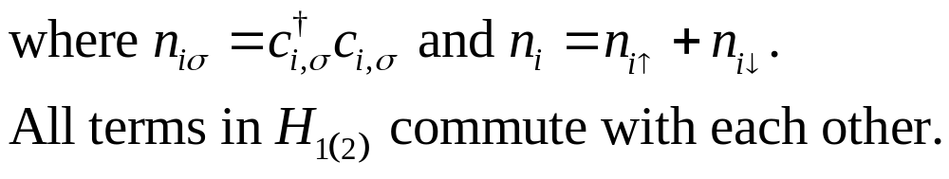
1-D Extended Hubbard Model
Parameter:
Coulomb interactions: U, V, (t = 1).
Band filling: ρ ≡ N_{e}/N.

Slide 27
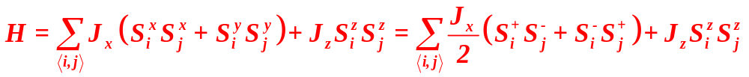
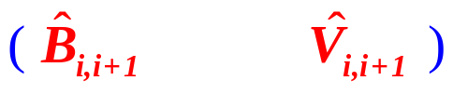
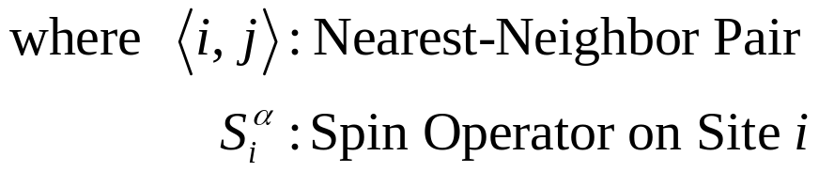
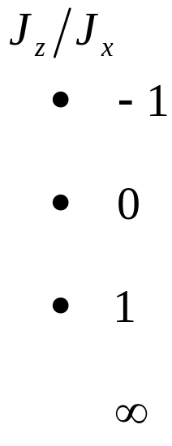
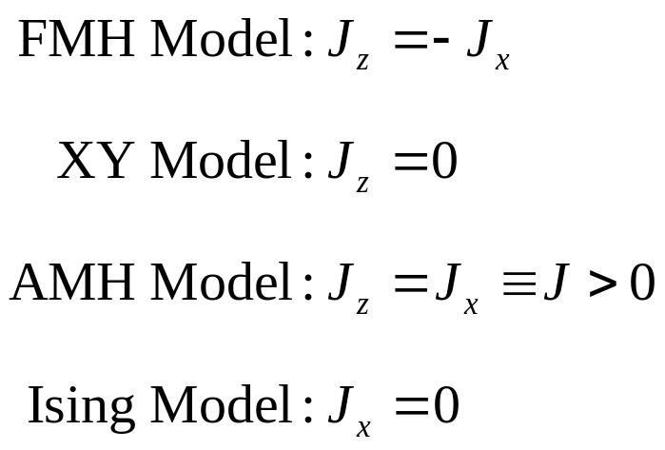
XXZ Model Hamiltonian

Slide 28
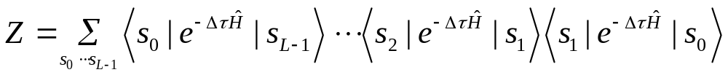
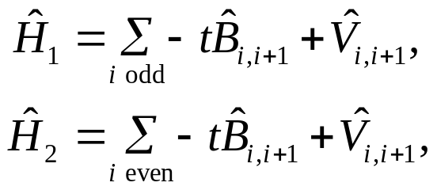
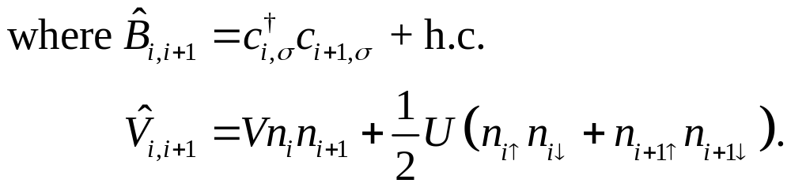
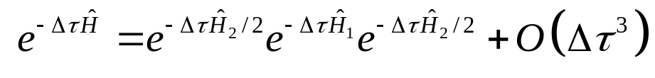
Functional Integral Decomposition
The partition function Z = Tr e^{–βĤ}, could be rewritten as a discrete form by dividing the imaginary time interval 0 ≤ τ < β into L slices of width Δτ = β/L and inserting complete sets of states at each time-slice:
Write Ĥ as the sum of two easily diagonalizable pieces, Ĥ = Ĥ₁ + Ĥ₂,
Trotter approximation:

Slide 29
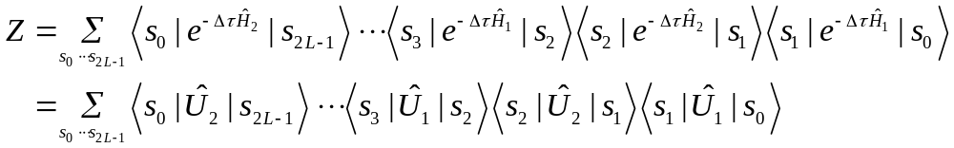
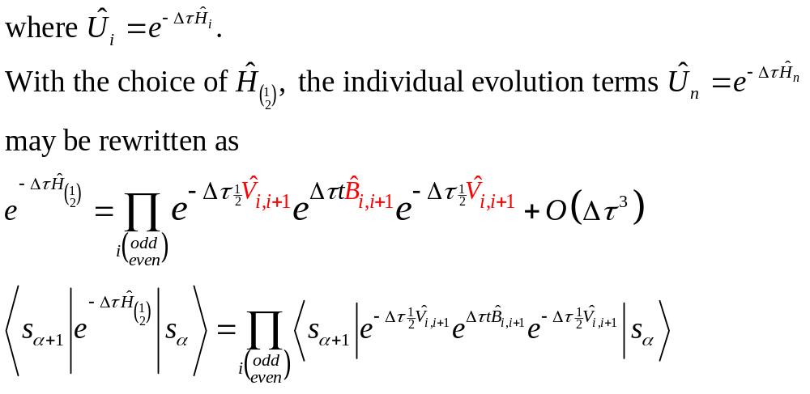
We obtain,

Slide 30
Checkboard and World-lines

Slide 31
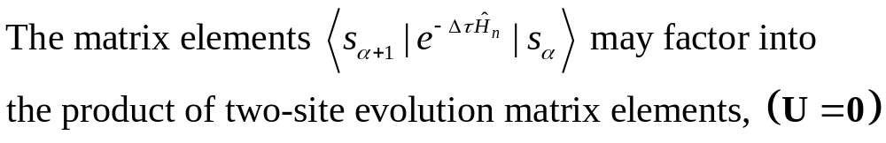
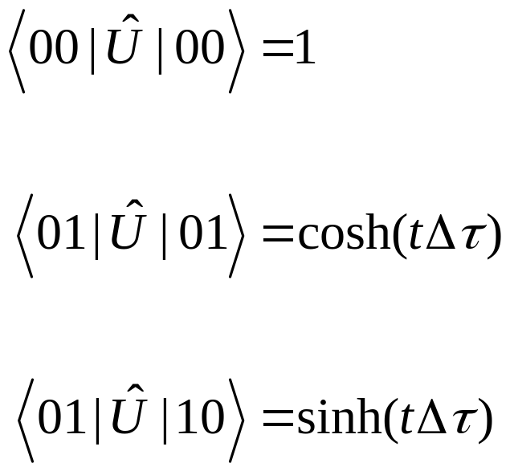
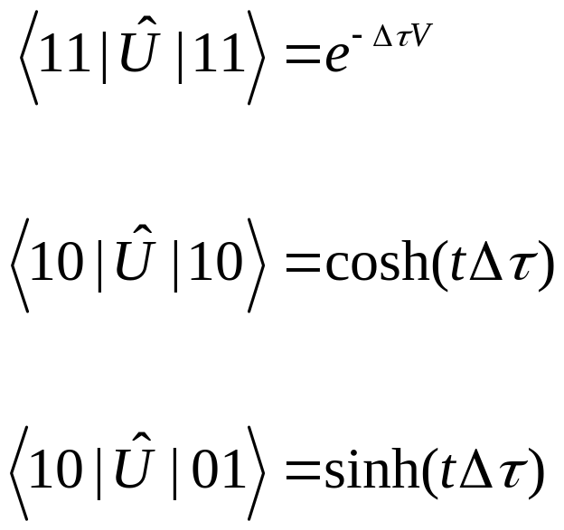
Propagation Matrix Elements
0000₂ = 0
1111₂ = 15
0110₂ = 6
1001₂ = 9
1010₂ = 10
0101₂ = 5

Slide 32
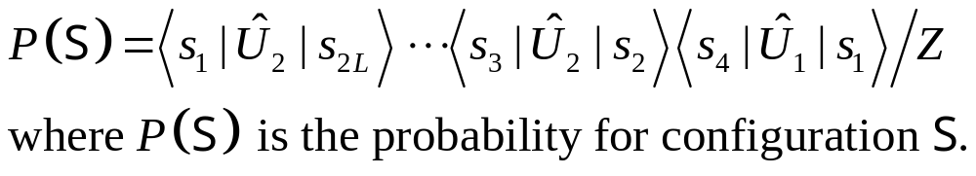
Monte Carlo Simulations
Boltzmann Weight
Possible Move
s ≡ n_{i,l} + n_{i,l+1} – n_{i+1,l} – n_{i+1,l+1}
= ±2
Ratio of Change
R = [tanh(Δτ t)]^{sx}[cosh(Δτ t)]^{sy}
x = 1 – n_{i+1,l–1} – n_{i+1,l+2}
y = n_{i–1,l} – n_{i+2,l}

Slide 33
Plaquette Representation and Bits Operation
16 binary numbers
0000₂ = 0
0101₂ = 5
0110₂ = 6
1001₂ = 9
1010₂ = 10
1111₂ = 15
1001
0011
1010
XOR
⇒
1111
0000
0110
1001
1001
1001
1010
1100
0110

Slide 34
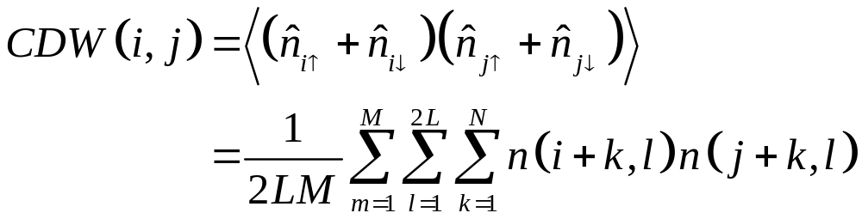
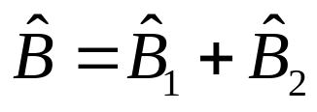
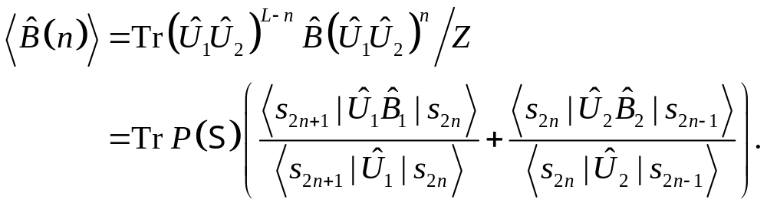
Correlation Functions and Measurements
Local Operator
Non-local Operator
2-Site Operator

Slide 35
Statistics of WLQMC
MC Steps
  Fast
Measurements
  Slow (non-local)
Reach Equilibrium
  Slow
Local Minimum for Large U, V
  Special treatment.

Slide 36


Comments - Technical Issues
Choice of the size of Δτ
  Empirically determined so the systematic error is smaller than the acceptable statistical error.
  If made too small, unacceptably large auto-correlation times result.
  New methods (continuous time methods) eliminate the Trotter approximation but that is not their principal advantage.
Measurement of unequal time Green's functions such as G_{ij} (τ >0) = ⟨x_{i}(τ) x_{j}(0)⟩ is impractical.
  Measurements of this type of quantity is the main advantage of the continuous time methods.

Slide 37
Comments - General Issues
Three-dimensional simulations are almost never done because of the small systems sizes possible with currently available computer time allocations.
The World-Line (Path Integral) method is very useful for 1,2D bosonic and quantum spin systems.
These methods are not very useful for frustrated quantum spin systems.
  The lack of positivity of matrix elements prevent the sampling probability from always being positive.
  This, as other QMC sign problems, leads to variances in computed results increasing exponentially with increasing system size and decreasing temperature.

Slide 38
For electron and electron-phonon systems, use is limited to 1D
In 2D, the fermion sign problem can be horrendous.
  It requires sampling from probabilities which are not always positive.
  It is caused by exchanging an odd number of electrons.
Simulations of fermions with spin use two checkerboards, one for up and one for down spin.
  With the electron occupancies on one spin are fixed, one samples the occupancies of the other spin, then vice versa.
Simulation of electron-phonon systems use the world-line method for the electron part and the path integral method for the phonon part.
  With the electron occupancies fixed, one samples the lattice displacements and then vice versa.

Slide 39
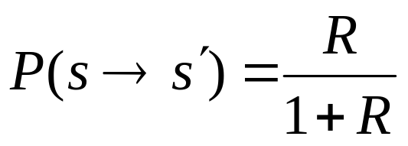
The Metropolis algorithm is not always the most efficient Monte Carlo algorithm
For lattice system with a small number of discrete states per plaquette
where R is the ratio of the after and before probabilities, is often more efficient.
For quantum spins and some electron problems, loop/cluster algorithms can be three or more orders of magnitude more efficient.
For boson (phonon) systems the hybrid Monte Carlo method is much more efficient (see below).

Slide 40
Parallelisation of WLQMC
Parallel Machines:
Origin 2000,
PC Cluster, etc
Four independent
sub-lattices.
a
b
a
b
c
d
c
d
b
a
b
a
d
c
d
c
a
b
a
b
c
d
c
d
b
a
b
a
d
c
d
c

Slide 41
Other QMC Methods
The principle is the same: change quantum problem into classical problem via path integral, quantum D dimensions => classical D+1 dimensions.
Operator => numeric number by evaluating it in a selected basis {|s_{l}⟩}. Choice of {|s_{l}⟩}?
Express all measurements in a matrix form.
Perform Monte Carlo integration (sampling) to evaluate relevant summations.
For boson & spin systems, straightforward, while for fermion, there is “sign” problem.

Slide 42
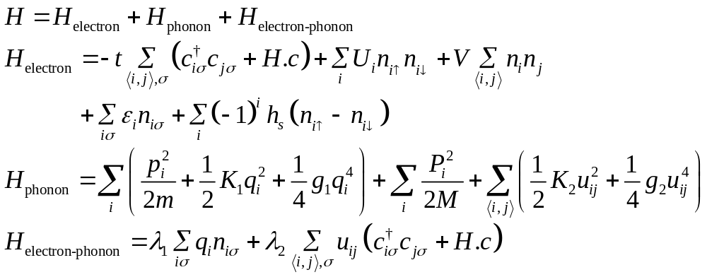
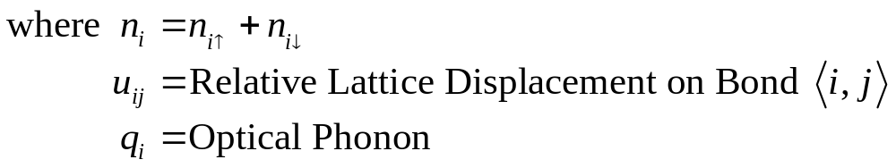
The Peierls-Hubbard Model
SSH, Holstein (Dimerization, Soliton, etc).
Adiabatic Approximation (Double well)

Slide 43
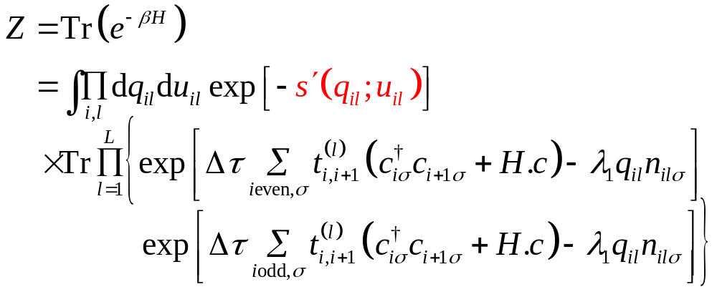
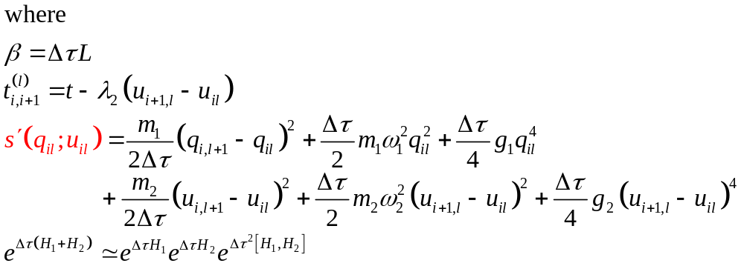
Monte Carlo Simulations

Slide 44
Notation
Use electron occupation number as basis
n_{ilσ} (operator) → n_{ilσ} (c-number)
represents matrix elements
represent electron world line
Change of configurations (Stochastic Process)
Electron Part:
local move (highly parallel)
conservation rule, etc.

Slide 45
Checkboard Representation of Configuration
1
t₄₁(2)
t₂₃(2)
q₂₁
q₂₂
q₂₃
q₂₄
t₁₂(2)
t₃₄(2)
l
2
t₂₃(1)
t₄₁(1)
q₁₁
q₁₂
q₁₃
q₁₄
t₁₂(1)
t₃₄(1)
1
1
2
3
4
1
j

Slide 46
Methodology
Electron Part: World-line Monte Carlo,
which is local
  Parallelizable (Vectorizable)
  Much Fast
  Larger system and lower Temperature
  e.g. N = 512, β = 128, U = 16
Phonon Part: Hybrid Monte Carlo
  Reach equilibrium faster than Metropolies

Slide 47
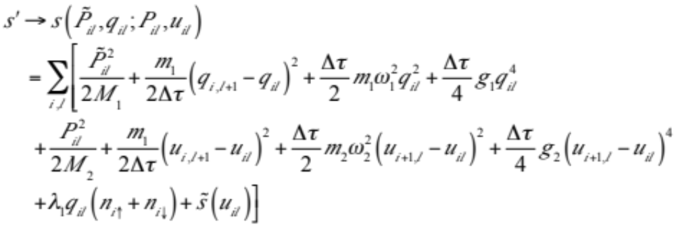
Phonon Part
Metropolis: q_{il} → q_{il} + Δr r' ∈ [– 1,1]
u_{il} → u_{il} + Δr' r' ∈ [– 1,1]
compare e^{Δs} with r'' ∈ [0,1]. (Slowly reach equilibrium).
Hybrid Monte Carlo: Introduce fictitious momentum P_{il} and P_{il} conjugate to q_{il} and u_{il}, respectively.

Slide 48
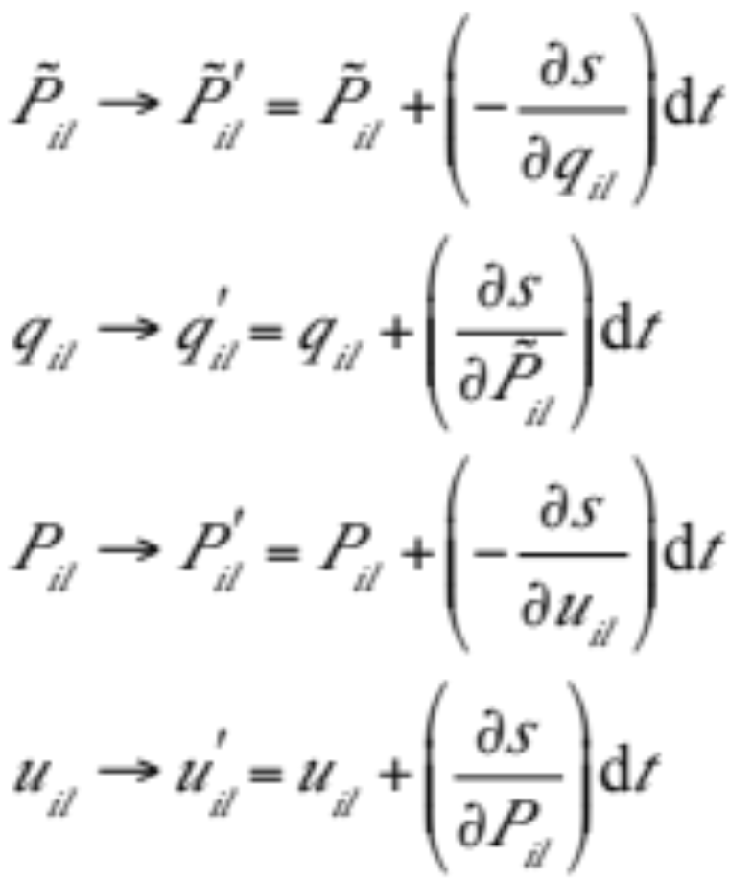
Dynamic Equations
Energy conservation s(t₀) = s(t₁), sampling phase space move rapidly.
Accumulate error after finite time interval t is taken care of by Metropolis algorithm e^{Δs}V(r).
Highly parallelizable (vectorization)

Slide 49
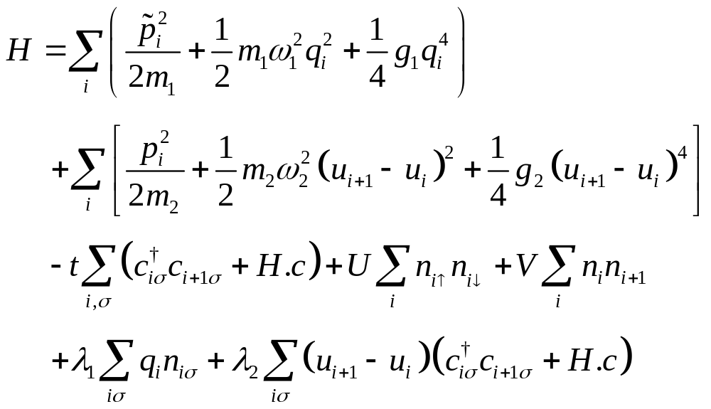
Model Hamiltonian

Slide 50
Quantum Monte Carlo Simulations
•
•
•
•
•
•
•
•

Slide 51
Program code

