Slide 1

Intro to auxiliary field
Quantum Monte Carlo methods
Rubem Mondaini
Beijing Computational Science Research Center

Slide 2
Outline
Fermionic systems in nature
The Hubbard Hamiltonian
Exact Diagonalization and why is limited
Revision: Classical Monte Carlo Methods
Quantum Monte Carlo:
The general problem
Hubbard-Stratonovich transformations
Observables and correlations
“Cake” recipe
Sign problem
Famous results in the literature
Projector Quantum Monte Carlo
Summary

Slide 3
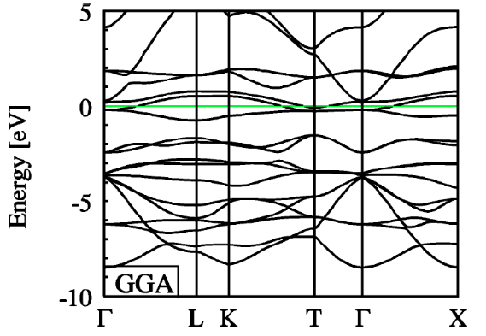
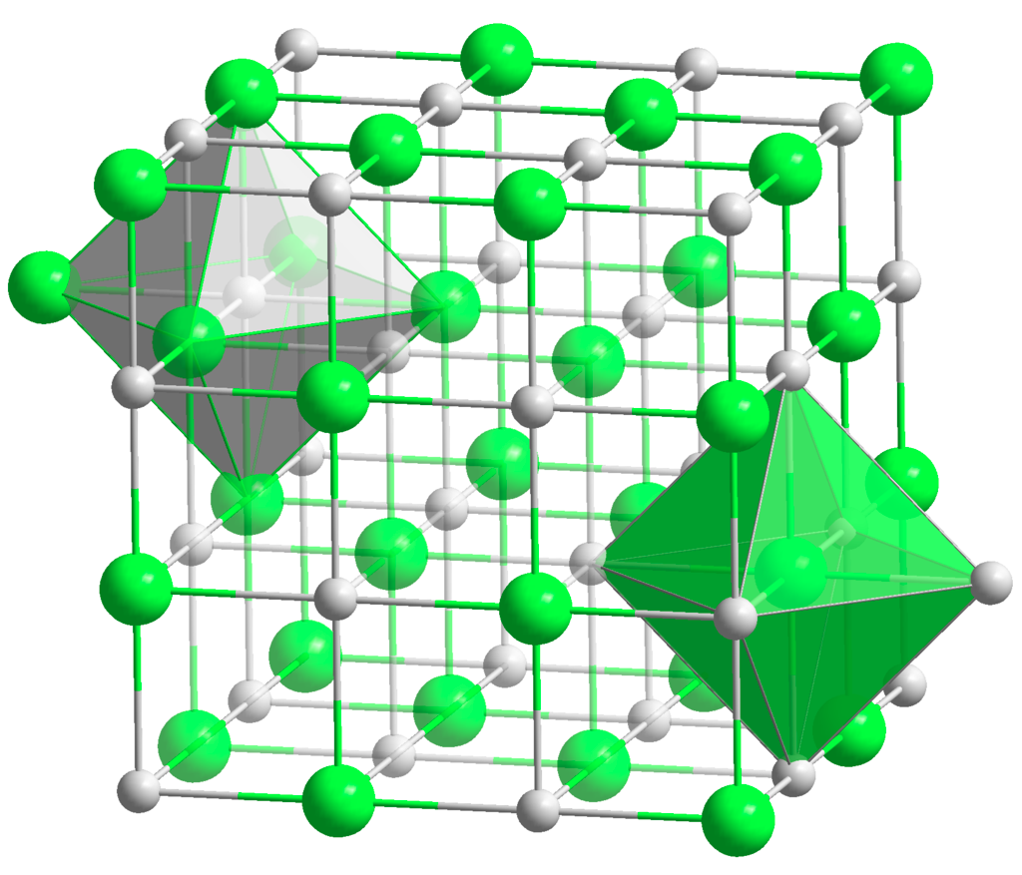
Fermionic systems in nature
Interplay of charge and spin degrees of freedom explain several phenomena
observed in real materials
Antiferromagnetism/ferromagnetism in Transition Metal oxides – MnO ; FeO; CoO
Band structure picture – DFT (GGA)
Experimentally
Insulating and antiferromagnetic
Metal!
Fe³⁺
→ 3d⁵

Slide 4
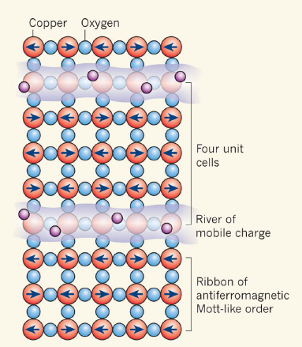

Fermionic systems in nature
Interplay of charge and spin degrees of freedom explain several phenomena
observed in real materials
High-temperature superconductivity
Crystalline structure:
Copper-Oxygen planes:
Proto phase diagram:
- La/Sr-Ba
- O
- Cu
[K.A. Moler Nature 468, 643–644 (2010)]
Stripes – hole rich quasi 1D region
perovskite
[M. Hashimoto et al., Nature Physics 2014]

Slide 5
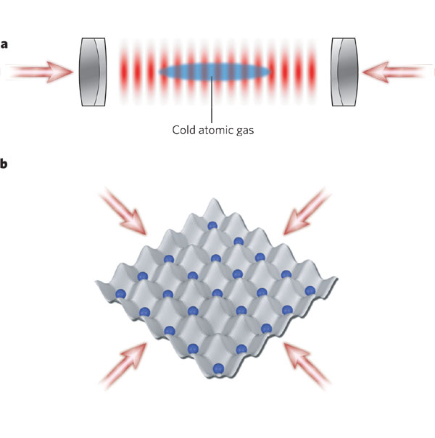
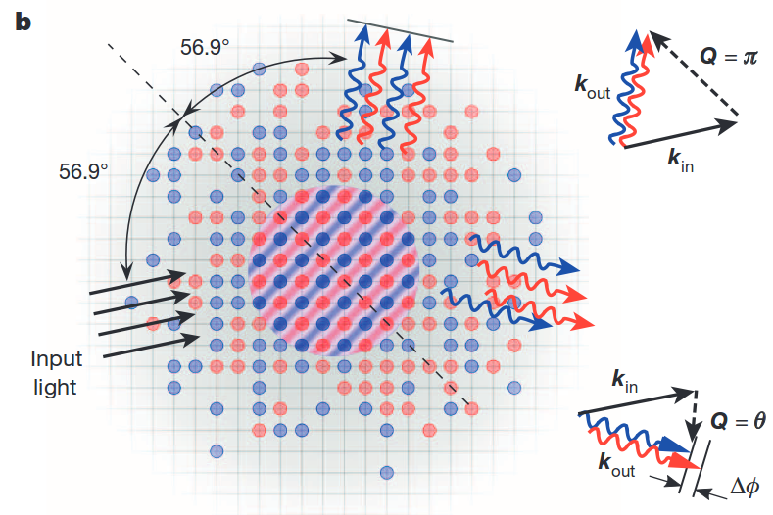
Fermionic systems in nature
Interplay of charge and spin degrees of freedom explain several phenomena
observed in real materials
Emulation testbed to probe these effects: Optical lattices
Counter propagating laser beams generate an optical trapping potential
Trapping cold atoms
Easily adjustable parameters (by tuning laser parameters) and external magnetic fields (Feschbach resonances)
Proto magnetism
[I. Bloch et al., Nature 2008]
[R. Hart et al., Nature 2015]

Slide 6
The Hubbard Hamiltonian – qualitative aspects
Mott insulators
D(ε)
U=0
D(ε)
U ≠ 0
+ U
∝ U
ε
ε
Ex: 1d lattice – s-band
∝ U
Magnetic properties of the ground state
2nd order perturbation theory:
hopping not allowed
(Pauli exclusion principle)
Perturbation theory:
Virtual hopping
processes
AFM ground state is energetically favorable - Magnetism
hopping allowed
In the Hubbard model insulating behavior and antiferromagnetism go hand-in-hand

Slide 7
The Hubbard Hamiltonian
Paradigmatic model for correlations in a tight-binding approximation
Hopping term (Kinetic energy)
Local e⁻- e⁻ interactions
: number
operator
Simplest case: s-band→ maximum of 2 e⁻ per site
Energy scales
Density
Lattice dimensionality
Lattice geometry
Temperature
...
Properties? Metal? Insulator? Magnetism?
Depends on a variety of factors...

Slide 8

Exact Diagonalization and why is limited
Typical Fock state (occupation basis):
How are the thermodynamical properties of the Hubbard model?
Physical observables:
Ex.:
states
Ex.:
Ex.:
states
states
Diag. complexity:

Slide 9
Is there a way that we can still know without having to completely solve the quantum system?
Even in a classical systems this is still a problem… Think of the classical Ising model:
;
Sum with
terms!
Motto of statistical physics: not all of those configurations are actually relevant
Configuration : ocurrence probability→
: Boltzmann
factor
Can be
No need to generate all the configurations… Importance sampling?
Start from a random spin configuration
Generate a chain of the most likely configurations (plus fluctuations) by visiting each
site of the lattice and attempting a flip

Slide 10
Classical Monte Carlo: Ising model
Attempting local spin flips
Energy difference
between configurations:
Ratio between the correspondent Boltzmann factors:
Metropolis algorithm:
If accept the move
If accept it with probability
: accounts for fluctuations
Heat-bath algorithm:
If accept the move
If accept it with probability

Slide 11
Classical Monte Carlo: Ising model
Attempting local spin flips
Traversing the whole lattice constitutes a sweep
or one MC step
Observables:
: Magnetization
MC steps
Warm up
Averaging regime

Slide 12
Good… but how about QUANTUM Monte Carlo?
As before, is it possible to devise an importance sampling mechanism that will prevent us
to average over all possible configurations? In this case all possible states ?
Classical system:
Quantum system:
Boltzmann
factor:
: number
: operator
Partition
function:
The quantum partition function can be interpreted as a sum of closed path integrals
in Hilbert space:
One term:
“Imaginary time”:
Discretized path integral→ small “time” steps:
Discretizing the inverse temperature

Slide 13
The Suzuki-Trotter aproximation
Breaking up one body and two body terms in the Hamiltonian… It will be clear why later
Recall that:
For the (grand-canonical and particle-hole symmetric) Hubbard Hamiltonian:
Sum of quadratic and quartic terms of fermionic operators
This approximation is exact in the limit that and constitutes the only single
approximation in determinant quantum Monte Carlo methods.

Slide 14

Integrating out free fermions – quadratic terms
Suppose we have a Hamiltonian with only quadratic terms in fermionic operators
, where
and
Unitary
transformation
Occupation numbers… for femions:
!

Slide 15
But the Hubbard Hamiltonian has quartic terms...
Hubbard-Stratonovich transformation:
The part on the partition function related to this term is:
Let's take one term of this independent products for site :
Is there a transformation that can take this term and make it quadratic in fermion ops.?
: Gaussian integration
For fermions:
!

Slide 16
Auxiliary field!
The repulsive Coulomb interaction has been replaced by a bosonic (scalar) field which
couples to the magnetization in a given site!
But what if ? → Another transformation...
!
The auxiliary field couples to the charge at a given site… Physically it creates charge
fluctuations in that orbital
This is all great but having a continuous (scalar field) is still complicated when dealing
with actual simulations...

Slide 17

Discrete auxiliary field!
Ising-like field!

Slide 18
Let's pick up where we left...
Hubbard-Stratonovich tranformation→
is a diagonal matrix

Slide 19
Let's pick up where we left...
Remember that all this craziness was for a given imaginary time slice….
So the auxiliary discrete field can be then generalized for different imaginary times
Hopping matrix – 1d Hubbard model:
Plugging back everything and changing the order of the traces:

Slide 20
We are almost there!
We need to be able to integrate out the fermions… But we know how to do that
in the case of quadratic terms in fermionic operators
In this case with two exponentials:
For many exponentials:

Slide 21
Summary – Physical picture
: grand-canonical partition function
Suzuki-Trotter decomposition
[Blankenbecler et al.1981]
Discretization in
and
Ex: 1D
Δτ
τ
Hubbard-Stratonovich transformation
N_{s}
Interacting fermions in D dimensions
Non-interacting fermions coupled to an external Ising-like and fluctuating field in (D+1) dimensions
x
N_{t}
Field is spanned as in an usual classical Monte Carlo Method – importance sampling

Slide 22
Computing things – Green's functions
Central quantity!
where
Computing the fermionic trace, one can show that
But how about other observables?
Density on site i with spin
Total density:

Slide 23
Computing things – Green's functions
Central quantity!
Kinetic energy:
More complicated ones Wick's theorem:
Example – z component of spin-spin correlation:

Slide 24
Importance sampling – Metropolis for the scalar field
Only one component of the field
at imaginary-time at site is updated
How to accept or reject this move?
Ratio of “Boltzmann weights”:
This seems too expensive… Is there a simple way of computing it?

Slide 25
Importance sampling – Metropolis for the scalar field
Only one component of the field at imaginary-time at site is updated
where
How does that affect the Green's function?
Single-particle propagators:

Slide 26
Importance sampling – Metropolis for the scalar field
Only one component of the field at imaginary-time at site is updated
Spin-dependent ratio of Boltzmann weights:
Since the matrix has only one non-zero element, one can show that
Just a scalar!

Slide 27
Updating the Green's functions
Only one component of the field at imaginary-time at site is updated

Slide 28
Cake recipe – how to perform simulations
Establish parameters:
Start the auxiliary Ising-like field randomly
→
Monte Carlo loop (warms + measurement sweeps)
Site
Loop in space-”time” lattice (double loop)
Propose field update:
Compute Metropolis ratio – ratio of Boltzmann weights
Acceptance-rejection: Throw a random number
→ Update the Green's functions
if number of loops in imaginary-time is above a certain threshold perform measurements (combinations of Green's functions elements)

Slide 29
Sign problem – life is not that “easy”
Some configurations of the imaginary time may result in a negative Boltzmann weight...
Should always be positive to be interpreted as a Boltzmann weight
In fact one can introduce a measure of when this is positive

Slide 30
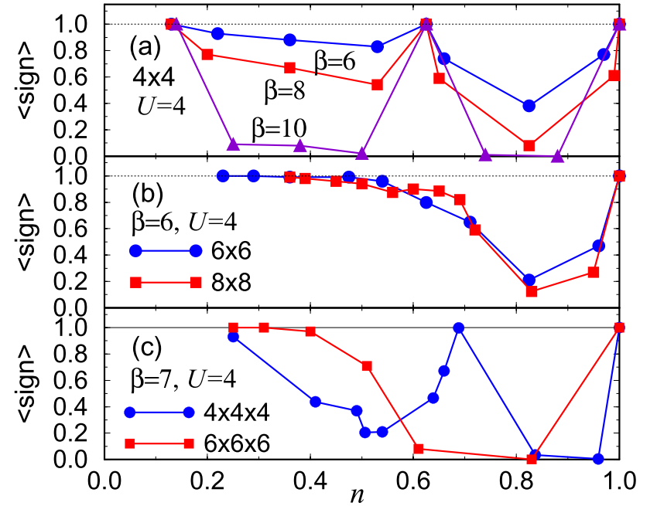
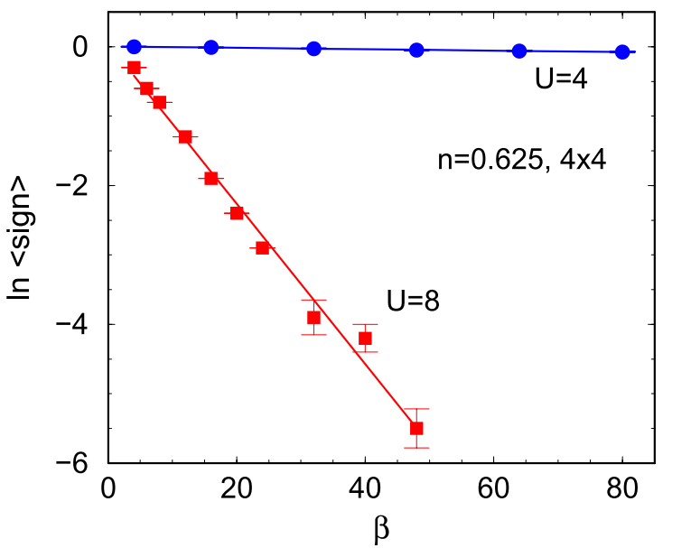
Sign problem – life is not that “easy”
Dependence of the sign with parameters...
At half-filling there is no sign problem

Slide 31
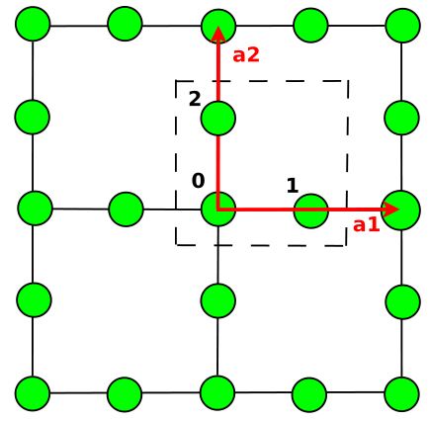
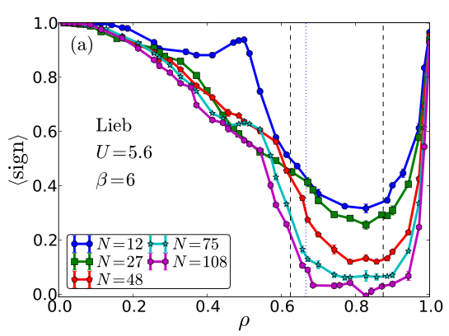
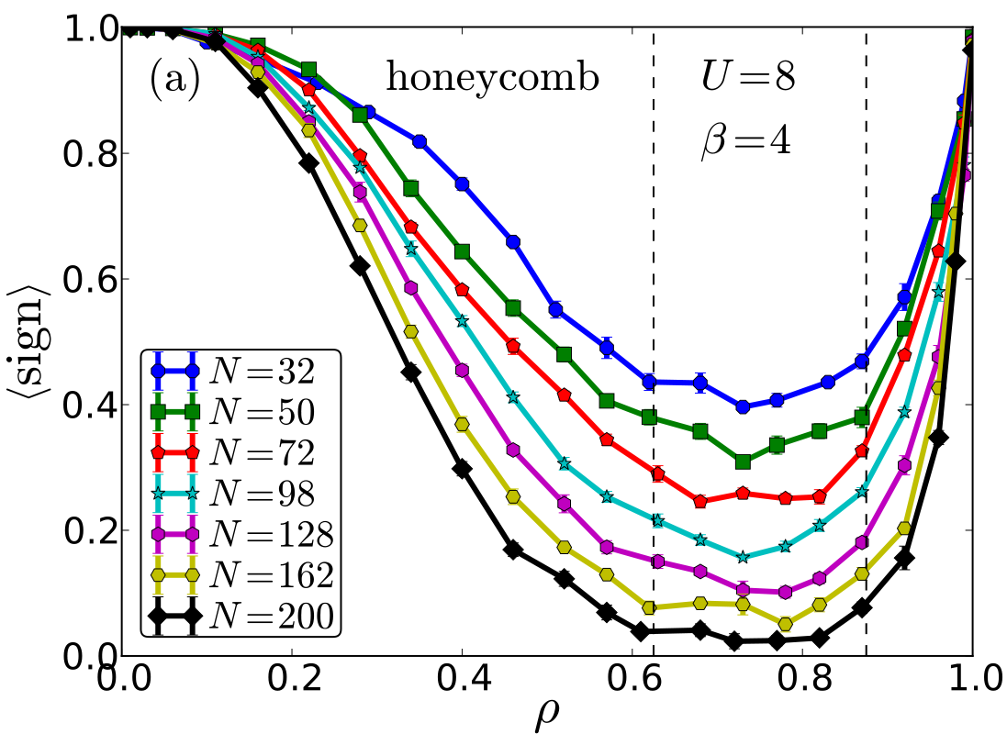
Sign problem – life is not that “easy”
Other types of lattices
[Iglovikov et al. PRB 92, 045110 (2015) ]

Slide 32



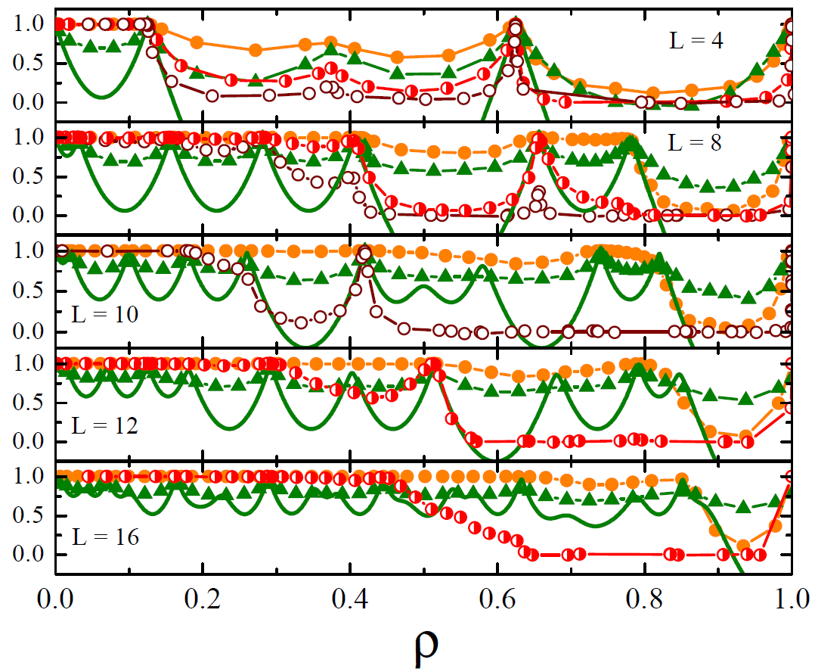
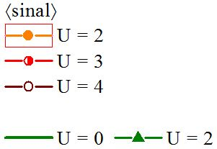

Sign problem – life is not that “easy”
Defining:
Closed-shell (U=0)
and the sign problem
Pseudo-insulating states
Direct relation of the pseudo-insulating states and the sign (for small values of U)
[RM et al. PRB 85, 125127 (2012) ]

Slide 33

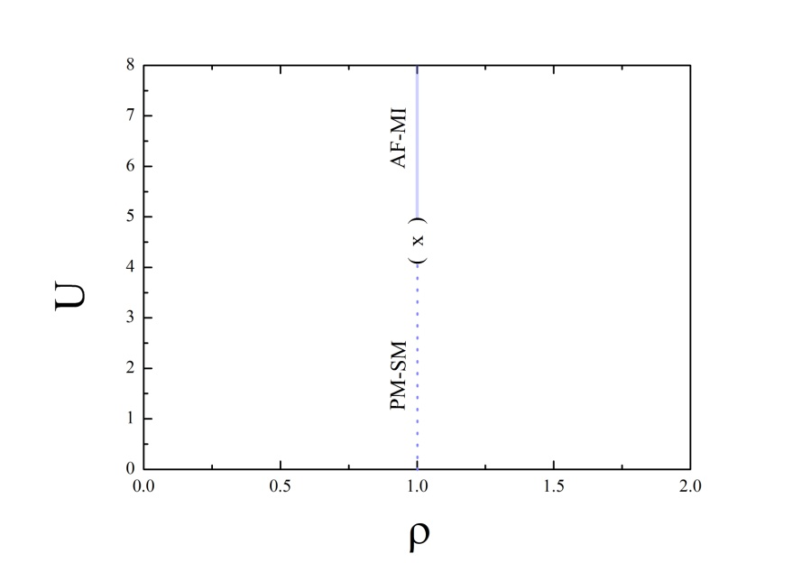
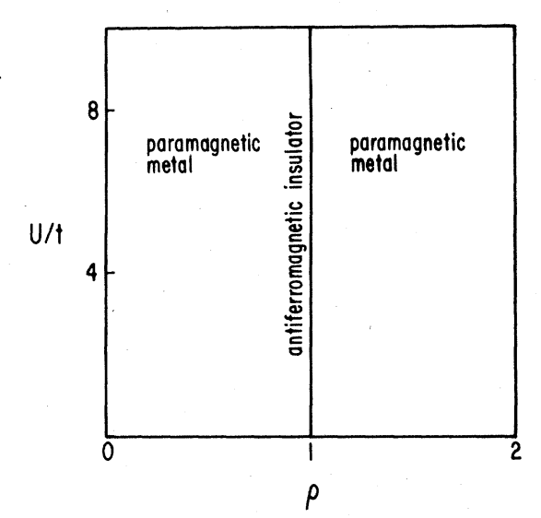


Famous results
Phase diagrams obtained with DQMC
Square lattice
Honeycomb lattice
?
?
[Hirsch 1985]
[T. Paiva et al.2005]
Away from half-filling is very hard to get low-temperature results due to the sign problem

Slide 34
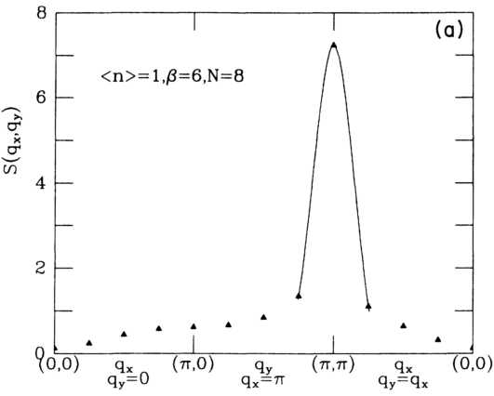
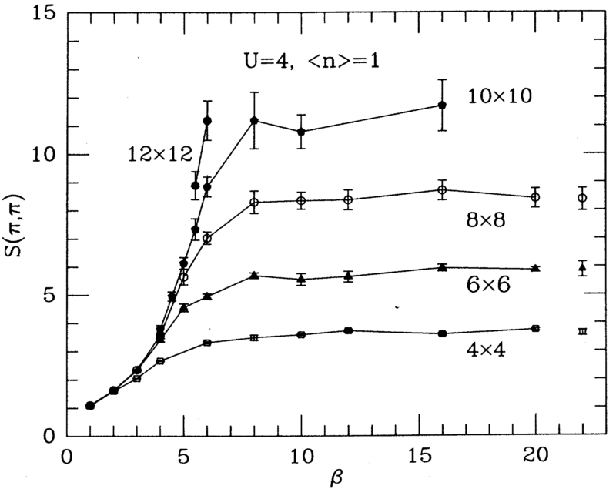
Famous results
Structure factor
Square lattice
[Moreo et al. PRB 41 2313, 1990]
[Hirsch, PRB 31, 4403 1985]
[White et al. PRB 40 506, 1989]

Slide 35
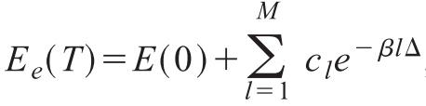
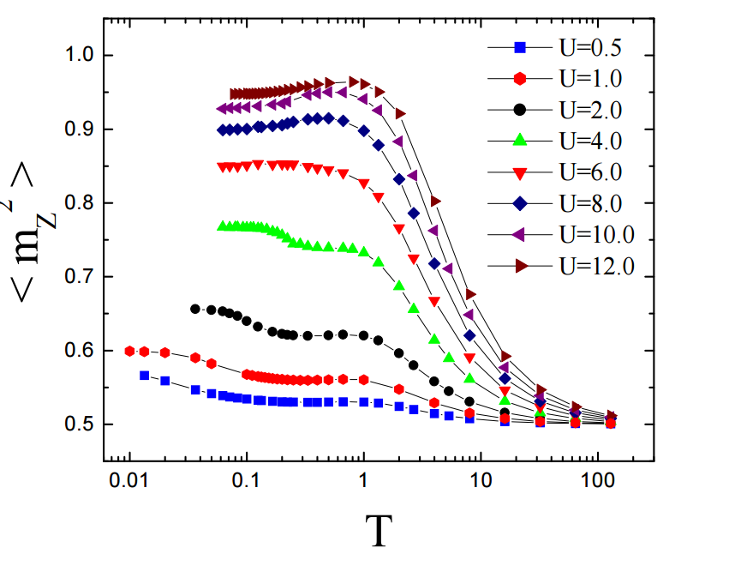
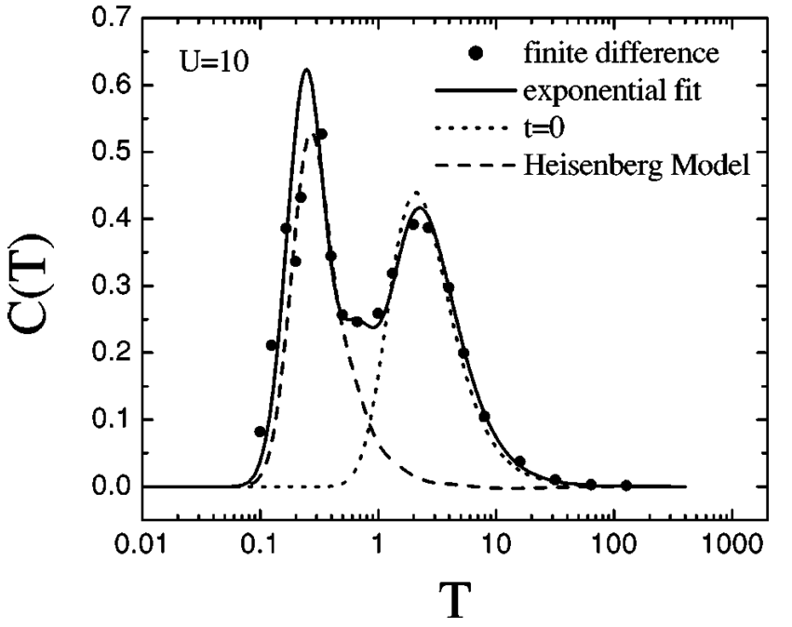
Famous results
Square lattice

Slide 36
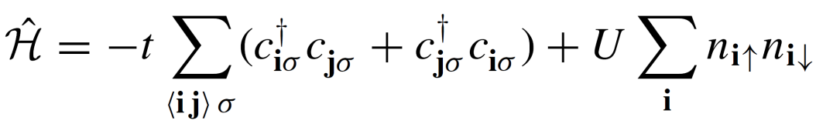
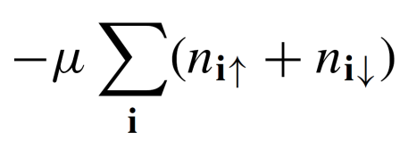
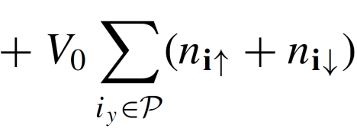




Not so famous results – stripes and SC fluctuations
2D repulsive Hubbard Hamiltonian
Formation of hole rich stripe regions
increasing the onsite energy in certain rows
Instead of being spontaneous, the striped formation is induced
L
[K.A. Moler Nature 468, 643–644 (2010)]
Simulations using DQMC performed in the underdoped regime:

Slide 37

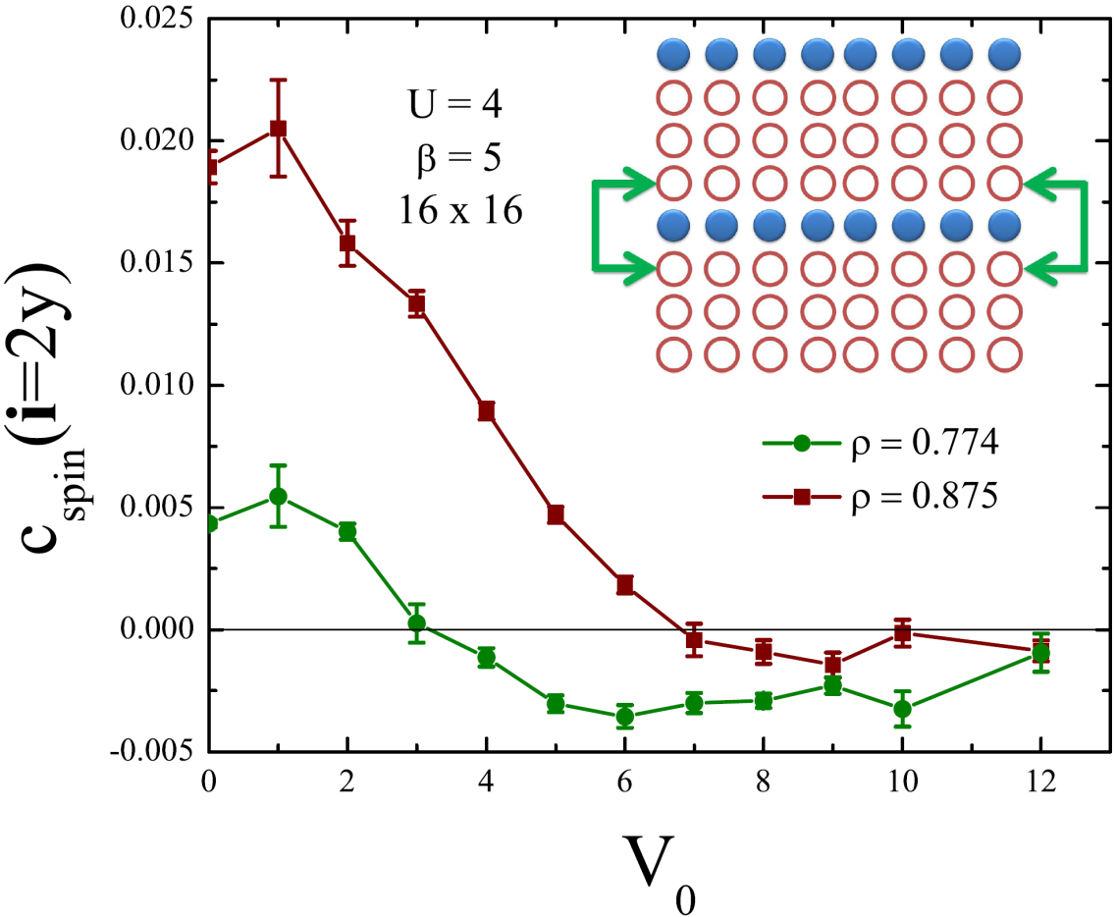

Not so famous results – stripes and SC fluctuations
absence of phase shift
- phase shift
As experimentally observed

Slide 38
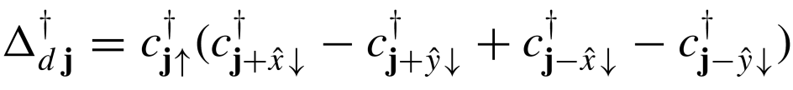
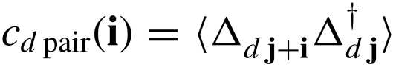
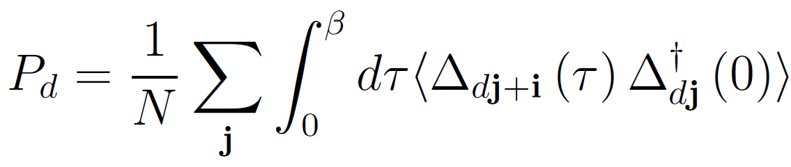
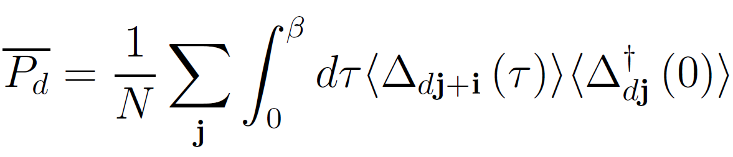
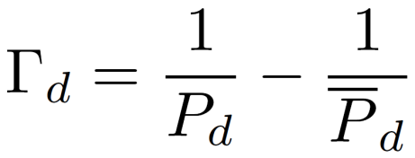
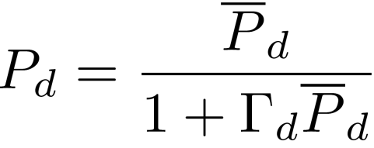

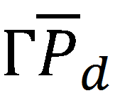

Not so famous results – stripes and SC fluctuations
Pair formation
d-wave pair creation operator:
d-wave pair corr. function:
Pair-field susceptibility
Uncorrelated pair-field susceptibility
Interaction vertex:
SC instability
repulsive pairing
attractive pairing

Slide 39
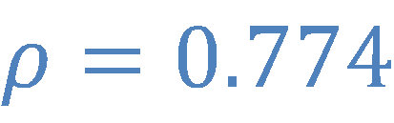

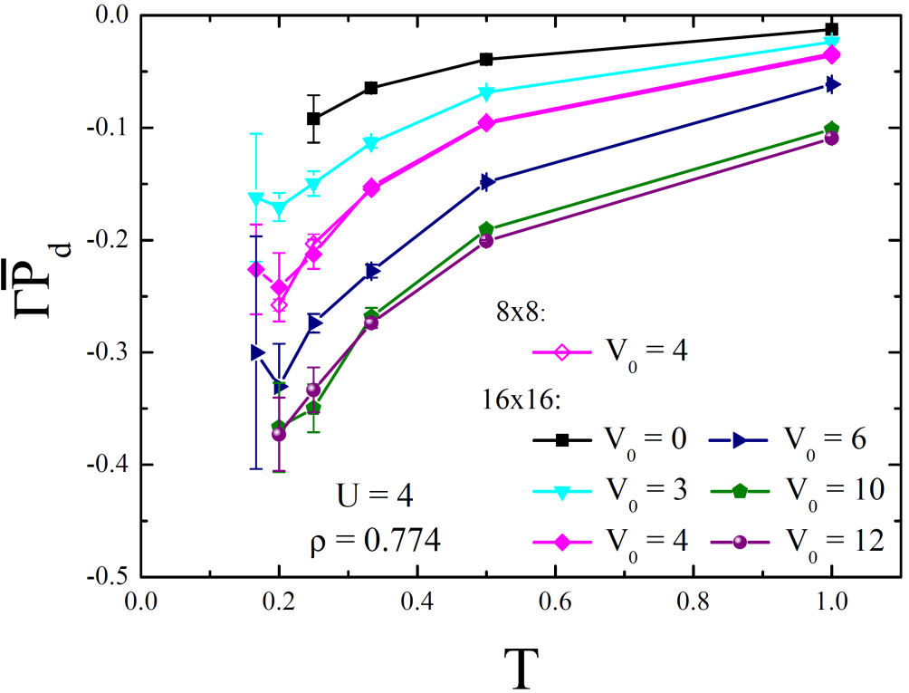
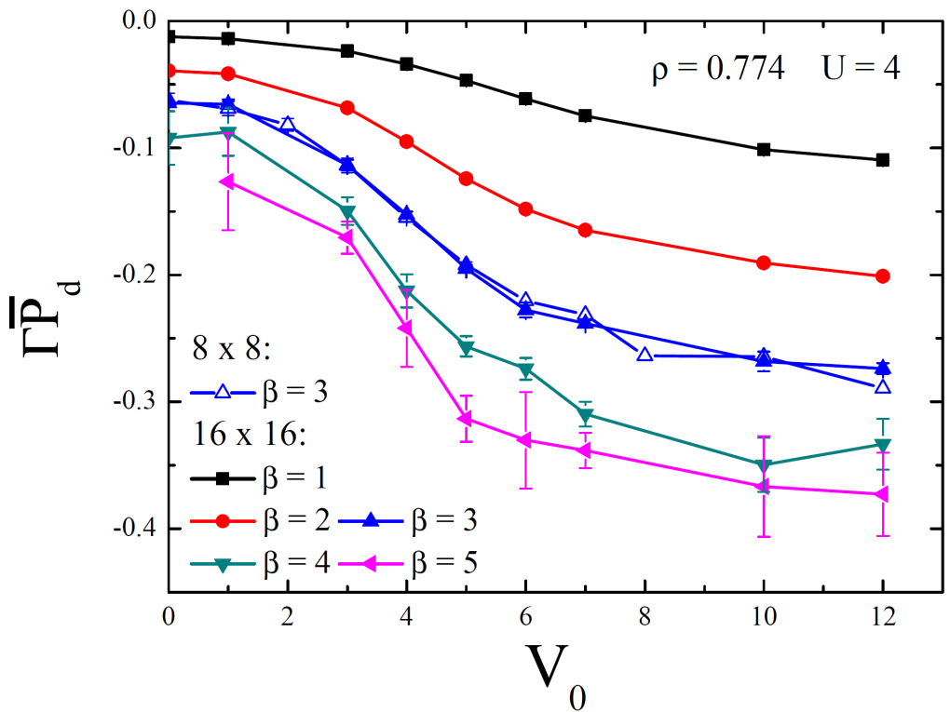

Not so famous results – stripes and SC fluctuations
Pair formation –
Sign problem prevents direct establishment of
The observed trend indicates that stripe formation favors SC
Small finite size effects
Charge domains (by increasing ) enhance the d -wave pairing

Slide 40
Summary – Physical picture
: grand-canonical partition function
Suzuki-Trotter decomposition
[Blankenbecler et al.1981]
Discretization in
and
Ex: 1D
Δτ
τ
Hubbard-Stratonovich transformation
N_{s}
Interacting fermions in D dimensions
Non-interacting fermions coupled to an external Ising-like and fluctuating field in (D+1) dimensions
x
N_{t}
Field is spanned as in an usual classical Monte Carlo Method – importance sampling

Slide 41
Are there more QMC methods?
YES! Many more…
One simple variation is the Projector QMC which tackles the GS directly
Rationale:
If is really large, one may argue that
the boundary condition in imaginary time
becomes unimportant
Sum in all closed paths in imaginary time
at a given temperature
Who are now the endpoints and ?
Let’s do it in a more appropriate form

Slide 42
Basic formulation - PQMC
Suppose one is interested in computing an observable of a given Hamiltonian
Is a trial wave functions that gets projected out if the parameter is large
If the projection parameter is large enough, we can take the endpoints to be equal
can be the the ground-state of the non-interacting part of the Hamiltonian, the mean-field solution of the problem, etc.. In reality, what matters is how fast the GS is approached with the smallest possible number of steps
State can be written as:
P’s are coefficients of the many
body-state in the single-particle
basis, for example.
where

Slide 43
PQMC method
In matrix form:
and
Finally, the partitition function can be written as:
Is the single particle propagator (as before)
But yet, we don’t know how to compute the central quantity, the Green’s functions…

Slide 44
PQMC method – computing Green’s functions
Computing Green’s function matrix element (for a given configuration x of the
imaginary-time field):
with
Let’s define the probability of a given configuration x of the imaginary-time field as
We have introduced a source term which will be taken to zero in the following
and has a single nonzero element
Using the definitions
and
The expectation value becomes:

Slide 45
PQMC method – computing Green’s functions
Finally, the Green’s functions at equal times can be written as:
Once the Green’s fucntions are obtained, the previous formalism essentially works in the
same way.
Even the updates are similar, and one has to focus in how the observables approach an
equilibrium value once the projection parameter is increased

Slide 46
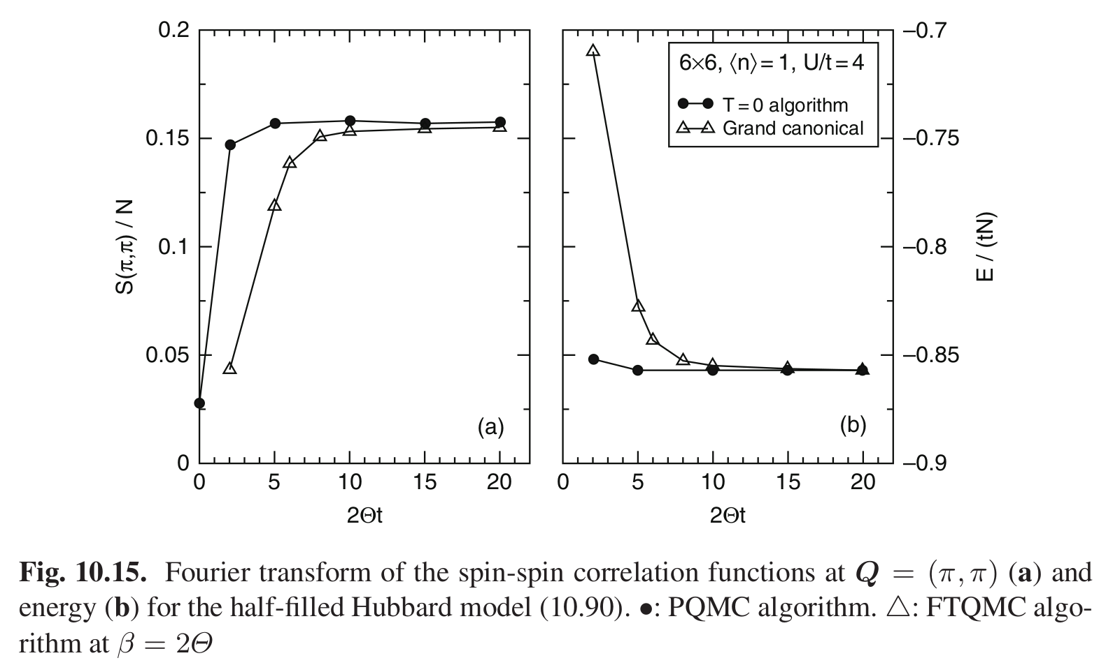
PQMC method – some basic results
Convergence of quantities witht the projection parameter

Slide 47
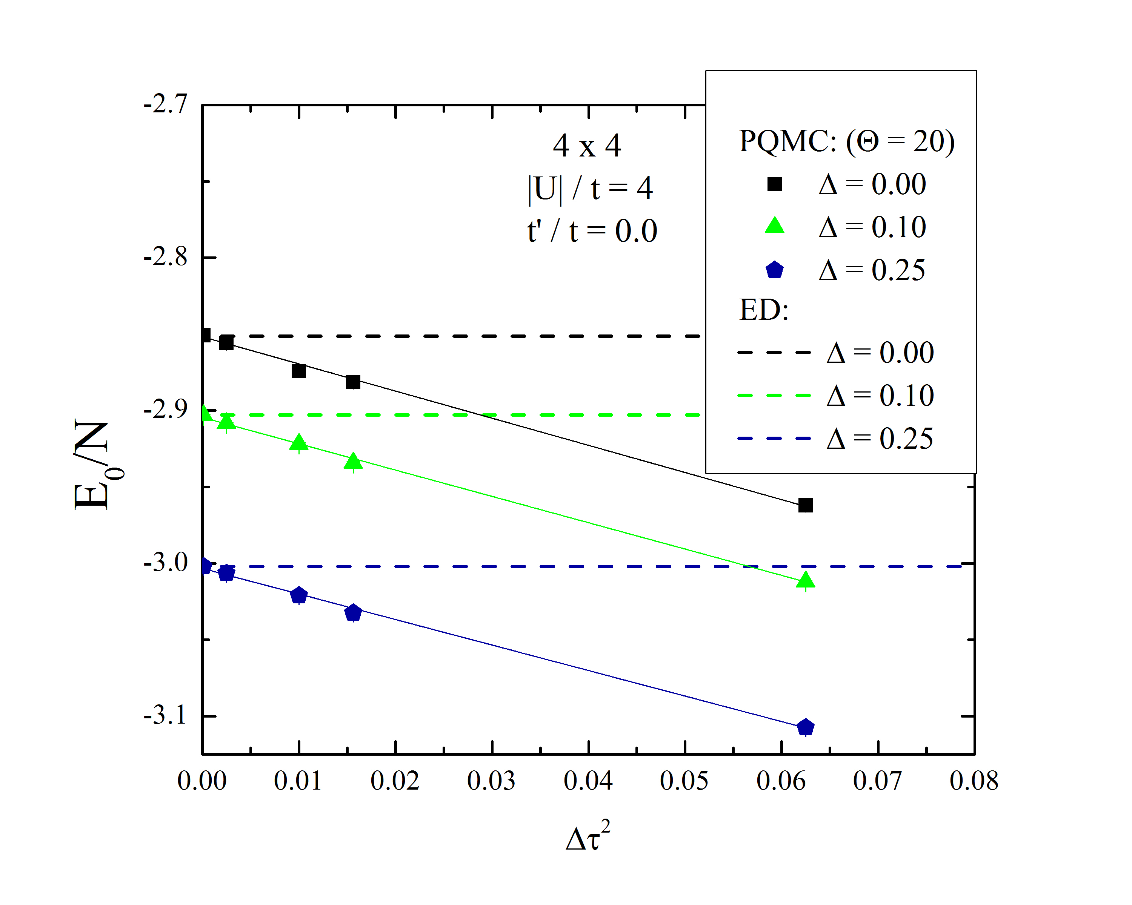
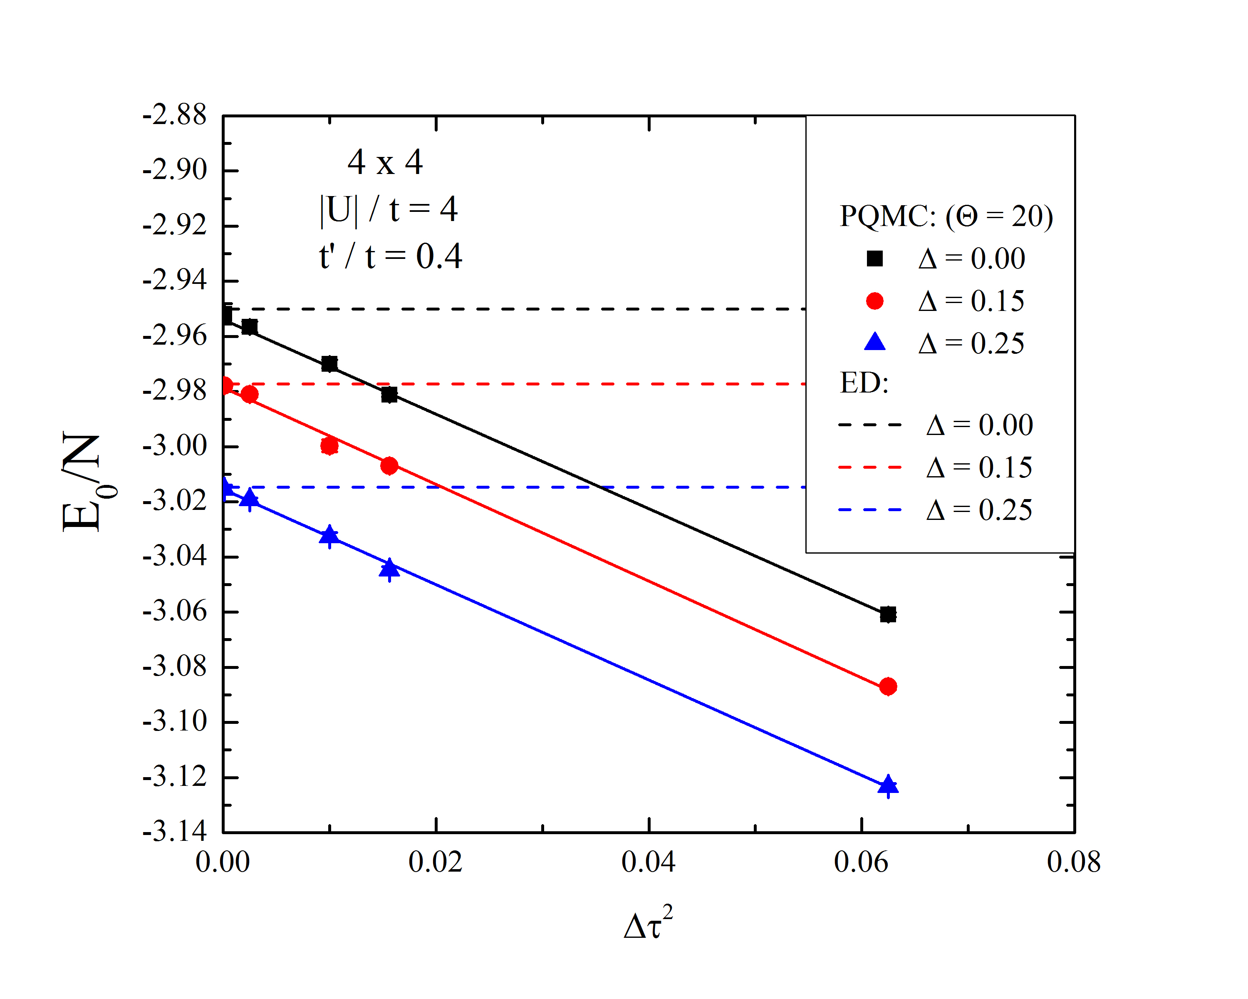

PQMC method – some basic results
Convergence of quantities witht the projection parameter
Attractive Hubard model with NNN hopping and staggered potential

Slide 48
Summary
Interacting fermionic problem in a lattice can be solved either in finite or zero temperature
if special conditions are met.
Sign problem appears in many classes of fermionic problems and there is no simple
solution to it.
In some special classes of Hamiltonian, one can circumvent the sign problem by
working on a different basis, called the Majorana basis. → These results were obtained
recently by Tsinghua researchers!
This is just a small and simplified introduction to the method of QMC for the case of auxiliary
fields... There are many more “QMC” methods as the
Wordline algorithm
Stochastic Series Expansions
Stochastic Green’s functions
etc.
That’s all folks!

