Slide 1

Spin-fermion hamiltonian
(a preliminary for a an auxiliary field QMC)
Rubem Mondaini
Beijing Computational Science Research Center

Slide 2
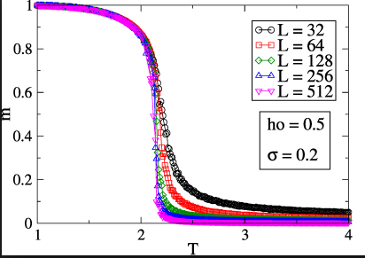
Brief review - Classical Monte Carlo for the Ising Model
The model: Ising model (classical model to describe magnetism/paramagnetism in a lattice)
;
: Ferromagnetic interactions
(lower energies for aligned moments)
: Anti-Ferromagnetic interactions
(lower energies for anti-aligned
moments)
Critical temperatures separating both regimes:
Projects – Computational Physics

Slide 3
Comparison of single flip update and cluster updates in Classical Monte Carlo
The model: Ising model (classical model to describe magnetism/paramagnetism in a lattice)
;
Sum with
terms!
Motto of statistical physics: not all of those configurations are actually relevant
Configuration : ocurrence probability→
: Boltzmann
factor
Can be
No need to generate all the configurations… Importance sampling ?
Start from a random spin configuration
Generate a chain of the most likely configurations (plus fluctuations) by visiting each
site of the lattice and attempting a flip
Projects – Computational Physics

Slide 4
Comparison of single flip update and cluster updates in Classical Monte Carlo
Attempting local spin flips
Energy difference
between configurations:
Ratio between the correspondent Boltzmann factors:
Metropolis algorithm:
If accept the move
Projects – Computational Physics
Accept the flip
If accept it with probability
generate a uniform deviate and if

Slide 5
Comparison of single flip update and cluster updates in Classical Monte Carlo
Attempting local spin flips
Traversing the whole lattice constitutes a sweep
or one MC step
Observables:
: Magnetization
MC steps
Warm up
Averaging regime

Slide 6
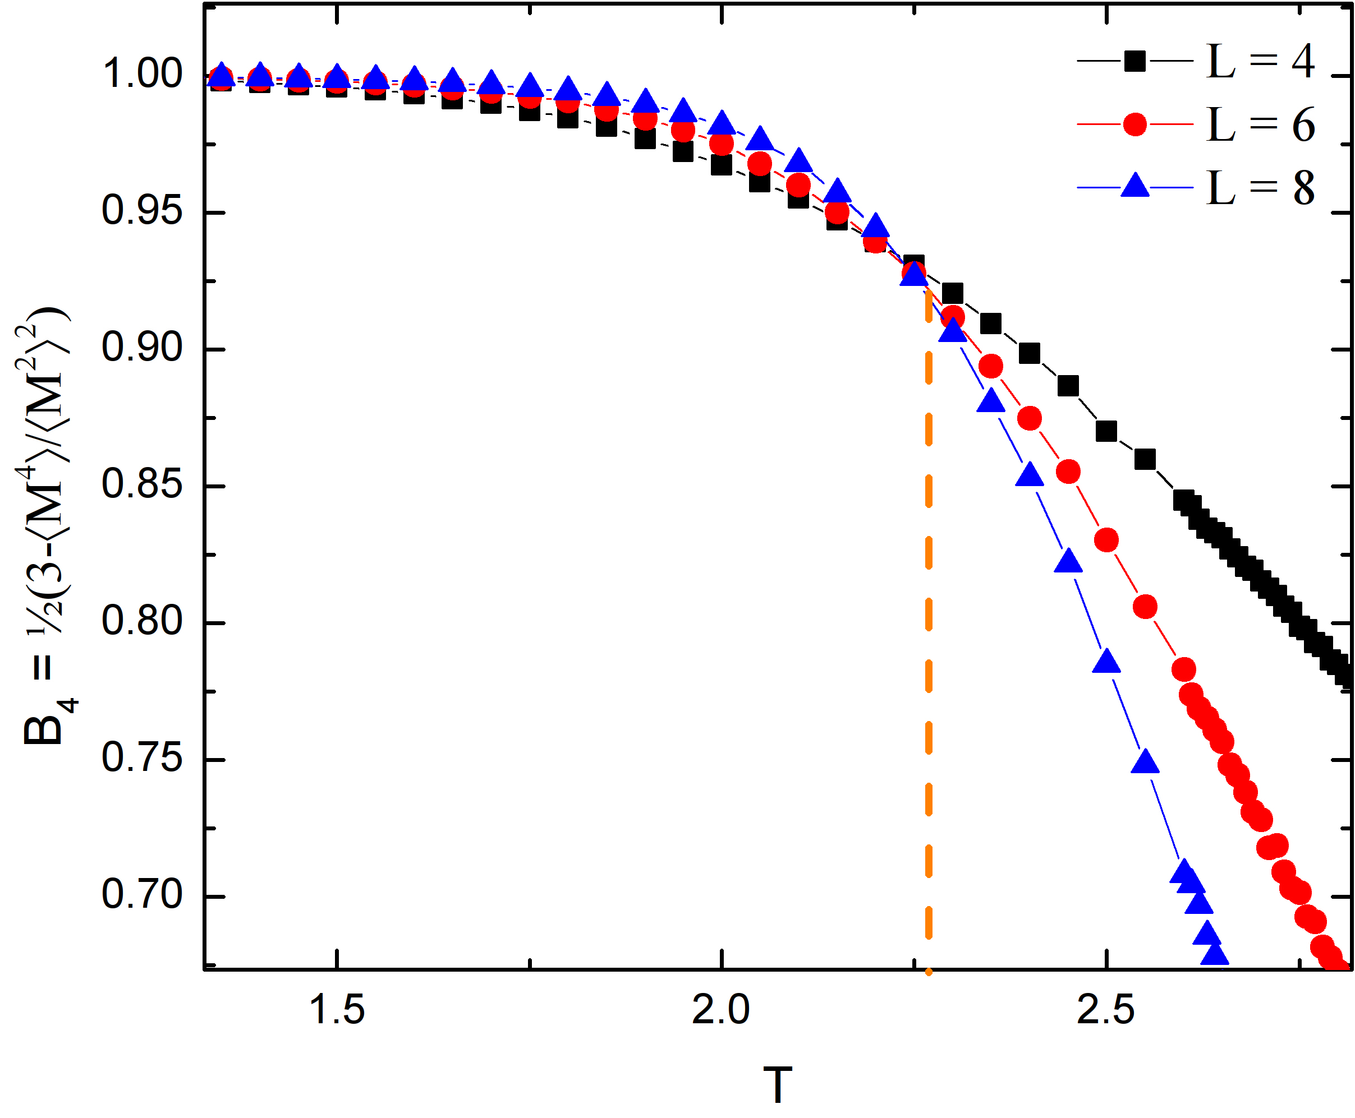
Comparison of single flip update and cluster updates in Classical Monte Carlo
Binder cumulant: very precise in obtaining the critical temperature (it is a crossing of the
different system sizes results)
[K. Binder, Z. Physik B 43, 119 (1981);
Phys. Rev. Lett. 47, 693 (1981)]

Slide 7
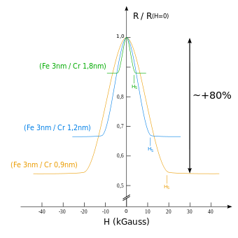
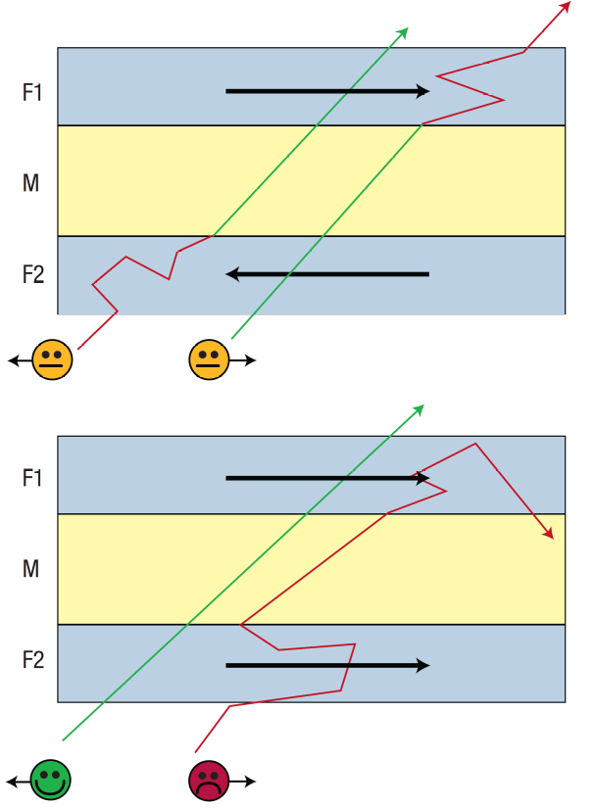
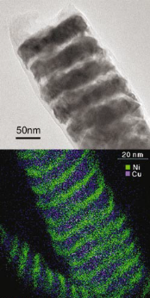
Giant magnetoresistance
Why is interesting?
Magnetic multilayers in nanowires: Ni / Cu
Spin valve
Giant magnetoresistance (GMR) → ΔR/R ~ 150%
High-sensitive magnetic sensors
[Fert et al. Nature 2007]
[Chen et al. APL, 2003]

Slide 8
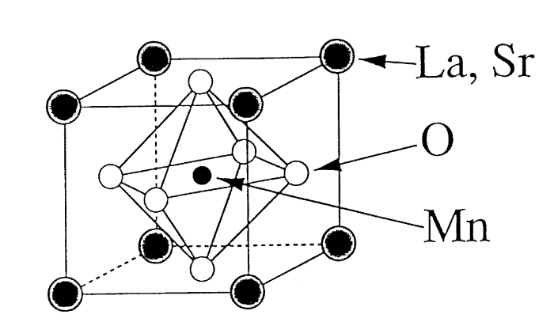
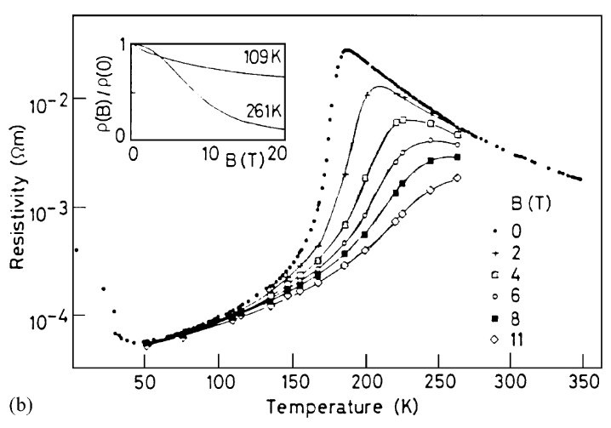
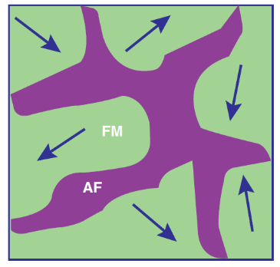
Giant magnetoresistance - background
Not necessary multilayers, but a variety of materials can display this phenomenon
Manganites:
[E. Dagotto,
Science 2005]
[Kusters et al. (1989)]
Complex interplay of different magnetic orderings
affecting transport

Slide 9
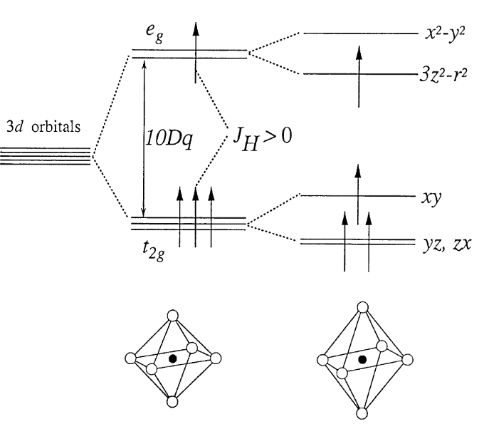
Giant magnetoresistance – why spin-fermion?
Typical orbital arrangement in Mn atoms:
Itinerant electrons are affected by a
polarized background (spin!)
Itinerant
Localized
Typical interaction – Hund’s coupling:
with
Simplification: What if the spin S is classical?

Slide 10
Realizing GMR with models of classical spins + free fermions
Models:
The double-exchange Hamiltonian
Magnetic multilayers in nanowires: Ni / Cu
Takes into account the spin and charge degrees of freedom
Fermionic part:
Hopping term (Kinetic energy)
Chemical potential
: number
operator
Ising spins!
Ising spin-spin interaction
Hund’s coupling
[Chen et al. APL, 2003]

Slide 11
Realizing GMR with models of classical spins + free fermions
Models:
The double-exchange Hamiltonian
Magnetic multilayers in nanowires: Ni / Cu
Takes into account the spin and charge degrees of freedom
Fermionic part:
Hopping term (Kinetic energy)
Chemical potential
: number
operator
Ising spin-spin interaction
Hund’s coupling
[Chen et al. APL, 2003]

Slide 12

Realizing GMR with models of classical spins + free fermions
Models:
The double-exchange Hamiltonian
Magnetic multilayers in nanowires: Ni / Cu
Simplest way to consider this type of system
Spherical cow
Fermions hopping
on a rectangular lattice
Classical Ising spins
on small rectangular slabs
Great… How exactly to solve this problem at finite T?
[Chen et al. APL, 2003]

Slide 13
Realizing GMR with models of classical spins + free fermions
Method:
(easy) Quantum Monte Carlo
Treat exactly the quantum degrees of freedom and perform importance sampling
on the classical variables
In other words: Classical Monte Carlo method on the Ising configuration with
full diagonalization of the Hamiltonian
Fermionic partition function:
are eigenvalues of
requires diagonalization
The fermionic Hamiltonian is built in the so-called single particle basis

Slide 14
Realizing GMR with models of classical spins + free fermions
Method:
(easy) Quantum Monte Carlo
Example:
4 sites with PBC
One can always diagonalize using standard routines

Slide 15
Realizing GMR with models of classical spins + free fermions
Method:
(easy) Quantum Monte Carlo
Metropolis algorithm on the Ising spins with the following transition probability:
Later, compute quantities using the Green’s functions:
But since,
then
are unitary matrices that diagonalize , i.e., they are the eigenvector matrices

Slide 16
Realizing GMR with models of classical spins + free fermions
Method:
(easy) Quantum Monte Carlo
The Green’s functions are important because of its versatility in obtaining observables
For example, the density of electrons of spin at site :
Or the kinetic energy:
And many others will follow… Talk to me later if interested.

Slide 17
Realizing GMR with models of classical spins + free fermions
Summary:
Itinerant fermions interacting with classical spins are thought to be sufficient
for a minimal explanation of magnetoresistance phenomena
One has a a slightly more complicated Monte Carlo. It is still classical Monte Carlo
(Metropolis) but with a quantum flavor in it...
The bottleneck is that one requires to diagonalize the fermionic matrix for every
single configuration along the MC phase space evolution → very expensive!
(There are simpler and more involved numerical methods, e.g. KPM,
but this already gives you an intuition of how quantum particles interact with a
a classical field )
Now, let’s head towards a full quantum problem again!

