Slide 1
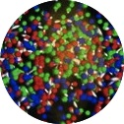
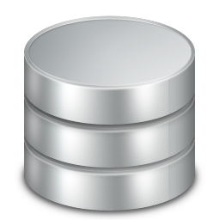

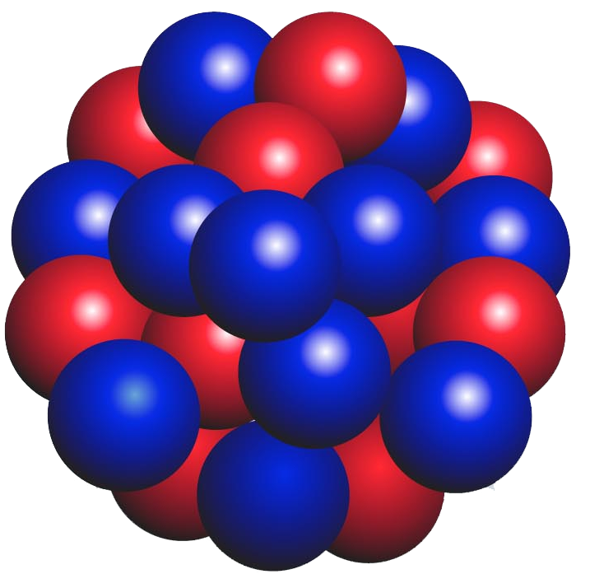
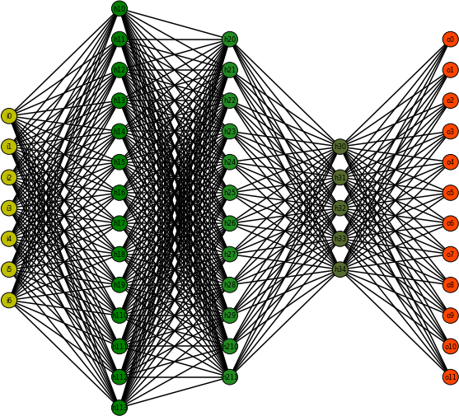
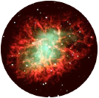
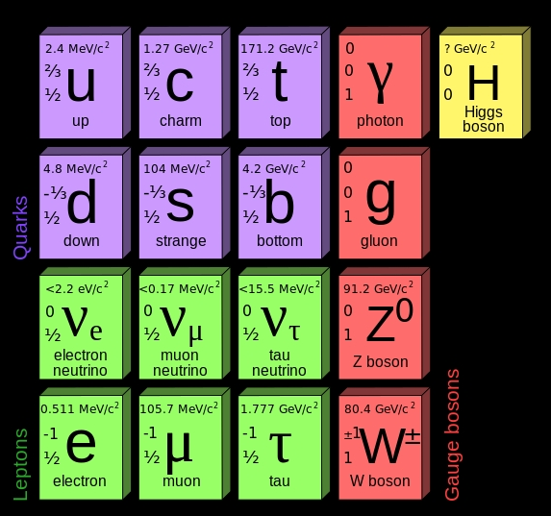
Nuclear Theory
Correlations and predictions
Estimations and causations
Hot and Dense Nuclear
Matter
Hadrons
Nuclear data
Databases
Data Mining
Visualization
Artificial Intelligence
Machine Learning
Discovery
Applications
Atomic Nucleus
Experimental
Design
Nuclei in the Cosmos
Nuclear Experiment
Methods
Tools
Accelerator Science and Operations
Fundamental interactions

