Slide 1
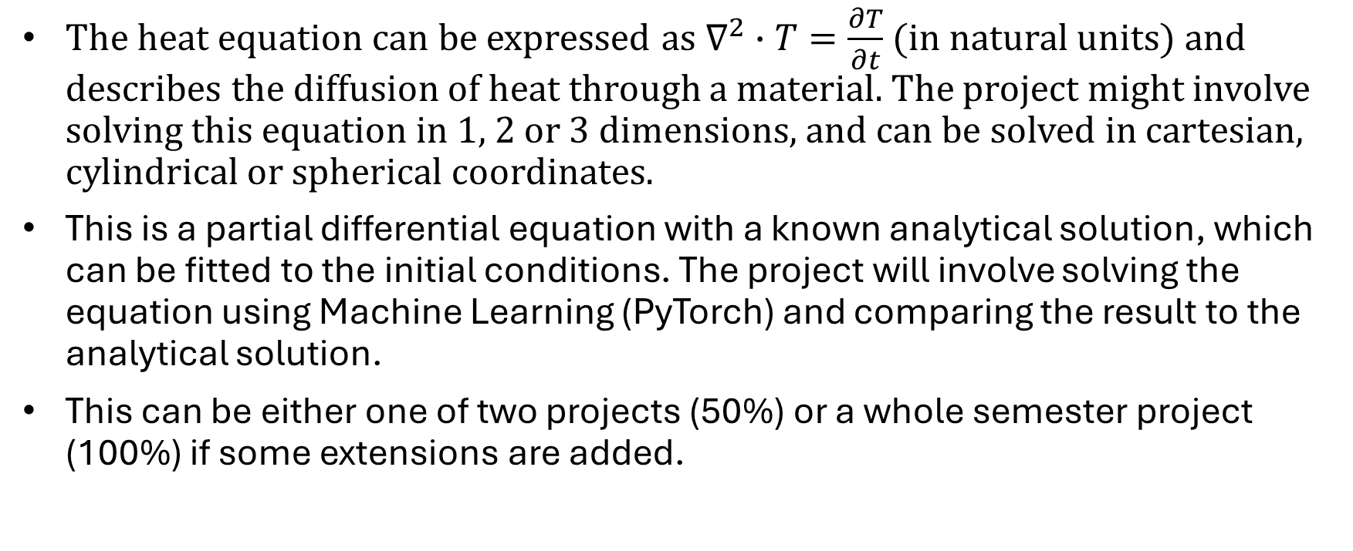
FYS5429 Project – Solving the Heat Equation with Machine Learning
The heat equation can be expressed as $∇^{2}∙T=\frac{∂T}{∂t}$ (in natural units) and describes the diffusion of heat through a material. The project might involve solving this equation in 1, 2 or 3 dimensions, and can be solved in cartesian, cylindrical or spherical coordinates.
This is a partial differential equation with a known analytical solution, which can be fitted to the initial conditions. The project will involve solving the equation using Machine Learning (PyTorch) and comparing the result to the analytical solution.
This can be either one of two projects (50%) or a whole semester project (100%) if some extensions are added.

Slide 2
Possible extensions:
What if a heating/cooling element is added in parts of the material?
What if we consider heat diffusion through an object which is composed of multiple materials, such as a wire composed of a conductor and an insulator, which have different thermal conductivity?
What if we consider heat diffusion in an object with temperature-dependent density (such as water)
What if we add other sources of heat diffusion, such as radiative emission or convection.

Slide 3
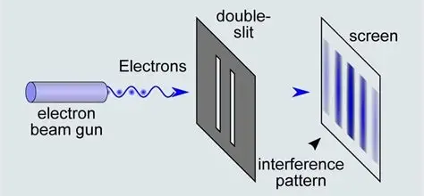
Also possible: Schrödinger Equation
In the absence of a potential, the Schrödinger equation has the same form as the heat equation. This project can revolve around solving the Schrödinger equation instead if that sounds more appealing.
One extension to such a project could be to add a potential to the Schrödinger equation (for instance a potential wall representing one or more slits) and solve for the time-evolution of the wave-function of a particle.

Slide 4
If you are interested in joining this project, or you think I might be interested in joining your project, email me at: haholen@uio.no

