Slide 1
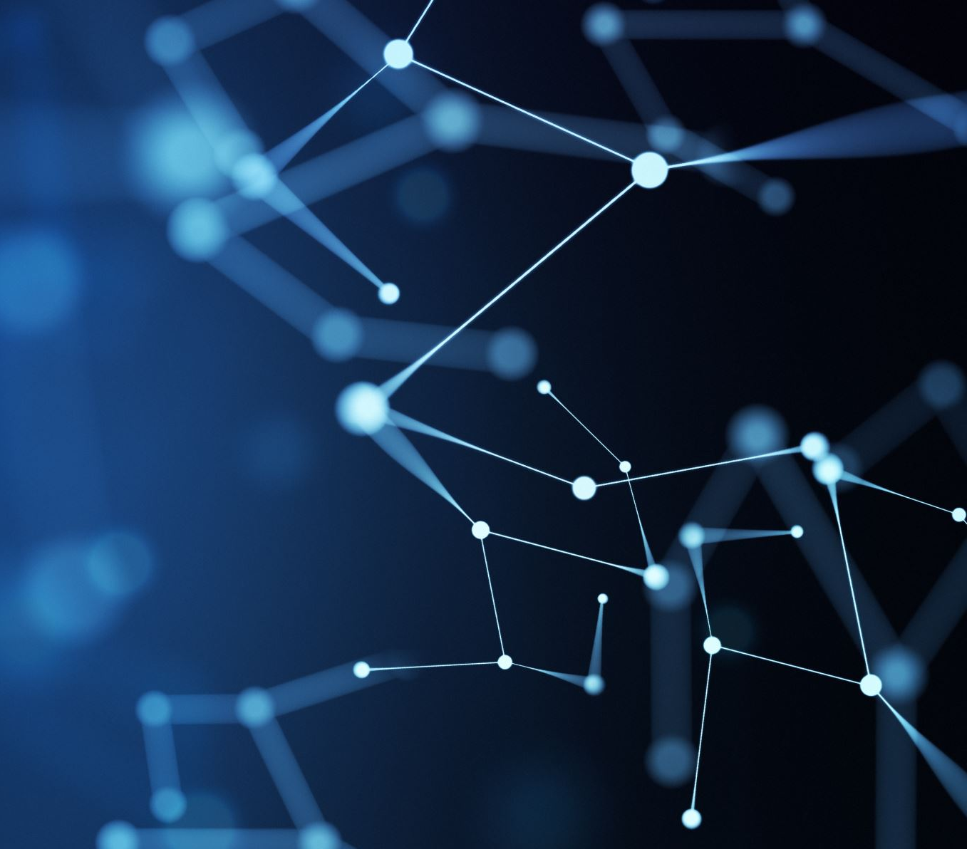
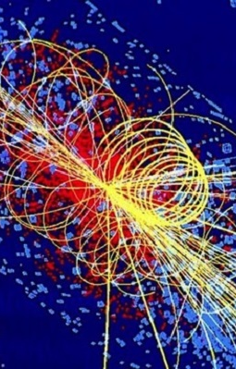
Project introduction for FYS5429
By Vaitian, Cecilie and Max

Slide 2

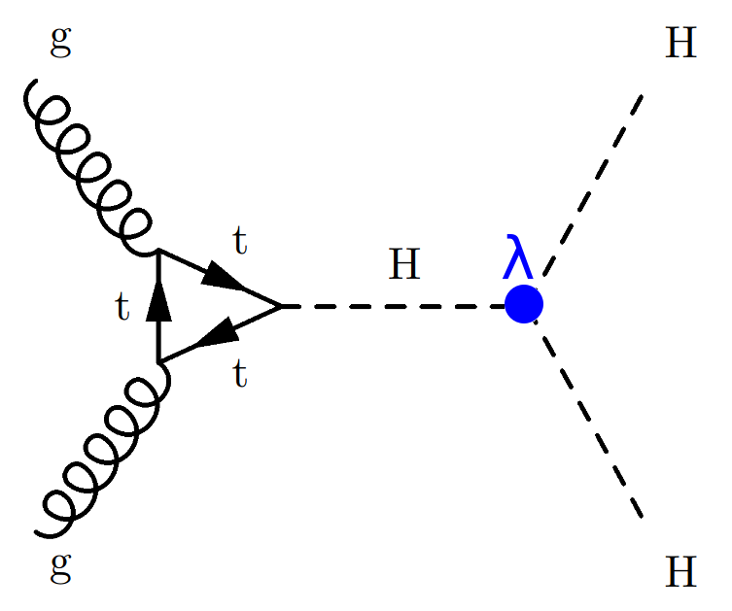
Background and motivation
3 master students working on the same team within the Atlas group at HEP
Working jointly on the Di-Higgs team
Di-Higgs is still an undiscovered part of the Standard Model
Master thesis:
Vaitian will develop a novel ML architecture for Di-Higgs search
Max will use this novel ML architecture to analyze and compare large datasets
Cecilie will use this processed data to do High-Luminosity projections into the future

Slide 3
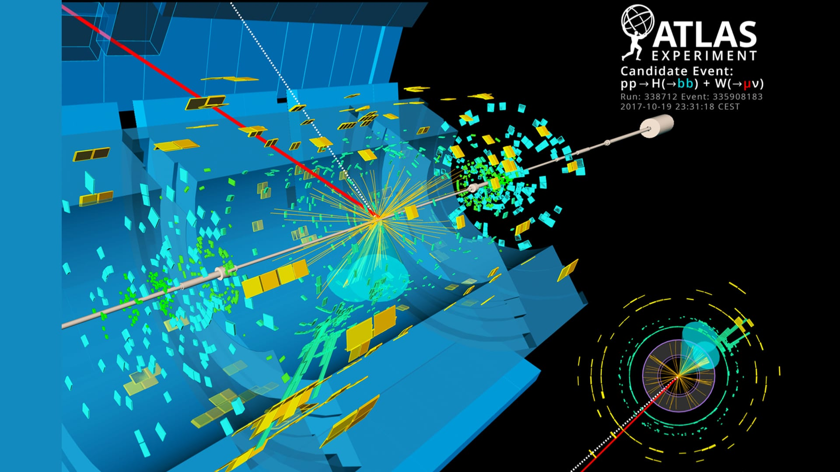
Projects
Projects will be related to our masters
Will divide into 2 projects
Main project will be project 2 – end goal
Project 2: Transformers
Transformers are neural networks that process data by letting every element “pay attention” to every other element, so they can model context and relationships in parallel rather than step by step. This attention-based design makes them especially powerful and scalable for language, vision, and other sequence-like data like particle track event reconstruction.
A «hot topic» within particle physics and CERN
The data we will use will be from Atlas open data
Project 1: Steppingstone to Transformers
Either GNN or RNN to reconstruct track events and possibly compare this to transformers in project 2

