Slide 1
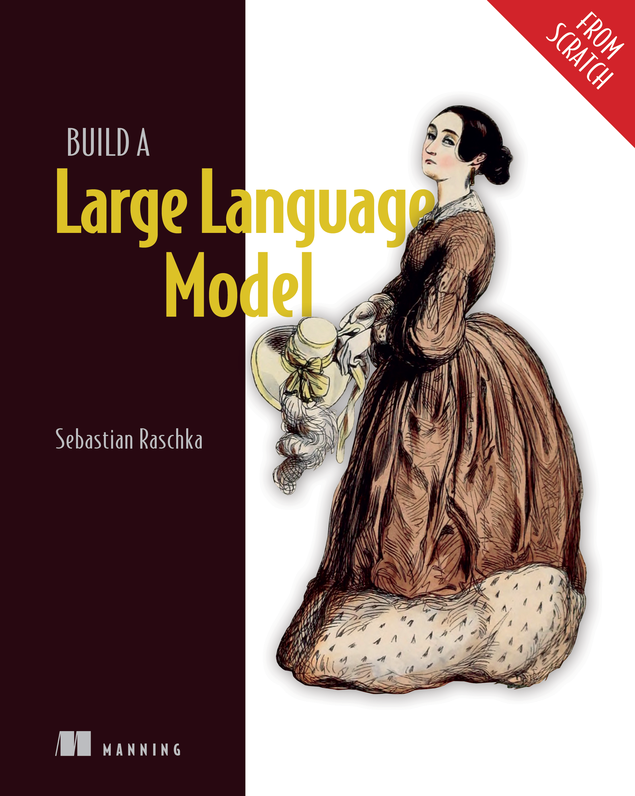
Build an LLM (from scratch)
«The book provides arguably the clearest step by step walkthrough for building a GPT-style LLM»
Val Andrei Fajardo
Founding Software/ml Engineer at LlamaIndex
Suggested coding path project
for FYS5429

Slide 2
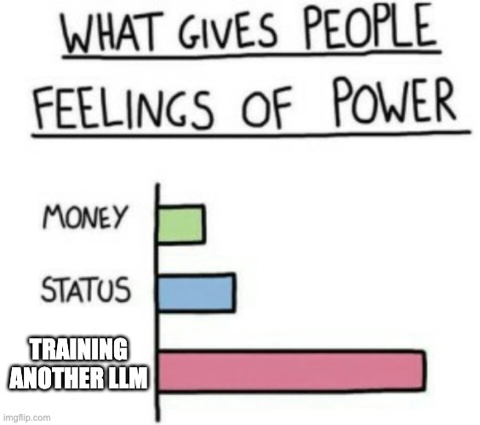
Resources:
Book by Raschka
With plenty of material in Github
And Youtube tutorials from same author
Text analysis and question answering
We could explore how an LLM extracts specific pieces of info from PDFs
Up for other suggestions here!
Use case:

Slide 3

Is it doable?
Yes!
Book published: officially nov 2024, unofficially jan 2024
Several people have already finished their solo Raschka LLM projects by now.
With more people and good teamwork we can make a decent LLM based on transformer architecture by june 1st.
Learning outcomes:
Plan and code an LLM comparable to GPT-2
Load pretrained weights
Construct a complete training pipeline
Fine-tune your LLM for text classification
Develop LLMs that follow human instructions

