Slide 1

Introduction to Docker
Presenter: Jiabao Cao

Slide 2
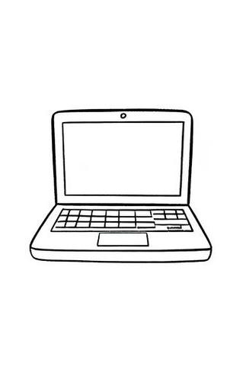

Equipment A
Equipment B
Project document file

Slide 3
Content
1.Basic introduction to Docker
2.Origin of Docker
3.Advantage of Docker
4.Basic structure of Docker
5.Workflow and related concept of Docker
6.Foundamental operations of Docker

Slide 4
1.Basic introduction to Docker

Slide 5
What is Docker
Simply put, Docker is a lightweight containerization technology and platform used to solve common environment problems in programming.
It packages applications, dependencies, and user-space environments together in a container.

Slide 6
Subsequently, if you need to run this application on another computer, you just need to run this container without worrying about the application's environment issues.

Slide 7
Today
we are going to create a container through image, and learning how to use them.❤️

Slide 8
2.Origin of Docker

Slide 9

dot Cloud is a cloud-based application platform that allows developers to deploy and manage applications in the cloud.

Slide 10
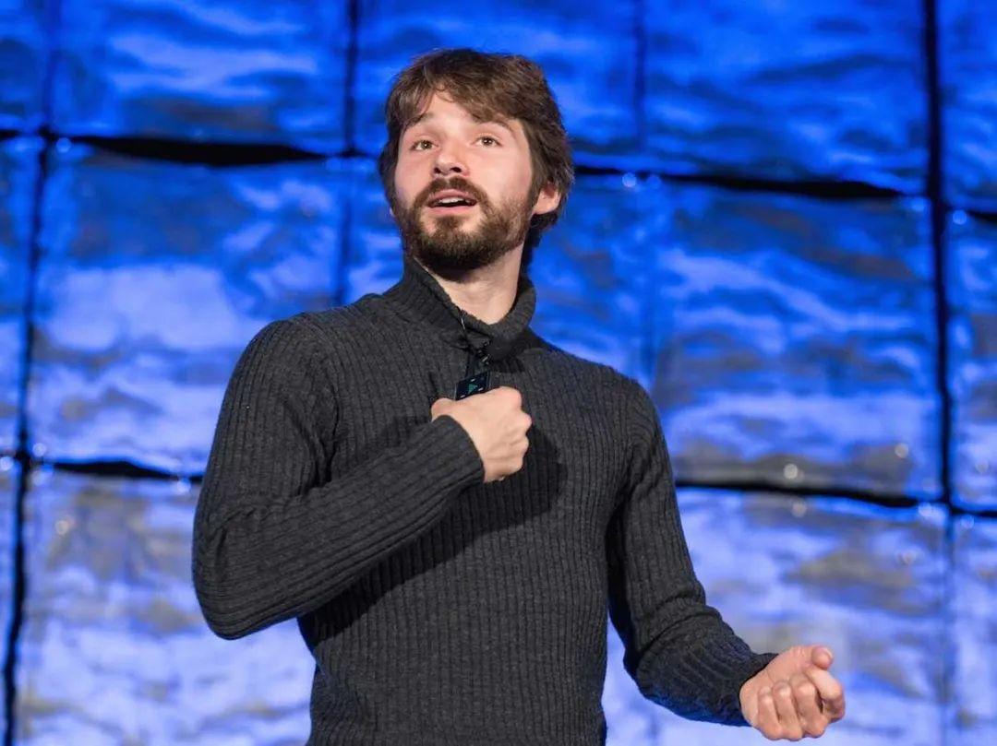
One person called Hykes noticed that
when running applications on dotCloud, different applications required different dependencies and runtime environments,
which were often difficult to coexist in the same system.

Slide 11
This led to environment configuration problems because different applications might require different environments
To solve this problem, Hykes began thinking about how to package applications and their environments together so they could run anywhere.

Slide 12
Furthermore, Hykes decided to create a new tool for packaging applications and their environments.
And the name of a dock worker is exactly Docker. Hykes thought this name was very appropriate for the tool's functionality, so he named the tool Docker.
Thus, Docker was born.

Slide 13
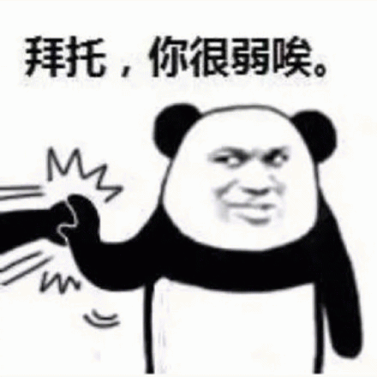
Why can't virtual machines solve this problem? Isn't it also a famous containerization technology?

Slide 14
3. Advantages of Docker

Slide 15
Docker stands out among containerization technologies for several reasons:
1. Lightweight and fast
2. Portability
3. Isolation
4. Scalability

Slide 16
Compared to virtual machines
Feature | Docker | Virtual Machine
Resource usage | Lightweight | Heavyweight
Startup speed | Fast | Slow
Portability | High | Low
Isolation | Process-level isolation | Complete
Scalability | High | Limited

Slide 17
4.Basic structure of Docker

Slide 18
Docker's Architecture
Docker consists of the following 4 things:
1. Docker Object
2. Docker Client
3. Docker Daemon
4. Docker Registry

Slide 19

You can imagine this as a little company.
Slave
Work and output
Manager
Give command
Task
Given to
Boss
Docker Daemon
Docker Registry
Docker Object
Docker Client

Slide 20
Docker Objects:
Core objects including images, containers, networks, volumes, etc.

Slide 21
Docker Client:
A command-line tool for users to interact with Docker, responsible for receiving user commands and sending them to the Docker Daemon for execution

Slide 22
Docker Daemon:
A background service process responsible for processing Docker Client instructions and managing resources such as images and containers

Slide 23
Docker Registry:
An image repository responsible for storing and distributing Docker images, similar to GitHub, with the most commonly used being the official Docker Hub

Slide 24
5.Docker’s workflow

Slide 25
Docker's workflow is primarily as follows:
1. Build an image: Developers define the application's environment and dependencies by writing a Dockerfile, then build the image using the `docker build` command.
2. Distribute the image: The built image can be uploaded to a Docker Registry for other users to use.
3. Run a container: Users can pull images from the Registry and run containers using the `docker run` command.
4. Manage containers: Users can manage running containers using commands like `docker ps`, `docker stop`, `docker restart`, etc.

Slide 26

Image

Slide 27
Then what is image?

Slide 28
What is an Image
An image (read-only) consists of multiple layers (recorded in multiple files)
First layer:
Second layer:
nth layer:
The user-space file system (e.g., ubuntu:22.04)
The language environment (e.g., python 3.10)
Other information

Slide 29
App

Slide 30
What is Container
A container is simply a set of processes, but unlike regular processes, these processes have some restrictions:
- 1. Cannot see files outside the image
- 2. Relies on the image's system files to run, using the Linux kernel to execute processes

Slide 31
https://github.com/CompPsyUnion/docker-tutorial

Slide 32
