Slide 1
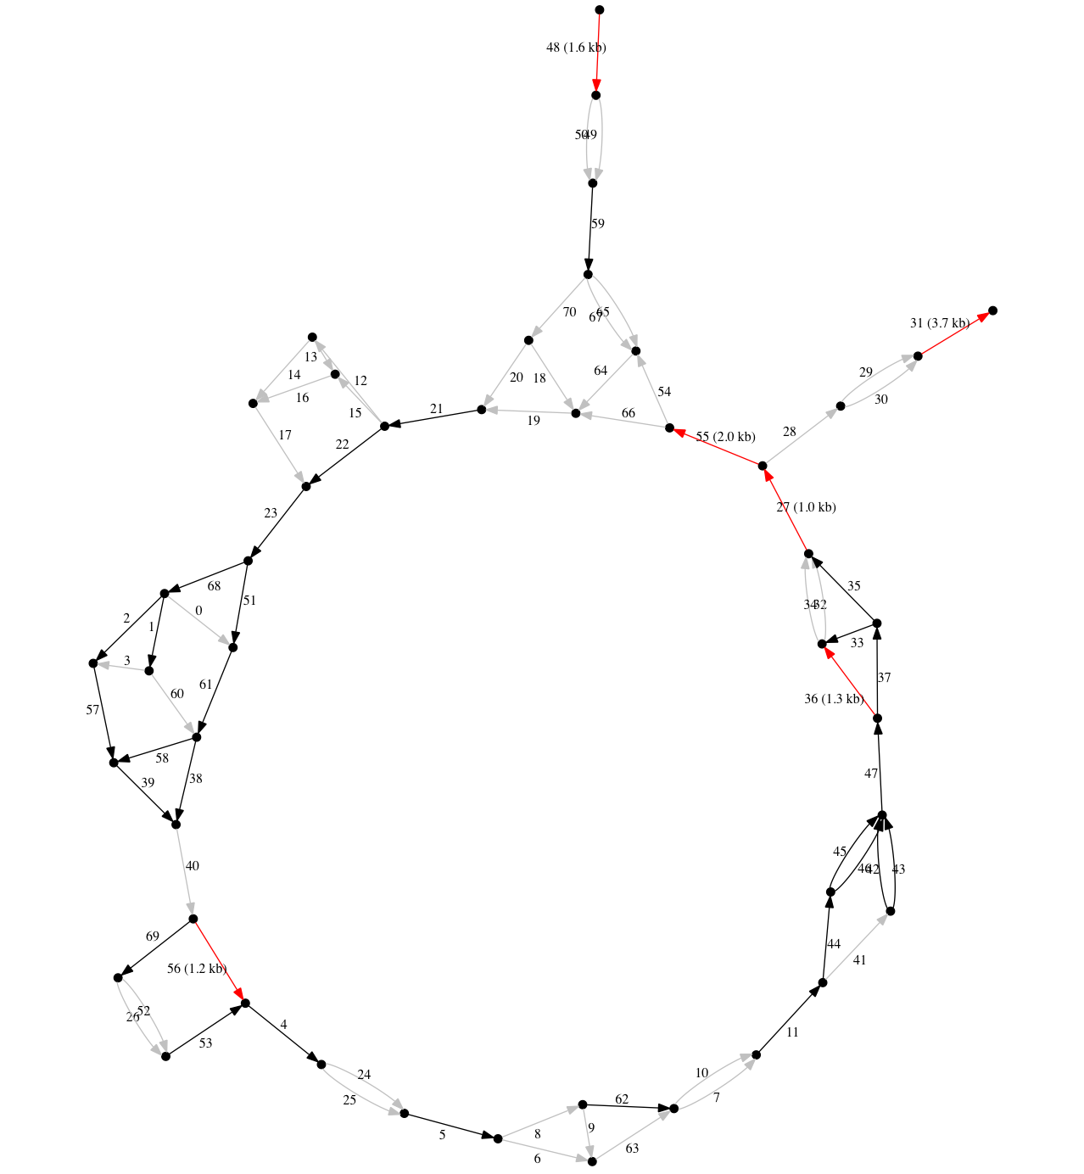
total diffs within assembly
= 42 subs, 5 indels
total coding diffs with reference
= 8 subs
total nonsynonymous diffs
= 4 subs
coding exons in region shown, counting starts at 0, transcript NEB-204, perfect except as noted [...]
flattens to 1 sub
flattens to 3 subs
0, 1, 2
10[Leu→Val, Ala→Val, syn]
flattens to 1 sub
3, 11(...)
flattens to 3 subs and 1 single-base indel; note two entries
flattens to 4 subs and 1 single-base indel
flattens to 7 subs, 2 single-base indels, and 1 eight-base indel
4, 5[syn]
8[Gly→Ser, syn], 9[Val→Ile]
flattens to 8 subs
flattens to 10 subs, 1 single-base indel, and 1 two-base indel
flattens to 1 sub
6
7[syn]
flattens to 4 subs

