Slide 1



Python Warm-Up Coding Exercises
/* Its important to practice coding regularly, like any language, repetition reenforces newly learned concepts and builds muscle memory that make you an efficient coder:
After each major concept introduced in class, we’ll have a chance to practice with the following warmup exercise questions. Collect them all in one place to be marked periodically throughout the course…if you’re listening in class, the solutions are normally reviewed and this should be an easy way to build up a good grade in the course. */
Useful References when completing these exercises include:
https://www.w3schools.com/java/default.asp
Cheatsheet.zip

Slide 2
CONFIGURING GIT and GIT BASH TO CLONE REPO
git config --global http.sslbackend schannel
Our secured network relies on Trust Certificates Signed By NBED to allow traffic via https. Git requires steps to use certificates on your computers:
OPEN GIT BASH -> Right Click Anywhere on your desktop
TYPE: git config --global http.sslbackend schannel
HIT ENTER
TO CLONE THE CLASS GIT REPO, TYPE:
git clone https://github.com/CompSci-110-LHHS/cs110mainclass.git

Slide 3
CONFIGURING PIP TO INSTALL PYTHON MODULES
git config --global http.sslbackend schannel
Our secured network relies on Trust Certificates Signed By NBED to allow traffic via https. pip requires steps to use certificates on your computers:
ON YOUR TERMINAL IN VSCode:
TYPE: pip install --trusted-host pypi.org --trusted-host pypi.python.org --trusted-host files.pythonhosted.org <package_name>
HIT ENTER (WHERE <package_name> is the module you want (like pygame)

Slide 4
#1 Coding Warm-Up: Loops & Logic
#Q: PRIME OR NOT?
Write a python program that calculates if a given number is PRIME or not:
#HINT: A Prime number is divisible by only one and itself. Ex: 3, 5, 7 etc…
#HINT: Use the modulo operator (%) to test if n % i == 0 (Where i is in the range
1 to n)
#HINT: Think ‘for loop’ and how to loop over a range of numbers, what would we test on each loop cycle?

Slide 5
#2 Coding Warm-Up: Loops & Logic
#Q: EVEN OR NOT?
Write a python program that prints if a user input number is even or not

Slide 6
#3 Coding Warm-Up: Loops & Logic
#Q: CREATE A NUMBER GUESSING GAME
Write a python program That is A Two Player Game That Takes One Players Secret Number as Input and Allow Player Two To Guess Infinity the Number
HINT: Keep the range reasonable (0-20)

Slide 7
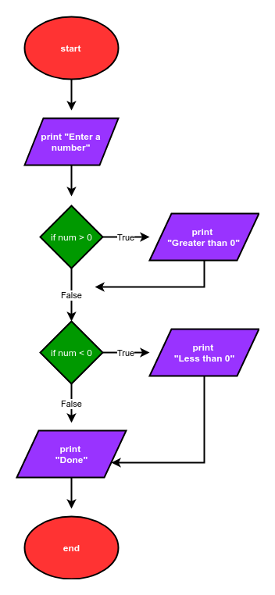
#4 Practice With Methods
Assignment: Break down an everyday task into a “program” of at least five or six procedures.
Try to use Methods when tasks are repeated often (i.e. opening and closing a door)
You can write as pseudo code or use a flowchart like below before writing your final program:

Slide 8
#5 Coding Warm-Up: Classes
EXAMPLE CODE
#Q: Write a python program Uses the ‘Student’ Class. Add another two Class attributes: Hobby and Favorite Programming Language and print that to the screen for a student instance of that class:
Hint Consider the Example Code:
class Student:
#Class constructor, a special function that always runs
#When a new class instance is made
def __init__(self, first_name, last_name):
self.first_name = first_name
self.last_name = last_name
self.email = first_name + "." + last_name + "@school-email.com"
#Instance Variable
age = None
def set_age(self, age): #setter function
self.age = age
def get_age(self): #getter function
return self.age Student1 = Student("Hailey", "Powers")
Student1.set_age(17)
Student1.set_grade(4) print(Student1.get_age())
print(Student1.email)
print(Student1.first_name)

Slide 9
#6 Coding Warm-Up: Class Inheritance
#Q: Write a python program that uses the ‘Student’ Class and adds a class method called ‘snowday’ that decrement numSchoolDays
class Student:
#Instance Variable
schoolName = "Leo Hayes High School"
numSchoolDays = 216
def __init__(self, first_name, last_name):
self.first_name = first_name
self.last_name = last_name
self.email = first_name + "." + last_name + "@school-email.com"
def full_name(self):
return self.first_name + " " + self.last_name
@staticmethod #Static Method, doesn't depend class or instance variables
def is_schoolDay(day):
if day == "saturday" or day == "sunday":
return "not a school day"
else:
return "go to class"
@classmethod #Class Method, takes the class as the first argument
def set_schoolDays(cls, days):
cls.numSchoolDays = days

Slide 10
#7 Coding Warm-Up: Inheriting a Class
#Q: Write a python program that inherits from the ‘Student’ Class and adds a unique attribute or method.
HINT: In our school database example,
This might be an Admin, Librarian, Bus Driver
Bus Driver could have an attribute like ‘bus_num’
class Student:
#Instance Variable
schoolName = "Leo Hayes High School"
numSchoolDays = 216
def __init__(self, first_name, last_name):
self.first_name = first_name
self.last_name = last_name
self.email = first_name + "." + last_name + "@school-email.com"
def full_name(self):
return self.first_name + " " + self.last_name
#Static Method, doesn't depend class or instance variables @staticmethod
def is_schoolDay(day):
if day == "saturday" or day == "sunday":
return "not a school day"
else:
return "go to class“
#Class Method, takes the class as the first argument
@classmethod
def set_schoolDays(cls, days):
cls.numSchoolDays = days

Slide 11
#8 Coding Warm-Up: Working With Files
#Q:Write a python program that copies a text file named “input.txt” with a list of ten items and saves it as “output.txt” with list in reverse order
Hint1: readlines() #Returns an list with one item for each line
Hint2: list method call reverse()
Hint3: split(“\n”) but the is also rsplit(“\n”)

Slide 12
#9 Coding Warm-Up: Working With Images
#Q:Write a python program that copies a text file named “input.txt” with a list of ten items and saves it as “output.txt” with list in reverse order
Hint1: Remember to read in chunks of the OG files by defining a buffer size in bytes
100 would be good, loop through reading the file until there a no more bytes
to read
Hint2: Remember to read and write the file in “rb” and “wb” byte mode respectively

Slide 13
#10 Coding Warm-Up: Working CSV Data Files
#Q:Write a python that takes the LHHS staff list and rewrite the file in a new format contains the following columns: First Name, Last Name, Email and includes ONLY TEACHERS – No VPs, principal etc…
HINT: Use DictReader and DictWriter methods
HINT: Use find() method to find “Teacher” (returns -1 if not found)
HINT: Use an if…else statement determine if Position contains the string “teacher”

Slide 14
#11 Coding Warm-Up: Create A Tkinter GUI
#Q:Write a python program that uses tkinter and creates a form to submit data about a student. The for should have the following elements:
TOP FRAME
A title label called “Student Record Form”
MIDDLE FRAME (HINT: Use grid() not pack() )
Student Number label / entry field (Just make up a number here)
First name label / entry field
Last name label / entry field
Age label / entry field
Grade label / entry field
Current Grade label /entry field (out of 4)
BOTTOM FRAME
Submit Button – calls the submit() method that prints the text “Record Created” to the terminal

Slide 15
#12 Coding Warm-Up: Creating A Timer With Tkinter & Datetime
#Q:Looking at the course code examples (UNIT 5 01_Python_Modules), Write a python program that uses the datetime module to count the time remaining a certain day (End of the School Year Maybe)
Next, use tkinter to create a GUI that prints the counter to the screen and updates every 1 second (See the last Example 6 in the course code notes)

