Slide 1



Java Warm-Up Coding Exercises
/* Its important to practice coding regularly, like any language, repetition reenforces newly learned concepts and builds muscle memory that make you an efficient coder:
After each major concept introduced in class, we’ll have a chance to practice with the following warmup exercise questions. Collect them all in one place to be marked periodically throughout the course…if you’re listening in class, the solutions are normally reviewed and this should be an easy way to build up a good grade in the course. */
Useful References when completing these exercises include:
https://www.w3schools.com/java/default.asp
Cheatsheet.zip

Slide 2
CONFIGURING GIT and GIT BASH TO CLONE REPO
git config --global http.sslbackend schannel
Our secured network relies on Trust Certificates Signed By NBED to allow traffic via https. Git requires steps to use certificates on your computers:
OPEN GIT BASH -> Right Click Anywhere on your desktop
TYPE: git config --global http.sslbackend schannel
HIT ENTER
TO CLONE THE CLASS GIT REPO, TYPE:
git clone https://github.com/CompSci-120-LHHS/cs120mainclass.git

Slide 3
#1 Coding Warm-Up: Loops & Logic
//Write a java program that calculates if a given number is PRIME or not:
//HINT: A Prime number is divisible by only one and itself. Ex: 3, 5, 7 etc…
//HINT: Use the modulo operator (%) to test if n % i == 0 (Where i is in the range
1 to n)
//HINT: Think ‘for loop’ and how to loop over a range of numbers, what would we //test on each loop cycle?

Slide 4
#2 Coding Warm-Up: Looping Through Arrays
/* Define an array of Booleans with the following values: True, True, False, True
Loop through this array. If a false condition is met, print a ‘dialog warning’ that an alarm has been triggered. Reset the ‘false’ value to true problem has been corrected (theoretically) */
Hint0: Review the ‘Swing Dialog’ Example
Hint1: import javax.swing.JOptionPane;
Hint2: statusInput = JOptionPane.showInputDialog("Has The Problem Been Resolved (Y/N): ");

Slide 5
#3 Coding Warm-Up: add() and clear() ArrayList
/* Start A New Java Project And…
Write a java program that allows a list of players to be stored in a ArrayList. Once a min of 5 players is added, the program will 'launch the game' and clear the ArrayList */

Slide 6
#4 Coding Warm-Up: Methods
#Write a java program that includes a method that applies a raise amount of 5% to an employee’s salary when ever it is called:

Slide 7
#5 Coding Warm-Up: Defining a Class
//Create a Rectangle class, with attributes height, width, and color.
/* It has 3 constructors:
1) one that takes in no information and sets the height, width, and color to 1.0,
2.0, and “red”
2) a second that takes in two doubles, and sets the height equal to the first
double, the width equal to the second double, and the color equal to “none”
3) a third that takes in two doubles and a String and sets the height and width
equal to the doubles, and the color equal to the String. */
//It also has 4 methods, getHeight(), getWidth(), getColor(), calculateArea()

Slide 8
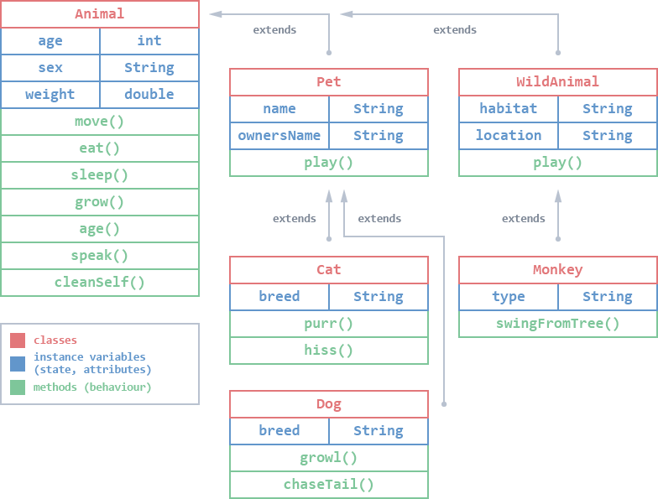
#6 Coding Warm-Up: Class Inheritance
//Download 02.2_Class_Inheritance from the Course Code Git Repo
//Complete the missing code for the subclasses: X = WildAnimal, Cat, Monkey
//HINT: Refer to the diagram for subclass specific variables and methods to add to each incomplete class

Slide 9
#7 Coding Warm-Up: Class Inheritance
/* Download the 02_OOP_Class_Intro zip From the Course Code Repo
Find the empty ‘Teacher’ package
Add two new classes to this package according to the tables below:
1) A General ‘Teacher’ Class
2) A more specific subclass like ‘CSteacher’ that inherits from Teacher */
extends
Teacher
- first_name:String - last_name:String -school:String = “LHHS” - salary:double = 50000.00 - raiseAmount:double = 1.05
+ applyRaise() + setRaise(raiseAmount:double)
CSTeacher
- subject:String = “programming” - Language:String = “java” - raiseAmount:double = 1.10
+ writeCode() + drinkCoffee()

