Slide 1

Java Programming
A Project Based Approach to Learning Java

Slide 2
Anatomy of a Java Program
All java programs share a common structure required for the code to compile and run:
public class App {
public static void main(String[] args) throws Exception {
System.out.println("Hello, World!");
}
}
Public: Defines the ‘access level’ – Data inside function is usable by other class instances
Static: Function belongs to class
Void: function does not return a value

Slide 3
Commenting In Java
All java programs can be commented and include lines “hidden” from the compiler to help make code more readable:
/* String */ | begins with /* and ends with */, and may span more than one lines
// | begins with // and lasts until the end of the current line

Slide 4
Anatomy of a Java Program
All java programs share a common structure required for the code to compile and run:
public class App {
public static void main(String[] args) throws Exception {
System.out.println("Hello, World!");
}
}
The basic unit of a Java program is a class. A class called "Hello" is defined via the keyword "class". The braces {......} encloses the body of the class.
In Java, the name of the source file must be the same as the name of the class with a mandatory file extension of ".java". Hence, this file MUST be saved as “App.java", case-sensitive.
public class App {
…
}

Slide 5
Anatomy of a Java Program
All java programs share a common structure required for the code to compile and run:
public class App {
public static void main(String[] args) throws Exception {
System.out.println("Hello, World!");
}
}
defines the main() method, which is the entry point for program execution. Again, the braces {......} encloses the body of the method, which contains programming statements
public static void main(String[] args){
…
}
prints the string "Hello, world!" to the display console. A string is surrounded by a pair of double quotes and contain texts. Programming statements end with a semi-colon (;)
System.out.println("Hello, World!");

Slide 6
Java Vocabulary
Comments | A multi-line comment begins with /* and ends with */, and may span multiple lines. An end-of-line (single-line) comment begins with // and lasts till the end of the current line. Comments are NOT executable statements and are ignored by the compiler, but they provide useful explanation and documentation. I strongly suggest that you write comments liberally to explain your thought and logic. You will be marked on comments!!
Statement | A programming statement performs a single piece of programming action. It is terminated by a semi-colon (;), just like an English sentence is ended with a period
Block | A block is a group of programming statements enclosed by a pair of braces {}. This group of statements is treated as one single unit. There are two blocks in the above program. One contains the body of the class Hello. The other contains the body of the main() method. There is no need to put a semi-colon after the closing brace
Whitespaces | Blank, tab, and newline are collectively called whitespace. Extra whitespaces are ignored, i.e., only one whitespace is needed to separate the tokens. Nonetheless, extra whitespaces improve the readability, and I strongly suggest you use extra spaces and newlines liberally. Again, you will be marked on this!
Case Sensitivity | Java is case sensitive - a ROSE is NOT a Rose, and is NOT a rose. The filename is also case-sensitive.

Slide 7
Printing to The Console
public class App {
public static void main(String[] args) throws Exception {
System.out.println("Hello, World!"); //moves cursor to the next line and before printing again
System.out.println();
System.out.println("Hello, World!");
System.out.println("Hello,");
System.out.print(" ");
System.out.print("World");
System.out.println("Hello World!");
}
}

Slide 8
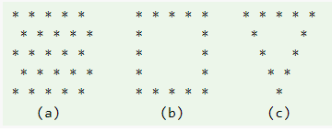
Printing challenge

Slide 9
Printing program outputs
public class App {
public static void main(String[] args) throws Exception {
int number1 = 11; //declares and assigns an int value
int number2 = 22;
int number3 = 23;
int number4 = 44;
int number5 = 55;
int sum; //Declares a variable int without assigning a literal value
sum = number1 + number2 + number3 + number4 + number5;
System.out.print("The Sum is: ");
System.out.println(sum);
}
}

Slide 10
Formatting Strings
There are three common ways to create larger strings using variables:
//This Example demonstrates simple concatentation
int num1 = 2;
double num2 = 1.02e8;
String name = "Venus"; String phrase = "The planet " + name + " is the " + num1 + "'nd from thes un, at a distance of " + num2 + "km";
System.out.print(phrase);
//This Example demonstrates format() method
int num1 = 2;
double num2 = 1.02e8;
String name = "Venus"; String phrase = String.format("The planet %2$s is the %1$d'nd from the sun, at a distance of %3$e km", num1, name, num2);
//%2$s can be read as: Take the second variable in the list (%2) and format as a string ($s
System.out.println(phrase);
//This Example demonstrates printf() method
int num1 = 2;
double num2 = 1.02e8;
String name = "Venus"; String phrase = "The planet %2$s is the %1$d'nd from the sun, at a distance of %3$e km";
//%2$s can be read as: Take the second variable in the list (%2) and format as a string ($s
System.out.printf(phrase, num1, name, num2);

Slide 11
Formatting Strings
Format Specifier | Data Type | Output
%a | floating point (except BigDecimal) | Returns Hex output of floating point number.
%b | Any type | "true" if non-null, "false" if null
%c | character | Unicode character
%d | integer (incl. byte, short, int, long, bigint) | Decimal Integer
%e | floating point | decimal number in scientific notation
%f | floating point | decimal number
%g | floating point | decimal number, possibly in scientific notation depending on the precision and value.
%h | any type | Hex String of value from hashCode() method.
%n | none | Platform-specific line separator.
%o | integer (incl. byte, short, int, long, bigint) | Octal number
%s | any type | String value
%t | Date/Time (incl. long, Calendar, Date and TemporalAccessor) | %t is the prefix for Date/Time conversions. More formatting flags are needed after this. See Date/Time conversion below.
%x | integer (incl. byte, short, int, long, bigint) | Hex string.

Slide 12
String Methods
String exampleString = "LHHS-499 Cliffe Street-Fredericton";
System.out.println(exampleString.length()); //returns int equal to number of char in string
System.out.println(exampleString.toLowerCase());
System.out.println(exampleString.toUpperCase());
System.out.println(exampleString.indexOf("Fredericton")); //returns starting position of matching string
System.out.println(exampleString.substring(0,4)); //Slices a string according to index values
//Spliting String Based on Delimiters ""
int start = exampleString.indexOf("-");
String nextSegment = exampleString.substring(start+1);
int next = nextSegment.indexOf("-");
String school = exampleString.substring(0, start);
String address = exampleString.substring((start+1), (next+start+1));
String city = exampleString.substring((next+start+2));
System.out.printf("1: %1$s\n2: %2$s \n3: %3$s",school, address,city);

Slide 13
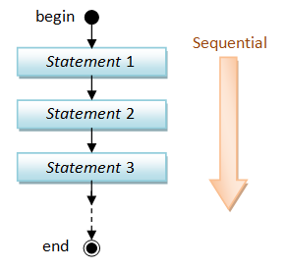
What is a Program?
A program is a sequence of instructions (called programming statements), executing one after another in a predictable manner. Sequential flow is the most common and straight-forward, where programming statements are executed in the order that they are written - from top to bottom in a sequential manner, as illustrated in the following flow chart

Slide 14
Running a simple program
public class App {
public static void main(String[] args) throws Exception {
double radius, area, circumference; //declares variables
final double PI = 3.14159265; //declares constant
//Assign values to radius
radius = 1.2;
//Compute area and circumference
area = radius * radius * PI;
circumference = 2 * PI * radius;
//print results
System.out.print("The Radius is: ");
System.out.println(radius);
System.out.print("The area is: ");
System.out.println(area);
System.out.print("The circumference is: ");
System.out.println(circumference);
}
}

Slide 15
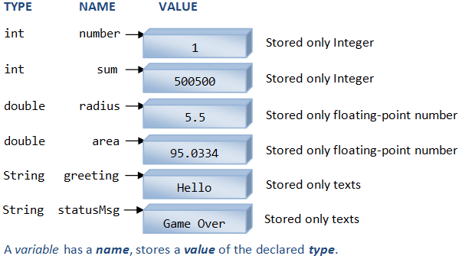
Variable Types
The following diagram illustrates three types of variables: int, double and String. An int variable stores an integer (whole number); a double variable stores a real number (which includes integer as a special form of real number); a String variable stores texts

Slide 16
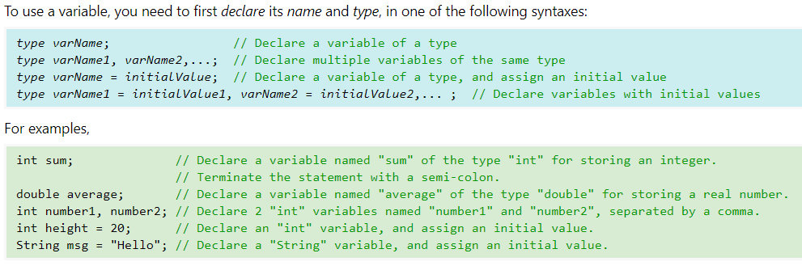
Declaring Variables
Each variable declaration statement begins with a type name
ou cannot mix 2 types in one variable declaration statement.
Each statement is terminated with a semi-colon (;).
In multiple-variable declaration, the names are separated by commas (,).
The symbol '=', known as the assignment operator, can be used to assign an initial value to a variable

Slide 17
Declaring Variables
Type | Description | Default | Size | Example Literals | Range of values
boolean | true or false | false | 1 bit | true, false | true, false
byte | twos-complement integer | 0 | 8 bits | (none) | -128 to 127
char | Unicode character | \u0000 | 16 bits | ‘a’, ‘\u0041’, ‘\101’, ‘\\’, ‘\’, ‘\n’, ‘β’ | characters representation of ASCII values 0 to 255
short | twos-complement integer | 0 | 16 bits | (none) | -32,768 to 32,767
int | twos-complement intger | 0 | 32 bits | -2,-1,0,1,2 | -2,147,483,648 to 2,147,483,647
long | twos-complement integer | 0 | 64 bits | -2L,-1L,0L,1L,2L | -9,223,372,036,854,775,808 to 9,223,372,036,854,775,807
float | IEEE 754 floating point | 0.0 | 32 bits | 1.23e100f , -1.23e-100f , .3f ,3.14F | upto 7 decimal digits
double | IEEE 754 floating point | 0.0 | 64 bits | 1.23456e300d , -123456e-300d , 1e1d | upto 16 decimal digits

Slide 18
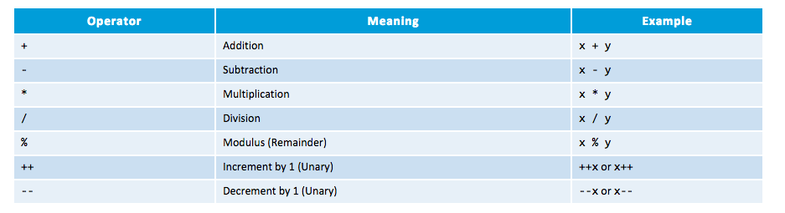
basic arithmetic operations
Addition, subtraction, multiplication, division and remainder are binary operators that take two operands (e.g., x + y); while negation (e.g., -x), increment and decrement (e.g., ++x, --x) are unary operators that take only one operand

Slide 19
basic arithmetic operations
Addition, subtraction, multiplication, division and remainder are binary operators that take two operands (e.g., x + y); while negation (e.g., -x), increment and decrement (e.g., ++x, --x) are unary operators that take only one operand

