Slide 1

Java Programming
A Project Based Approach to Learning Java

Slide 2
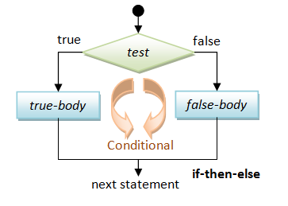
Conditional (Decision Making)
if… then…
if… then… else…
if… else if… else…
nested if
Switch (Next Slide)

Slide 3
Break and Continue Statements
Break
Continue
for (int i = 1; i <= 10; i++){
if (i == 5){
break; // terminate loop if i is 5
}
System.out.print(i + " ");
}
for (int i = 1; i <= 10; i++){
if (i % 2 == 0) {
continue; // skip next statement if i is even
}
System.out.print(i + " ");
}
Output: 1 2 3 4
Output: 1 3 5 7 9

Slide 4
Switch Statements

Slide 5
Branching Use Switch Cases
public class SwitchCaseExample {
public static void main(String[] args) throws Exception {
char letter = 'a';
switch (letter) {
case 'a', 'b', 'c':
System.out.println("2");
break;
case 'd', 'e', 'f':
System.out.println("3");
break;
case 'g', 'h', 'i':
System.out.println("4");
break;
case 'j', 'k', 'l':
System.out.println("5");
break;
case 'm', 'n', 'o':
System.out.println("6");
break;
case 'p', 'q', 'r', 's':
System.out.println("7");
break;
case 't', 'u', 'v':
System.out.println("8");
break;
case 'w', 'x', 'y', 'z':
System.out.println("9");
break;
default:
System.out.println("Not a valid input");
break;
}
}
}
Versus a HUGE number of If…Else If…Else If…
Statements

