Slide 1

Java Programming
A Project Based Approach to Learning Java

Slide 2
UNIT 1 : Manipulating Data, Logic and Looping
Getting Started In The Programming Environment | Learn how to install the JDK, explore the Java API documentation and install VSCode For Java
Java Syntax and Commenting | Learn how java code is structured within class and the role of the main() method
Data Types in Java | Learn how different forms of data are represented in Java
Numbers & Casting | The first of the Primitive Data Types: Int, doubles, chars and booleans
Operators | Operations, as arithmetic, to manipulate variables and values
Strings | Declaring and assigning strings of characters, formatting strings and string methods
Booleans | TRUE and FALSE, basic elements of programming logic
if…else if…else | Operations, as arithmetic, to manipulate variables and values
Exceptions Handling | Try, Catch Finally blocks help handle unexpected conditions that would otherwise crash a program
Switch Statements and Enums | Manage branching use switches instead of large combinations of …else if… blocks
Loops | For and while loops repeat a defined section of code until their conditions evaluate as “false”
Arrays, ArrayList and HashMaps | Group data and perform operations on java objects

Slide 3
Anatomy of a Java Program
All java programs share a common structure required for the code to compile and run:
/* Where is a basic ‘Hello World’ java program called App.java
public class App {
public static void main(String[] args) throws Exception {
System.out.println("Hello, World!"); //This Prints ‘Hello World’
}
}
Public | Defines the ‘access level’ – Data inside function is usable by other class instances
Static | Function can be called without creating a class instance
Void | Function does not return a value
throws Exception | Used to handle errors ‘thrown’ in body of main function

Slide 4
Commenting In Java
All java programs can be commented and include lines “hidden” from the compiler to help make code more readable:
/*…………………… ……………………*/ | begins with /* and ends with */, and may span more than one lines
// | begins with // and lasts until the end of the current line

Slide 5
Anatomy of a Java Program
All java programs share a common structure required for the code to compile and run:
public class App {
public static void main(String[] args) throws Exception {
System.out.println("Hello, World!");
}
}
The basic unit of a Java program is a class. A class called "Hello" is defined via the keyword "class". The braces {......} encloses the body of the class.
In Java, the name of the source file must be the same as the name of the class with a mandatory file extension of ".java". Hence, this file MUST be saved as “App.java", case-sensitive.
public class App {
…
}

Slide 6
Anatomy of a Java Program
All java programs share a common structure required for the code to compile and run:
public class App {
public static void main(String[] args) throws Exception {
System.out.println("Hello, World!");
}
}
defines the main() method, which is the entry point for program execution. Again, the braces {......} encloses the body of the method, which contains programming statements
public static void main(String[] args){
…
}
prints the string "Hello, world!" to the display console. A string is surrounded by a pair of double quotes and contain texts. Programming statements end with a semi-colon (;)
System.out.println("Hello, World!");

Slide 7
Java Vocabulary
Comments | A multi-line comment begins with /* and ends with */, and may span multiple lines. An end-of-line (single-line) comment begins with // and lasts till the end of the current line. Comments are NOT executable statements and are ignored by the compiler, but they provide useful explanation and documentation. I strongly suggest that you write comments liberally to explain your thought and logic. You will be marked on comments!!
Statement | A programming statement performs a single piece of programming action. It is terminated by a semi-colon (;), just like an English sentence is ended with a period
Block | A block is a group of programming statements enclosed by a pair of braces {}. This group of statements is treated as one single unit. There are two blocks in the above program. One contains the body of the class Hello. The other contains the body of the main() method. There is no need to put a semi-colon after the closing brace
Whitespaces | Blank, tab, and newline are collectively called whitespace. Extra whitespaces are ignored, i.e., only one whitespace is needed to separate the tokens. Nonetheless, extra whitespaces improve the readability, and I strongly suggest you use extra spaces and newlines liberally. Again, you will be marked on this!
Case Sensitivity | Java is case sensitive - a ROSE is NOT a Rose, and is NOT a rose. The filename is also case-sensitive.

Slide 8
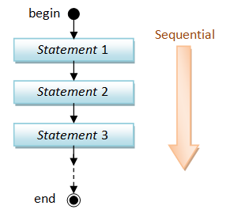
What is a Program?
A program is a sequence of instructions (called programming statements), executing one after another in a predictable manner. Sequential flow is the most common and straight-forward, where programming statements are executed in the order that they are written - from top to bottom in a sequential manner, as illustrated in the following flow chart

Slide 9
Running a simple program
public class App {
public static void main(String[] args) throws Exception {
double radius, area, circumference; //declares variables
final double PI = 3.14159265; //declares constant
//Assign values to radius
radius = 1.2;
//Compute area and circumference
area = radius * radius * PI;
circumference = 2 * PI * radius;
//print results
System.out.print("The Radius is: ");
System.out.println(radius);
System.out.print("The area is: ");
System.out.println(area);
System.out.print("The circumference is: ");
System.out.println(circumference);
}
}

Slide 10
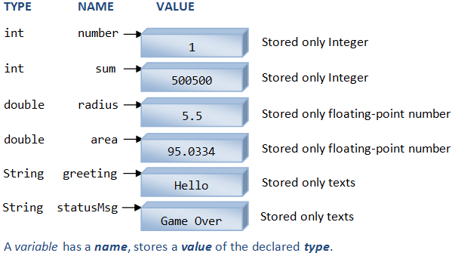
Variable Types
The following diagram illustrates three types of variables: int, double and String. An int variable stores an integer (whole number); a double variable stores a real number (which includes integer as a special form of real number); a String variable stores texts

Slide 11
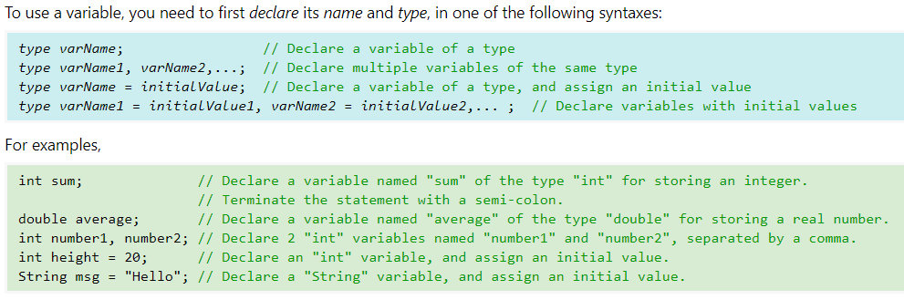
Declaring Variables
Each variable declaration statement begins with a type name
you cannot mix 2 types in one variable declaration statement.
Each statement is terminated with a semi-colon (;).
In multiple-variable declaration, the names are separated by commas (,).
The symbol '=', known as the assignment operator, can be used to assign an initial value to a variable

Slide 12
Primitive Data Types
Type | Description | Default | Size | Example Literals | Range of values
boolean | true or false | false | 1 bit | true, false | true, false
byte | twos-complement integer | 0 | 8 bits | (none) | -128 to 127
char | Unicode character | \u0000 | 16 bits | ‘a’, ‘\u0041’, ‘\101’, ‘\\’, ‘\’, ‘\n’, ‘β’ | characters representation of ASCII values 0 to 255
short | twos-complement integer | 0 | 16 bits | (none) | -32,768 to 32,767
int | twos-complement intger | 0 | 32 bits | -2,-1,0,1,2 | -2,147,483,648 to 2,147,483,647
long | twos-complement integer | 0 | 64 bits | -2L,-1L,0L,1L,2L | -9,223,372,036,854,775,808 to 9,223,372,036,854,775,807
float | IEEE 754 floating point | 0.0 | 32 bits | 1.23e100f , -1.23e-100f , .3f ,3.14F | upto 7 decimal digits
double | IEEE 754 floating point | 0.0 | 64 bits | 1.23456e300d , -123456e-300d , 1e1d | upto 16 decimal digits

Slide 13
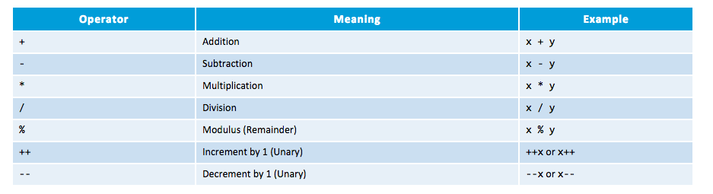
basic arithmetic operations
Addition, subtraction, multiplication, division and remainder are binary operators that take two operands (e.g., x + y); while negation (e.g., -x), increment and decrement (e.g., ++x, --x) are unary operators that take only one operand

Slide 14
MATH Methods
Syntax:
MATH.method()

Slide 15
Strings

Slide 16
Printing to The Console
public class App {
public static void main(String[] args) throws Exception {
System.out.println("Hello, World!"); //moves cursor to the next line and before printing again
System.out.println();
System.out.println("Hello, World!");
System.out.println("Hello,");
System.out.print(" ");
System.out.print("World");
System.out.println("Hello World!");
}
}

Slide 17
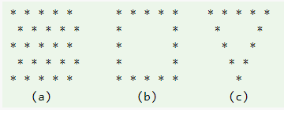
Printing challenge

Slide 18
Printing program outputs
public class App {
public static void main(String[] args) throws Exception {
int number1 = 11; //declares and assigns an int value
int number2 = 22;
int number3 = 23;
int number4 = 44;
int number5 = 55;
int sum; //Declares a variable int without assigning a literal value
sum = number1 + number2 + number3 + number4 + number5;
System.out.print("The Sum is: ");
System.out.println(sum);
}
}

Slide 19
Formatting Strings
There are three common ways to create larger strings using variables:
//This Example demonstrates simple concatentation
int num1 = 2;
double num2 = 1.02e8;
String name = "Venus"; String phrase = "The planet " + name + " is the " + num1 + "'nd from thes un, at a distance of " + num2 + "km";
System.out.print(phrase);
//This Example demonstrates format() method
int num1 = 2;
double num2 = 1.02e8;
String name = "Venus"; String phrase = String.format("The planet %2$s is the %1$d'nd from the sun, at a distance of %3$e km", num1, name, num2);
//%2$s can be read as: Take the second variable in the list (%2) and format as a string ($s
System.out.println(phrase);
//This Example demonstrates printf() method
int num1 = 2;
double num2 = 1.02e8;
String name = "Venus"; String phrase = "The planet %2$s is the %1$d'nd from the sun, at a distance of %3$e km";
//%2$s can be read as: Take the second variable in the list (%2) and format as a string ($s
System.out.printf(phrase, num1, name, num2);

Slide 20
Formatting Strings
Format Specifier | Data Type | Output
%a | floating point (except BigDecimal) | Returns Hex output of floating point number.
%b | Any type | "true" if non-null, "false" if null
%c | character | Unicode character
%d | integer (incl. byte, short, int, long, bigint) | Decimal Integer
%e | floating point | decimal number in scientific notation
%f | floating point | decimal number
%g | floating point | decimal number, possibly in scientific notation depending on the precision and value.
%h | any type | Hex String of value from hashCode() method.
%n | none | Platform-specific line separator.
%o | integer (incl. byte, short, int, long, bigint) | Octal number
%s | any type | String value
%t | Date/Time (incl. long, Calendar, Date and TemporalAccessor) | %t is the prefix for Date/Time conversions. More formatting flags are needed after this. See Date/Time conversion below.
%x | integer (incl. byte, short, int, long, bigint) | Hex string.

Slide 21
String Methods
Syntax:
string.method()

Slide 22
Char Methods
Syntax:
char.method()

Slide 23
String Method - Example
String exampleString = "LHHS-499 Cliffe Street-Fredericton";
System.out.println(exampleString.length()); //returns int equal to number of char in string
System.out.println(exampleString.toLowerCase());
System.out.println(exampleString.toUpperCase());
System.out.println(exampleString.indexOf("Fredericton")); //returns starting position of matching string
System.out.println(exampleString.substring(0,4)); //Slices a string according to index values
//Spliting String Based on Delimiters ""
int start = exampleString.indexOf("-");
String nextSegment = exampleString.substring(start+1);
int next = nextSegment.indexOf("-");
String school = exampleString.substring(0, start);
String address = exampleString.substring((start+1), (next+start+1));
String city = exampleString.substring((next+start+2));
System.out.printf("1: %1$s\n2: %2$s \n3: %3$s",school, address,city);

Slide 24
Input/Output – Scanner & Formatter

Slide 25

The Scanner Class
import java.util.Scanner; //imports the package from java API
public class ScannerInput {
public static void main(String[] args) throws Exception {
//Declare variables used in the program
int num1;
double num2;
double sum;
double product;
double div;
String name;
//Initialize a scanner object
Scanner scan = new Scanner(System.in); //Read Input From keyboard
System.out.print("Hello User, Please Enter An Integer: "); //this will show a prompt in your terminal
num1 = scan.nextInt(); //This reads the value from the prompt after pressing 'enter'
System.out.print("Enter a float: "); //this will show a prompt in your terminal
num2 = scan.nextDouble(); //This reads the value from the prompt after pressing 'enter'
System.out.print("Enter your name: ");
name = scan.next();
//Working with the stored input
sum = num1 + num2;
product = num1 * num2;
div = num1 / num2; System.out.println("Thank you " + name);
System.out.println("Sum of " + num1 + " and " + num2 + " is: " + sum);
System.out.println("Product of " + num1 + " and " + num2 + " is: " + product);
System.out.println("Division of " + num1 + " and " + num2 + " is: " + div);
scan.close();
}
}
Using input from the user’s keyboard:

Slide 26

The Swing Class
Using input from a dialogue box:
import javax.swing.JOptionPane;
public class SwingDialoguePrompt {
public static void main(String[] args) throws Exception {
String radiusInputStr;
Double radius, area;
//Read input string from dialog box
radiusInputStr = JOptionPane.showInputDialog("Enter radius of the circle: ");
radius = Double.parseDouble(radiusInputStr); //Converts string to double
area = Math.pow(radius, 2)*Math.PI;
System.out.println("The area is: " + area);
}
}

Slide 27

The Scanner Class
import java.util.Scanner; //imports the package from java API
import java.io.File; //imports File class
import java.io.FileNotFoundException; //imports File Exceptions
String num1;
String num2;
String name;
//Initialize a scanner object
File fileToRead = new File("src/input.txt");
Scanner inputFile = new Scanner(fileToRead);
//Read Input From keyboard
System.out.println("The following text was read from your file");
System.out.println("*****************************************");
num1 = inputFile.next();
System.out.println("Age: " + num1);
num2 = inputFile.next();
System.out.println("PI: " + num2);
name = inputFile.next();
System.out.println("Name: " + name);
System.out.println("*****************************************");
inputFile.close();
Reading from a file:

Slide 28
The Scanner Class
import java.util.Scanner; //imports the package from java API
import java.io.File; //imports File class
import java.io.FileNotFoundException; //imports File Exceptions
import java.io.IOException;
import java.io.FileReader;
import java.io.BufferedReader;
public class ScannerFile {
public static void main(String[] args) throws FileNotFoundException {
//This Example Loops over all lines in a text file and numbers them
int lineFile = 0; //initialize first line as zero
String lineText = null;
//Initialize a scanner object
FileReader fileToRead = new FileReader("src/longtext.txt");
try{
BufferedReader line = new BufferedReader(fileToRead);
while((lineText = line.readLine()) != null){
lineFile++;
System.out.print(lineFile + ": ");
System.out.println(lineText);
}
line.close();
}catch(IOException e){
e.printStackTrace();
}
}
}
Looping over a file:

Slide 29
The Formatter Class
import java.io.File;
import java.io.FileNotFoundException;
import java.util.Formatter;
public class WriteToText {
public static void main(String[] args) throws FileNotFoundException {
String firstName = "Jeff";
String lastName = "McDowell";
String role = "Teacher";
String languages[] = {"java", "python", "c++", "php", "javascript"};
String schoolName = "Leo Hayes High School";
File outputText = new File("src/output.txt");
try{ //try to write to file
Formatter text = new Formatter(outputText);
text.format("%1$s %2$s is a %3$s at %4$s who enjoys programming %6$s and %5$s", firstName, lastName,
role, schoolName, languages[0], languages[1]);
System.out.println("New txt file has been written!");
text.close();
}catch (FileNotFoundException ex){
ex.getStackTrace();
}
}
}
Writing to a file:

Slide 30
Booleans

Slide 31
Booleans – Truth or False
int a = 5;
int b = 3;
int c = 5;
String item1 = "apples";
String item2 = "oranges";
//Using comparison operators
System.out.println(a > b); // returns true, because 5 is higher than 3
System.out.println(a >= c); // returns true, because 5 equals 5
System.out.println(a == c); // returns true, because 5 equals 5
System.out.println(item1 == item2); // returns false because strings are not the same
//alternatively, using the equals() method
System.out.println(item1.equals(item2)); // returns false because strings are not the same
//Using Logic Operators
System.out.println(a >= c && a == c); // AND operator: returns true, both conditions are true
System.out.println(a < c || a == c); // OR operator: returns true, because a==c
System.out.println(!(a < c || a == c)); // NOT operator: returns false, because !

Slide 32
Booleans in If…Else, If…Else If…Else
int x = 5;
int y = 3;
String item3 = "apples";
String item4 = "oranges";
if (x == y){
System.out.println("This is A TRUE Statement");
}else
else{
System.out.println("This is A FALSE Statement");
}
if (item3.equals(item4)){
System.out.println("This is A TRUE Statement");
}else{
System.out.println("This is A FALSE Statement");
}

Slide 33
Booleans in loops
int i = 0;
boolean status = false;
//Has the loop repeated 20 times?
while (status == false){
if (i == 19){
status = true;
System.out.println("Loop iteration: " + (i+1) + " ...All Done!");
}else{
status = false;
System.out.println("Loop iteration: " + (i+1) + " ...Loop Again");
i++;
}
}

Slide 34
If…Else

Slide 35
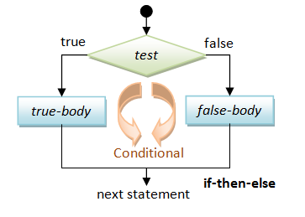
Conditional (Decision Making)
if… then…
if… then… else…
if… else if… else…
nested if
Switch (Next Slide)

Slide 36
Break and Continue Statements
Break
Continue
for (int i = 1; i <= 10; i++){
if (i == 5){
break; // terminate loop if i is 5
}
System.out.print(i + " ");
}
for (int i = 1; i <= 10; i++){
if (i % 2 == 0) {
continue; // skip next statement if i is even
}
System.out.print(i + " ");
}
Output: 1 2 3 4
Output: 1 3 5 7 9

Slide 37
Error Handling try…catch…finally blocks

Slide 38
try…catch..finally Blocks
OUTPUT:
Printing Loop #: 0
Printing Loop #: 2
Printing Loop #: 4
Printing Loop #: 6
Printing Loop #: 8
Printing Loop #: 10
Finished First Loop!
-----------------------
Hmmm....Second Loop Threw An Error!
java.util.UnknownFormatConversionException: Conversion = '1'
-----------------------
Printing Loop #: 10
Printing Loop #: 8
Printing Loop #: 6
Printing Loop #: 4
Printing Loop #: 2
Printing Loop #: 0
Finished Third Loop!
public class ExceptionHandling {
public static void main(String[] args) throws Exception {
/*---------------------EXAMPLE-1 START -------------------- */
/*--------------UNCOMMENT TO RUN CODE (Ctrl+/)------------- */
//First Loop
for (int i=0; i <=10; i+=2){ //loops from i =0 to i = 10, incrementing i by 2
System.out.printf("Printing Loop #: %d\n", i);
}
System.out.println("Finished First Loop!");
//Second Loop
//There is a syntax error in this next loop
//try...catch can handle this error without breaking the code
try {
for (int i=10; i >= 0; i--){
System.out.printf("Printing Loop #: %1\n", i);
}
}catch (Exception e) { // e is the variable name we give to the error, it can be anything, but 'e' is convension
System.out.println("-----------------------\nHmmm....Second Loop Threw An Error!");
System.out.println(e.fillInStackTrace()+"\n-----------------------"); //'fillInStackTrace' is usually informative
}finally{
//This block executes not matter what
//Third Loop
for (int i=10; i >=0; i-=2){ //loops from i =0 to i = 10, incrementing i by 2
System.out.printf("Printing Loop #: %d\n", i);
}
System.out.println("Finished Third Loop!");
}
}
}

Slide 39
Switch Statements

Slide 40
Branching Use Switch Cases
public class SwitchCaseExample {
public static void main(String[] args) throws Exception {
char letter = 'a';
switch (letter) {
case 'a', 'b', 'c':
System.out.println("2");
break;
case 'd', 'e', 'f':
System.out.println("3");
break;
case 'g', 'h', 'i':
System.out.println("4");
break;
case 'j', 'k', 'l':
System.out.println("5");
break;
case 'm', 'n', 'o':
System.out.println("6");
break;
case 'p', 'q', 'r', 's':
System.out.println("7");
break;
case 't', 'u', 'v':
System.out.println("8");
break;
case 'w', 'x', 'y', 'z':
System.out.println("9");
break;
default:
System.out.println("Not a valid input");
break;
}
}
}
Variable being evaluated
Multiple values can be evaluated in each case (think ==). If letter = ‘a’ char, the first case would be true.
OUTPUT: 2
Switch Cases Can be used to replace a large number of …else if… Statements
See the course notes for a state machine
example that uses a case switch to control
a simple machines UI

Slide 41
ENUMS
import java.util.*;
public class EnumExample {
public static void main(String[] args) throws Exception {
/*---------------------EXAMPLE-1 START -------------------- */
/*--------------UNCOMMENT TO RUN CODE (Ctrl+/)------------- */
//Enums are a type of class (more on this later), that list constants and are often used in
//combination with switch cases:
enum MachineState{INITIALIZE, RUN, STOP, DEBUG};
MachineState myMachineState = MachineState.INITIALIZE;
//Try uncommenting another value of myMachineState
// myMachineState = MachineState.RUN;
// myMachineState = MachineState.STOP;
// myMachineState = MachineState.DEBUG;
switch (myMachineState){
case INITIALIZE:
System.out.println("In INITIALIZE case");
break;
case RUN:
System.out.println("In RUN case");
break;
case STOP:
System.out.println("In STOP case");
break;
case DEBUG:
System.out.println("In DEBUG case");
break;
}

Slide 42
Loops

Slide 43
Using Loops
While Loop
Do…While
while (conditional statement){
// your code goes here
}
do {
statement(s)
} while (conditional statement);
For Loop
Enhanced For Loop
for (initialization; conditional; increment) {
statement(s)
}
for (String element : array) {
System.out.println("Element: " + element);
}
Ex:
for (int i=0; i < array.length; i++) {
System.out.println("Element: " + array[i]);
}

Slide 44
Looping Example
public class WhileLoopExamples {
public static void main(String[] args) throws Exception {
int lowerbound = 1;
int upperbound = 1000;
int sum = 0;
int number = lowerbound; //current number in the count
//use while loop to sum each number together from lowerbound to upperbound
while(number <= upperbound){
sum = sum + number;
number++;
}
System.out.printf("The sum from %1$d to %2$d is %3$d", lowerbound, upperbound, sum);
}
}
//CHALLENGE: Refactor the above code to use the 'for loop' and 'do...while' loop

Slide 45
Arrays

Slide 46
Declaring and Assigning Arrays
OUTPUT:
//Arrays can only hold one data type (int, char, String etc...)
//Arrays can be declared and assigned values separately as below:
int[] grades = new int[5]; //only 5 grades can fit in this array
grades[0] = 2;
grades[1] = 4; //assigns the first two values
System.out.println(grades); //prints only the memory address of the array object
System.out.println(grades[1]); //must address
System.out.println(grades[2]); //empty slot in array returns '0'
String[] names = {"Jeff", "Abed", "Brita", "Annie"}; //array values can be declared all at once
System.out.println(names[1]);
names[1] = "Troy"; //values can be addressed and re-assigned
System.out.println(names[1]);
[I@372f7a8d
4
0
Abed
Troy

Slide 47
Looping Arrays
//Arrays can Looped over in two ways using for loops
String[] names = {"Jeff", "Abed", "Brita", "Annie"};
//Method 1:
System.out.println("Method #1: ");
for (int i=0; i < names.length; i++){ //using the 'length' attribute
System.out.println(names[i]);
}
System.out.println("----------------");
//Method 2:
System.out.println("Method #2: ");
for (String name : names){
System.out.println(name);
}
OUTPUT:
Method #1:
Jeff
Abed
Brita
Annie
----------------
Method #2:
Jeff
Abed
Brita
Annie

Slide 48
Multidimensional Arrays
char[][] image1 = {
{' ',' ','O',' ',' '},
{' ',' ','O',' ',' '},
{' ',' ','O',' ',' '},
{' ',' ','O',' ',' '},
{' ',' ','O',' ',' '},
};
for (char[] row:image1){
System.out.println(row);
}
OUTPUT:
O
O
O
O
O

Slide 49
Array Lists

Slide 50
Array Lists can be dynamically sized and require specific methods to read and write values to the list. Look Through This Example
Array List Basics
import java.util.ArrayList; //this package must be imported to use the ArrayList functionality
import java.util.Arrays;
public class ArrayListExample {
public static void main(String[] args) throws Exception {
/*---------------------EXAMPLE-1 START -------------------- */
/*--------------UNCOMMENT TO RUN CODE (Ctrl+/)------------- */
//arraylist are resizable, iterable and mutable. But they store only one datatype NOTE: , <String> declares the type for variable
ArrayList<String> shipNames = new ArrayList<String>(); //declared without variables assigned
shipNames.add("Heart of Gold");
shipNames.add("Black Pearl");
shipNames.add("In Amber Clad");
shipNames.add("Thunder Child");
System.out.println(shipNames); //returns the values wrapped in []
//indexing items uses the .get() method ....not the [] notation used for regular arrays
System.out.println(shipNames.get(2));
//Changing values used the .set() method
shipNames.set(2,"Forward Unto Dawn");
System.out.println(shipNames.get(2));
//other useful methods used with array lists are:
int sizeOfArrayList = shipNames.size(); //useful when looping through arraylists
System.out.printf("Number of elements in the ArrayList: %d\n", sizeOfArrayList);
shipNames.clear(); //clears the arraylist contents
sizeOfArrayList = shipNames.size();
System.out.printf("Number of elements in the ArrayList: %d\n", sizeOfArrayList);

Slide 51
The add() method is used to pass a new element to the array list (in chronological order)
//arraylist are resizable, iterable and mutable. But they store only one datatype
ArrayList<String> shipNames = new ArrayList<String>(); shipNames.add("Heart of Gold");
shipNames.add("Black Pearl");
shipNames.add("In Amber Clad");
shipNames.add("Thunder Child");
The get() method used to return the value of an element at a specific index
//indexing items uses the .get() method ....not the [] notation used for regular arrays
System.out.println(shipNames.get(2));
//Changing values used the .set() method
shipNames.set(2,"Forward Unto Dawn");
System.out.println(shipNames.get(2));
The set() method used to modify and element at a specific index

Slide 52
size() returns list size and clear() empties the list values
//other useful methods used with array lists are:
int sizeOfArrayList = shipNames.size(); //useful when looping through arraylists
System.out.printf("Number of elements in the ArrayList: %d\n", sizeOfArrayList);
shipNames.clear(); //clears the arraylist contents
sizeOfArrayList = shipNames.size();
System.out.printf("Number of elements in the ArrayList: %d\n", sizeOfArrayList);

Slide 53
HashMap

Slide 54
Hash Map Basics
import java.util.HashMap;
public class HashMapExample {
public static void main(String[] args) throws Exception {
/*---------------------EXAMPLE-1 START -------------------- */
/*--------------UNCOMMENT TO RUN CODE (Ctrl+/)------------- */
//Hashmaps work with 'key/value' pairs like a dictionary
HashMap<String, Integer> weatherConditions = new HashMap<String, Integer>();
weatherConditions.put("Fredericton",10);
weatherConditions.put("Moncton",2);
weatherConditions.put("Saint John",11);
weatherConditions.put("Sussex",5);
System.out.println(weatherConditions);
System.out.println(weatherConditions.size());
//Addressing values in HashMaps using .get method and key value:
System.out.printf("The temperature in Moncton is current %d degC\n", weatherConditions.get("Moncton"));
for (String city: weatherConditions.keySet()){ //use values() method to get the values instead of keys
System.out.println(city);
}
/*---------------------EXAMPLE-1 END -------------------- */
}
}
Dynamically Sized
Iterable and Mutable
Uses Key-Value Pairs
Uses put() method to add elements
Uses get() to return value of specific key
keyset() returns array of keys in the hash map

